Slide 1
NoSQL. Mongodb
by Ihor Dubas

Slide 2
What is NoSQL?
NoSQL is a general designation of principles aimed at the implementation of database management mechanisms, which have tangible differences from conventional models with access to information through the SQL language.
While standard DBMSs embody the principles of atomicity, isolation, and consistency, NoSQL is characterized by a flexible state, which can change over time.

Slide 3
The features of NoSQL
The features of NoSQL include:
Using any type of storage
Flexibility. As a rule, NoSQL databases offer flexible schemas, which allows for faster development and phased implementation.
Scalability in a linear format - the more processors, the higher the performance
Versatility - great opportunities for data storage and analytics

Slide 4
NoSQL CHARACTERISTICS
In the NoSQL database, you can use all information models - text, graphics, a document using a key-value pair. Under the term NoSQL, you can find different databases, but there are a number of characteristics inherent to everyone without exception.
Unstructured structure. Unlike relational databases, NoSQL does not have a standard structure. Here you can add fields in any places without changing the general appearance of the data.
Information is presented in the form of aggregates. A NoSQL database uses data as integral objects, and not as part of general information.
Distribution occurs without shared resources.

Slide 5
NoSQL Database Types
Using NoSQL principles, data can be presented in a variety of ways.
There are 4 main types:
Key-value storage - it has a large hash table containing keys and values. Examples: Riak, Amazon DynamoDB;
Document-oriented storage - stores documents consisting of tagged elements. Example: MongoDB;
Column storage - each block stores data from only one column. Examples: HBase, Cassandra;
Graph-based storage is a network database that uses nodes and edges to display and store data. Example: Neo4J.
Thus, NoSQL is becoming a universal way to arrange data and can be used in almost all industries.

Slide 6
MongoDB
MongoDB implements a new approach to building databases where there are no tables, schemas, SQL queries, foreign keys, and many other things that are inherent in object-relational databases.
Unlike relational databases, MongoDB offers a document-oriented data model, which makes MongoDB faster, more scalable, and easier to use.
The entire MongoDB system can represent not only one database located on one physical server. MongoDB functionality allows you to host multiple databases on multiple physical servers, and these databases can easily exchange data and maintain integrity.

Slide 7
Data Format in MongoDB
One of the popular standards for data exchange and storage is JSON (JavaScript Object Notation). JSON efficiently describes complex data. The way data is stored in MongoDB in this regard is similar to JSON, although formally JSON is not used. For storage, MongoDB uses a format called BSON, or short for binary JSON.
BSON allows you to work with data faster: faster search and processing. Although it should be noted that BSON, in contrast to storing data in JSON format, has a small drawback: in general, data in JSON format takes up less space than in BSON format, on the other hand, this drawback is more than paying for speed.

Slide 8

Cross-platform
MongoDB is written in C ++, so it is easy to port to a wide variety of platforms. MongoDB can be deployed on the platforms Windows, Linux, MacOS, Solaris. You can also download the source code and compile MongoDB yourself, but it is recommended that you use libraries from offsite.

Slide 9
Documents instead of lines
If relational databases store rows, then MongoDB stores documents. Unlike strings, documents can store complex information. A document can be thought of as a repository of keys and values.
A key represents a simple label with which a specific piece of data is associated.
However, with all the differences, there is one feature that brings MongoDB and relational databases closer together. In relational DBMS there is such a thing as a primary key. This concept describes a certain column that has unique values. MongoDB has a unique identifier for each document called _id. And if you do not explicitly specify its value, then MongoDB will automatically generate a value for it.

Slide 10
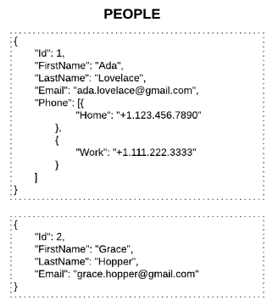
Collections
If there are tables in the traditional SQL world, then there are collections in the MongoDB world. And if relational database tables store the same type of rigidly structured objects, then the collection can contain a variety of objects that have a different structure and a different set of properties.

Slide 11
Gridfs
One of the problems when working with any database systems is the storage of large data.
Unlike relational DBMSs, MongoDB allows you to save various documents with a different set of data, however, the document size is limited to 16 mb. But MongoDB offers a solution - a special GridFS technology that allows you to store data larger than 16 MB in size.
To test GridFS, you can use the special mongofiles utility, which comes in the mongodb package.

Slide 12

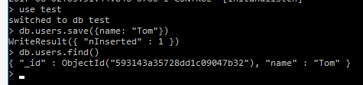
Get started with MongoDB
To install MongoDB, download one redistributable package from the official site https://www.mongodb.com/download-center/community.
We will enter the following commands in mongo sequentially and after each command press Enter:
Then we will get:

Slide 13
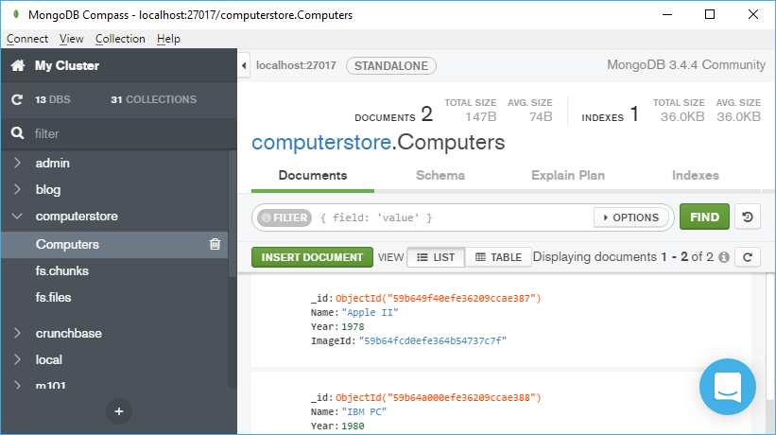
Compass
You can use the official Compass graphical client to work with MongoDB.
Using the compass GUI, we can manage this data, add, modify, delete them.

Slide 14
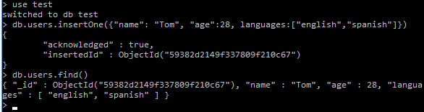

Insert data
Three methods can be used to add to a collection:
insertOne (): adds one document
insertMany (): adds multiple documents
insert (): can add one or several documents
To display it in a more readable form, add the pretty () method:

Slide 15
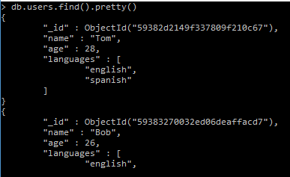
Database selection
To display it in a more readable form, add the pretty () method:
List all documents in which name = Tom:

Slide 16

Data grouping
Consider the grouping commands: count, group, distinct.
Using the count () function, you can get the number of elements in a collection.
You can group search parameters and the count function to count how many specific documents, for example, have name = Tom:
Distinct function
A collection may contain documents that contain the same values ​​for one or more fields. For example, several documents define name: "Tom". And we need to find only unique differing values ​​for one of the document fields. To do this, we can use the distinct function:

Slide 17
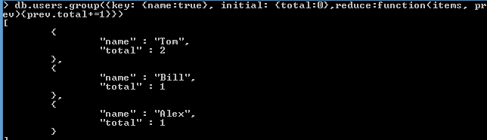
Group method
Using the group method is similar to using the GROUP BY clause in SQL. The group method takes three parameters:
key: indicates the key by which to group
initial: initializes the fields of the document that will represent the group of documents
reduce: represents a function that returns the number of elements. This function takes two parameters as arguments: the current element and the aggregate result document for the current group

Slide 18
Data update
Save
Update. It takes three parameters:
query: accepts a request to select the document to be updated
objNew: presents a document with new information that will replace the old one when updating
options: defines additional options when updating documents. It can take two arguments: upsert and multi.
If the upsert parameter is true, then mongodb will update the document if it is found, and create a new one if there is no such document.

Slide 19



Delete data
To remove documents, MongoDB provides a remove method:
To delete all documents from the collection at once, you must leave the query parameter empty:
To delete collections, use the drop function:
To delete the entire database, you need to use the dropDatabase () function:

Slide 20
References
https://www.mongodb.com/download-center/community.
https://metanit.com/nosql/mongodb/1.2.php
https://www.mongodb.com/download-center/community.
https://tproger.ru/translations/sql-vs-nosql/

Slide 21


