Slide 1
"THIS" KEYWORD, FUNCTIONS CALL/APPLY/BIND, "THIS" IN ARROW FUNCTIONS
by Ihor Dubas

Slide 2

This
This is a keyword used in JavaScript that has a special meaning, depending on the context in which it is used.
The reason this causes so much confusion for newbies is that the context of this changes depending on its use.
Context is always the value of the this keyword, which refers to an object that "owns" the code that is currently executing. However, the context that relates to this is not the same as the execution context.

Slide 3

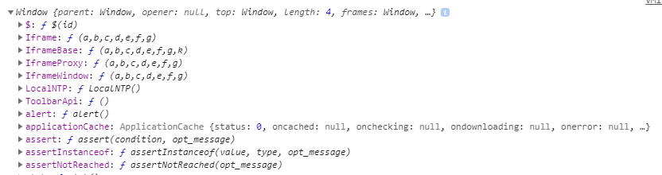
This points to a window object
If you try to access the this keyword in the global scope, it will be bound to the global context, that is, to the window object in the browser.
When using functions that are available in the global context (this distinguishes them from object methods), the this keyword in them will point to the window object.

Slide 4
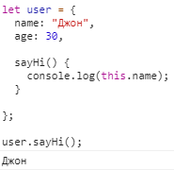
"This" in methods
As a rule, an object’s method needs access to information that is stored in the object in order to perform any actions with it (in accordance with the purpose of the method).
To access information inside an object, a method can use the this keyword.
The value of this is the "before the point" object that was used to invoke the method.

Slide 5
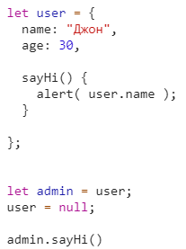
It is also technically possible to access an object without the this keyword, referencing it through an external variable (which stores a reference to this object):
... But such a code would be unreliable.

Slide 6
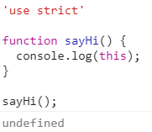
Call without an object
In strict mode ("use strict") in this code, this will be undefined. If we try to access name using this.name, this will cause an error.
Typically, such a call is a programming error. If this is used inside the function, then it is expected that it will be called in the context of some object.

Slide 7
The consequences of not fixed this
In JavaScript, this is “free”, its value is calculated at the time the method is called and does not depend on where this method was declared, but depends on which object calls the method (which object is “before the point”).
This idea of computing this at runtime has its pros and cons. On the one hand, a function can be reused as a method for various objects (which increases flexibility). On the other hand, greater flexibility increases the likelihood of errors.

Slide 8
bind, call, apply
Bind(), call(), apply() - methods for binding the context of a function. They are similar, but have some differences.

Slide 9
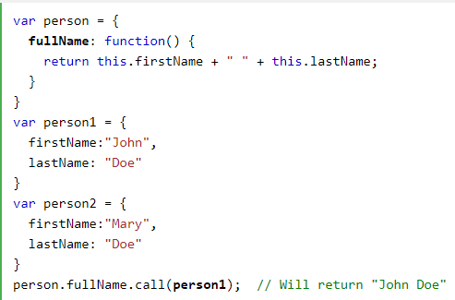
call()
The call() method is a predefined JavaScript method.
It can be used to invoke (call) a method with an owner object as an argument (parameter).
With call(), an object can use a method belonging to another object.
This example calls the fullName method of person, using it on person1:

Slide 10
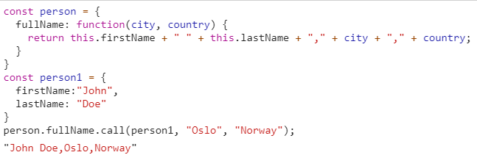
call() with arguments

Slide 11
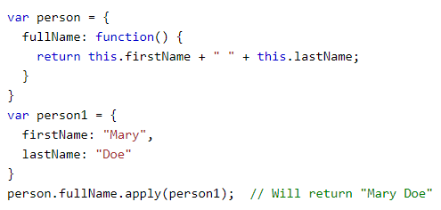
apply()
The apply() method is similar to the call() method

Slide 12

apply() with arguments

Slide 13
The difference between call() and apply()
The difference is:
The call() method takes arguments separately.
The apply() method takes arguments as an array.

Slide 14

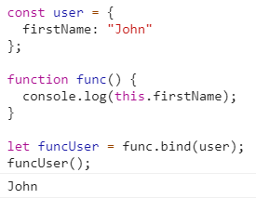
bind()
Basic bind syntax:
a boundFunc call is similar to a func call with a fixed this.

Slide 15
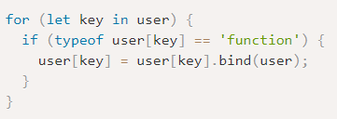
bindAll()
If the object has many methods and we plan to actively pass them, then you can bind the context for them all in the loop:
Some JS libraries provide built-in functions for convenient mass context binding, such as _.bindAll (obj) in lodash.

Slide 16
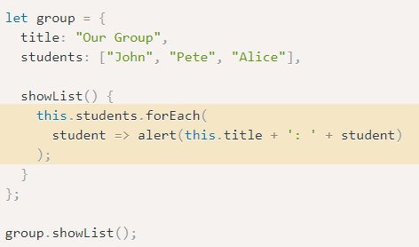
this in arrow functions
Arrow functions do not have this. If this is accessed, its value is taken externally.
For example, we can use this to iterate inside an object method:

Slide 17
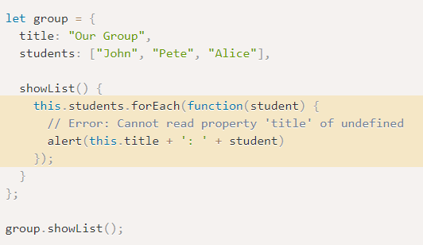
If we used the "normal" function, there would be an error:

Slide 18
Arrow Functions VS bind
There is a subtle difference between the arrow function => and the regular function called with .bind (this):
.bind (this) creates a “linked version” of the function.
Arrow => does not bind anything. The function simply does not have this. When this value is received, it, like a regular variable, is taken from the external lexical environment.

Slide 19


