Slide 1
CSS Preprocessors
Ihor Dubas

Slide 2
CSS preprocessors
CSS preprocessors are scripting languages that extend the default capabilities of CSS. They enable us to use logic in our CSS code, such as variables, nesting, inheritance, mixins, functions, and mathematical operations.
CSS preprocessors make it easy to automate repetitive tasks, reduce the number of errors and code bloat, create reusable code snippets, and ensure backward compatibility.

Slide 3



Top 3 CSS preprocessors
Sass
Less
Stylus

Slide 4
DRY principle
All of this preprocessors follows the DRY (Don’t Repeat Yourself) programming principle in order to avoid duplication.
It has two features that allow us to implement DRY: mixins and the @extend rule.

Slide 5

Sass
Syntactically Awesome Stylesheets
First appeared: November 28, 2006 (13 years ago)
Sass supports two different syntaxes: Sass and SCSS (Sassy CSS)

Slide 6
Sass
Sass has an incredible ecosystem with an active developer community and many tools and libraries.
The two most widely-used frontend frameworks, Bootstrap and Zurb Foundation are both written in Sass, which gives an extra traction to the language.
Moreover, Sass has powerful mixin libraries and authoring frameworks that further enhance the functionality of the language, such as Compass and Bourbon.
There are several notable companies who use Sass in their production sites, for instance Airbnb, Kickstarter, Hubspot, Zapier, Freshbooks, and many others.

Slide 7
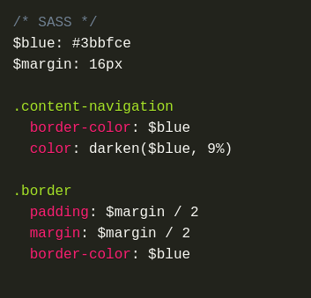
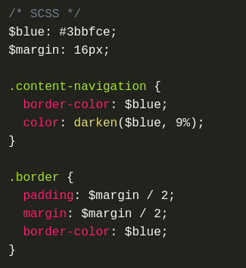
Difference between Sass and SCSS

Slide 8
Pros for SCSS
Pros for Sass
#1: The Sass syntax is more concise
#2: The Sass syntax is easier to read
#3: The Sass syntax doesn't complain about missing semi-colons
#1: SCSS provides a much lower barrier to entry
#2: SCSS encourages proper nesting of rules
#3: SCSS could become the next version of CSS

Slide 9

Less
Leaner Style Sheets
First appeared: 2009 (11 years ago)

Slide 10
Less
Bootstrap’s decision to move Bootstrap 4 from LESS to Sass was a huge hit to the popularity of LESS.
There are other LESS frameworks as well such as Cardinal and Semantic UI also has a LESS-only distribution. LESS has some mixin libraries out there such as LESS Hat.
We can also encounter LESS on production sites such as WeChat, Indiegogo, Transferwise, Patreon, Nordstrom, the Royal Opera House, and many others.

Slide 11

Stylus
Syntactically Awesome Stylesheets
First appeared: 2010 (10 years ago)
Stylus is written in Node.js so that developers can easily integrate it into their Node projects.

Slide 12
Stylus
Stylus has a handful of mixin libraries such as Nib and Ride.css that provide developers with ready-made cross-browser Stylus mixins.
The most notable corporate users of Stylus are Coursera, Livestorm, Accenture, Zenchef, HackerEarth.

Slide 13
Advantages of Using a Preprocessor
Variables
Nesting
Mixins
Extends
If/Else Statements
Color Functions
Loops
Imports
Math

Slide 14
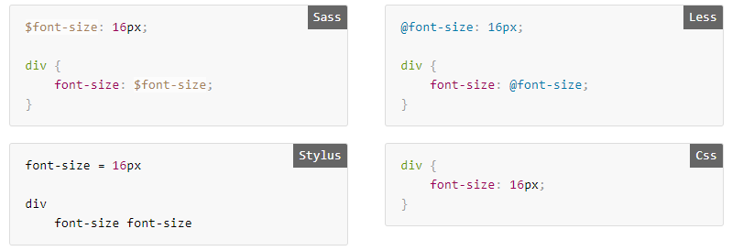
Variables
Variables can be created to reuse data multiple times within your stylesheet:

Slide 15
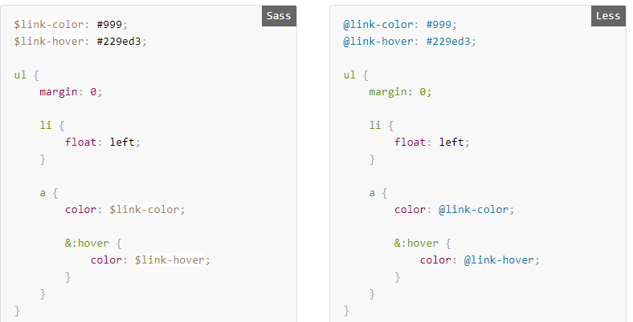
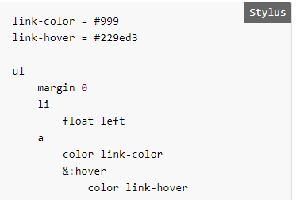
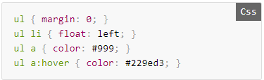
Nesting
Preprocessors give you functionality to create a nested visual hierarchy of CSS elements :

Slide 16
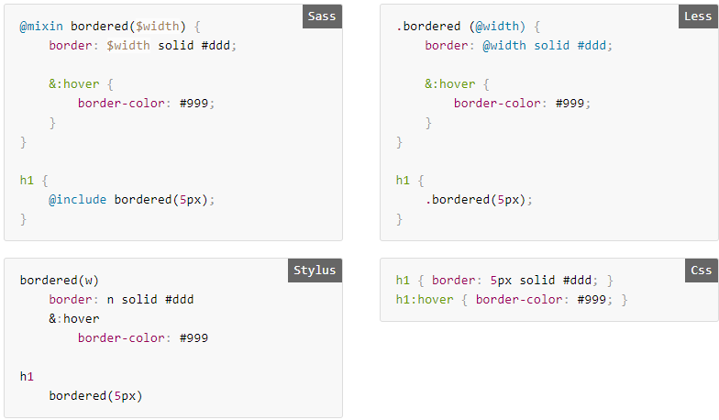
Mixins
Mixins allow you to create reusable CSS blocks. This helps to avoid code duplication.

Slide 17
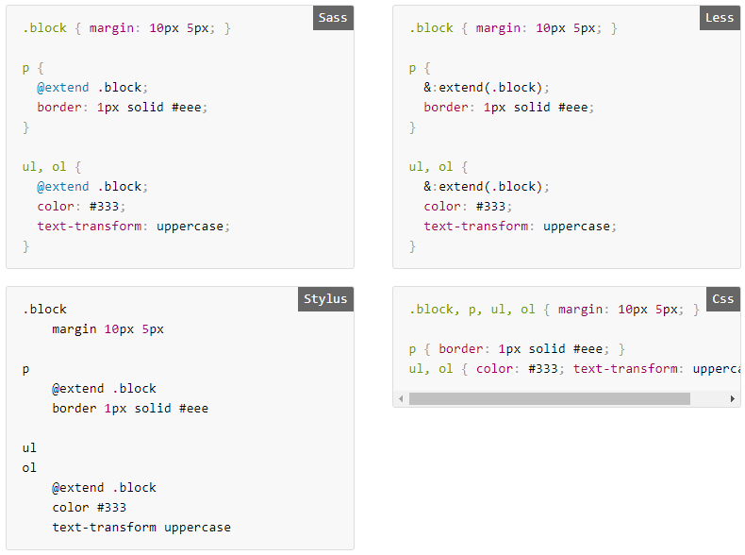
Extends
Extends let you share the entire list of CSS rules of one element with any other element of your choice.

Slide 18
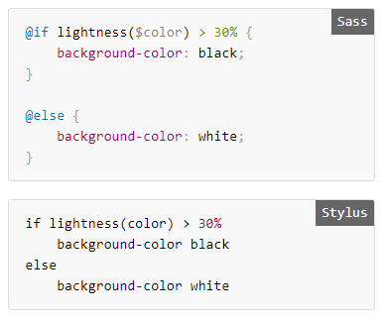
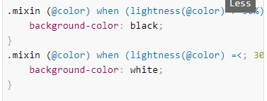

If/Else Statements
SASS and Stylus support normal if/else conditionals.

Slide 19
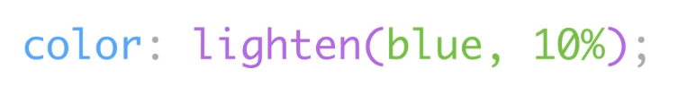
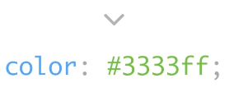
Question?
How Does It Work?

Slide 20
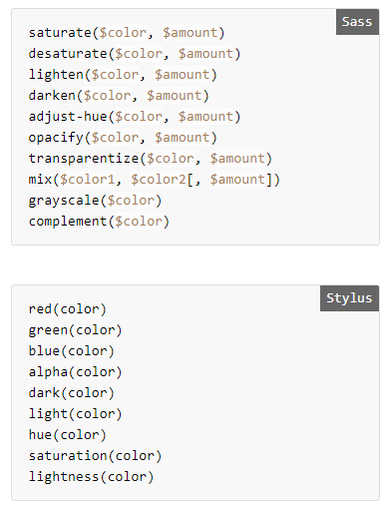
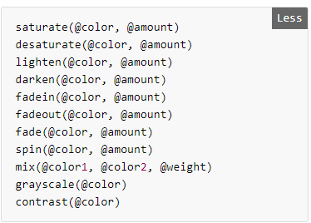
Color Functions
Preprocessors support a wide variety of built in functions for altering a color dynamically.

Slide 21
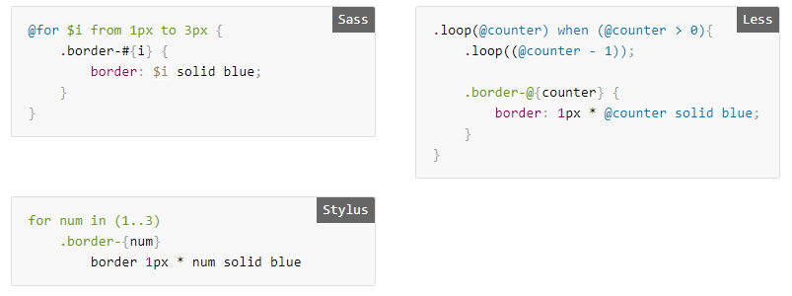
Loops
Loops are useful when iterating through an array or creating a series of styles as in grid widths.

Slide 22
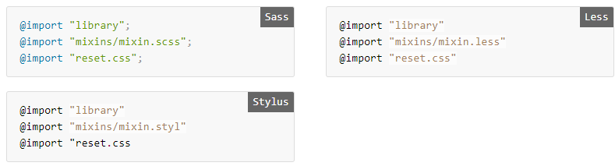
Imports
You can easily combine multiple stylesheets into one without rewriting any code by importing them.

Slide 23
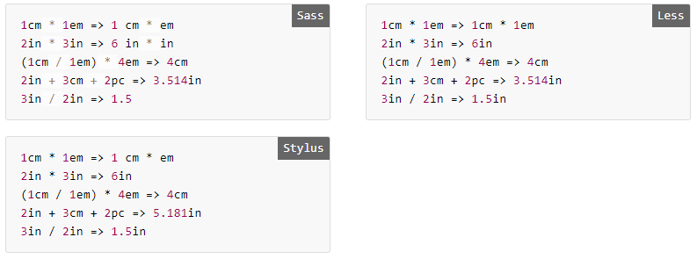
Math
Preprocessors allow for arithmetic to be written anywhere within a CSS rule without the need for the calc() function used in vanilla CSS.

Slide 24



Installing Sass
If you use Node.js, then you can install Sass using npm:
In your project folder type this:

Slide 25
Gulp
Gulp is a front-end development automation tool. It will help you automate routine tasks and speed up your work.
The main tasks that Gulp will help you solve:
Minimization and concatenation of Javascript and CSS files;
HTML minimization;
Using CSS preprocessors Sass, Less, Stylus and others;
Image optimization.

Slide 26
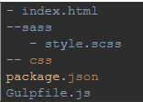
Gulp Sass - installation and setup
Run the install command:
Example project structure:
The sass folder contains the style.scss file, which will be compiled into css.

Slide 27
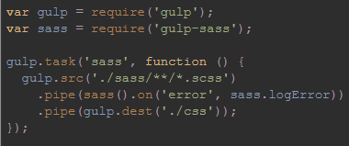
Configuring Gulpfile.js
In the line gulp.src ('./ sass / ** / *. Scss') indicate that you need to compile all files with the extension .scss in the sass folder.
In the line .pipe (gulp.dest ('./ css')); specify the destination folder for compiled CSS.

Slide 28
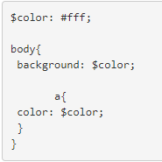
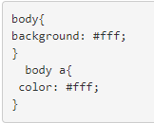
In the style.scss file we write, for example:
Now run gulp sass
The style.css file appears in the project folder

Slide 29

In order not to enter the gulp sass command each time, we add in the gulpfile.js file

Slide 30
Conclusion
In fact, all CSS preprocessors have similar functionalities such as variables, mixins, importing, and nesting. They all follow the DRY principle and can perform conditional statements, functions, and operations. However, there are some important differences in their advanced features we need to think about before we choose one over the other.
Sass and Stylus are more like programming languages, as they have advanced logical and looping abilities and allow us to write custom functions. Moreover, Sass has a huge ecosystem and an active community, and popular frontend frameworks also use it.

Slide 31


