Slide 1
STRING LITERALS, TEMPLATE LITERALS, STRING OBJECT AND ITS METHODS
by Ihor Dubas

Slide 2
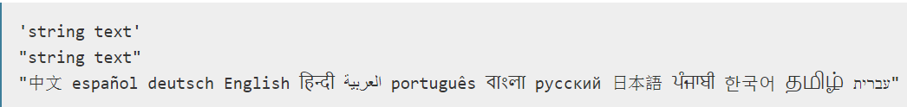

STRING LITERALS
Syntax:
String literals take the forms:
Strings can also be created using the String global object directly:
Anything to be converted to a string.

Slide 3
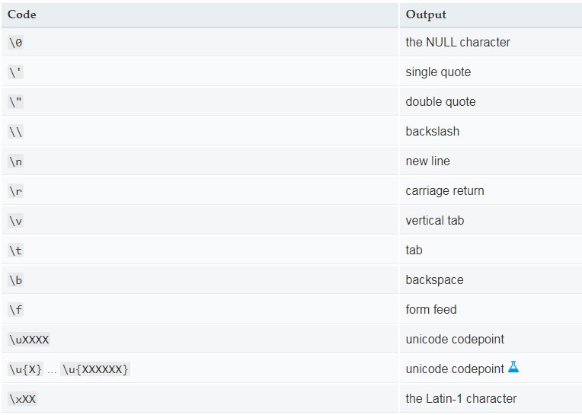
ESCAPE NOTATION
Beside regular, printable characters, special characters can be encoded using escape notation:

Slide 4
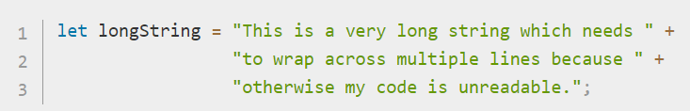
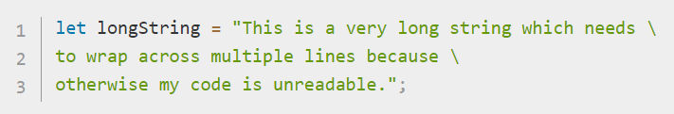
LONG LITERAL STRINGS
There are two ways you can do this.
You can use the + operator to append multiple strings together, like this:
Or you can use the backslash character ("\") at the end of each line:
Both of these result in identical strings being created.

Slide 5


CHARACTER ACCESS
There are two ways to access an individual character in a string. The first is the charAt() method:
The other way (introduced in ECMAScript 5) is to treat the string as an array-like object, where individual characters correspond to a numerical index:
For character access using bracket notation, attempting to delete or assign a value to these properties will not succeed. The properties involved are neither writable nor configurable.

Slide 6

TEMPLATE LITERALS
Template literals are string literals allowing embedded expressions. You can use multi-line strings and string interpolation features with them.
They were called "template strings" in prior editions of the ES2015 specification.
Basic usage:

Slide 7


MULTI-LINE
The great thing about Template Literals is that we can now create multi-line strings! In the past, if we wanted a string to be on multiple lines, we had to use the \n or new line character.
With a Template Literal string, we can just go ahead and add the new line into the string as we write it.
This will produce a string with a new line in it. The ability to do this with expressions makes Template Literals a really nice templating language for building of bits of HTML.

Slide 8


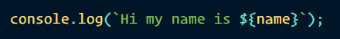
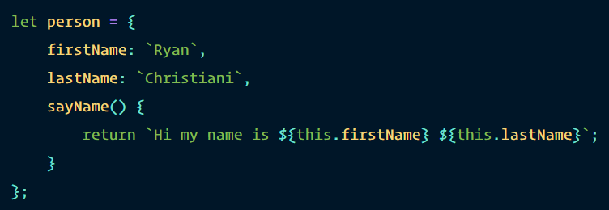

EXPRESSIONS
In the new Template Literal syntax we have what are called expressions, and they look like this: ${expression}. Consider the code below.
The ${} syntax allows us to put an expression in it and it will produce the value, which in our case above is just a variable that holds a string!
We can also use this with a more complex object.

Slide 9
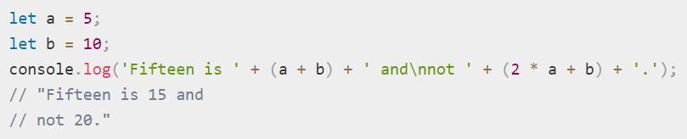
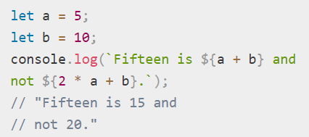
EXPRESSION INTERPOLATION
In order to embed expressions within normal strings, you would use the following syntax:
Now, with template literals, you are able to make use of the syntactic sugar, making substitutions like this more readable:

Slide 10
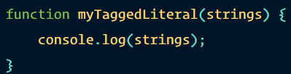

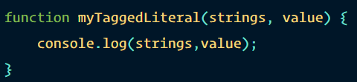
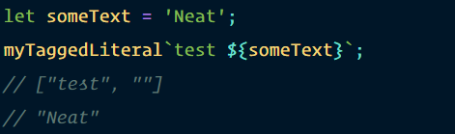
TAGGED TEMPLATES
Another features of Template Literals is the ability to create Tagged Template Literals. You create a function and this function will look like any other function, however it looks different when you call it:
Let’s expand on the string we send to the function and we will have it include an expression, and we will include a new parameter in our function as well.

Slide 11
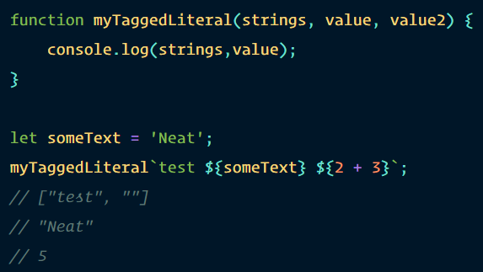
When we use an expression we can access that from the next parameters and this keeps going. Say we added another expression.
This is pretty powerful: it allows you to take the data used in a string and manipulate it to your liking.

Slide 12

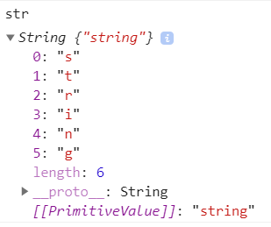
STRING OBJECT
The String object lets you work with a series of characters; it wraps Javascript's string primitive data type with a number of helper methods.
As JavaScript automatically converts between string primitives and String objects, you can call any of the helper methods of the String object on a string primitive.
Use the following syntax to create a String object:

Slide 13
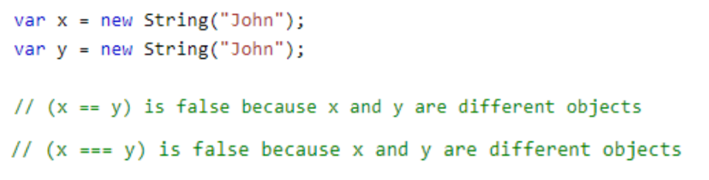
Using object String can lead to unexpected results:

Slide 14
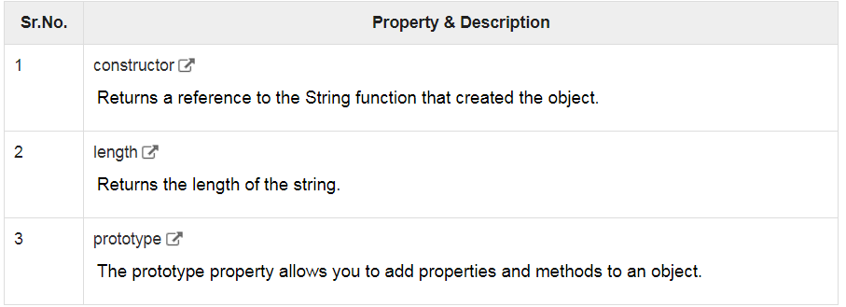

String Properties
Here is a list of the properties of String object and their description.

Slide 15
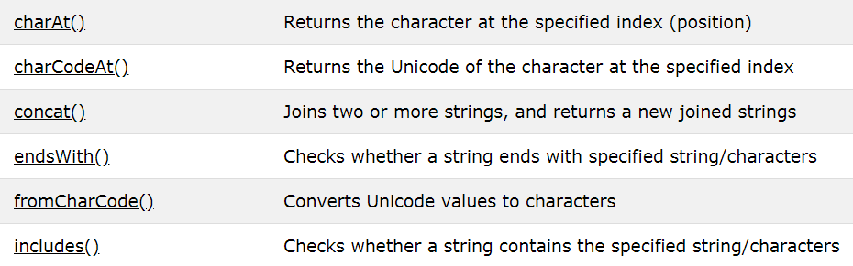
STRING METHODS
All string methods return a new value. They do not change the original variable.

Slide 16
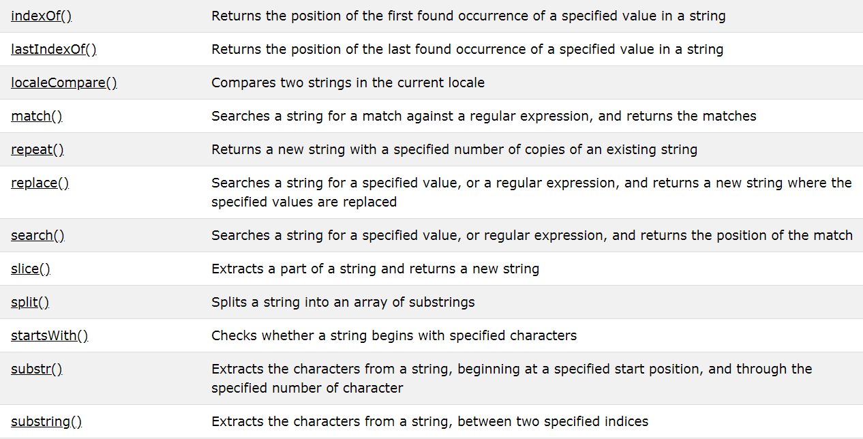

Slide 17
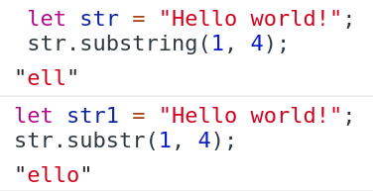
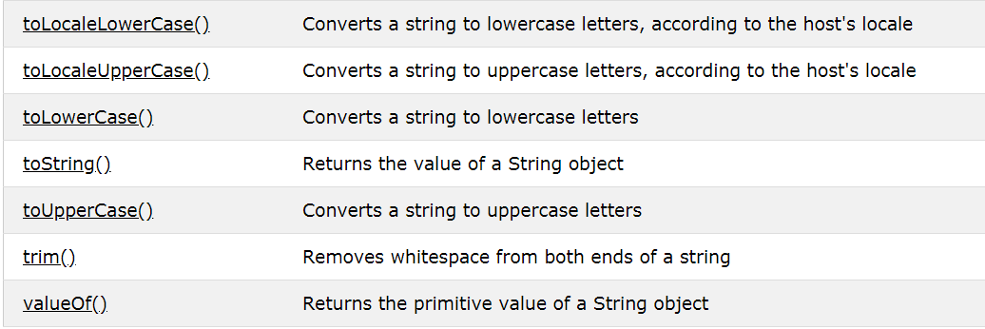

Slide 18
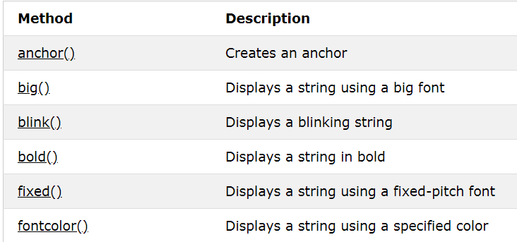
STRING HTML WRAPPER METHODS
The HTML wrapper methods return the string wrapped inside the appropriate HTML tag.
These are not standard methods, and may not work as expected in all browsers.

Slide 19
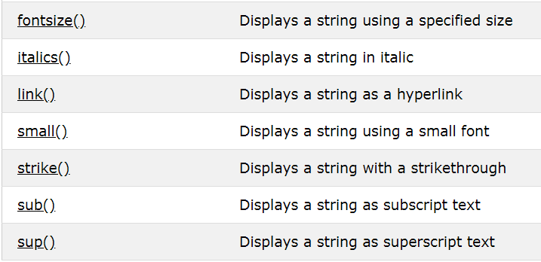
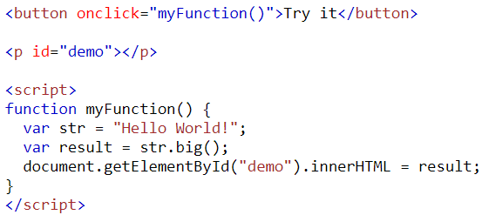
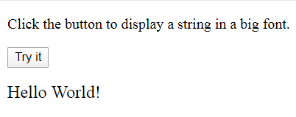
Example

Slide 20


