Slide 1
Event switch, Layout component, Container component
Ihor Dubas

Slide 2


Event switch
When writing event handlers it's common to adopt the handle{eventName} naming convention.
For components that handle several event types, these function names can be repetitive. The names themselves might not provide much value, as they simply proxy to other actions/functions.

Slide 3
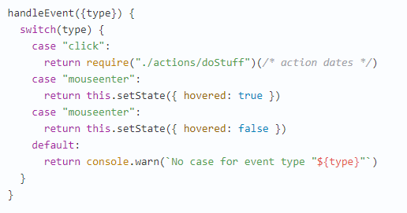
Example
Single event handler for component and switching on event.type.

Slide 4

Alternatively, for simple components, you can call imported actions/functions directly from components, using arrow functions.
Don't fret about performance optimizations until you have problems.
Seriously don't.

Slide 5



This approach is not entirely successful, since it does not add readability to the code. Many programmers prefer to use React features with functions that bind to the context with an automaton. That is, the following notation is no longer necessary
The following notation works instead
And then write

Slide 6
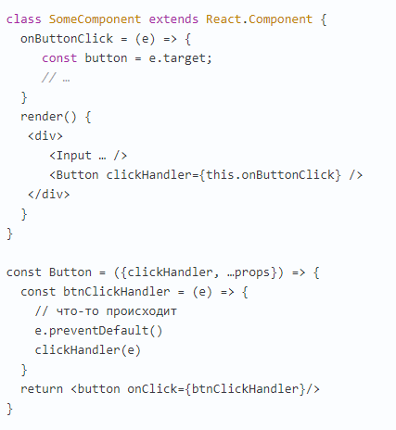
In this case, the context (this) will not be lost if the handler refers to it inside the function. Accordingly, such functions can be easily transferred as props to other components and called in them.
Also, in case we pass such a function to a descendant, the Simple Component, we can get a link to the DOM element of this component through event.target in the parent component, which is sometimes useful.

Slide 7
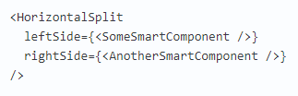
Layout component
Layout components result in some form of static DOM element. It might not need to update frequently, if ever.
Consider a component that renders two children side-by-side.
We can optimize this component.

Slide 8
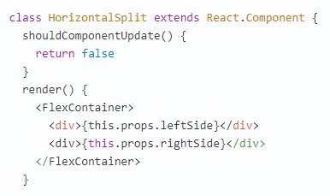
While HorizontalSplit will be parent to both components, it will never be their owner. We can tell it to update never, without interrupting the lifecycle of the components inside.

Slide 9
Container component
Components much easier to reuse and reason about if you divide them into two categories. People call them Container and Presentational components* but also it can be Fat and Skinny, Smart and Dumb, Stateful and Pure, Screens and Components, etc.
These all are not exactly the same, but the core idea is similar.

Slide 10
Presentational components
Are concerned with how things look.
May contain both presentational and container components** inside, and usually have some DOM markup and styles of their own.
Don’t specify how the data is loaded or mutated.
Receive data and callbacks exclusively via props.
Rarely have their own state (when they do, it’s UI state rather than data).
Are written as functional components unless they need state, lifecycle hooks, or performance optimizations.
Examples: Page, Sidebar, Story, UserInfo, List.

Slide 11
Container components
Are concerned with how things work.
May contain both presentational and container components** inside but usually don’t have any DOM markup of their own except for some wrapping divs, and never have any styles.
Provide the data and behavior to presentational or other container components.
Are often stateful, as they tend to serve as data sources.
Are usually generated using higher order components such as connect() from React Redux, createContainer() from Relay, or Container.create() from Flux Utils, rather than written by hand.
Examples: UserPage, FollowersSidebar, StoryContainer, FollowedUserList.

Slide 12

Blue is representing the container component while gray is the presentational

Slide 13
Benefits of This Approach
Better separation of concerns. You understand your app and your UI better by writing components this way.
Better reusability. You can use the same presentational component with completely different state sources, and turn those into separate container components that can be further reused.
Presentational components are essentially your app’s “palette”. You can put them on a single page and let the designer tweak all their variations without touching the app’s logic.
This forces you to extract “layout components” such as Sidebar, Page, ContextMenu and use this.props.children instead of duplicating the same markup and layout in several container components.

Slide 14

“A container does data fetching and then renders its corresponding
sub-component. That’s it.” — Jason Bonta
“Corresponding” meaning a component that shares the same name:

Slide 15
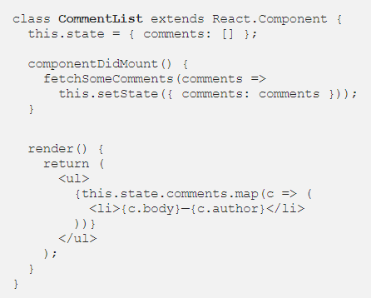
Why containers?
Say you have a component that displays comments. You didn’t know about container components. So, you put everything in one place:

Slide 16
Your component is responsible for both fetching data and presenting it. There’s nothing “wrong” with this but you miss out on a few benefits of React:
Reusability
CommentList can’t be reused unless under the exact same circumstances.
Data structure
Your markup components should state expectations of the data they require.
Our component is about data structure but has no way of expressing those opinions. This componeopinionated nt will break silently if the json endpoint change.

Slide 17
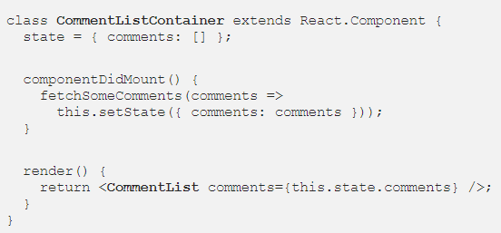
Once again. This time with a container
First, lets pull out data-fetching into a container component.

Slide 18
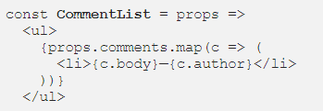
Now, let’s rework CommentList to take comments as a prop.
So, what did we get?

Slide 19
Profs of using Container Components
We’ve separated our data-fetching and rendering concerns.
We’ve made our CommentList component reusable.
Container components make components easier to read.

Slide 20
How to use container components
Programmers suggest you to start building your app with just presentational components first. Eventually you’ll realize that you are passing too many props down the intermediate components. When you notice that some components don’t use the props they receive but merely forward them down and you have to rewire all those intermediate components any time the children need more data, it’s a good time to introduce some container components. This way you can get the data and the behavior props to the leaf components without burdening the unrelated components in the middle of the tree.
This is an ongoing process of refactoring so don’t try to get it right the first time. As you experiment with this pattern, you will develop an intuitive sense for when it’s time to extract some containers, just like you know when it’s time to extract a function.

Slide 21


