Slide 1
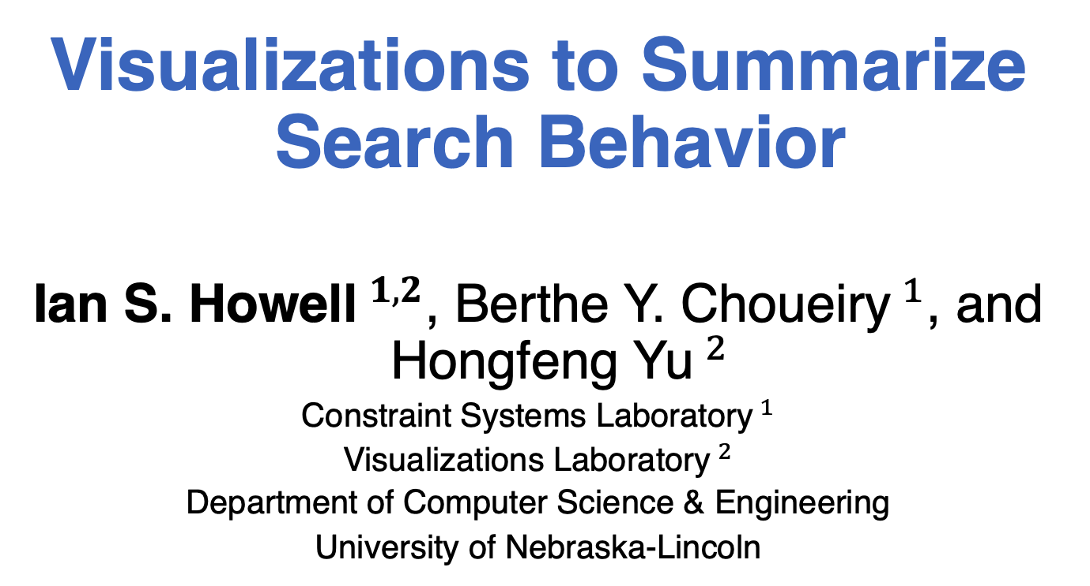
Visualizations to Summarize Search Behavior
Ian S. Howell$^{1,2}$, Berthe Y. Choueiry$^{1}$, and Hongfeng Yu$^{2}$
Constraint Systems Laboratory$^{1}$
Visualizations Laboratory$^{2}$
Department of Computer Science & Engineering
University of Nebraska-Lincoln

Slide 2
Introduction
Backtrack search when solving a constraint satisfaction problem (CSP) suffers from thrashing
Enforcing a consistency property reduces thrashing at the cost of further processing
The tradeoff of running a higher-level consistency (HLC) is poorly understood.
We propose to summarize search

Slide 3
Background
A constraint satisfaction problem (CSP) consists of a set of variables, the variables’ domains, and constraints.
A solution is a domain to variable assignment that satisfies all constraints.
Backtrack search is only sound and complete method of solving a CSP.

Slide 4
Background
Thrashing is the main malady of search
Repeatedly performing same logic
Applying a consistency algorithm after variable instantiation reduces thrashing
Past visualizations focus on debugging and inspecting search
Detect thrashing through isomorphic subtrees
Debug individual issues by investigating the state of variables, propagators, etc.

Slide 5
Background
Woodward et al. propose to measure:
thrashing with Backtracks per Depth (BpD)
HLC cost with consistency calls per depth (CpD)

Slide 6
Contributions
Criteria for computing distance between two time samples based on the BpD
A clustering technique for summarizing search into a history of qualitatively distinct regimes
A new visualization that examines the behavior of variable ordering heuristics

Slide 7
Outline
Introduction
Background
Contributions
Outline
Distance between timestamps
Summarizing search history
Example: Analyzing structure
Visualizing variable ordering
Example: Variable ordering
Conclusions and discussion

Slide 8


Distance between timestamps
Design goal: capture the “shape” change
#BT at time $t$
#BT at time $t′$
Depth

Slide 9
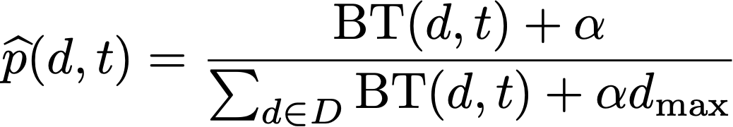
Distance between timestamps
Adapt Kulbak-Liebler Divergence
BpD distribution:
Use additive smoothing to account for zero-probability intervals

Slide 10
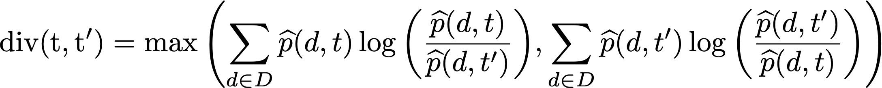


Distance between timestamps

Slide 11
Summarizing search history
Create a clustering tree
Use agglomerative, hierarchical clustering
Only merge temporally adjacent clusters
Each cluster’s representative is the middle of the interval of included timestamps
Divergence
time
t₀
t₁
t₂
t₃
t₄
t₅
t₆
t₇
t₈
t₉
t₁₀
t₁₁

Slide 12

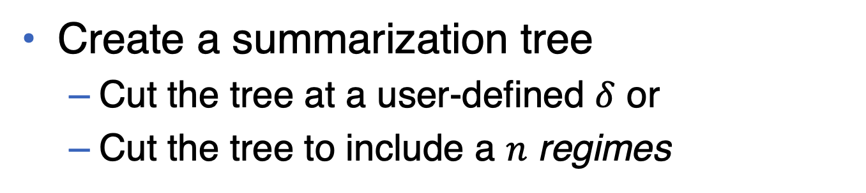
Summarizing search history
Create a summarization tree
Cut the tree at a user-defined $δ$ or
Cut the tree to include a $n$ regimes
Divergence
$$δ$$
r₁
r₂
r₃
r₄
r₅
time
t₀
t₁
t₂
t₃
t₄
t₅
t₆
t₇
t₈
t₉
t₁₀
t₁₁

Slide 13
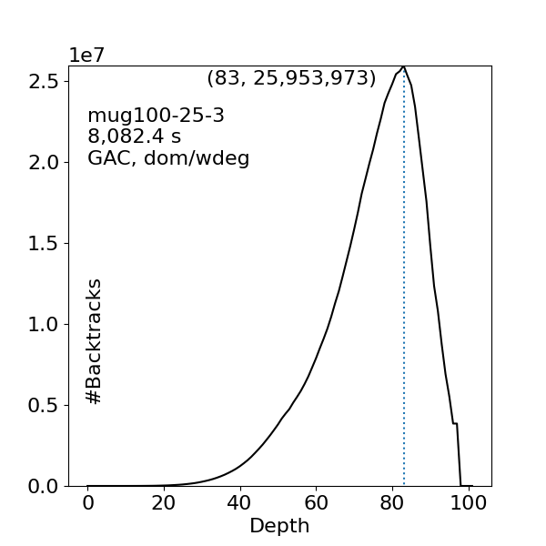
Example: Analyzing structure

Slide 14
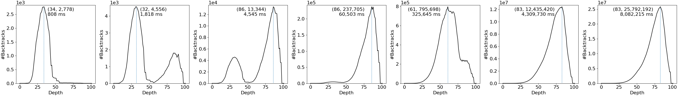
Example: Analyzing structure
0.1-summarization of GAC on mug100-25-3

Slide 15
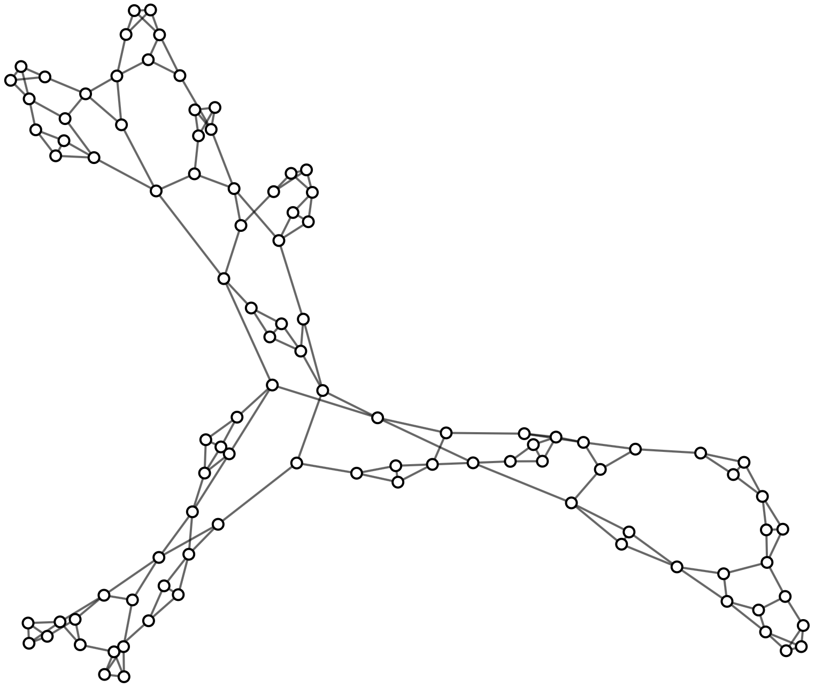
Example: Analyzing structure
Primal graph of mug100-25-3

Slide 16
Example: Analyzing structure
Many large cycles
Primal graph of mug100-25-3

Slide 17
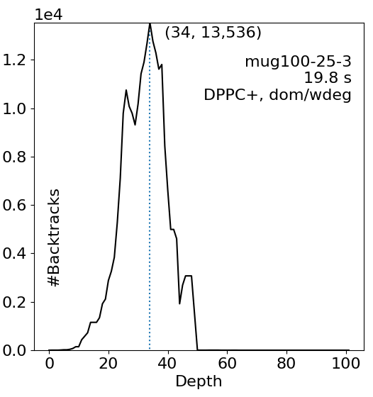
Example: Analyzing structure
BpD of GAC and DPPC+ on mug100-25-3

Slide 18
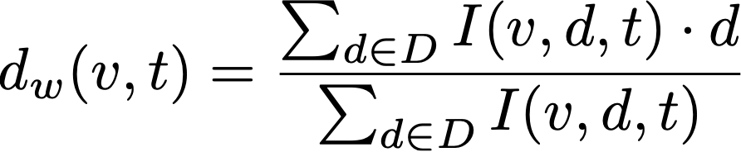
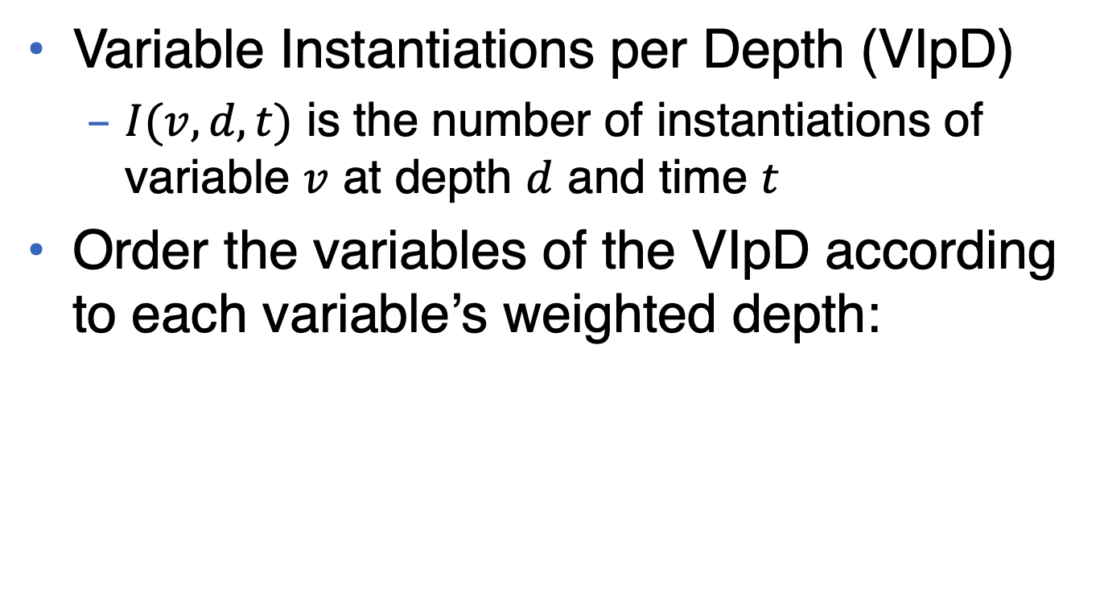
Visualizing variable ordering
Variable Instantiations per Depth (VIpD)
$I(v,d,t)$ is the number of instantiations of variable $v$ at depth $d$ and time $t$
Order the variables of the VIpD according to each variable’s weighted depth:

Slide 19
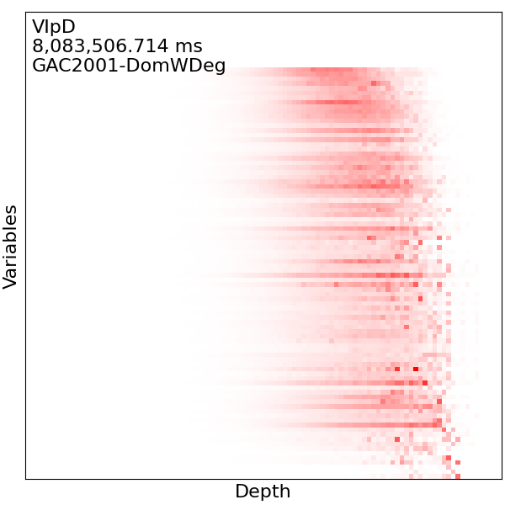
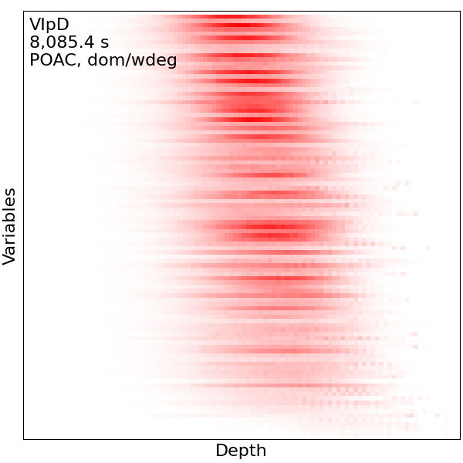
Example: Variable ordering
VIpD of GAC and POAC with dom/wdeg on mug100-1-3

Slide 20
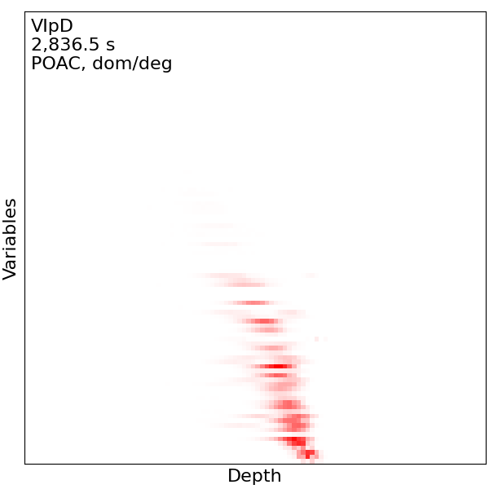
Example: Variable ordering
VIpD of POAC with dom/deg on mug100-1-3

Slide 21
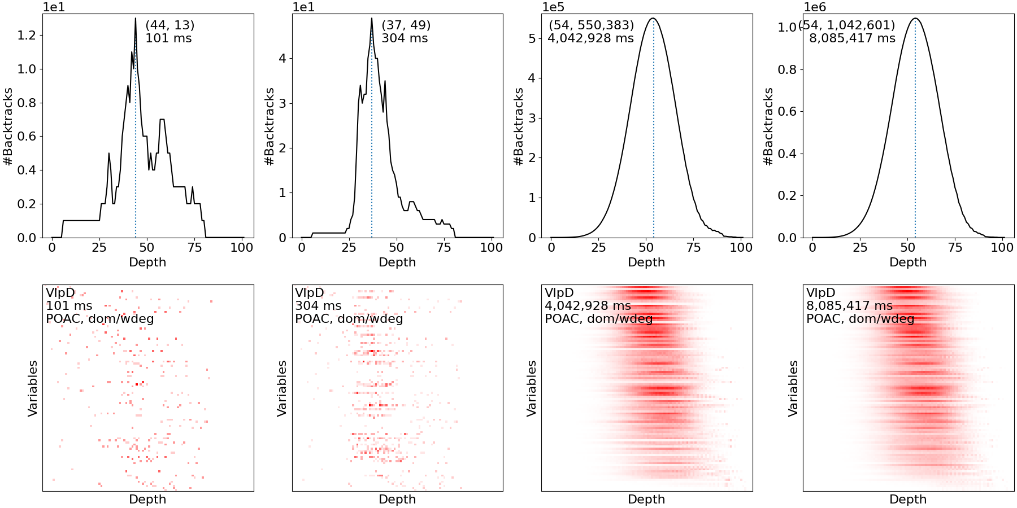
Example: Variable ordering
0.1-summarization of POAC with dom/wdeg on mug100-1-3

Slide 22
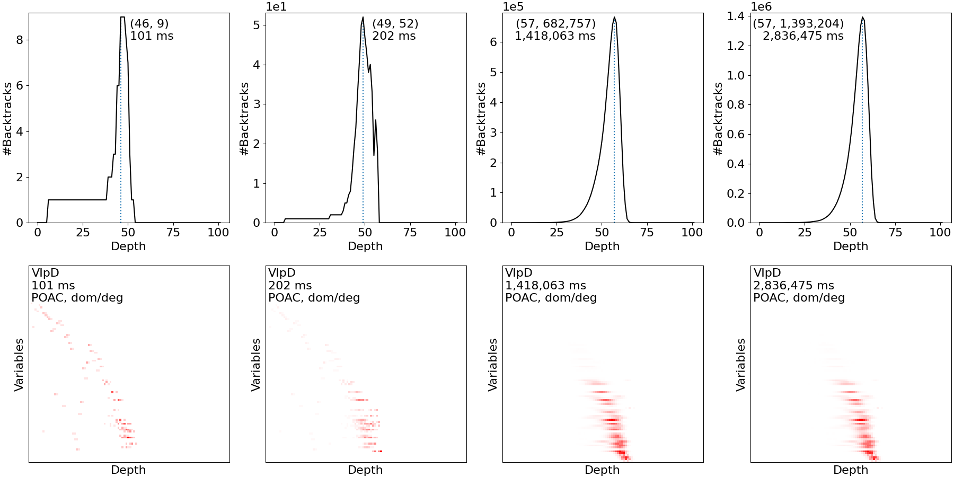
Example: Variable ordering
0.1-summarization of POAC with dom/deg on mug100-1-3

Slide 23
Conclusions and discussion
Summarizations can be used to help explain the (changing) behavior of search
Researchers and developers can use these tools iteratively to better study the impact of a strategy on a given problem
Summarizations can catch small and large behavior that a human could not

Slide 24
Conclusions and discussion
Initial results of BpD with binary branching give similar results
We currently provide a ‘post-mortem’ analysis. Future work includes an ‘in-vivo’ analysis that enables human experts

Slide 25
Acknowledgements
This research is supported by NSF Grant No. RI-1619344 and NSF CAREER Award No. III-1652846.
The experiments were completed utilizing the Holland Computing Center of the University of Nebraska, which receives support from the Nebraska Research Initiative.

