Slide 1
3407001022021 Basic Information Technologies
İsmail Hakkı Parlak
ismail.parlak@ibu.edu.tr
Room: 335
https://github.com/ihpar/bit_chem

Slide 2
Algorithm
An algorithm is a procedure used for solving a problem or performing a computation.
Algorithms act as an exact list of instructions that conduct specified actions step by step.
Algorithms are widely used throughout all areas of IT. In mathematics, computer programming and computer science, an algorithm usually refers to a small procedure that solves a recurrent problem.
https://www.techtarget.com/whatis/definition/algorithm

Slide 3
Algorithm
Wash Your Hands:
Open the water tap.
Put soap on your hands.
Clean your hands with water.
Shut down the water tap.
Dry your hands.
https://diana-vile.medium.com/everyday-routines-to-explain-algorithms-flowcharts-1b17a4415023

Slide 4
Flowchart
A flowchart is a type of diagram that represents a workflow or process. A flowchart can also be defined as a diagrammatic representation of an algorithm, a step-by-step approach to solving a task.
Flowcharts consist of sets of connected symbols.
https://diana-vile.medium.com/everyday-routines-to-explain-algorithms-flowcharts-1b17a4415023

Slide 5
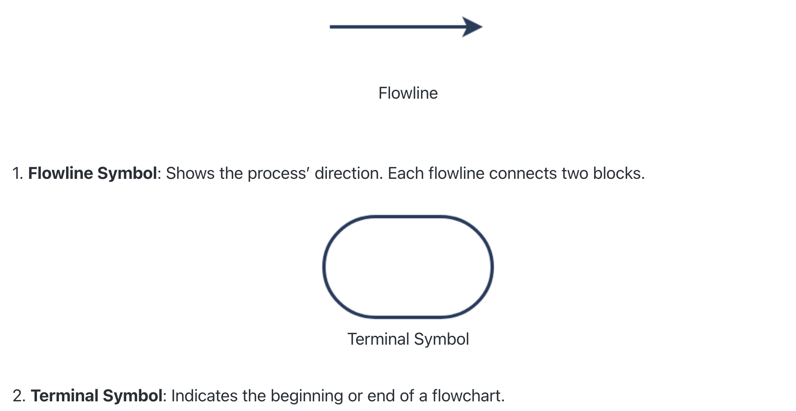
Flowchart
https://www.zenflowchart.com/flowchart-symbols

Slide 6
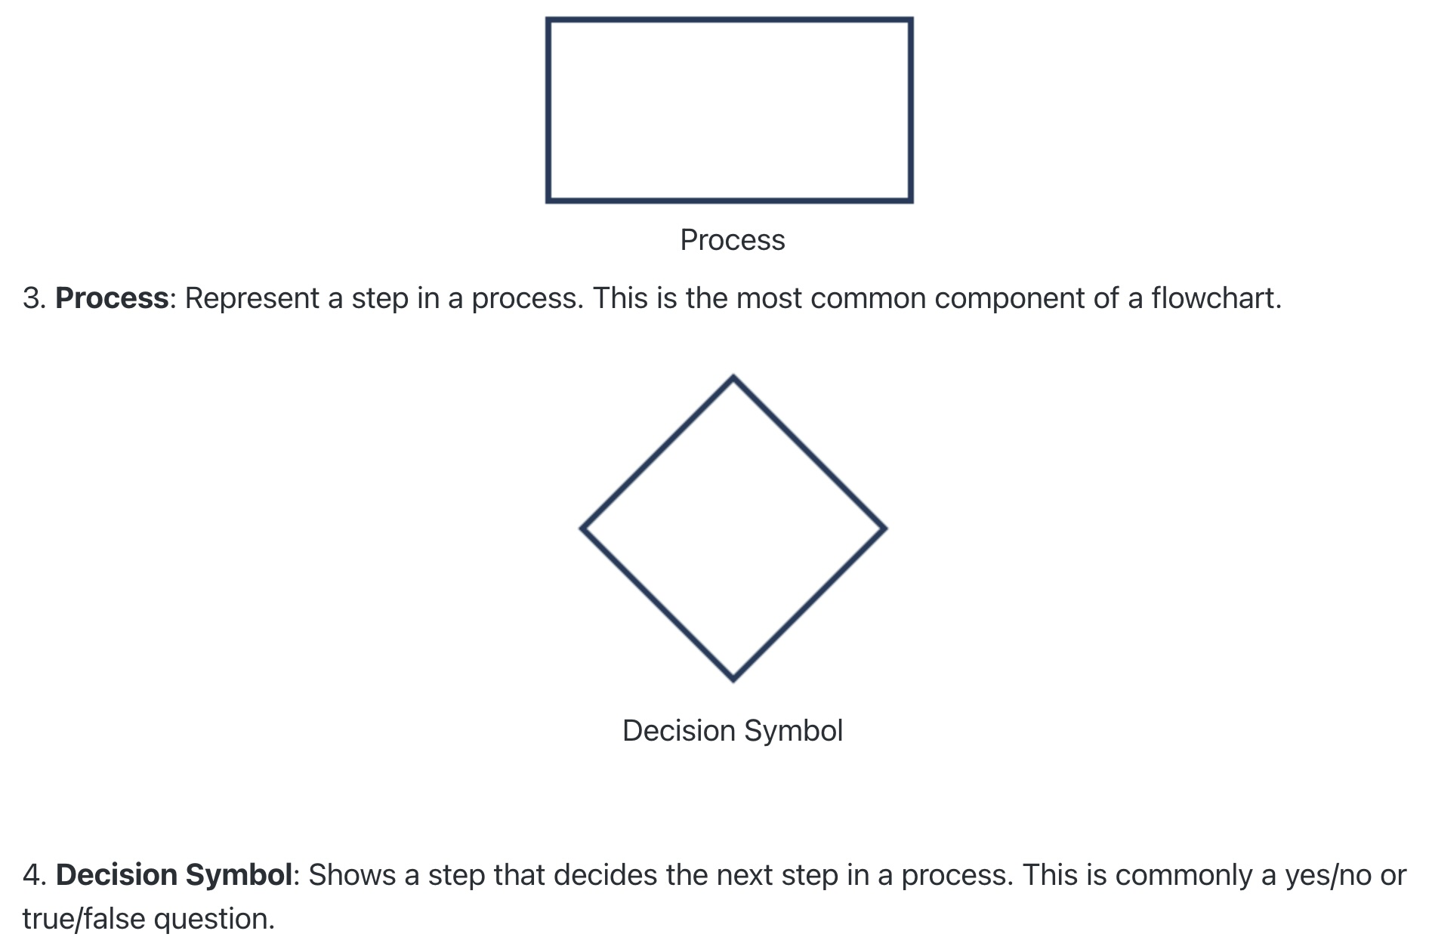
Flowchart
https://www.zenflowchart.com/flowchart-symbols

Slide 7
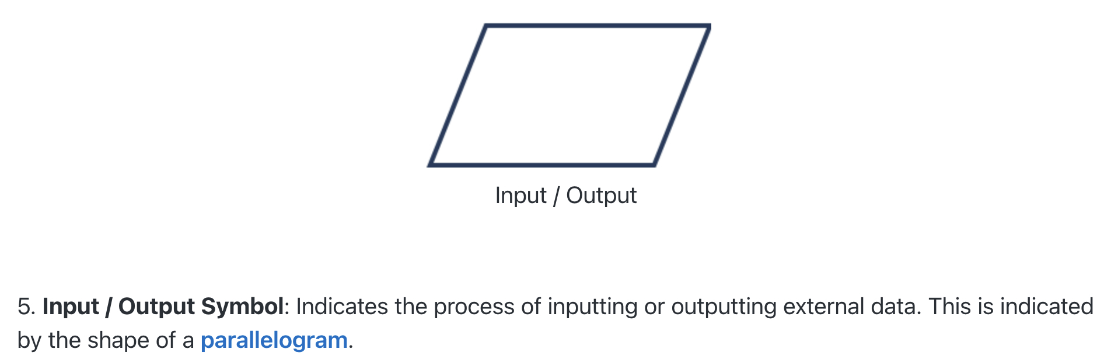
Flowchart
https://www.zenflowchart.com/flowchart-symbols

Slide 8
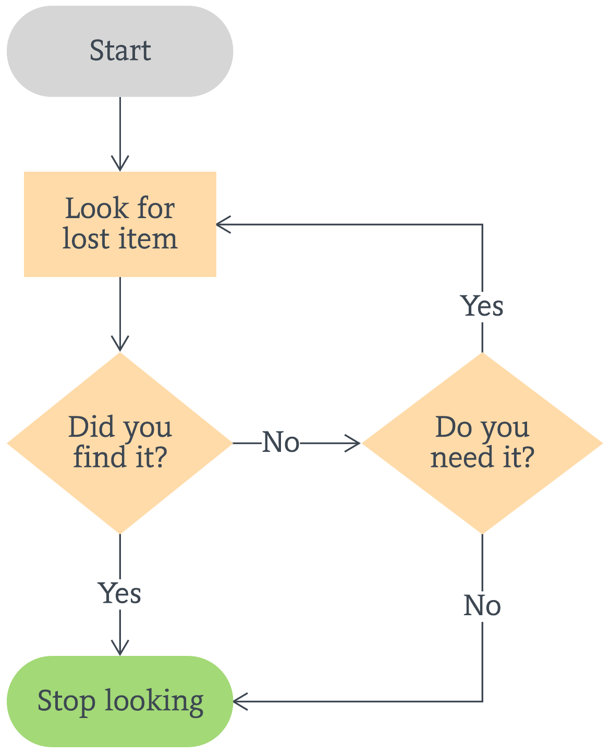
Flowchart
https://www.lucidchart.com/blog/flowchart-templates

Slide 9
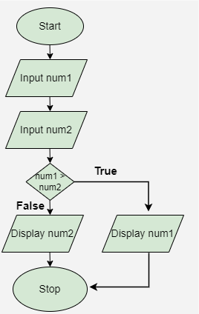
Flowchart
https://www.geeksforgeeks.org/an-introduction-to-flowcharts/

Slide 10
Conditional Statements
Conditional statements in Python are used to execute certain blocks of code based on specific conditions.
If statement is the simplest form of a conditional statement. It executes a block of code if the given condition is true.
age = 20
if age >= 18:
print("Eligible to vote.")
https://www.geeksforgeeks.org/conditional-statements-in-python/

Slide 11
Conditional Statements
Else allows us to specify a block of code that will execute if the condition(s) associated with an if or elif statement evaluates to False. Else block provides a way to handle all other cases that don't meet the specified conditions.
age = 10
if age <= 12:
print("Travel for free.")
else:
print("Pay for ticket.")
https://www.geeksforgeeks.org/conditional-statements-in-python/

Slide 12
Conditional Statements
elif statement in Python stands for "else if." It allows us to check multiple conditions , providing a way to execute different blocks of code based on which condition is true.
age = 25
if age <= 12:
print("Child.")
elif age <= 19:
print("Teenager.")
elif age <= 35:
print("Young adult.")
else:
print("Adult.")
https://www.geeksforgeeks.org/conditional-statements-in-python/

Slide 13
User Input
Python allows for user input. That means we are able to ask the user for input.
username = input("Enter username:") print("Username is: " + username)
Note that type of user input is always string (str)!
If we want to take integer input, we can do it like:
age = int(input("Enter your age:"))
https://www.w3schools.com/python/python_user_input.asp

