Slide 1
3407001022021 Basic Information Technologies
İsmail Hakkı Parlak
ismail.parlak@ibu.edu.tr
Room: 335
https://github.com/ihpar/bit_chem

Slide 2
Course Objectives
Learning information technology terms
Learning computer concepts
Learning the Python programming language at a basic level

Slide 3
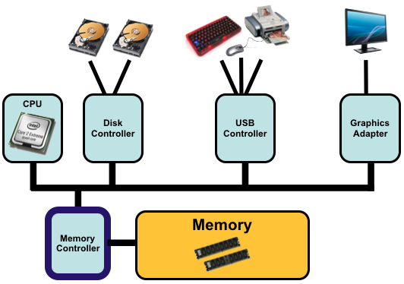
Computer System
https://www2.it.uu.se/education/course/homepage/os/vt18/module-1/definitions/

Slide 4
Hardware
CPU: The central processing unit (CPU) is the electronic circuitry within a computer that carries out the instructions of a computer program by performing the basic arithmetic, logical, control and input/output (I/O) operations specified by the instructions.
The fundamental operation of most CPUs is to execute a sequence of stored instructions that is called a program. The instructions to be executed are kept in some kind of computer memory.
https://www2.it.uu.se/education/course/homepage/os/vt18/module-1/definitions/
https://en.wikipedia.org/wiki/Central_processing_unit

Slide 5
Hardware
Memory: Memory refers to the computer hardware integrated circuits that store information for immediate use in a computer.
The term memory is often synonymous with the terms RAM, main memory, or primary storage.
https://www2.it.uu.se/education/course/homepage/os/vt18/module-1/definitions/
https://en.wikipedia.org/wiki/Computer_memory

Slide 6
Hardware
Input/Output (I/O): I/O is the communication between a computer, and the outside world, possibly a human or another information processing system.
Inputs are the signals or data received by the system and outputs are the signals or data sent from it.
https://www2.it.uu.se/education/course/homepage/os/vt18/module-1/definitions/

Slide 7
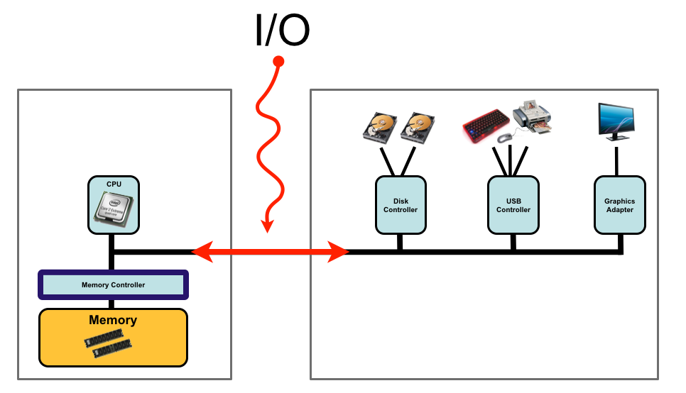
Hardware
https://www2.it.uu.se/education/course/homepage/os/vt18/module-1/definitions/

Slide 8
Software
Operating system: An operating system (OS) is system software that manages computer hardware and software resources and provides common services for computer programs. The OS controls the hardware and coordinates its use among the various application programs for the various user.
Examples: Windows, MacOS, Linux
https://www2.it.uu.se/education/course/homepage/os/vt18/module-1/definitions/

Slide 9
Software
Program: A set of instructions which is in human readable format. A passive entity stored on secondary storage.
Executable: A compiled form of a program including machine instructions and static data that a computer can load and execute. A passive entity stored on secondary storage.
Process: A program loaded into memory and executing or waiting. A process typically executes for only a short time before it either finishes or needs to perform I/O (waiting). A process is an active entity and needs resources such as CPU time, memory etc. to execute.
https://www2.it.uu.se/education/course/homepage/os/vt18/module-1/definitions/

Slide 10
Bits & Bytes
At the smallest scale in the computer, information is stored as bits and bytes.
A "bit" is the smallest unit of storage and stores just a 0 or 1
A bit is too small to be much use
Group 8 bits together to make 1 byte
One byte = collection of 8 bits e.g. 01011010
https://web.stanford.edu/class/cs101/bits-bytes.html

Slide 11
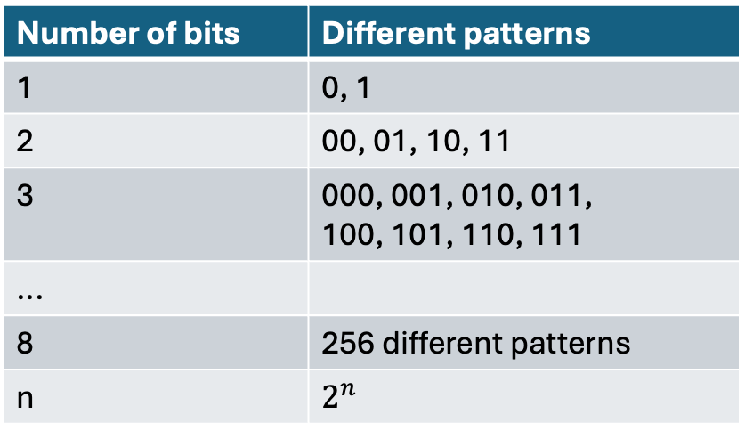
Bits & Bytes
Number of bits | Different patterns
1 | 0, 1
2 | 00, 01, 10, 11
3 | 000, 001, 010, 011, 100, 101, 110, 111
...
8 | 256 different patterns
n | $$2^{n}$$
https://web.stanford.edu/class/cs101/bits-bytes.html

Slide 12
Bits & Bytes
1 Byte (B) = 8 Bits
1 KB = 1024 Bs
1 MB = 1024 KBs
1 GB = 1024 MBs
1 TB = 1024 GBs
https://web.stanford.edu/class/cs101/bits-bytes.html

Slide 13
Bits & Bytes
Decimal ↔ Binary conversion:
https://www.rapidtables.com/convert/number/how-binary-to-decimal.html

