Slide 1
3407001022021 Basic Information Technologies
İsmail Hakkı Parlak
ismail.parlak@ibu.edu.tr
Room: 335
https://github.com/ihpar/bit_chem

Slide 2
Loops
Loops in Python are used to repeat actions efficiently.
The main types are For loops (counting through items) and While loops (based on conditions).
Additionally, Nested Loops allow looping within loops for more complex tasks.
While all the ways provide similar basic functionality, they differ in their syntax and condition-checking time.
https://www.geeksforgeeks.org/loops-in-python/

Slide 3
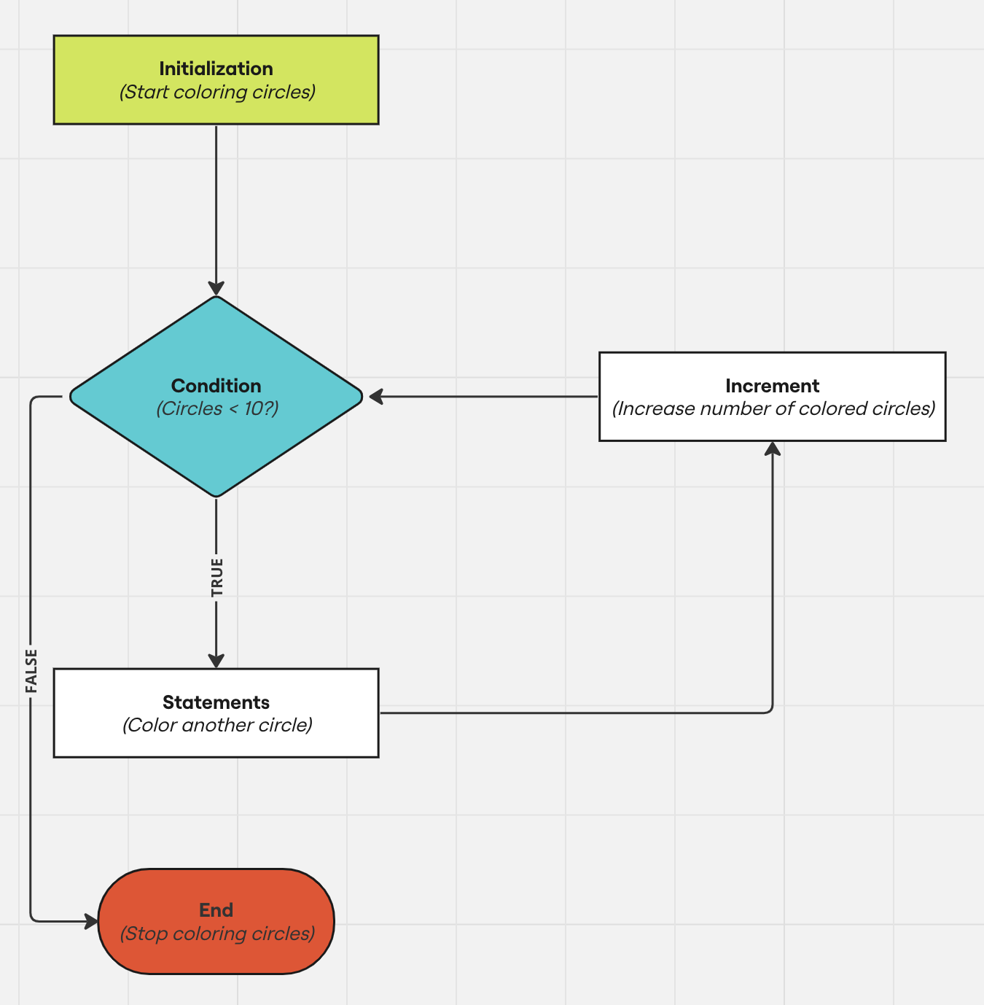
Loops
https://miro.com/blog/flowchart-loops-guide/

Slide 4
While Loops
With the while loop we can execute a set of statements as long as a condition is true.
i = 1 while i < 6: print(i) i += 1
https://www.w3schools.com/python/python_while_loops.asp

Slide 5
While Loops
With the break statement we can stop the loop even if the while condition is true.
i = 1 while i < 6: print(i) if i == 3: break i += 1
https://www.w3schools.com/python/python_while_loops.asp

Slide 6
While Loops
With the continue statement we can stop the current iteration and continue with the next.
i = 0 while i < 6: i += 1 if i == 3: continue print(i)
https://www.w3schools.com/python/python_while_loops.asp

Slide 7
Exercises
Print numbers from 1 to 10.
Print even numbers between 0 and 20.
Find the sum of numbers from 1 to 10.
Find the product of numbers from 1 to 10.
Print * (asterisk) symbols side by side, repeated n times.
Find the sum of numbers entered by the user.

