Slide 1



Quantifying spatial heterogeneity
of malaria in the endemic Papua region
of Indonesia
Ihsan Fadilah
Eijkman-Oxford Clinical Research Unit
Jakarta, Indonesia

Slide 2
Ihsan Fadilah • December 2021

Slide 3
Ihsan Fadilah • December 2021

Slide 4
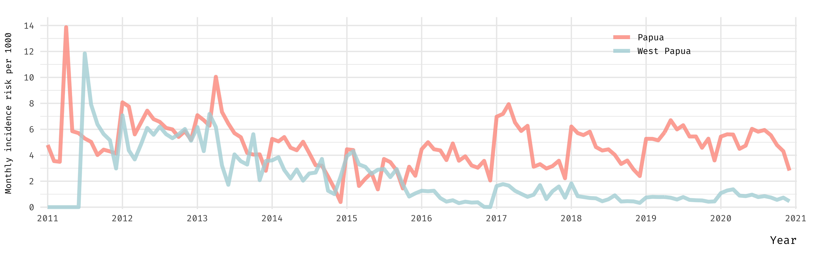
Ihsan Fadilah • December 2021

Slide 5
Ihsan Fadilah • December 2021

Slide 6
Ihsan Fadilah • December 2021

Slide 7
Ihsan Fadilah • December 2021

Slide 8
Ihsan Fadilah • December 2021

Slide 9
Ihsan Fadilah • December 2021

Slide 10
Authors
Acknowledgement
Ihsan Fadilah • December 2021

Slide 11
Quantifying spatial heterogeneity
of malaria in the endemic Papua region
of Indonesia
Ihsan Fadilah
Eijkman-Oxford Clinical Research Unit
Jakarta, Indonesia

