Slide 1
ASSESSING THE POPULATION PROJECTION DEBATE
STAT 563 - Term Paper
Ihsan Kahveci

Slide 2
Brief History of the Debate
In 2020, IHME researchers published a paper with a different projection framework. (Vollset, 2020)
According to their models, world population will peak at 9.7 billion in 2064, then decline to 8.8 billion in 2100.
IHME’s main claim is that TFR is fragile to “tempo effect.”
Alternative: Complete Cohort Fertility Rate at age 50 (CCF50)
IHME argues that their estimates are better than alternatives.
They warn policymakers about the declining fertility threat.

Slide 3
Critiques
Upward bias of contraceptive met need forecasts leading to downward bias of fertility forecasts. (Alkema 2020)
Potential overfitting: (Stuart Gietel-Basten and Tomáš Sobotka, 2020)
IHME uses one birth per woman lower limit
No upper limit
Data quality issues with GBD past data.
Lack of out-of-sample prediction test.

Slide 4
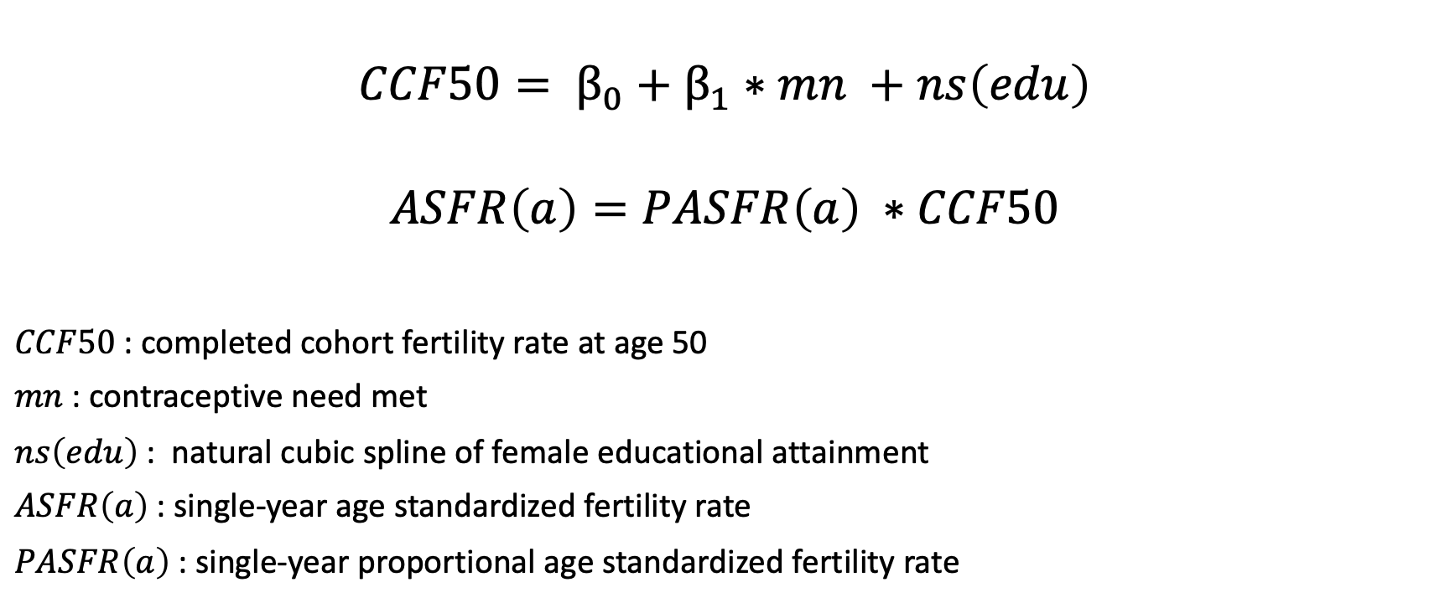
IHME’S ESTIMATION METHOD
$$CCF50= β_{0}+β_{1}∗mn +ns\left(edu\right)$$
$$ASFR\left(a\right)=PASFR\left(a\right) ∗CCF50$$
$CCF50$: completed cohort fertility rate at age 50
$mn$: contraceptive need met
$ns\left(edu\right)$: natural cubic spline of female educational attainment
$ASFR\left(a\right)$: single-year age standardized fertility rate
$PASFR\left(a\right)$: single-year proportional age standardized fertility rate

Slide 5
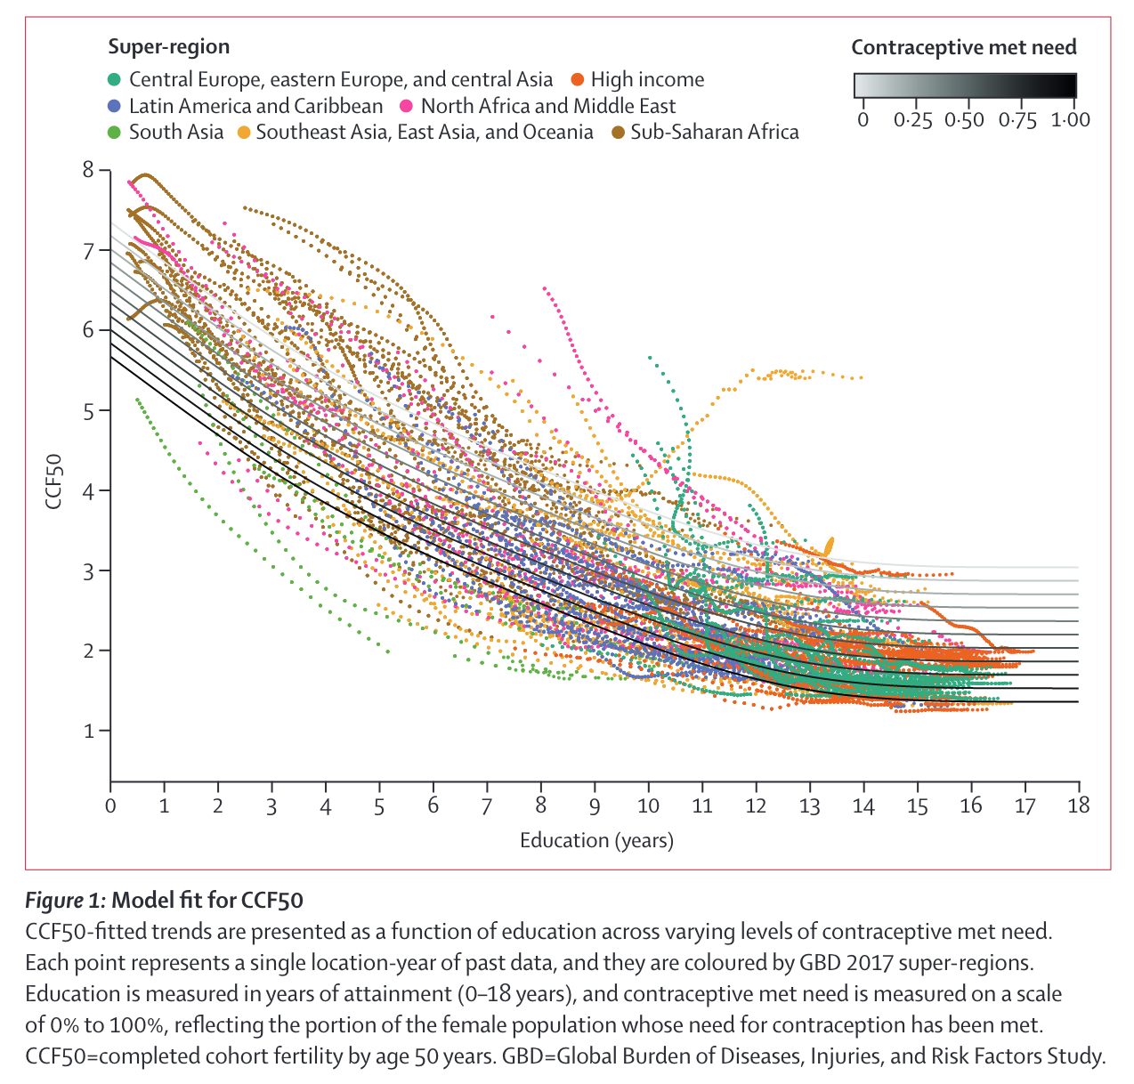
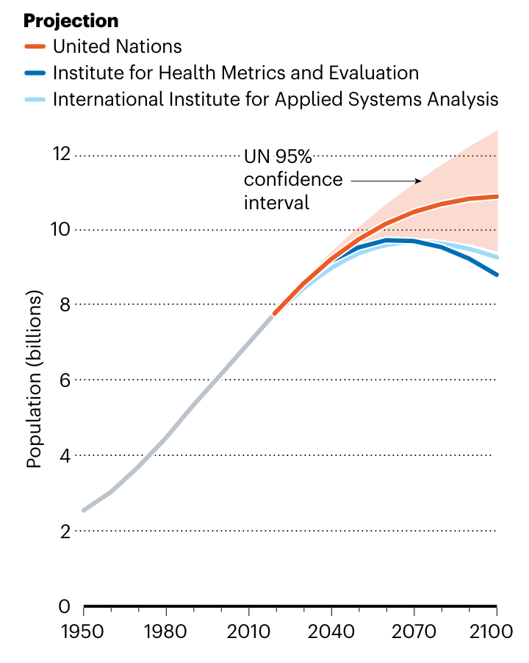

Slide 6
Proposal: Does CCF50 provide better estimates?
Probabilistic modeling of TFR
Bayesian Hierarchical Model:
Using IHME/GBD past data (for reproducibility)
Parameters for educational attainment & contraceptive met need
First estimating CCF50, then TFR
Using bayesTFR R package.
Challenge: computational power
Solution: small sample of countries:
3-5 number of countries from each fertility ranges. (low-mid-high)

Slide 7
Works Cited:
Adam, David. 2021. “How Far Will Global Population Rise? Researchers Can’t Agree.” Nature 597(7877):462–65. doi: 10.1038/d41586-021-02522-6.
Alkema, Leontine. 2020. The Global Burden of Disease Fertility Forecasts: Summary of the Approach Used and Associated Statistical Concerns. preprint. Open Science Framework. doi: 10.31219/osf.io/3m6va.
Gietel-Basten, Stuart, and Tomas Sobotka. 2020. Uncertain Population Futures: Critical Reflections on the IHME Scenarios of Future Fertility, Mortality, Migration and Population Trends from 2017 to 2100. preprint. SocArXiv. doi: 10.31235/osf.io/5syef.
Vollset, Stein Emil, Emily Goren, Chun-Wei Yuan, Jackie Cao, Amanda E. Smith, Thomas Hsiao, Catherine Bisignano, Gulrez S. Azhar, Emma Castro, Julian Chalek, Andrew J. Dolgert, Tahvi Frank, Kai Fukutaki, Simon I. Hay, Rafael Lozano, Ali H. Mokdad, Vishnu Nandakumar, Maxwell Pierce, Martin Pletcher, Toshana Robalik, Krista M. Steuben, Han Yong Wunrow, Bianca S. Zlavog, and Christopher J. L. Murray. 2020. “Fertility, Mortality, Migration, and Population Scenarios for 195 Countries and Territories from 2017 to 2100: A Forecasting Analysis for the Global Burden of Disease Study.” The Lancet 396(10258):1285–1306. doi: 10.1016/S0140-6736(20)30677-2.

