Slide 1
Fully Bayesian Benchmarking of Small Area Estimation Models
STAT 563 - Term Paper Presentation
Spencer Pease

Slide 2
Background: Overview
Obtaining estimates for small geographic/social/demographic areas presents challenges when there are few observations per area
Direct methods (i.e. counting events and exposure) lack credibility
Modeled estimates are not consistent with aggregate area estimates (found using direct methods)
Discrepancies present issues, political and otherwise, so small area estimates are adjusted to match aggregate estimates
Current adjustment methods focus on providing point estimates, not distributions

Slide 3
Background: Terms
Benchmarks:
Aggregate area estimates, generally obtained using direct methods
What you compare your small area estimates to
Internal benchmarks: calculated from small area data sources
External benchmarks: calculated from other data sources
Benchmarking:
Techniques for forcing small area estimates to agree with benchmarks
How you reconcile discrepancies between small area estimates and aggregate estimates
Exact benchmarking: Making estimates exactly agree with benchmarks
Inexact benchmarking: Allowing discrepancy between estimates and benchmarks

Slide 4
Methods: Summary
Published in 2020 by Junni L. Zhang and John Bryant
Present a fully Bayesian approach to small area benchmarking
Benchmarks are estimates for underlying aggregate parameters
Benchmark agreement is a distribution conditional on the aggregate parameters
The original likelihood is multiplied by the probability distribution of the benchmarks
A “compromise” between the original likelihood and requirement to meet the benchmark
The revised likelihood and prior together yield the benchmarked posterior distribution

Slide 5
Methods: Advantages
Include multiple benchmarks
Benchmarks can be nonlinearly related to small area estimates (i.e. age specific mortality benchmarked against life expectancy)
Specify allowable discrepancy

Slide 6
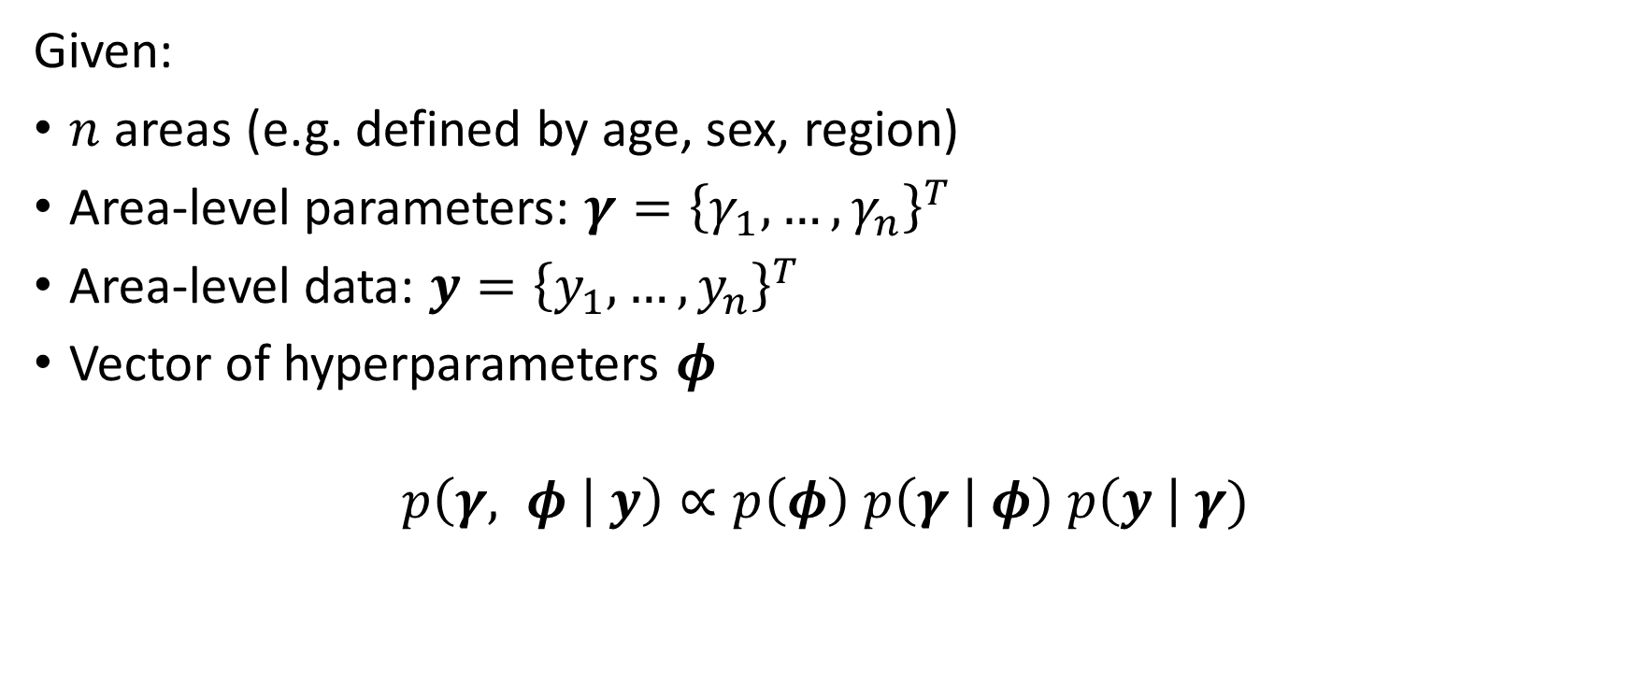
Methods: Bayesian estimation of area-level models
Given:
$n$ areas (e.g. defined by age, sex, region)
Area-level parameters: $γ={\left\{γ_{1}, …,γ_{n}\right\}}^{T}$
Area-level data: $y={\left\{y_{1}, …,y_{n}\right\}}^{T}$
Vector of hyperparameters $φ$
$$p\left(γ, φ | y\right)∝p\left(φ\right) p\left(γ | φ\right) p\left(y \right| γ)$$

Slide 7
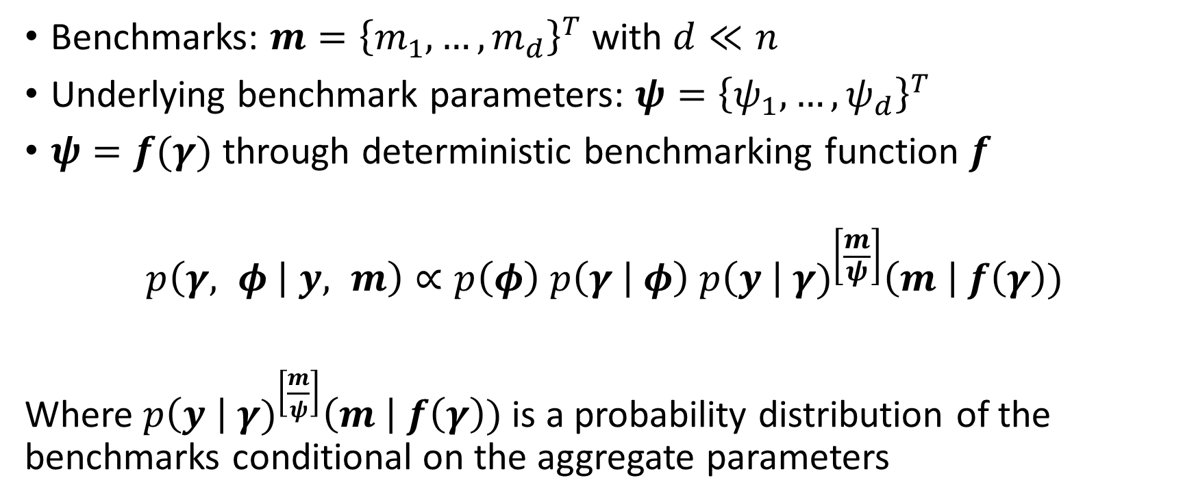
Methods: Bayesian estimation of area-level models with benchmarked posterior
Benchmarks: $m={\left\{m_{1},…,m_{d}\right\}}^{T}$ with $d≪n$
Underlying benchmark parameters: $ψ={\left\{ψ_{1},…,ψ_{d}\right\}}^{T}$
$ψ=f(γ)$ through deterministic benchmarking function $f$
$$p\left(γ, φ | y, m\right)∝p\left(φ\right) p\left(γ | φ\right) {p\left(y \right| γ)}^{\left[\frac{m}{ψ}\right]}\left(m \right| f\left(γ\right))$$
Where ${p\left(y \right| γ)}^{\left[\frac{m}{ψ}\right]}\left(m \right| f\left(γ\right))$ is a probability distribution of the benchmarks conditional on the aggregate parameters

Slide 8
Proposal
Recreate the authors’ application of their methods to age-sex specific mortality rates in local authority districts of England and Wales
Apply these method in the Philippines -- another location with small subnational units and available data
Note: the authors have released code alongside their article, which was used to re-evaluate their methods

Slide 9
Evaluation: Estimating age-sex-specific mortality rates in England and Wales
Data: death counts and at-risk populations in 2014, for 20 age groups 0 to 90+, males and females, in 348 local authority districts (belonging to 10 regions)
Total deaths: 500,3134
Total population: 57,408,654
Variable | Min | 25% | Median | Mean | 75% | Max
Deaths | 0.00 | 1.00 | 8.00 | 36.05 | 48.00 | 1004.00
Population | 17 | 1985 | 3211 | 4136 | 5,033 | 50,381

Slide 10
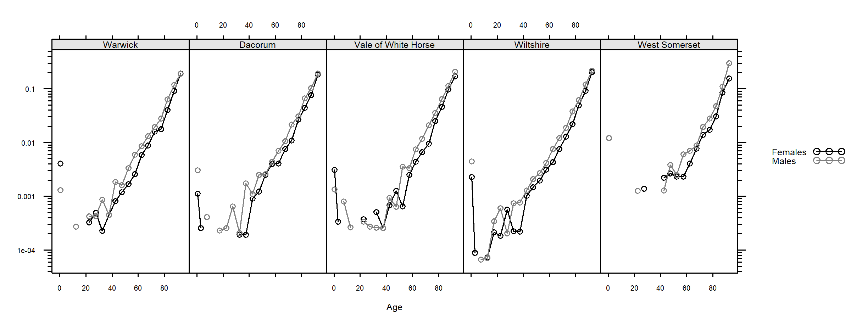
Evaluation: Estimating age-sex-specific mortality rates in England and Wales
Sample of mortality rates using direct estimation:

Slide 11
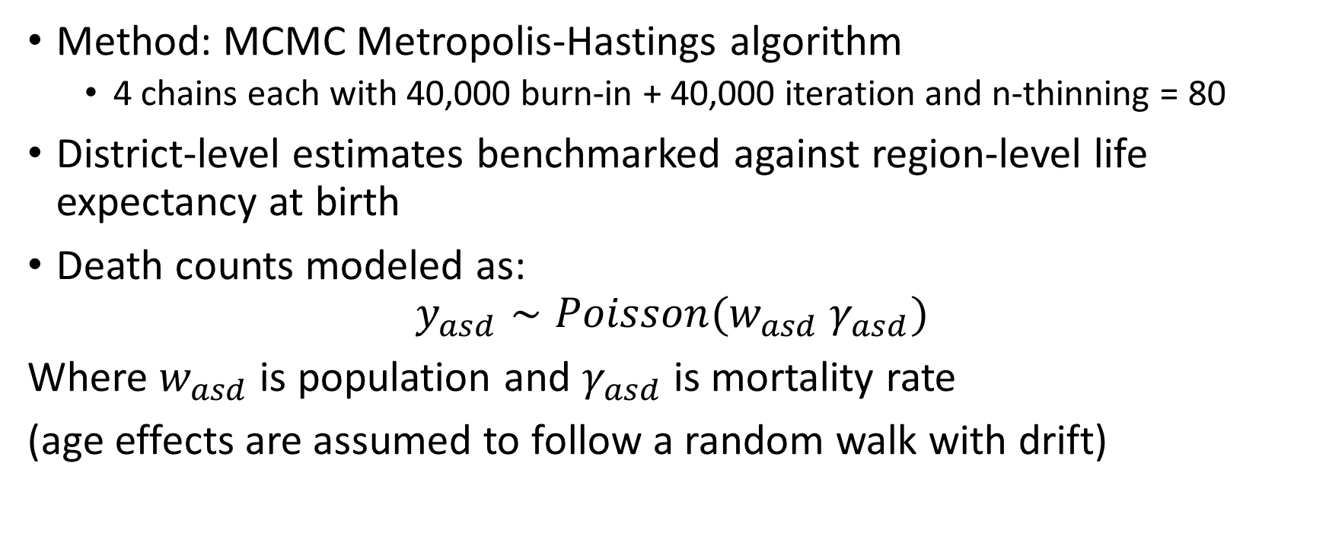
Evaluation: Estimating age-sex-specific mortality rates in England and Wales
Method: MCMC Metropolis-Hastings algorithm
4 chains each with 40,000 burn-in + 40,000 iteration and n-thinning = 80
District-level estimates benchmarked against region-level life expectancy at birth
Death counts modeled as:
$$y_{asd}∼Poisson(w_{asd} γ_{asd})$$
Where $w_{asd}$ is population and $γ_{asd}$ is mortality rate
(age effects are assumed to follow a random walk with drift)

Slide 12
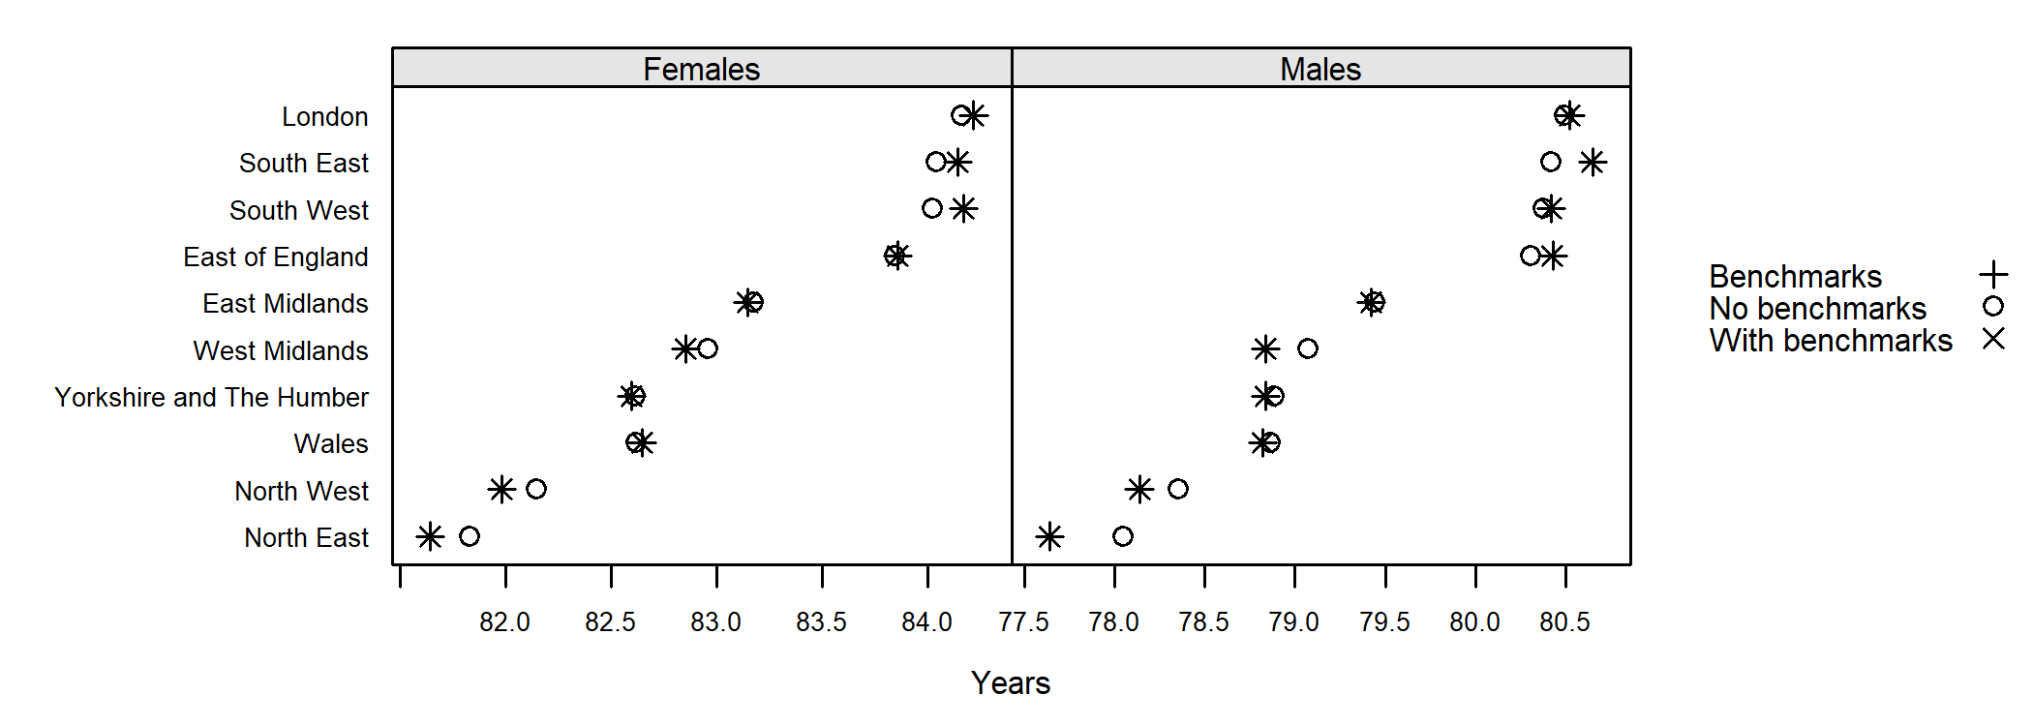
Evaluation: Estimating age-sex-specific mortality rates in England and Wales
Point estimates of life expectancy by region for benchmarked and non-benchmarked models

Slide 13
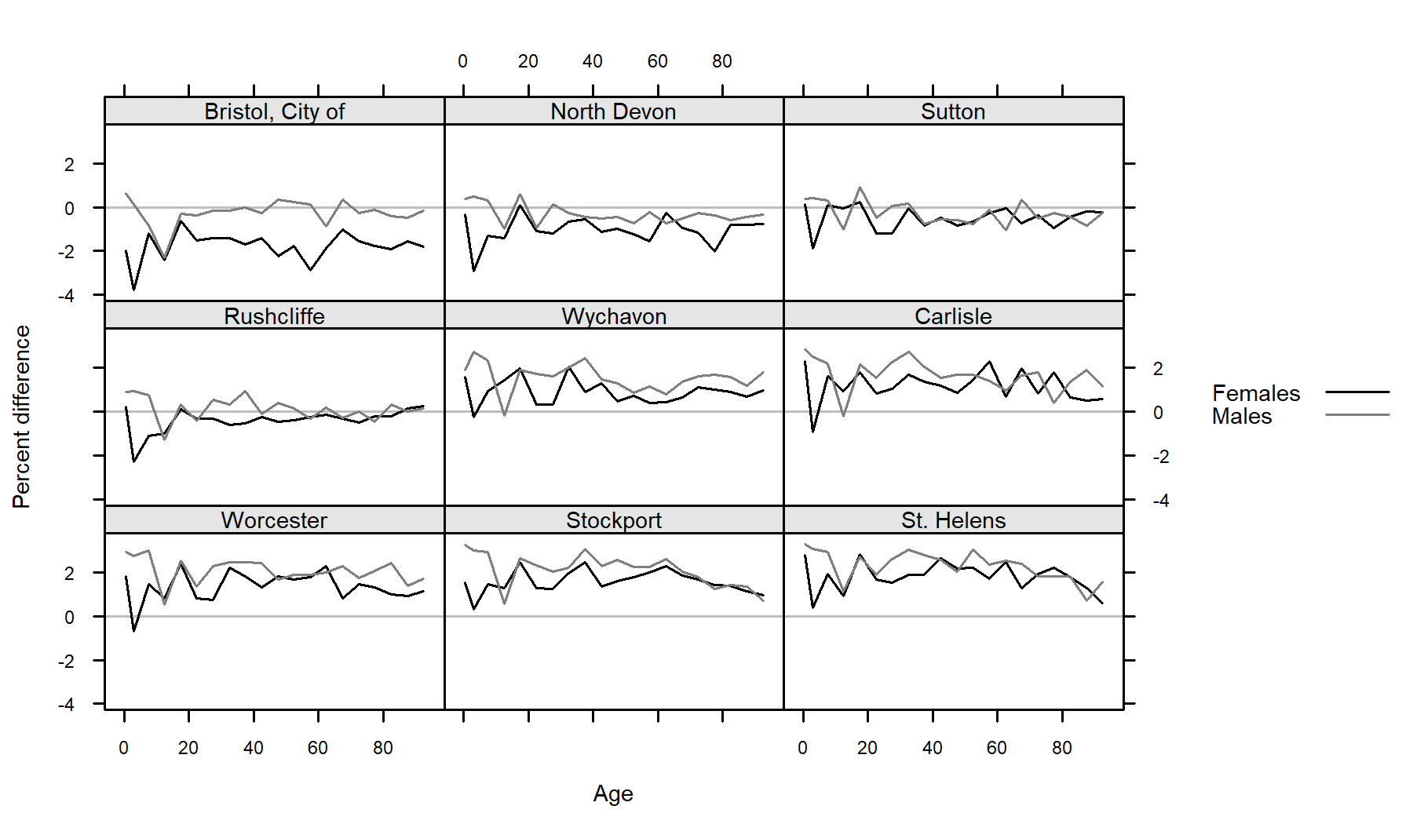
Evaluation: Estimating age-sex-specific mortality rates in England and Wales
Percent difference between district mortality rates for benchmarked and non-benchmarked models

Slide 14
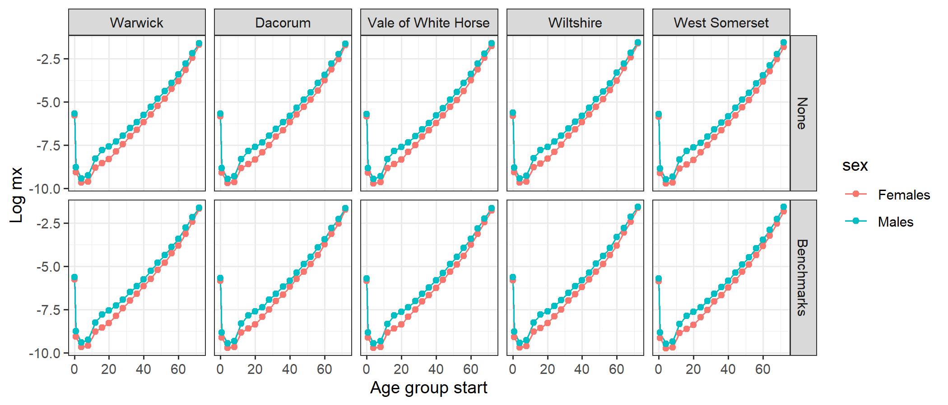
Evaluation: Estimating age-sex-specific mortality rates in England and Wales
Percent difference between district mortality rates for benchmarked and non-benchmarked models

Slide 15
Evaluation: Philippines
Currently in the process of extending the authors’ methods to new data

