Slide 1
Stroke Prediction website using Machine Learning
Kazi Aniya Ahmed(2011775642)
Marjana Ahammad(2013627642)
Group – Unpredictable!

Slide 2
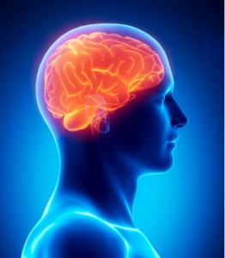
Brief Overview
Stroke occurs when the blood flow to various areas of the brain is disrupted. Our project aims to predict the likelihood of an individual having a stroke.
Accurate and efficient method of stroke prediction that can aid in the early detection of stroke.
The project uses machine learning algorithms to analyze large volumes of health data and identify patterns and risk factors associated with stroke.
Overall, the stroke prediction project has the potential to improve healthcare outcomes and reduce the burden of stroke on individuals and society.

Slide 3
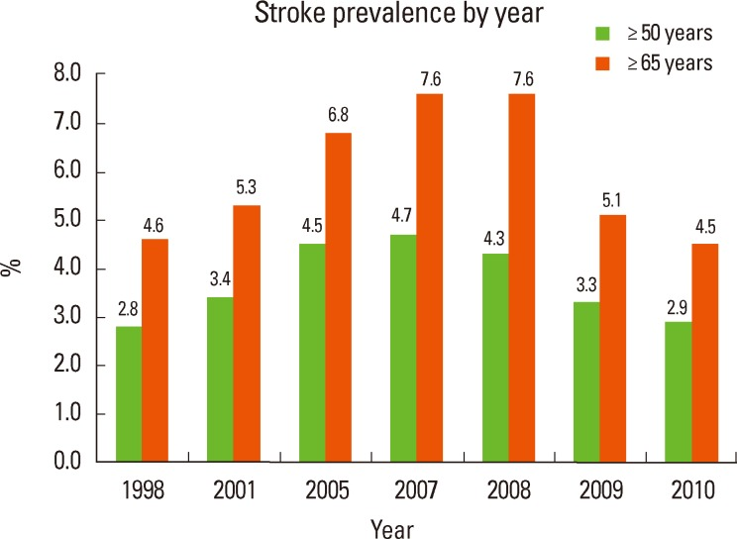
Motivation
According to the World Health Organization, stroke is the second leading cause of death globally.
Motivation for this project is to develop a more accurate and efficient method of stroke prediction.
Also motivated by the need to address the increasing burden of stroke globally and the potential of machine learning algorithms to improve early detection and prevention strategies.

Slide 4
Project Dataset
Public Dataset
We have collected 48,000 public data from Kaggle, Zindi and UCI datasets.

Slide 5
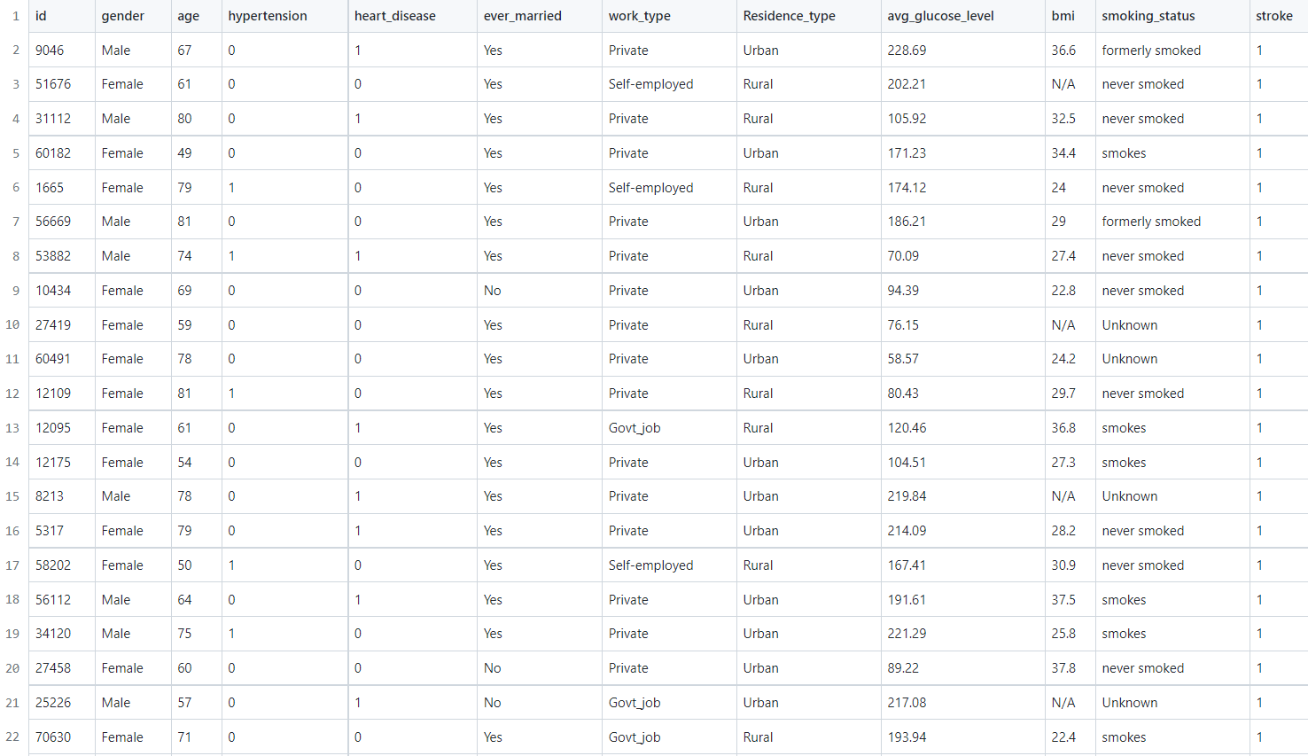
Sample Dataset

Slide 6
Dataset Features
Categorical Data
Numerical Data
Gender
Hypertension
Heart disease
Married
Work type
Residence type
Smoking status.
Age
Glucose level
BMI.

Slide 7

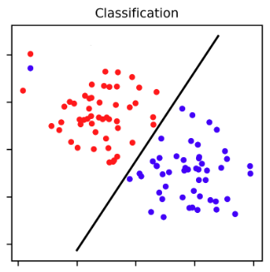
Problem Type
Supervised
Classification

Slide 8
Software Stack & Budget
Language: Python
Machine Learning Algorithm: Decision Tree, Random Forest,
K-nearest Neighbor, Logistic Regression.
IDE: Jupyter Notebook
Budget: As this will be software based project, we don’t need any hardware. So there will be no budget for the project. We just need to spend our valuable time.

Slide 9
Flow Diagram
Data Collection
EDA & Preprocessing
Train the Model
Model Evaluation
Deployment

Slide 10
High Level Software Diagram
ML Model
Front End
(Input)
Backend
Result

Slide 11
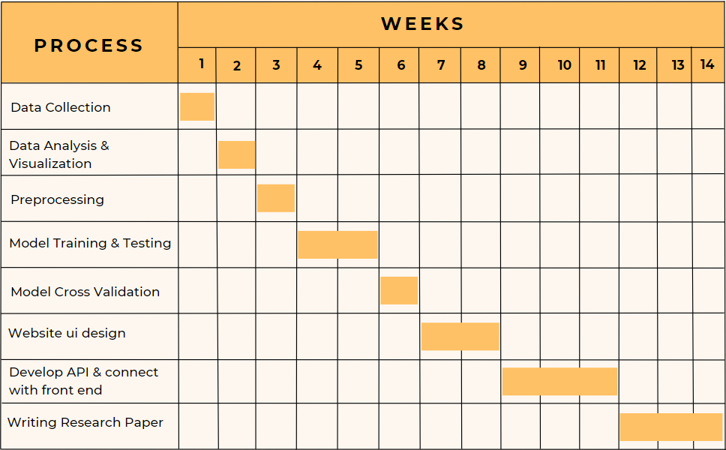
Gantt Chart

Slide 12

Work Distribution
Kazi Aniya Ahmed
Marjana Ahammad
ML Model Selection
Feature Extraction
Model Training
Cross Validation
Backend API Develop
Writing Paper
Collecting Dataset
Data Preprocessing
Model Testing
Model Evaluation
Website Ui develop
Writing Paper

Slide 13
Reference
[1] G. Sailasya and G. L. A. Kumari, “Analyzing the Performance of Stroke Prediction using ML Classification Algorithms,” International Journal of Advanced Computer Science and Applications, vol. 12, no. 6, 2021, doi: https://doi.org/10.14569/ijacsa.2021.0120 662
[2] M. U. Emon, M. S. Keya, T. I. Meghla, Md. M. Rahman, M. S. A. Mamun, and M. S. Kaiser, “Performance Analysis of Machine Learning Approaches in Stroke Prediction,” IEEE Xplore, 2020. https://ieeexplore.ieee.org/document/929 7525
[3] Khosla, Y. Cao, C. C.-Y. Lin, H.-K. Chiu, J. Hu, and H. Lee, “An integrated machine learning approach to stroke prediction,” Proceedings of the 16th ACM SIGKDD international conference on Knowledge discovery and data mining - KDD ’10, 2010, doi: https://doi.org/10.1145/1835804.1835830 .
[4] S. Min, S. Park, D. Kim, M. Subramaniyam, and K.-S. Lee, “Development of an Algorithm for Stroke Prediction: A National Health Insurance Database Study in Korea,” European Neurology, vol. 79, no. 3–4, pp. 214–220, 2018, doi: https://doi.org/10.1159/000488366.
[5] T. Lumley, R. A. Kronmal, M. Cushman, T. A. Manolio, and S. Goldstein, “A stroke prediction score in the elderly,” Journal of Clinical Epidemiology, vol. 55, no. 2, pp. 129– 136, Feb. 2002, doi: https://doi.org/10.1016/s0895- 4356(01)00434-6.
[6] H. K V, H. P, G. Gupta, V. P, and P. K B, “STROKE PREDICTION USING MACHINE LEARNING ALGORITHMS,” International Journal of Innovative Research in Engineering & Management, vol. 8, no. 4, Jul. 2021, doi: https://doi.org/10.21276/ijirem.2021.8.4. 2.
[7] Kunder Akash, H N Shashank, SSrikanth S, Thejas A.M. "Prediction of Stroke Using Machine Learning". June 2020. ResearchGate.

Slide 14
Thank You!

