Slide 1
Aim Travel & Tours – Data Analytics Project
“Turning Data into Decisions”
Digital Skills Bootcamp • SQL • Python • Tableau

Slide 2
Elevator Pitch
My name is Muhammad Ihtesham Minhas, and I bring nearly twenty years of experience across travel & tourism, accounting, energy, customer service, retail and micro-finance.
Recently, I completed the Digital Skills Bootcamp in Data at Just IT, gaining hands-on experience in SQL, Python, Power BI, Tableau, Excel and Azure.
In this project, I applied MySQL for structuring data, Python for cleaning and analysis, and Power BI for building clear, insight-driven dashboards based on Aim Travel & Tours’ operations.

Slide 3
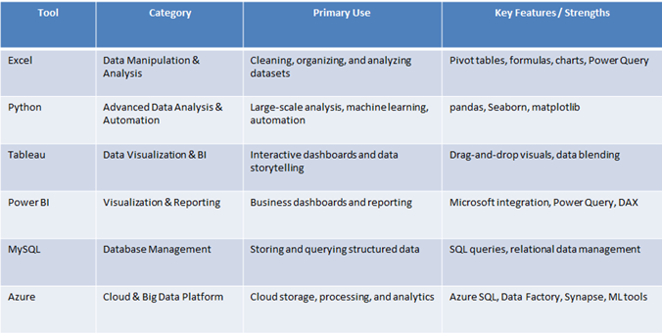
Key Tools from the Bootcamp

Slide 4
Project Overview
This project uses a synthetic but realistic dataset of 250 trips for Aim Travel & Tours, based on real routes, pricing, vehicle types and cost assumptions.
Objectives:
• Identify profitable routes and trip types
• Understand seasonal demand
• Analyse key cost drivers
• Recommend actions to improve margins and efficiency

Slide 5
Business Questions
1. Which routes and trip types deliver the strongest profitability?
2. How does demand vary across the year?
3. What cost components have the largest impact on margins?
4. How can pricing or operations be adjusted to improve profitability?

Slide 6
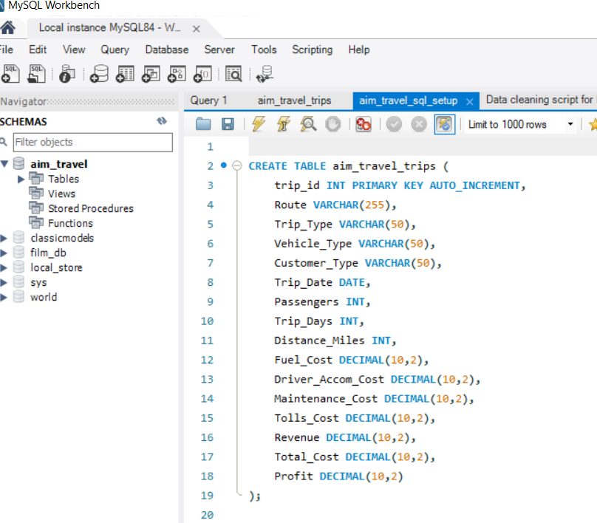
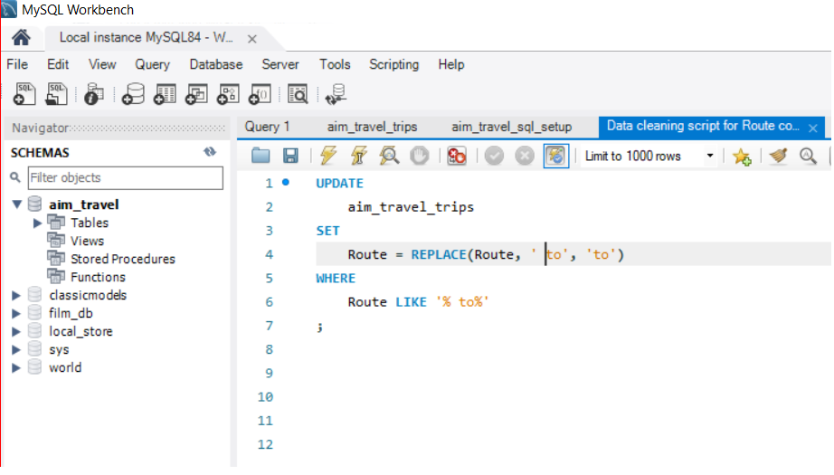
Data Preparation

Slide 7
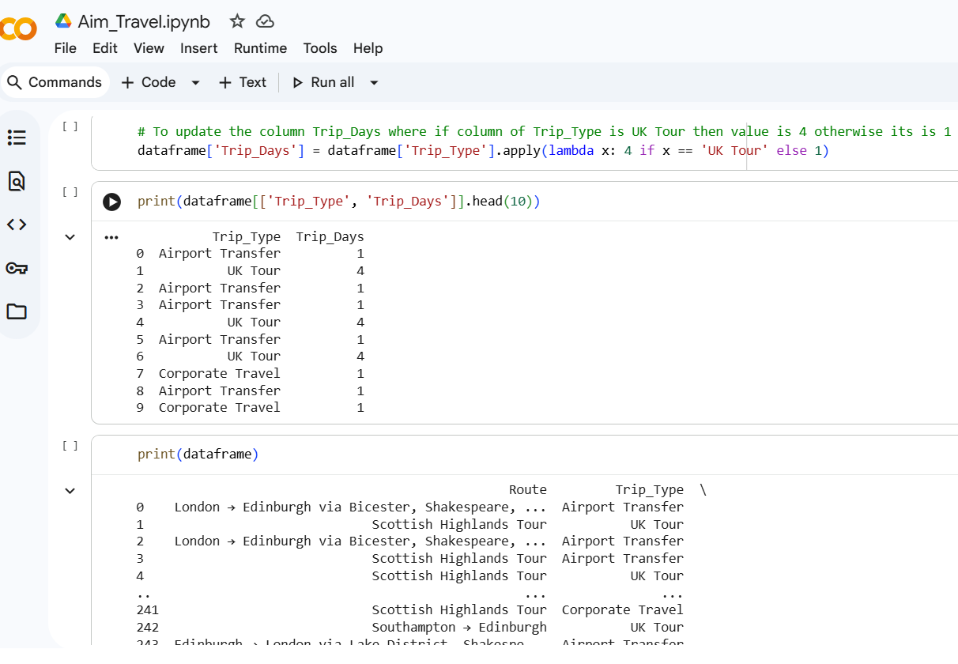
Data Cleaning - Python

Slide 8
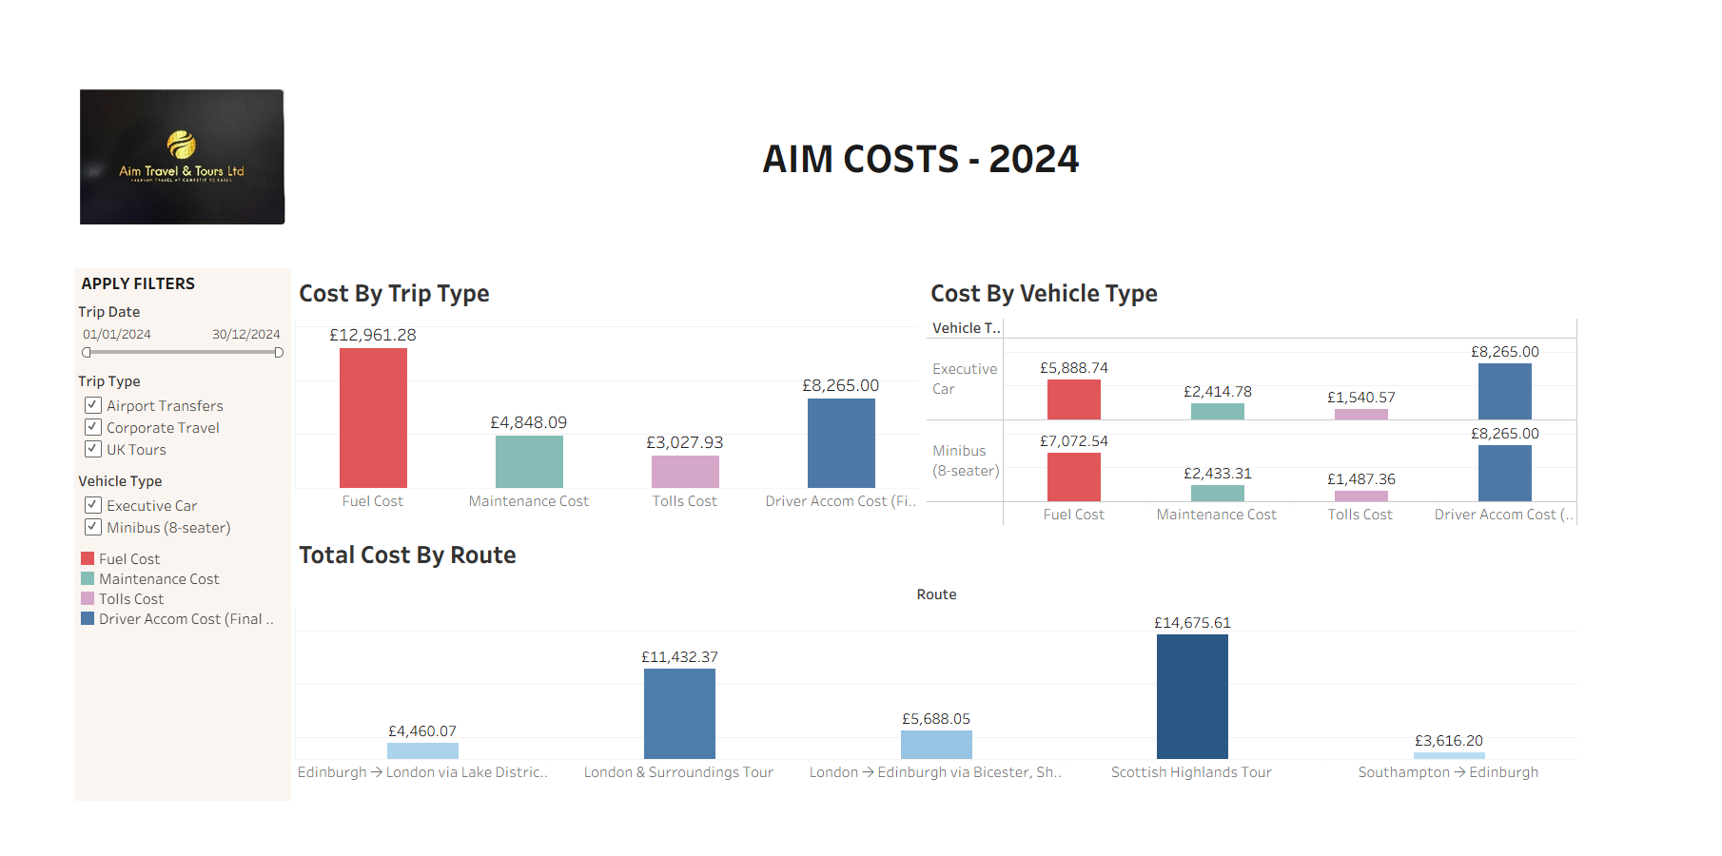
Aim Costs - Tableau

Slide 9
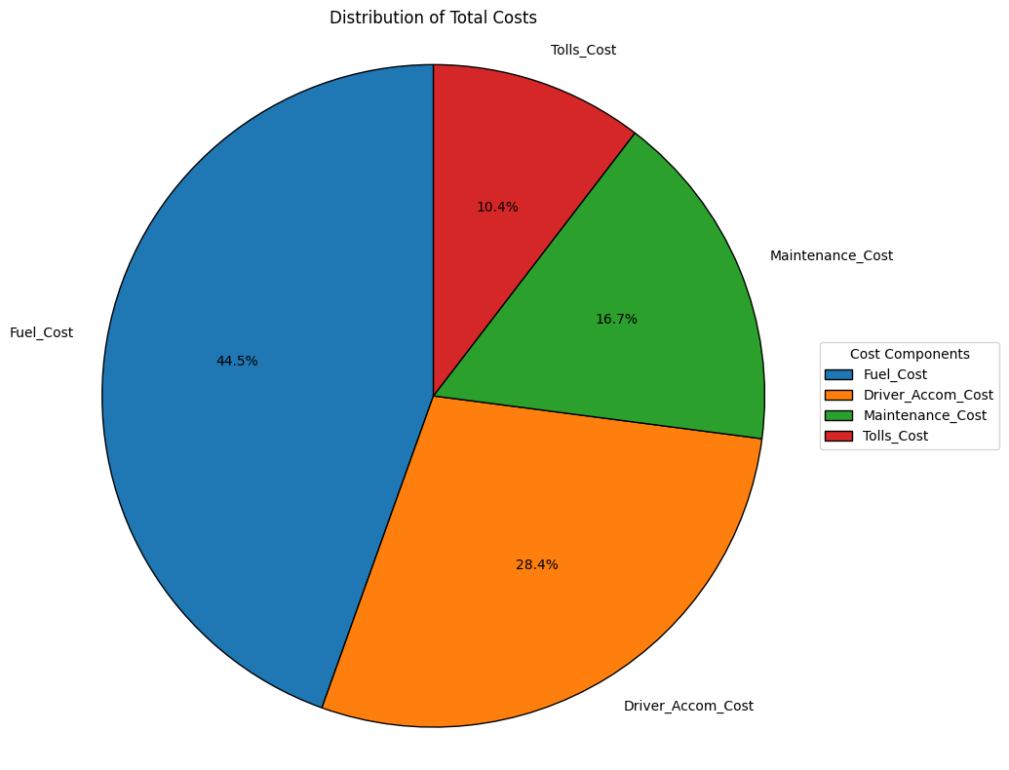
Aim Costs Distribution – Python

Slide 10
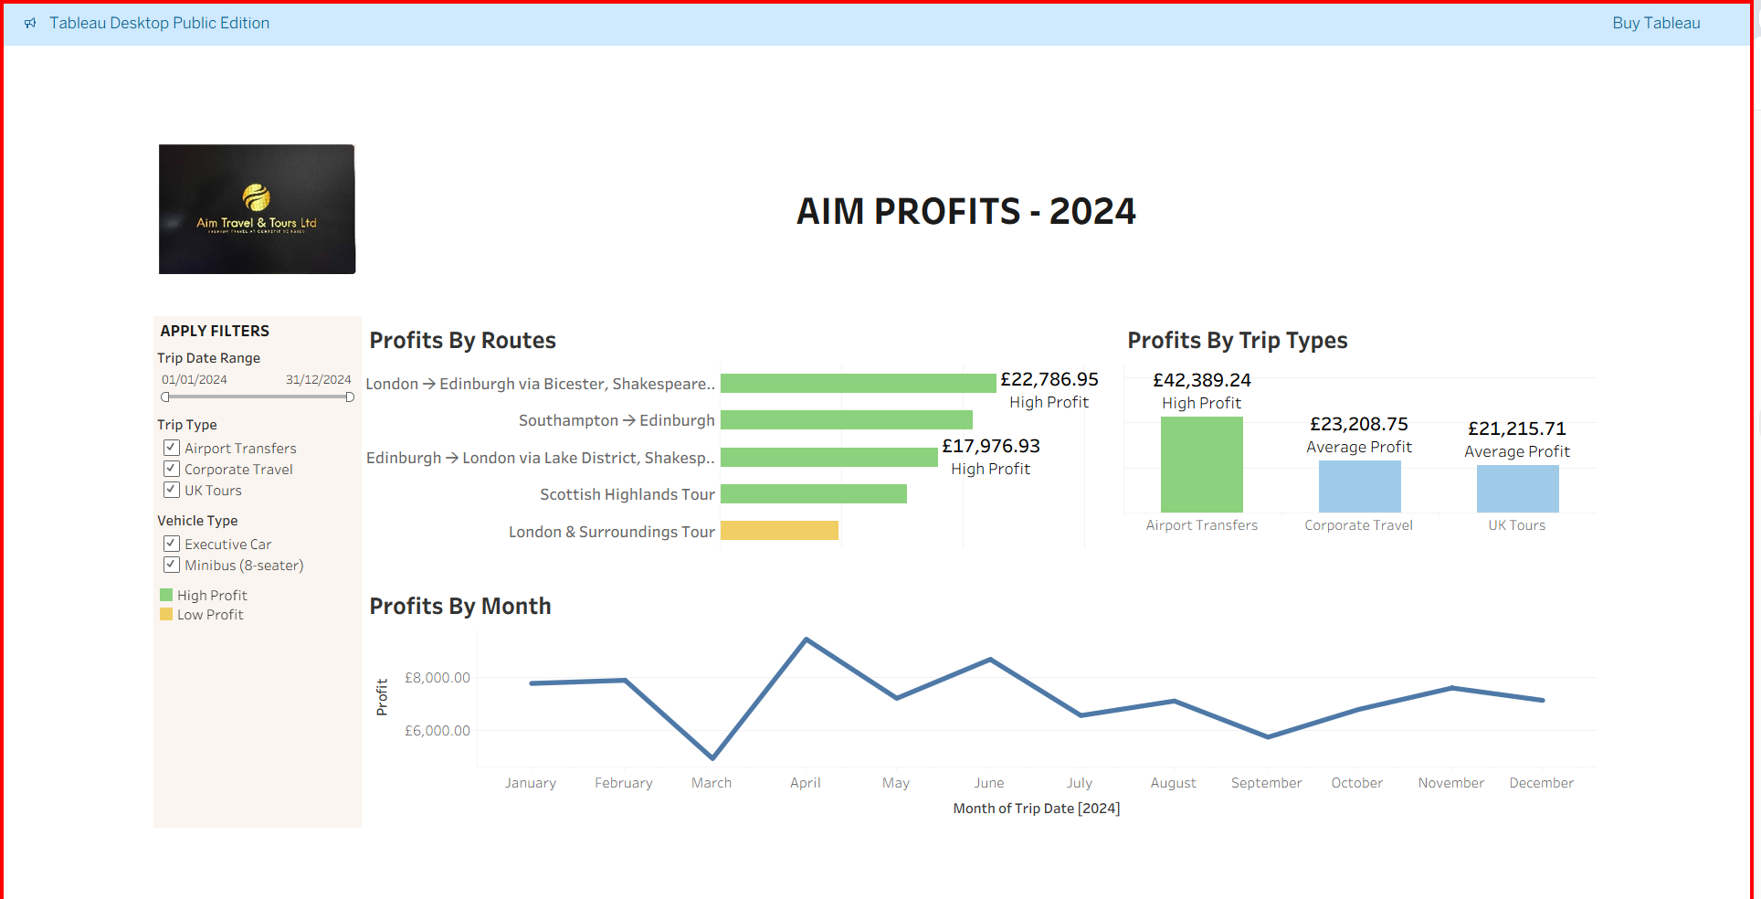
Aim Profits

Slide 11
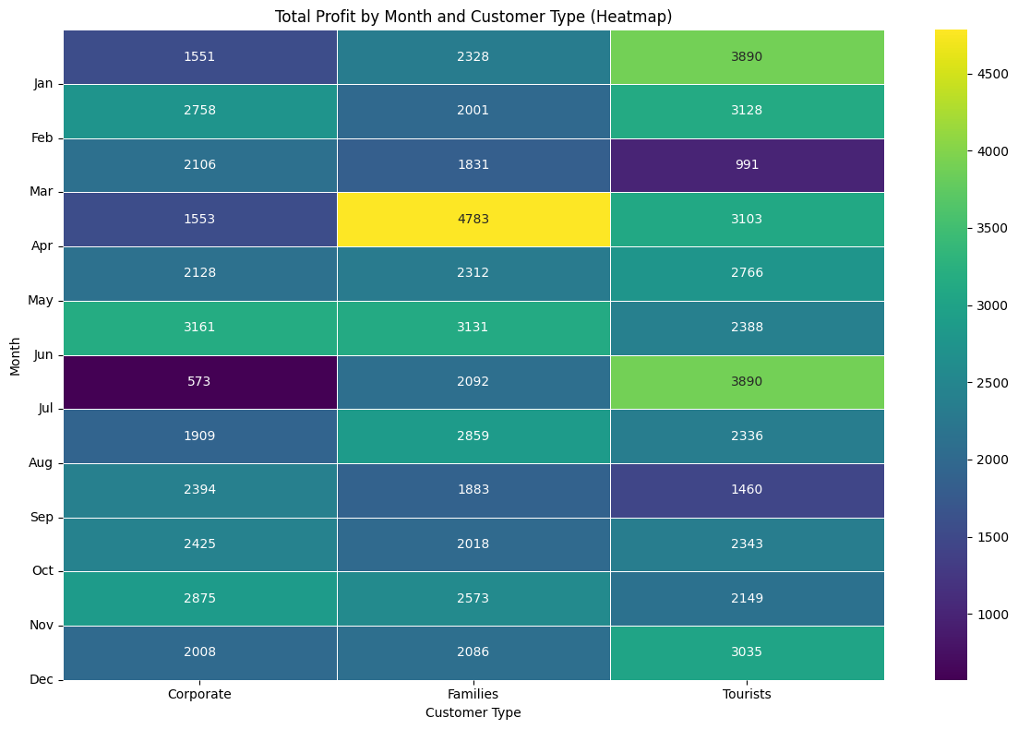
Monthly Profitability Heatmap

Slide 12
Recommendations
Prioritize Long-Distance Airport Transfers: Focus marketing and resource allocation on maximizing bookings for high-profit long-distance airport transfer routes.
Optimize UK Tours: Investigate ways to increase the average profit for UK Tours, perhaps by bundling premium services or optimizing routes.
Evaluate Pricing for High-Frequency Routes: Review pricing strategies for routes with high volume but lower average profit to ensure optimal revenue capture.
Fuel Efficiency Initiatives: Implement strategies to reduce fuel consumption, such as optimizing routes for fuel efficiency, investing in more fuel-efficient vehicles, or driver training on economical driving techniques.
Accommodation Cost Management: Explore options for reducing driver accommodation expenses, such as negotiating corporate rates with hotels or planning routes to minimize overnight stays where possible.

Slide 13
Conclusion
This project demonstrates how SQL, Python and Power BI can turn operational transport data into practical insights.
By combining my industry experience with new data skills, I can support better decisions around pricing, routes and cost control.
Thank you for listening.

