Slide 1
Digital Transmission Chapter 4
Engr. Dr. Javed Khan
Assistant Professor, Software Engineering Deptt.

Slide 2
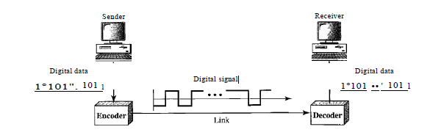
Conversion of Digital Data to Digital Signal
Line coding is the process of converting digital data to digital signals.
Data,( text, numbers, graphical images, audio, or video) are stored in computer memory as sequences of bits

Slide 3
Data Rate Versus Signal Rate
Data rate defines the number of data elements (bits) sent in Is. The unit is bits per second (bps).
Signal rate is the number of signal elements sent in Is. The unit is the baud. The signal rate is sometimes called the pulse rate, the modulation rate, or the baud rate.
The ratio r (equals to bits/signal element) which is the number of data elements carried by each signal element.

Slide 4
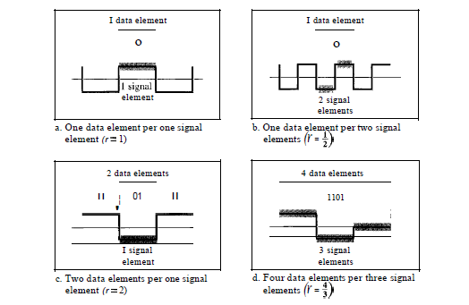
Data Element to Signal Element ratio (r=N/S)

Slide 5
Design
We can formulate the relationship between data rate and signal rate as
S =c *N* 1/r baud ----------------(1)
where N is the data rate (bps); c is the case factor, which varies for each case; S is the number of signal elements; and r is the previously defined factor.
Although the actual bandwidth of a digital signal is infinite, the effective bandwidth is finite.
The minimum bandwidth can be determined through formula (1)

Slide 6
Baseline, Baseline Wandering
Baseline Wandering:
In decoding a digital signal, the receiver calculates a running average of the received signal power. This average is called the baseline.
The incoming signal power is evaluated against this baseline to determine the value of the data element.
A long string of 0’s or 1’s can cause a drift in the baseline (baseline wandering) and make it difficult for the receiver to decode correctly.
A good line coding scheme needs to prevent baseline wandering.

Slide 7
Self-Synchronization, DC component
DC Components: When the voltage level in a digital signal is constant for a while, the spectrum creates very low frequencies (results of Fourier analysis). These frequencies around zero, called DC (direct-current) components, present problems for a system that cannot pass low frequencies .
Self-synchronization: To correctly interpret the signals received from the sender, the receiver's bit intervals must correspond exactly to the sender's bit intervals.
If the receiver clock is faster or slower, the bit intervals are not matched and the receiver might misinterpret the signals.
Figure 4.3 shows a situation in which the receiver has a shorter bit duration. The sender sends 10110001, while the receiver receives 110111000011

Slide 8
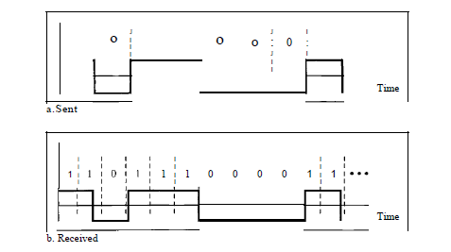
Self-Synchronization

Slide 9
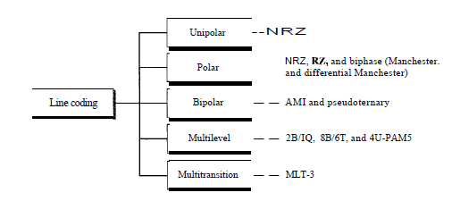
Desirable Features of a Line coding Scheme
Built-in Error Correction
Immunity to noise and interference
Complexity:

Slide 10
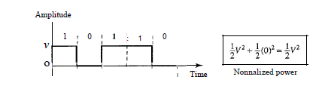
Unipolar line Coding Scheme
In a unipolar scheme, all the signal levels are on one side of the time axis, either above or below.
Traditionally, a unipolar scheme was designed as a non-return-to-zero (NRZ) scheme in which the positive voltage defines bit I and the zero voltage defines bit O.
It is called NRZ because the signal does not return to zero at the middle of the bit.
Compared with its polar counterpart this scheme is very costly.
The normalized power (power needed to send 1 bit per unit line resistance) is double that for polar NRZ.
This scheme is normally not used in data communications today.

Slide 11
Polar Schemes
In polar schemes, the voltages are on the both sides of the time axis.
In polar NRZ encoding, we use two levels of voltage amplitude.
The voltage level for 0 can be positive and the voltage level for I can be negative.
There are two versions of polar NRZ:
(1) NRZ-L and (2) NRZ-I,
NRZ-L (NRZ-Level), the level of the voltage determines the value of the bit.
NRZ-I (NRZ-Invert), the change or lack of change in the level of the voltage determines the value of the bit.
If there is no change, the bit is 0; if there is a change, the bit is 1.

Slide 12
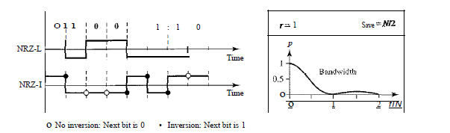
Polar (NRZ-L, NRZ-I)
NRZ-L (NRZ-Level), the level of the voltage determines the value of the bit.
NRZ-I (NRZ-Invert), the change or lack of change in the level of the voltage determines the value of the bit.
If there is no change, the bit is 0; if there is a change, the bit is 1.

Slide 13
Pros and Cons of Polar Schemes
Baseline wandering is a problem for both variations, it is twice as severe in NRZ-L.
If there is a long sequence of Os or Is in NRZ-L, the average signal power becomes skewed. The receiver might have difficulty discerning the bit value.
The synchronization problem (sender and receiver clocks are not synchronized) also exists in both schemes.
Both schemes have an average signal rate of NI2 Bd.
NRZ-L and NRZ-J both have an average signal rate ofNI2 Bd.

Slide 14
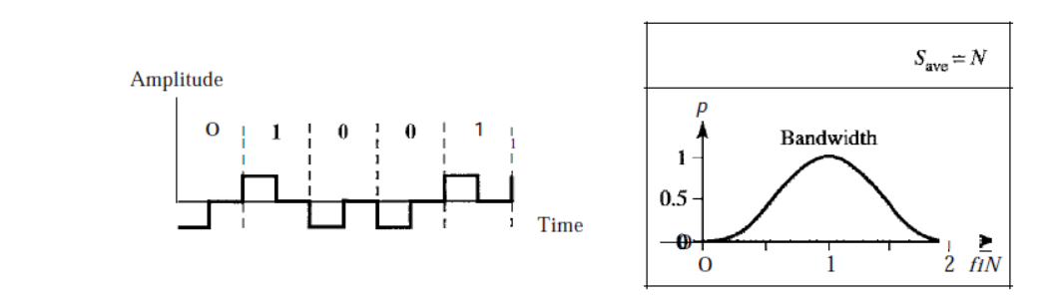
Return to Zero Schemes (+ve , -ve,0)
NRZ-L and NRZ-I both have a DC component problem.
One solution is the Return-to-zero (RZ) scheme, which uses three values: positive, negative, and zero.
In RZ, the signal changes not between bits but during the bit.
The main disadvantage of RZ encoding is that it requires two signal changes to encode a bit and therefore occupies greater bandwidth.
The same problem we mentioned, a sudden change of polarity resulting in all as interpreted as 1s and all 1s interpreted as as, still exist here, but there is no DC component problem.
Another problem is the complexity: RZ uses three levels of voltage, which is more complex to create and discern.
As a result of all these deficiencies, the scheme is not used today.

Slide 15
Manchester and Differential Manchester (Biphase)
Return to Zero Scheme has been replaced by the better-performing Manchester and Differential Manchester schemes.
In Manchester encoding, the duration of the bit is divided into two halves.
The voltage remains at one level during the first half and moves to the other level in the second half.
The transition at the middle of the bit provides synchronization.
Differential Manchester, on the other hand, combines the ideas of RZ and NRZ-I.
There is always a transition at the middle of the bit, but the bit values are determined at the beginning of the bit. If the next bit is 0, there is a transition; if the next bit is 1, there is none.

Slide 16
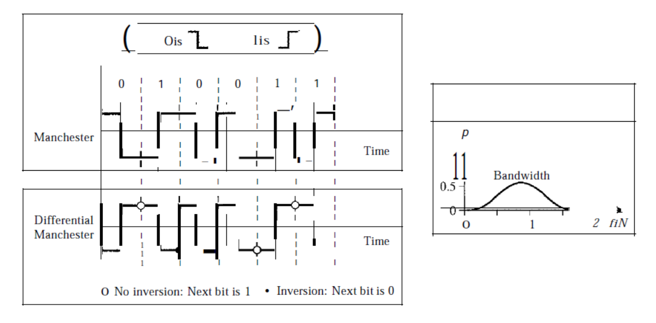
Mancheter and Differential Manchester

Slide 17
Bipolar Schemes (+ve, -ve and 0)
In bipolar encoding (sometimes called multilevel binary), there are three voltage levels: positive, negative, and zero.
The voltage level for one data element is at zero, while the voltage level for the other element alternates between positive and negative.
Two variations of bipolar encoding:
AMI and pseudo-ternary.
A common bipolar encoding scheme is called bipolar alternate mark inversion (AMI). In the term alternate mark inversion, the word mark comes from telegraphy and means 1. So AMI means alternate I inversion.
A neutral zero voltage represents binary O. Binary Is are represented by alternating positive and negative voltages.
A variation of AMI encoding is called pseudoternary in which the 1 bit is encoded as a zero voltage and the 0 bit is encoded as alternating positive and negative
voltages.

Slide 18
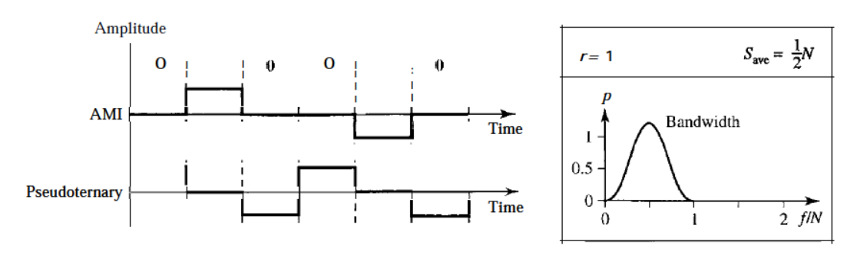
Bipolar line Coding Scheme(AMI and Pseudoternary)

Slide 19
Bipolar Schemes
The bipolar scheme was developed as an alternative to NRZ.
The bipolar scheme has the same signal rate as NRZ, but there is no DC component.
The NRZ scheme has most of its energy concentrated near zero frequency, which makes it unsuitable for transmission over channels with poor performance around this frequency.
The concentration of the energy in bipolar encoding is around frequency N12.

Slide 20




Impress
The improved Presenter View has new tools to keep you in control. The new Auto-Extend instantly applies the right settings for you, so you can focus on speaking instead of your display.
Slide zoom – Help focus your audience on your ideas. Just click to zoom in and out on a specific diagram, chart or graphic.
Slide Navigator – A feature that enables the user to visually browse for and navigate to other slides without leaving Slide Show view. Your audience only sees the slide you’re presenting.

Slide 21
PowerPoint 2013
Intuitively design beautiful presentations, easily share and work together with others and give a professional performance with advanced presenting tools.
Find out more at the PowerPoint Getting Started Center
(Click the arrow when in Slide Show mode)
Notes:
In Slide Show mode, click the arrow to enter the PowerPoint Getting Started Center.

