Slide 1
Data Link Layer
Engr. Dr. Javed Khan

Slide 2
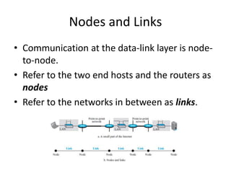
Data Link Layer

Slide 3
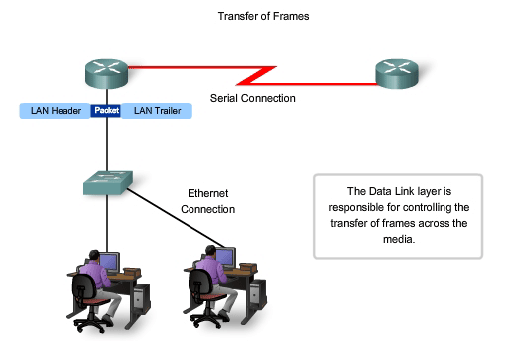
Data Link Layer
Concept of Nodes and Links:
Communication at the data link layer is node-to-node.
A data unit form one point in the Internet needs to pass through many networks(LANs and WANs) to reach another point. These LANs and WANs are connected by routers.
The end hosts and routers are called nodes
The network in between is called Links

Slide 4
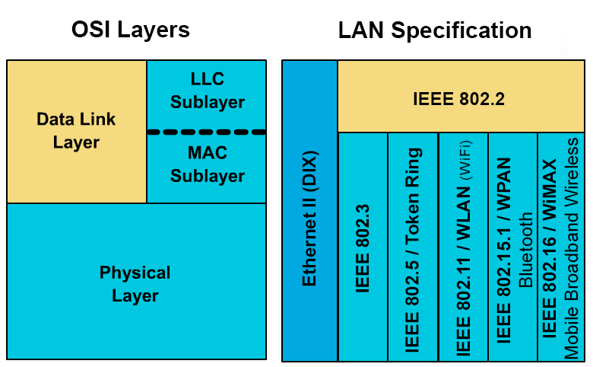
Functionality & Services of DLL (data link layer)
The two main functions of the data link layer are data link control and media access control.
The first, data link control, deals with the design and procedures for communication between two adjacent nodes: node-to-node communication.
The second function of the data link layer is media access control, or how to share the link.
Data link control functions include framing, flow and error control,
Framing, or how to organize the bits that are carried by the physical layer.

Slide 5
Data Link Layer
Concept of Nodes and Links:
Communication at the data link layer is node-to-node.
A data unit form one point in the Internet needs to pass through many networks(LANs and WANs) to reach another point. These LANs and WANs are connected by routers.
The end hosts and routers are called nodes
The network in between is called Links

Slide 6
Services of Data Link Layer
What is Data Link Layer?
The Data Link layer transforms a raw transmission facility into a line that appears free of undetected transmission errors to the network layer and is responsible for node-to-node delivery. It makes error-free the physical layer appear to the upper layer (network layer).
Data Link Layer is the second layer of OSI Layered Model after Physical Layer.
When a packet or message reaches to a network, it is the responsibility of Data Link Layer to transmit it to the Host using its MAC address.
Data Link Layer devices are Switch & Bridges.
Sublayers of Data Link Layer
Data Link Layer has two sublayers,
Logical Link Control (LLC): This is the uppermost sub-layer, LLC consists of protocols running at the top of the data link layer, and also provides flow control, acknowledgment, and error notification. The LLC provides addressing and data link control. It specifies which methods are to be used for addressing channels over the transmission medium and for controlling the data exchanged between the generator of packet and recipient of the message.

Slide 7
Services of Data Link Layer
Media Access Control (MAC): Who can access the media at any one time, determines by the MAC sublayer(e.g. CSMA/CD).
The packet obtains from the Network layer is further divided into frames depending on the frame size of NIC(Network Interface Card). DLL also encases Sender's and Receiver's MAC address in the header.
An ARP(Address Resolution Protocol) request is placed onto the wire asking "Who has that IP address?" and after getting this message destination host replies with its MAC address. By this, the receiver's MAC address is obtained.
Design Issues with Data Link Layer
The issue that arises in the data link layer (and most of the higher layers as well) is the speed mismatch between sender and receiver.
Some traffic regulation mechanism is often needed to know the exact available free space, the receiver has at the moment. Frequently, the flow regulation and error handling are combined in this layer.
Here is an additional issue in the data link layer with broadcast networks that is how to control access to the shared channel. The Medium Access Control (MAC), the sub-layer of the data link layer deals with this problem.

Slide 8
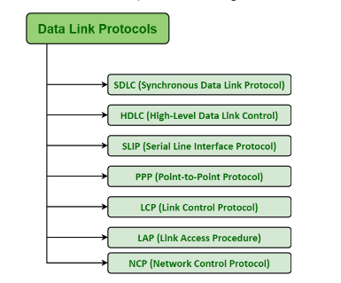
Function of Data Link Layer
Framing: The data link layer receives the stream of bits from the network layer divides into manageable data units called frames.
Physical addressing: If frames are to be distributed to different stations on the network. To define the physical address of the sender (source address) and/or receiver (destination address) of the frame, the DLL adds a header to the frame.
If the frame is to be sent for a system outside the sender's network. The receiver's address means the address of the device that connects one network to the another.

Slide 9
Services of Data Link Layer
Flow control: If the rate at which the data are consumed by the receiver is less than the rate produced by the sender, the data link layer deals with a flow control mechanism to prevent overrun the receiver.
Error control: The data link layer also deals with damaged or lost frames. By adding mechanisms to detect and retransmit lost frames increases reliability.
A trailer added to the end of the frame to achieve error control.
Access control: When more than two or two devices are connected to the common link, data link layer protocols are necessary to determine which device has control over the link at any point of time.
Example: In this figure, a node with physical address 23 sends a frame to a node with physical address 92. The two nodes connected by a link level. At the link level this frame contains physical (link) addresses in the header.
These are the only addresses needed. The remaining header contains other information that is required at this level. The extra bits needed for error detection contains by the trailer.

Slide 10
Services of Data Link Layer
The data link layer is located between Physical and Network layer.
It provides services to the network .
It receives services from the physical layer.
The duty scope of the data link layer is node to node .
When a packect

Slide 11
Services of Data Link Layer
The data link layer is located between Physical and Network layer.
It provides services to the network .
It receives services from the physical layer.
The duty scope of the data link layer is node to node .
When a packect

Slide 12
ARP
Address Resolution Protocol (ARP) is a protocol or procedure that connects an ever-changing Internet Protocol (IP) address to a fixed physical machine address, also known as a media access control (MAC) address, in a local-area network (LAN).
This mapping procedure is important because the lengths of the IP and MAC addresses differ, and a translation is needed so that the systems can recognize one another.
The most used IP today is IP version 4 (IPv4). An IP address is 32 bits long.
However, MAC addresses are 48 bits long. ARP translates the 32-bit address to 48 and vice versa.

Slide 13
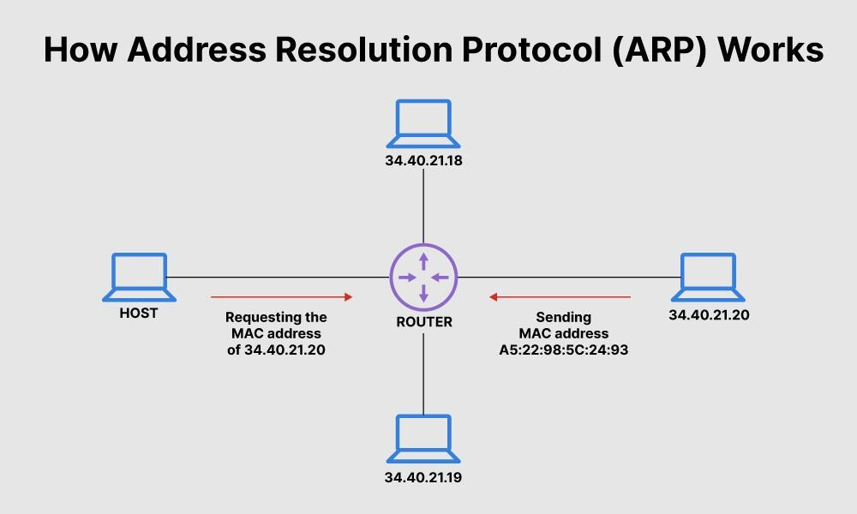
Design

Slide 14
What is address resolution protocol's relationship with DHCP and DNS? How do they differ?
ARP is the process of connecting a dynamic IP address to a physical machine's MAC address
IP addresses, by design, are changed constantly for the simple reason that doing so gives users security and privacy. However changes on IP addresses should not be completely random. There should be rules that allocate an IP address from a defined range of numbers available in a specific network.
This helps prevent issues, such as two computers receiving the same IP address. The rules are known as DHCP or Dynamic Host Configuration Protocol.
IP addresses as identities for computers are important because they are needed to perform an internet search. When users search for a domain name or Uniform Resource Locator (URL), they use an alphabetical name. Computers, on the other hand, use the numerical IP address to associate the domain name with a server. To connect the two, a Domain Name System (DNS) server is used to translate an IP address from a confusing string of numbers into a more readable, easily understandable domain name, and vice versa.

Slide 15
ARP details
ARP (Address Resolution Protocol) is a Layer 2 Protocol.
Layer 2 uses Physical addresses (MAC addresses) and Layer 3 uses Logical addresses (IP Addresses) for the communication.
ARP Protocol is used to discover the MAC Address of a node associated with a given IPv4 Address.
This important duty makes this protocol a key protocol for Ethernet based networks.
ARP is used with IPv4 only.
Basically for the transfer of the IP packets in a network, beside the IP adddress, the destination hardware address (MAC Address) also must be known by the sender (Source).
If the source do not know the destinatin MAC address, then it sends the packets to everyone in the network.
In other words, it floods the traffic. This will cause an unnecessary traffic in the network.
But, if this destination MAC Address is known, then the source can send this packet directly to the destination.
So, if the destination MAC Address is not known before the transmission, it must be learned. ARP does this role.

Slide 16
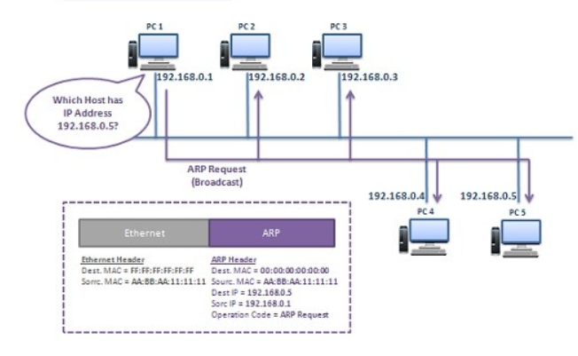
ARP request

Slide 17
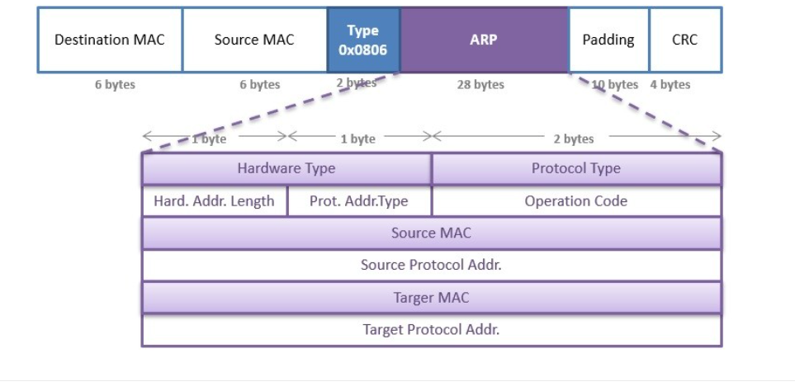
ARP packet format

Slide 18
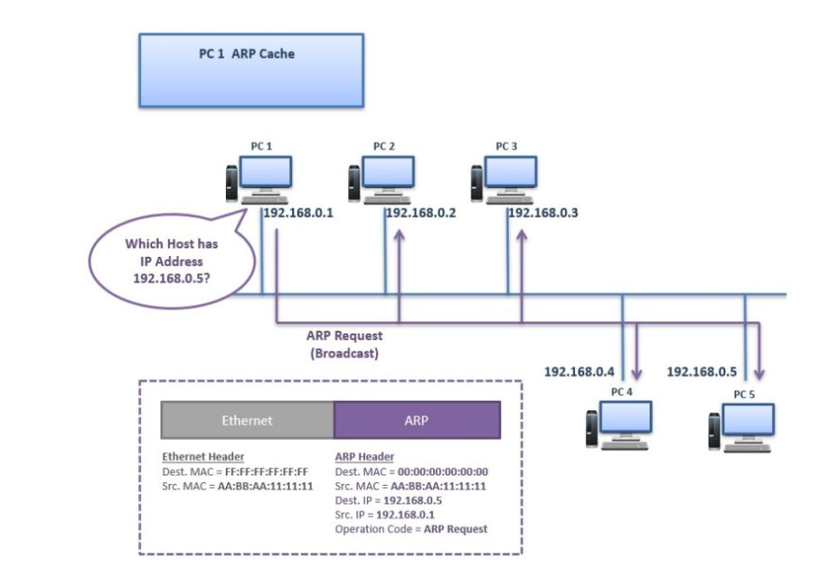
ARP request

Slide 19
ARP request
PC 1 sends an “ARP Request” Message to the network as broadcast. This ARP Request is sent to all the nodes in the network. The meaning of this ARP Request is:
“Which Host has IP Address 192.168.0.5?”
This ARP Request Message consist of source and destination IP, source MAC address and operation code “Request”. Destination MAC is written as 00:00:00:00:00:00:00 means it is requested.
In the Layer 2 header of this message, the destination MAC is FF:FF:FF:FF:FF:FF. This is the broadcast MAC address.

Slide 20
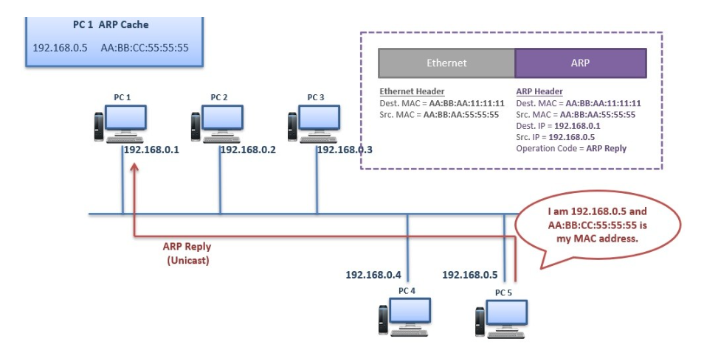
Pros and Cons of Polar Schemes

Slide 21
ARP Reply
PC 5 replies this ARP Request Message with an “ARP Reply” Message. PC 5 sends this ARP Reply Message directly to the PC 1 as unicast message. This ARP Reply Message means:
“I am 192.168.0.5 and this AA:BB:CC:55:55:55 is my MAC address.”

Slide 22
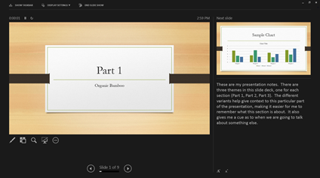

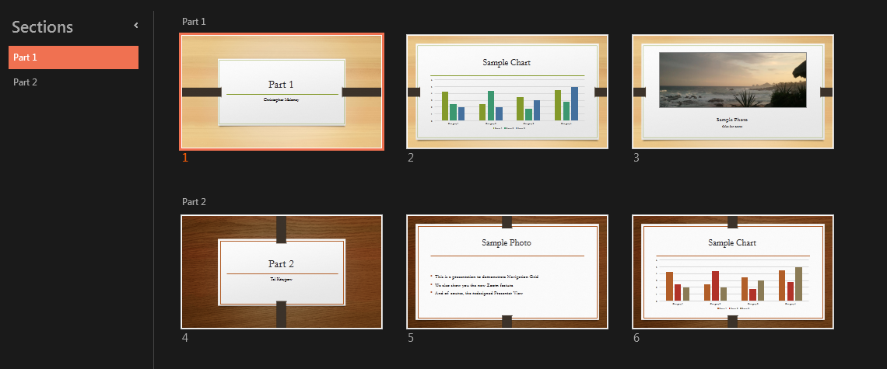

Impress
The improved Presenter View has new tools to keep you in control. The new Auto-Extend instantly applies the right settings for you, so you can focus on speaking instead of your display.
Slide zoom – Help focus your audience on your ideas. Just click to zoom in and out on a specific diagram, chart or graphic.
Slide Navigator – A feature that enables the user to visually browse for and navigate to other slides without leaving Slide Show view. Your audience only sees the slide you’re presenting.

Slide 23
PowerPoint 2013
Intuitively design beautiful presentations, easily share and work together with others and give a professional performance with advanced presenting tools.
Find out more at the PowerPoint Getting Started Center
(Click the arrow when in Slide Show mode)
Notes:
In Slide Show mode, click the arrow to enter the PowerPoint Getting Started Center.

