Slide 1

Transport Layer
Process-to-Process Delivery:
UDP, TCP, and SCTP
https://www.digitalocean.com/community/tutorials/python-socket-programming-server-client
23.<number>
Copyright © The McGraw-Hill Companies, Inc. Permission required for reproduction or display.

Slide 2
23-1 PROCESS-TO-PROCESS DELIVERY
The transport layer is responsible for process-to-process delivery—the delivery of a packet, part of a message, from one process to another.
Two processes communicate in a client/server relationship.
Topics discussed in this section:
Client/Server Paradigm
Multiplexing and Demultiplexing
Connectionless Versus Connection-Oriented Service
Reliable Versus Unreliable
Three Protocols
23.<number>

Slide 3
Client-Server Paradigm
There are several ways to achieve process-to-process communication, the most common one is through the client/server paradigm.
A process on the local host, called a client, needs services from a process usually on the remote host, called a server.
Both processes (client and server) have the same name.
Operating systems today support both multiuser and multiprogramming environments.
A remote computer can run several server programs at the same time, just as local computers can run one or more client programs at the same time. For communication,
we must define the following:
1. Local host
2. Local process
3. Remote host
4. Remote process
23.<number>

Slide 4
23-1 PROCESS-TO-PROCESS DELIVERY
Real communication takes place between two processes (application programs).
However, at any moment, several processes may be running on the source host and several on the destination host.
To complete the delivery, we need a mechanism to deliver data from one of these processes running on
the source host to the corresponding process running on the destination host.
23.<number>

Slide 5

Figure 23.1 Types of data deliveries
23.<number>

Slide 6
Port Numbers, Transport Layer Address
The port numbers are 16-bit integers between 0 and 65,535.
The client program defines itself with a port number, chosen randomly by the transport layer software running on the client host.
This is the ephemeral (short lived) port number and should be greater than 1023.
23.<number>

Slide 7
Port Numbers, Transport Layer Address
The server process must also define itself with a port number.
This port number, however, cannot be chosen randomly.
If the computer at the server site runs a server process and assigns a random number as the port number, the process at the client site that wants to access that server and use its services will not know the port number.
Of course, one solution would be to send a special packet and request the port number of a
specific server, but this requires more overhead.
The Internet has decided to use universal port numbers for servers; these are called well-known port numbers.
There are some exceptions to this rule; for example, there are clients that are assigned well-known port numbers.
Every client process knows the well-known port number of the corresponding server process. For example, while the Daytime client process, discussed above, can use an ephemeral (temporary) port number 52,000 to identify itself, the Daytime server process must use the well-known (permanent) port number 13.
23.<number>

Slide 8

Figure 23.2 Port numbers
23.<number>

Slide 9
Port Numbers, Transport Layer Address
The server process must also define itself with a port number.
This port number, however, cannot be chosen randomly.
If the computer at the server site runs a server process and assigns a random number as the port number, the process at the client site that wants to access that server and use its services will not know the port number.
Of course, one solution would be to send a special packet and request the port number of a
specific server, but this requires more overhead.
The Internet has decided to use universal port numbers for servers; these are called well-known port numbers.
There are some exceptions to this rule; for example, there are clients that are assigned well-known port numbers.
Every client process knows the well-known port number of the corresponding server process. For example, while the Daytime client process, discussed above, can use an ephemeral (temporary) port number 52,000 to identify itself, the Daytime server process must use the well-known (permanent) port number 13.
23.<number>

Slide 10

Figure 23.3 IP addresses versus port numbers
23.<number>

Slide 11
ICANN Ranges
ICANN divided the port numbers into three ranges;
Well-known port: The port ranging from 0 to 1023 are assigned and controlled by ICANN. These are well-known ports.
Registered ports: The ports ranging from 1024 to 49151 are not assigned or controlled by ICANN. They can only be registered with ICANN to prevent duplication.
Dynamic Ports: The ports ranging from 49152 to 65535 are neither controlled nor registered . They can be used as temporary or private port numbers
23.<number>

Slide 12

Figure 23.4 IANA ranges
23.<number>

Slide 13

Figure 23.5 Socket address
A transport layer protocol in the TCP suite needs both the IP address and the port number, at each end, to make the connection.
The client socket address (IP+port) defines the client process uniquely while
The server socket address (IP+port) defines the server process uniquely
23.<number>

Slide 14
Multiplexing and Demultiplexing
A transport layer protocol in the TCP suite needs both the IP address and the port number, at each end, to make the connection.
The client socket address (IP+port) defines the client process uniquely while
The server socket address (IP+port) defines the server process uniquely
23.<number>

Slide 15
Multiplexing
At the sender site, there may be several processes that need to send packets.
However, there is only one transport layer protocol at any time.
This is a many-to-one relationship and requires multiplexing. The protocol accepts messages from different processes, differentiated by their assigned port numbers. After adding the header, the transport layer passes the packet to the network layer.
23.<number>

Slide 16
De-Multiplexing
At the receiver site, the relationship is one-to-many and requires de-multiplexing.
The transport layer receives datagrams from the network layer.
After error checking and dropping of the header, the transport layer delivers each message to the appropriate process based on the port number.
23.<number>

Slide 17

Figure 23.6 Multiplexing and demultiplexing
23.<number>

Slide 18
Connnectionless Vs Connection Oriented
In a connectionless service, the packets are sent from one station to another with no need
for connection establishment or connection release.
The packets are not numbered; they may be delayed or lost or may arrive out of sequence. There is no acknowledgment either.
UDP, is connectionless.
23.<number>

Slide 19
Connnectionless Vs Connection Oriented
In a connection-oriented service, a connection is first established between the sender and the receiver.
Data are transferred.
At the end, the connection is released.
TCP and SCTP are connection-oriented protocols
23.<number>

Slide 20
Connnectionless Vs Connection Oriented
The transport layer service can be reliable or unreliable.
Reliability at the transport layer can be achieved by implementing flow and error control at the transport layer.
This means a slower and more complex service.
On the other hand, if the application program does not need reliability because it uses its own flow and error control mechanism or it needs fast service or
the nature of the service does not demand flow and error control (real-time applications), then an unreliable protocol can be used.
23.<number>

Slide 21
Connnectionless Vs Connection Oriented
If the data link layer is reliable and has flow and error control, do we need this at the transport layer, too?
The answer is yes.
Reliability at the data link layer is between two nodes; we need reliability between two ends.
Because the network layer in the Internet is unreliable (best-effort delivery), we need to implement
reliability at the transport layer.
To understand that error control at the data link layer does
not guarantee error control at the transport layer
23.<number>

Slide 22

Figure 23.7 Error control
23.<number>

Slide 23

Figure 23.8 Position of UDP, TCP, and SCTP in TCP/IP suite
23.<number>

Slide 24
23-2 USER DATAGRAM PROTOCOL (UDP)
The User Datagram Protocol (UDP) is called a connectionless, unreliable transport protocol. It does not add anything to the services of IP except to provide process-to-process communication instead of host-to-host communication.
Topics discussed in this section:
Well-Known Ports for UDP
User Datagram
Checksum
UDP Operation
Use of UDP
23.<number>

Slide 25
23-2 USER DATAGRAM PROTOCOL (UDP)
With the disadvantages come some advantages. UDP is a very simple protocol using a minimum of overhead.
If a process wants to send a small message and does not care much about reliability, it can
use UDP.
Sending a small message by using UDP takes much less interaction between the sender and receiver than using TCP or SCTP.
23.<number>

Slide 26


Table 23.1 Well-known ports used with UDP
23.<number>

Slide 27

Example 23.1
In UNIX, the well-known ports are stored in a file called /etc/services. Each line in this file gives the name of the server and the well-known port number. We can use the
grep utility to extract the line corresponding to the desired application. The following shows the port for FTP. Note that FTP can use port 21 with either UDP or TCP.
23.<number>

Slide 28

Example 23.1 (continued)
SNMP uses two port numbers (161 and 162), each for a different purpose, as we will see in Chapter 28.
23.<number>

Slide 29

Figure 23.9 User datagram format
23.<number>

Slide 30

Note
UDP length
= IP length – IP header’s length
23.<number>

Slide 31

Figure 23.10 Pseudoheader for checksum calculation
23.<number>

Slide 32
Example 23.2
Figure 23.11 shows the checksum calculation for a very small user datagram with only 7 bytes of data. Because the number of bytes of data is odd, padding is added for checksum calculation. The pseudoheader as well as the padding will be dropped when the user datagram is delivered to IP.
23.<number>

Slide 33

Figure 23.11 Checksum calculation of a simple UDP user datagram
23.<number>

Slide 34
Queuing in UDP
If a process wants to communicate with multiple processes, it obtains only one port number and eventually one outgoing and one incoming queue.
The queues opened by the client are, in most cases, identified by ephemeral port numbers.
The queues function as long as the process is running. When the process terminates, the queues are destroyed.
The client process can send messages to the outgoing queue by using the source port number specified in the request.
UDP removes the messages one by one and, after adding the UDP header, delivers them to IP.
An outgoing queue can overflow. If this happens, the operating system can ask the client process to wait before sending any more messages.
23.<number>

Slide 35

Figure 23.12 Queues in UDP
23.<number>

Slide 36
Queuing in UDP
If a process wants to communicate with multiple processes, it obtains only one port number and eventually one outgoing and one incoming queue.
The queues opened by the client are, in most cases, identified by ephemeral port numbers.
The queues function as long as the process is running. When the process terminates, the queues are destroyed.
The client process can send messages to the outgoing queue by using the source port number specified in the request.
UDP removes the messages one by one and, after adding the UDP header, delivers them to IP.
An outgoing queue can overflow. If this happens, the operating system can ask the client process to wait before sending any more messages.
23.<number>

Slide 37
23-3 TCP
TCP is a connection-oriented protocol; it creates a virtual connection between two TCPs to send data. In addition, TCP uses flow and error control mechanisms at the transport level.
Topics discussed in this section:
TCP Services
TCP Features
Segment
A TCP Connection
Flow Control
Error Control
23.<number>

Slide 38

Table 23.2 Well-known ports used by TCP
23.<number>

Slide 39

Figure 23.13 Stream delivery
23.<number>

Slide 40

Figure 23.14 Sending and receiving buffers
23.<number>

Slide 41

Figure 23.15 TCP segments
23.<number>

Slide 42
Note
The bytes of data being transferred in each connection are numbered by TCP.
The numbering starts with a randomly generated number.
23.<number>

Slide 43

Example 23.3
The following shows the sequence number for each segment:
23.<number>

Slide 44
Note
The value in the sequence number field of a segment defines the
number of the first data byte
contained in that segment.
23.<number>

Slide 45
Note
The value of the acknowledgment field in a segment defines
the number of the next byte a party expects to receive.
The acknowledgment number is cumulative.
23.<number>

Slide 46

Figure 23.16 TCP segment format
23.<number>

Slide 47

Figure 23.17 Control field
23.<number>

Slide 48

Table 23.3 Description of flags in the control field
23.<number>

Slide 49

Figure 23.18 Connection establishment using three-way handshaking
23.<number>

Slide 50
Note
A SYN segment cannot carry data, but it consumes one sequence number.
23.<number>

Slide 51
Note
A SYN + ACK segment cannot
carry data, but does consume one
sequence number.
23.<number>

Slide 52
Note
An ACK segment, if carrying no data, consumes no sequence number.
23.<number>

Slide 53

Figure 23.19 Data transfer
23.<number>

Slide 54

Figure 23.20 Connection termination using three-way handshaking
23.<number>

Slide 55
Note
The FIN segment consumes one sequence number if it does
not carry data.
23.<number>

Slide 56
Note
The FIN + ACK segment consumes
one sequence number if it
does not carry data.
23.<number>

Slide 57

Figure 23.21 Half-close
23.<number>

Slide 58

Figure 23.22 Sliding window
23.<number>

Slide 59
Note
A sliding window is used to make transmission more efficient as well as
to control the flow of data so that the destination does not become
overwhelmed with data.
TCP sliding windows are byte-oriented.
23.<number>

Slide 60
Example 23.4
What is the value of the receiver window (rwnd) for host A if the receiver, host B, has a buffer size of 5000 bytes and 1000 bytes of received and unprocessed data?
Solution
The value of rwnd = 5000 − 1000 = 4000. Host B can receive only 4000 bytes of data before overflowing its buffer. Host B advertises this value in its next segment to A.
23.<number>

Slide 61
Example 23.5
What is the size of the window for host A if the value of rwnd is 3000 bytes and the value of cwnd is 3500 bytes?
Solution
The size of the window is the smaller of rwnd and cwnd, which is 3000 bytes.
23.<number>

Slide 62
Example 23.6
Figure 23.23 shows an unrealistic example of a sliding window. The sender has sent bytes up to 202. We assume that cwnd is 20 (in reality this value is thousands of bytes). The receiver has sent an acknowledgment number of 200 with an rwnd of 9 bytes (in reality this value is thousands of bytes). The size of the sender window is the minimum of rwnd and cwnd, or 9 bytes. Bytes 200 to 202 are sent, but not acknowledged. Bytes 203 to 208 can be sent without worrying about acknowledgment. Bytes 209 and above cannot be sent.
23.<number>

Slide 63

Figure 23.23 Example 23.6
23.<number>

Slide 64
Note
Some points about TCP sliding windows:
❏ The size of the window is the lesser of rwnd and
cwnd.
❏ The source does not have to send a full window’s
worth of data.
❏ The window can be opened or closed by the
receiver, but should not be shrunk.
❏ The destination can send an acknowledgment at
any time as long as it does not result in a shrinking
window.
❏ The receiver can temporarily shut down the
window; the sender, however, can always send a
segment of 1 byte after the window is shut down.
23.<number>

Slide 65
Note
ACK segments do not consume sequence numbers and are not acknowledged.
23.<number>

Slide 66
Note
In modern implementations, a retransmission occurs if the retransmission timer expires or three duplicate ACK segments have arrived.
23.<number>

Slide 67
Note
No retransmission timer is set for an ACK segment.
23.<number>

Slide 68
Note
Data may arrive out of order and be temporarily stored by the receiving TCP,
but TCP guarantees that no out-of-order segment is delivered to the process.
23.<number>

Slide 69

Figure 23.24 Normal operation
23.<number>

Slide 70

Figure 23.25 Lost segment
23.<number>

Slide 71
Note
The receiver TCP delivers only ordered data to the process.
23.<number>

Slide 72

Figure 23.26 Fast retransmission
23.<number>

Slide 73
23-4 SCTP
Stream Control Transmission Protocol (SCTP) is a new reliable, message-oriented transport layer protocol. SCTP, however, is mostly designed for Internet applications that have recently been introduced. These new applications need a more sophisticated service than TCP can provide.
Topics discussed in this section:
SCTP Services and Features
Packet Format
An SCTP Association
Flow Control and Error Control
23.<number>

Slide 74
Note
SCTP is a message-oriented, reliable protocol that combines the best features of UDP and TCP.
23.<number>

Slide 75
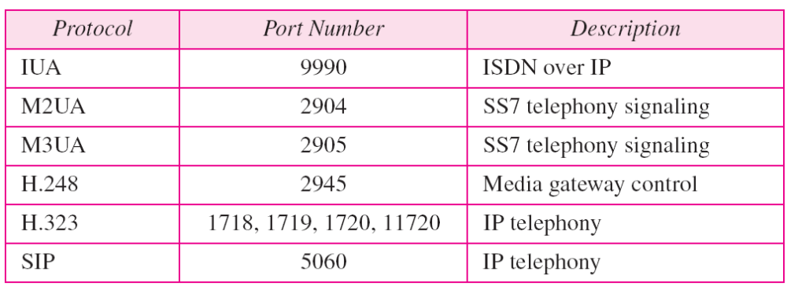
Table 23.4 Some SCTP applications
23.<number>

Slide 76
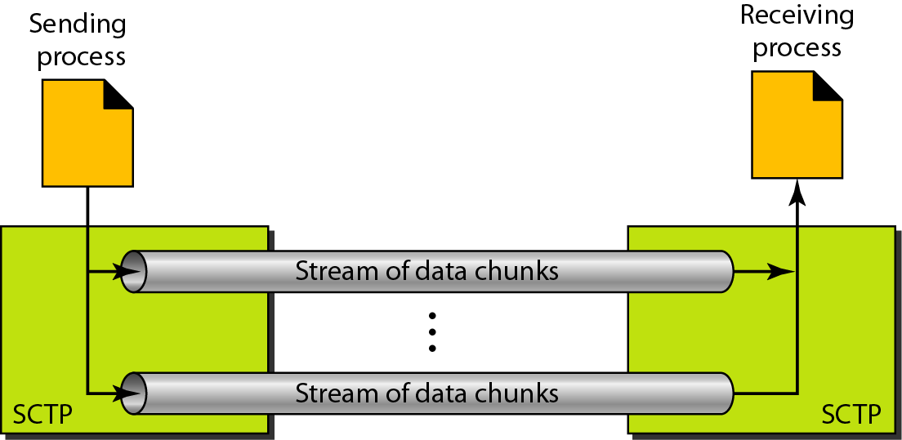
Figure 23.27 Multiple-stream concept
23.<number>

Slide 77
Note
An association in SCTP can involve multiple streams.
23.<number>

Slide 78
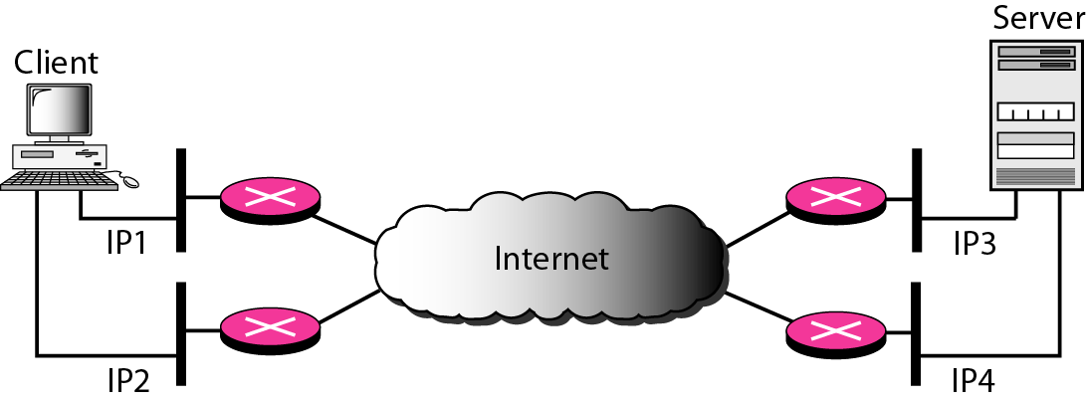
Figure 23.28 Multihoming concept
23.<number>

Slide 79
Note
SCTP association allows multiple IP addresses for each end.
23.<number>

Slide 80
Note
In SCTP, a data chunk is numbered using a TSN.
23.<number>

Slide 81
Note
To distinguish between different streams, SCTP uses an SI.
23.<number>

Slide 82
Note
To distinguish between different data chunks belonging to the same stream, SCTP uses SSNs.
23.<number>

Slide 83
Note
TCP has segments; SCTP has packets.
23.<number>

Slide 84
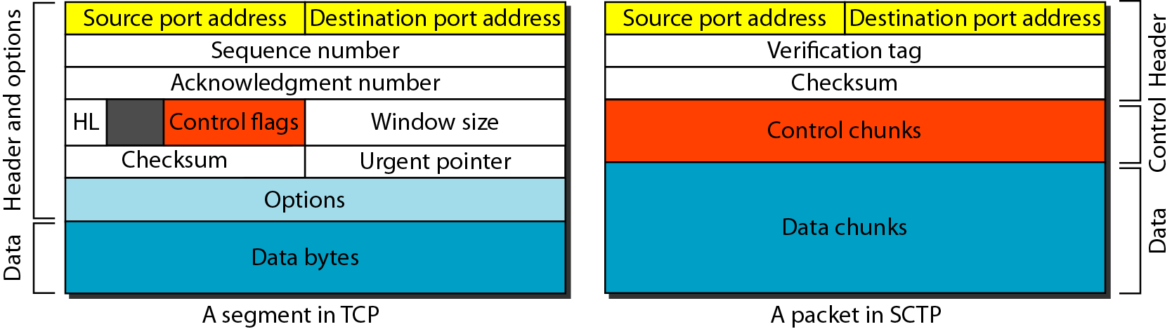
Figure 23.29 Comparison between a TCP segment and an SCTP packet
23.<number>

Slide 85
Note
In SCTP, control information and data information are carried in separate chunks.
23.<number>

Slide 86
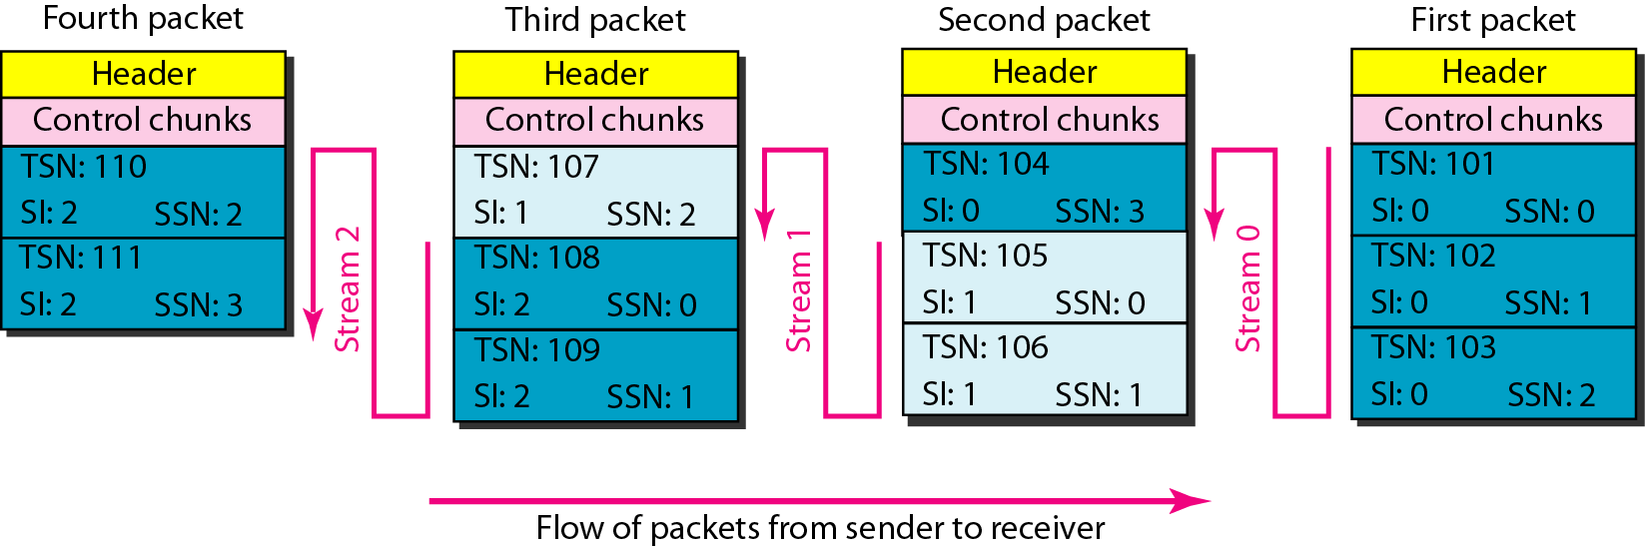
Figure 23.30 Packet, data chunks, and streams
23.<number>

Slide 87
Note
Data chunks are identified by three items: TSN, SI, and SSN.
TSN is a cumulative number identifying the association; SI defines the stream; SSN defines the chunk in a stream.
23.<number>

Slide 88
Note
In SCTP, acknowledgment numbers are used to acknowledge only data chunks;
control chunks are acknowledged by other control chunks if necessary.
23.<number>

Slide 89
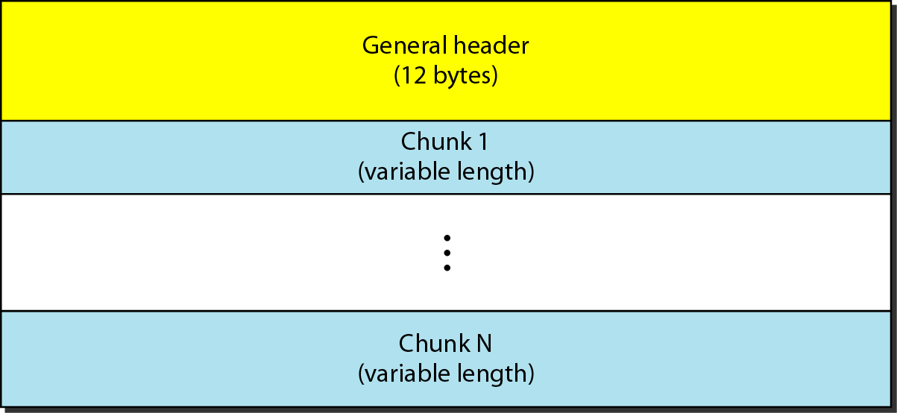
Figure 23.31 SCTP packet format
23.<number>

Slide 90
Note
In an SCTP packet, control chunks come before data chunks.
23.<number>

Slide 91
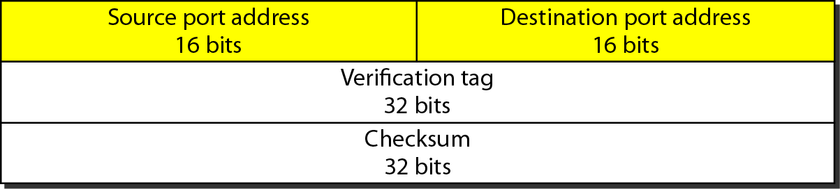
Figure 23.32 General header
23.<number>

Slide 92
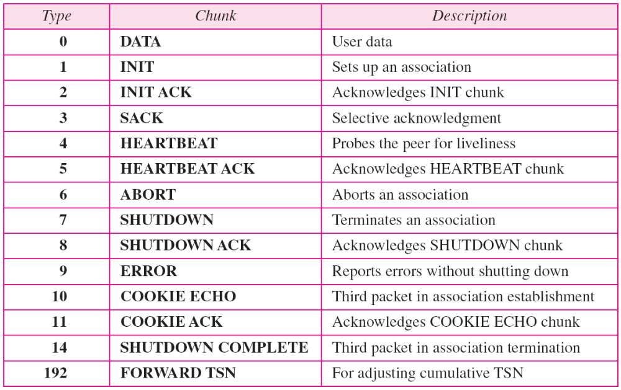
Table 23.5 Chunks
23.<number>

Slide 93
Note
A connection in SCTP is called an association.
23.<number>

Slide 94
Note
No other chunk is allowed in a packet carrying an INIT or INIT ACK chunk.
A COOKIE ECHO or a COOKIE ACK chunk can carry data chunks.
23.<number>

Slide 95
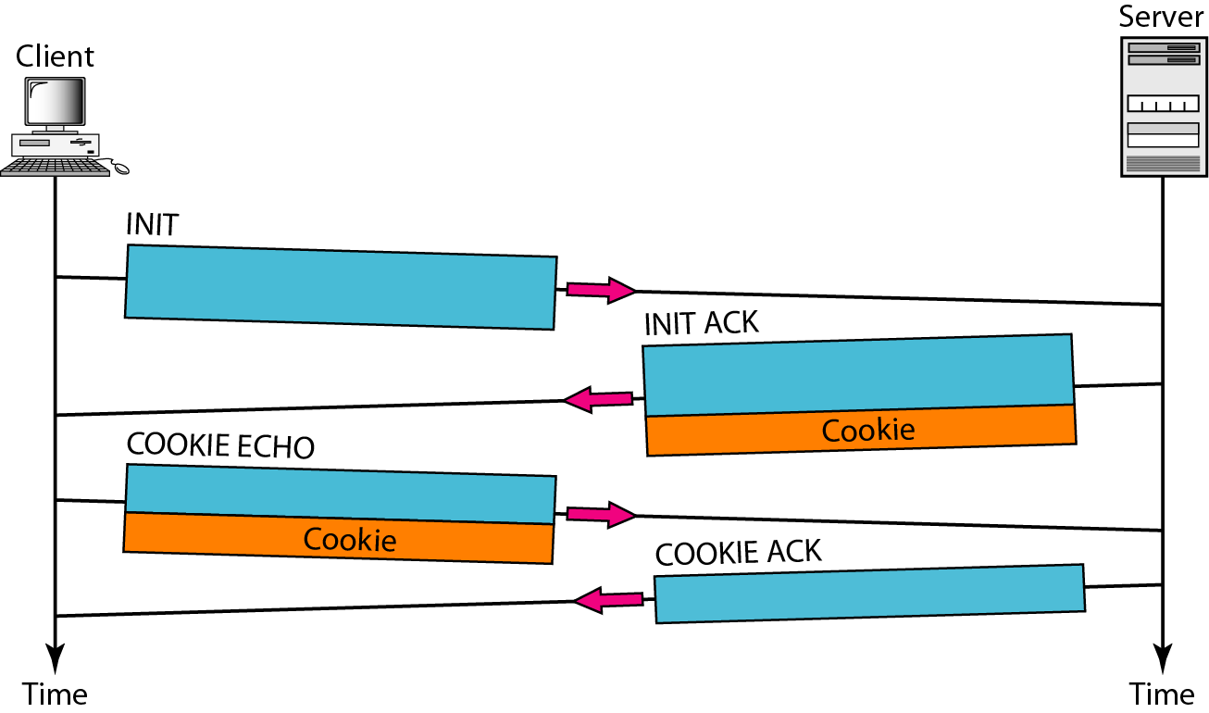
Figure 23.33 Four-way handshaking
23.<number>

Slide 96
Note
In SCTP, only DATA chunks
consume TSNs;
DATA chunks are the only chunks
that are acknowledged.
23.<number>

Slide 97
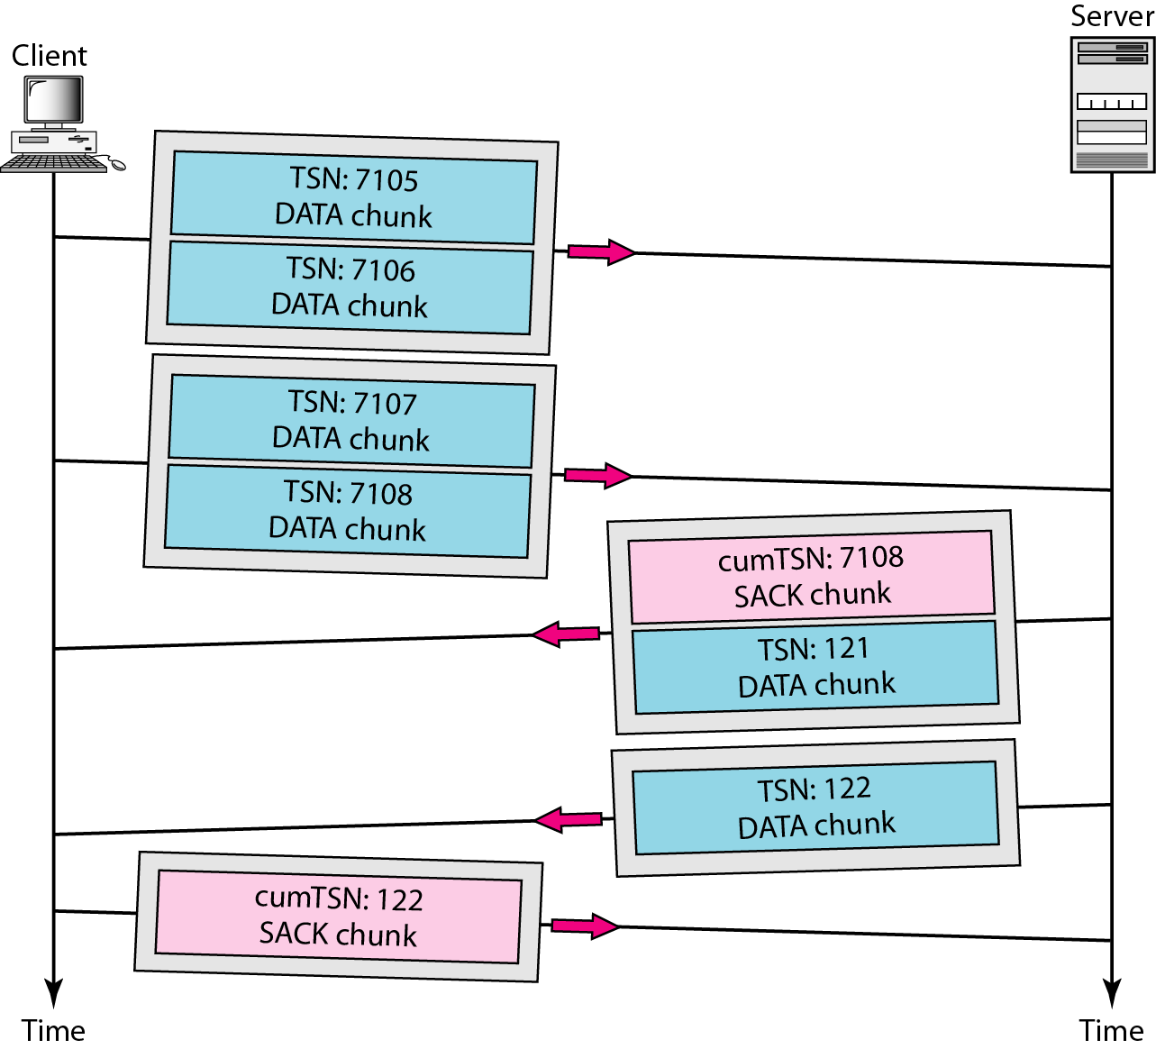
Figure 23.34 Simple data transfer
23.<number>

Slide 98
Note
The acknowledgment in SCTP defines the cumulative TSN, the TSN of the last data chunk received in order.
23.<number>

Slide 99
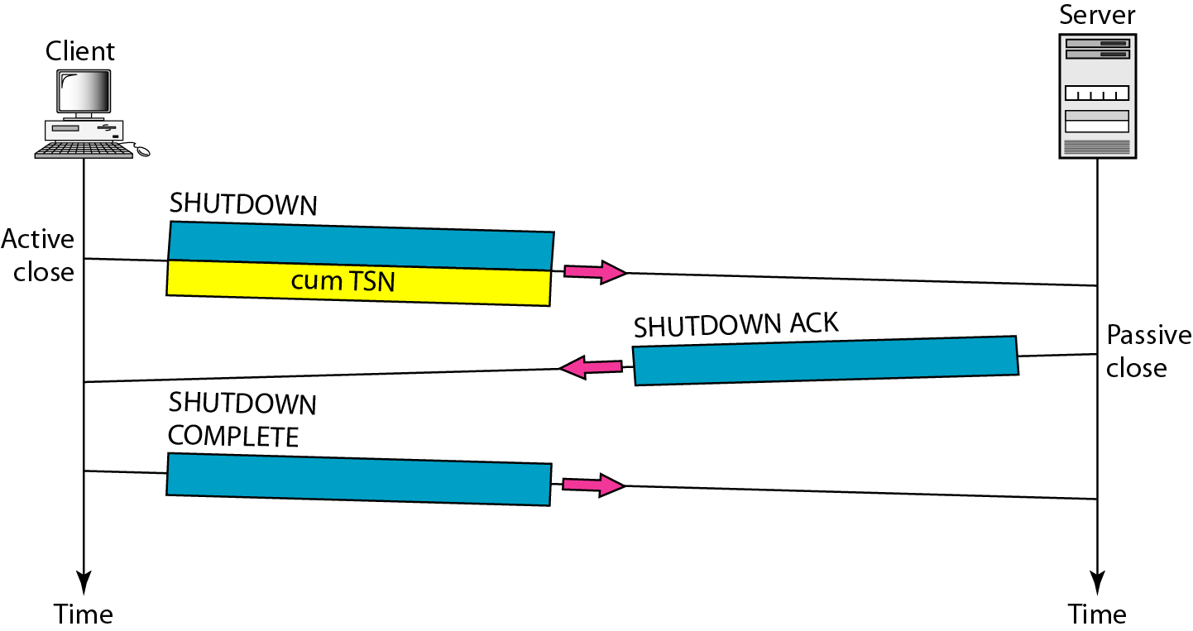
Figure 23.35 Association termination
23.<number>

Slide 100
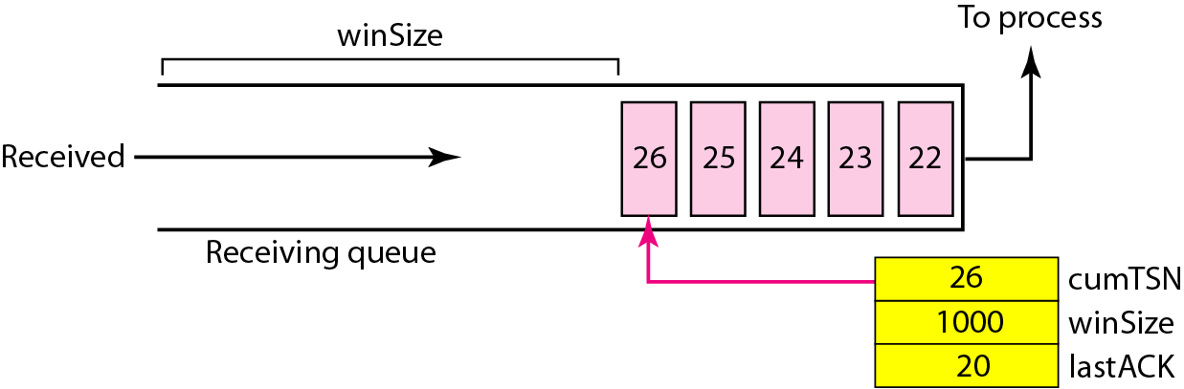
Figure 23.36 Flow control, receiver site
23.<number>

Slide 101
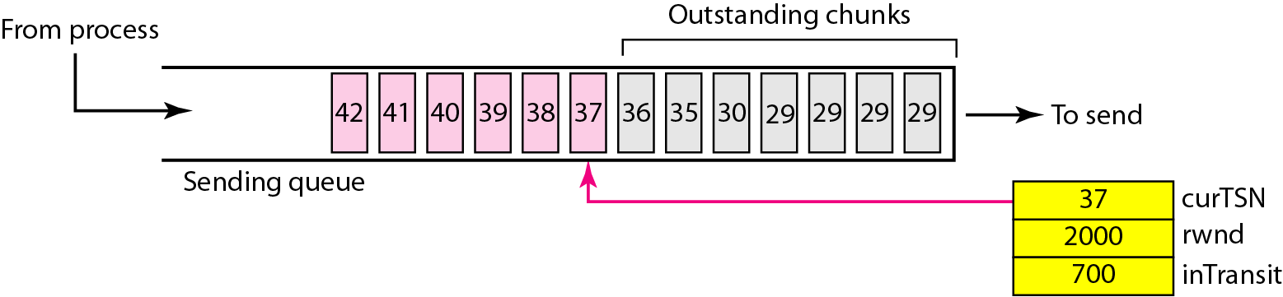
Figure 23.37 Flow control, sender site
23.<number>

Slide 102
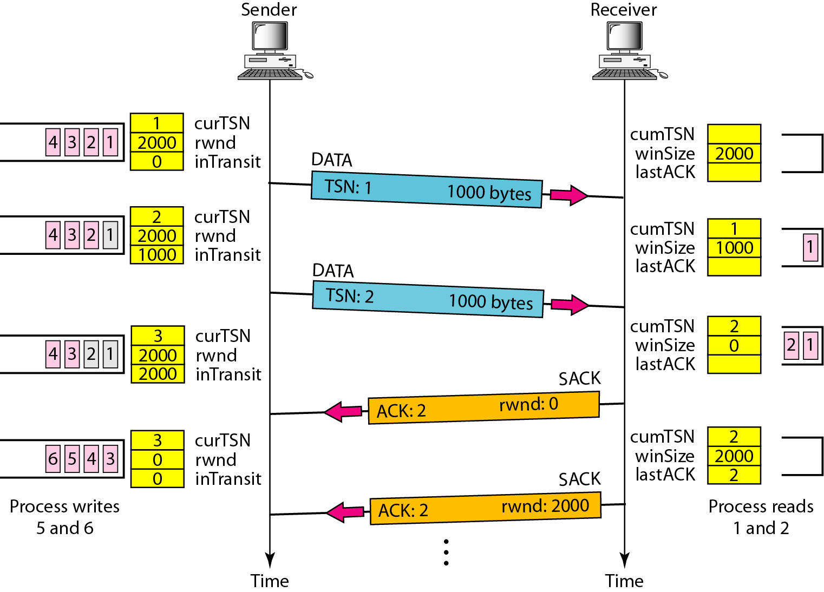
Figure 23.38 Flow control scenario
23.<number>

Slide 103
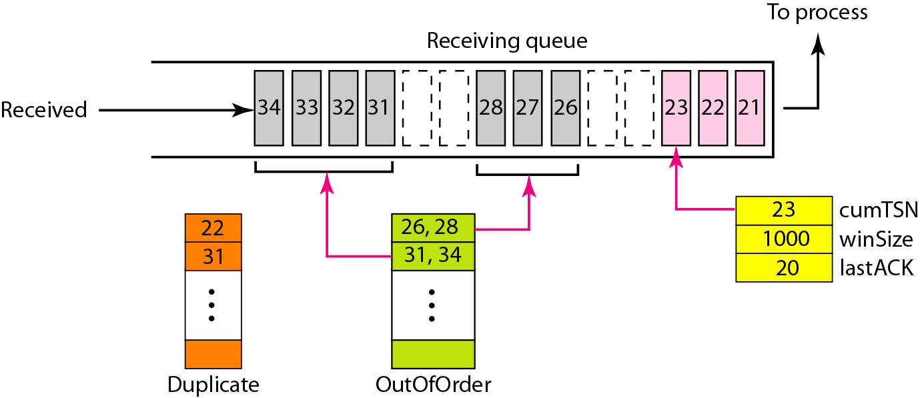
Figure 23.39 Error control, receiver site
23.<number>

Slide 104
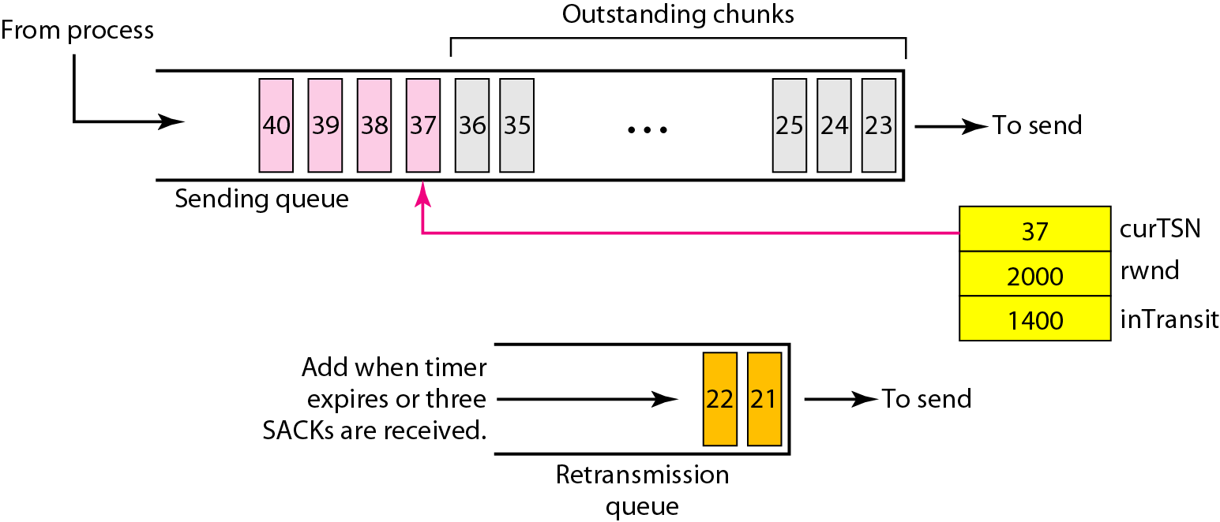
Figure 23.40 Error control, sender site
23.<number>

