Slide 1
Chapter 12
Local Area Networks
Project 802
Ethernet
Token Ring
FDDI
WCB/McGraw-Hill
© The McGraw-Hill Companies, Inc., 1998

Slide 2
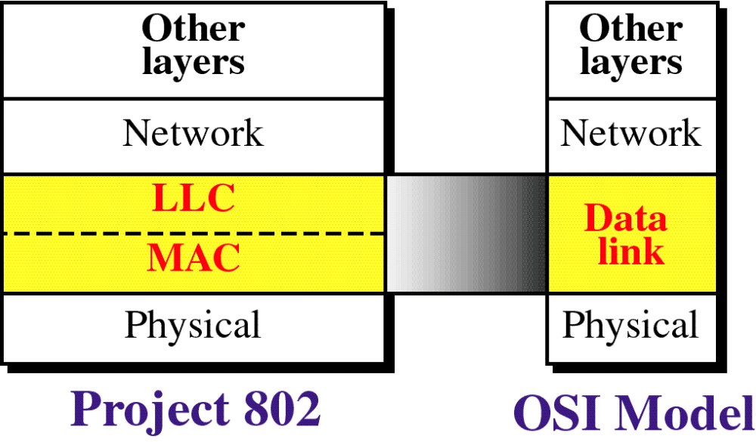
Figure 12-1
OSI Model and Project 802
WCB/McGraw-Hill
© The McGraw-Hill Companies, Inc., 1998

Slide 3
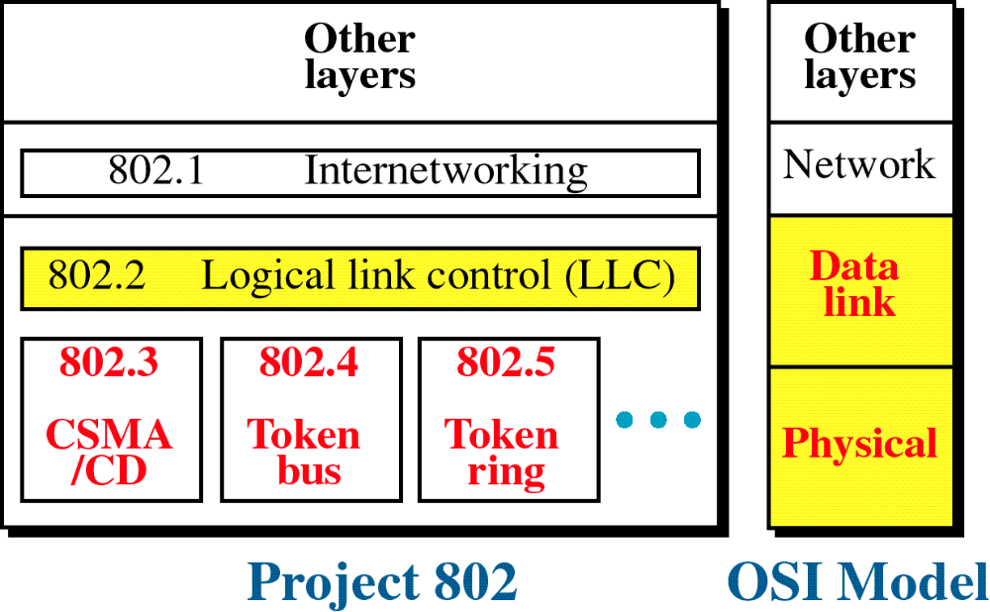
Figure 12-2
Project 802
WCB/McGraw-Hill
© The McGraw-Hill Companies, Inc., 1998

Slide 4
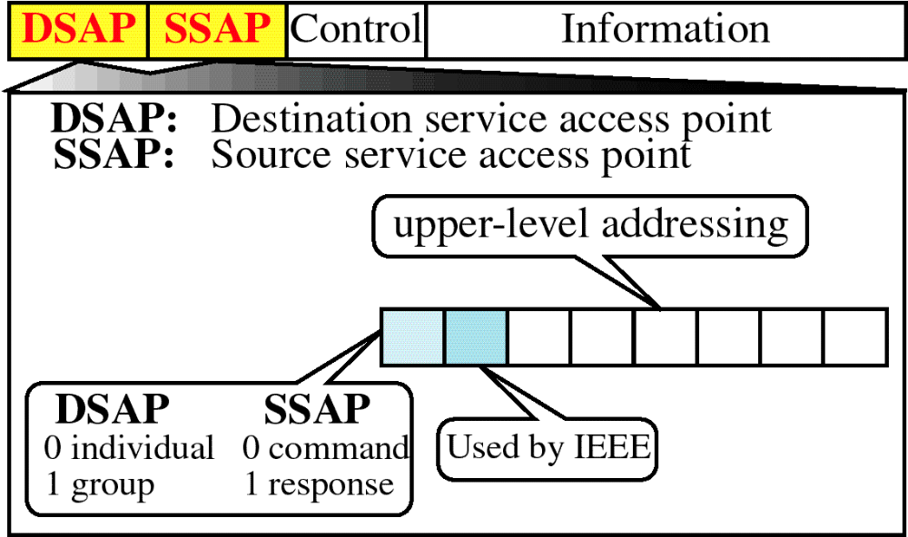
Figure 12-3
PDU Format
WCB/McGraw-Hill
© The McGraw-Hill Companies, Inc., 1998

Slide 5
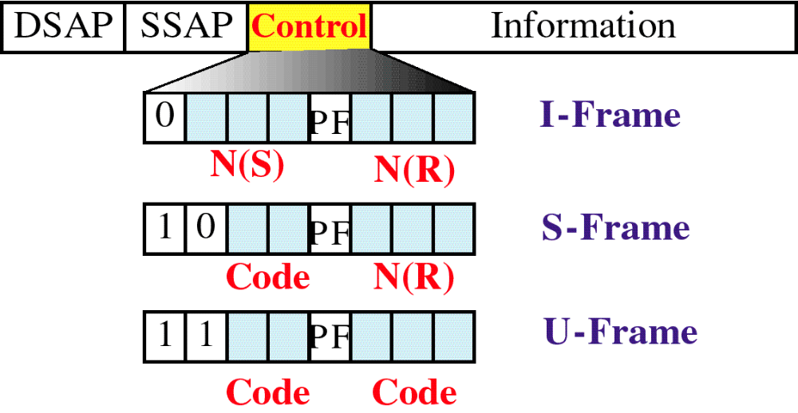
Figure 12-4
PDU Control Field
WCB/McGraw-Hill
© The McGraw-Hill Companies, Inc., 1998

Slide 6
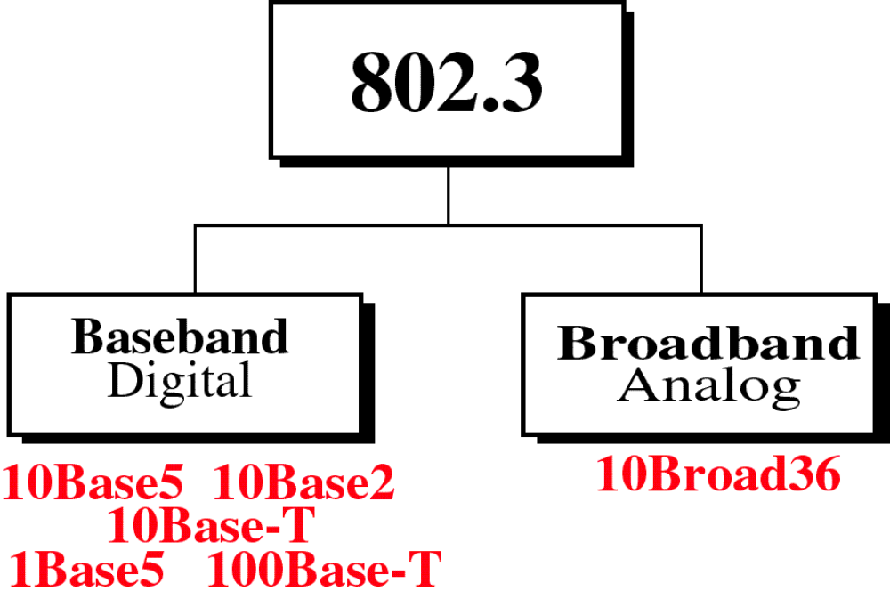
Figure 12-5
WCB/McGraw-Hill
© The McGraw-Hill Companies, Inc., 1998

Slide 7
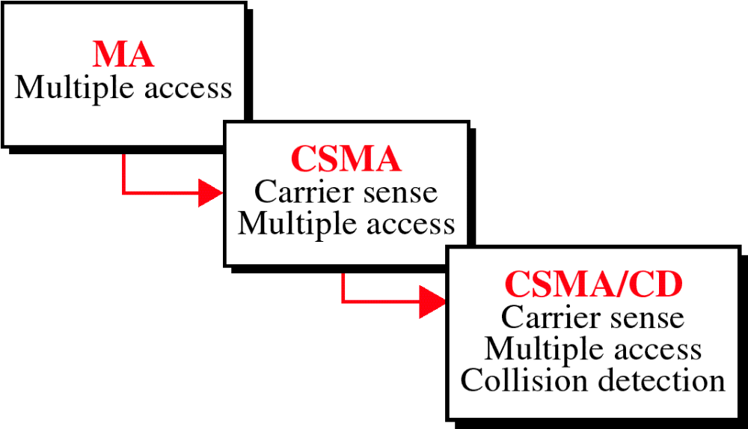
Figure 12-6
Evolution of CSMA/CD
WCB/McGraw-Hill
© The McGraw-Hill Companies, Inc., 1998

Slide 8
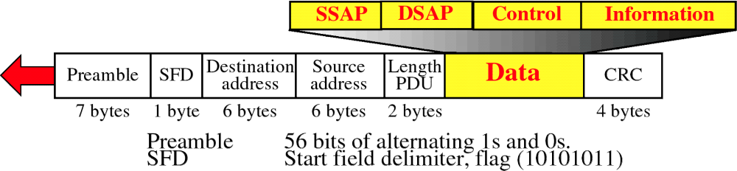
Figure 12-7
MAC Frame
WCB/McGraw-Hill
© The McGraw-Hill Companies, Inc., 1998

Slide 9
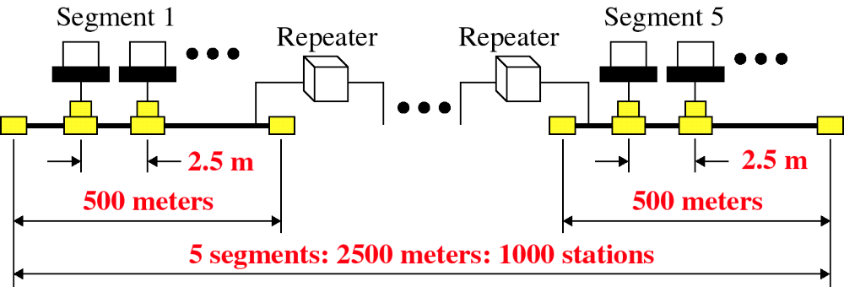
Figure 12-8
Ethernet Segments
WCB/McGraw-Hill
© The McGraw-Hill Companies, Inc., 1998

Slide 10
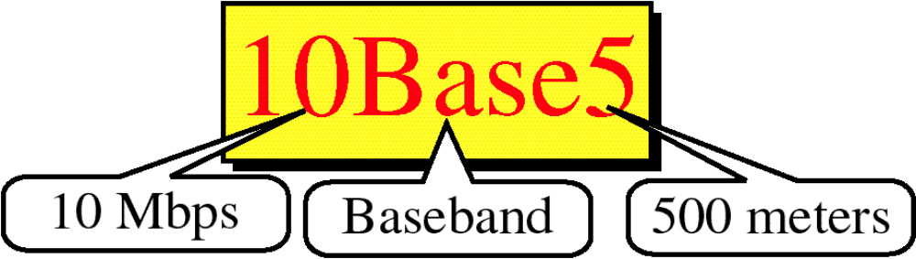
Figure 12-9
WCB/McGraw-Hill
© The McGraw-Hill Companies, Inc., 1998

Slide 11
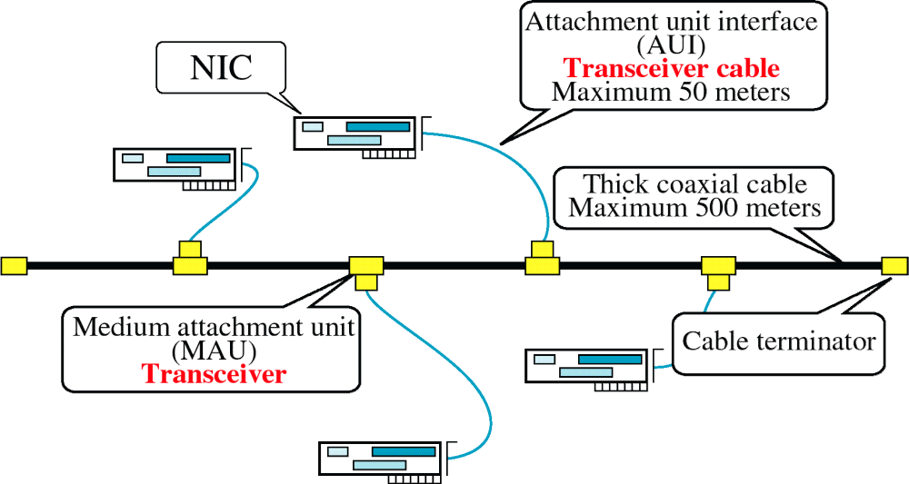
Figure 12-9-continued
10BASE5
WCB/McGraw-Hill
© The McGraw-Hill Companies, Inc., 1998

Slide 12
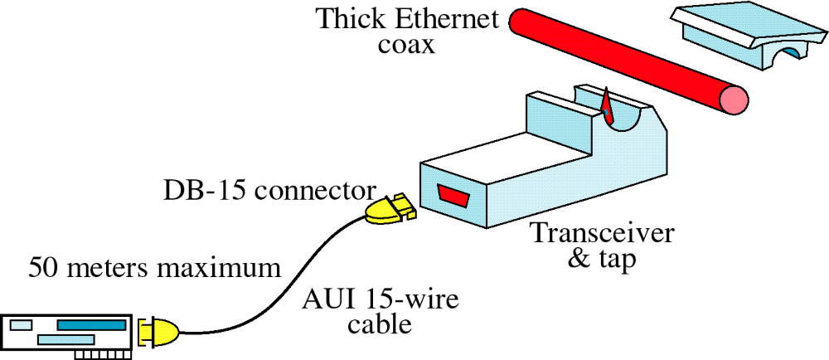
Figure 12-10
Transceiver
WCB/McGraw-Hill
© The McGraw-Hill Companies, Inc., 1998

Slide 13
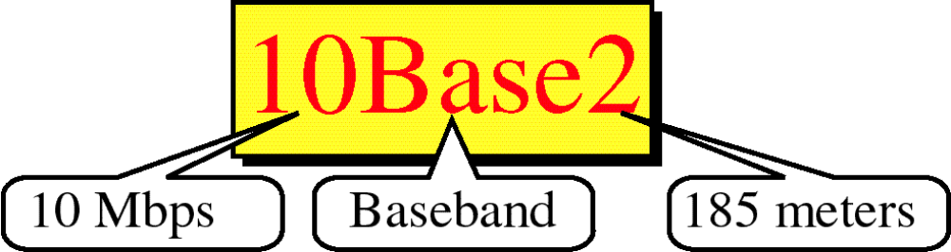
Figure 12-11
WCB/McGraw-Hill
© The McGraw-Hill Companies, Inc., 1998

Slide 14
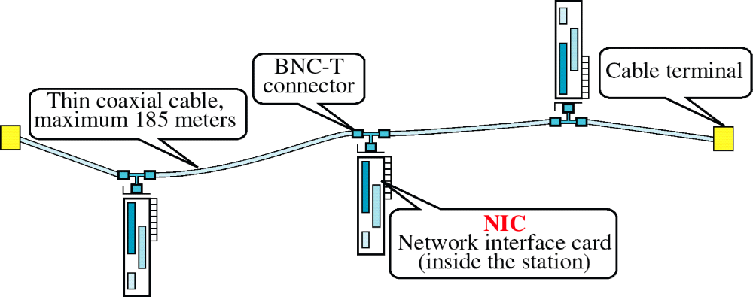
Figure 12-11-continued
10BASE2
WCB/McGraw-Hill
© The McGraw-Hill Companies, Inc., 1998

Slide 15
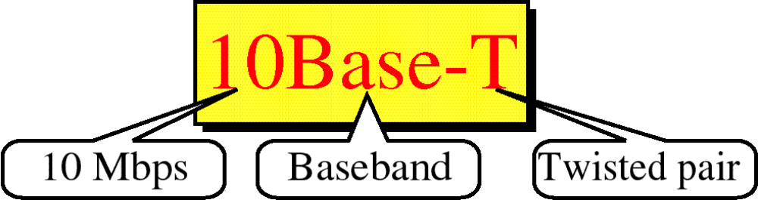
Figure 12-12
WCB/McGraw-Hill
© The McGraw-Hill Companies, Inc., 1998

Slide 16
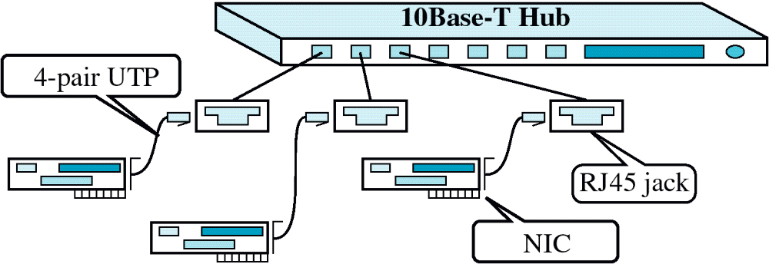
Figure 12-12-continued
10BASET
WCB/McGraw-Hill
© The McGraw-Hill Companies, Inc., 1998

Slide 17
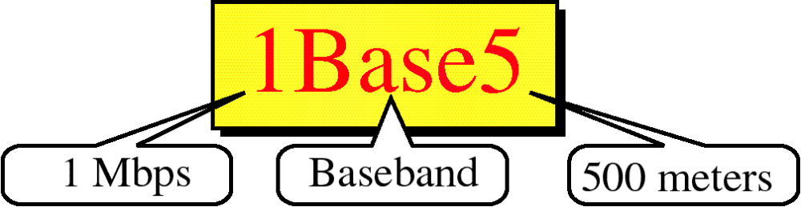
Figure 12-13
WCB/McGraw-Hill
© The McGraw-Hill Companies, Inc., 1998

Slide 18
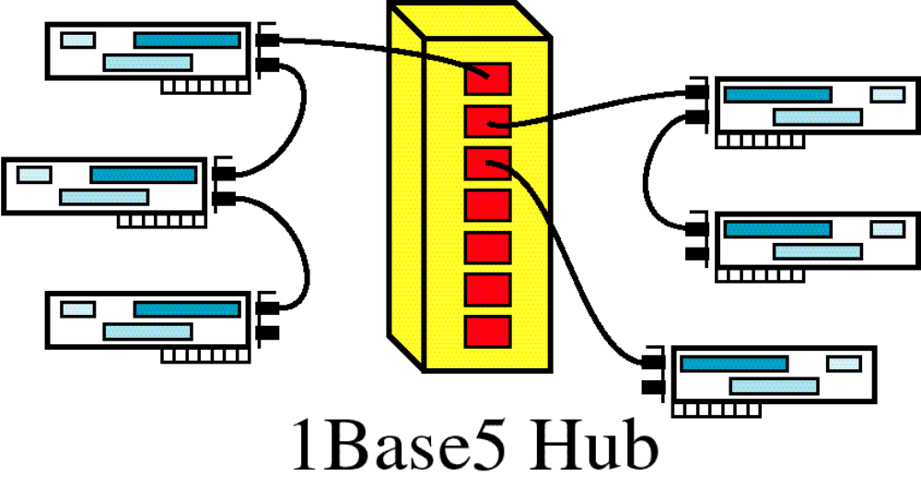
Figure 12-13-continued
1BASE5
WCB/McGraw-Hill
© The McGraw-Hill Companies, Inc., 1998

Slide 19
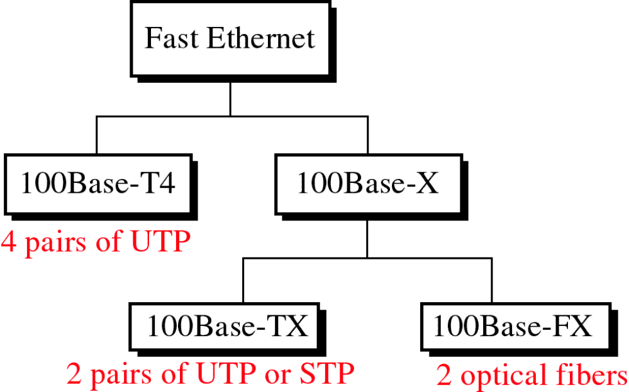
Figure 12-14
WCB/McGraw-Hill
© The McGraw-Hill Companies, Inc., 1998

