Slide 1

Chapter 19
Network Layer:
Logical Addressing
19.<number>
Copyright © The McGraw-Hill Companies, Inc. Permission required for reproduction or display.

Slide 2
Network Laye-5
The network layer in the TCP/IP suite is responsible for the host-to-host delivery of datagrams.
It provides services to the transport layer and receives services from the data link layer.
19.<number>

Slide 3
Network Laye-5
The services provided by network layer include:
Packetizing;
Forwarding and Routing and comparing the two.
Flow, error and congestion control
Packet switching; datagram approach and virtual circuit approach.
19.<number>

Slide 4
Packetizing
Packetizing: Encapsulating the payload (data received from upper layer) in a network-layer packet at the source and encapsulating the payload from the network layer packet at the destination.
That is to carry a payload from the source to the destination without changing or using it.
The routers in the path are not allowed to decapsulate the packets they received unless the packets need to be fragmented.
19.<number>

Slide 5
Routing and Forwarding
A physical network is a combination of networks (LANs and WANs) and routers that connect them.
More than one route may exist from the source to the destination.
The network layer is responsible for finding the best one among these possible route.
This is done by running some routing protocols to help the routers coordinate their knowledge about the neighborhood and to come up with consistent tables to be used when a packet arrives.
19.<number>

Slide 6
Forwarding
If routing is applying strategies and running some routing protocols to create the decision-making tables for each router.
Forwarding can be defined as the action applied by each router when a packet arrives at one of its interfaces.
The decision-making table a router normally uses for applying this action is sometimes called forwarding table and sometime routing table.
19.<number>

Slide 7
Forwarding
If routing is applying strategies and running some routing protocols to create the decision-making tables for each router.
Forwarding can be defined as the action applied by each router when a packet arrives at one of its interfaces.
The decision-making table a router normally uses for applying this action is sometimes called forwarding table and sometime routing table.
19.<number>

Slide 8
Error Control
The packet in the network layer may be fragmented at each router, which makes error checking at this layer inefficient.
The designer of the network layer, however, have added a checksum field to the datagram to control any corruption in the header, but not in the whole datagram.
The internet also uses auxiliary protocols such ICMP that provides some kind of error control if the datagram is discarded or has some unknown information in the header.
19.<number>

Slide 9
Flow Control
Flow control regulates the amount of data a source can send overwhelming the receiver.
The network layer in the internet, however, does not directly provide any flow control.
The datagrams are sent by the sender when they are ready, without any attention to the readiness of the receiver.
19.<number>

Slide 10
Congestion Control
Congestion in the network layer is a situation in which too many datagrams are present in an area of the internet.
Congestion may occur if the number of datagram sent by source computers is beyond the capacity of the network or routers.
19.<number>

Slide 11
A router, in fact, is switch that creates a kind of connection between an input port and an out port (or set of output ports) just as an electrical switch connects the input to the output to let electricity flow.
In Data communication, switching is divided into two categories ; circuit switching and packet switching.
Circuit switching is used at physical layer….
Packet-switch network can use two different approaches to route the packets;
Datagram approach and virtual circuit approach.
Packet Switching
19.<number>

Slide 12
A connectionless Service
In the datagram approach, the forwarding decision is based on the destination address of the packet.
In a connection-less service, the network layer protocol treats each packet independently with each packet having no relationship to any other packet.
In this approach, the packets in a message may or may not travel the same path to their destination.
Datagram Approach
19.<number>

Slide 13
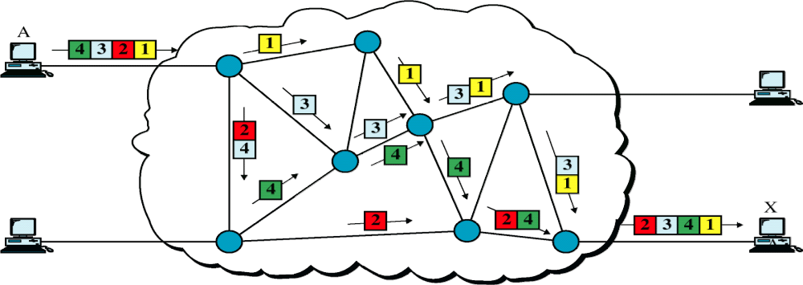
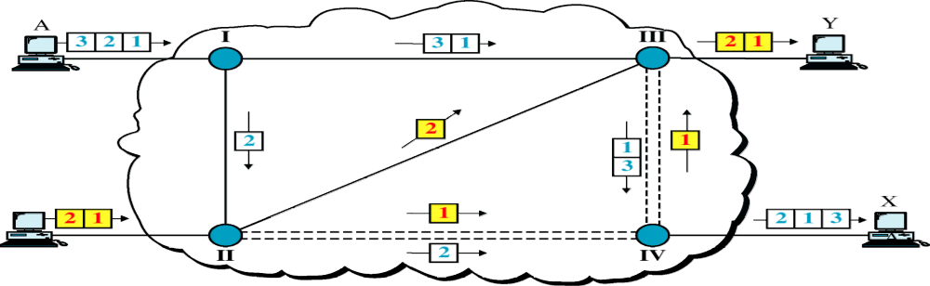
Packet Switching
19.<number>

Slide 14
Virtual Circuit Approach:
Connection –oriented Service
In a connection-oriented service also called virtual-circuit approach, there is a relationship between all packets belonging to a message.
Before all datagrams in a message can be sent, a virtual connection should be set up to define the path for the datagrams.
After connection setup, the datagrams can all follow the same path.
It must also contain a flow label , a virtual circuit identifier that defines the virtual path the packet should follow.
19.<number>

Slide 15
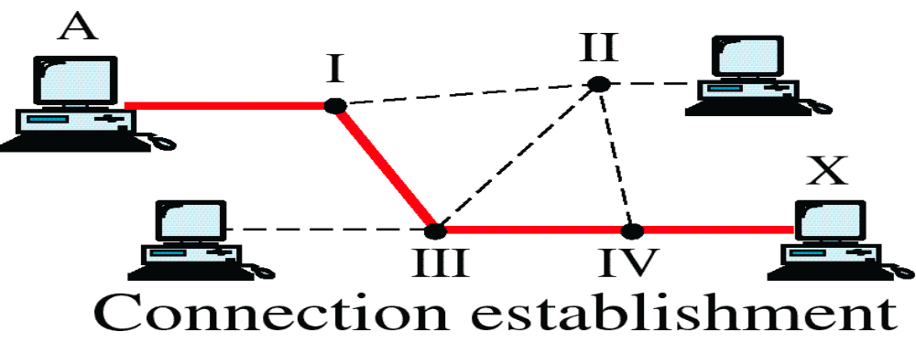
Packet Switching
19.<number>

Slide 16
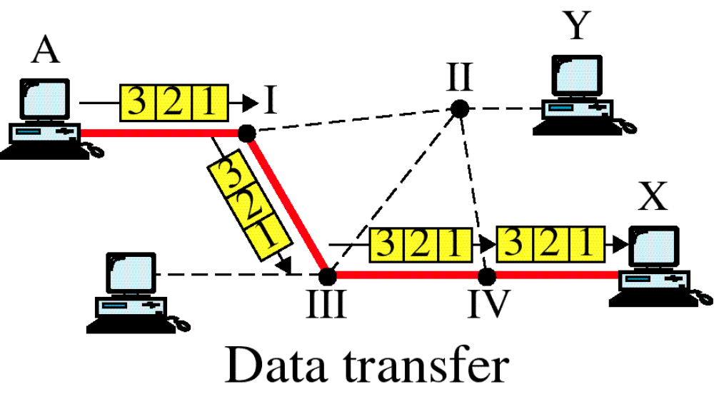
Packet Switching
19.<number>

Slide 17
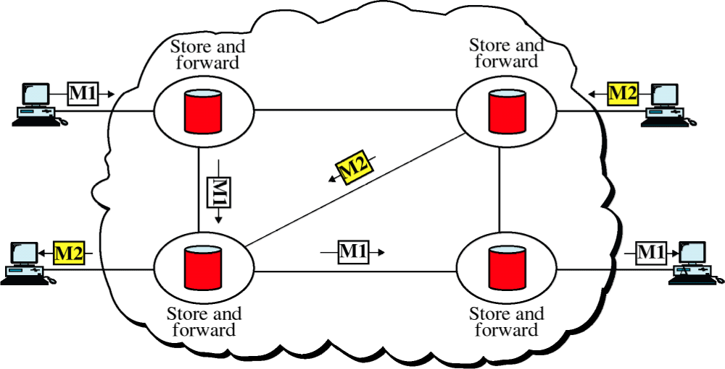
Packet Switching
19.<number>

Slide 18
19-1 IPv4 ADDRESSES
An IPv4 address is a 32-bit address that uniquely and universally defines the connection of a device (for example, a computer or a router) to the Internet.
The IP address is the address of the connection, not the host or the router, because if the device is moved to another network, the IP address may be changed.
19.<number>

Slide 19

Note
An IPv4 address is 32 bits long.
19.<number>

Slide 20
Note
The IPv4 addresses are unique
and universal.
19.<number>

Slide 21
Note
The address space of IPv4 is
2³² or 4,294,967,296.
19.<number>

Slide 22

Figure 19.1 Dotted-decimal notation and binary notation for an IPv4 address
19.<number>

Slide 23
Note
Numbering systems are reviewed in Appendix B.
19.<number>

Slide 24


Example 19.1
Change the following IPv4 addresses from binary notation to dotted-decimal notation.
Solution
We replace each group of 8 bits with its equivalent decimal number (see Appendix B) and add dots for separation.
19.<number>

Slide 25


Example 19.2
Change the following IPv4 addresses from dotted-decimal notation to binary notation.
Solution
We replace each decimal number with its binary equivalent (see Appendix B).
19.<number>

Slide 26

Example 19.3
Find the error, if any, in the following IPv4 addresses.
Solution
a. There must be no leading zero (045).
b. There can be no more than four numbers.
c. Each number needs to be less than or equal to 255.
d. A mixture of binary notation and dotted-decimal
notation is not allowed.
19.<number>

Slide 27
A 32-bit IPv4 address is also hierarchical , but divided into two parts;
prefix: the first part defining the network.
Suffix: the second part defining node (connection of a device to the internet)
n bits | 32-n
Prefix | Suffix
19.<number>

Slide 28
19-1 IPv4 ADDRESSES
A prefix can be fixed length o r variable length.
The Scheme which uses a fixed length prefix is called classful addressing.
The one with variable length is called classless addressing
19.<number>

Slide 29
Note
In classful addressing, the address space is divided into five classes:
A, B, C, D, and E.
19.<number>

Slide 30

Figure 19.2 Finding the classes in binary and dotted-decimal notation
19.<number>

Slide 31
Example 19.4
Find the class of each address.
a. 00000001 00001011 00001011 11101111
b. 11000001 10000011 00011011 11111111
c. 14.23.120.8
d. 252.5.15.111
Solution
a. The first bit is 0. This is a class A address.
b. The first 2 bits are 1; the third bit is 0. This is a class C
address.
c. The first byte is 14; the class is A.
d. The first byte is 252; the class is E.
19.<number>

Slide 32
Address Depletion
To alleviate address depletion, two strategies were proposed:
Sub-netting
Super-netting
Subnetting: In sub-netting, class A or B block is divided into several subnets. Each sub-net has a large prefix length than the original network.
If a network in class A is divided into four sbubets, each subnet has a prefix of nsub =10. at the same time,
if all of the addresses in a network are not used, subnetting allows the addresses to be divided among several orgnizations.
19.<number>

Slide 33
Address Depletion
Super-netting was devised to combine several class C blocks into a larger block to be attractive to organization that need more than the 256 addresses available in a class C block.
19.<number>

Slide 34

Table 19.1 Number of blocks and block size in classful IPv4 addressing
19.<number>

Slide 35
Note
In classful addressing, a large part of the available addresses were wasted.
19.<number>

Slide 36
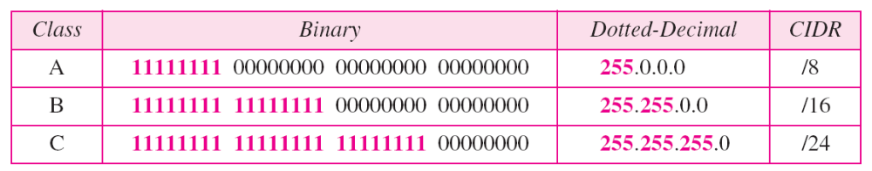
Table 19.2 Default masks for classful addressing
classless interdomain routing
(CIDR)
19.<number>

Slide 37
Note
Classful addressing, which is almost obsolete, is replaced with classless addressing.
19.<number>

Slide 38
Example 19.5
Figure 19.3 shows a block of addresses, in both binary and dotted-decimal notation, granted to a small business that needs 16 addresses.
We can see that the restrictions are applied to this block. The addresses are contiguous. The number of addresses is a power of 2 (16 = 2⁴), and the first address is divisible by 16. The first address, when converted to a decimal number, is 3,440,387,360, which when divided by 16 results in 215,024,210.
19.<number>

Slide 39
Classless Addressing
Sub-netting and super-netting in classful addressing did not really solve the address depletion problem.
ISP(Internet Service Provider) is an organization that provides Internet Access for individuals, small businesses and midsize organizations that do not want to create an Internet site and become involved in providing Internet services (such as electronic mail) for their employs.
19.<number>

Slide 40
Classless Addressing
In classless addressing, variable-length blocks are used that belong to no classes.
There can be a block of 1 address, 2 addresses, 4 addresses.
Theoretically, we can have a block of 20, 21……232 address.
19.<number>

Slide 41

Figure 19.3 A block of 16 addresses granted to a small organization
19.<number>

Slide 42
Note
In IPv4 addressing, a block of
addresses can be defined as
x.y.z.t /n
in which x.y.z.t defines one of the addresses and the /n defines the mask.
19.<number>

Slide 43
Note
The first address in the block can be found by setting the rightmost
32 − n bits to 0s.
19.<number>

Slide 44
Example 19.6
A block of addresses is granted to a small organization. We know that one of the addresses is 205.16.37.39/28. What is the first address in the block?
Solution
The binary representation of the given address is
11001101 00010000 00100101 00100111
If we set 32−28 rightmost bits to 0, we get
11001101 00010000 00100101 0010000
or
205.16.37.32.
This is actually the block shown in Figure 19.3.
19.<number>

Slide 45
Note
The last address in the block can be found by setting the rightmost
32 − n bits to 1s.
19.<number>

Slide 46
Example 19.7
Find the last address for the block in Example 19.6.
Solution
The binary representation of the given address is
11001101 00010000 00100101 00100111
If we set 32 − 28 rightmost bits to 1, we get
11001101 00010000 00100101 00101111
or
205.16.37.47
This is actually the block shown in Figure 19.3.
19.<number>

Slide 47
Note
The number of addresses in the block can be found by using the formula
2^{32−n}.
19.<number>

Slide 48
Example 19.8
Find the number of addresses in Example 19.6.
Solution
The value of n is 28, which means that number
of addresses is 2 ³²⁻²⁸ or 16.
19.<number>

Slide 49
Example 19.9
Another way to find the first address, the last address, and the number of addresses is to represent the mask as a 32-bit binary (or 8-digit hexadecimal) number. This is particularly useful when we are writing a program to find these pieces of information. In Example 19.5 the /28 can be represented as
11111111 11111111 11111111 11110000
(twenty-eight 1s and four 0s).
Find
a. The first address
b. The last address
c. The number of addresses.
19.<number>

Slide 50

Example 19.9 (continued)
Solution
a. The first address can be found by ANDing the given
addresses with the mask. ANDing here is done bit by
bit. The result of ANDing 2 bits is 1 if both bits are 1s;
the result is 0 otherwise.
19.<number>

Slide 51

Example 19.9 (continued)
b. The last address can be found by ORing the given
addresses with the complement of the mask. ORing
here is done bit by bit. The result of ORing 2 bits is 0 if
both bits are 0s; the result is 1 otherwise. The
complement of a number is found by changing each 1
to 0 and each 0 to 1.
19.<number>

Slide 52
Example 19.9 (continued)
c. The number of addresses can be found by
complementing the mask, interpreting it as a decimal
number, and adding 1 to it.
19.<number>

Slide 53
Figure 19.4 A network configuration for the block 205.16.37.32/28
19.<number>

Slide 54
Note
The first address in a block is
normally not assigned to any device;
it is used as the network address that represents the organization
to the rest of the world.
19.<number>

Slide 55

Figure 19.5 Two levels of hierarchy in an IPv4 address
19.<number>

Slide 56

Figure 19.6 A frame in a character-oriented protocol
19.<number>

Slide 57
Note
Each address in the block can be considered as a two-level
hierarchical structure:
the leftmost n bits (prefix) define
the network;
the rightmost 32 − n bits define
the host.
19.<number>

Slide 58

Figure 19.7 Configuration and addresses in a subnetted network
19.<number>

Slide 59

Figure 19.8 Three-level hierarchy in an IPv4 address
19.<number>

Slide 60
Example 19.10
An ISP is granted a block of addresses starting with 190.100.0.0/16 (65,536 addresses). The ISP needs to distribute these addresses to three groups of customers as follows:
a. The first group has 64 customers; each needs 256
addresses.
b. The second group has 128 customers; each needs 128
addresses.
c. The third group has 128 customers; each needs 64
addresses.
Design the subblocks and find out how many addresses are still available after these allocations.
19.<number>

Slide 61

Example 19.10 (continued)
Solution
Figure 19.9 shows the situation.
Group 1
For this group, each customer needs 256 addresses. This means that 8 (log2 256) bits are needed to define each host. The prefix length is then 32 − 8 = 24. The addresses are
19.<number>

Slide 62

Example 19.10 (continued)
Group 2
For this group, each customer needs 128 addresses. This means that 7 (log2 128) bits are needed to define each host. The prefix length is then 32 − 7 = 25. The addresses are
19.<number>

Slide 63

Example 19.10 (continued)
Group 3
For this group, each customer needs 64 addresses. This means that 6 (log₂64) bits are needed to each host. The prefix length is then 32 − 6 = 26. The addresses are
Number of granted addresses to the ISP: 65,536
Number of allocated addresses by the ISP: 40,960
Number of available addresses: 24,576
19.<number>

Slide 64

Figure 19.9 An example of address allocation and distribution by an ISP
19.<number>

Slide 65

Table 19.3 Addresses for private networks
19.<number>

Slide 66

Figure 19.10 A NAT implementation
19.<number>

Slide 67

Figure 19.11 Addresses in a NAT
19.<number>

Slide 68

Figure 19.12 NAT address translation
19.<number>

Slide 69

Table 19.4 Five-column translation table
19.<number>

Slide 70

Figure 19.13 An ISP and NAT
19.<number>

Slide 71
19-2 IPv6 ADDRESSES
Despite all short-term solutions, address depletion is still a long-term problem for the Internet. This and other problems in the IP protocol itself have been the motivation for IPv6.
Topics discussed in this section:
Structure
Address Space
19.<number>

Slide 72
Note
An IPv6 address is 128 bits long.
19.<number>

Slide 73

Figure 19.14 IPv6 address in binary and hexadecimal colon notation
19.<number>

Slide 74

Figure 19.15 Abbreviated IPv6 addresses
19.<number>

Slide 75

Example 19.11
Expand the address 0:15::1:12:1213 to its original.
Solution
We first need to align the left side of the double colon to the left of the original pattern and the right side of the double colon to the right of the original pattern to find how many 0s we need to replace the double colon.
This means that the original address is.
19.<number>

Slide 76

Table 19.5 Type prefixes for IPv6 addresses
19.<number>

Slide 77

Table 19.5 Type prefixes for IPv6 addresses (continued)
19.<number>

Slide 78

Figure 19.16 Prefixes for provider-based unicast address
19.<number>

Slide 79

Figure 19.17 Multicast address in IPv6
19.<number>

Slide 80

Figure 19.18 Reserved addresses in IPv6
19.<number>

Slide 81

Figure 19.19 Local addresses in IPv6
19.<number>

