Slide 1
Multiplexing & De-multiplexing
Multiplexing is the process in various data signals are integrated/combined together to a give single output.
Serial to parallel conversion is used in multiplexing.
De-multiplexing is a process in which one input data signal is divided into various signals.
It provides multiple output signals and takes one input signal only.
Parallel to serial conversion is used in de-multiplexers.
WCB/McGraw-Hill
© The McGraw-Hill Companies, Inc., 1998

Slide 2
Based-band and Broad/Band-pass Transmission &
Baseband Transmission: sending a digital signal over a channel without changing the digital signal to an analog signal.
It requires a low-pass-channel, a channel with a bandwidth that starts from zero.
The required band-with is proportional to the bit-rate; if we need to send bits faster, we more bandwidth.
WCB/McGraw-Hill
© The McGraw-Hill Companies, Inc., 1998

Slide 3
Based-band and Broad/Band-pass Transmission &
Broadband Transmission (modulation ): means changing the digital signal into analog signal for transmission. Modulation allows us to use a band-pass channel – a channel with a bandwidth that does not start from zero.
If the available channel is a band-pass channel, we cannot send the digital signal directly to the channel, we need to convert the digital signal to an analog signal before transmission.
WCB/McGraw-Hill
© The McGraw-Hill Companies, Inc., 1998

Slide 4
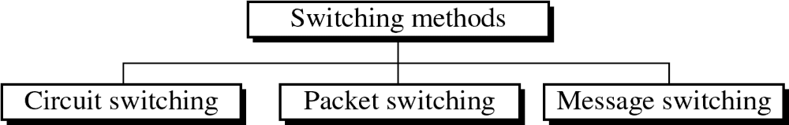
Figure 14-2
WCB/McGraw-Hill
© The McGraw-Hill Companies, Inc., 1998

Slide 5
Circuit Switching
Connection is created b/w src and dst by establishing a dedicated path b/w src & Dst. (Connection Creation)
Queuing: No queue is formed or required.
Message and Packets: There is one big entire data stream called a message.
Routing:
One single dedicated path exists between the source and destination.
Propagation delay: No
Transmission Capacity: Low
Sequencing order. Message arrives in Sequence.
Use Bandwidth: Wastage.
WCB/McGraw-Hill
© The McGraw-Hill Companies, Inc., 1998

Slide 6
Packet Switching
Links are created independently one by one between the nodes on the way.
Queue is formed.
The big message is divided into a small number of packets.
Packets follow the independent path to hold the destination.
Packets are addressed and sequencing is done as all the packets follow the independent route.
There exists propagation delay.
Transmission capacity is maximum.
Bandwidth is used to its maximum extent.
WCB/McGraw-Hill
© The McGraw-Hill Companies, Inc., 1998

Slide 7
Message Switching
Links are created independently one by one between nodes on the way.
Queues is formed .
There is one big entire data stream called a message.
Messages follow the independent route to reach a destination .
Messages are addressed as independent routes are established.
Propagation delay exists
Transmission capacity is maximum.
Bandwidth is used to its maximum extent.
WCB/McGraw-Hill
© The McGraw-Hill Companies, Inc., 1998

Slide 8
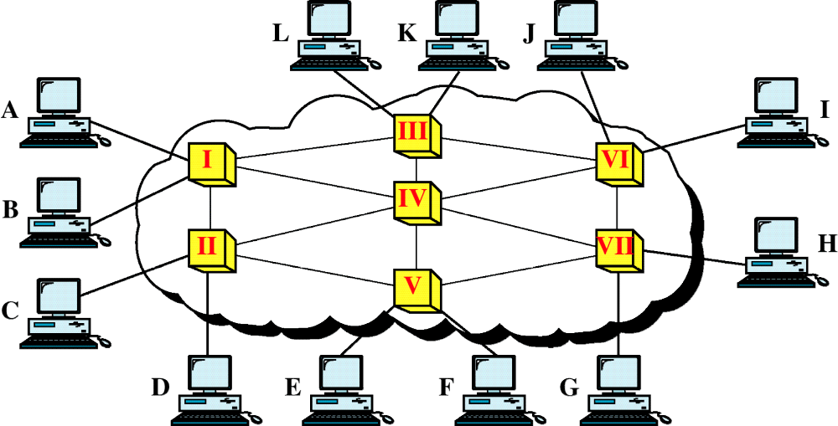
Figure 14-1
Switched Network
WCB/McGraw-Hill
© The McGraw-Hill Companies, Inc., 1998

Slide 9
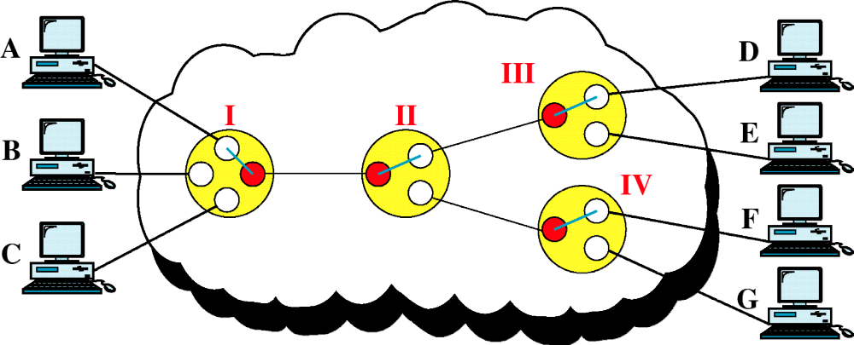
Figure 14-3
Circuit-Switched Network
WCB/McGraw-Hill
© The McGraw-Hill Companies, Inc., 1998

Slide 10
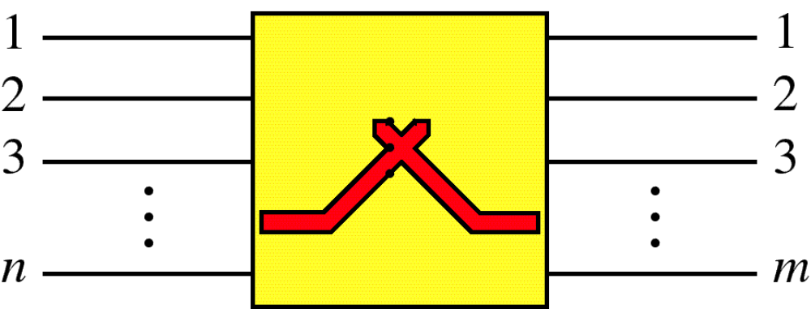
Figure 14-4
Switch
WCB/McGraw-Hill
© The McGraw-Hill Companies, Inc., 1998

Slide 11
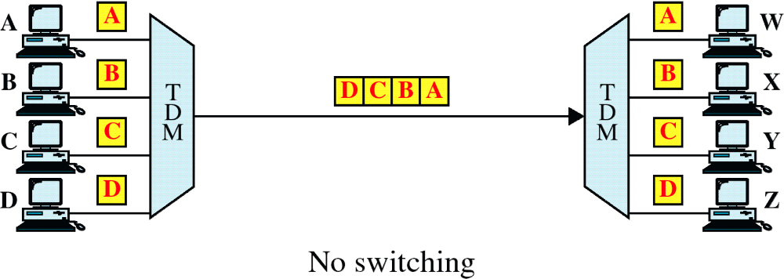
Figure 14-10
TDM without TSI
WCB/McGraw-Hill
© The McGraw-Hill Companies, Inc., 1998

Slide 12
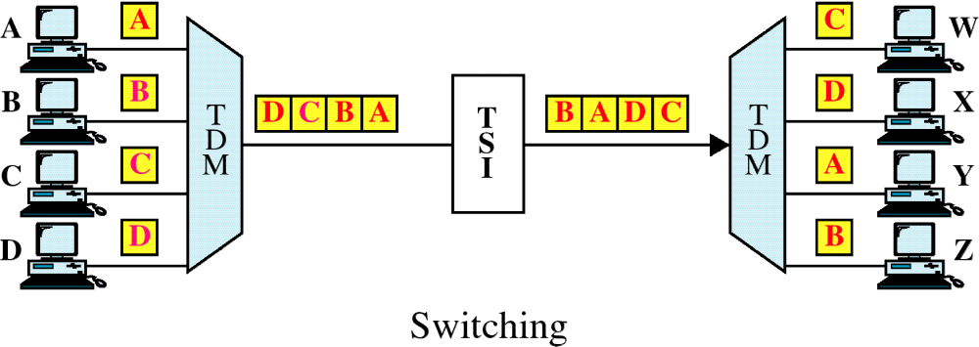
Figure 14-10-continued
TDM with TSI
WCB/McGraw-Hill
© The McGraw-Hill Companies, Inc., 1998

Slide 13
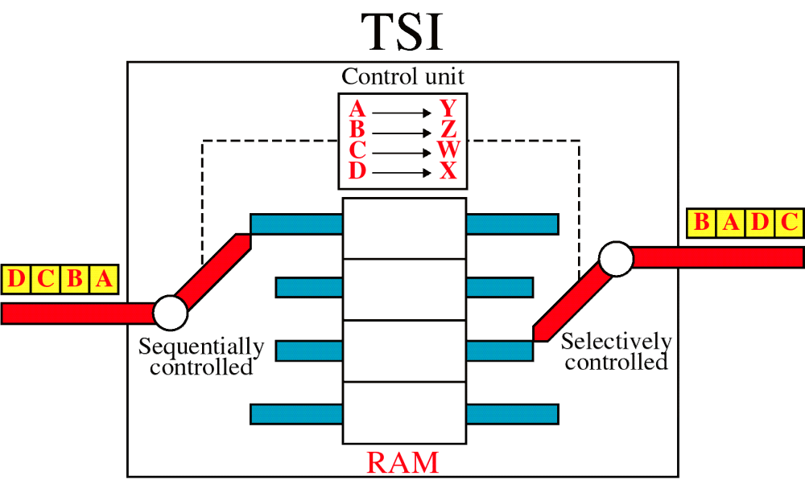
Figure 14-11
Time-Slot Interchange
WCB/McGraw-Hill
© The McGraw-Hill Companies, Inc., 1998

Slide 14
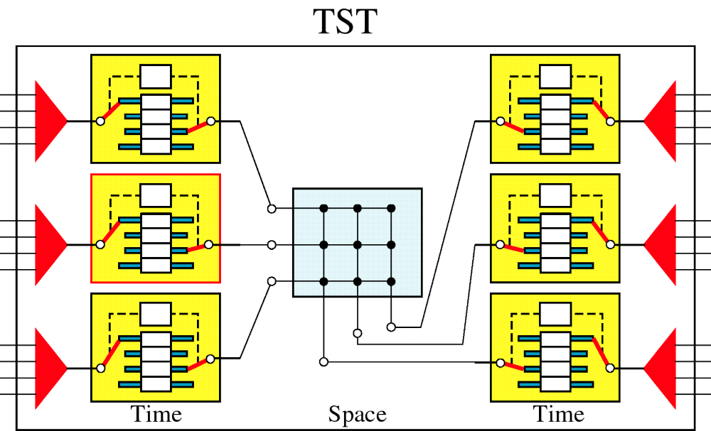
Figure 14-12
TST Switch
WCB/McGraw-Hill
© The McGraw-Hill Companies, Inc., 1998

Slide 15
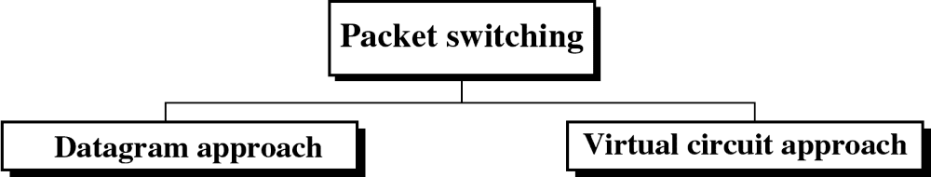
Figure 14-13
WCB/McGraw-Hill
© The McGraw-Hill Companies, Inc., 1998

Slide 16
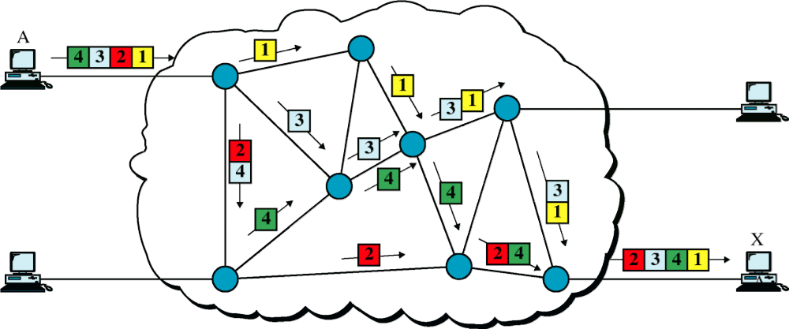
Figure 14-14
Datagram Approach
WCB/McGraw-Hill
© The McGraw-Hill Companies, Inc., 1998

Slide 17
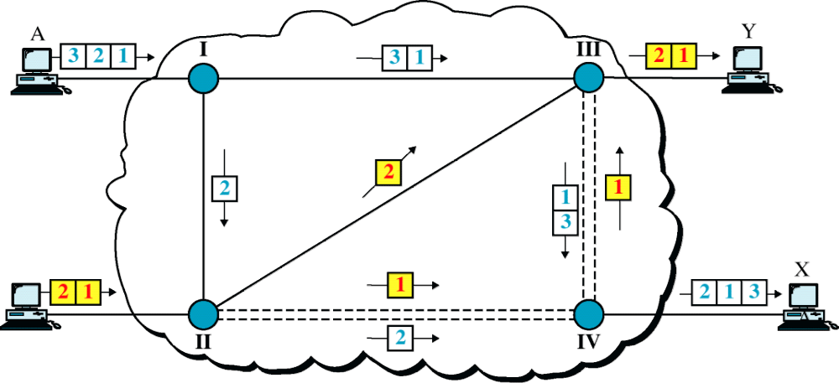
Figure 14-15
Datagram Approach, Multiple Channels
WCB/McGraw-Hill
© The McGraw-Hill Companies, Inc., 1998

Slide 18
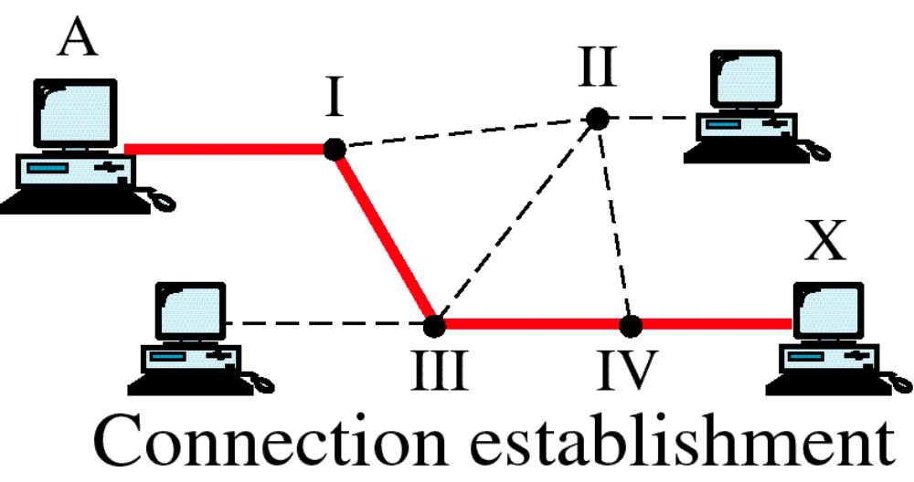
Figure 14-16
Switched Virtual Circuit
WCB/McGraw-Hill
© The McGraw-Hill Companies, Inc., 1998

Slide 19
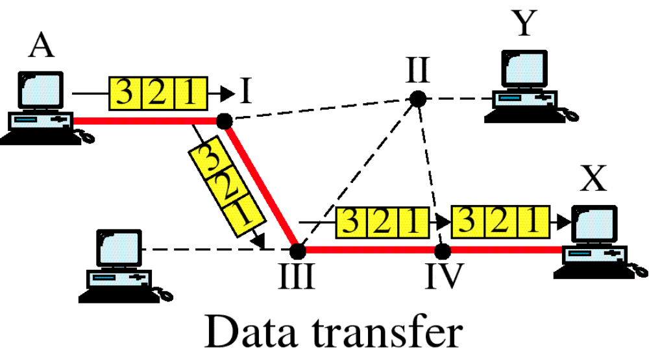
Figure 14-16-continued
Switched Virtual Circuit
WCB/McGraw-Hill
© The McGraw-Hill Companies, Inc., 1998

Slide 20
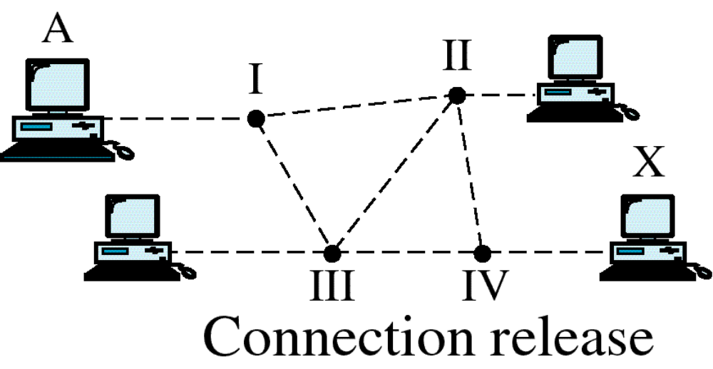
Figure 14-16-continued
Switched Virtual Circuit
WCB/McGraw-Hill
© The McGraw-Hill Companies, Inc., 1998

Slide 21
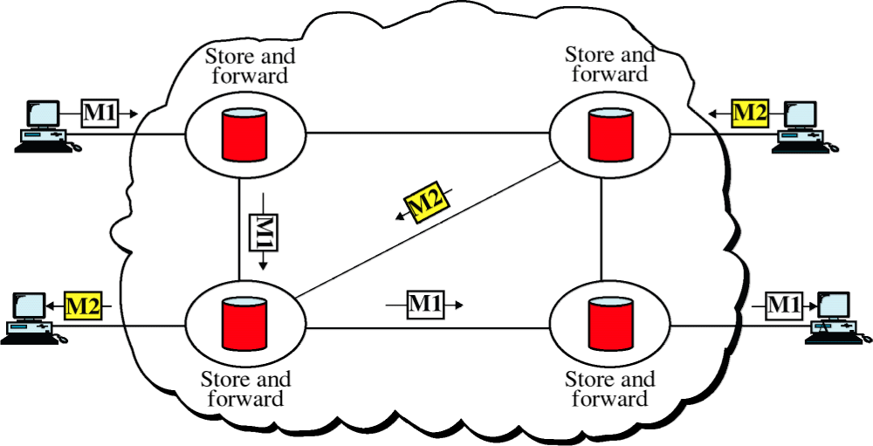
Figure 14-17
Message Switching
WCB/McGraw-Hill
© The McGraw-Hill Companies, Inc., 1998

