Slide 1
Image Super Resolution using Generative Adversarial Networks
學生: 黃羿衡
口試委員: 王益文 教授
陳德生 教授
許懷中 教授
口試時間: 2018/11/14

Slide 2
OUTLINE
Introduction
Related works
Methodology
Experiments
Conclusion
Reference

Slide 3
Introduction

Slide 4
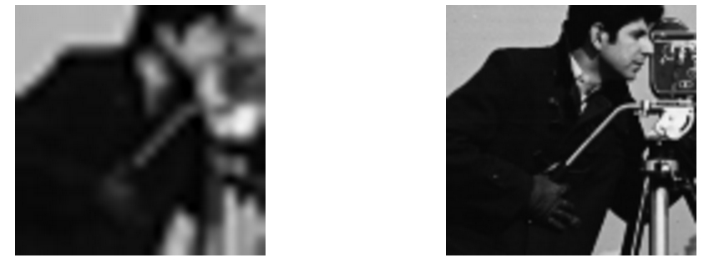
Introduction(01/30)
Super-resolution

Slide 5
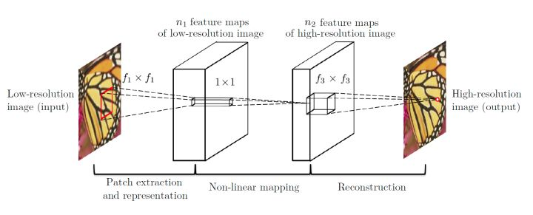
Related works(02/30)
SRCNN
Preprocessing (bicubic)
Extractor and representation
Non-linear mapping
Reconstruction

Slide 6
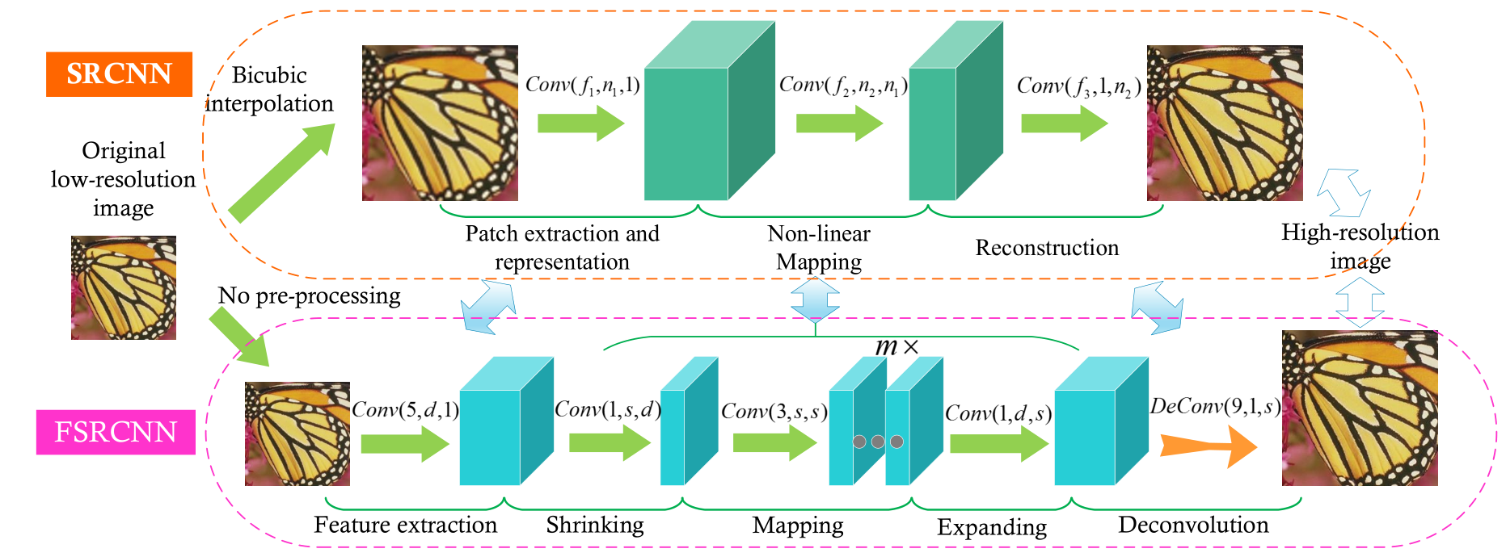
Related works(03/30)
FSRCNN
Shrink & Expand (feature concentrated or Expand)
Deconvolution (resizing smoothly)
Mapping (more layers)

Slide 7
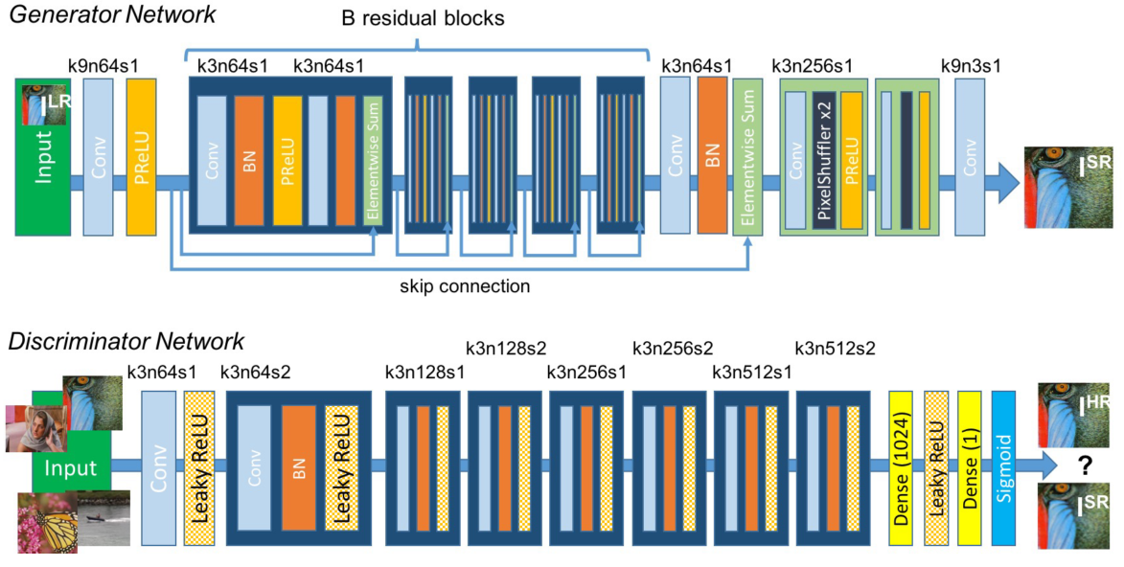
Related works(04/30)
SRGAN
Generator
Discriminator

Slide 8
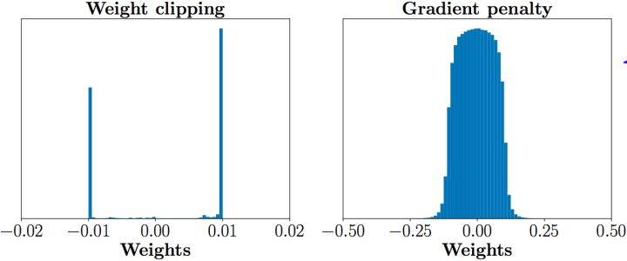
Related works(05/30)
WGAN
Discriminator
Wasserstein distance
Remove sigmoid output
Weight clipping
WGAN-GP
Discriminator
Gradient penalty

Slide 9
Methodology

Slide 10
Methodology(06/30)
My work
Architecture
Optimization
Loss function
Activation function
Weights regularization & normalization
Reconstruction

Slide 11
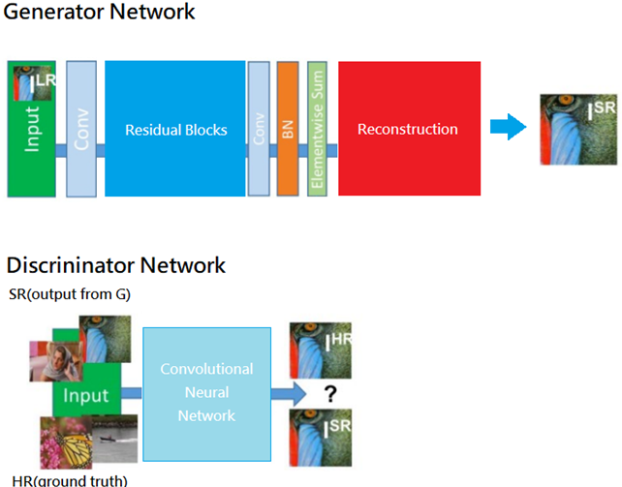

Methodology(07/30)
My work
Generator
Feature extractor
Non-linear mapping
Reconstruction
Discriminator
Critic
The purpose
$P_{G}$($x;θ$) => $P_{real}$($x;θ$)
Notes:
Error 趨勢圖來自此網址: http://www.cse.unsw.edu.au/~cs9417ml/MLP2/BackPropagation.html

Slide 12
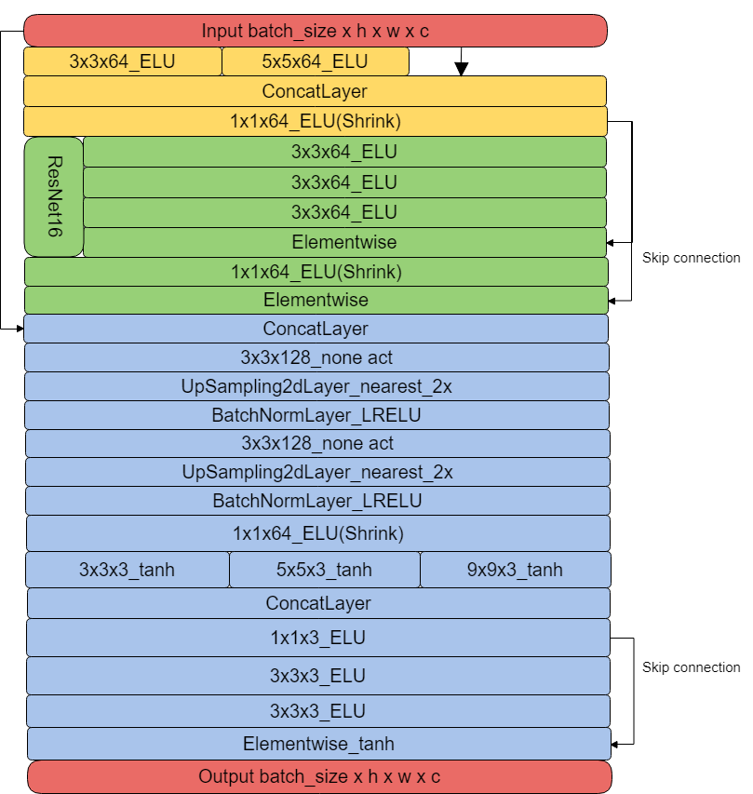
Methodology(08/30)
Architecture
Generator

Slide 13
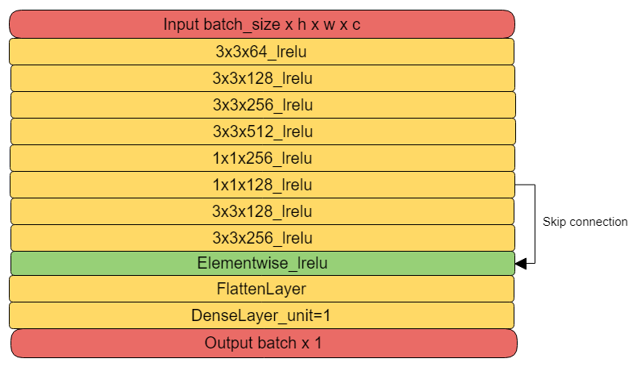
Methodology(09/30)
Discriminator

Slide 14
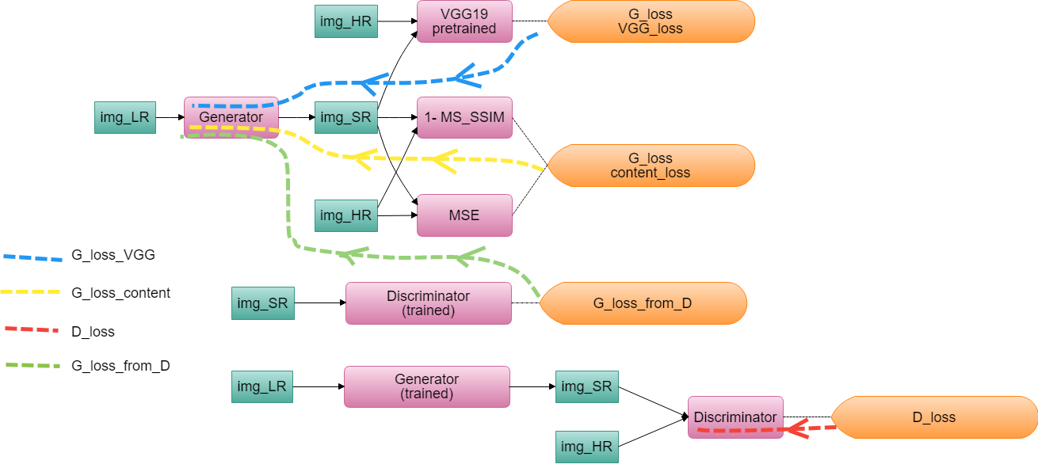
Methodology(10/30)
Optimization
Loss flow

Slide 15
Methodology(11/30)
Loss function
Discriminator
logistic_fake = D(SR)
logistic_real = D(HR)
D_loss = logistic_fake – logistic_real
D() : Discriminator function
SR : fake image from G
HR : real image Ground truth

Slide 16
Methodology(12/30)
G : Generator
D : Discriminator
SR : fake image from G
HR : real image Ground truth
Generator
VGG_loss
pre-trained VGG19 model
For calculate SR and HR difference
Content_loss
MSE loss
(1-SSIM)
(1-MS_SSIM)
From_D_loss = - logistic_fake
G_loss = VGG loss + Content_loss + from_D_loss

Slide 17
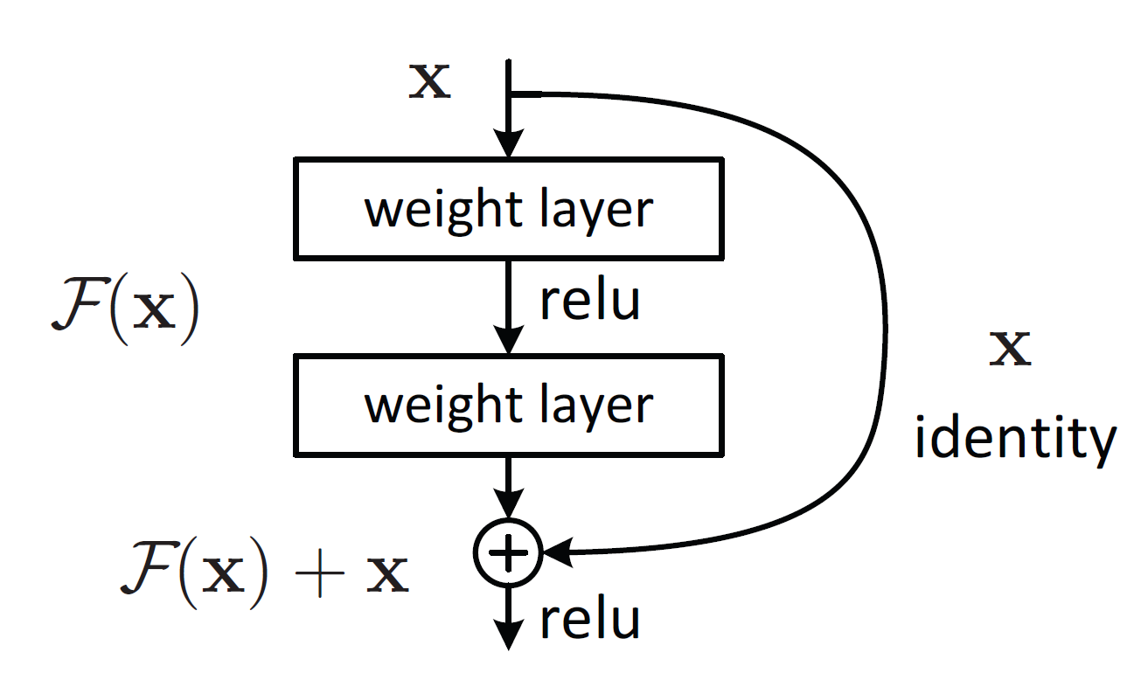
Methodology(13/30)
Residual block
Just learning residual
Shortcut
More than 2 layers

Slide 18
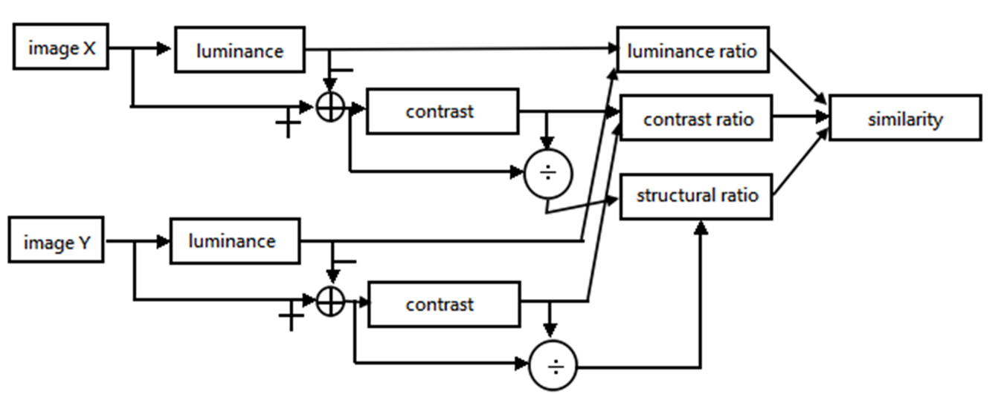
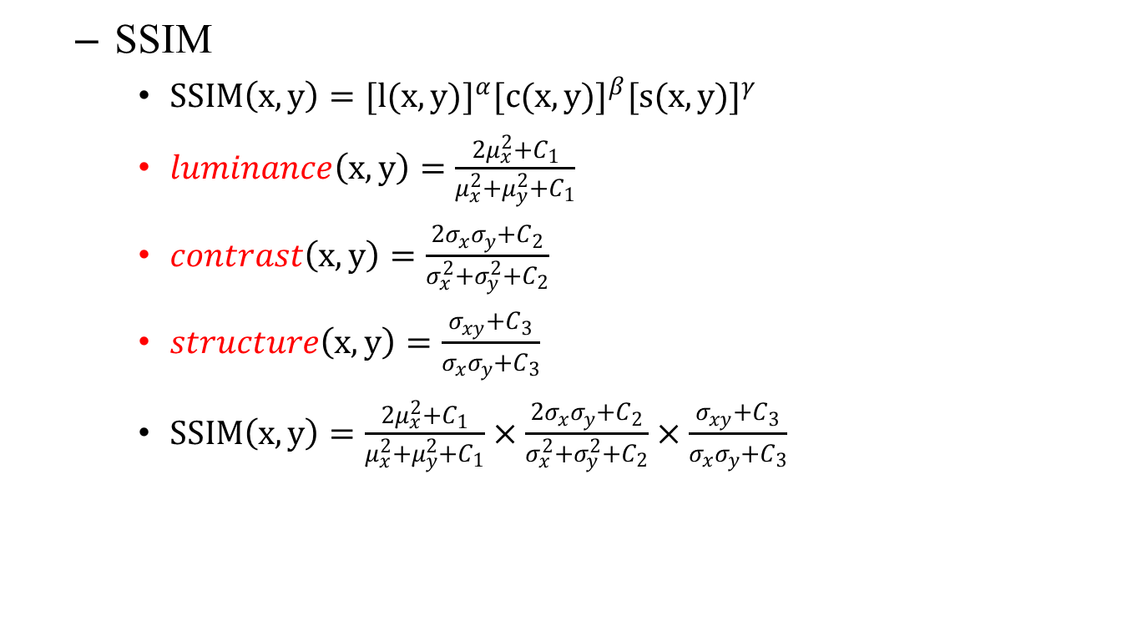
Methodology(14/30)
SSIM
$SSIM\left(x,y\right)={[l(x,y)]}^{α}{[c(x,y)]}^{β}{[s(x,y)]}^{γ}$
$luminance\left(x,y\right)=\frac{{2μ}_{x}^{2}+C_{1}}{μ_{x}^{2}+μ_{y}^{2}+C_{1}}$
$contrast\left(x,y\right)=\frac{2σ_{x}σ_{y}+C_{2}}{σ_{x}^{2}+σ_{y}^{2}+C_{2}}$
$structure\left(x,y\right)=\frac{σ_{xy}+C_{3}}{σ_{x}σ_{y}+C_{3}}$
$SSIM\left(x,y\right)=\frac{{2μ}_{x}^{2}+C_{1}}{μ_{x}^{2}+μ_{y}^{2}+C_{1}}×\frac{2σ_{x}σ_{y}+C_{2}}{σ_{x}^{2}+σ_{y}^{2}+C_{2}}×\frac{σ_{xy}+C_{3}}{σ_{x}σ_{y}+C_{3}}$

Slide 19
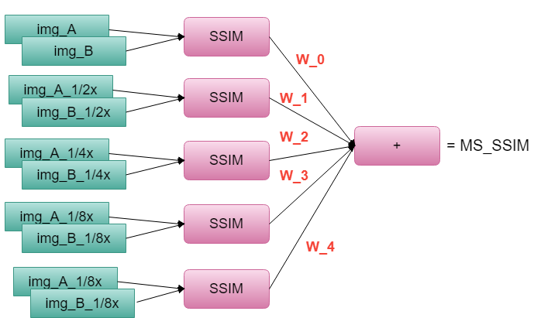
Methodology(15/30)
Multi-scale SSIM(MS_SSIM)
Base on SSIM
Multi-scale
Original size
1/2x
1/4x
1/8x
1/16x
w : weight

Slide 20
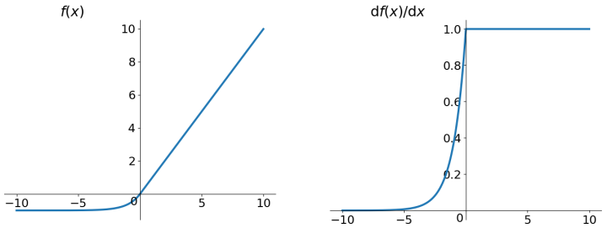
Methodology(16/30)
Activation function
Exponential Linear Units (ELU)
Bipolar
More non-linear
Zero-centered
More computing consumption
Notes:
Logistic function圖來自此Wiki網址: https://en.wikipedia.org/wiki/Logistic_function

Slide 21
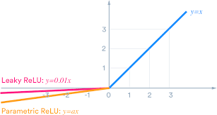
Methodology(17/30)
Leaky Rectifier Linear Unit (Leaky ReLU)
Bipolar
ReLU’s deformation
Adjustable y
Better capability of convergence than traditional ReLU

Slide 22
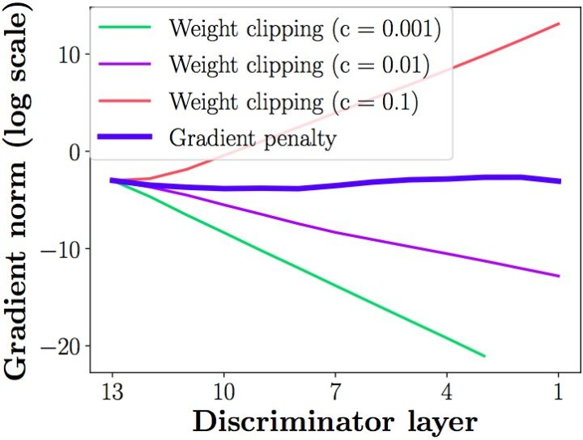
Methodology(18/30)
Weights regularization & normalization
Weights clipping
Limiting discriminator weights
Avoid gradient vanishing
The clipping range is difficult to handle
If weights limited is quite big
gradient explosion
Weights limited is small
gradient vanishing
Get a weak discriminator
All the weights become ultra (get closing 0 or max value)
Deteriorating to binary mapping

Slide 23


Methodology(19/30)
Gradient penalty
Lipschitz function :
ReLU$[{||∇_{x}D(x)||}_{p}−K]$
Limited discriminator gradient can not beyond K
Make a better discriminator
$$\left|f\left(x_{1}\right)−f\left(x_{2}\right)\right|≤K|x_{1}−x_{2}|$$

Slide 24
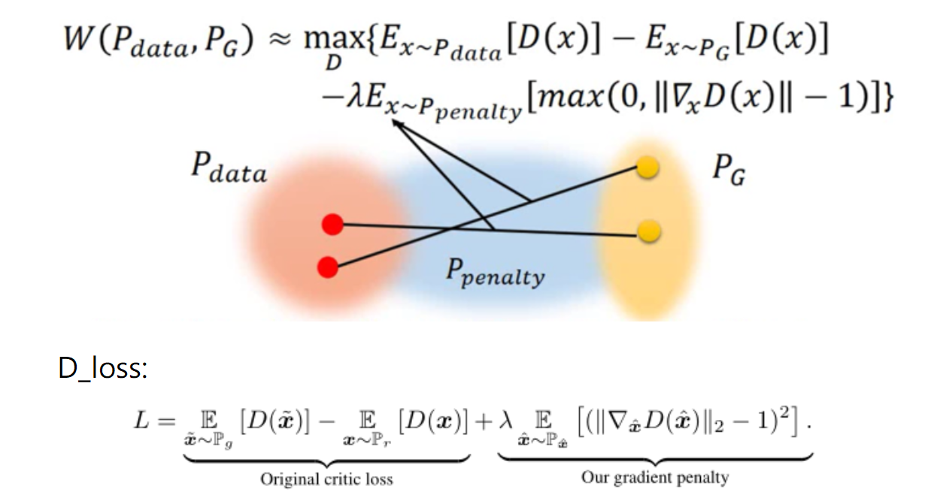
Methodology(20/30)

Slide 25

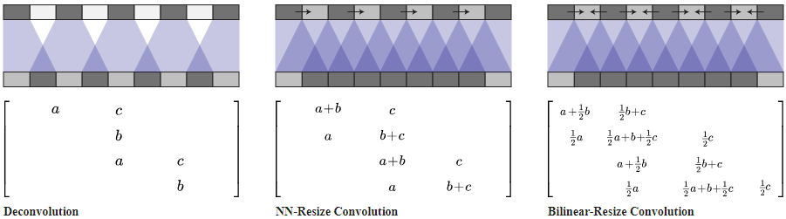
Methodology(21/30)
All
Deconv.
layers
Reconstruction
Resize convolution
Avoid checkboard artifacts
More quickly than deconvolution
Deconv.
with
last two layers
Resize
Conv.

Slide 26
Experiment

Slide 27

Experiment(22/30)
Common setting
Dataset
STL10(truck & ship)
896 pics for training
16 pics for validation
Parameter
Batch size : 16
Input size : 12x12
Output size : 48x48
Learning rate : ${10}^{−4}$
Learning rate decay : 0.1
Training epoch : 5000

Slide 28
Experiment(23/30)
My work
Loss function setting
Content loss
the first 200 epochs of training
using MSE loss
the other epochs
(1-MS_SSIM)
VGG loss
Input 224 -> 56
Using the first 4 conv. layers

Slide 29
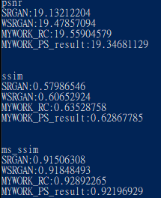

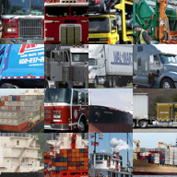
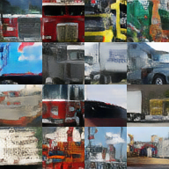
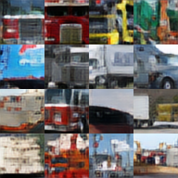
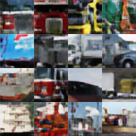
Experiment(24/30)
Comparing with difference Works
SRGAN
Wasserstein SRGAN(W-SRGAN)
My work
HR(GT)
SRGAN
WSRGAN
MYWORK_RC

Slide 30
Experiment(25/30)
Results
 | PSNR | SSIM | MS-SSIM | GMSD | Execution time
SRGAN | 19.1321 | 0.5798 | 0.9150 | 0.1481 | 0.8196s
W-SRGAN | 19.4785 | 0.6065 | 0.9184 | 0.1428 | 0.8777s
My Work | 19.5590 | 0.6352 | 0.9289 | 0.1394 | 0.8795s
SRGAN
WSRGAN
MYWORK_RC

Slide 31
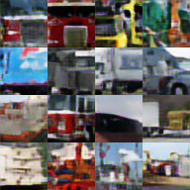
Experiment(26/30)
Comparing with different Reconstruction
Sub-pixel convolution(PS conv.)
Resize convolution(Resize conv.)
MYWORK_RC
HR(GT)
MYWORK_PS

Slide 32
Experiment(27/30)
Results
 | PSNR | SSIM | MS-SSIM | GMSD | Execution time
PS conv. | 19.346 | 0.6286 | 0.9219 | 0.1494 | 0.7620s
Resize conv. | 19.559 | 0.6352 | 0.9289 | 0.1394 | 0.8795s
MYWORK_PS
MYWORK_RC

Slide 33
Conclusion

Slide 34
Conclusion(28/30)
PROS.
New idea
Getting a little improvement
CONS.
SSIM series loss
Needs some constrain
Needs more network capability
More dependence relation with VGG loss than MSE

Slide 35
Reference

Slide 36
Reference(29/30)
Chao Dong, Chen Change Loy, Kaiming He, Xiaoou Tang."Image Super-Resolution Using Deep Convolutional Networks" Image, Video, and Multidimensional Signal Processing Workshop (IVMSP)， 2015.
Ian J. Goodfellow, Jean Pouget-Abadie, Mehdi Mirza, Bing Xu, David Warde-Farley, Sherjil Ozair, Aaron Courville, Yoshua Bengio. “Generative Adversarial Networks” 2014.
Christian Ledig, Lucas Theis, Ferenc Huszar, Jose Caballero, Andrew Cunningham, Alejandro Acosta, Andrew Aitken, Alykhan Tejani, Johannes Totz, Zehan Wang, Wenzhe Shi. “Photo-Realistic Single Image Super-Resolution Using a Generative Adversarial Network”Computer Vision and Pattern Recognition (CVPR), 2017.
Karen Simonyan, Andrew Zisserman. “Very Deep Convolutional Networks for Large-Scale Image Recognition” Pattern Recognition (ACPR), 2015.

Slide 37
Reference(30/30)
Alex Krizhevsky ,Ilya Sutskever, Geoffrey E. Hinton.“Imagenet classification with deep convolutional neural networks” Advances in Neural Information Processing Systems ， 2012.
Jonathan Long, Evan Shelhamer, Trevor Darrell “Fully Convolutional Networks for Semantic Segmentation” IEEE Transactions on Pattern Analysis and Machine Intelligence.， 2016.
Ishaan Gulrajani, Faruk Ahmed, Martin Arjovsky, Vincent Dumoulin, Aaron Courville ” Improved Training of Wasserstein GANs ” , 2017
Zhou Wang, Eero P. Simoncelli and Alan C. Bovik Multi-scale ” Structural Similarity for Image Quality Assessment ” 2003.

Slide 38
Thanks for Your Attention

