Slide 1
ChatProfit: WhatsApp Group Monetization (Analysis, Insights, and Recommendations)
The Analytics Team:
Blessedsarah Omolola, Damilare Adefowope, Diseph Dum

Slide 2
Project overview
ChatProfit, a WhatsApp Group Monetization Platform, designed to facilitate connections between advertisers and WhatsApp Group Admins, enabling targeted advertising in niche communities.
Objective: Help ChatProfit’s Team identify key insights and data requirements to guide the initial platform setup and ensure product-market fit.

Slide 3

Problem STATEMENT
WhatsApp group admins and advertisers struggle to find effective, user-friendly ways to monetize group engagement without disrupting the user experience.
CORE ISSUES:
Limited Monetization Options for Admins
Advertisers face high costs and limited options to target niche communities effectively within WhatsApp
Ad fatigue and privacy concerns for members

Slide 4
Market Research
Market Trends: The digital ad market is projected to grow from $300 billion in 2022 to $720 billion by 2030, with increased adoption of social platforms for commerce.
WhatsApp Usage: WhatsApp’s 2.7 billion users make it a growing channel for informal commerce and advertising.

Slide 5
Methodology
We conducted a structured survey targeting three key segments:
Group Members: Individuals active in WhatsApp groups who interact with in-group content.
Group Owners/Admins: Managers of WhatsApp groups with a focus on growth and engagement.
Business Owners/Advertisers: Brands and individuals looking to advertise within WhatsApp groups.
Responses Collected: 126 total responses (49 members, 37 admins, 40 advertisers)

Slide 6
Group Member Insights: Demographics & Interests
Demographic Overview:
Majority are within the 18-34 age range, indicating a tech-savvy audience comfortable with online and social interactions.
Breakdown:
18-24 years: 15 respondents
25-34 years: 25 respondents
35+ years: Minor representation

Slide 7
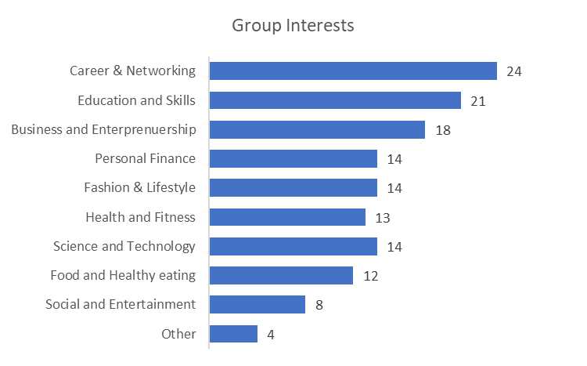
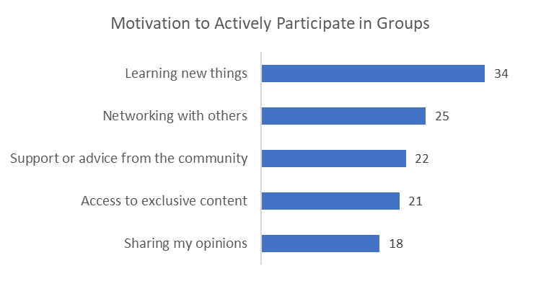
Group Member Insights: Interests & MOTIVATION
Key motivations include learning things, networking, and personal/professional growth

Slide 8
Group Member Insights: Ad Perception & Engagement
Attitudes toward Ads:
Group members are open to ads, especially when relevant to their interests or the group’s theme (e.g., tech ads in tech groups).
Preferred Formats:
Text and image ads are favored over video, as they are non-intrusive.
Engagement Willingness:
Members are more likely to interact with ads that genuinely add value. Ad fatigue is a common concern.

Slide 9
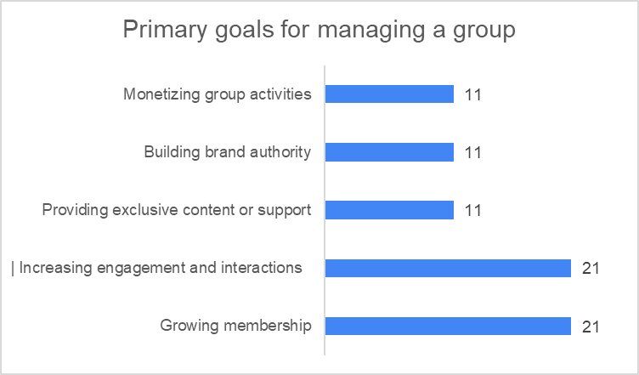
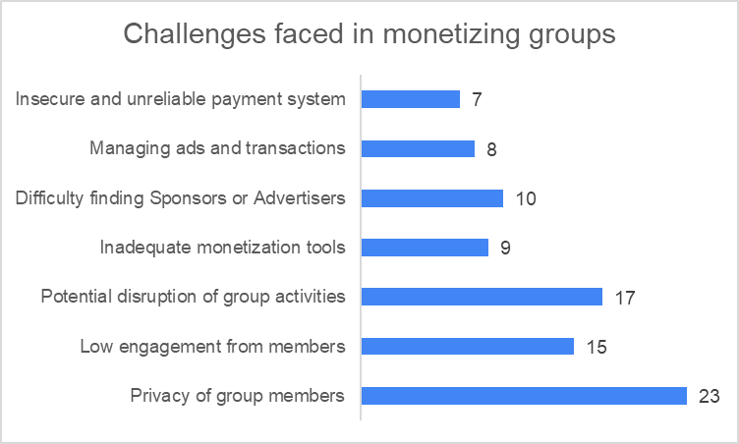
Group Admin Analysis: Goals & Challenges
Primary Goals: Growing membership and increasing group engagement are the top priorities for admins.
Challenges: Privacy concerns and balancing monetization without disrupting group interactions.

Slide 10
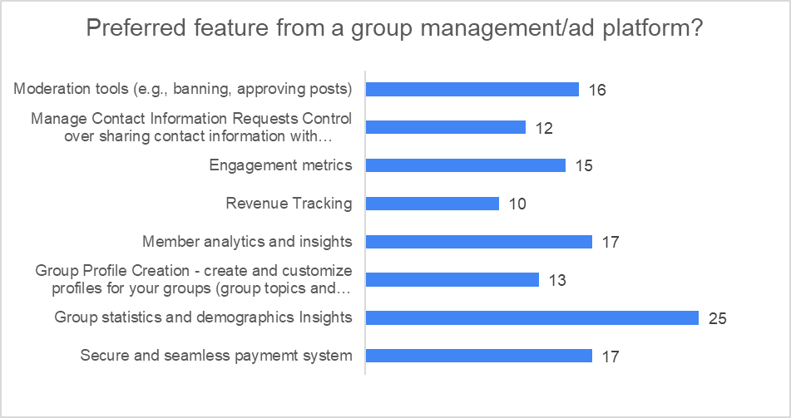
Group Admin Preferences
Ad Preferences: Admins prefer relevant ads that match the group’s purpose; sponsored content is also welcome if it aligns well.
Desired Platform Features: Group statistics, a secure payment system, and member analytics to better understand and engage with members

Slide 11
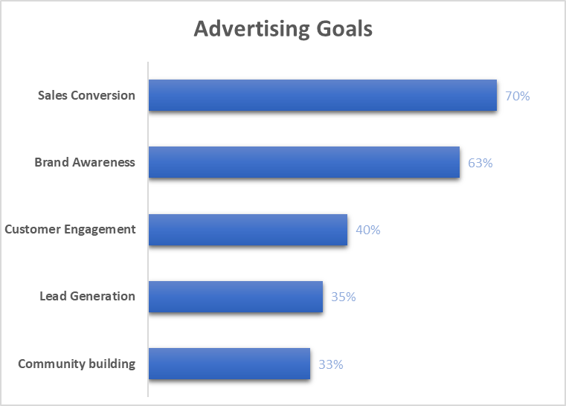
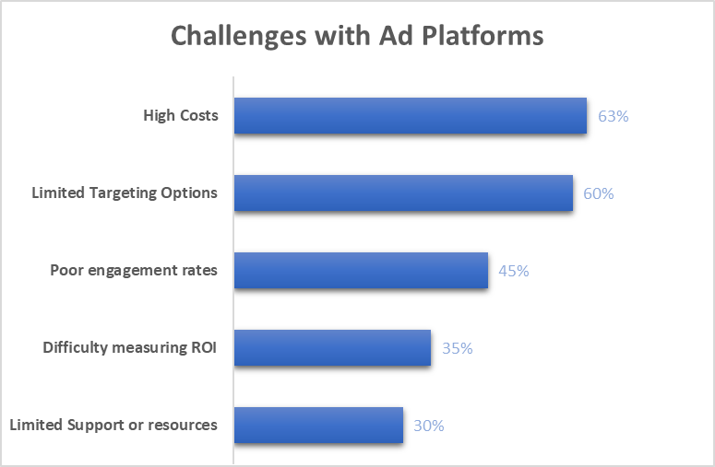
Advertiser Insights: Goals & Challenges
Goals: Prioritize conversions and brand awareness.
Challenges: High advertising costs and limited targeting options on existing platforms.

Slide 12
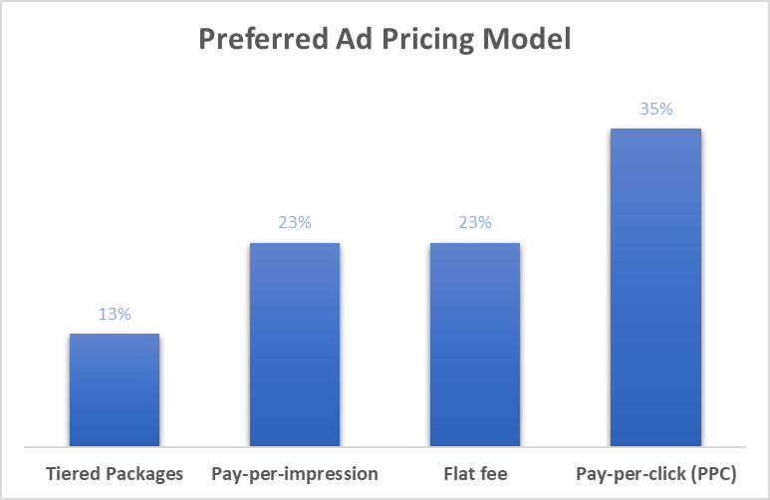
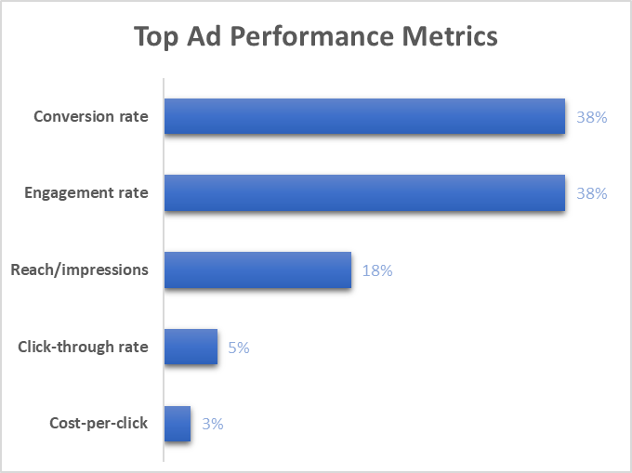
Advertiser Preferences
Pricing Model: Pay-per-click (PPC) is the most popular but not strongly preferred, suggesting room for alternative models.
Key Metrics: Conversion and engagement rates are the primary metrics for ad performance, showing that advertisers value measurable engagement.

Slide 13
Advertiser Preferences
Feature Preference Engagement metrics and Audience analytics are the primary preferred feature

Slide 14
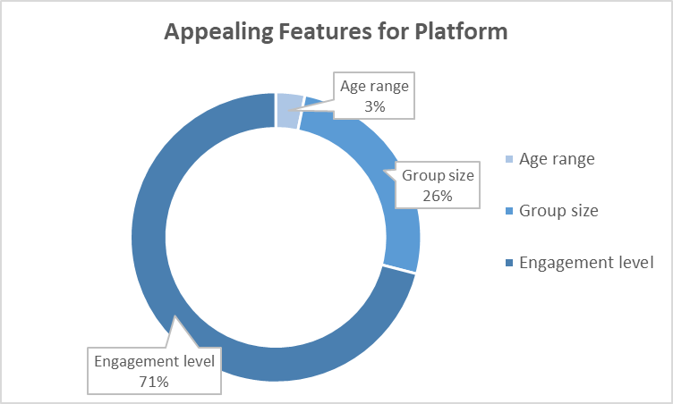
ADVERTISER INTEREST FACTORs
Group engagement level and size are crucial indicators for advertisers, with less focus on age demographics.

Slide 15
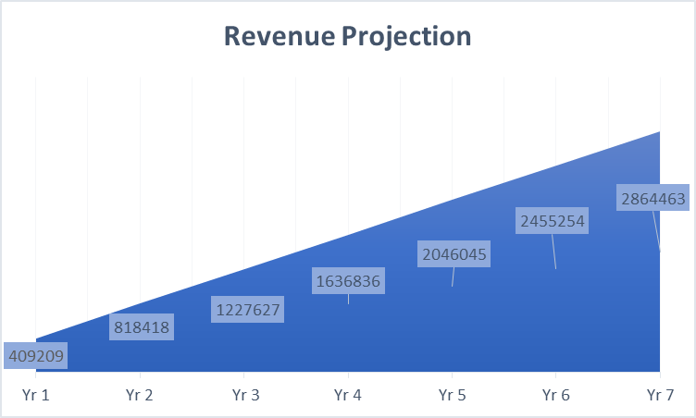
REVENUE PROJECTION
Based on the survey data and our estimated advertising model, all things being equal, the projected revenue for the platform is approximately ₦410,000 in the first year, with a forecasted increase of 85% over seven years. This projection reflects the potential for our startup to capture a substantial share of the social advertising market as it matures.

Slide 16
KEY RECOMMENDATIONS
For Group Admins:
Focus on engagement-driven advertising that encourages interactions while being mindful of group privacy.
Implement unobtrusive ads and sponsored posts that integrate seamlessly with group discussions.
For Advertisers:
Provide flexible pricing options to cater to various budgets and objectives.
Develop insights on high-engagement groups to optimize ad placements and improve results.
Offer a support system that addresses advertiser pain points, including measuring returns and assistance with ad optimization.

Slide 17
CONCLUSION
Summary
NEXT STEP
Develop key platform features based on user feedback.
Refine ad placement options and expand advertiser reach to support ChatProfit’s growth and market impact.
The survey shows a positive response to monetization through relevant, non-intrusive ads. By prioritizing user-friendly features, targeted ad placements, and engagement insights, ChatProfit can meet the needs of group admins and advertisers.

Slide 18
THANK YOU!

