Slide 1
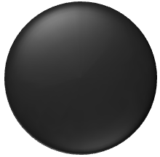
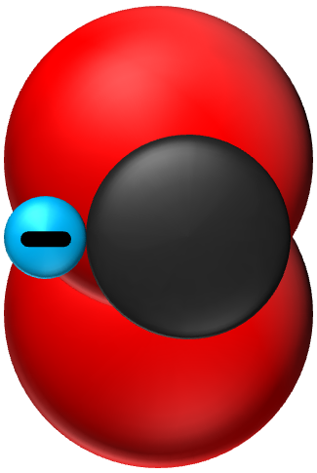
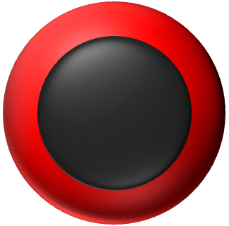
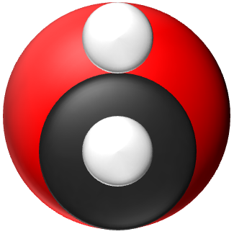
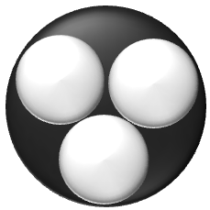
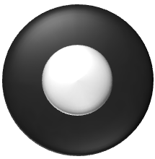
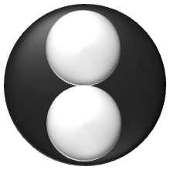
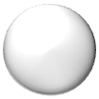
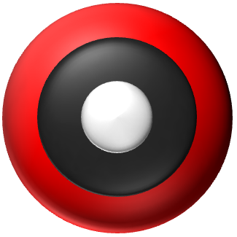
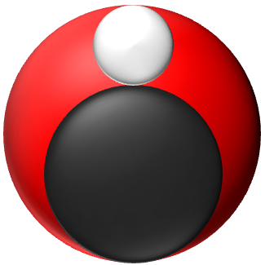
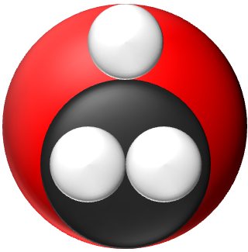

Slide 2
Acetyl-CoA: CoA-S-(C=O)-CH3
Oxaloacelate: COO—CH2-(C=O)-COO⁻
Citrate: COO—-CH2-((C-OH)-COO—)-CH2-COO—

Slide 3
Citrate
Alpha-Ketoglurate
COO—-CH2-((C-OH)-COO—)-CH2-COO—
COO—-(C=O)-CH2-CH2-COO—
Iso-Citrate
Succinyl-CoA
COO—-(CH-OH)-(CH-COO—)-CH2-COO—
(COA-SH)-(C=O)-CH2-CH2-COO—

Slide 4
Succinyl-CoA
Succinate
COO—-CH2-CH2-COO—
Fumerate
COO—-CH-CH-COO—
(COA-S)-(C=O)-CH2-CH2-COO—
Malate
Succinate
COO—-CH2-(CH-OH)-COO—
Oxaloacetate
COO—-CH2-(C=O)-COO—
COO—-CH2-CH2-COO—

Slide 5
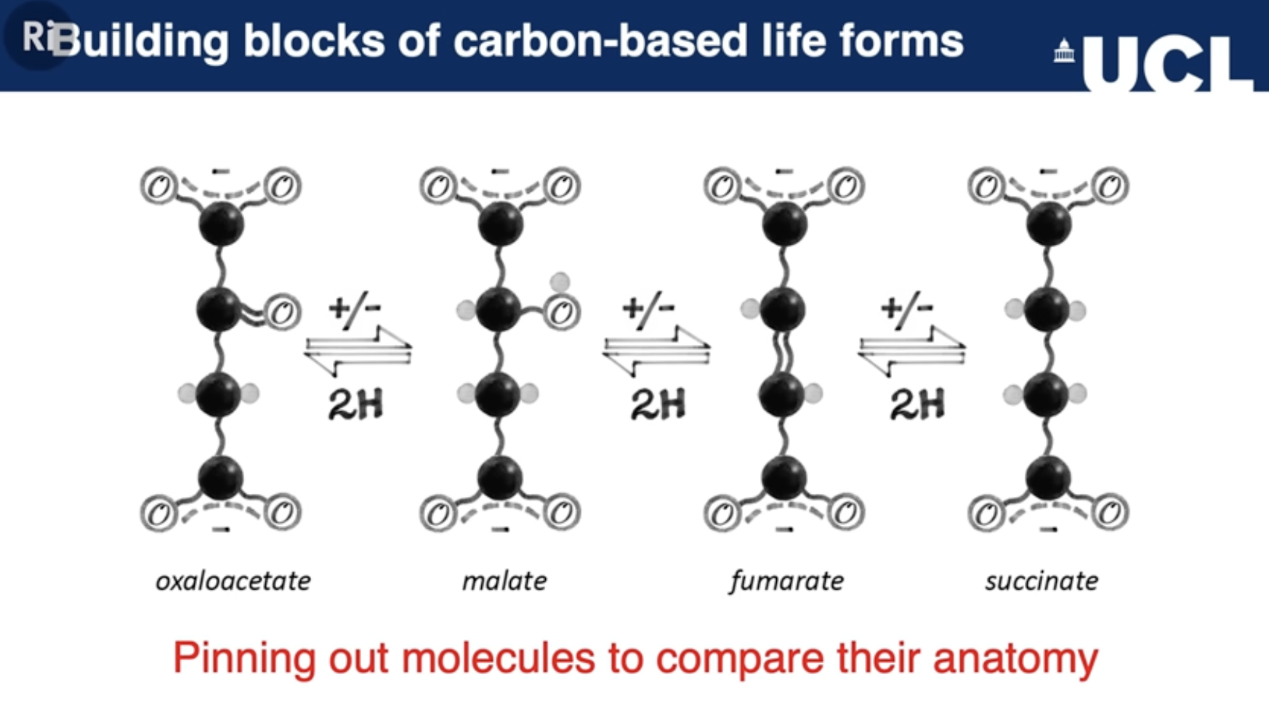

Slide 7
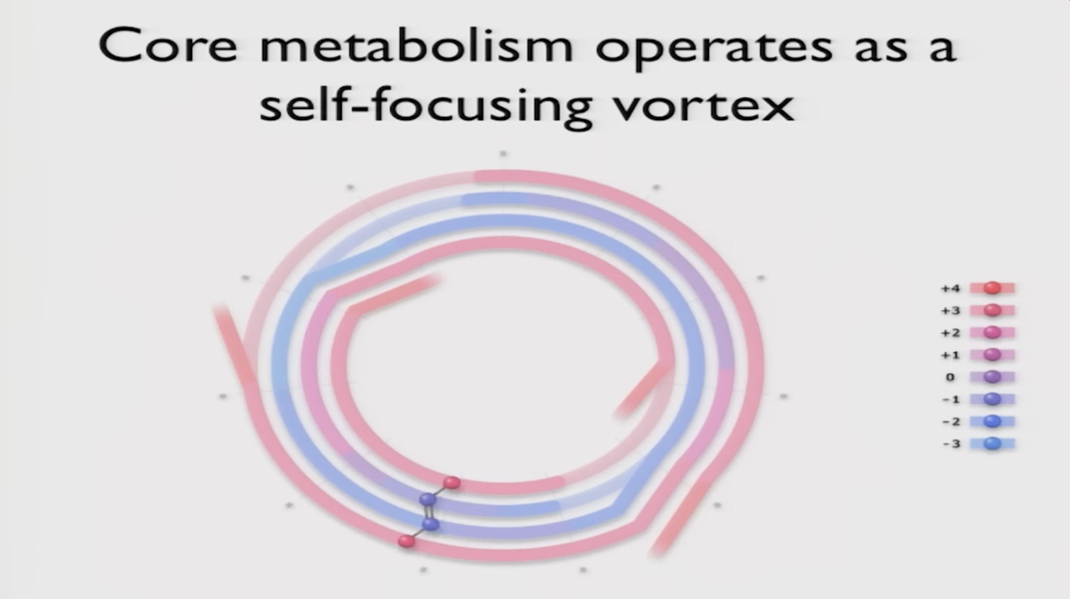

Slide 9
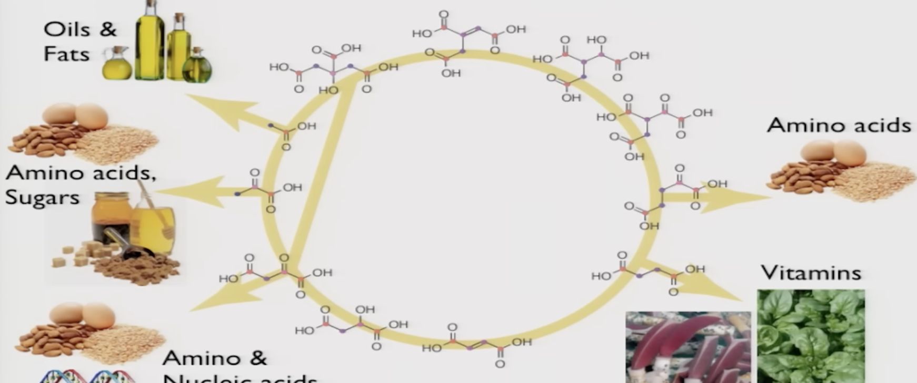
Citrate:
(COO-)-CH2-(OH-C-COO-)-CH2-COO-
Oxalsäure (Kleesäure):
COOH-COOH
Oxaloacetic acid (Oxalacetat):
COOH-CH-CH-COOH
Fumeric acid (Fumarsäure):
COOH-CH-CH-COOH
Succinic acid (Bernsteinsäure):
COOH-CH2-CH2-COOH

Slide 10
Glucose:
COH-HCOH-HOCH-HCOH-HCOH-CH2OH
Fructose:
CH2OH-(C=O)-HOCH-HCOH-HCOH-CH2OH
Pyruvic acid:
CH2OH-(C=O)-HOCH-HCOH-HCOH-CH2OH
Oxalsäure (Kleesäure):
COOH-COOH
Citrate:
(COO-)-CH2-(OH-C-COO-)-CH2-COO-
Oxaloacetic acid (Oxalacetat):
COOH-CH-CH-COOH
Fumeric acid (Fumarsäure):
COOH-CH-CH-COOH
Succinic acid (Bernsteinsäure):
COOH-CH2-CH2-COOH

Slide 11
Citrate:
(COO-)-CH2-(OH-C-COO-)-CH2-COO-
Fumeric acid (Fumarsäure):
COOH-CH-CH-COOH
Succinic acid (Bernsteinsäure):
COOH-CH2-CH2-COOH

