Slide 1




Slide 2


Meet The Group
Aadrika Singh 221210001
Abhidnya Brahmankar 221210003
Aditya Ray 221210010
Aditya Shaurya 221210012
Anandita Sharma 221210018

Slide 3

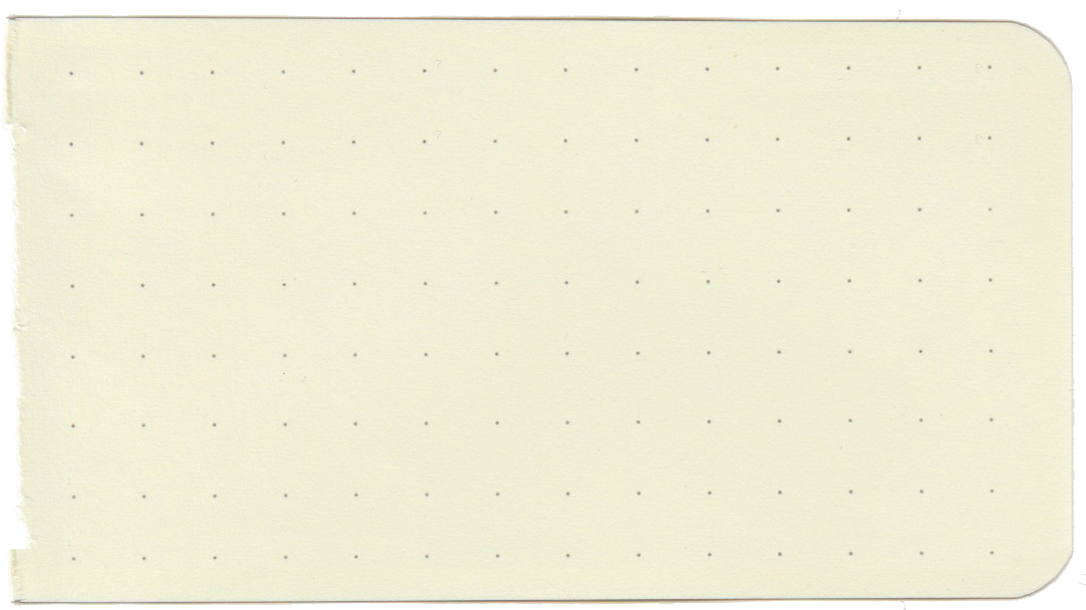


Introduction
Word guessing game
Guess a 5 letter word
You have 6 chances
The program provides feedback on the similarity between the user's word and the word to be guessed

Slide 4

Implementation
Tool used: Backend programming language C
Utilizes a random word generator to select a 5-letter word from
text file
Program compares the letters in the user's word with the original word
The program indicates which letters in the user's word match the letters
of the original word and their correct positions

Slide 5
Algorithm
Compares the letters of the guessed word with the target word,
Identifies correctly guessed letters in the correct position and letters that
are present in the word but in the wrong position
It then prints the guessed word with different colors to indicate
the correctness of the guessed letters.
The game continues until the word is found and until the player runs out
of tries

Slide 6
Interactive Interface
Green: For correct letter and its correct position
Yellow : If the letter is present the word at any position
The visiual feedback assists the userin narrowing down their options
and making more informed guesses

Slide 7


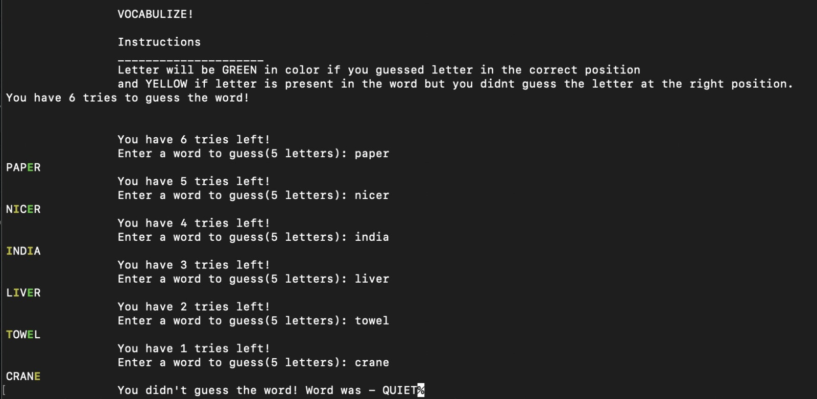
Output

Slide 8
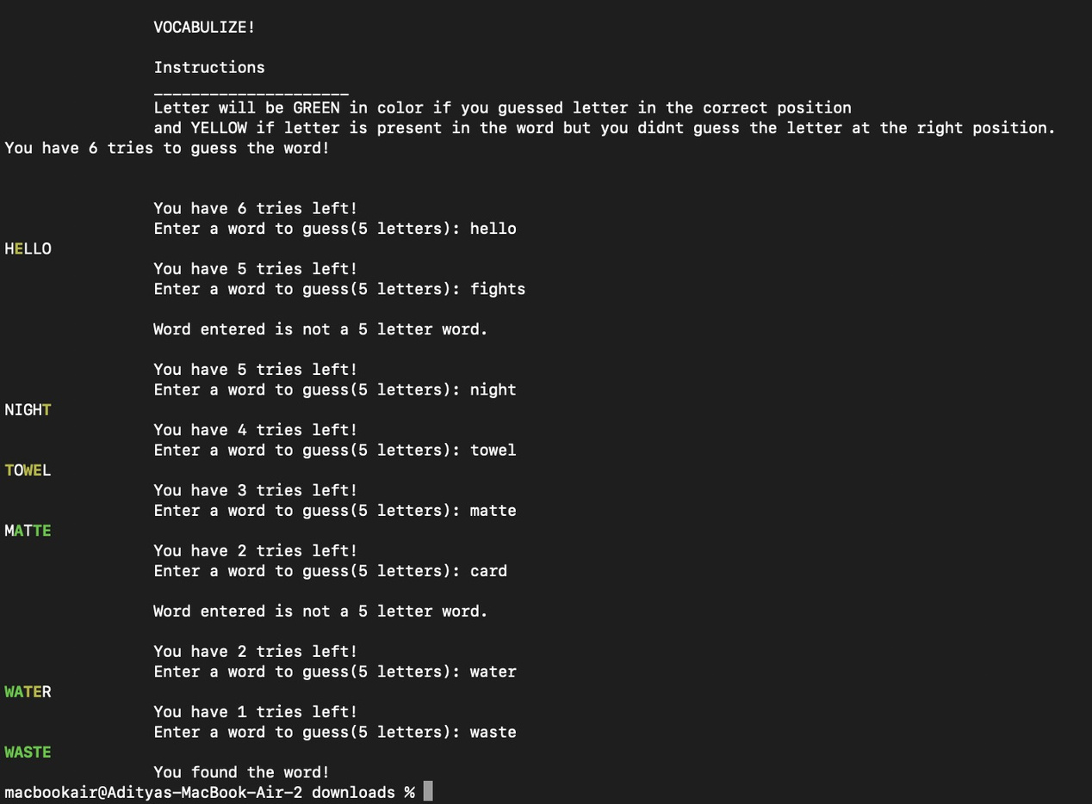
Output

Slide 9

Motivation
Educational value
Skill Development
Entertainment and casual gaming
The game is of significant educational value for non-native English speakers aspiring to hone and enhance their linguistic skills
Helps players improve their vocabulary but word recognition, and problem-solving skills..
Encourages players to think critically and analyse patterns, fostering mental agility and linguistic abilities.
Task Name
One primary motivation for creating Vocabulize is to provide users with an enjoyable and engaging gaming experience.
It can cater to players looking for a quick, casual gaming experience.
Task Name

Slide 10
Future Scope
01
Game Expansion : Introducing new game modes,difficulty levels,and word categories
02
Platform Diversification : Developing mobile application for iOS and Android
Task Name
03
Social Features Enhancement : Include more social features such as leaderboards,
multiplayer competitions,and the ability to challenge friends
04
Customization and personalization: Adding customization options like themes,avatars
Task Name
05
Integration with learning platforms: Collaborating with online platforms or
educational institutions

Slide 11
Conclusion
Provides an entertaining and challenging experience for players.
Engages the player's critical thinking and word recognition skills.
With its simple and intuitive interface, Vocabulize offers an enjoyable gaming experience for users of all ages.

Slide 12
References
E., Balaguruswamy, and Balaguruswamy E. Prgramming in ANSI-C. Prenticehall of India Pvt. Ltd., 1996.
“Learn C and C++ Programming.” Learn C and C++ Programming - Cprogramming.Com, www.cprogramming.com/. Accessed 5 June 2023.
“Wordle - a Daily Word Game.” The New York Times, www.nytimes.com/games/wordle/index.html. Accessed 5 June 2023.

Slide 13


THANK YOU

