Slide 1
Data Analysis Exploration & Cleaning

Slide 2
Let’s start together…
Introduction to Data Analysis

Slide 3

Agenda
Data Analysis Workflow
Data Types Handling
Data Exploration Methodologies
Data Challenges
Outliers Handling
Data Quality
Missing values Handling

Slide 4
Data Analysis Flow
Define Objectives
&
Relevant Measures
Notes:
Data analysis involves several systematic steps to effectively understand, interpret, and derive insights from data. While the specific steps can vary slightly depending on the nature of the project, the general flow usually includes the following stages:
Define Your Questions: Start by clearly defining the questions you want your data analysis to answer. This helps in guiding the entire process and setting objectives.
Set Clear Measurement Priorities: Determine what data is needed to answer your questions, and identify which metrics are most relevant to your analysis.
Collect Data: Gather the required data from various sources. This could involve extracting data from internal databases, conducting surveys, or using public datasets.
Clean Data: Prepare your data for analysis by cleaning it. This includes handling missing values, removing duplicates, and correcting errors in the data.
Explorable Analyze Data: Use statistical methods and analysis techniques to explore the data. This could involve descriptive analytics to summarize the data, inferential analytics to make predictions, or exploratory data analysis to find patterns and relationships.
Interpret Results: Draw conclusions from your analysis. This involves interpreting the statistical results in the context of your research questions and the data's limitations.
Visualize Data: Present your findings through visualizations such as charts, graphs, and dashboards. Effective visualizations can make complex data more accessible.
Make Data-Informed Decisions: Use the insights gained from your analysis to inform decisions, solve problems, or answer your research questions.
Report Your Findings: Compile a report or presentation that summarizes the analysis process, findings, and conclusions. Tailor your reporting to your audience, ensuring it's understandable and actionable.
Act on Your Insights: Implement the decisions or actions based on your analysis. This could involve making changes to business strategies, improving processes, or pursuing further research.
Review and Iterate: Finally, review the outcomes of the decisions or actions taken. Use what you've learned to refine your analysis and explore additional questions as needed.

Slide 5
Data Analysis Flow
Define Objectives
&
Relevant Measures
Generate Questions
Notes:
Data analysis involves several systematic steps to effectively understand, interpret, and derive insights from data. While the specific steps can vary slightly depending on the nature of the project, the general flow usually includes the following stages:
Define Your Questions: Start by clearly defining the questions you want your data analysis to answer. This helps in guiding the entire process and setting objectives.
Set Clear Measurement Priorities: Determine what data is needed to answer your questions, and identify which metrics are most relevant to your analysis.
Collect Data: Gather the required data from various sources. This could involve extracting data from internal databases, conducting surveys, or using public datasets.
Clean Data: Prepare your data for analysis by cleaning it. This includes handling missing values, removing duplicates, and correcting errors in the data.
Explorable Analyze Data: Use statistical methods and analysis techniques to explore the data. This could involve descriptive analytics to summarize the data, inferential analytics to make predictions, or exploratory data analysis to find patterns and relationships.
Interpret Results: Draw conclusions from your analysis. This involves interpreting the statistical results in the context of your research questions and the data's limitations.
Visualize Data: Present your findings through visualizations such as charts, graphs, and dashboards. Effective visualizations can make complex data more accessible.
Make Data-Informed Decisions: Use the insights gained from your analysis to inform decisions, solve problems, or answer your research questions.
Report Your Findings: Compile a report or presentation that summarizes the analysis process, findings, and conclusions. Tailor your reporting to your audience, ensuring it's understandable and actionable.
Act on Your Insights: Implement the decisions or actions based on your analysis. This could involve making changes to business strategies, improving processes, or pursuing further research.
Review and Iterate: Finally, review the outcomes of the decisions or actions taken. Use what you've learned to refine your analysis and explore additional questions as needed.

Slide 6
Data Analysis Flow
Define Objectives
&
Relevant Measures
Generate Questions
Collect Data
Notes:
Data analysis involves several systematic steps to effectively understand, interpret, and derive insights from data. While the specific steps can vary slightly depending on the nature of the project, the general flow usually includes the following stages:
Define Your Questions: Start by clearly defining the questions you want your data analysis to answer. This helps in guiding the entire process and setting objectives.
Set Clear Measurement Priorities: Determine what data is needed to answer your questions, and identify which metrics are most relevant to your analysis.
Collect Data: Gather the required data from various sources. This could involve extracting data from internal databases, conducting surveys, or using public datasets.
Clean Data: Prepare your data for analysis by cleaning it. This includes handling missing values, removing duplicates, and correcting errors in the data.
Explorable Analyze Data: Use statistical methods and analysis techniques to explore the data. This could involve descriptive analytics to summarize the data, inferential analytics to make predictions, or exploratory data analysis to find patterns and relationships.
Interpret Results: Draw conclusions from your analysis. This involves interpreting the statistical results in the context of your research questions and the data's limitations.
Visualize Data: Present your findings through visualizations such as charts, graphs, and dashboards. Effective visualizations can make complex data more accessible.
Make Data-Informed Decisions: Use the insights gained from your analysis to inform decisions, solve problems, or answer your research questions.
Report Your Findings: Compile a report or presentation that summarizes the analysis process, findings, and conclusions. Tailor your reporting to your audience, ensuring it's understandable and actionable.
Act on Your Insights: Implement the decisions or actions based on your analysis. This could involve making changes to business strategies, improving processes, or pursuing further research.
Review and Iterate: Finally, review the outcomes of the decisions or actions taken. Use what you've learned to refine your analysis and explore additional questions as needed.

Slide 7
Data Analysis Flow
Define Objectives
&
Relevant Measures
Generate Questions
Collect Data
Data Exploration Analysis (EDA)
Notes:
Data analysis involves several systematic steps to effectively understand, interpret, and derive insights from data. While the specific steps can vary slightly depending on the nature of the project, the general flow usually includes the following stages:
Define Your Questions: Start by clearly defining the questions you want your data analysis to answer. This helps in guiding the entire process and setting objectives.
Set Clear Measurement Priorities: Determine what data is needed to answer your questions, and identify which metrics are most relevant to your analysis.
Collect Data: Gather the required data from various sources. This could involve extracting data from internal databases, conducting surveys, or using public datasets.
Clean Data: Prepare your data for analysis by cleaning it. This includes handling missing values, removing duplicates, and correcting errors in the data.
Explorable Analyze Data: Use statistical methods and analysis techniques to explore the data. This could involve descriptive analytics to summarize the data, inferential analytics to make predictions, or exploratory data analysis to find patterns and relationships.
Interpret Results: Draw conclusions from your analysis. This involves interpreting the statistical results in the context of your research questions and the data's limitations.
Visualize Data: Present your findings through visualizations such as charts, graphs, and dashboards. Effective visualizations can make complex data more accessible.
Make Data-Informed Decisions: Use the insights gained from your analysis to inform decisions, solve problems, or answer your research questions.
Report Your Findings: Compile a report or presentation that summarizes the analysis process, findings, and conclusions. Tailor your reporting to your audience, ensuring it's understandable and actionable.
Act on Your Insights: Implement the decisions or actions based on your analysis. This could involve making changes to business strategies, improving processes, or pursuing further research.
Review and Iterate: Finally, review the outcomes of the decisions or actions taken. Use what you've learned to refine your analysis and explore additional questions as needed.

Slide 8
Data Analysis Flow
Define Objectives
&
Relevant Measures
Generate Questions
Collect Data
Data Exploration Analysis (EDA)
Clean Data
Notes:
Data analysis involves several systematic steps to effectively understand, interpret, and derive insights from data. While the specific steps can vary slightly depending on the nature of the project, the general flow usually includes the following stages:
Define Your Questions: Start by clearly defining the questions you want your data analysis to answer. This helps in guiding the entire process and setting objectives.
Set Clear Measurement Priorities: Determine what data is needed to answer your questions, and identify which metrics are most relevant to your analysis.
Collect Data: Gather the required data from various sources. This could involve extracting data from internal databases, conducting surveys, or using public datasets.
Clean Data: Prepare your data for analysis by cleaning it. This includes handling missing values, removing duplicates, and correcting errors in the data.
Explorable Analyze Data: Use statistical methods and analysis techniques to explore the data. This could involve descriptive analytics to summarize the data, inferential analytics to make predictions, or exploratory data analysis to find patterns and relationships.
Interpret Results: Draw conclusions from your analysis. This involves interpreting the statistical results in the context of your research questions and the data's limitations.
Visualize Data: Present your findings through visualizations such as charts, graphs, and dashboards. Effective visualizations can make complex data more accessible.
Make Data-Informed Decisions: Use the insights gained from your analysis to inform decisions, solve problems, or answer your research questions.
Report Your Findings: Compile a report or presentation that summarizes the analysis process, findings, and conclusions. Tailor your reporting to your audience, ensuring it's understandable and actionable.
Act on Your Insights: Implement the decisions or actions based on your analysis. This could involve making changes to business strategies, improving processes, or pursuing further research.
Review and Iterate: Finally, review the outcomes of the decisions or actions taken. Use what you've learned to refine your analysis and explore additional questions as needed.

Slide 9
Data Analysis Flow
Define Objectives
&
Relevant Measures
Generate Questions
Collect Data
Data Exploration Analysis (EDA)
Clean Data
Notes:
Data analysis involves several systematic steps to effectively understand, interpret, and derive insights from data. While the specific steps can vary slightly depending on the nature of the project, the general flow usually includes the following stages:
Define Your Questions: Start by clearly defining the questions you want your data analysis to answer. This helps in guiding the entire process and setting objectives.
Set Clear Measurement Priorities: Determine what data is needed to answer your questions, and identify which metrics are most relevant to your analysis.
Collect Data: Gather the required data from various sources. This could involve extracting data from internal databases, conducting surveys, or using public datasets.
Clean Data: Prepare your data for analysis by cleaning it. This includes handling missing values, removing duplicates, and correcting errors in the data.
Explorable Analyze Data: Use statistical methods and analysis techniques to explore the data. This could involve descriptive analytics to summarize the data, inferential analytics to make predictions, or exploratory data analysis to find patterns and relationships.
Interpret Results: Draw conclusions from your analysis. This involves interpreting the statistical results in the context of your research questions and the data's limitations.
Visualize Data: Present your findings through visualizations such as charts, graphs, and dashboards. Effective visualizations can make complex data more accessible.
Make Data-Informed Decisions: Use the insights gained from your analysis to inform decisions, solve problems, or answer your research questions.
Report Your Findings: Compile a report or presentation that summarizes the analysis process, findings, and conclusions. Tailor your reporting to your audience, ensuring it's understandable and actionable.
Act on Your Insights: Implement the decisions or actions based on your analysis. This could involve making changes to business strategies, improving processes, or pursuing further research.
Review and Iterate: Finally, review the outcomes of the decisions or actions taken. Use what you've learned to refine your analysis and explore additional questions as needed.

Slide 10
Data Analysis Flow
Define Objectives
&
Relevant Measures
Generate Questions
Interpret Results
&
Generate Reports
Collect Data
Data Exploration Analysis (EDA)
Clean Data
Notes:
Data analysis involves several systematic steps to effectively understand, interpret, and derive insights from data. While the specific steps can vary slightly depending on the nature of the project, the general flow usually includes the following stages:
Define Your Questions: Start by clearly defining the questions you want your data analysis to answer. This helps in guiding the entire process and setting objectives.
Set Clear Measurement Priorities: Determine what data is needed to answer your questions, and identify which metrics are most relevant to your analysis.
Collect Data: Gather the required data from various sources. This could involve extracting data from internal databases, conducting surveys, or using public datasets.
Clean Data: Prepare your data for analysis by cleaning it. This includes handling missing values, removing duplicates, and correcting errors in the data.
Explorable Analyze Data: Use statistical methods and analysis techniques to explore the data. This could involve descriptive analytics to summarize the data, inferential analytics to make predictions, or exploratory data analysis to find patterns and relationships.
Interpret Results: Draw conclusions from your analysis. This involves interpreting the statistical results in the context of your research questions and the data's limitations.
Visualize Data: Present your findings through visualizations such as charts, graphs, and dashboards. Effective visualizations can make complex data more accessible.
Make Data-Informed Decisions: Use the insights gained from your analysis to inform decisions, solve problems, or answer your research questions.
Report Your Findings: Compile a report or presentation that summarizes the analysis process, findings, and conclusions. Tailor your reporting to your audience, ensuring it's understandable and actionable.
Act on Your Insights: Implement the decisions or actions based on your analysis. This could involve making changes to business strategies, improving processes, or pursuing further research.
Review and Iterate: Finally, review the outcomes of the decisions or actions taken. Use what you've learned to refine your analysis and explore additional questions as needed.

Slide 11
Data Analysis Flow
Define Objectives
&
Relevant Measures
Generate Questions
Interpret Results
&
Generate Reports
Visualize Results
Collect Data
Data Exploration Analysis (EDA)
Clean Data
Notes:
Data analysis involves several systematic steps to effectively understand, interpret, and derive insights from data. While the specific steps can vary slightly depending on the nature of the project, the general flow usually includes the following stages:
Define Your Questions: Start by clearly defining the questions you want your data analysis to answer. This helps in guiding the entire process and setting objectives.
Set Clear Measurement Priorities: Determine what data is needed to answer your questions, and identify which metrics are most relevant to your analysis.
Collect Data: Gather the required data from various sources. This could involve extracting data from internal databases, conducting surveys, or using public datasets.
Clean Data: Prepare your data for analysis by cleaning it. This includes handling missing values, removing duplicates, and correcting errors in the data.
Explorable Analyze Data: Use statistical methods and analysis techniques to explore the data. This could involve descriptive analytics to summarize the data, inferential analytics to make predictions, or exploratory data analysis to find patterns and relationships.
Interpret Results: Draw conclusions from your analysis. This involves interpreting the statistical results in the context of your research questions and the data's limitations.
Visualize Data: Present your findings through visualizations such as charts, graphs, and dashboards. Effective visualizations can make complex data more accessible.
Make Data-Informed Decisions: Use the insights gained from your analysis to inform decisions, solve problems, or answer your research questions.
Report Your Findings: Compile a report or presentation that summarizes the analysis process, findings, and conclusions. Tailor your reporting to your audience, ensuring it's understandable and actionable.
Act on Your Insights: Implement the decisions or actions based on your analysis. This could involve making changes to business strategies, improving processes, or pursuing further research.
Review and Iterate: Finally, review the outcomes of the decisions or actions taken. Use what you've learned to refine your analysis and explore additional questions as needed.

Slide 12
Data Analysis Flow
Define Objectives
&
Relevant Measures
Generate Questions
Interpret Results
&
Generate Reports
Visualize Results
Collect Data
Data Exploration Analysis (EDA)
Present Results
Clean Data
Notes:
Data analysis involves several systematic steps to effectively understand, interpret, and derive insights from data. While the specific steps can vary slightly depending on the nature of the project, the general flow usually includes the following stages:
Define Your Questions: Start by clearly defining the questions you want your data analysis to answer. This helps in guiding the entire process and setting objectives.
Set Clear Measurement Priorities: Determine what data is needed to answer your questions, and identify which metrics are most relevant to your analysis.
Collect Data: Gather the required data from various sources. This could involve extracting data from internal databases, conducting surveys, or using public datasets.
Clean Data: Prepare your data for analysis by cleaning it. This includes handling missing values, removing duplicates, and correcting errors in the data.
Explorable Analyze Data: Use statistical methods and analysis techniques to explore the data. This could involve descriptive analytics to summarize the data, inferential analytics to make predictions, or exploratory data analysis to find patterns and relationships.
Interpret Results: Draw conclusions from your analysis. This involves interpreting the statistical results in the context of your research questions and the data's limitations.
Visualize Data: Present your findings through visualizations such as charts, graphs, and dashboards. Effective visualizations can make complex data more accessible.
Make Data-Informed Decisions: Use the insights gained from your analysis to inform decisions, solve problems, or answer your research questions.
Report Your Findings: Compile a report or presentation that summarizes the analysis process, findings, and conclusions. Tailor your reporting to your audience, ensuring it's understandable and actionable.
Act on Your Insights: Implement the decisions or actions based on your analysis. This could involve making changes to business strategies, improving processes, or pursuing further research.
Review and Iterate: Finally, review the outcomes of the decisions or actions taken. Use what you've learned to refine your analysis and explore additional questions as needed.

Slide 13
Data Types
Data types Can be broadly be categorized into two groups
Categorical
(Qualitative)
Data Types
Numerical
(Quantitative)
Notes:
Understanding data types is crucial for selecting the appropriate analysis technique and tools.
Categorical Data: Nominal (no natural order) and Ordinal (natural order).
Numeric Data: Discrete (countable, e.g., number of students) and Continuous (measurable, e.g., temperature).
Time Series Data: Sequential data points indexed in time order (e.g., daily stock prices).
Dates: Specific moments in time, often tied with time series data but also standalone (e.g., birthdates, event dates).
Notes:
Definition and Importance: Start by emphasizing how the nature of the data informs the preprocessing steps, analysis techniques, and even the choice of algorithms. Mention that incorrect handling of data types can lead to misleading results or errors in analysis.
Categorical Data: Explain the difference between nominal and ordinal data with examples. Nominal data examples could include countries, colors, or brands. Ordinal data examples might be rating scales (e.g., satisfaction from 1 to 5), educational levels, or any category that implies a ranking or order.
Numeric Data: Discuss the difference between discrete and continuous data, noting that discrete data often results from counting processes while continuous data from measuring processes. Highlight the importance of recognizing this difference in statistical analysis and modeling.
Time Series Data: Clarify that time series data is not just any data that includes times or dates but specifically refers to data points collected or recorded at regular time intervals. This could be financial data, weather data, or even something like the number of daily visits to a website.
Dates: Point out that while dates can be part of time series data, they also stand alone in many datasets as significant markers or features. Handling dates properly can unlock valuable insights, such as seasonal trends or age calculations

Slide 14
Data Types
Data types Can be broadly be categorized into two groups and each of these groups can further be divided
Nominal
Categorical
(Qualitative)
Ordinal
Data Types
Discrete
Numerical
(Quantitative)
Continuous
Notes:
Understanding data types is crucial for selecting the appropriate analysis technique and tools.
Categorical Data: Nominal (no natural order) and Ordinal (natural order).
Numeric Data: Discrete (countable, e.g., number of students) and Continuous (measurable, e.g., temperature).
Time Series Data: Sequential data points indexed in time order (e.g., daily stock prices).
Dates: Specific moments in time, often tied with time series data but also standalone (e.g., birthdates, event dates).
Notes:
Definition and Importance: Start by emphasizing how the nature of the data informs the preprocessing steps, analysis techniques, and even the choice of algorithms. Mention that incorrect handling of data types can lead to misleading results or errors in analysis.
Categorical Data: Explain the difference between nominal and ordinal data with examples. Nominal data examples could include countries, colors, or brands. Ordinal data examples might be rating scales (e.g., satisfaction from 1 to 5), educational levels, or any category that implies a ranking or order.
Numeric Data: Discuss the difference between discrete and continuous data, noting that discrete data often results from counting processes while continuous data from measuring processes. Highlight the importance of recognizing this difference in statistical analysis and modeling.
Time Series Data: Clarify that time series data is not just any data that includes times or dates but specifically refers to data points collected or recorded at regular time intervals. This could be financial data, weather data, or even something like the number of daily visits to a website.
Dates: Point out that while dates can be part of time series data, they also stand alone in many datasets as significant markers or features. Handling dates properly can unlock valuable insights, such as seasonal trends or age calculations

Slide 15
Data Types
Data types Can be broadly be categorized into two groups and each of these groups can further be divided
Note that there are other divisions that will be explained later from a statistical perceptive
Nominal
No Natural order
Examples: countries, colors, or brands
Categorical
(Qualitative)
Ordinal
Natural order
Examples: Education level, satisfaction rating
Data Types
Discrete
Countable
Examples: Number of students in a class
Numerical
(Quantitative)
Continuous
Measurable
Examples: Prices, Temperature
Notes:
Understanding data types is crucial for selecting the appropriate analysis technique and tools.
Categorical Data: Nominal (no natural order) and Ordinal (natural order).
Numeric Data: Discrete (countable, e.g., number of students) and Continuous (measurable, e.g., temperature).
Time Series Data: Sequential data points indexed in time order (e.g., daily stock prices).
Dates: Specific moments in time, often tied with time series data but also standalone (e.g., birthdates, event dates).
Notes:
Definition and Importance: Start by emphasizing how the nature of the data informs the preprocessing steps, analysis techniques, and even the choice of algorithms. Mention that incorrect handling of data types can lead to misleading results or errors in analysis.
Categorical Data: Explain the difference between nominal and ordinal data with examples. Nominal data examples could include countries, colors, or brands. Ordinal data examples might be rating scales (e.g., satisfaction from 1 to 5), educational levels, or any category that implies a ranking or order.
Numeric Data: Discuss the difference between discrete and continuous data, noting that discrete data often results from counting processes while continuous data from measuring processes. Highlight the importance of recognizing this difference in statistical analysis and modeling.
Time Series Data: Clarify that time series data is not just any data that includes times or dates but specifically refers to data points collected or recorded at regular time intervals. This could be financial data, weather data, or even something like the number of daily visits to a website.
Dates: Point out that while dates can be part of time series data, they also stand alone in many datasets as significant markers or features. Handling dates properly can unlock valuable insights, such as seasonal trends or age calculations

Slide 16
Data Types
Data types Can be broadly be categorized into two groups and each of these groups can further be divided
Note that there are other divisions that will be explained later from a statistical perceptive
Nominal
No Natural order
Examples: countries, colors, or brands
Categorical
(Qualitative)
Ordinal
Natural order
Examples: Education level, satisfaction rating
Data Types
Discrete
Countable
Examples: Number of students in a class
Numerical
(Quantitative)
Continuous
Measurable
Examples: Prices, Temperature
Notes:
Understanding data types is crucial for selecting the appropriate analysis technique and tools.
Categorical Data: Nominal (no natural order) and Ordinal (natural order).
Numeric Data: Discrete (countable, e.g., number of students) and Continuous (measurable, e.g., temperature).
Time Series Data: Sequential data points indexed in time order (e.g., daily stock prices).
Dates: Specific moments in time, often tied with time series data but also standalone (e.g., birthdates, event dates).
Notes:
Definition and Importance: Start by emphasizing how the nature of the data informs the preprocessing steps, analysis techniques, and even the choice of algorithms. Mention that incorrect handling of data types can lead to misleading results or errors in analysis.
Categorical Data: Explain the difference between nominal and ordinal data with examples. Nominal data examples could include countries, colors, or brands. Ordinal data examples might be rating scales (e.g., satisfaction from 1 to 5), educational levels, or any category that implies a ranking or order.
Numeric Data: Discuss the difference between discrete and continuous data, noting that discrete data often results from counting processes while continuous data from measuring processes. Highlight the importance of recognizing this difference in statistical analysis and modeling.
Time Series Data: Clarify that time series data is not just any data that includes times or dates but specifically refers to data points collected or recorded at regular time intervals. This could be financial data, weather data, or even something like the number of daily visits to a website.
Dates: Point out that while dates can be part of time series data, they also stand alone in many datasets as significant markers or features. Handling dates properly can unlock valuable insights, such as seasonal trends or age calculations

Slide 17
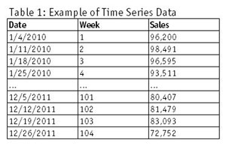
Special Data Types
There are some datatypes that need particular care while handling it, The following are two such types:
Time Series Data: Clarify that time series data is not just any data that includes times or dates but specifically refers to data points collected or recorded at regular time intervals. This could be financial data, weather data, or something like the number of daily visits to a website.
Dates: Point out that while dates can be part of time series data, they also stand alone in many datasets as significant markers or features. Handling dates properly can unlock valuable insights, such as seasonal trends or age calculations.
How to handle each of these will be explained further down the road for now its worth noting that they need special care due to there unique nature

Slide 18
Data Exploration & Data Wrangling
Data Exploration
Exploration involves using visual and quantitative methods to understand a dataset.
Methods and Techniques:
Summary Statistics: Calculating mean, median, mode, etc., to understand data distribution.
Visualization: Using histograms, box plots, scatter plots, etc., to visually explore data.
Correlation Analysis: Identifying relationships between variables.
Dimensionality Reduction: Reducing the number of variables with techniques like PCA (will be explained later) to study feature importance.

Slide 19
Data Exploration & Data Wrangling
Data Exploration
Exploration involves using visual and quantitative methods to understand a dataset.
Methods and Techniques:
Summary Statistics: Calculating mean, median, mode, etc., to understand data distribution.
Visualization: Using histograms, box plots, scatter plots, etc., to visually explore data.
Correlation Analysis: Identifying relationships between variables.
Dimensionality Reduction: Reducing the number of variables with techniques like PCA (will be explained later) to study feature importance.

Slide 20
Data Exploration & Data Wrangling
Data Exploration
Exploration involves using visual and quantitative methods to understand a dataset.
Methods and Techniques:
Summary Statistics: Calculating mean, median, mode, etc., to understand data distribution.
Visualization: Using histograms, box plots, scatter plots, etc., to visually explore data.
Correlation Analysis: Identifying relationships between variables.
Dimensionality Reduction: Reducing the number of variables with techniques like PCA (will be explained later) to study feature importance.
Data Wrangling
Data wrangling cleans and unifies complex data sets for analysis.
Processes Involved:
Data Cleaning: Handling missing data, removing duplicates, and correcting errors.
Data Transformation: Converting data into a different format or structure.
Data Enrichment: Merging additional information from other sources.
Data Reduction: Removing irrelevant or redundant features.
Data Integration: Combining data from different sources into a coherent store.

Slide 21
Data Exploration & Data Wrangling
Data Exploration
Exploration involves using visual and quantitative methods to understand a dataset.
Methods and Techniques:
Summary Statistics: Calculating mean, median, mode, etc., to understand data distribution.
Visualization: Using histograms, box plots, scatter plots, etc., to visually explore data.
Correlation Analysis: Identifying relationships between variables.
Dimensionality Reduction: Reducing the number of variables with techniques like PCA (will be explained later) to study feature importance.
Data Wrangling
Data wrangling cleans and unifies complex data sets for analysis.
Processes Involved:
Data Cleaning: Handling missing data, removing duplicates, and correcting errors.
Data Transformation: Converting data into a different format or structure.
Data Enrichment: Merging additional information from other sources.
Data Reduction: Removing irrelevant or redundant features.
Data Integration: Combining data from different sources into a coherent store.
Both processes are iterative, with insights from exploration potentially informing further wrangling, and vice versa, laying the groundwork for effective analysis and modeling.

Slide 22
Data Summarization Data Exploration
Summary statistics are numerical measures that capture key characteristics of a dataset, simplifying large amounts of data into smaller, informative summaries. They are crucial for understanding the distribution and central tendencies of the data.
Here are the primary summary statistics (More details can be found in the descriptive statistics presentation):
Mean
Median
Maximum
Minimum
Standard Deviation
Variance
Mode

Slide 23
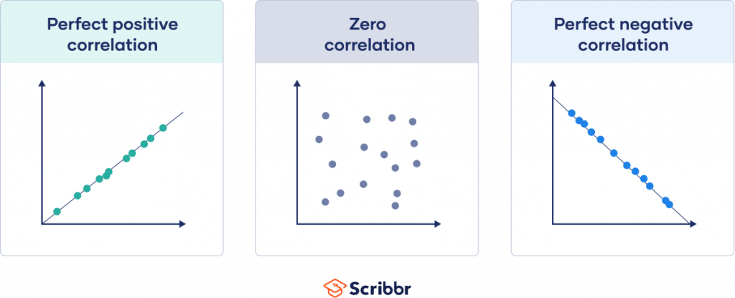
Correlation Analysis Data Exploration
Correlation analysis involves quantifying the degree to which two variables are related. It helps in understanding how one variable may change in relation to another.
Key points:
Correlation Coefficient: From -1 (strong negative) to 1 (strong positive), with 0 indicating no linear relationship.
Methods: Common methods include Pearson correlation (measures linear correlation) and Spearman's rank correlation (for non-linear relationships).
Usage: Used to identify potential associations or to suggest hypotheses for further study.

Slide 24

Data Issues and Challenges
Missing Values: :
Absent data due to collection issues or applicability.
Duplicates:
Repeated entries that skew analysis results.
Outliers:
Extreme values that may indicate errors or anomalies.
Inconsistent Formats:
Differing date and numerical formats, or text casing
Unstandardized Data:
Varying codes or names for the same items.
Notes:
Inconsistent Data Formats: Variations in how data is formatted across different sources can create inconsistencies. Examples include different date formats (MM/DD/YYYY vs. YYYY-MM-DD), numerical formats (comma vs. dot as decimal separator), or string formatting (uppercase vs. lowercase).
Missing Values: Data can have missing values for various reasons, such as errors in data collection, transmission losses, or simply because some information was not applicable. Handling missing data requires careful consideration to avoid introducing bias or inaccuracies.
Duplicate Data: Duplicate entries can occur due to errors in data entry, merging datasets without proper deduplication, or repeated data collection. Duplicates can skew analysis results and lead to incorrect conclusions.
Outliers: Data points that deviate significantly from other observations can indicate variability in measurement or errors. Outliers need to be detected and appropriately handled, whether that means removing them or understanding their impact on the analysis.
Mixed Data Types in Single Columns: A single column containing multiple types of data, such as numeric and text data together, can complicate parsing, analysis, and visualization.
Erroneous Data: Errors in data can arise from faulty data collection instruments, human error during data entry, or misinterpretation of data sources. Identifying and correcting errors is crucial for maintaining data integrity.
Data Sprawl: The sheer volume and variety of data spread across different platforms and formats can make it challenging to manage and analyze data effectively.
Structural Issues: Problems with how data is organized, such as pivoted data that needs to be unpivoted for analysis or hierarchical data that is challenging to flatten, can pose significant obstacles.
Unstandardized Data: Lack of standardization across data sources, such as varying codes or names for the same item, can lead to misaggregation or missed insights.
Language and Encoding Issues: Data collected from different countries or regions might contain language-specific characters or be encoded in ways that create challenges in data processing.

Slide 25
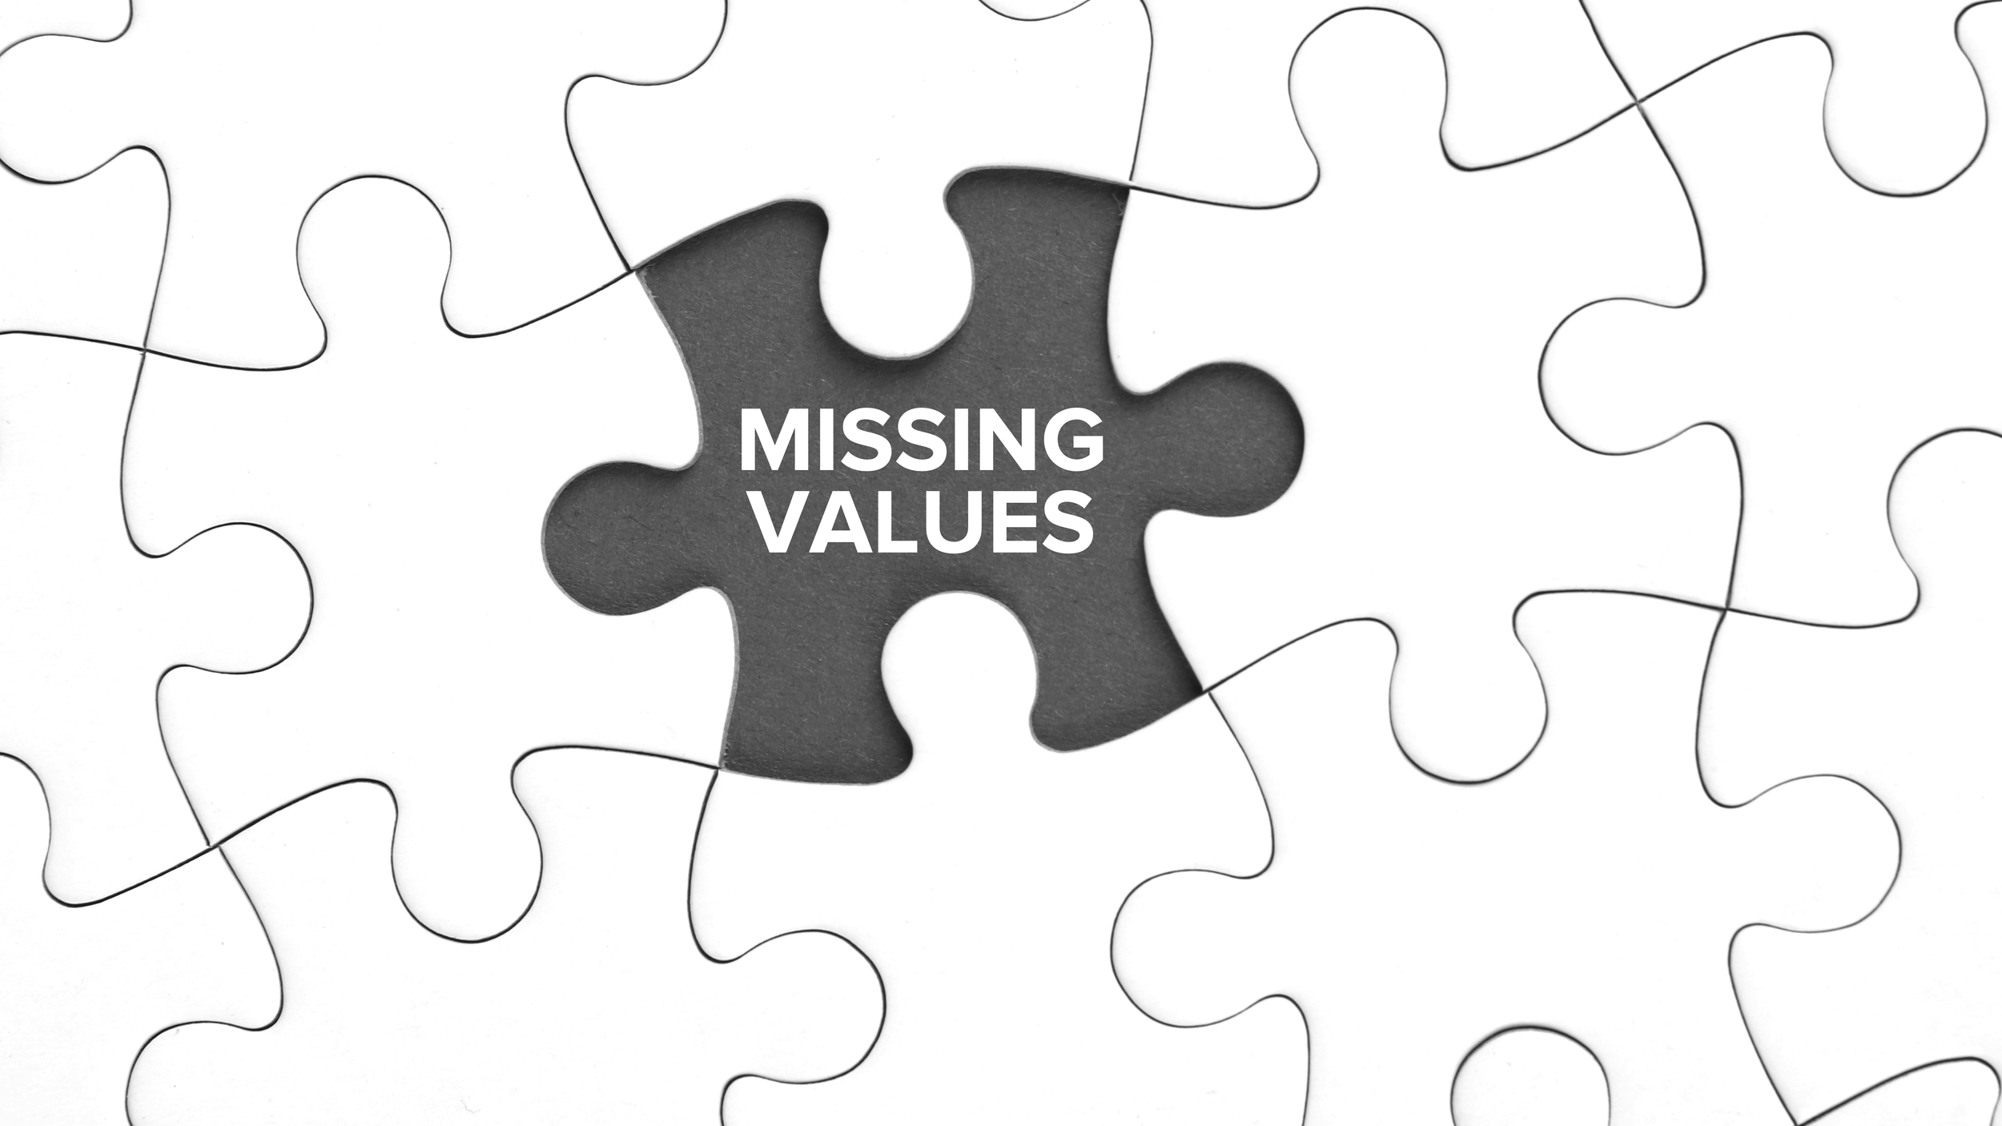
Missing Values Data Cleaning
Data can have missing values for various reasons, such as errors in data collection, transmission losses, or simply because some information was not applicable. Handling missing data requires careful consideration to avoid introducing bias or inaccuracies.
Ways of handling missing data:
Drop rows that have all missing values
Drop the affected rows
Drop column with high percentage of missing data
Impute columns based on data type
Basic imputation using Mean, Mode, Median
Advanced imputation using Machine Learning methods

Slide 26

Duplicates Data Cleaning
Data can have missing values for various reasons, such as errors in data collection, transmission losses, or simply because some information was not applicable. Handling missing data requires careful consideration to avoid introducing bias or inaccuracies.
Ways of handling Duplicated data:
Identifying Duplicates: Finding exact/approximate repeats based on one or more key columns.
Standardize categorical data and format numeric data
Checking if duplicates are legitimate to avoid valid data removal.
Drop/remove duplicated rows
Duplicates

Slide 27
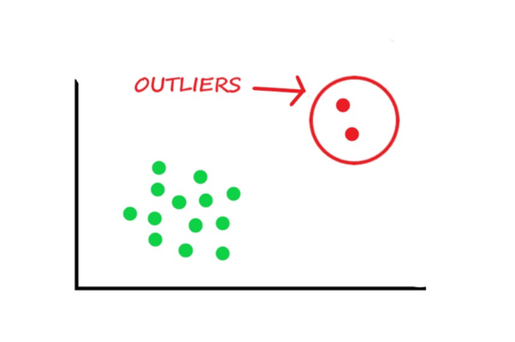
Outliers Data Cleaning
Outliers are data points that significantly differ from the rest of the dataset. They can indicate variability in measurement, experimental errors, or novel phenomena. Outliers can skew data analysis and may need to be examined separately or removed for accurate results.
Detection:
Statistical Tests: Z-score, IQR (Interquartile Range) method.
Visualization: Box plots, scatter plots to visually identify outliers.
Handling:
Removal: Eliminate outliers if they result from errors.
Adjustment: Transform data to reduce the impact of outliers.
Separate Analysis: Analyze outliers separately if they represent valuable information.

Slide 28
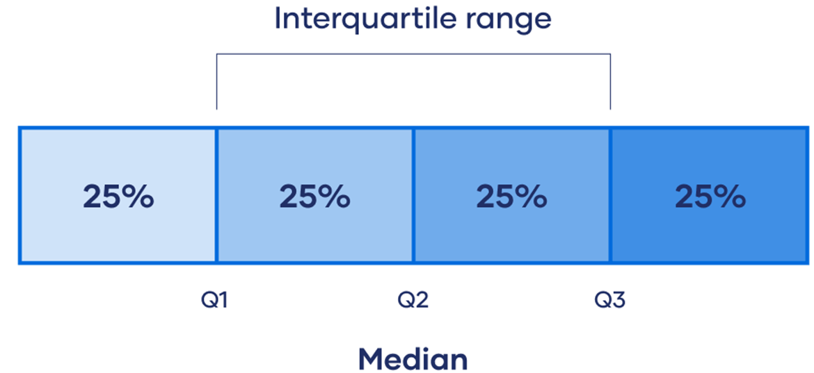
Outliers Detection IQR Data Cleaning
IQR (Interquartile Range):
Measures the spread of the middle 50% of data.
Calculation:
Subtract the first quartile (Q1, 25th percentile) from the third quartile (Q3, 75th percentile).
Use:
Identifies outliers by setting thresholds (typically 1.5*IQR above Q3 and below Q1) beyond which data points are considered outliers.
Notes:
IQR (Interquartile Range): Measures the spread of the middle 50% of data.
Calculation: Subtract the first quartile (Q1, 25th percentile) from the third quartile (Q3, 75th percentile).
Use: Identifies outliers by setting thresholds (typically 1.5*IQR above Q3 and below Q1) beyond which data points are considered outliers.

Slide 29
Data Quality Issues Data Cleaning
Challenge:
Variations in date formats (DD/MM/YYYY vs. MM/DD/YYYY), numerical representations (1,000 vs. 1000), and text casing (lowercase, UPPERCASE).
Impact:
Complicates data parsing, aggregation, and analysis.
Solution Strategies:
Standardize formats upon data ingestion.
Implement validation rules to enforce consistency.
Challenge:
Differing codes or names referring to the same items (e.g., "US" vs. "USA", "New York" vs. "NY").
Impact:
Leads to fragmented datasets, making it difficult to aggregate or compare data accurately.
Solution Strategies:
Develop a data dictionary or mapping table for custom business domain standardization.
Use data standardization such as NLTK tools to normalize data based on established conventions.

Slide 30
شــكراً لـــكـم

