Slide 1

The Stolen Life
Reclaiming Presence in the Age of Speed

Slide 2
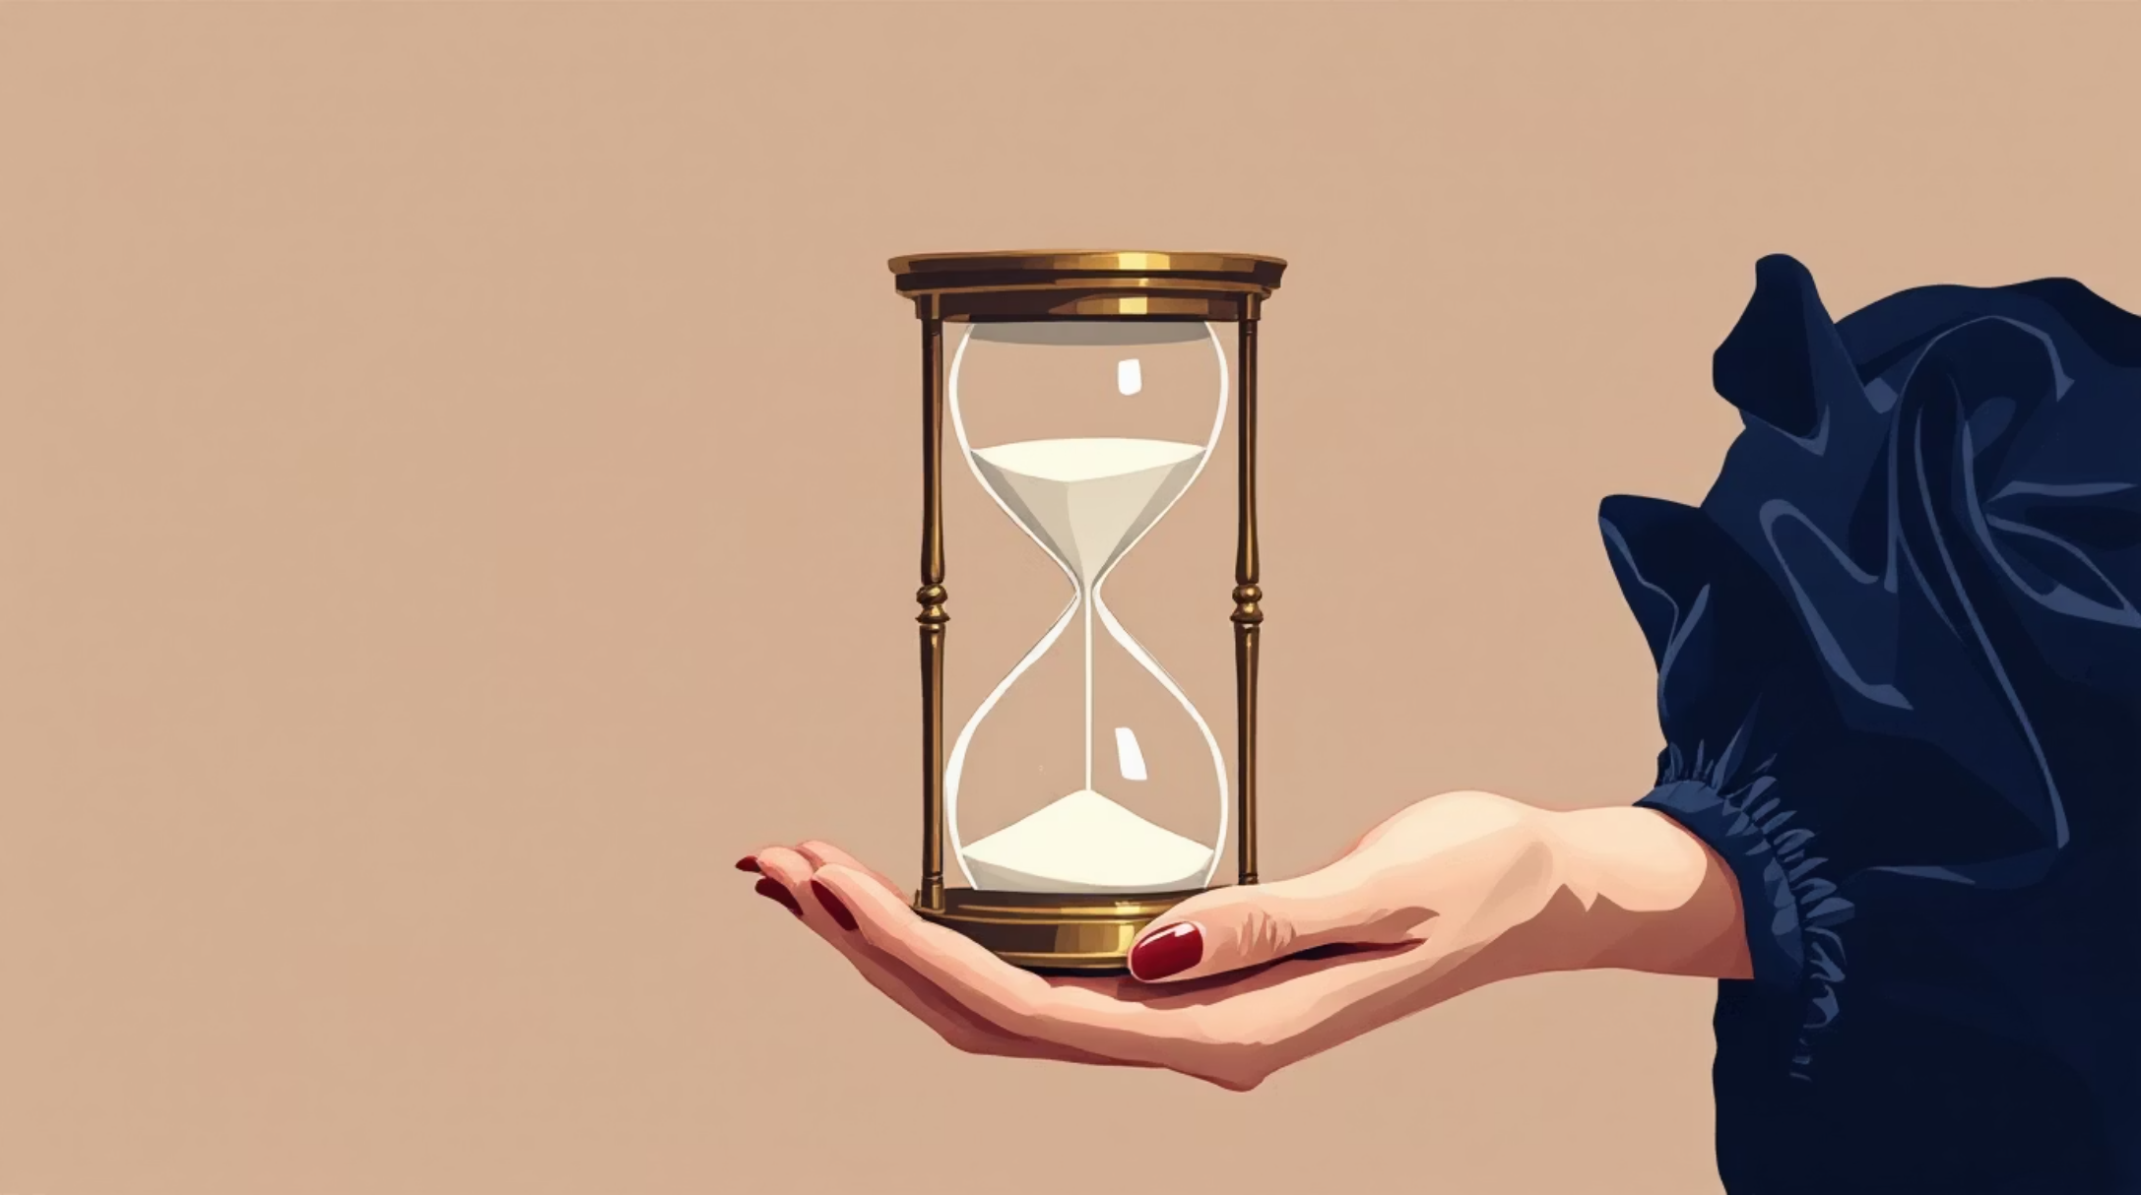
The Myth of "Keeping Up"
The 15-Second Illusion
The "Social Media Pace": Comparing reality to 15-second highlight reels
Pressure to be a "Success" by age 19
Speed creates burnout, not progress

Slide 3

Why We Forgot the Flavor
The Disconnected Meal
The "YouTube" Trap
Screen before fork
The Fact
Distracted eating leads to 20% more calories

Slide 4

Recording vs. Experiencing
The Memory Paradox
Memory Impairment Effect
Photos can make you forget details
The Study
Dr. Linda Henkel – Externalizing memory weakens recall

Slide 5

The Power of Doing Less
The Art of Mono-tasking
Mindfulness is a survival skill, not a luxury
Mono-tasking: doing one thing at a time

Slide 6


Small Steps, Deep Impact
The ROI of Slowness
Studying without notifications
→ 40% higher retention
Mindful living
→ lower anxiety, higher creativity

Slide 7

Live the Moment, Not the Content
"The central tenet of the Slow Movement is that we should be living better, not faster." — Carl Honoré

