Slide 1

Machine Learning Applications Overview
By Cel Rick D Almario
BSCS 3B

Slide 2

Healthcare: Predictive Diagnostics
Discuss early disease detection through predictive diagnostics
In the field of healthcare, predictive diagnostics, through machine learning are centered on detecting diseases such as cancer, diabetes and heart disease. This approach involves utilizing learning methods like classification models (such, as SVM and neural networks) to anticipate and identify diseases in their phases.
Machine Learning Type: Supervised Learning
Supervised learning is the form of machine learning used in healthcare diagnostics. It entails training models, with labeled data to predict outcomes. For example SVM and neural networks are classification models employed to categorize patients into disease groups based on specific characteristics.
Solution Impact: Improved Patient Outcomes
The influence of diagnostics, in the healthcare sector is substantial resulting in results, for patients. Detecting illnesses early allows for tailored treatment strategies, enhanced disease control and lower healthcare expenses.
Photos provided by Unsplash

Slide 3
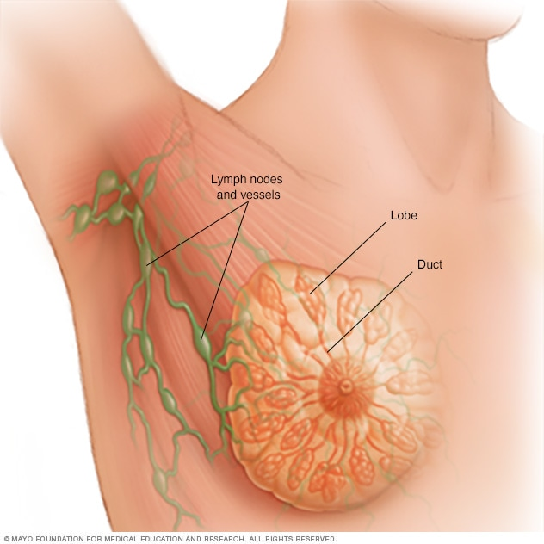
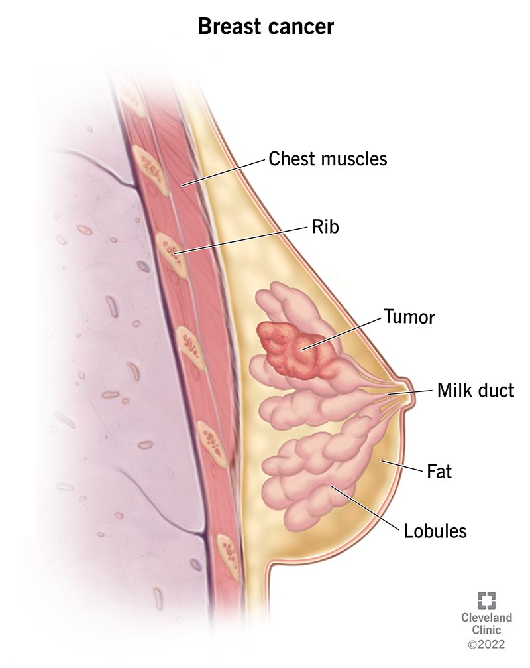
Breast Cancer Wisconsin (Diagnostic) Data Set
Data Set Example Link: https://www.kaggle.com/datasets/uciml/breast-cancer-wisconsin-data/data
Project Example Link: https://www.kaggle.com/code/kanncaa1/feature-selection-and-data-visualization
Photos provided by Unsplash

Slide 4
Finance: Fraud Detection
Solution Impact: Financial Security & Customer Trust
Examine real-time fraud detection in finance
Machine Learning Types: Unsupervised & Supervised Learning
Using machine learning, for fraud detection boosts security by spotting and stopping activities ahead of time. Moreover it builds customer confidence by guaranteeing secure transactions.
Detecting fraud, in the sector entails the utilization of advanced machine learning techniques to spot and thwart transactions promptly thereby reducing monetary losses and bolstering security protocols, for financial organizations.
Fraud detection uses machine learning techniques such, as learning (for example anomaly detection) and supervised learning (, like decision trees, neural networks) to identify suspicious patterns of fraudulent activity and reduce potential risks.

Slide 5

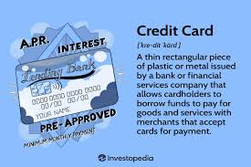
Credit Card Fraud Detection
Data Set Example Link: https://www.kaggle.com/datasets/mlg-ulb/creditcardfraud
Project Example Link: https://www.kaggle.com/code/janiobachmann/credit-fraud-dealing-with-imbalanced-datasets
Photos provided by Unsplash

Slide 6

Marketing: Customer Segmentation
Explore customer segmentation in marketing
Marketing uses customer segmentation, which includes using machine learning methods, especially unsupervised learning, like clustering algorithms such as k means to pinpoint customer groups, for personalized marketing plans.
Machine Learning Type: Unsupervised Learning
In marketing, unsupervised learning methods, such as clustering algorithms, are used to group customers who share similar behaviors or preferences. This approach allows companies to design more personalized and effective marketing campaigns for each customer segment.
Solution Impact: Enhanced Marketing Efficiency
Using machine learning for customer segmentation helps businesses market more efficiently, leading to higher engagement and better conversion rates. By accurately targeting specific customer groups, companies can significantly improve their overall marketing strategies.
Photos provided by Unsplash

Slide 7
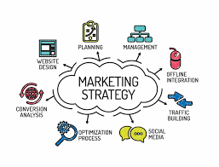
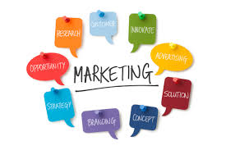
Mall Customer Segmentation Data
Data Set Example Link: https://www.kaggle.com/datasets/vjchoudhary7/customer-segmentation-tutorial-in-python
Project Example Link: https://www.kaggle.com/code/kushal1996/customer-segmentation-k-means-analysis
Photos provided by Unsplash

Slide 8

Summary of Machine Learning Applications
Significance of Machine Learning in Real-World Problems
Future Advancements and Potential
Machine learning plays a crucial role in addressing real-world challenges across various sectors. Its ability to analyze data, identify patterns, and make predictions offers innovative solutions, paving the way for advancements in healthcare, finance, marketing, and beyond.
The future of machine learning applications holds immense potential for driving further innovations and solving complex problems. By harnessing the capabilities of machine learning, industries can unlock new opportunities, streamline processes, and create impactful solutions.
Conclusion
In conclusion, the versatility and adaptability of machine learning applications are transforming industries and improving outcomes worldwide. As technology continues to evolve, the integration of machine learning will continue to revolutionize how we approach challenges and opportunities.

