Slide 1

Machine Learning Applications Overview
By Cel Rick D Almario
BSCS 3B

Slide 2
What is Machine Learning?
Machine learning is a field of study in artificial intelligence concerned with the development and study of statistical algorithms that can learn from data and generalize to unseen data and thus perform tasks without explicit instructions.
References: https://en.wikipedia.org/wiki/Machine_learning
Photos provided by Unsplash

Slide 3
Three Types Of Machine Learning You Should Know
1. Supervised Learning - This type of machine learning feeds historical input and output data in machine learning algorithms, with processing in between each input/output pair that allows the algorithm to shift the model to create outputs as closely aligned with the desired result as possible. Common algorithms used during supervised learning include neural networks, decision trees, linear regression, and support vector machines.
References: https://www.coursera.org/articles/types-of-machine-learning
Photos provided by Unsplash

Slide 4
2. Unsupervised Learning - While supervised learning requires users to help the machine learn, unsupervised learning algorithms don't use the same labeled training sets and data. Instead, the machine looks for less obvious patterns in the data. Unsupervised machine learning is very helpful when you need to identify patterns and use data to make decisions. Common algorithms used in unsupervised learning include Hidden Markov models, k-means, hierarchical clustering, and Gaussian mixture models.
References: https://www.coursera.org/articles/types-of-machine-learning
Photos provided by Unsplash

Slide 5
3. Reinforcement Learning - is the closest machine learning type to how humans learn. The algorithm or agent used learns by interacting with its environment and getting a positive or negative reward. Common algorithms include temporal difference, deep adversarial networks, and Q-learning.
References: https://www.coursera.org/articles/types-of-machine-learning
Photos provided by Unsplash

Slide 6
EXAMPLE OF MACHINE LEARNING
Photos provided by Unsplash

Slide 7

Healthcare: Predictive Diagnostics
Discuss early disease detection through predictive diagnostics
In the field of healthcare, predictive diagnostics, through machine learning are centered on detecting diseases such as cancer, diabetes and heart disease. This approach involves utilizing learning methods like classification models (such, as SVM and neural networks) to anticipate and identify diseases in their phases.
Machine Learning Type: Supervised Learning
Supervised learning is the form of machine learning used in healthcare diagnostics. It entails training models, with labeled data to predict outcomes. For example SVM and neural networks are classification models employed to categorize patients into disease groups based on specific characteristics.
Solution Impact: Improved Patient Outcomes
The influence of diagnostics, in the healthcare sector is substantial resulting in results, for patients. Detecting illnesses early allows for tailored treatment strategies, enhanced disease control and lower healthcare expenses.
Photos provided by Unsplash

Slide 8
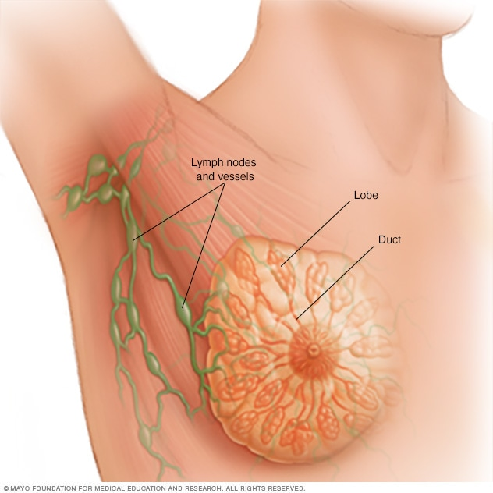
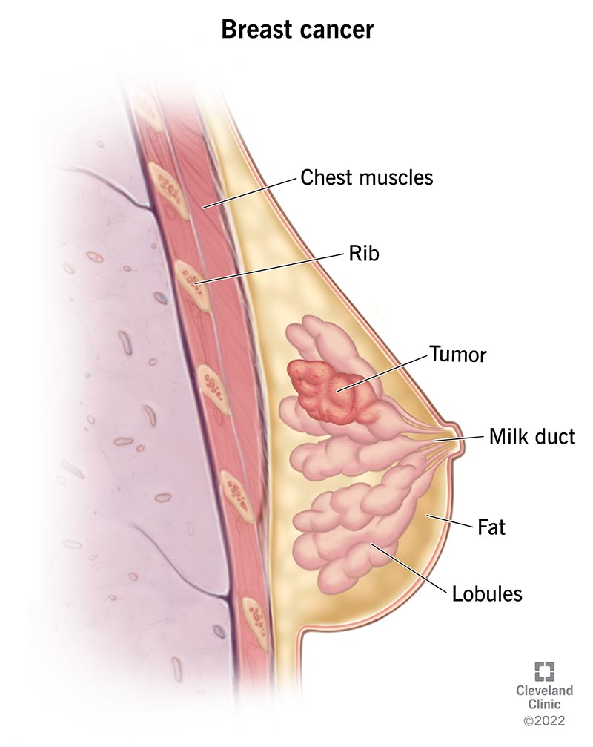
Breast Cancer Wisconsin (Diagnostic) Data Set
Data Set Example Link: https://www.kaggle.com/datasets/uciml/breast-cancer-wisconsin-data/data
Project Example Link: https://www.kaggle.com/code/kanncaa1/feature-selection-and-data-visualization
Photos provided by Unsplash

Slide 9
Finance: Fraud Detection
Solution Impact: Financial Security & Customer Trust
Examine real-time fraud detection in finance
Machine Learning Types: Unsupervised & Supervised Learning
Using machine learning, for fraud detection boosts security by spotting and stopping activities ahead of time. Moreover it builds customer confidence by guaranteeing secure transactions.
Detecting fraud, in the sector entails the utilization of advanced machine learning techniques to spot and thwart transactions promptly thereby reducing monetary losses and bolstering security protocols, for financial organizations.
Fraud detection uses machine learning techniques such, as learning (for example anomaly detection) and supervised learning (, like decision trees, neural networks) to identify suspicious patterns of fraudulent activity and reduce potential risks.

Slide 10

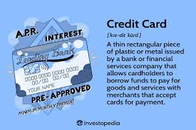
Credit Card Fraud Detection
Data Set Example Link: https://www.kaggle.com/datasets/mlg-ulb/creditcardfraud
Project Example Link: https://www.kaggle.com/code/janiobachmann/credit-fraud-dealing-with-imbalanced-datasets
Photos provided by Unsplash

Slide 11

Marketing: Customer Segmentation
Explore customer segmentation in marketing
Marketing uses customer segmentation, which includes using machine learning methods, especially unsupervised learning, like clustering algorithms such as k means to pinpoint customer groups, for personalized marketing plans.
Machine Learning Type: Unsupervised Learning
In marketing, unsupervised learning methods, such as clustering algorithms, are used to group customers who share similar behaviors or preferences. This approach allows companies to design more personalized and effective marketing campaigns for each customer segment.
Solution Impact: Enhanced Marketing Efficiency
Using machine learning for customer segmentation helps businesses market more efficiently, leading to higher engagement and better conversion rates. By accurately targeting specific customer groups, companies can significantly improve their overall marketing strategies.
Photos provided by Unsplash

Slide 12
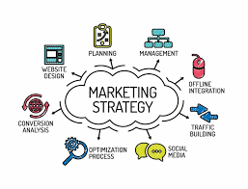
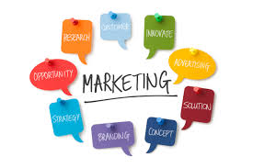
Mall Customer Segmentation Data
Data Set Example Link: https://www.kaggle.com/datasets/vjchoudhary7/customer-segmentation-tutorial-in-python
Project Example Link: https://www.kaggle.com/code/kushal1996/customer-segmentation-k-means-analysis
Photos provided by Unsplash

Slide 13

Summary of Machine Learning Applications
Significance of Machine Learning in Real-World Problems
Future Advancements and Potential
Machine learning plays a crucial role in addressing real-world challenges across various sectors. Its ability to analyze data, identify patterns, and make predictions offers innovative solutions, paving the way for advancements in healthcare, finance, marketing, and beyond.
The future of machine learning applications holds immense potential for driving further innovations and solving complex problems. By harnessing the capabilities of machine learning, industries can unlock new opportunities, streamline processes, and create impactful solutions.
Conclusion
In conclusion, the versatility and adaptability of machine learning applications are transforming industries and improving outcomes worldwide. As technology continues to evolve, the integration of machine learning will continue to revolutionize how we approach challenges and opportunities.

