Slide 1
QAI
What should the tutor explain next?
AI on Campus / Reply Student Tech Clash 2026
Notes:
0:00–0:35. Picture a first-year Analisi I tutorial. The tutor is finishing a worked example. Some students follow, others are stuck. Before the tutor moves on, what evidence would tell them which step to explain?

Slide 2
Two students write 42
A
−3(2) + 12(2²) = 42
B
42
The exercise was to evaluate 8 − 3x + 12x² as x approaches 2.
Notes:
0:35–1:15. Student A dropped the constant 8. Student B gave no working, so we cannot diagnose the same mistake. A multiple-choice poll could count both as wrong. The tutor needs a different response for each student.

Slide 3
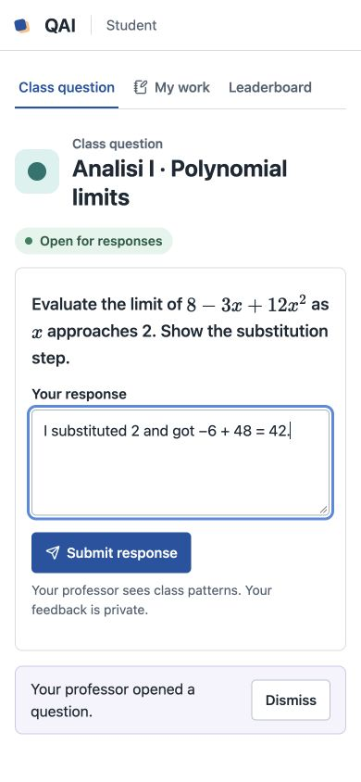
One exercise in class
The professor opens a question from their worksheet.
Students scan the QR and send a line of reasoning or a photo of their working.
Notes:
1:15–2:40. Switch to QAI now. Project the public QR. Open the polynomial question and submit one worked line on a phone. Show the private hint. The screenshot shows a student typing in the local rehearsal. The hosted room also accepts photos. Source: QAI prototype.

Slide 4
What the tutor learned
2 of 6
synthetic responses omitted the constant 8 in their working.
One student wrote only “42.” The cause stayed unknown.
Board example 8 − 3(2) + 12(2²) = 8 − 6 + 48 = 50
Notes:
2:40–3:35. Close the round and show the anonymous report. Use View example report for the six synthetic responses. Two other responses were sound. A fifth response got 50 using the invalid rule x² = 2x. These were test cases, not classroom outcomes. Source: submission/classroom-evaluation.md.

Slide 5
How the agent decides
Read the working
Compare the visible step with the approved reference. Ask for more working when the evidence is thin.
Choose a teaching step
Group supported errors across the class. Give the tutor a worked example and a fresh question to check understanding.
Notes:
3:35–4:20. Luna handles typed work and images. Code validates text evidence and counts each student once. Only the professor publishes. The companion calculus agent can call a slope checker, inspect its result and recall prior hints. Its bounded loop hands uncertain work to a human. Sources: demo/quiz/open.mjs and demo/agent/orchestrator.mjs.

Slide 6
A first tutorial pilot
One tutor. Five first-year students. One Analisi I worksheet.
Which step did the tutor change after seeing the report? Can students apply that step on a fresh problem?
Notes:
4:20–4:50. This is a proposed pilot. Record the tutor’s plan before the round and the step actually taught afterwards. Use a fresh question to check transfer. We are looking for a tutor willing to try this in a real class.

