Slide 1
QAI
A full classroom.
No clear picture.
Professors can’t see who is stuck or why.
Students watch. Copy. Lose focus.
Rick&Max

Slide 2
Main features
Course material in
Join in seconds
PDFs, images, text and Markdown
QR access, no student account
Three ways to answer
Private AI feedback
Text + LaTeX, photo or whiteboard
Reasoning checked against course material
Teaching priorities
Personal progress
Misconceptions, examples and fresh checks
Practice history and participation points

Slide 3
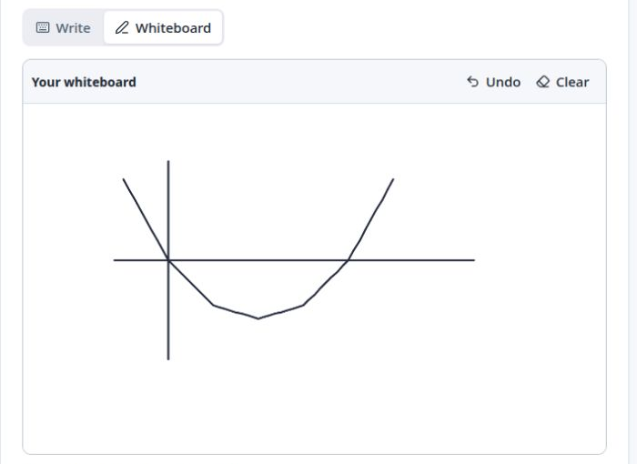
Work it out on the whiteboard
Draw directly
in the browser
Undo. Clear.
Add a note. Submit.
Type or upload a photo, too.

Slide 4
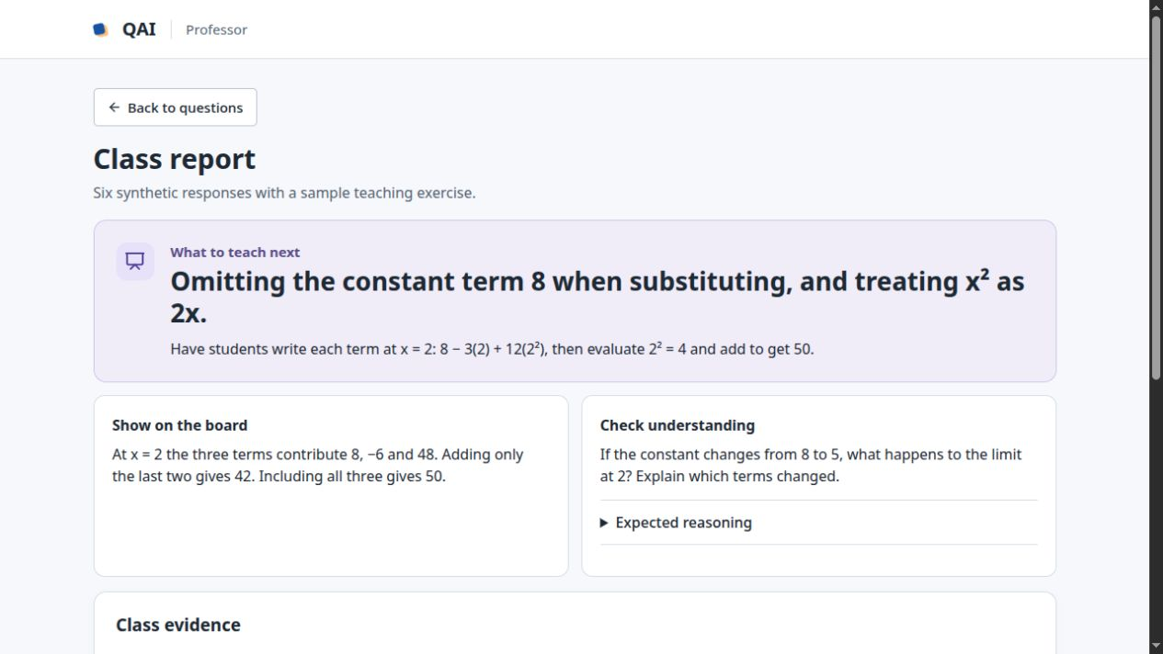
Know what to teach next
2 of 6
synthetic responses
missed the same term
A worked explanation.
A fresh check.
QAI · Rick&Max

Slide 5
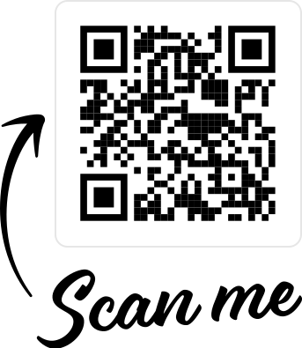
Try out the demo!
https://solution-room-demo.onrender.com/join

