Slide 1
QAI
42
The reasoning
behind the answer
What went wrong?
Rick&Max
Notes:
0:00–0:12
We’re Rick and Max. QAI helps professors see the reasoning behind an answer. In a calculus exercise, several students write forty-two. What went wrong?
Source: Restored ai-classroom-feedback-proposal.md; submission/pitch.md. The 42 example is a synthetic calculus response, not a measured classroom outcome.

Slide 2
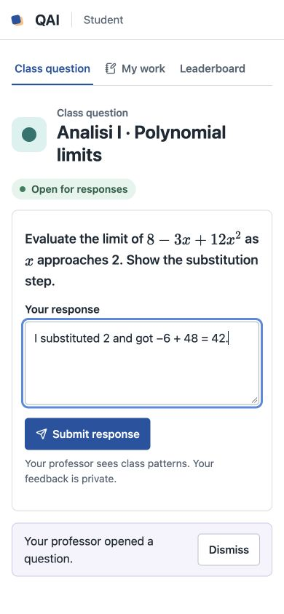
Students share their working
Scan the QR
A line of reasoning
or a photo
Private feedback
Notes:
0:12–0:28
The professor opens a question from their own material. Students scan a QR code and send a step or a photo. AI compares the work with the approved reference and gives private feedback.
Source: Merged demo/README.md; demo/web/teaching.js. Original prototype screenshot embedded in submission/QAI.pptx, ppt/media/image.jpeg. Screenshot uses synthetic example work.

Slide 3
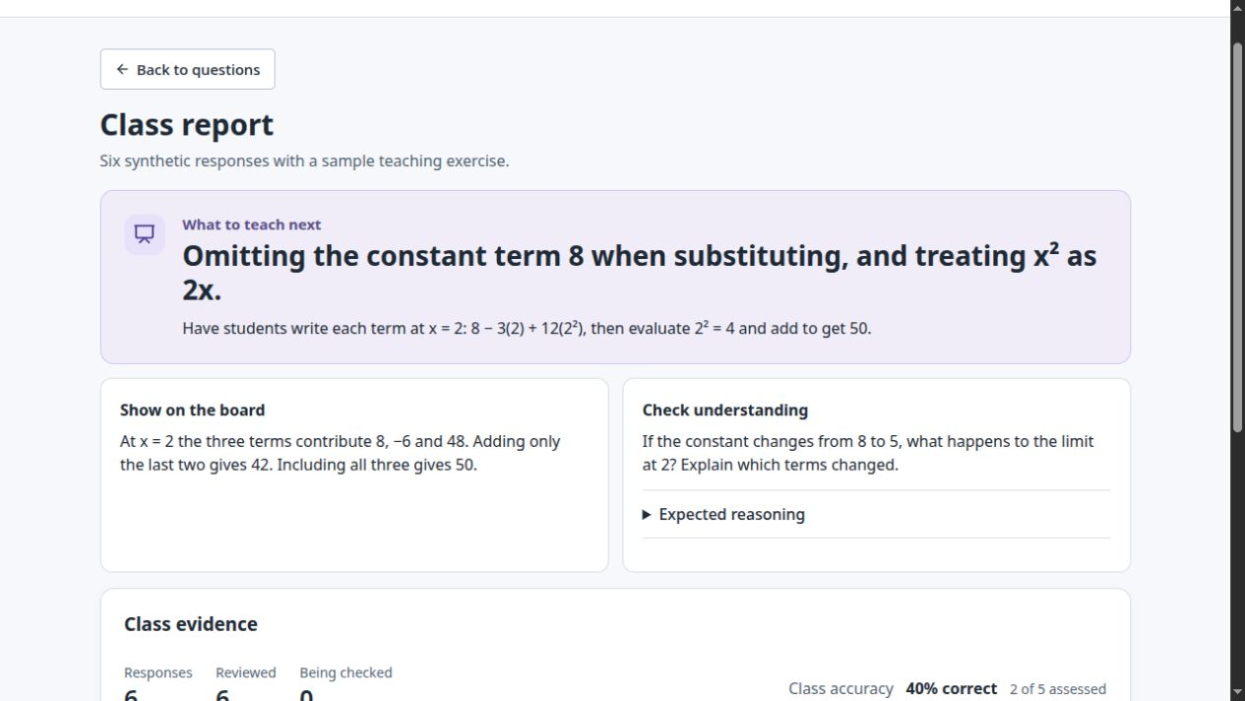
Professors see what to explain
2 of 6
synthetic responses
omitted the constant
“42” alone:
ask for the missing step
Notes:
0:28–0:45
The professor sees the mistakes behind the results. In a six-answer synthetic class, two students omitted the constant eight. An unsupported forty-two triggered a request for the missing step.
Source: submission/classroom-evaluation.md, simulated responses 3, 4 and 6; demo/web/sample-report.js, evidence counts and unclear response. Screenshot captured from isolated local demo, View example report. This is synthetic evidence and does not establish learning gains.

Slide 4
Feedback before the exam
Professor approval stays central
Next: one real tutorial
Measure teaching decisions
and transfer to a fresh problem
Rick&Max
QAI
Notes:
0:45–1:00
The professor chooses what to explain, then publishes a fresh check. Our next step is one real tutorial: measure whether the report changes teaching, and whether students transfer the idea.
Source: Restored ai-classroom-feedback-proposal.md: professor approval and transfer reassessment; submission/pitch.md: proposed tutorial pilot. These measures are a proposed next test, not demonstrated educational impact.

