Slide 1

Energy distribution
POWERED BY
BUSINESS INTELLIGENCE
Diogo Rosário, uc2023185395
João Raposo, uc2023147060

Slide 2

CONTEXT

Slide 3
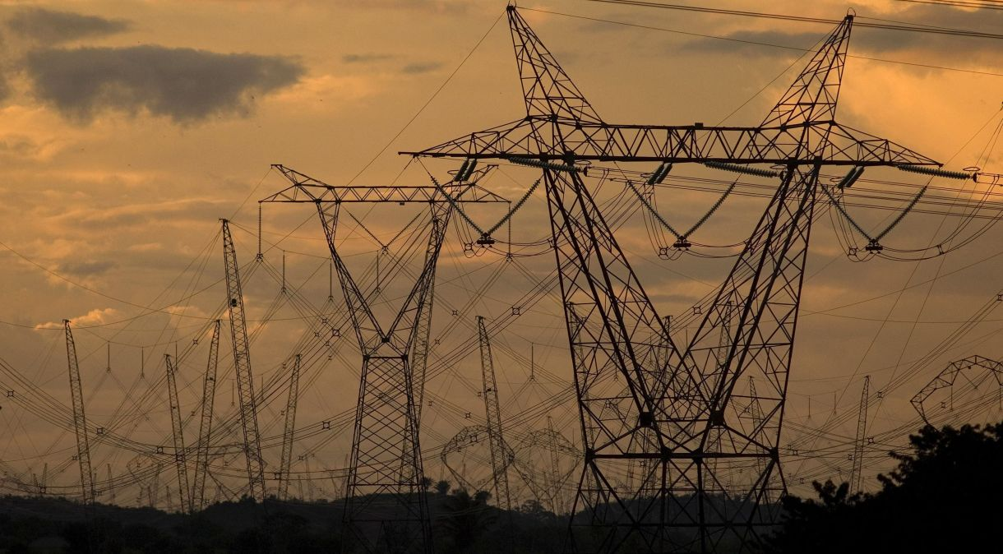
Value Proposition

Slide 4
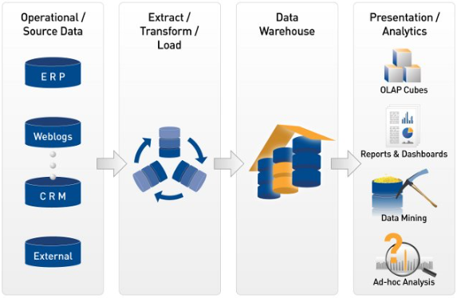
DEVELOPMENT

Slide 5

DATA

Slide 6
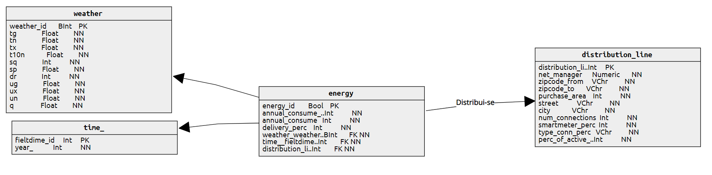
STAR MODEL

Slide 7

DATA CORRECTION

Slide 8
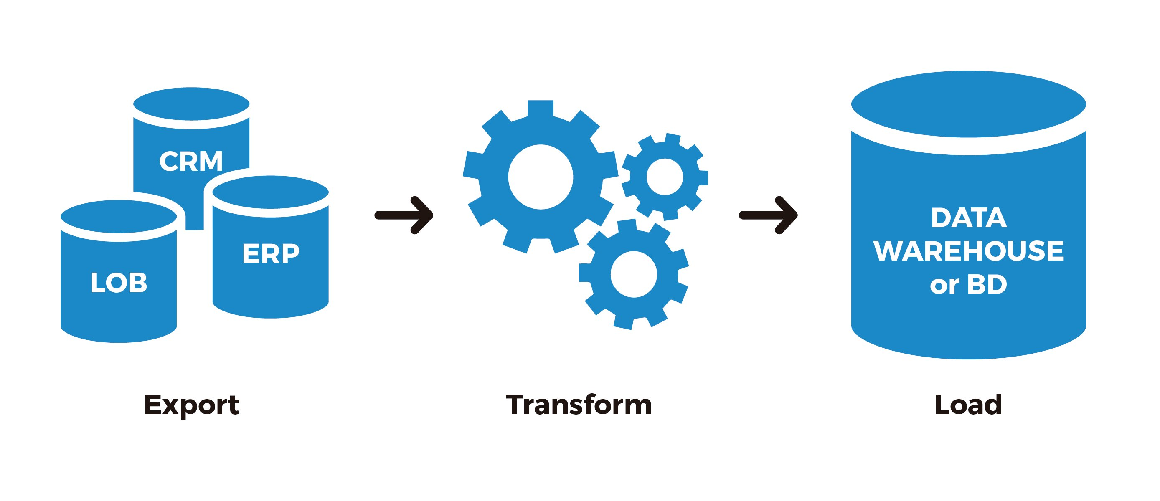
ETL & PENTAHO

Slide 9
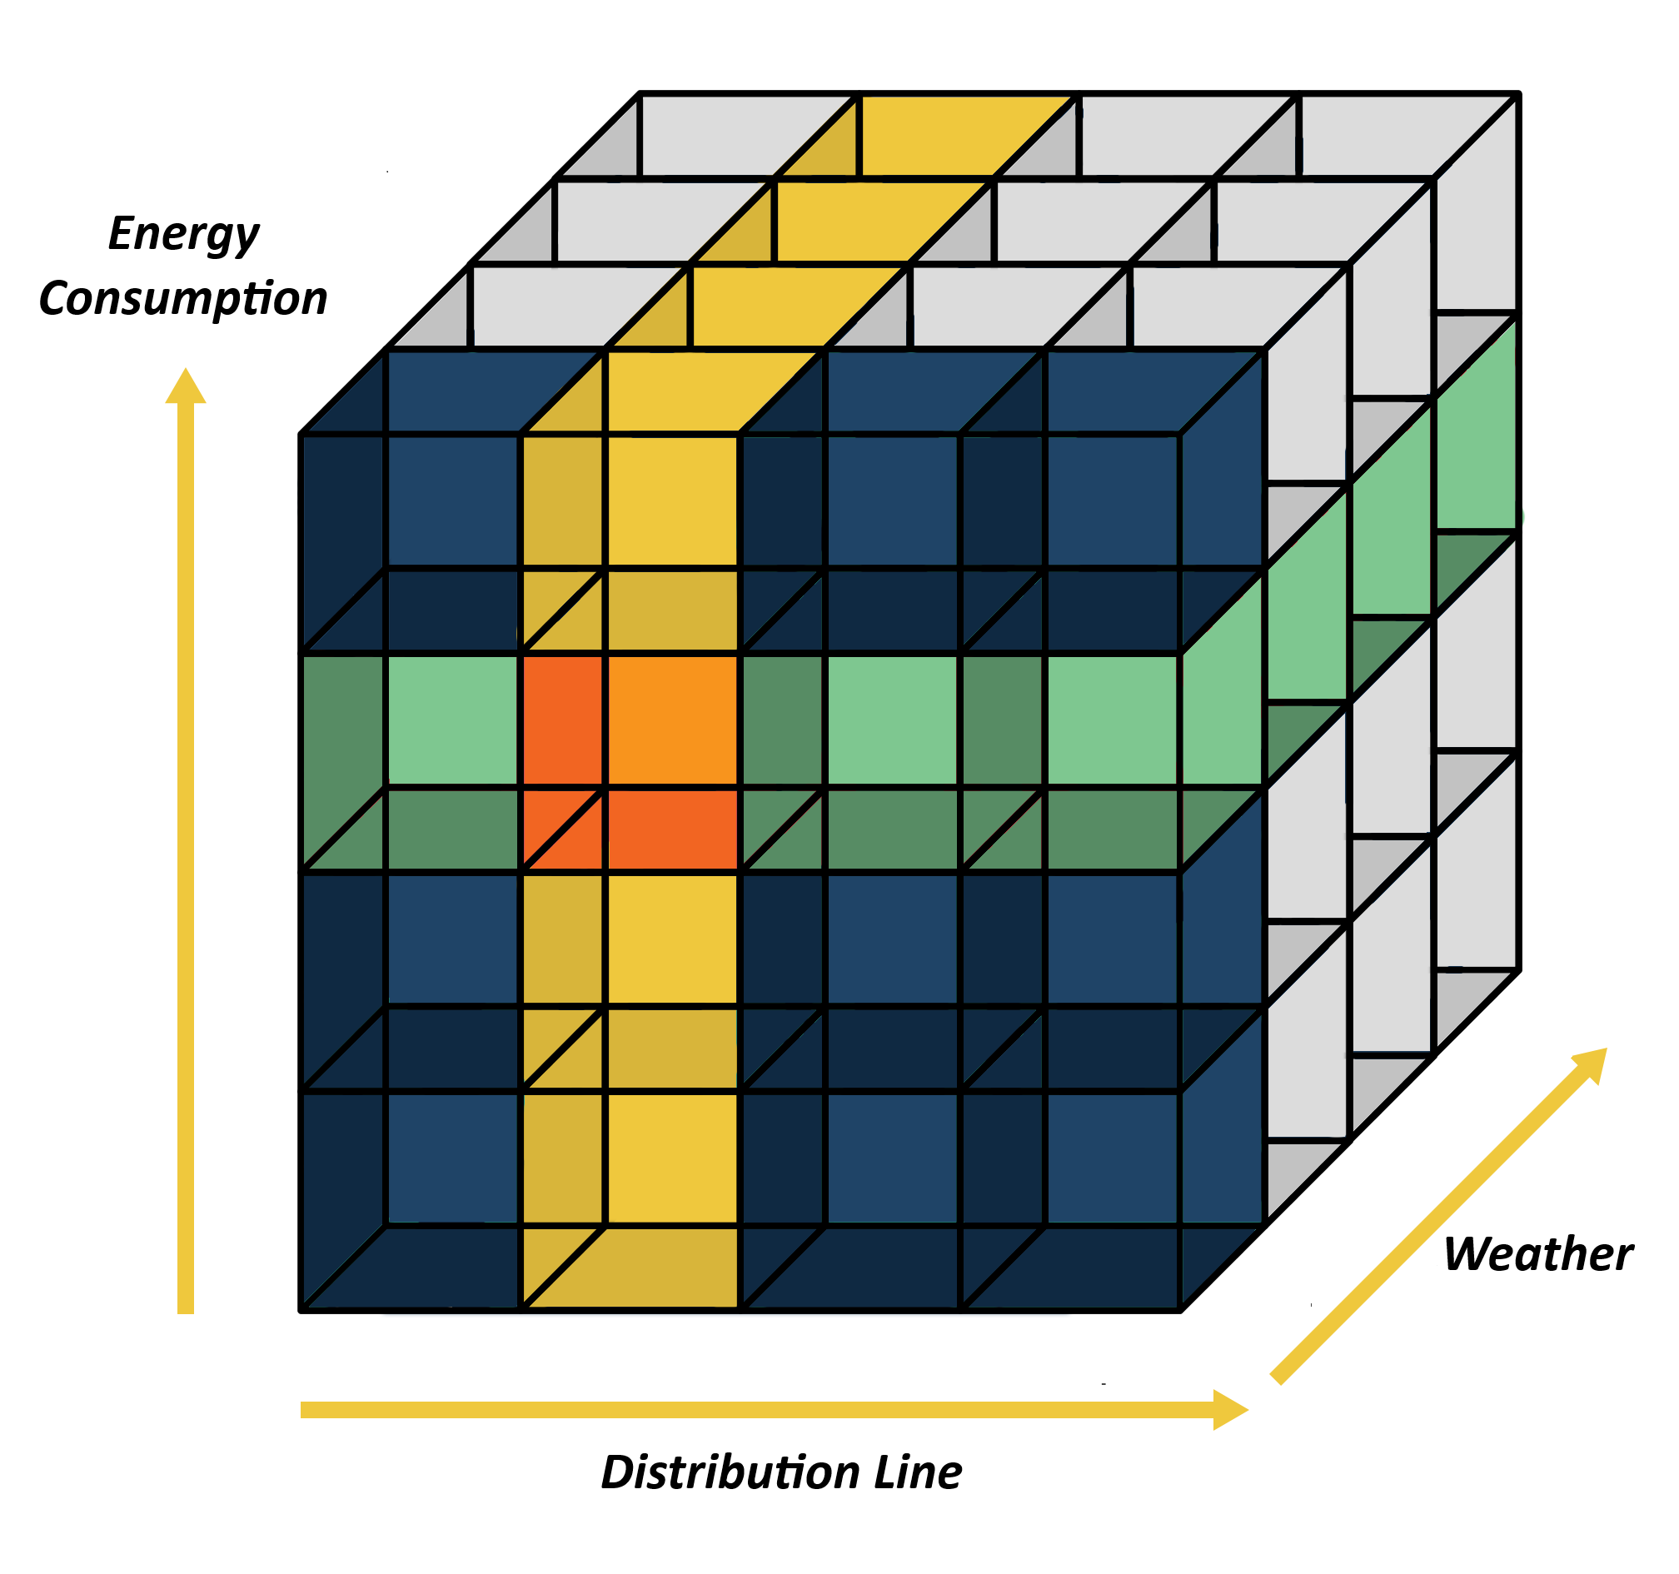
OLAP

Slide 10

MOCKUPS

