Slide 1
Intro to Git or, Git for Demographers
Scott Yabiku, Population Research Institute, Department of Sociology & Criminology
sty105@psu.edu

Slide 2
Aims
What I’m going to do today
What I’m not going to do today

Slide 3
Why Git?
To decrease the suck

Slide 4
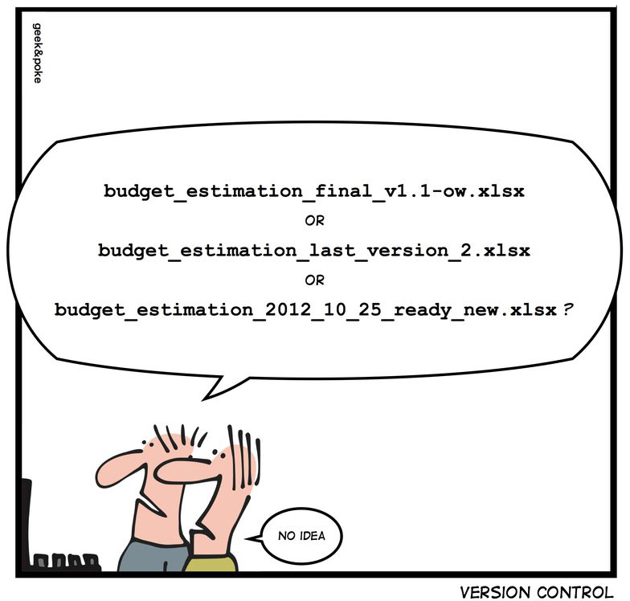
Ever happen to you?

Slide 5
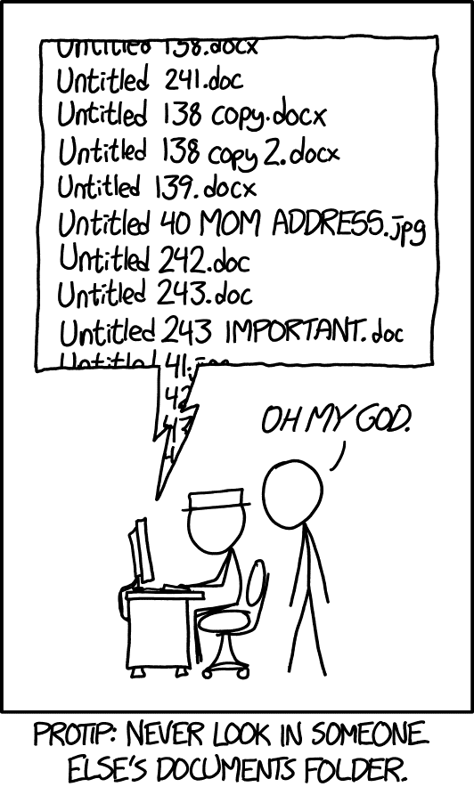
How about this?
xkcd.com

Slide 6
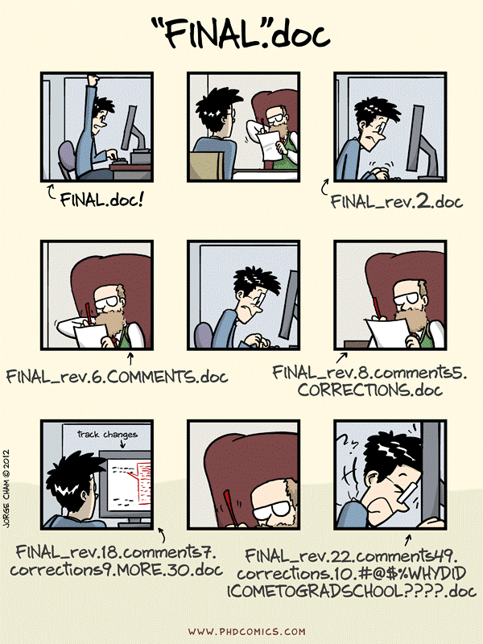
So true…

Slide 7
Git solves this Git is a version control system (VCS) used by the most valuable software projects in the world
“Great! Sign me up!”

Slide 8
TANSTAAFL
in reality a person or a society cannot get "something for nothing". Even if something appears to be free, there is always a cost to the person or to society as a whole…
You’ll have to learn Git
There is a learning curve
https://en.wikipedia.org/

Slide 9
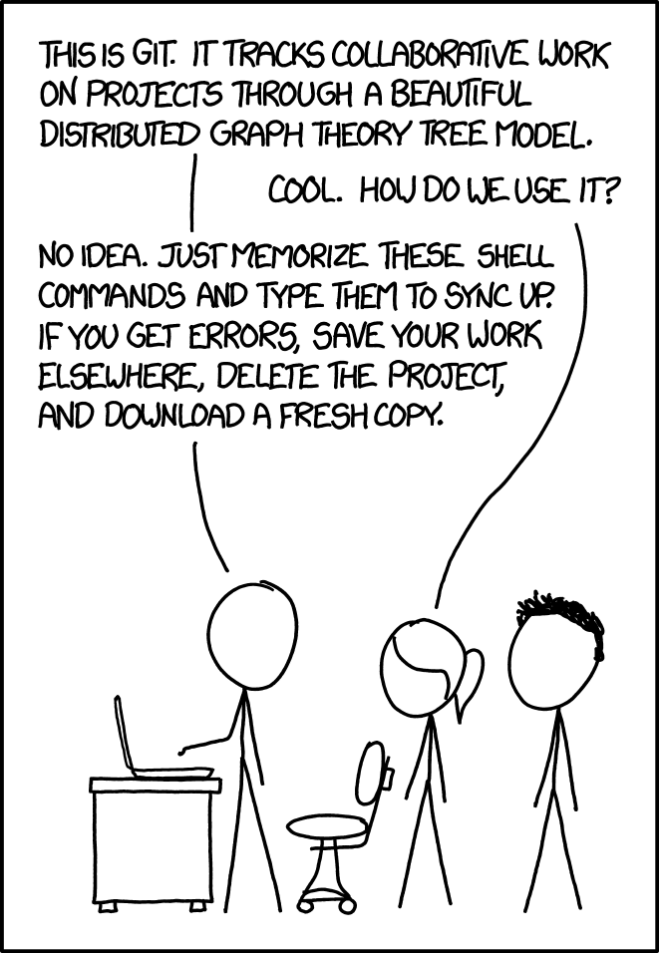
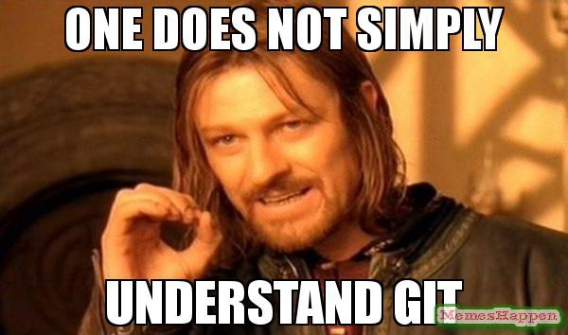
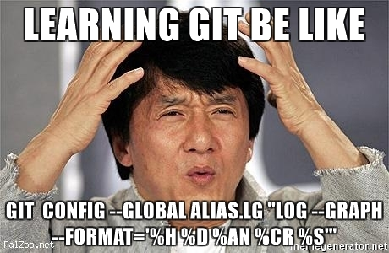
The perceived difficulty of Git has spawned many comics and memes
xkcd.com

Slide 10
Why my presentation is different
Most “intro to Git” presentations show trivial examples that are not related to your workflow as a demographer.
At best, you see Git as “interesting,” at worst it’s confusing and irrelevant.
You remain unconvinced of the value of Git, and so the decision to learn Git is a leap of faith.
Therefore, you don’t put in the effort to learn Git.

Slide 11
Workflow without a true version control system (VCS)
recodes.do
set maxvar 30000
use GSS7218_R1.DTA
gen female = .
replace female = 1 if (sex == 2)
replace female = 0 if (sex == 1)
gen yearseduc = .
replace yearseduc = educ
models.do
reg yearseduc female

Slide 12
. reg yearseduc female
Source | SS df MS Number of obs = 64,637
-------------+---------------------------------- F(1, 64635) = 77.42
Model | 780.201576 1 780.201576 Prob > F = 0.0000
Residual | 651331.177 64,635 10.0770663 R-squared = 0.0012
-------------+---------------------------------- Adj R-squared = 0.0012
Total | 652111.379 64,636 10.088981 Root MSE = 3.1744
------------------------------------------------------------------------------
yearseduc | Coef. Std. Err. t P>|t| [95% Conf. Interval]
-------------+----------------------------------------------------------------
female | -.2212475 .0251444 -8.80 0.000 -.2705306 -.1719643
_cons | 12.99324 .0187899 691.50 0.000 12.95641 13.03007
------------------------------------------------------------------------------

Slide 13
“Great but…”
Add race (white/non-white)
Make years education ordinal categories

Slide 14
The next version
recodes2.do
set maxvar 30000
use GSS7218_R1.DTA
gen female = .
replace female = 1 if (sex == 2)
replace female = 0 if (sex == 1)
gen yearseduc = .
replace yearseduc = 1 if (educ <= 11) & (educ>=0)
replace yearseduc = 2 if (educ ==12)
replace yearseduc = 3 if (educ <= 15) & (educ>=13)
replace yearseduc = 4 if (educ <= 20) & (educ>=16)
gen white = .
replace white = 1 if (race == 1)
replace white = 0 if (race == 2) | (race == 3)
models2.do
reg yearseduc female white

Slide 15
. reg yearseduc female white
Source | SS df MS Number of obs = 64,637
-------------+---------------------------------- F(2, 64634) = 259.56
Model | 599.362977 2 299.681489 Prob > F = 0.0000
Residual | 74624.1946 64,634 1.15456563 R-squared = 0.0080
-------------+---------------------------------- Adj R-squared = 0.0079
Total | 75223.5576 64,636 1.1638028 Root MSE = 1.0745
------------------------------------------------------------------------------
yearseduc | Coef. Std. Err. t P>|t| [95% Conf. Interval]
-------------+----------------------------------------------------------------
female | -.0795075 .0085161 -9.34 0.000 -.096199 -.062816
white | .2175207 .0106361 20.45 0.000 .1966739 .2383674
_cons | 2.350546 .0107816 218.02 0.000 2.329414 2.371678
------------------------------------------------------------------------------

Slide 16
“Great but…”
Add weights

Slide 17
Next try…
models3.do
reg yearseduc female white [weight=wtssall]

Slide 18
. reg yearseduc female white [weight=wtssall]
(analytic weights assumed)
(sum of wgt is 64,649.406117437)
Source | SS df MS Number of obs = 64,637
-------------+---------------------------------- F(2, 64634) = 229.41
Model | 521.791574 2 260.895787 Prob > F = 0.0000
Residual | 73505.6219 64,634 1.13725937 R-squared = 0.0070
-------------+---------------------------------- Adj R-squared = 0.0070
Total | 74027.4135 64,636 1.14529695 Root MSE = 1.0664
------------------------------------------------------------------------------
yearseduc | Coef. Std. Err. t P>|t| [95% Conf. Interval]
-------------+----------------------------------------------------------------
female | -.0548049 .0084231 -6.51 0.000 -.0713142 -.0382957
white | .2135525 .0105487 20.24 0.000 .192877 .2342281
_cons | 2.336966 .01059 220.68 0.000 2.316209 2.357722
------------------------------------------------------------------------------

Slide 19
Months pass
And then…
“Let’s go back to the original models: predicting years of schooling with female, no weights. Send me the most recent code so I can replicate it and then try some ideas.”

Slide 20
What did I do 4 months ago?
C:\users\you> dir
recodes.do
recodes2.do
models.do
models2.do
models3.do
“Dear Prof. X -- here’s the most recent recodes and the original models file.”
Attached: recodes2.do, models.do

Slide 21
EMERGENCY EMAIL
“I ran the files you sent me, but I don’t replicate the original results. Then I looked over the prior results you sent me, and my results don’t replicate any of those, either. What’s going on?”
“I need to submit this ASAP so you have to work on this RIGHT NOW. See what I’m talking about in these attachments. Please fix.”

Slide 22
RESULTS NOW:
. reg yearseduc female
Source | SS df MS Number of obs = 64,637
-------------+---------------------------------- F(1, 64635) = 100.23
Model | 116.463349 1 116.463349 Prob > F = 0.0000
Residual | 75107.0942 64,635 1.16201894 R-squared = 0.0015
-------------+---------------------------------- Adj R-squared = 0.0015
Total | 75223.5576 64,636 1.1638028 Root MSE = 1.078
------------------------------------------------------------------------------
yearseduc | Coef. Std. Err. t P>|t| [95% Conf. Interval]
-------------+----------------------------------------------------------------
female | -.085481 .0085385 -10.01 0.000 -.1022164 -.0687455
_cons | 2.528589 .0063806 396.29 0.000 2.516083 2.541096
------------------------------------------------------------------------------
RESULTS FROM 4 MONTHS AGO:
. reg yearseduc female
Source | SS df MS Number of obs = 64,637
-------------+---------------------------------- F(1, 64635) = 77.42
Model | 780.201576 1 780.201576 Prob > F = 0.0000
Residual | 651331.177 64,635 10.0770663 R-squared = 0.0012
-------------+---------------------------------- Adj R-squared = 0.0012
Total | 652111.379 64,636 10.088981 Root MSE = 3.1744
------------------------------------------------------------------------------
yearseduc | Coef. Std. Err. t P>|t| [95% Conf. Interval]
-------------+----------------------------------------------------------------
female | -.2212475 .0251444 -8.80 0.000 -.2705306 -.1719643
_cons | 12.99324 .0187899 691.50 0.000 12.95641 13.03007
------------------------------------------------------------------------------

Slide 23
WELCOME TO AN AFTERNOON/EVENING/WEEKEND OF SUCK

Slide 24
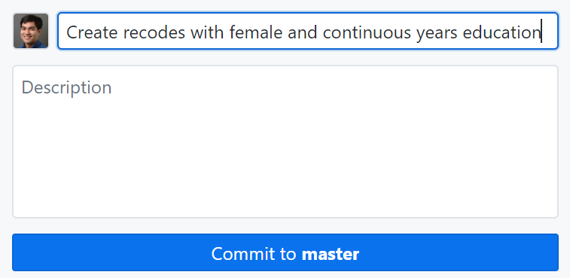
How would this work with Git? We document our changes by making snapshots with commits We will work in a repository, or repo The repo contains all our code and commits
recodes.do
set maxvar 30000
use GSS7218_R1.DTA
gen female = .
replace female = 1 if (sex == 2)
replace female = 0 if (sex == 1)
gen yearseduc = .
replace yearseduc = educ
What is master????

Slide 25
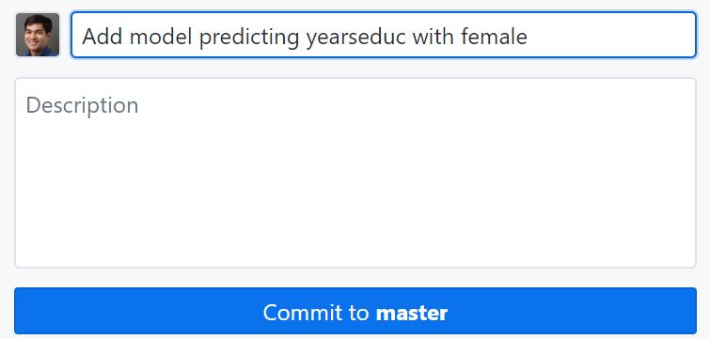
Your models file
models.do
reg yearseduc female

Slide 26
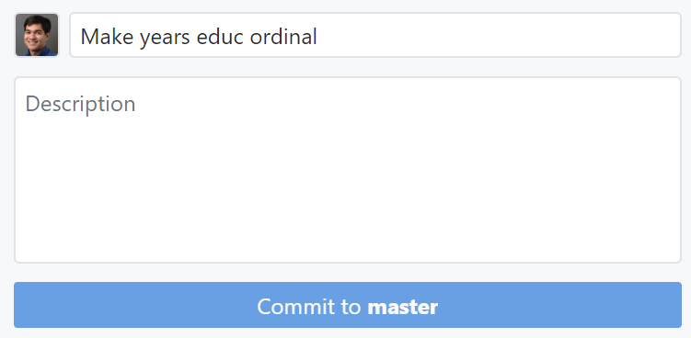
Recoding years educ as ordinal
recodes.do
set maxvar 30000
use GSS7218_R1.DTA
gen female = .
replace female = 1 if (sex == 2)
replace female = 0 if (sex == 1)
gen yearseduc = .
replace yearseduc = 1 if (educ <= 11) & (educ>=0)
replace yearseduc = 2 if (educ ==12)
replace yearseduc = 3 if (educ <= 15) & (educ>=13)
replace yearseduc = 4 if (educ <= 20) & (educ>=16)

Slide 27
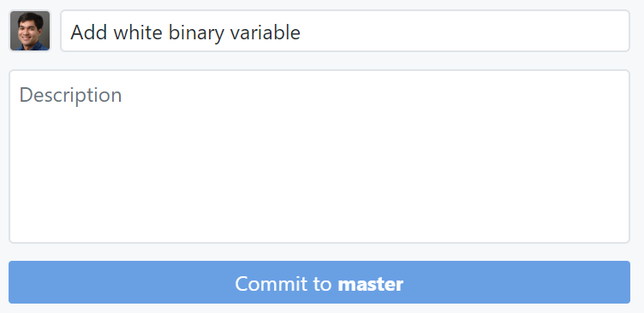
Adding recode for white
recodes.do
set maxvar 30000
use GSS7218_R1.DTA
gen female = .
replace female = 1 if (sex == 2)
replace female = 0 if (sex == 1)
gen yearseduc = .
replace yearseduc = 1 if (educ <= 11) & (educ>=0)
replace yearseduc = 2 if (educ ==12)
replace yearseduc = 3 if (educ <= 15) & (educ>=13)
replace yearseduc = 4 if (educ <= 20) & (educ>=16)
gen white = .
replace white = 1 if (race == 1)
replace white = 0 if (race == 2) | (race == 3)

Slide 28
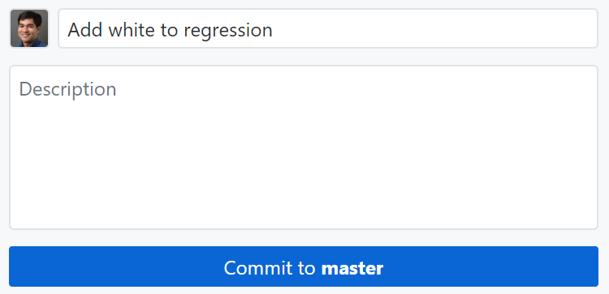
Updating your models
models.do
reg yearseduc female white

Slide 29
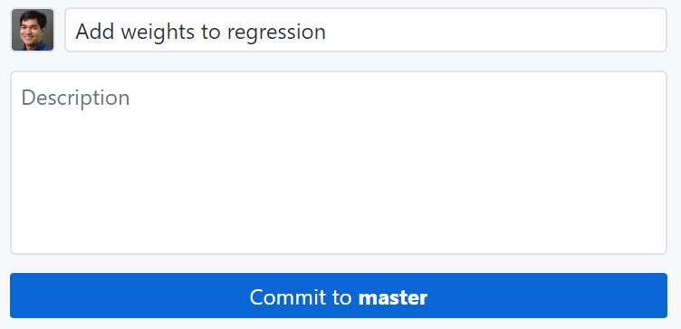
Weighted regressions
models.do
reg yearseduc female white [weight=wtssall]

Slide 30
Using Git, what did we do differently?
We did our work as usual, except after each “significant unit of work,” we paused and made a commit with a brief comment.
Each commit takes a snapshot of the entire repo at that point in time.
How often you commit is up to you.

Slide 31
What does this look like?
Much nicer!
C:\users\you> dir
recodes.do
models.do

Slide 32
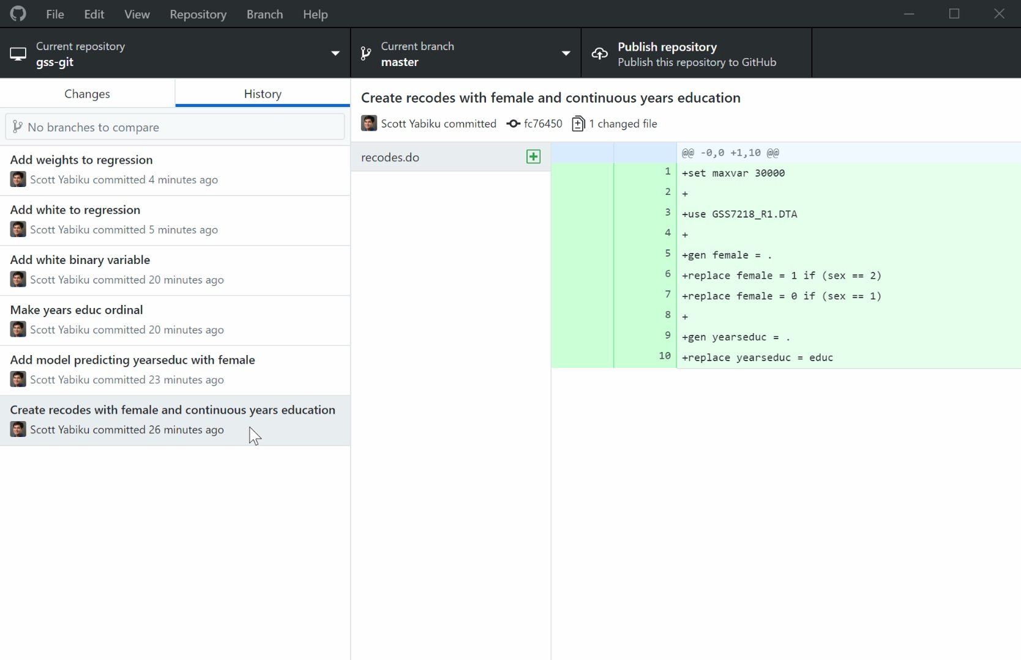
We also have a history of our commits The color coding on the right is a diff

Slide 33
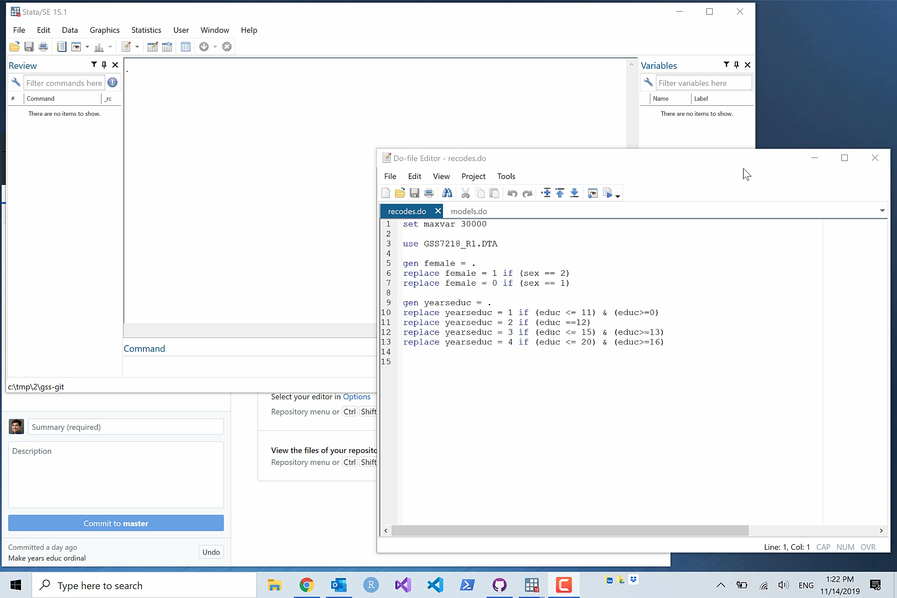

Slide 34
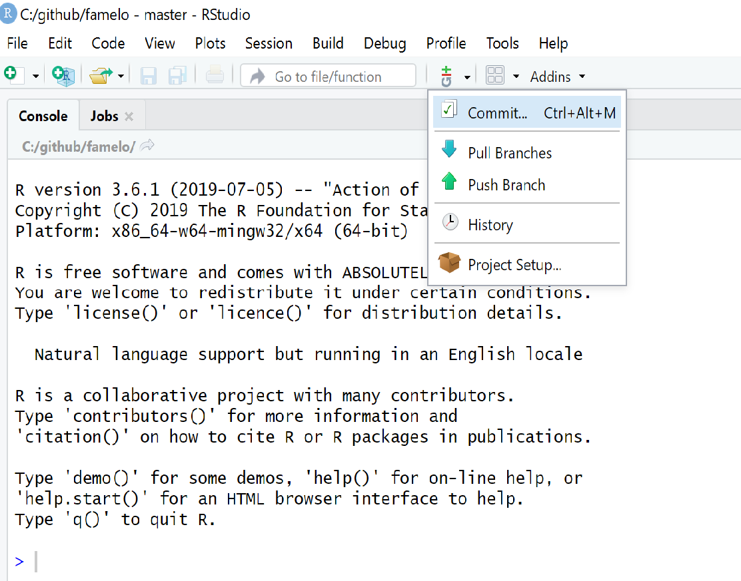
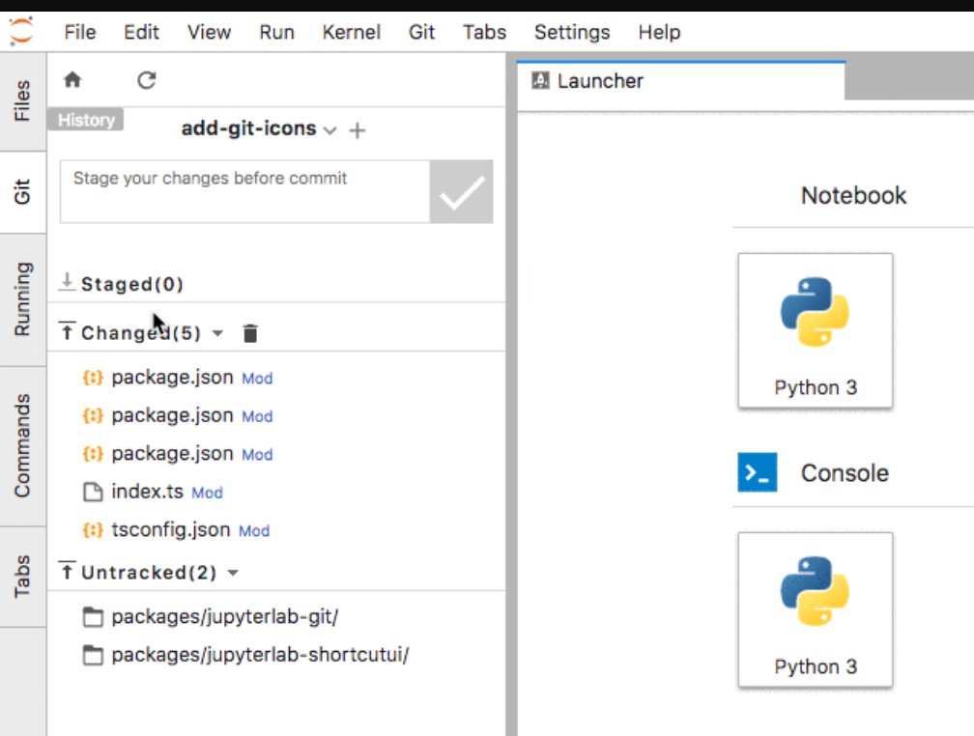

Slide 35
With this commit history, we can avoid some suck
“Let’s go back to the original models: predicting years of schooling with female, no weights. Send me the most recent code so I can replicate it and then try some ideas.”

Slide 36
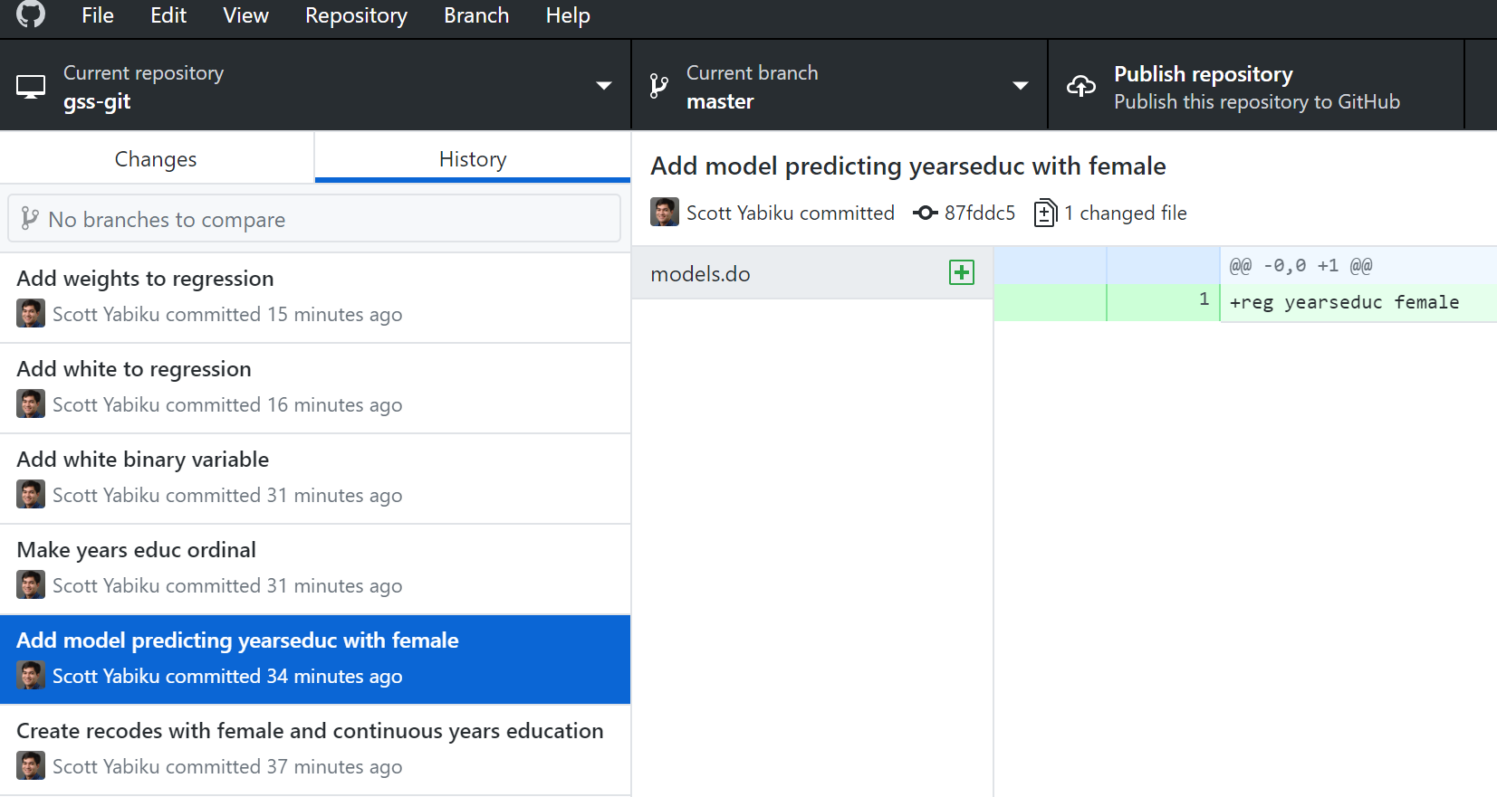
Let’s find that commit

Slide 37
Go back to the snapshot of all our files at that point in time. This will work with 2 files (like we have) or 20,000 files or…
This is now the contents of the files:
C:\users\you> git checkout 87fddc5
recodes.do
set maxvar 30000
use GSS7218_R1.DTA
gen female = .
replace female = 1 if (sex == 2)
replace female = 0 if (sex == 1)
gen yearseduc = .
replace yearseduc = educ
models.do
reg yearseduc female

Slide 38

Are you starting to understand the power of Git?

Slide 39
But…
“Thanks, I replicated our original analyses. But didn’t we also later do code for white and survey weights??? Can you send me that, but without the ordinal recoding?”

Slide 40
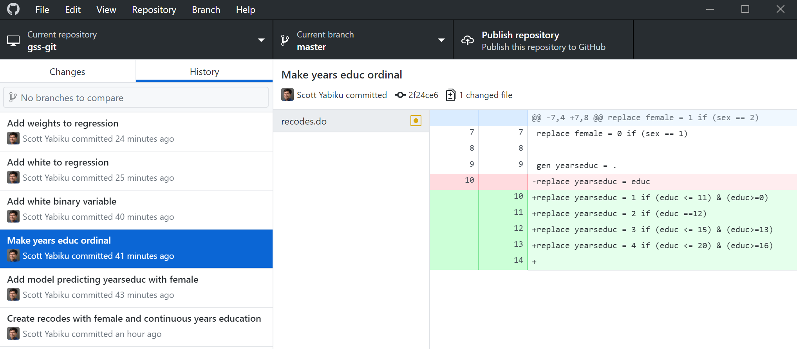
Look at the commit history again
I wish I hadn’t done this…

Slide 41
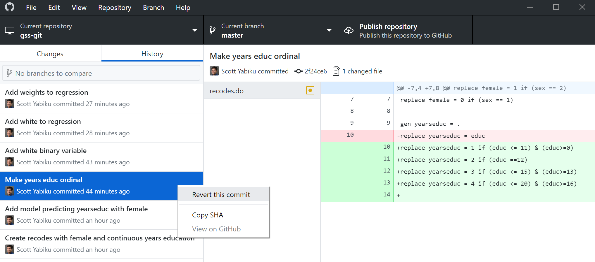
Revert!

Slide 42
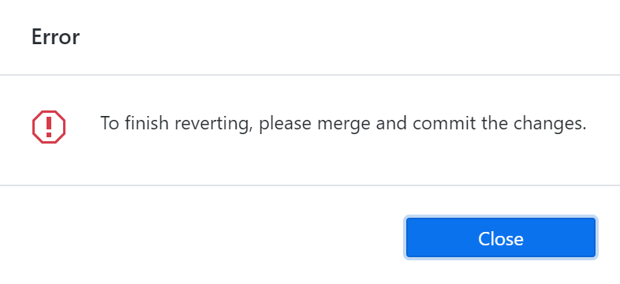
Merge conflict!
Git is telling you: “I can’t simply undo that commit, because it conflicts/interferes with other changes you have made after that commit.”

Slide 43
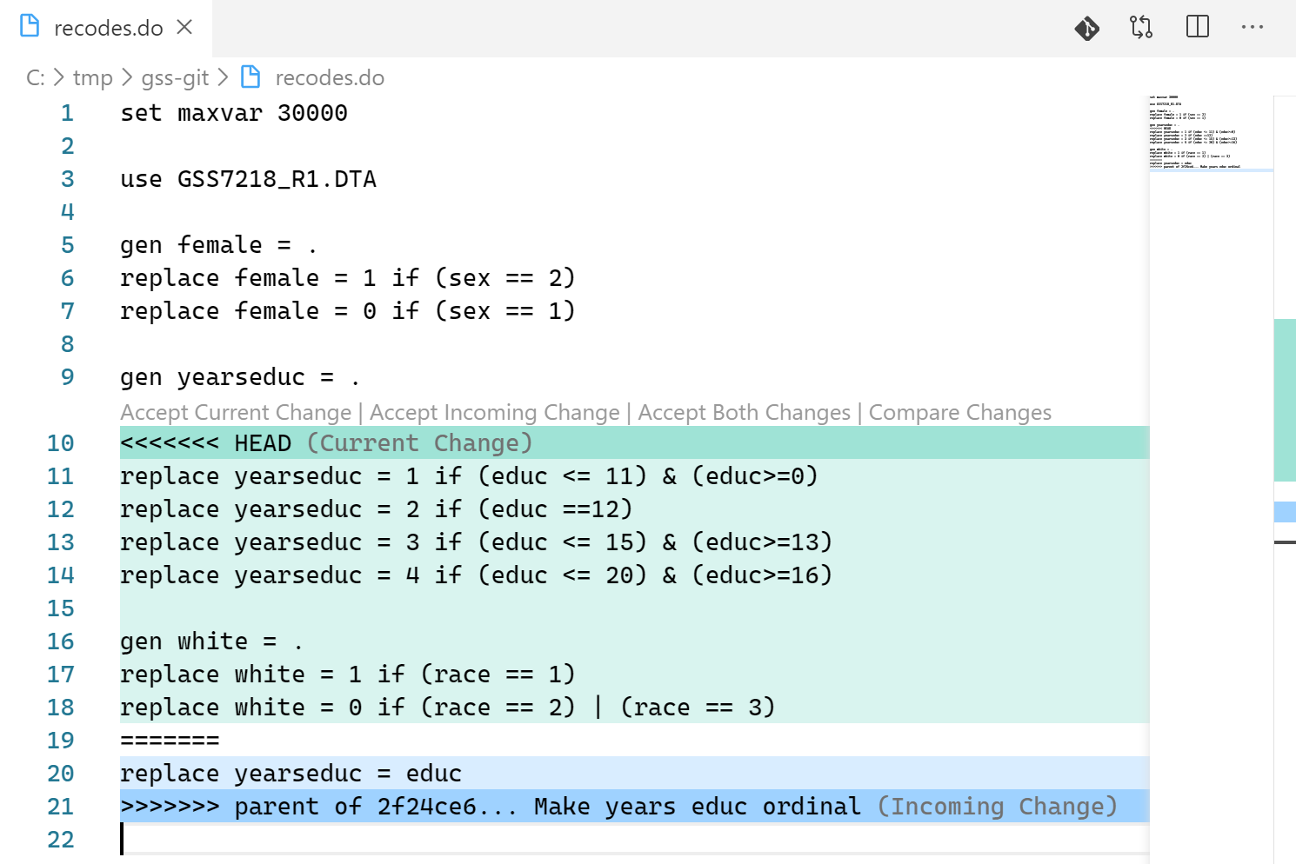
What does the merge conflict look like?

Slide 44
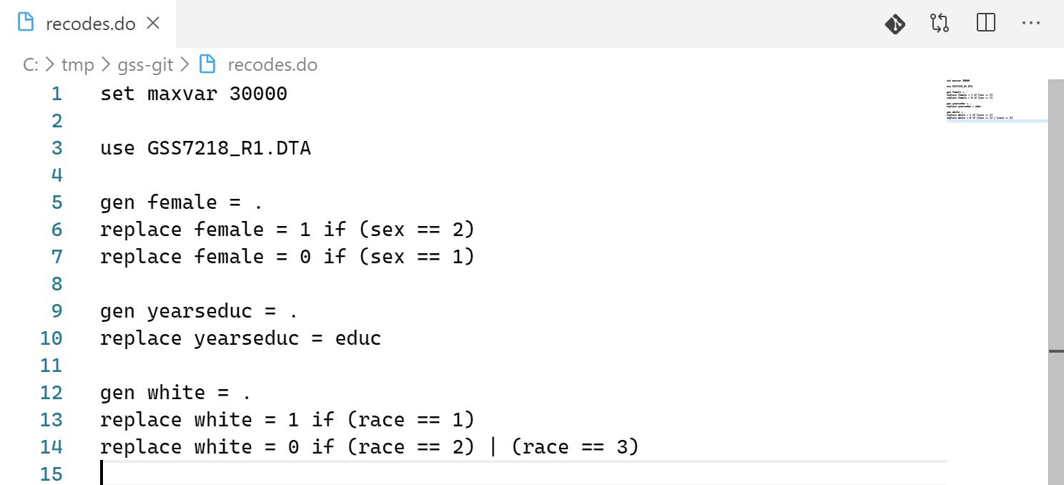
Resolve the merge conflict

Slide 45
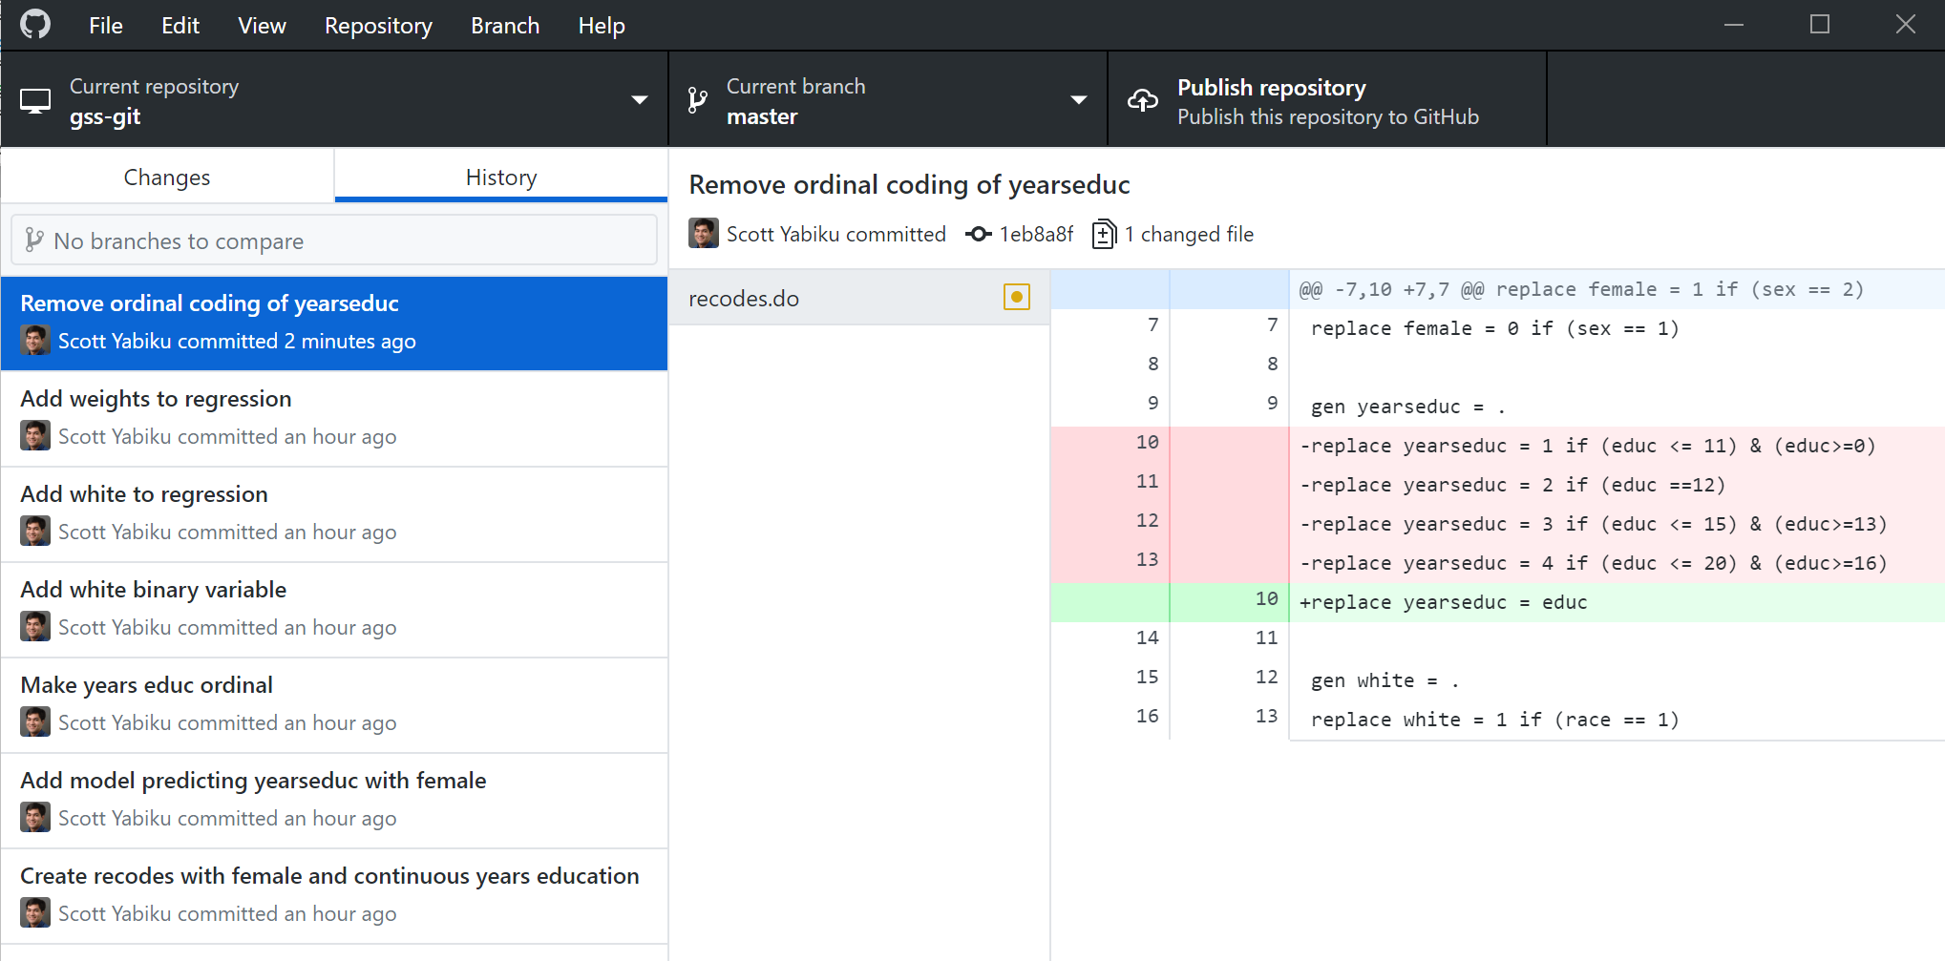
And commit

Slide 46
What’s the state of our repository now?
recodes.do
set maxvar 30000
use GSS7218_R1.DTA
gen female = .
replace female = 1 if (sex == 2)
replace female = 0 if (sex == 1)
gen yearseduc = .
replace yearseduc = educ
gen white = .
replace white = 1 if (race == 1)
replace white = 0 if (race == 2) | (race == 3)
models.do
reg yearseduc female white [weight=wtssall]

Slide 47
Another benefit of Git
Freedom to make changes to your code without feeling anxiety about “messing it up”

Slide 48
Ask yourself…
Git is an essential tool for organized and reproducible quantitative research
Do you agree? Then you’ll put in the effort to learn
Skeptical? Then it’s still a leap of faith.

Slide 49
Learning Git
Command line or GUI (graphical user interface)?
Free interactive online resources
https://www.katacoda.com/courses/git
https://www.datacamp.com/courses/introduction-to-git-for-data-science (first module is free)

Slide 50
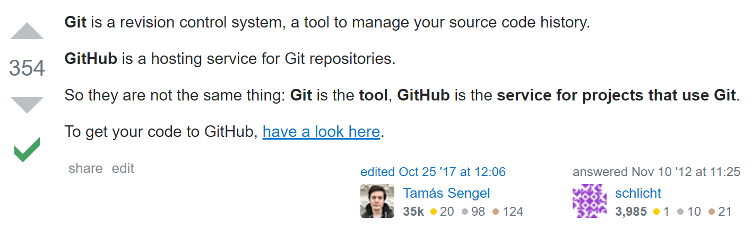
What is GitHub?
Git is the version control system. GitHub is an online service that lets you back up your repo (push) to the cloud privately; or you can share your repo publicly and allow others to copy it (clone). It also permits collaboration: multiple people making commits to the same repo.
Git can be used on its own. But you can’t use GitHub without Git.

Slide 51
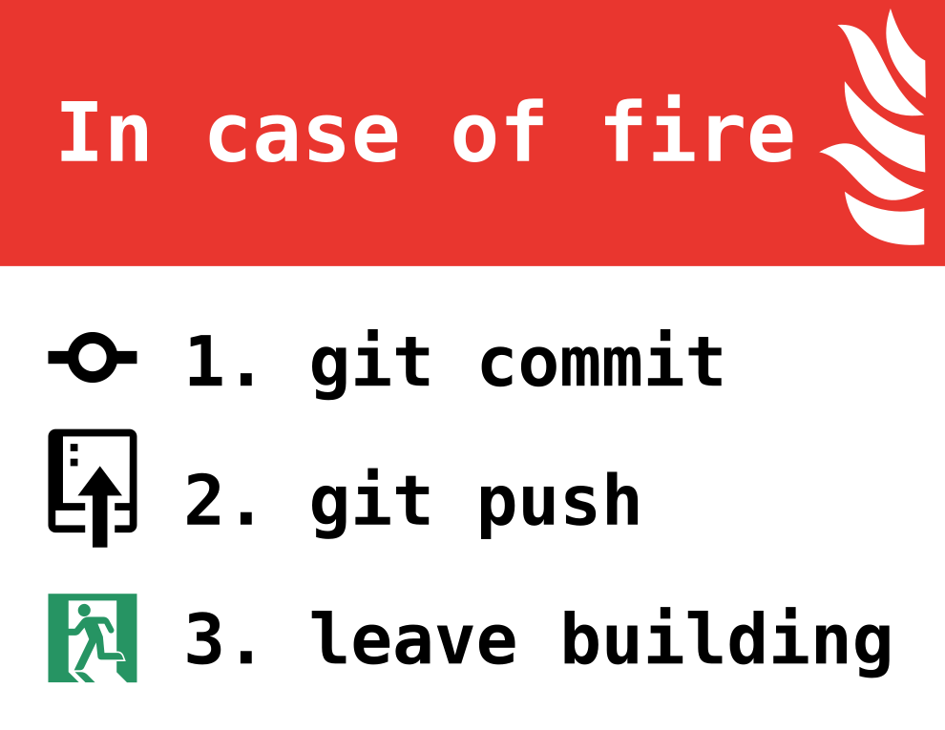
Lastly…
https://github.com/louim/in-case-of-fire/blob/master/in_case_of_fire.png

