Slide 1
Real-Time Bidding by Reinforcement Learning in Display Advertising
Name: Shreya Goswami
Roll Number: MCS21023

Slide 2
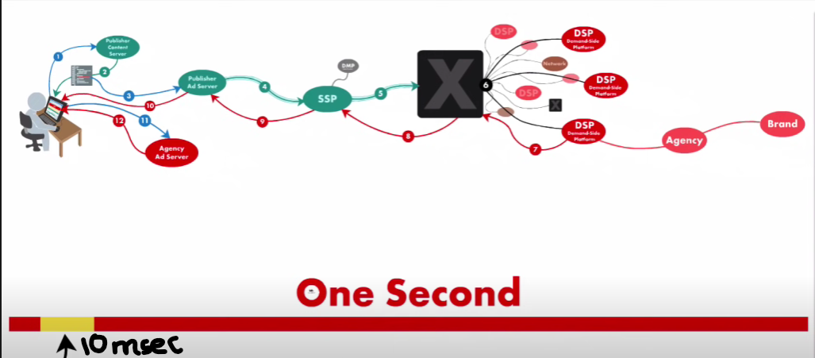
Introduction: How is an ad served in Real Time Bidding?

Slide 3
Steps in RTB
When you visit a publisher’s web page, the publisher is the website owner. Publishers generate content such as news, music. This content draws an audience. The publisher sells ad space to advertisers who want to reach that audience. Upon visiting the publisher’s web page, the browser opens a connection to the publisher’s server.
The publisher’s server then assembles content for the page after returning the requested content in the form of HTML. The browser begins to interpret and render it. At least one line of that HTML code represents an opportunity to display an ad. Within that line of code, there’s a URL that tells the browser where to go to retrieve ad content.
The publisher has an ad server that uses built in logic to choose what happens next by asking important questions like, “ Is there anything I know about the consumer viewing my content that will help me decide which advertisers should get this opportunity if the ad space isn’t reserved for any specific advertiser?” The publisher ad server may decide to put this opportunity in the open ad market where they might get a better deal.
To put the opportunity in the open market, the publisher ad server connects to an SSP(Supply Side Platform). A platform that the publisher uses to monetize its programmatic ad inventory. The SSP applies additional logic asking, “Have I seen this consumer before?”
Using that acquired knowledge, it sends the ad request to an Ad Exchange.
Meanwhile, the Ad Exchange has been busy connecting to and communicating with potential buying systems. These systems include DSPs(Demand Side Platform) and networks. In the next step, the exchange says to all of its partners, “If you want a chance to show an ad to a person meeting a specific criteria, tell me how much you are willing to pay and do it in less than 10 milliseconds.“ Exchange buyers respond in that time and the exchange selects a winning bid.

Slide 4
Steps in RTB(contd…)
The winning DSP passes instructions to the exchange for retrieving the ad creative.
The exchange passes those instructions to the SSP.
The SSP sends the request to the publisher ad server.
Finally the publisher ad server responds to the still open HTTP connection telling the browser to go to the agency ad server for the ad.
The agency ad server tracks ad performance for advertisers and upon receiving ad request and upon receiving ad request originating from the DSP with the winning bid, the agency ad server records the request as an impression. Impression=1
Now the web browser can finally render the ad within the web page content resulting in the delivery of an ad most appropriately matched to you.

Slide 5
Survey
The paper ‘Real-Time Bidding in Reinforcement Learning in Display Advertising’ was written and implemented by the following Organizations and Universities:
Alibaba Group, Beijing, China
University College London, London, United Kingdom
Shanghai Jiao Tong University, Shanghai, China

Slide 6
Problem and Formulation
In a RTB ad auction, each bidding agent acts on behalf of its advertiser and generates bids to achieve the campaign’s specific target.
The optimization target is to maximize the user responses on the displayed ads if the bid leads to auction winning. We consider clicks as our targeted user response objective, while other KPIs=Key Performance Indicator can be adopted similarly.

Slide 7
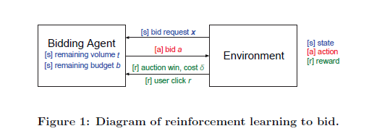
Diagram of Reinforcement Learning to Bid

Slide 8
Problem Definition
Consider bidding in display advertising as an episodic process where each episode comprises T auctions which are sequentially sent to the bidding agent.
A high dimensional feature vector x, which is indexed via one-hot binary encoding. Each entry of x corresponds to a category in a field. The feature vector x is basically a bid request.
The agent is initialized with a budget B, and the advertising target is set to acquire as many clicks as possible during the following T auctions.
Three main pieces of information are considered by the agent (i) the remaining auction number (ii) the unspent budget (iii) the feature vector x. During the episode, each auction will be sent to the agent sequentially and for each of them the agent needs to decide the bid price according to the current information t, b and x.

Slide 9
Problem Definition (contd..)
The agent maintains the remaining number of auctions t and the remaining budget b.
At each timestep, the agent receives an auction x ∈ X (the feature vector space), and determines its bid price a. We denote the market price p.d.f. given x as m(δ,x), where δ is the market price and m is its probability.
If the agent bids at price a>=δ , then it wins the auction and pays , and the remaining budget changes to b - δ . In this case, the agent can observe the user response and the market price later.
Alternatively, if losing, the agent gets nothing from the auction. We take predicted CTR(click through rate) (pCTR) (x) as the expected reward, to model the action utility. After each auction, the remaining number of auctions changes to t -1. When the all auctions of this episode runs out, the current episode ends and both the remaining auction number and budget are reset.

Slide 10
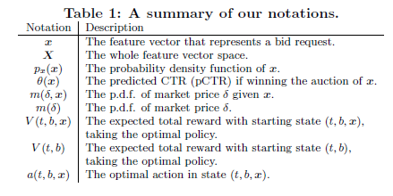
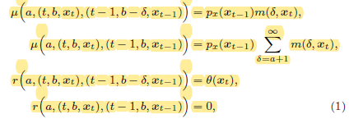


MDP Formulation of RTB
Transition probabilities and reward function:
Optimal Value function:

Slide 11
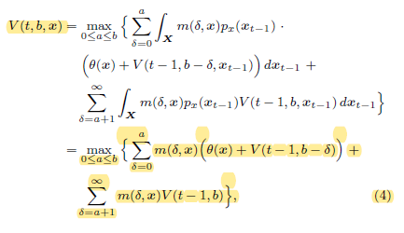

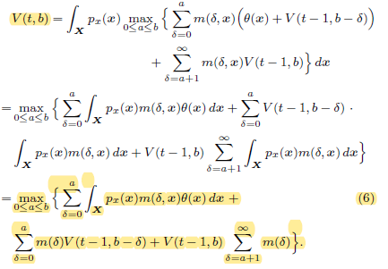
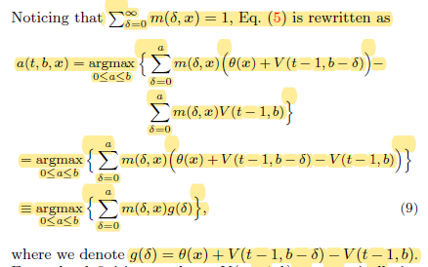
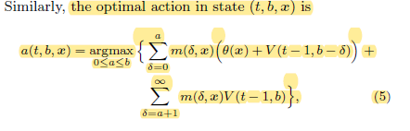
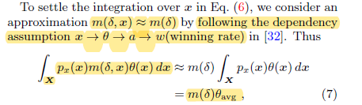

Dynamic Programming Solution

Slide 12
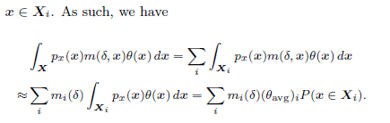
Derived Policy
Approximation of V (t,b)
Our derived policy (denoted as RLB) adjusts its bidding function according to current t and b.
RLB also introduces a linear form bidding function when b is large, but decreases the slope w.r.t. decreasing b and increasing t. When b is small (such as b < 300), RLB introduces a non-linear concave form bidding function.

Slide 13
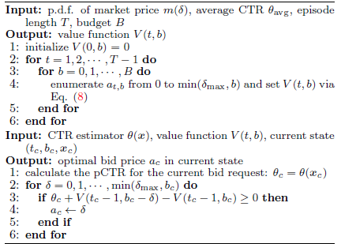
Algorithm 1: Reinforcement Learning to Bid

Slide 14
Experimental Setup:
1. Dataset:
iPinYou is one of the mainstream RTB ad companies in China. The whole dataset comprises 19.5M impressions, 14.79K clicks and 16.0K CNY(Chinese yuan renminbi (CNY) refers to the currency used in the People's Republic of China.) expense on 9 different campaigns over 10 days in 2013.

Slide 15
2. Evaluation Methods
The evaluation is from the perspective of an advertiser’s campaign with a predefined budget and lifetime (episode length).
Evaluation metrics:
The main goal of the bidding agent is to optimise the campaign's KPI (e.g., clicks, conversions, revenue, etc.) given the campaign budget. In our work, we consider the number of acquired clicks as the KPI, which is set as the primary evaluation measure in our experiments. We also analyze other statistics such as win rate, cost per milli impressions (CPM) and effective cost per click (eCPC).
Evaluation flow:
We divide the test data into episodes, each of which contains T records and is allocated with a budget B. Given the CTR estimator and the bid landscape forecasting, the bidding strategy goes through the test data episode by episode. Specially, the bidding strategy generates a price for each bid request (the bid price cannot exceed current budget). If the bid price is higher than or equal to the market price of the bid request, the advertiser wins the auction and then receives the market price as cost and the user click as reward and then updates the remaining auction number and budget.

Slide 16
Budget constraints:
Budget constraints should not be higher than the historic total cost of the test data. We determine the budget B in this way: B = CPM_{train} x 10⁻³ x T x c₀, where CPM_{train} is the cost per milli impressions in the training data and c₀ acts as the budget constraints parameter. We run the evaluation with c₀ = 1/32; 1/16; 1/8; 1/4; 1/2.
Episode length:
The episode auction number T influences the complexity of our algorithms. When T is high, the original Algorithm 1 is not capable of working with limited resources. For the small-scale evaluation, we set the episode length as 1,000. In addition, we run a set of evaluations with c0 = 0.2 and the episode length T = 200; 400; 600; 800; 1000 to give a more comprehensive performance analysis.

Slide 17
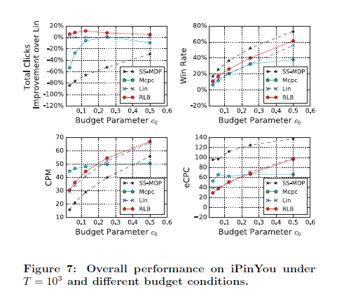
3. Compared Methods
The following bidding policies are compared with the same CTR estimation component which is a logistic regression model and the same bid landscape forecasting component which is a non-parametric method.
SS-MDP:
It considers the bid landscape but ignores the feature vector of bid request when giving the bid price.
MCPC:
gives its bidding strategy as a Mcpc(t; b; x) = CPC (x), which matches some advertisers' requirement of maximum CPC (cost per click).
Lin:
is a linear bidding strategy w.r.t. the pCTR: a_{Lin}(t; b; x)= b₀(theta x)/(theta avg), where b₀ is the basic bid price and is tuned using the training data.
RLB:
is our proposed model for the small-scale problem

Slide 18
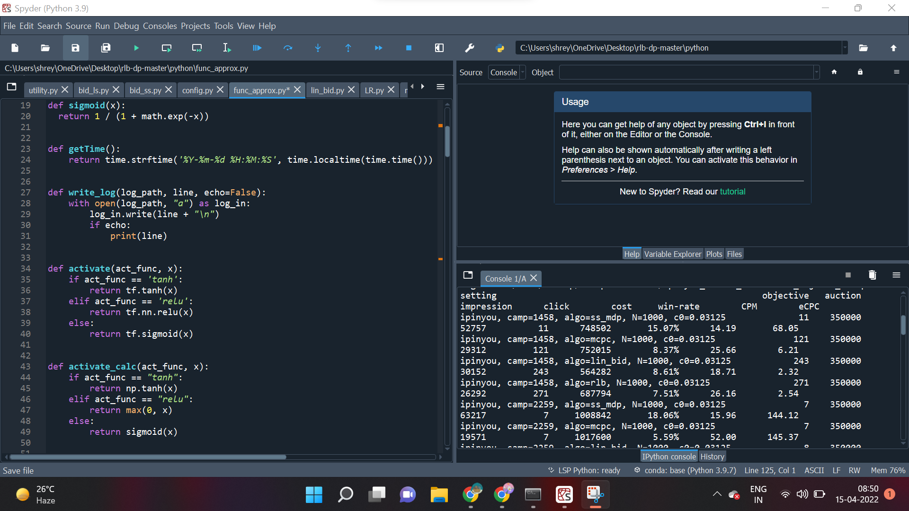
Experimental Results: Small-Scale Evaluation
Source Code
Output

Slide 19
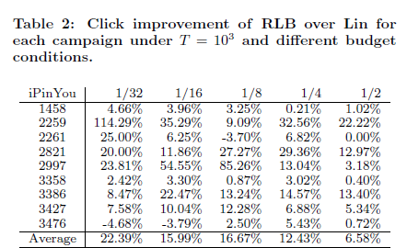
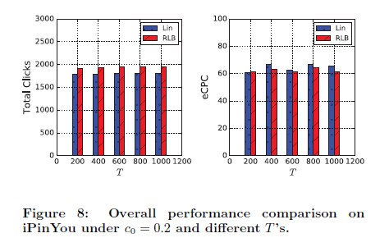
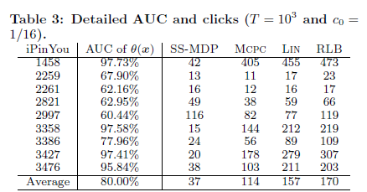
Experimental Results (contd..)

Slide 20
Code
Github link for the code and output results: https://github.com/iiShreya/Real-Time-Bidding-Using-RL

Slide 21
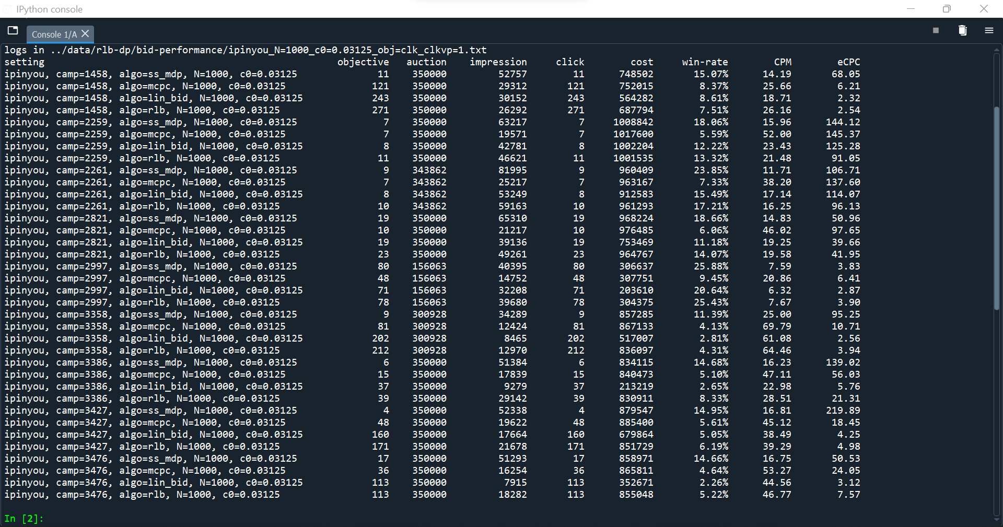
Results : output of the small-scale evaluation on ipinyou dataset These results are produced from a subset (the first 3,50,000 lines of each campaign in iPinYou) under T = 1000 and c0 = 1/32

Slide 22
Conclusion
Proposal of a model-based reinforcement learning model (RLB) for learning the bidding strategy in RTB display advertising.
The bidding strategy is naturally defined as the policy of making a bidding action given the state of the campaign's parameters and the input bid request information. With an MDP formulation, the state transition and reward function are captured via modeling the auction competition and user click, respectively. The optimal bidding policy is then derived using dynamic programming.
Experimental results on a real-world dataset demonstrated the superiority of our RLB solutions over several strong baselines and state-of-the-art methods, as well as their high efficiency to handle data.

Slide 23
Future Work
There will be investigation of model-free approaches such as Q-learning and policy gradient methods to unify utility estimation, bid landscape forecasting and bid optimization into a single optimization framework and to handle the highly dynamic environment.
Also, since RLB naturally tackles the problem of budget over- or under-spending across the campaign lifetime, there will be comparison of the discussed RLB solutions with the explicit budget pacing techniques

Slide 24
References
Research Paper : Real-Time Bidding by Reinforcement Learning in Display Advertising
by Han Cai, Kan Ren, Weinan Zhang, Kleanthis Malialis, Jun Wang, Yong Yu, Defeng Guo

Slide 25
THANK YOU

