Slide 1
Progress Report: Inital Training
By: Team 10

Slide 2
Model Training
Trained with ~60,000 sentence / emotion pairings
Utilized pre-trained KoELECTRA model
Percentage-based prediction

Slide 3
Cross Validation Method
K-fold Cross Validation
5 folds
Epoch = 5, 10

Slide 4
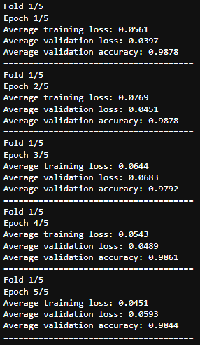
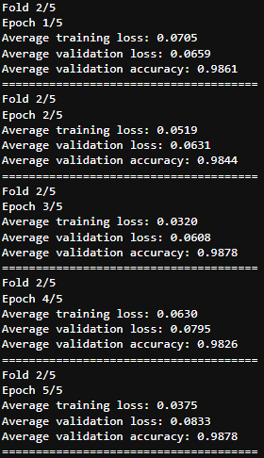
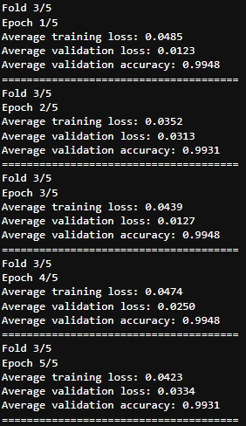
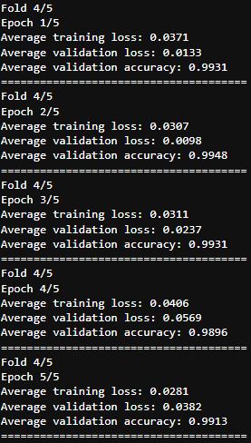
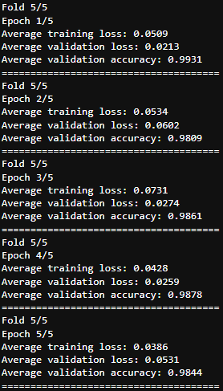
Cross Validation Results (e=5)

Slide 5
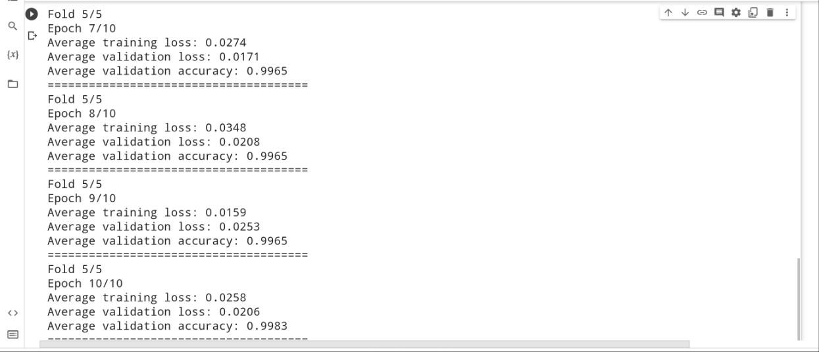
Cross Validation Results (e=10)

Slide 6
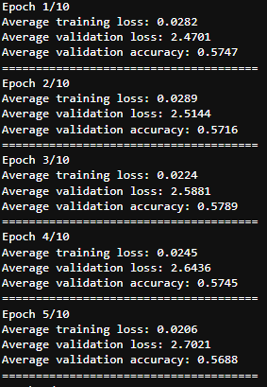
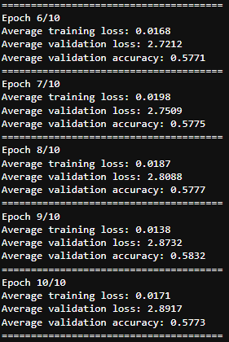
Training Results
Epoch = 10
Training loss = 0.017
Validation loss = 2.89
Accuracy = 0.57

Slide 7
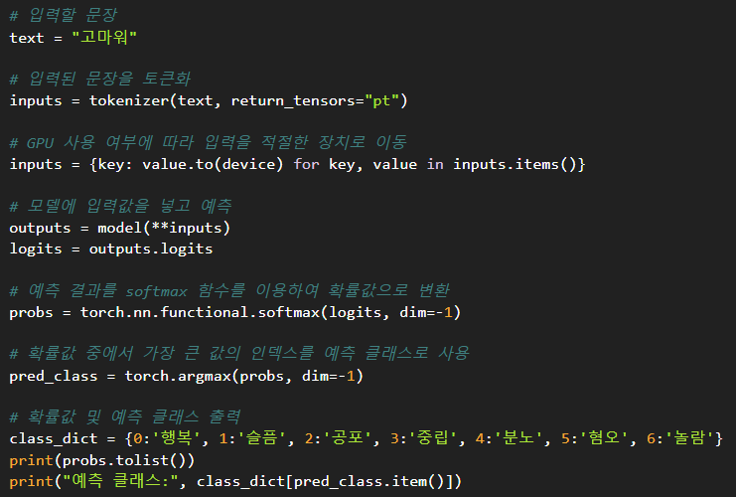
Prediction Results

Slide 8
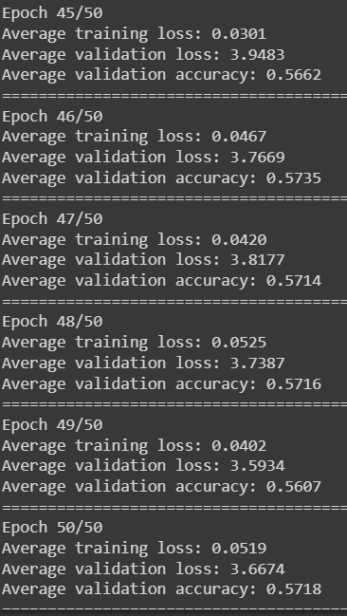
Overfitting
Validate using cross validation & high epoch value
High validation accuracy & consistent results even on Epoch count

Slide 9
Future Directions
Produce new model that utilizes Named Entity Recognition to procure training data for sentiment analysis
Use current model as baseline and compare against new model

