Slide 1
Internet-in-a-Box
Project
Sharing the world's Free information
Presented by
Braddock Gaskill
Humane Informatics LLC
SGVHAK
11 April 2013
SGVLUG

Slide 2
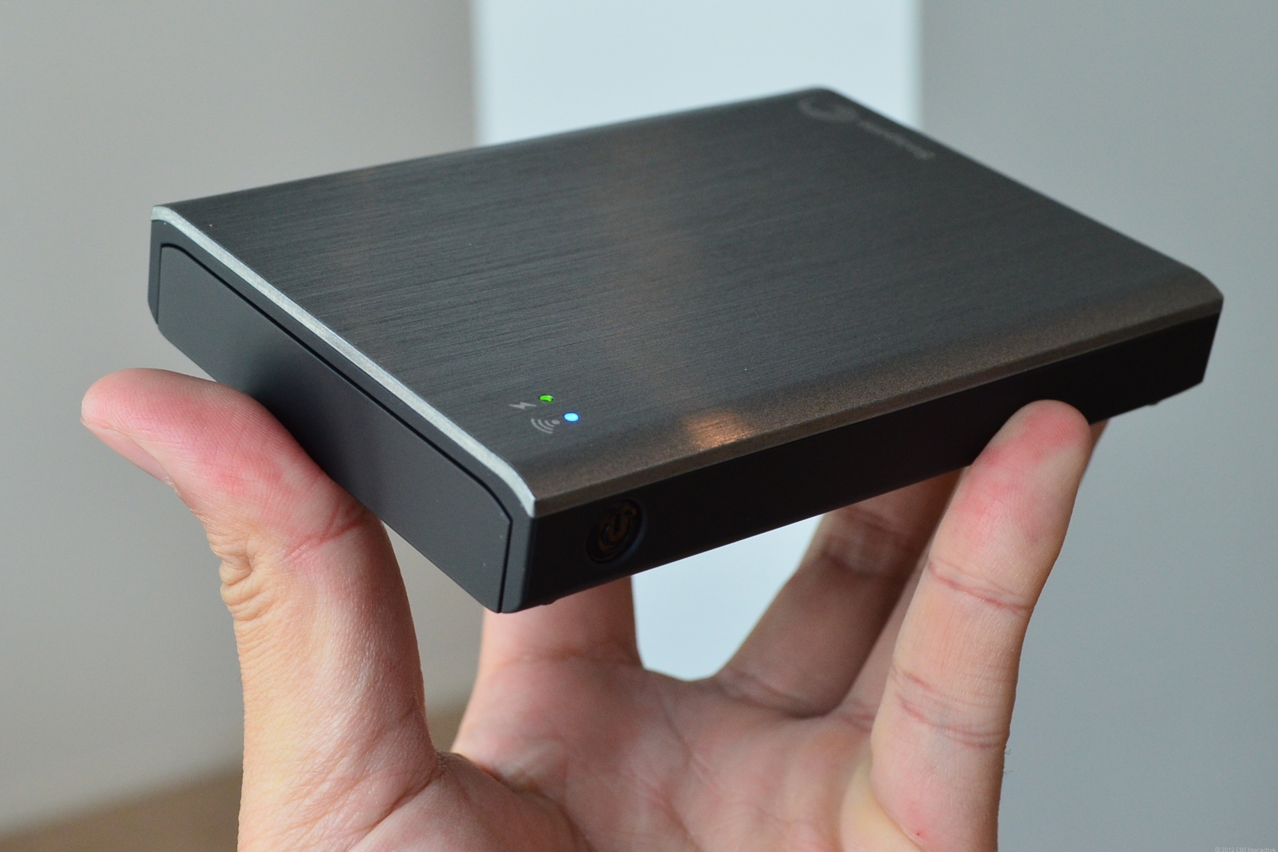
What is an Internet-in-a-Box?

Slide 3
What is an Internet-in-a-Box?
a small, inexpensive device ($250)
essential Internet resources without any Internet connection.
a local copy of almost a terabyte of the world's Free information.

Slide 4
Resources
Wikipedia: 40 languages
Maps: world-wide to street level
E-books: 40,000 books in many languages
Software: Open Source. Linux OS with all software package repositories. Source code.
Video: 500+ hours of instruction

Slide 5
For Who?
For schools and communities in the developing world.

Slide 6
Why?
Internet access is still expensive and difficult in the developing world
Inexpensive media now exists that can hold vast offline libraries of information
Large sources of content are available
Inexpensive reader devices now exist which can read libraries on media

Slide 7
Internet Penetration
70% use internet in ”developed” countries
Only 24% use internet in ”developing” countries*
* 2013, Napoli & Obar

Slide 8
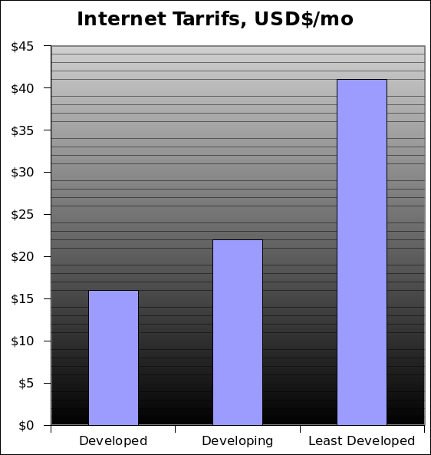
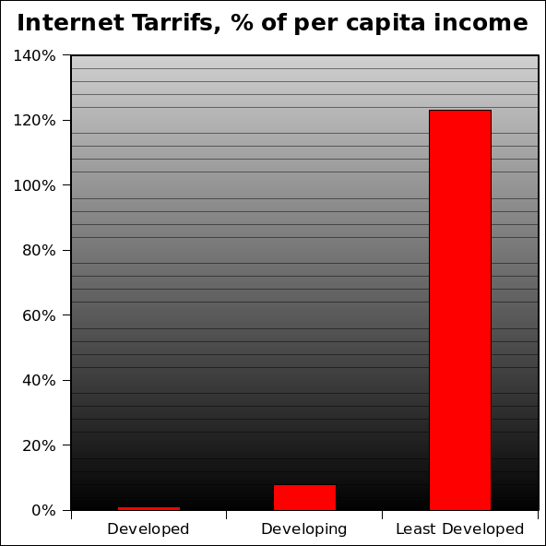
Internet Cost
Cost for 20 hours of dialup per month
8%
$492/yr
123%
$264/yr
1%
Global Information Society: A Statistical View 2008

Slide 9
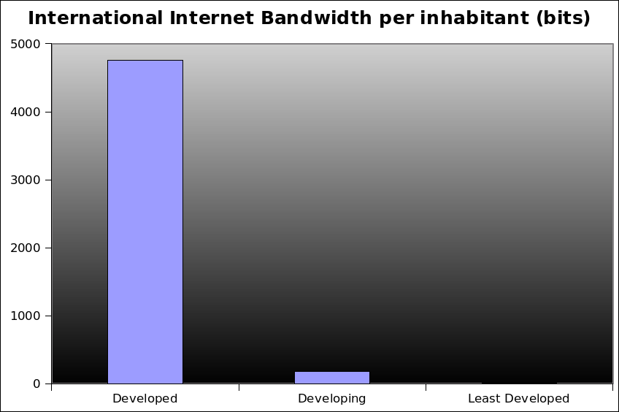
Internet Capacity
Deficit of internet infrastructure
4755
177
7
Global Information Society: A Statistical View 2008

Slide 10

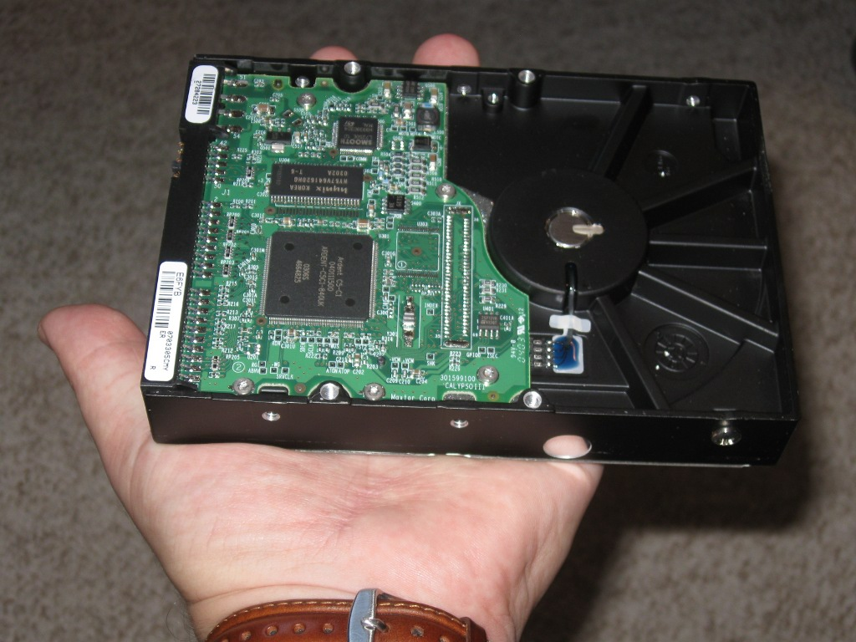
We Have The Technology
Half of the US Library of Congress Printed Collection would fit on ONE hard drive (text only)

Slide 11
The Law
You are NOT allowed to share most information

Slide 12
What can we share?
Open Source
  -Explicitly licensed for sharing
Public Domain
  Generally, pre-1923 is Free
  Congress often retro-actively extending. New material from 1923 starting in 2019 IF nothing changes.
  Some exceptions, it's complicated

Slide 13
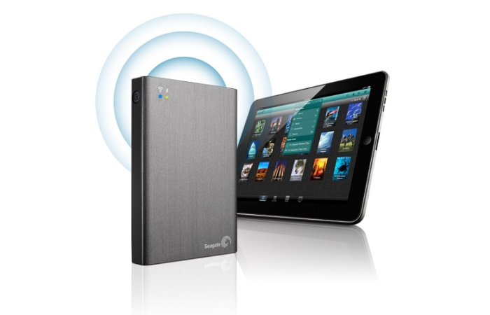
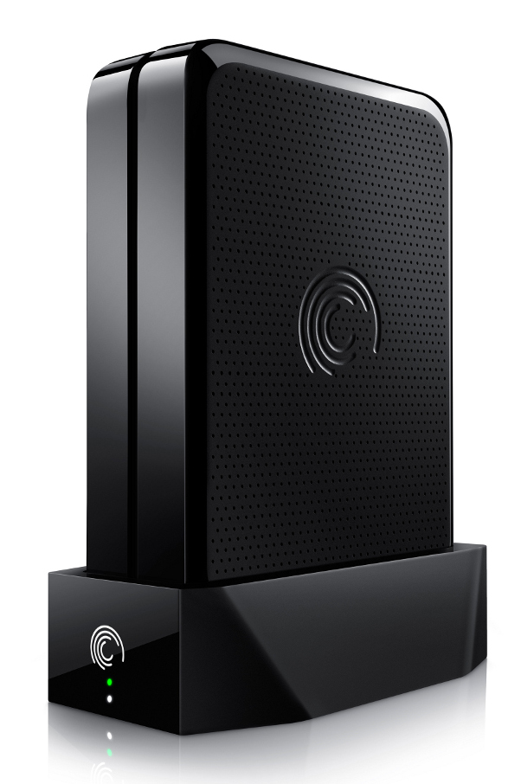

Wired and Wireless
Wireless
  Wifi Hotspot
  Battery
  Solar option
Wired
  Connect to existing network
  Network appliance

Slide 14

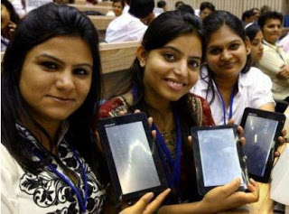

User Devices
One Laptop
Per Child
2.5 Million
users
Tablets
$50 in India
Phones
with wifi

Slide 15
Demo

Slide 16
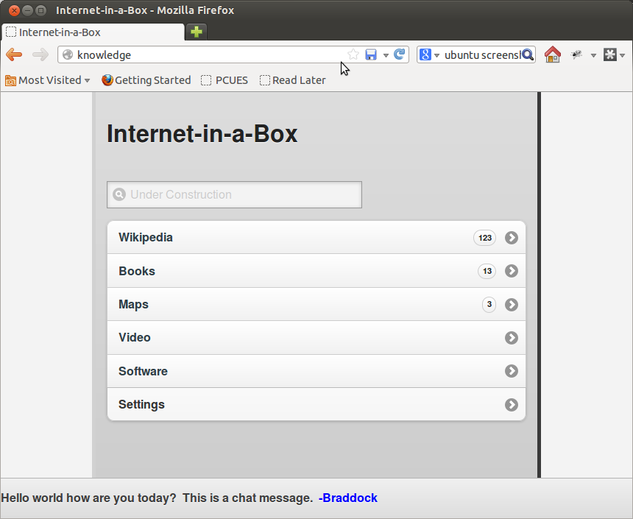
Main Menu

Slide 17
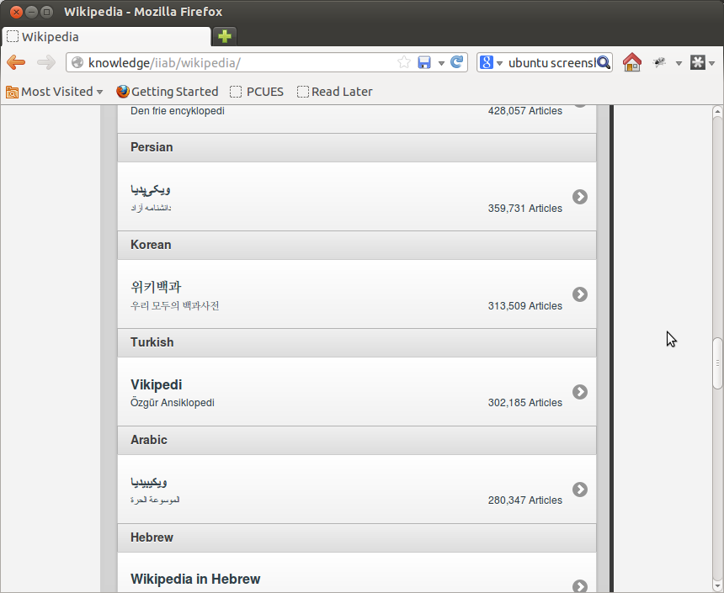
Wikipedia

Slide 18
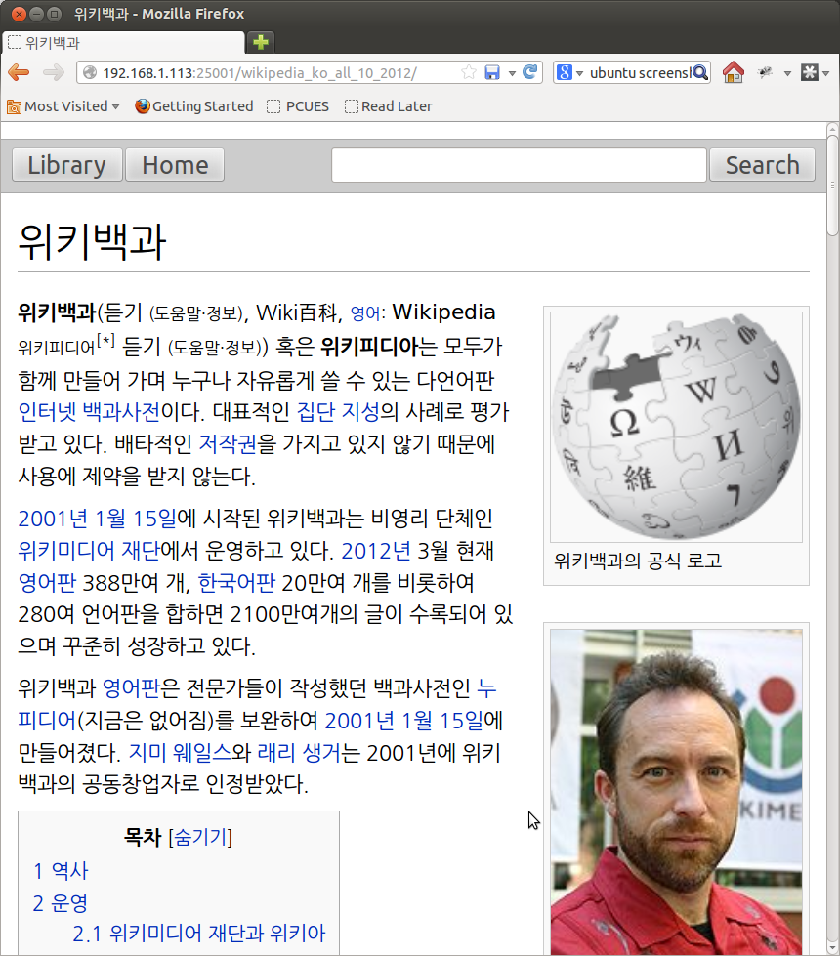
Wikipedia Article

Slide 19
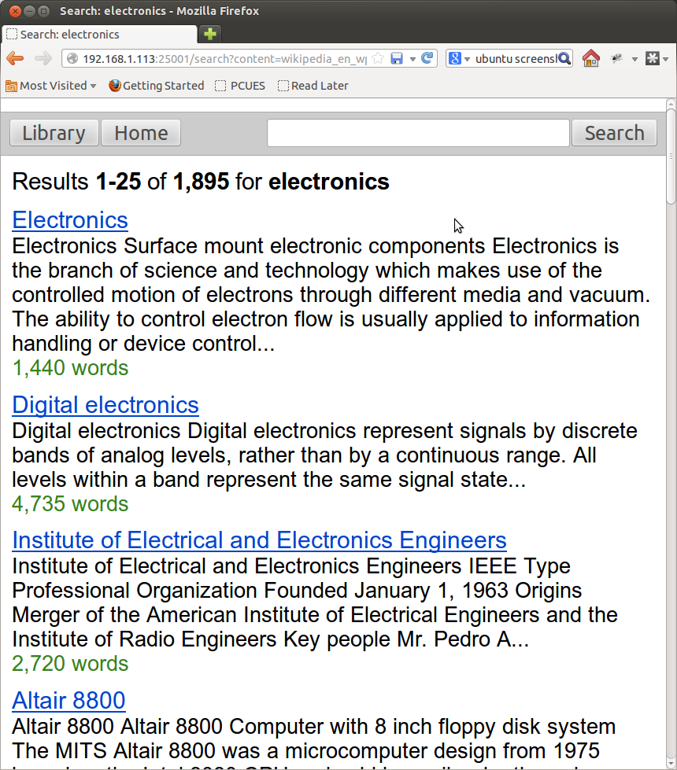
Wikipedia Search

Slide 20
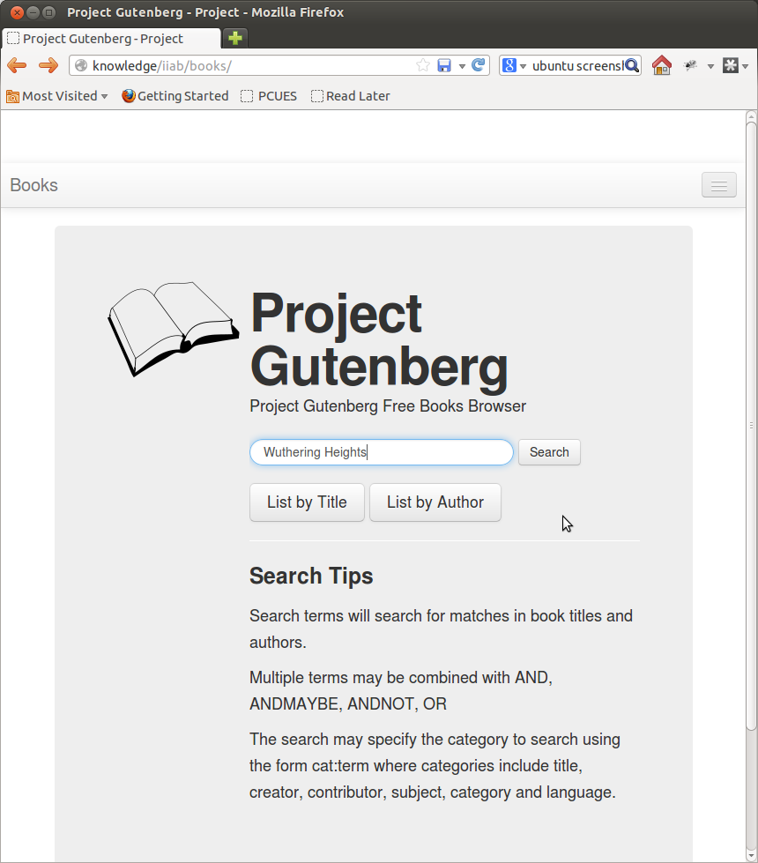
Books

Slide 21
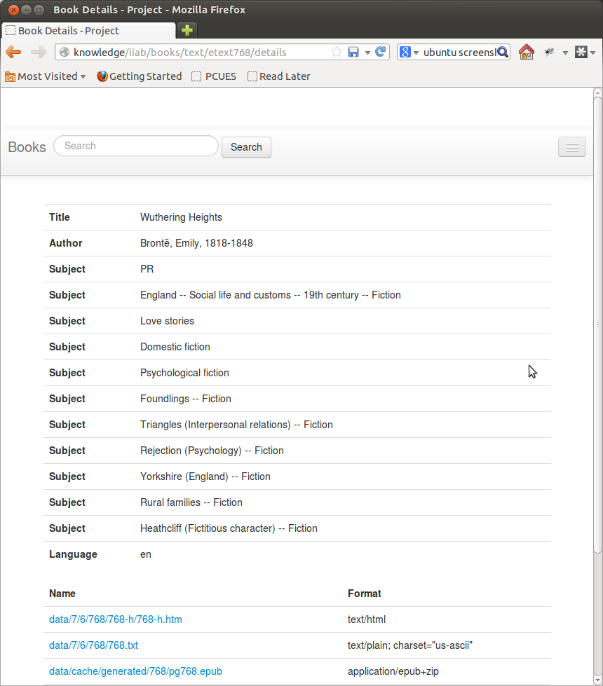
Books

Slide 22
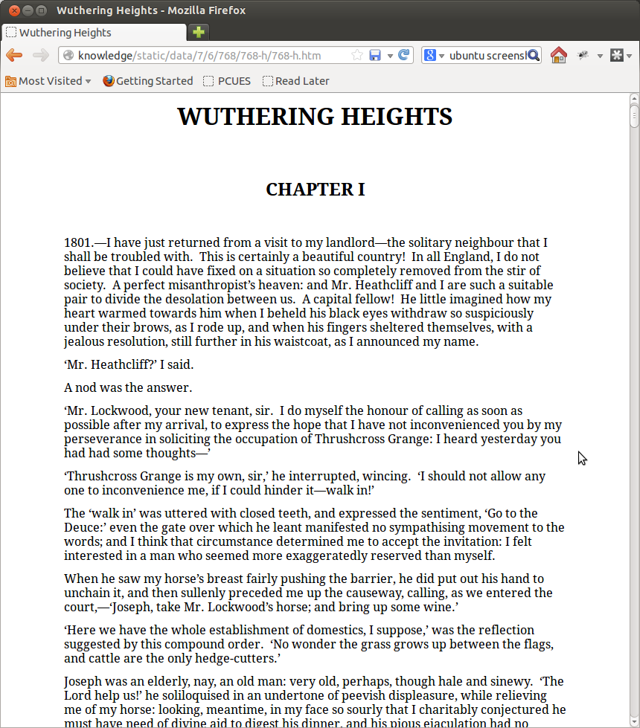
Read

Slide 23
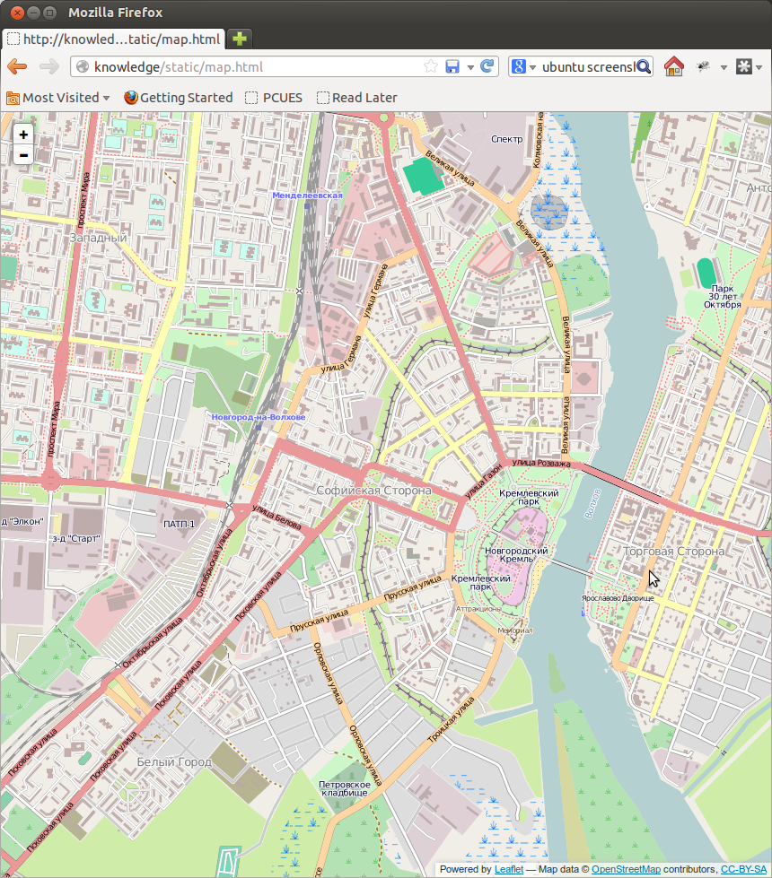
Maps

Slide 24
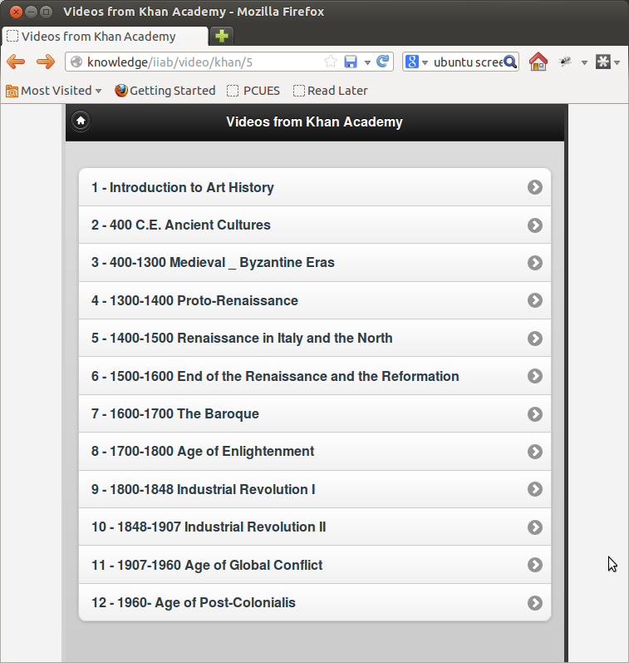
Video

Slide 25
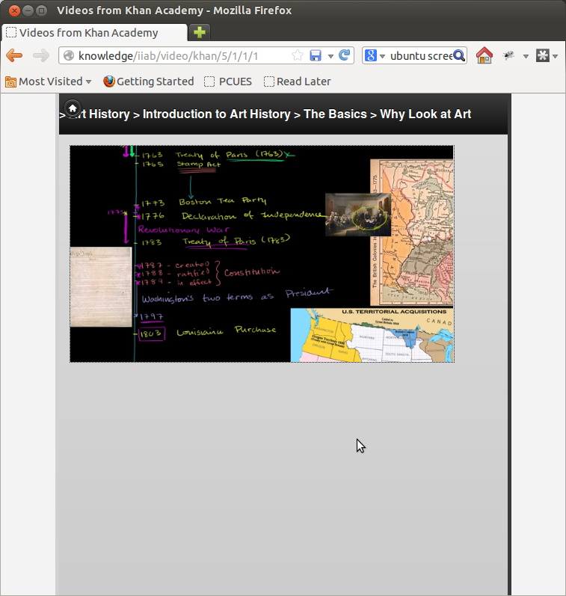
Video

Slide 26
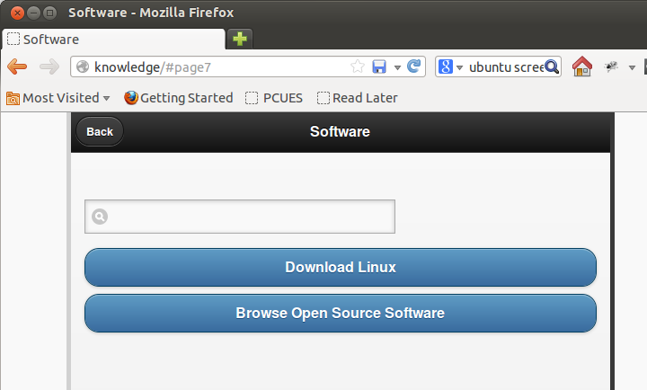
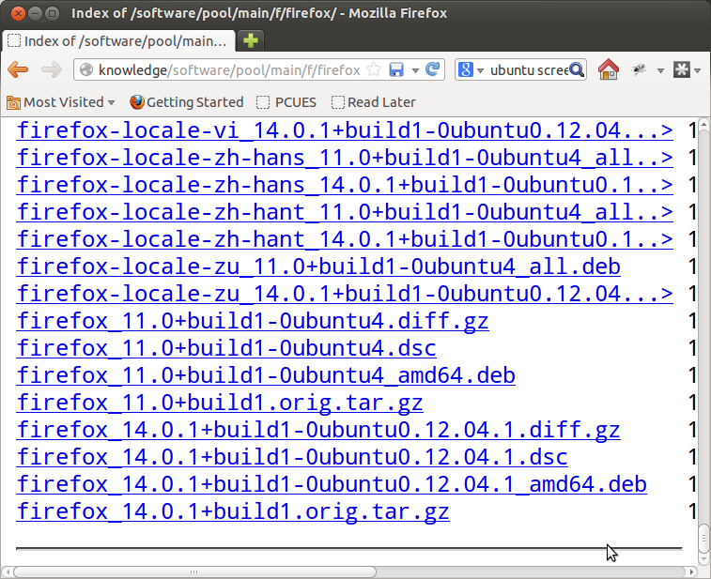
Software

Slide 27
Made Possible By
Books – Project Gutenberg
  Joel Steres (book browser)
Wikipedia - Kiwix and OpenZim
  Emmanuel Engelhart (kiwix)
Hardware – Arch Arm
  Mike Brown and Jeff Doozan (uboot)
SGVHAK – James, Michael S, Doug, et al
Maps – Open Street Map
Video – Khan Academy, Zurd torrent
Software – Ubuntu, Linux community

Slide 28
Resources
Braddock Gaskill
Internet-in-a-Box Project Lead
braddock@braddock.com
http://internet-in-a-box.org

Slide 29
Try It Now!
Wifi Hotspot:
SSID: internet in a box
Once connected, go to any web page
Or (”wired” version)
SSID: internet in a box wired
http://knowledge
or
http://192.168.1.113

Slide 31
TECHNICAL PRESENTATION
(Mis)-Adventures in Data Processing

Slide 32
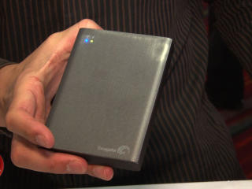
Meet the Hardware
Seagate Wireless Plus
  $200
  Wireless Harddrive
  1TB
  Argo Linux firmware
  Telnet root/goflex
  Uboot – working on Debian
  We run chroot debian

Slide 33
Meet the Hardware
Seagate GoFlex Home
  1TB Low-end NAS
  $150
  Ethernet 1Gbps
  Arch Arm Linux installed
  Can run Debian
  We run chroot Debian in Arch (don't ask!)

Slide 34
Meet the Hardware
Behind the scenes
Job Server ”Node-8”
  8GB RAM, Quad Core 2.5GHz, 1TB HDD
Job Server ”Node-16-SSD”
  16GB RAM, 500GB SSD, Quad Core 3GHz, 6TB HDD

Slide 35
Maps
Open Street Maps
  Open Source effort to map the world
  Merge data from many sources (government, donated, created)
  Open Data Commons Open Database License (ODbL)
  LeafletJS JavaScript app

Slide 36
Maps Process
Download ”Planet” File (30GB binary)
Import Planet into PostgreSQL DB
  350 GB final DB size (!)
  Import took 2 weeks (!) on Node-8, 4 days on Node-16-SSD
Render DB to image tiles (PNG)
  1 week with Node-8 & Node-16 in cluster
  ~150 GB of image tiles
Pack image tiles
  ~100 GB

Slide 37
Serving Maps
The GoFlex and Wireless Plus are too slow to render maps
  I know, I built the entire stack and tried it – 1 to 5 minutes per tile
We pre-render EVERYTHING
4,096 PNG images per file
Redundant tiles removed (many many!)
Python back-end extracts and serves images

Slide 38
Books
Project Gutenberg, founded 1971
40,000 e-books, mostly Public Domain
Custom Web UI (Thanks Joel!)

Slide 39
Books Process
Project Gutenberg Archive
  PG Archive is a mess
  Many formats, most redundant
  Ex: archive contains ISOs of prior versions of the archive (!)
Mirror
  Rsync from ibiblio (service to be discontinued)
  Rsync service slow (throttled?) and unreliable
  ~1.5 weeks

Slide 40
Wikipedia
Seventh highest ranked web site in the world
Fully Open Source content
Source: Wikipedia

Slide 41
Wikipedia
Using OpenZim and Kiwix
OpenZim
  A container file format designed FOR Wikipedia
  Wikipedia pre-rendered to HTML, HTML stored in Zim file
Kiwix
  Offline Wikipedia reader based on Zim
  Desktop reader and Zim server
  We reverse proxy kiwix-serve (for now)

Slide 42
Wikipedia: The Data
Direct Download
  All Wikimedia projects have XML dump files available for download
  No bulk download option for images
Zim community
  Provides pre-rendered Wikipedia ZIM torrents for 40 langauges
  Many include scaled images
  Some a few years stale

Slide 43
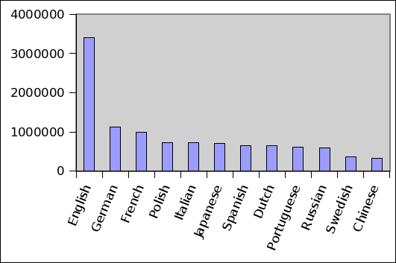
Wikipedia
Not rich in all languages
Number of articles for top languages
Source: Wikipedia

Slide 44
Future: Open Source Textbooks
Aka ”Open Educational Resources” (OER)
Many models emerging
  State-funded Model
    California Open Source Textbook Project
    State of California spends $400 million per year on textbooks
  Volunteer-driven Model
    South Africa – Free High School Science Texts (FHSST)
      Math and Science high school curriculum
    WikiBooks Project
      2,000+ books ”in progress”, few finished

Slide 45
Future: Open Source Textbooks
Many models emerging
  Publisher Model
    Flat World Knowledge (Publisher)
    40+ Textbooks, all English
    Publisher and author make money off print copies and formatted downloads
  University-driven Model
    MIT Open Courseware
    College course material provided both for students and others

Slide 46

WorldReader Project
Deploys commercial e-book readers

Slide 47
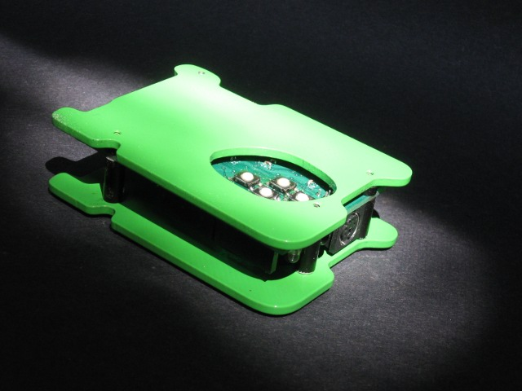
Humane Reader

Slide 48
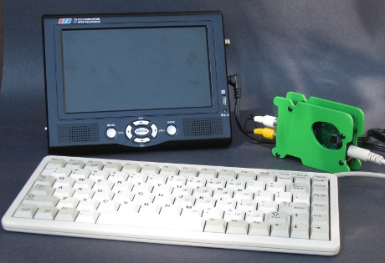
Humane Reader
Displays to television set
Reads Micro-SD Card (2GB)
Optional PS/2 Keyboard
Wikipedia reader
$20 in quantity

Slide 49
Humane Reader
Minimalist design
  Uses two 8-bit microcontrollers
  Specs of a 1977 Apple II computer
Cell phone standard micro-USB power
Open Source Design
  Effort to build community around platform
Arduino expansion slots
Can be used as simple 8-bit computer

Slide 50
Resources
Braddock Gaskill
Internet-in-a-Box Project Lead
braddock@braddock.com
http://internet-in-a-box.org

