Slide 1
Internet-in-a-Box
Project
Resources for the unconnected world
Presented by
Braddock Gaskill
23 February 2014
SCaLE 12x

Slide 2
Mission
Make Internet content available to the unconnected world.

Slide 3
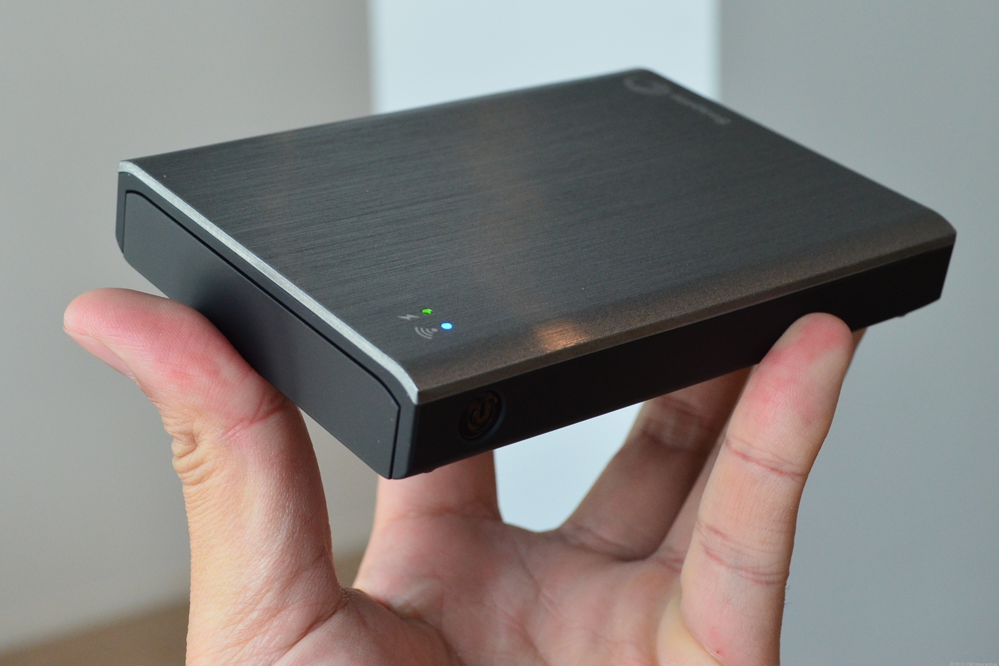
What is an Internet-in-a-Box?

Slide 4
What is an Internet-in-a-Box?
a small, inexpensive device ($70 - $250)
essential Internet resources without any Internet connection.
a local copy of almost a terabyte of the world's Free information.
a web interface

Slide 5
Resources
Wikipedia: 37 languages
Maps: world-wide to street level
E-books: 40,000 books in many languages
Software: Open Source. Linux OS with all software package repositories. Source code.
Video: 500+ hours of instruction

Slide 6
For Who?
For schools and communities in the developing world.

Slide 7
Why?
Internet access is still expensive and difficult in the developing world
Inexpensive media now exists that can hold vast offline libraries of information
Large sources of content are available
Inexpensive reader devices now exist which can read libraries on media

Slide 8
Internet Penetration
70% use internet in ”developed” countries
Only 24% use internet in ”developing” countries*
* 2013, Napoli & Obar

Slide 9
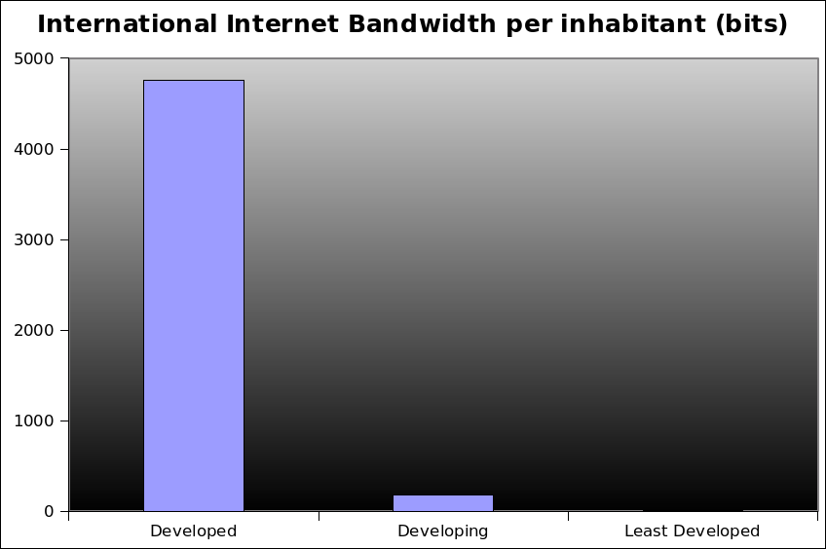
Internet Capacity
Deficit of internet infrastructure
4755
177
7
Global Information Society: A Statistical View 2008

Slide 10

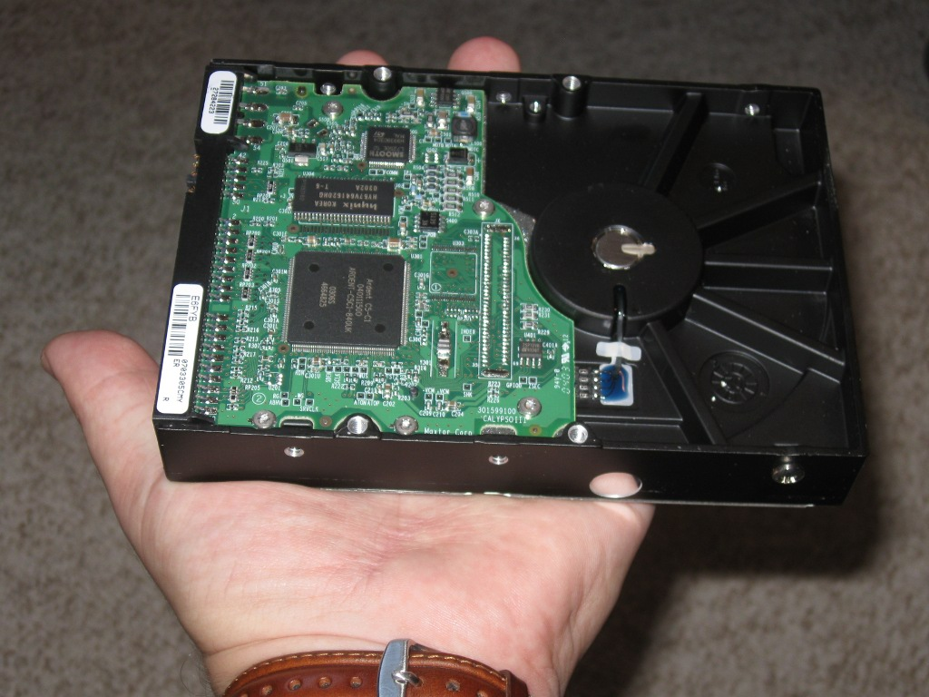
We Have The Technology
Half of the US Library of Congress Printed Collection would fit on ONE hard drive (text only)

Slide 11
The Law
You are NOT allowed to share most information

Slide 12
What can we share?
Open Source
  -Explicitly licensed for sharing
Public Domain
  Generally, pre-1923 is Free
  Congress often retro-actively extending. New material from 1923 starting in 2019 IF nothing changes.
  Some exceptions, it's complicated

Slide 13
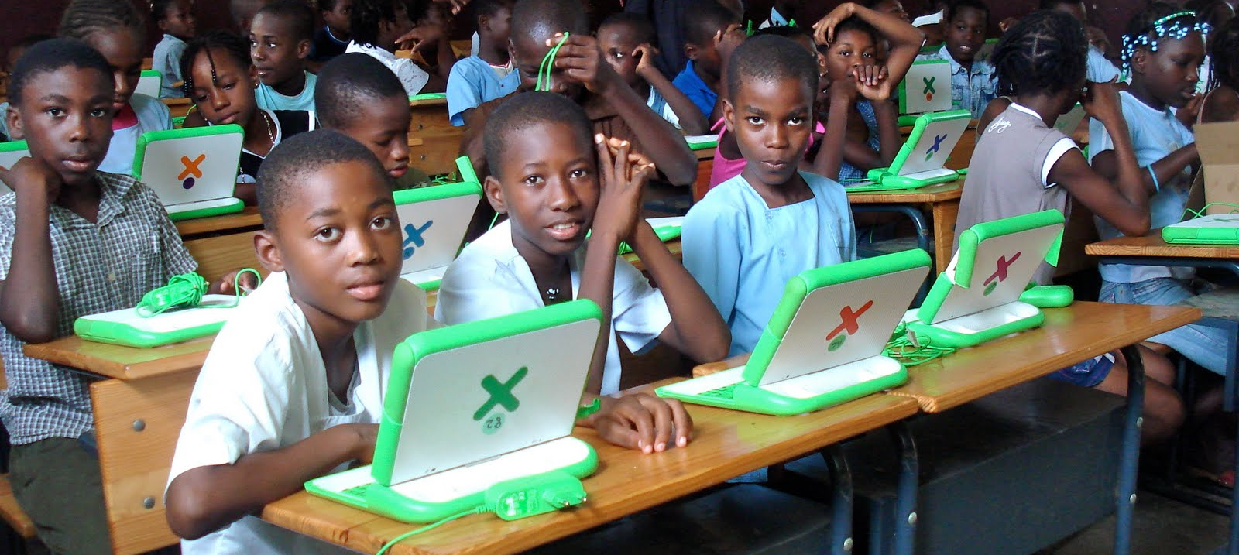
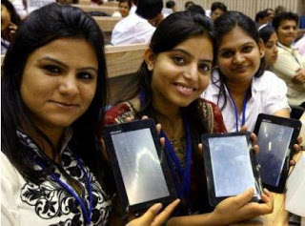
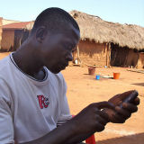
User Devices
One Laptop
Per Child
2.5 Million
laptops
Tablets
$50 in India
Phones
with wifi

Slide 14
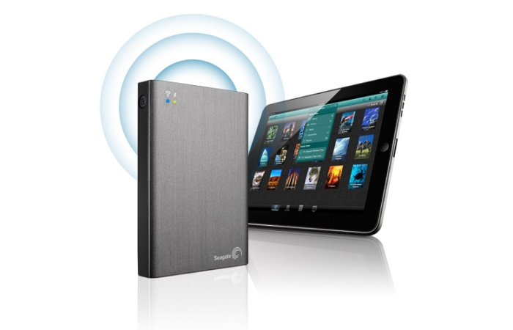
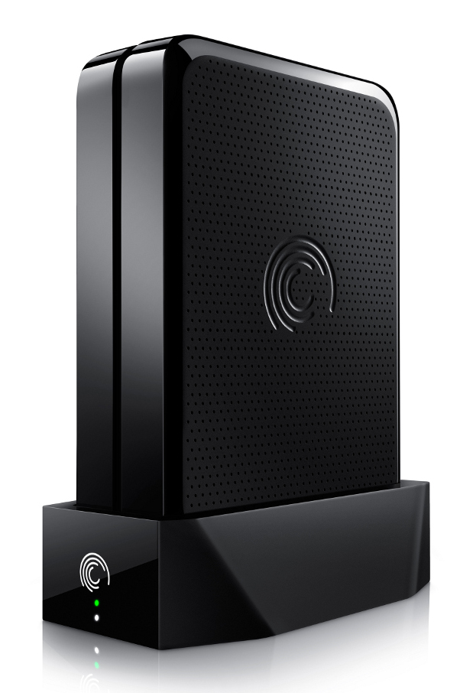

Wired and Wireless
Appliances
Wireless
  Wifi Hotspot
  Battery
Wired
  Connect to existing network
  Network appliance

Slide 15
Co-deployment with School Servers
One Laptop Per Child Community
  several Linux-based ”School Server” distributions to serve OLPC laptop deployments
  provide services to LAN including content and tools to keep laptops updated and running smoothly.

Slide 16
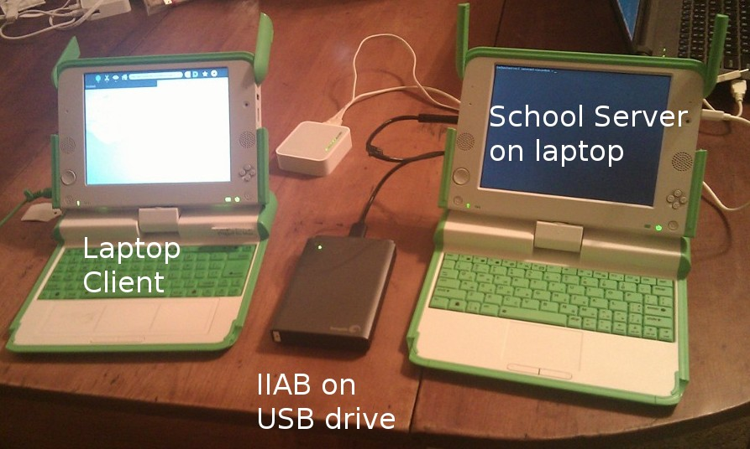
Co-deployment with School Servers
Example: IIAB as USB drive add-on for XSCE School Server

Slide 17
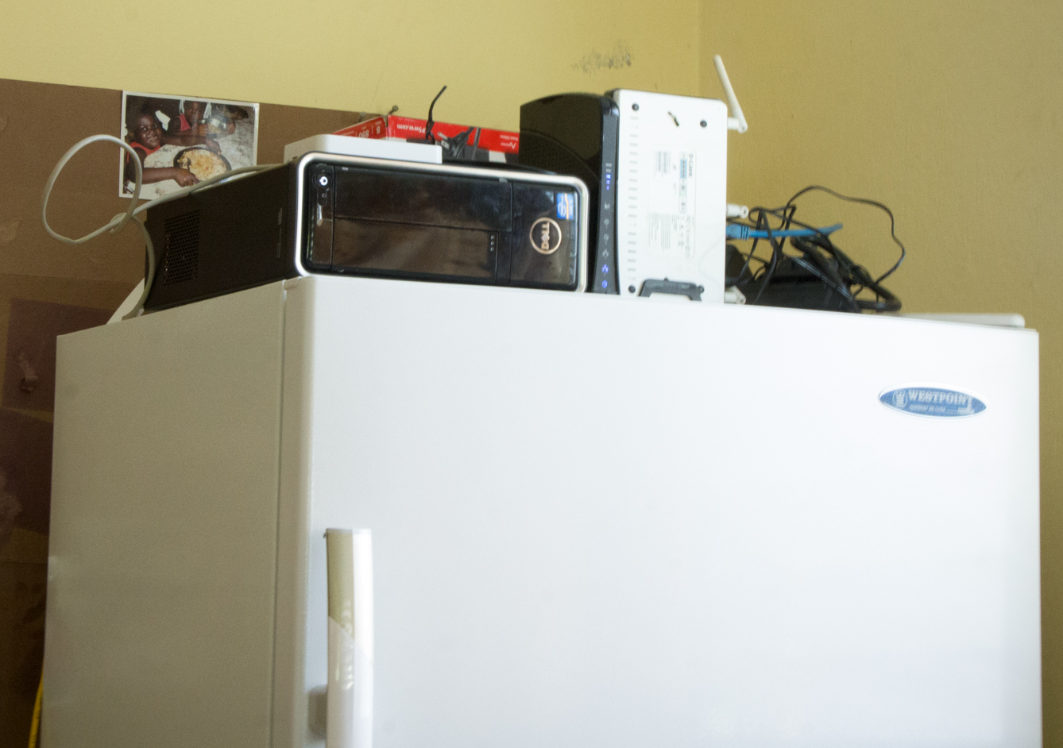
Co-deployment with School Servers
School Server with IIAB in Haiti

Slide 18
Project Bernie
Internet-in-a-Box installation PLUS
  English learning curriculum
  OLE Nepal 600 children books grades 2-6
  Old Time Radio shows
  Classical Music collection
  OLPC Laptop software collection

Slide 19
Demo

Slide 20
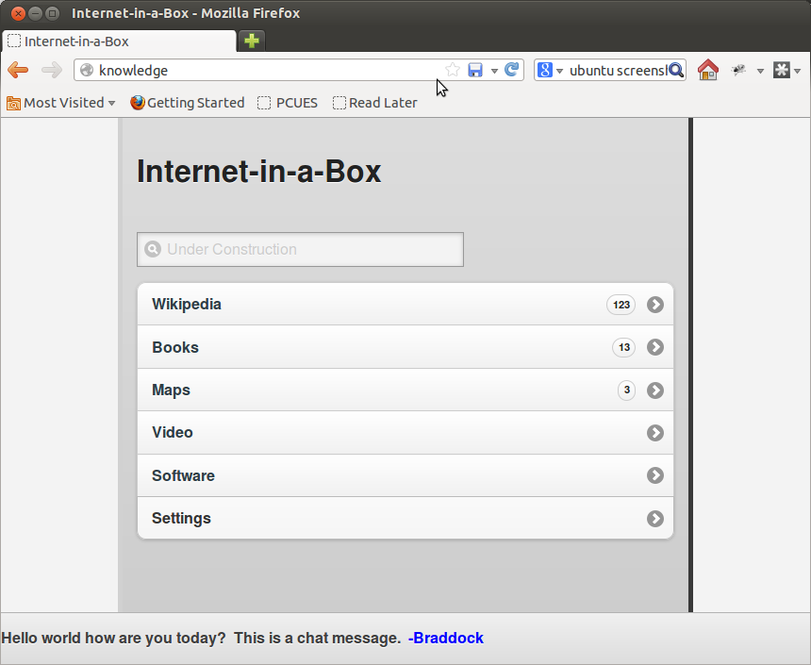
Main Menu

Slide 21
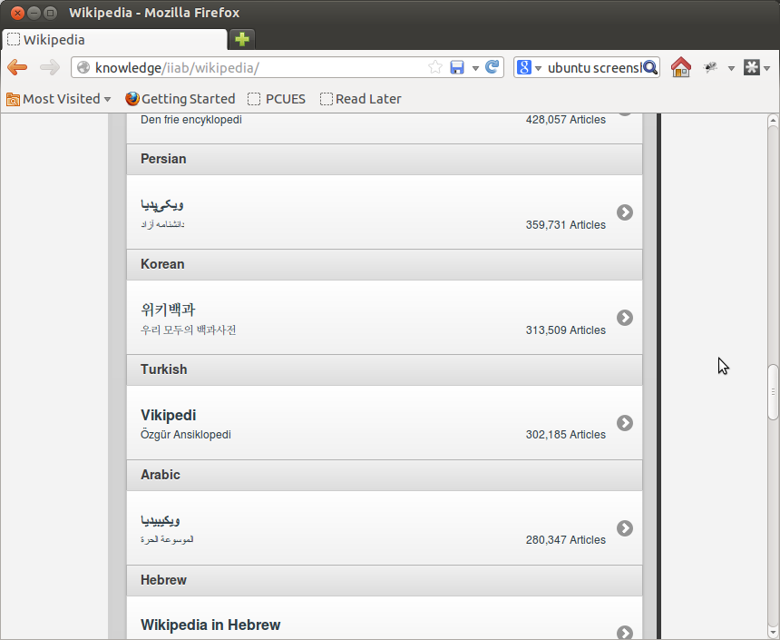
Wikipedia

Slide 22
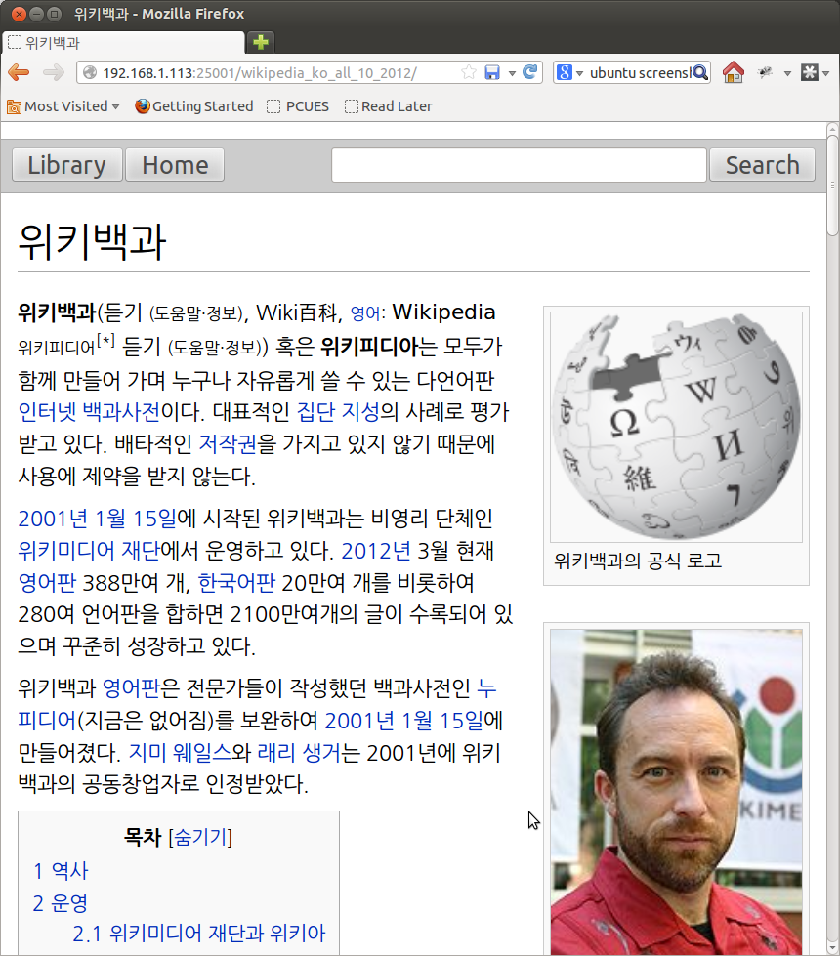
Wikipedia Article

Slide 23
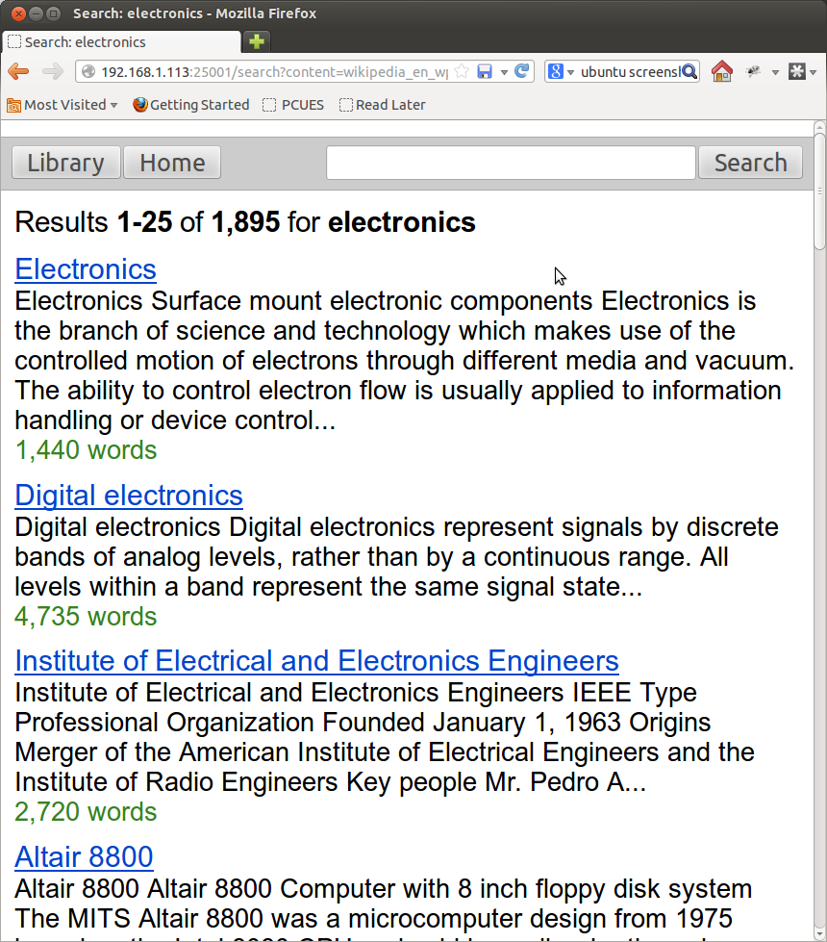
Wikipedia Search

Slide 24
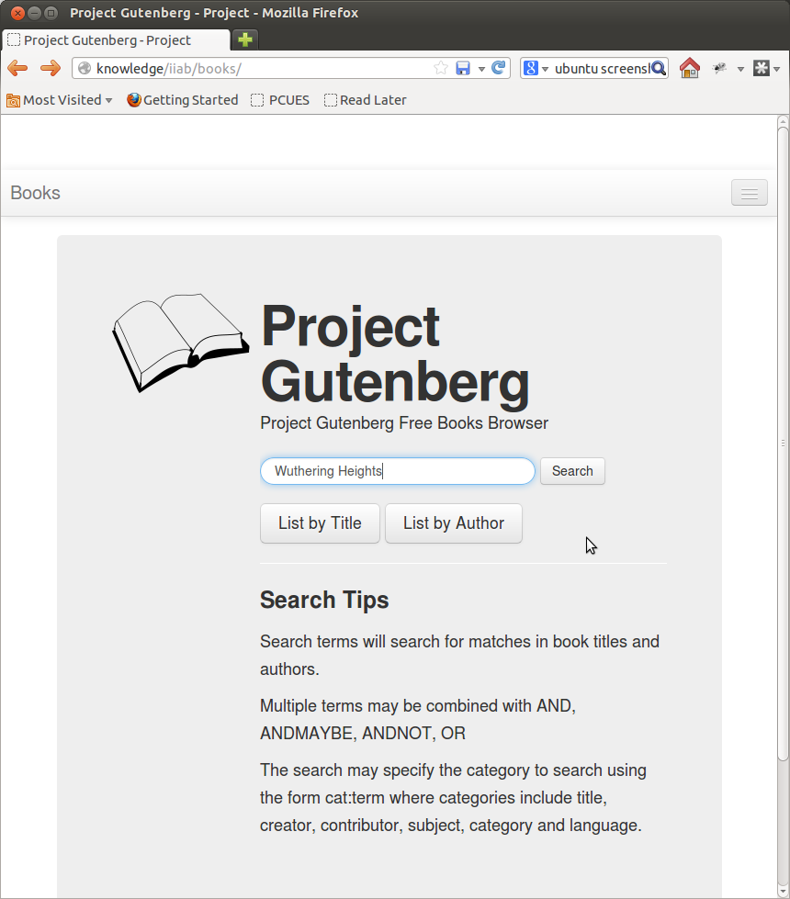
Books

Slide 25
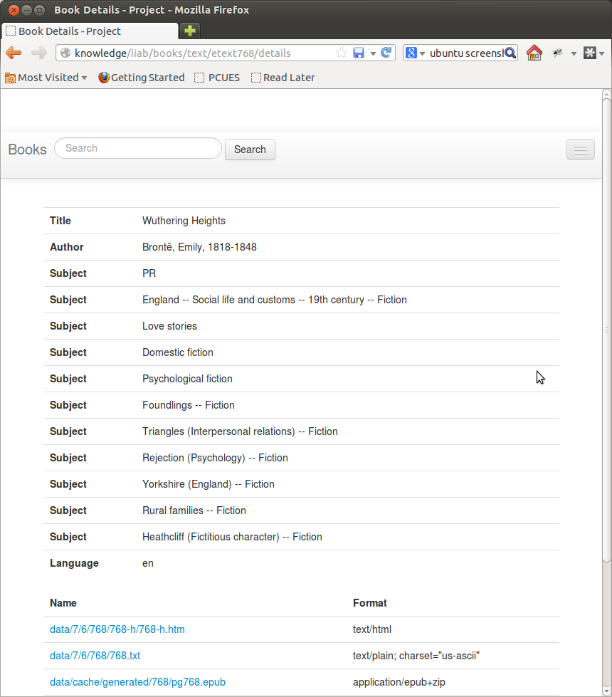
Books

Slide 26
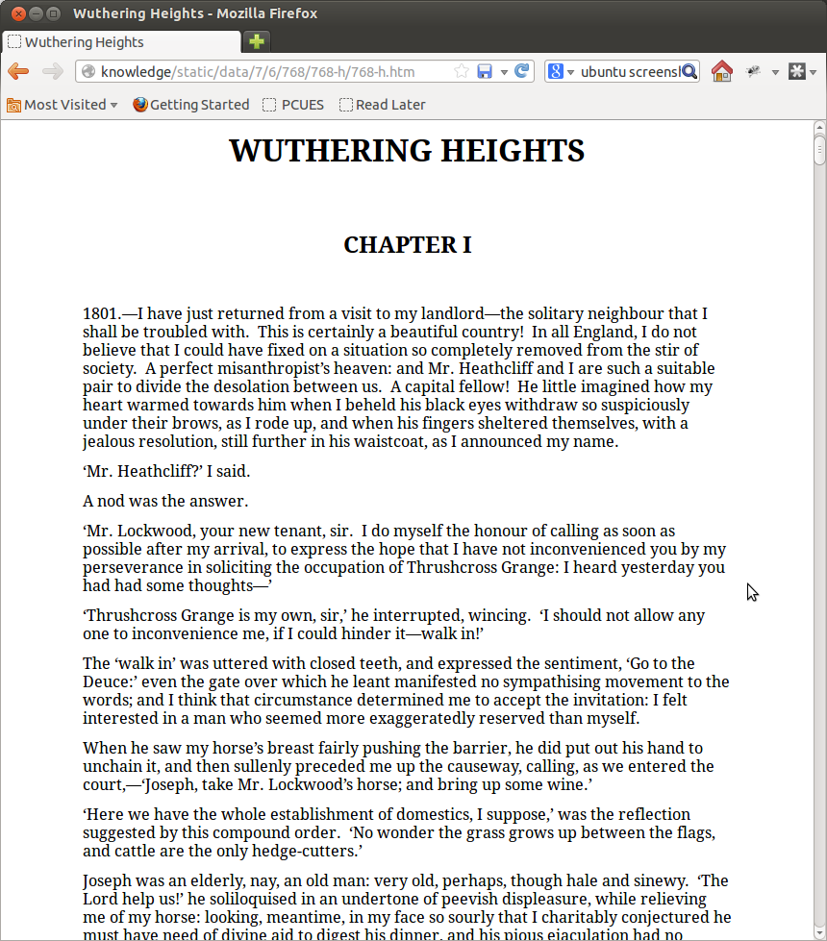
Read

Slide 27
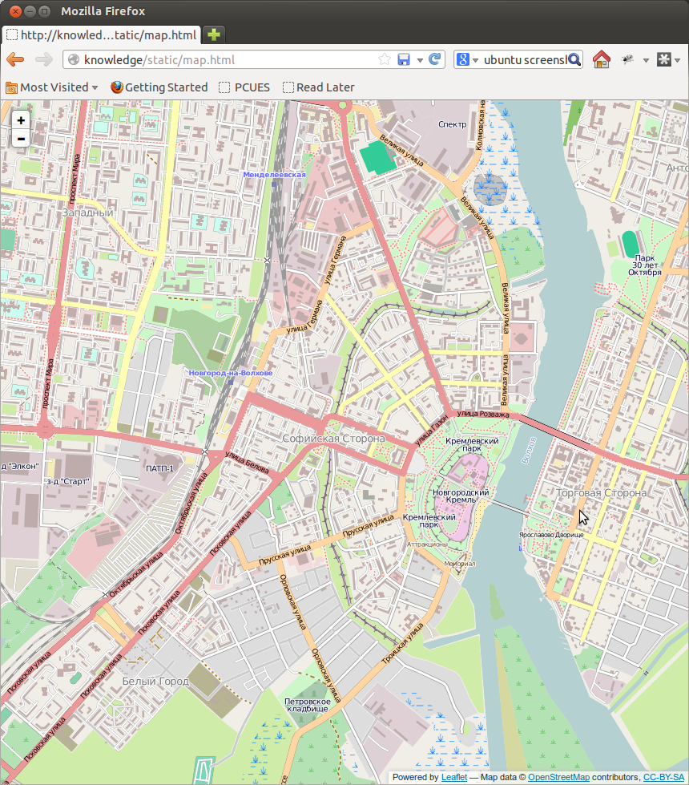
Maps

Slide 28
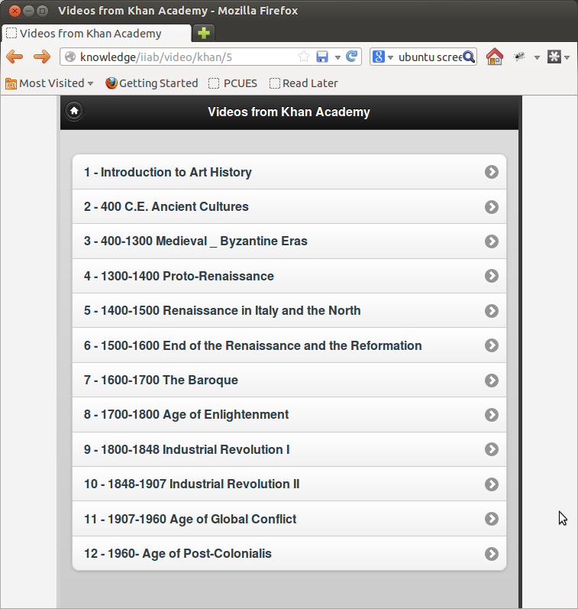
Video

Slide 29
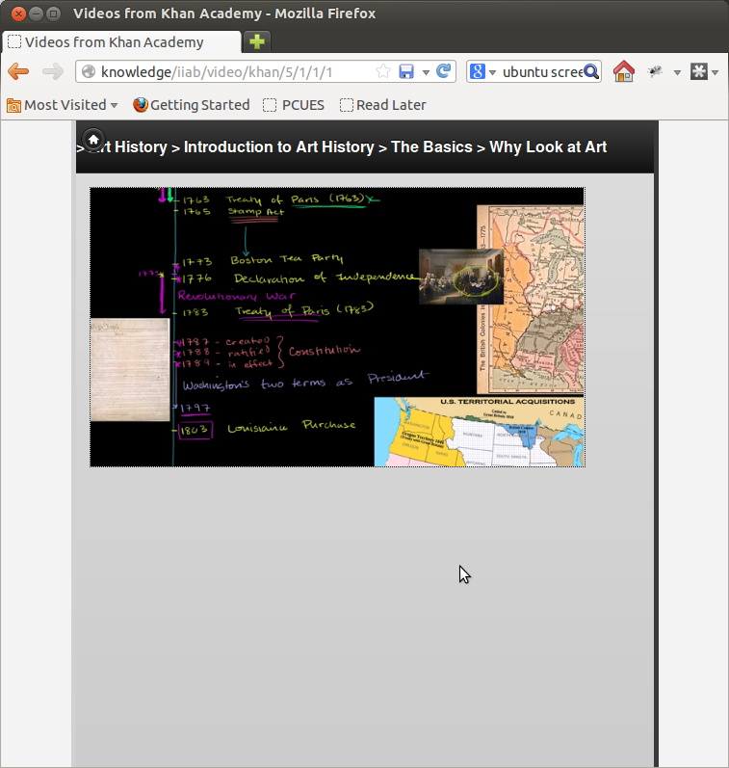
Video

Slide 30
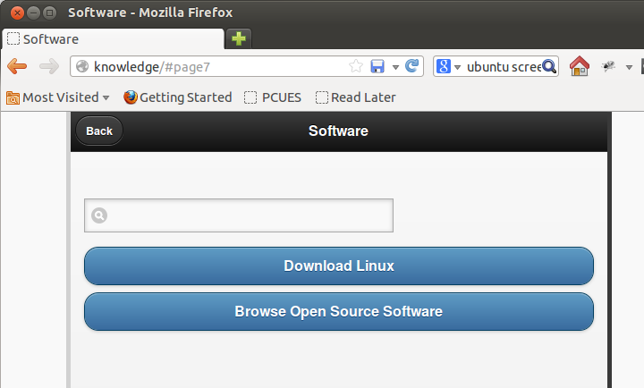
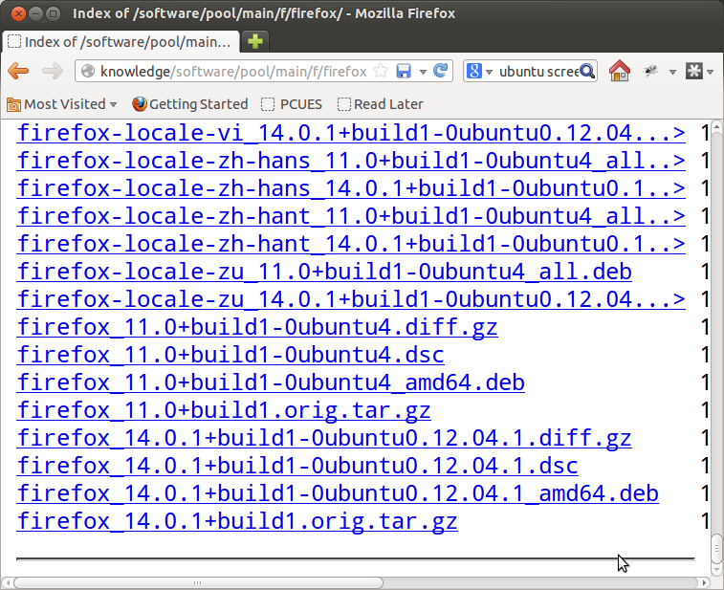
Software

Slide 31
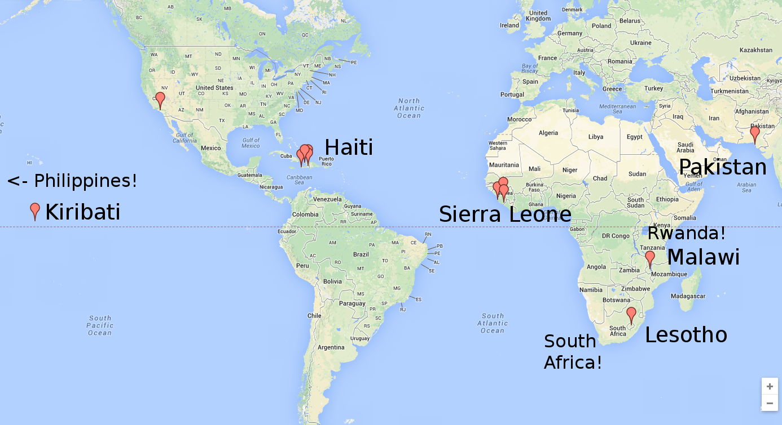
Deployments: the first year

Slide 32
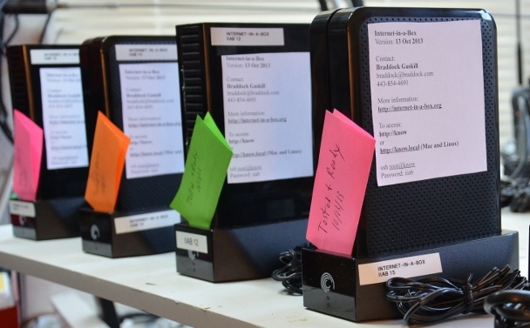
Deployments
Direct trials with IIAB Appliances
Indirect deployments with OLPC School Server community

Slide 33
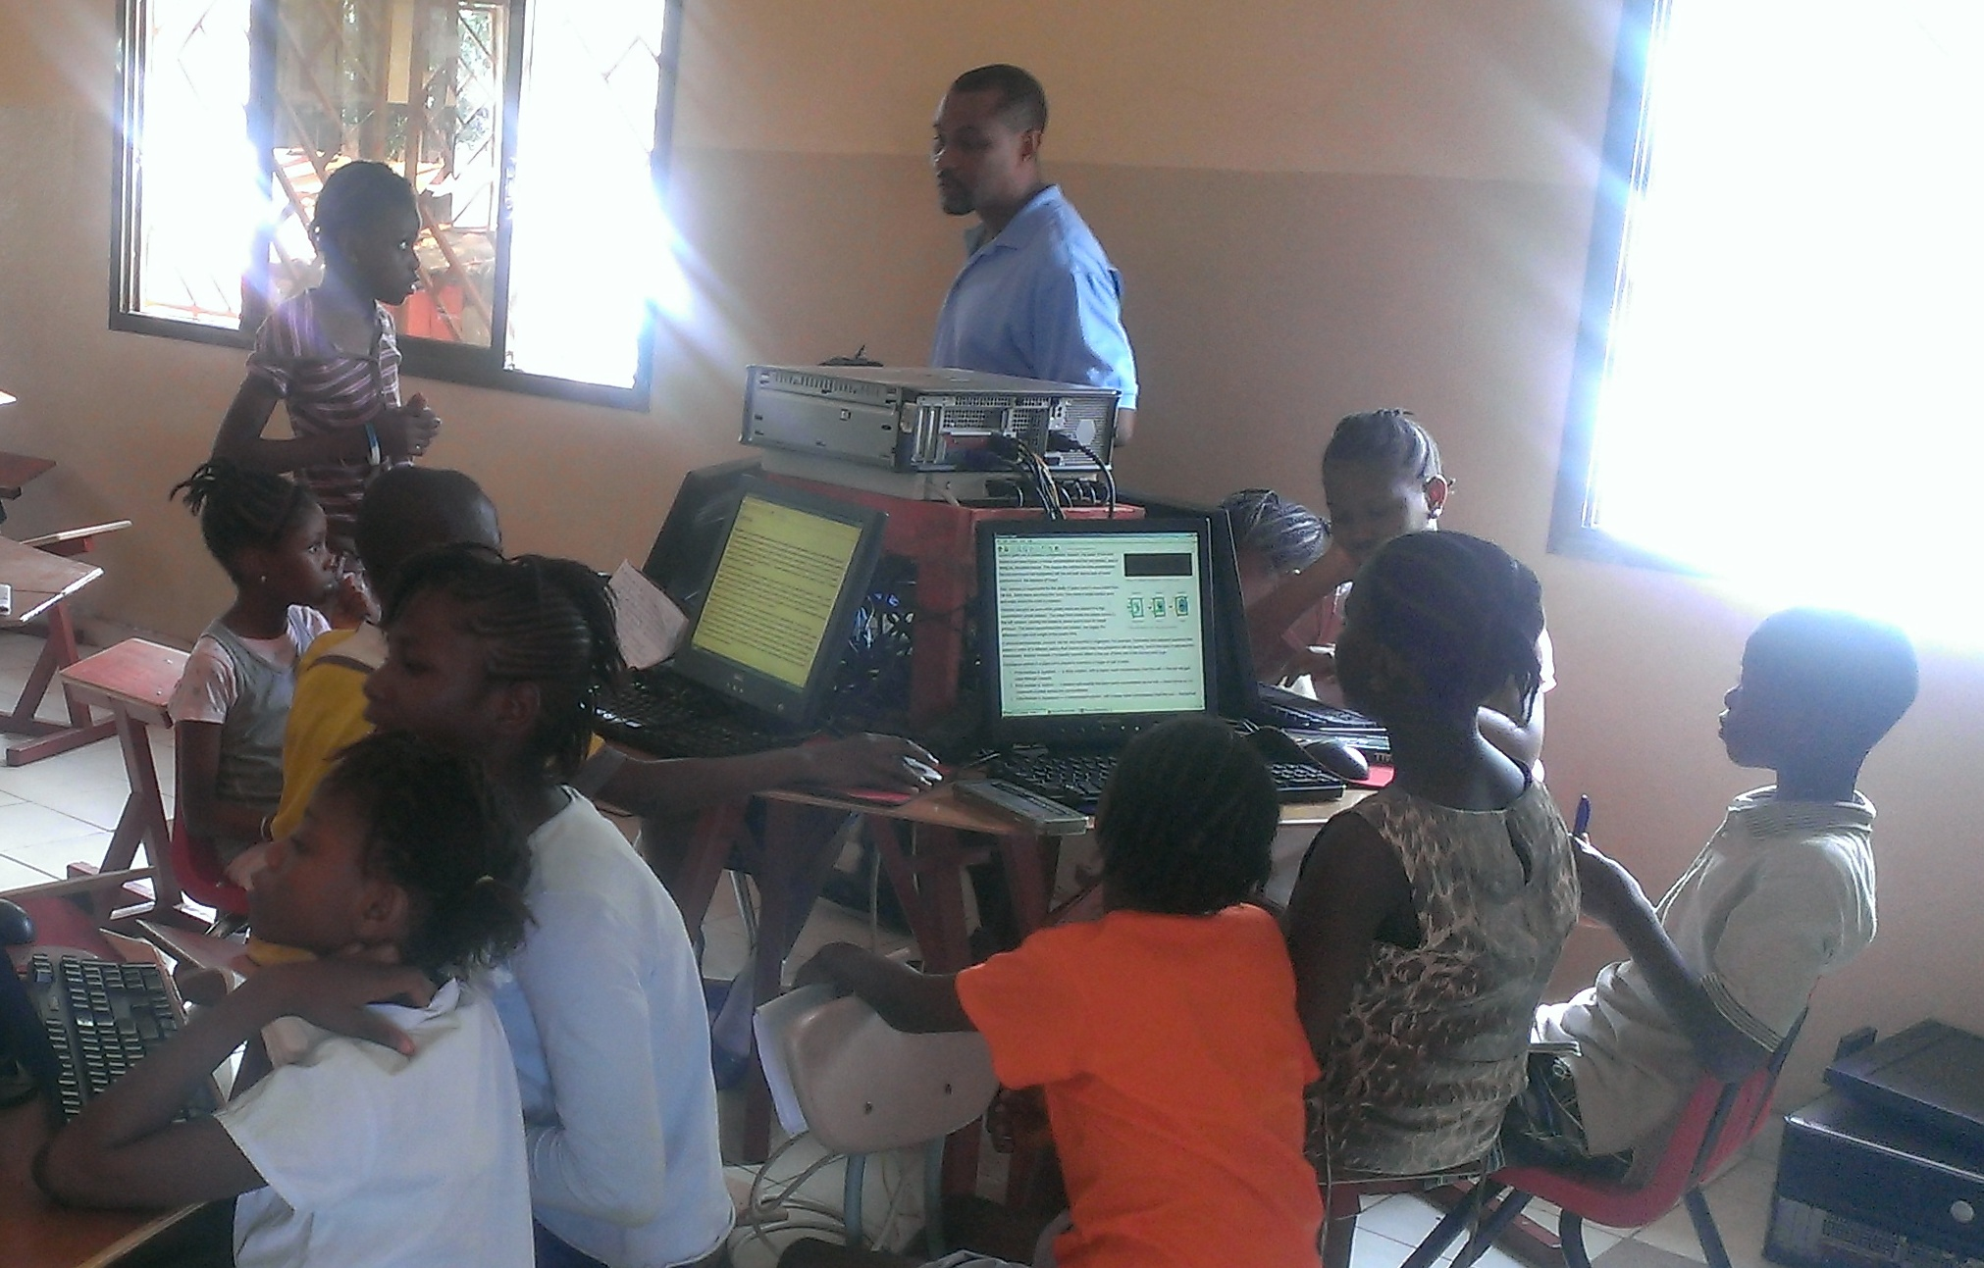
Sierra Leone

Slide 34
Sierra Leone

Slide 35
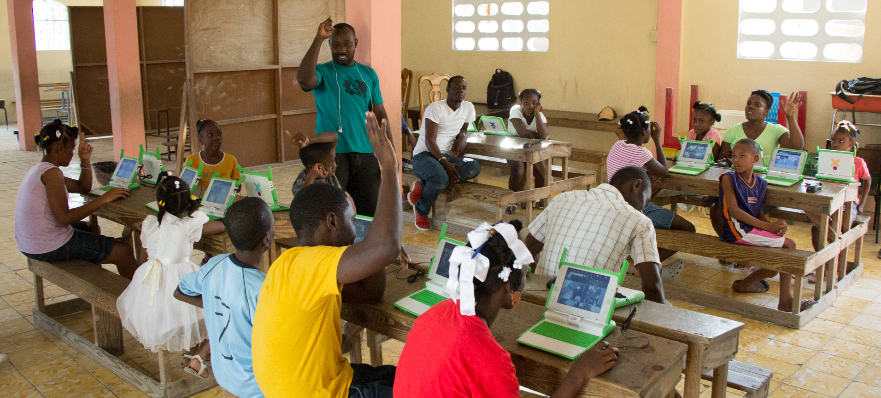
Haiti

Slide 36
Part 2: Behind the Data

Slide 37
Wikipedia
Seventh highest ranked web site in the world
Fully Open Source content
Source: Wikipedia

Slide 38
Wikipedia
Using OpenZim files
Zim files
  A container file format designed FOR Wikipedia
  Wikipedia pre-rendered to HTML, HTML stored in Zim file
  Zim Torrents prepared by the Kiwix community

Slide 39
Wikipedia: The Data
Zim community
  Provides pre-rendered Wikipedia ZIM torrents for 37 langauges
  Many include scaled images
  Some a few years stale

Slide 40
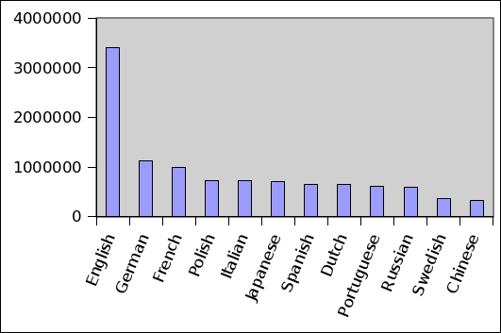
Wikipedia
Not rich in all languages
Number of articles for top languages
Source: Wikipedia

Slide 41
Maps
Open Street Maps
  Open Source effort to map the world
  Merge data from many sources (government, donated, created)
  Open Data Commons Open Database License (ODbL)
  LeafletJS JavaScript app

Slide 42
Maps Process
Download ”Planet” File (30GB binary)
Import Planet into PostgreSQL DB
  350 GB final DB size (!)
  Import took 4 days
Render DB to image tiles (PNG)
  1 week with a couple machines clustered
Pack image tiles
  ~100 GB

Slide 43
Serving Maps
Low end machines are too slow to render vector maps
We pre-render EVERYTHING
4,096 PNG images per file
Redundant tiles removed (many many!)
Python back-end extracts and serves images

Slide 44
Books
Project Gutenberg, founded 1971
40,000 e-books, mostly Public Domain
Custom Web UI (Thanks Joel!)

Slide 45
Books Process
Project Gutenberg Archive
  PG Archive is a mess
  Many formats, most redundant
  Ex: archive contains ISOs of prior versions of the archive (!)
Mirror
  Rsync service slow (throttled?) and unreliable
  ~1.5 weeks
Extract and convert all books to HTML and ePub

Slide 46
Video
4,000 Khan Academy Videos
Non-Commerical Use Creative Commons License
High demand for Spanish and French

Slide 47
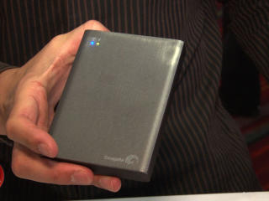
Meet the Hardware
Seagate Wireless Plus
  $200
  Wireless Harddrive
  1TB
  Argo Linux firmware
  Telnet root/goflex
  Uboot – working on Debian
  We run chroot debian

Slide 48
Meet the Hardware
Seagate GoFlex Home
  1TB Low-end NAS
  $150
  Ethernet 1Gbps
  Debian Arm Linux installed

Slide 49
IIAB Volunteers
Joel Steres – Gutenberg, map search
James McDuffie – Wikipedia search, web site, mailing list
John Kim – Testing and Release Manager
Lan Dang – Maps, Outreach
UI Translations – Pootle community
  Chris Leonard and his translation team

Slide 50
Upstream Projects
Books – Project Gutenberg
Wikipedia – OpenZim Community
  Emmanuel Engelhart (kiwix)
Maps – Open Street Map
Video – Khan Academy, Zurd torrent
Software – Ubuntu, Linux community
Arm Hardware
  Mike Brown and Jeff Doozan (uboot)

Slide 51
Thanks to partners
XSCE School Server Community
Unleash Kids
Project Bernie, Tony Anderson
Wonderful field trial volunteers

Slide 52
Resources
Braddock Gaskill
Internet-in-a-Box Project Lead
braddock@braddock.com
http://internet-in-a-box.org

Slide 53
END

Slide 54
Meet the Hardware
Behind the scenes
Job Server ”Node-8”
  8GB RAM, Quad Core 2.5GHz, 1TB HDD
Job Server ”Node-16-SSD”
  16GB RAM, 500GB SSD, Quad Core 3GHz, 6TB HDD

Slide 55
Future: Open Source Textbooks
Aka ”Open Educational Resources” (OER)
Many models emerging
  State-funded Model
    California Open Source Textbook Project
    State of California spends $400 million per year on textbooks
  Volunteer-driven Model
    South Africa – Free High School Science Texts (FHSST)
      Math and Science high school curriculum
    WikiBooks Project
      2,000+ books ”in progress”, few finished

Slide 56
Future: Open Source Textbooks
Many models emerging
  Publisher Model
    Flat World Knowledge (Publisher)
    40+ Textbooks, all English
    Publisher and author make money off print copies and formatted downloads
  University-driven Model
    MIT Open Courseware
    College course material provided both for students and others

Slide 57
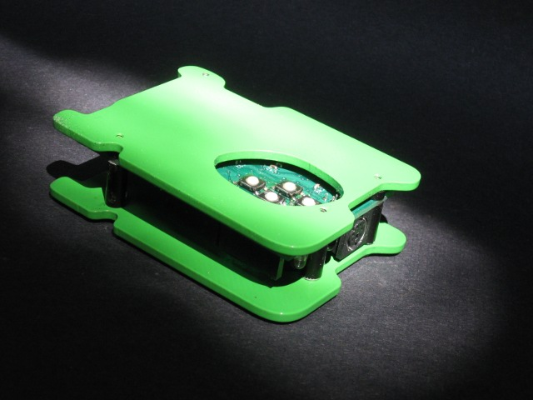
Humane Reader

Slide 58
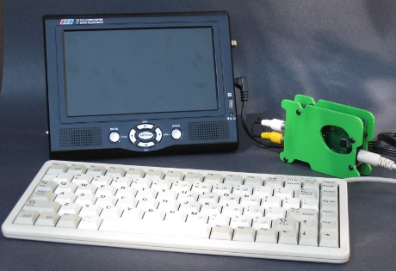
Humane Reader
Displays to television set
Reads Micro-SD Card (2GB)
Optional PS/2 Keyboard
Wikipedia reader
$20 in quantity

Slide 59
Humane Reader
Minimalist design
  Uses two 8-bit microcontrollers
  Specs of a 1977 Apple II computer
Cell phone standard micro-USB power
Open Source Design
  Effort to build community around platform
Arduino expansion slots
Can be used as simple 8-bit computer

Slide 60
Resources
Braddock Gaskill
Internet-in-a-Box Project Lead
braddock@braddock.com
http://internet-in-a-box.org

