Slide 1
AirLines Analysis

Slide 2
Airelines Analysis
The dataset provided tell us lot of things, includes delays of more than one condition ex. Weather, aircraft.
Dataset shows us that the situation before covid19 was more beneficial to the airlines in their financial.
The dataset shows that there is an issue on the delays and canceled tickets.

Slide 3
Airelines Analysis
The dataset shows us that there is a relation between the delays and canceled tickets, and the average increase of delays increases average of canceled tickets, and this comes hard to the airlines department.
In the dataset there is four main condition of delays, aircraft, weather, security and carrier.

Slide 4
Airelines Analysis
The analysis of the airline dataset shows us that the aircraft and carriers are the most reasoned for the delays, after that comes the weather and finally security.
In the next charts we gonna see the average of delays by all four conditions between 2014-16, and the reason behind using this years because of the number flights registered.

Slide 5
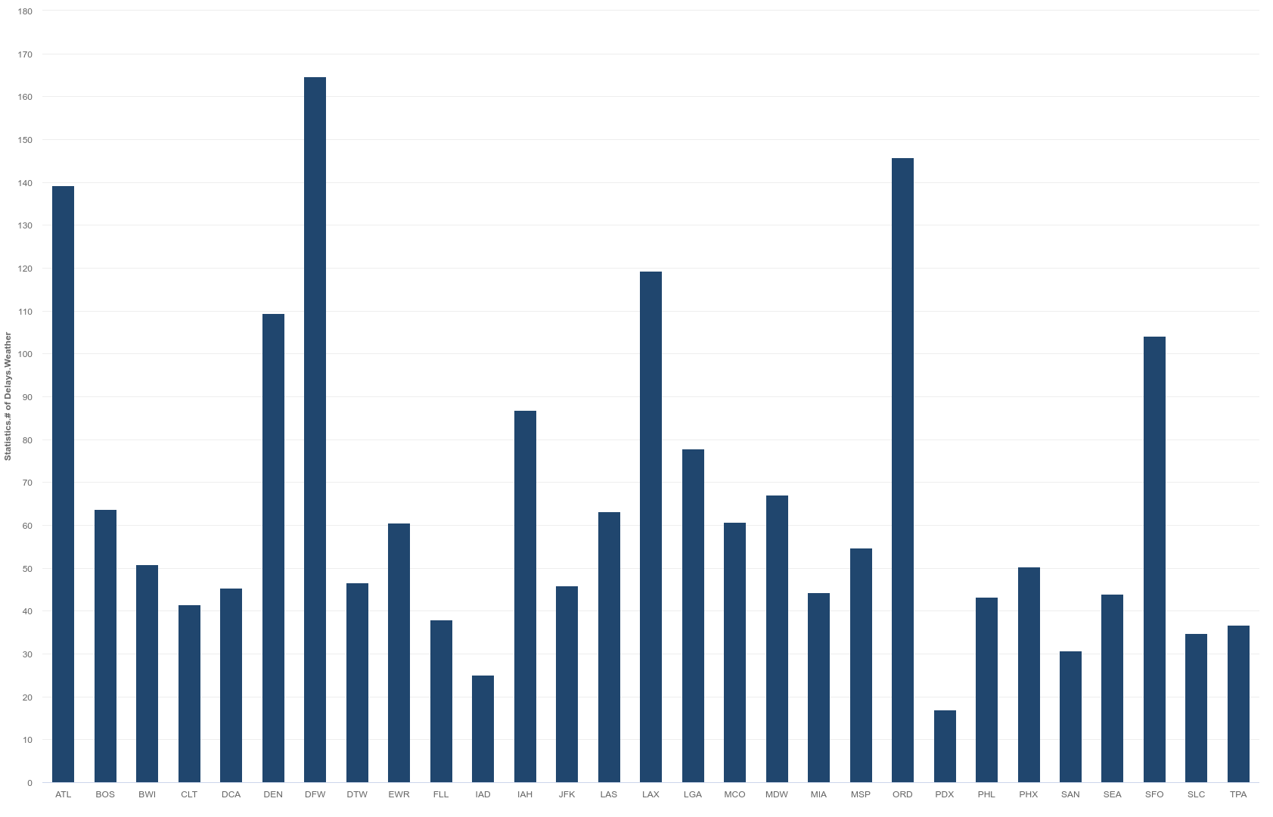
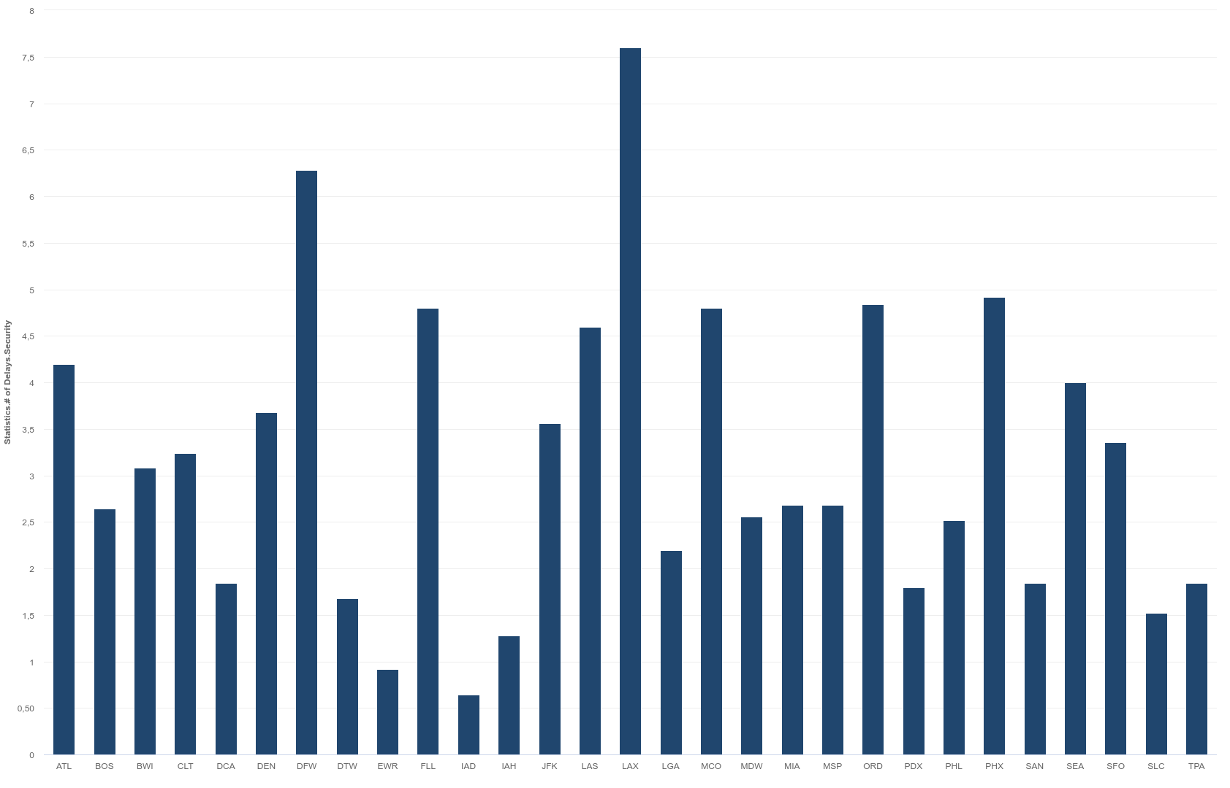
Airlines Analysis
Delays by Weather
Delays by Security

Slide 6
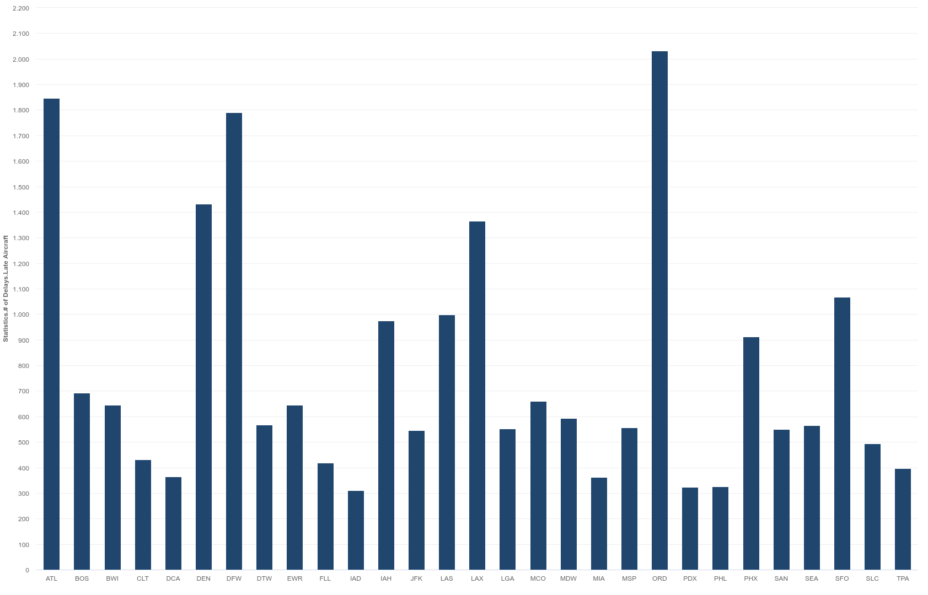
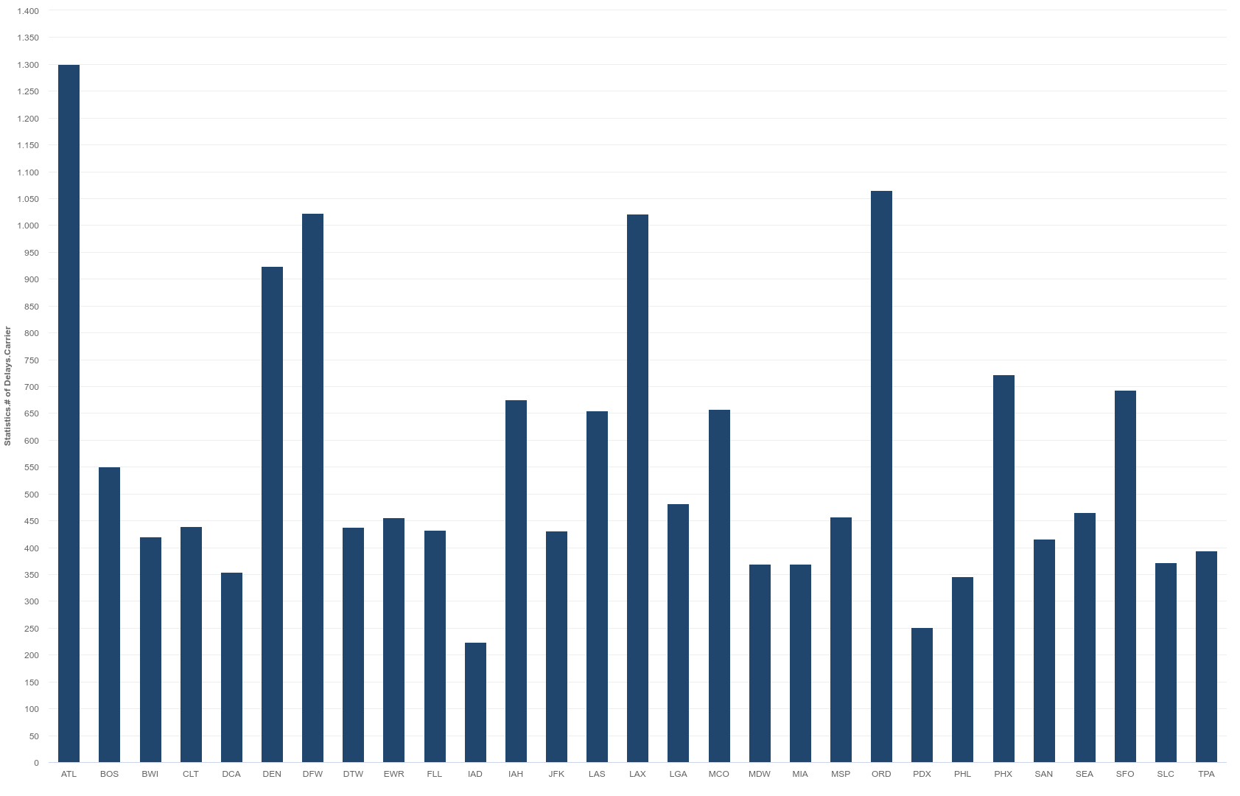
Airlines Analysis
Delays by Aircraft
Delays by Carrier

Slide 7
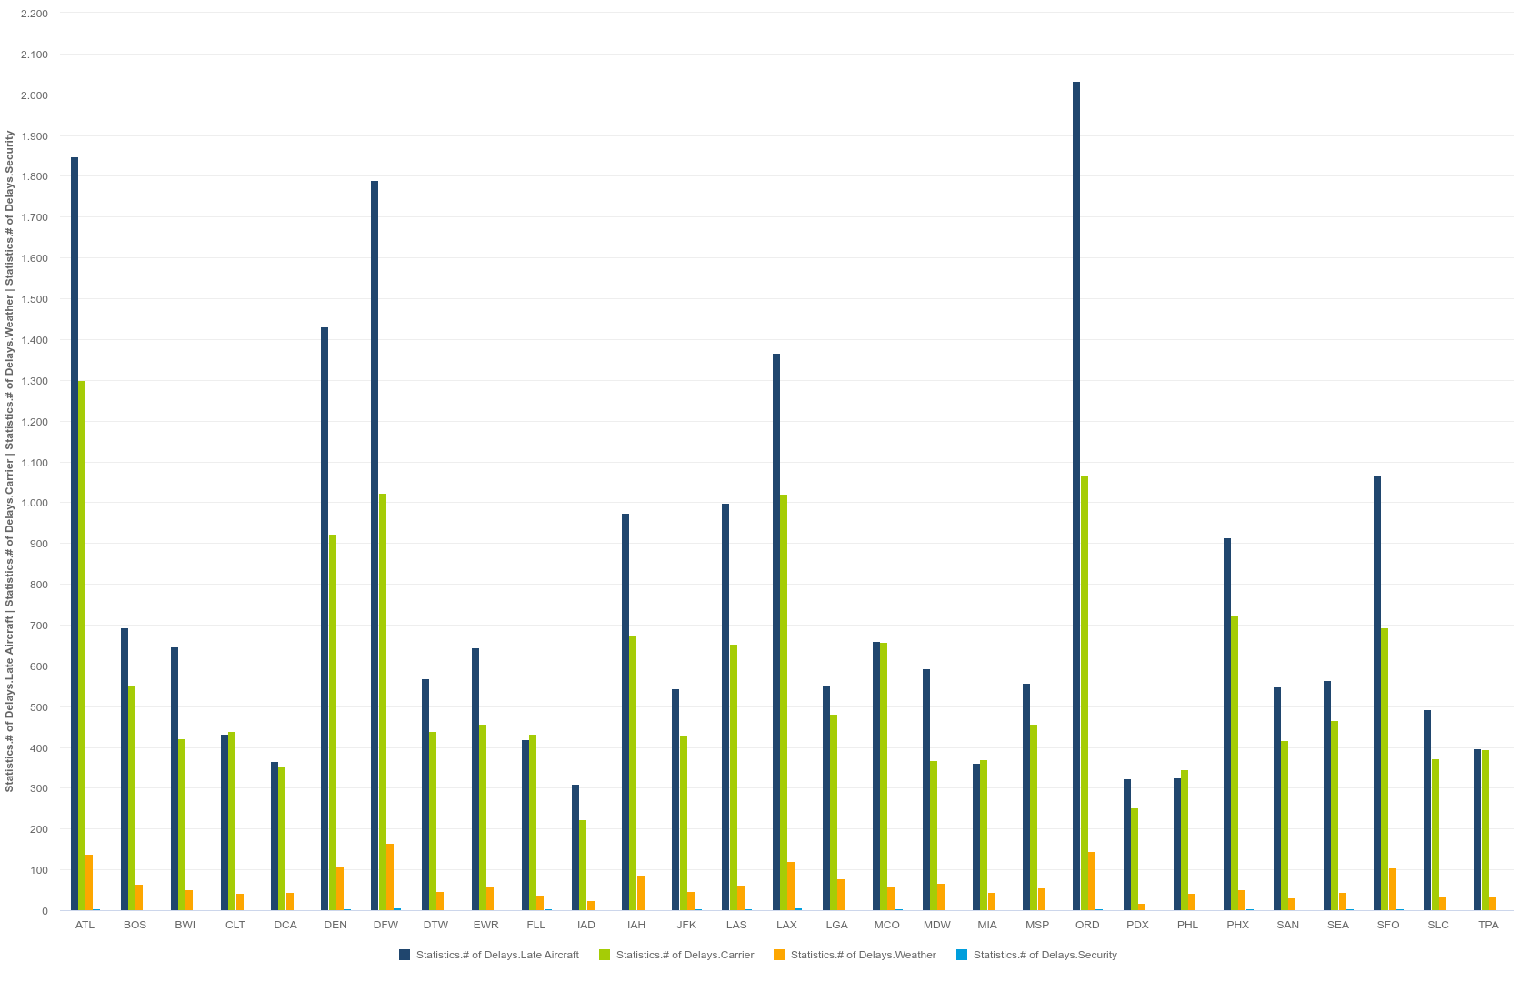
Airlines Analysis
Average Delays by all Conditions(Aircraft, Carrier, Weather and Security)

Slide 8
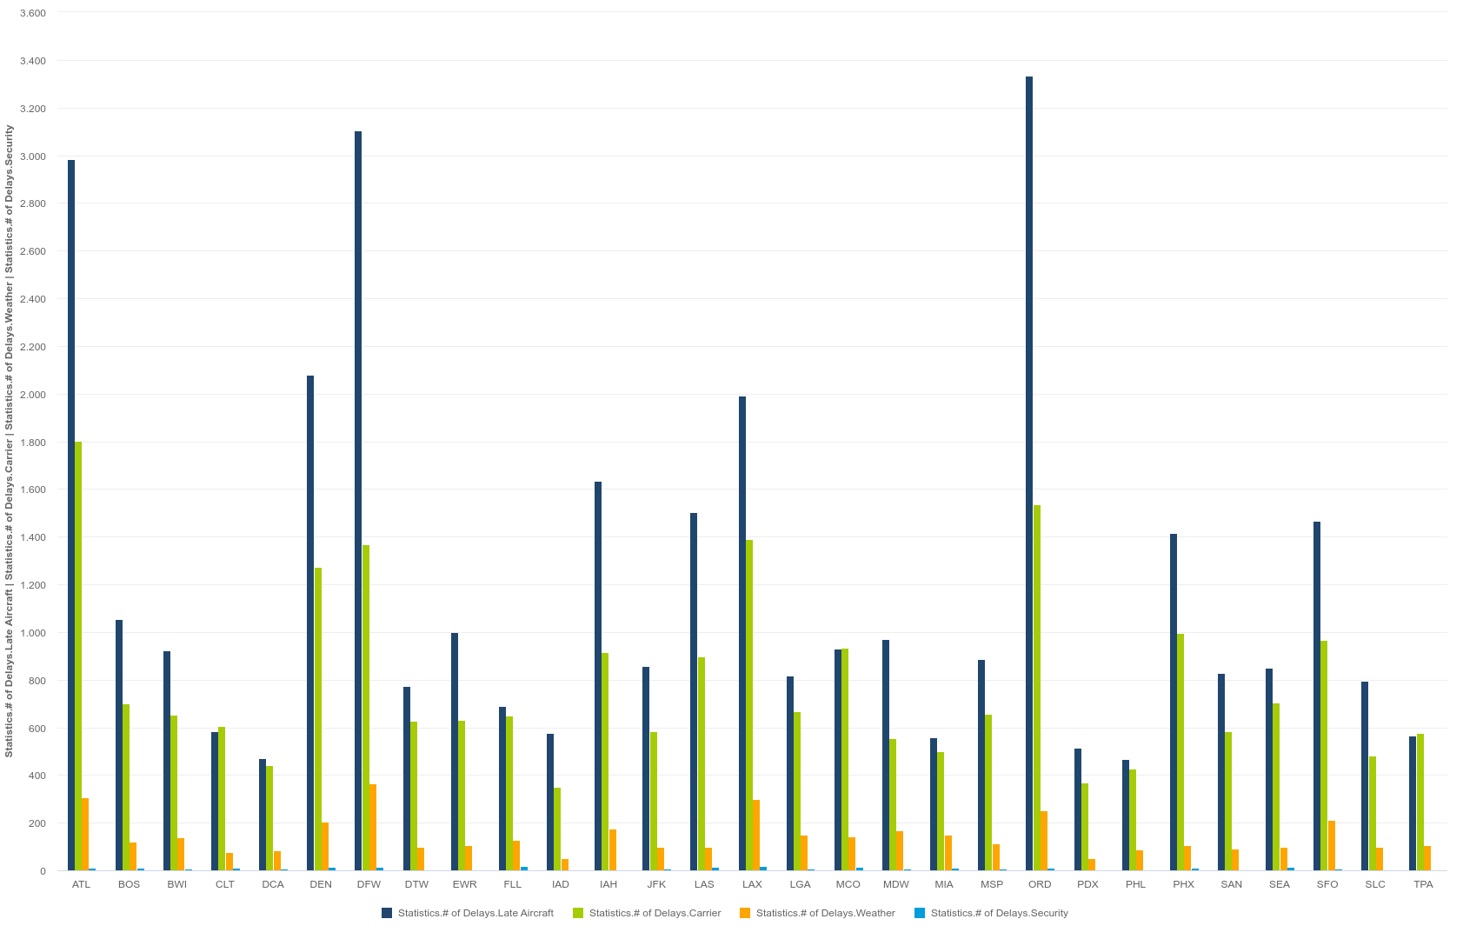
Airlines Analysis
Maximum Delays by all Conditions(Aircraft, Carrier, Weather and Security)

Slide 9
Airelines Analysis
The dataset also shows us another way to see the situation in a bigger scope.
By comparing between the flight delay, canceled and diverted.
Analyzing it shows us the increase of canceled flights because of the flight delay.
Which shows us another thing that people are canceling their flight ticket rather than diverting it, and this is a big deal and should be handled.

Slide 10
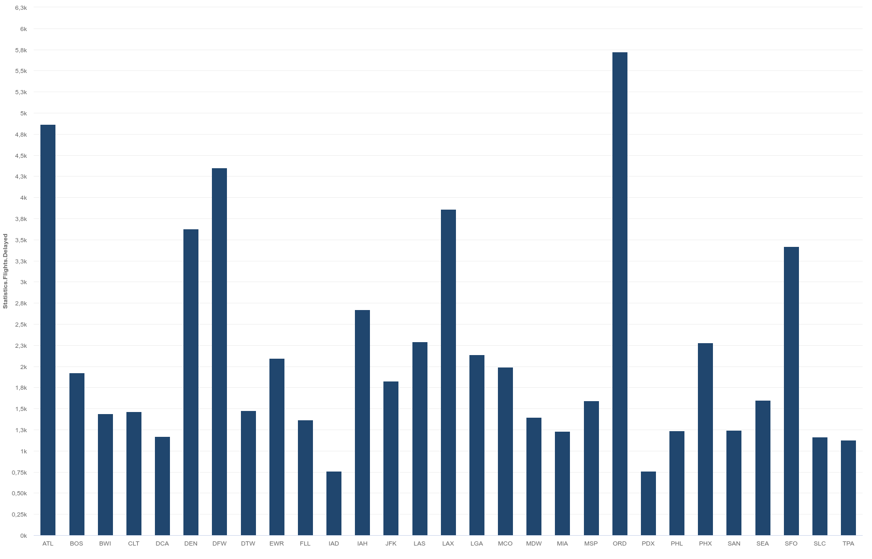
Airlines Analysis
Average Flight Delays

Slide 11
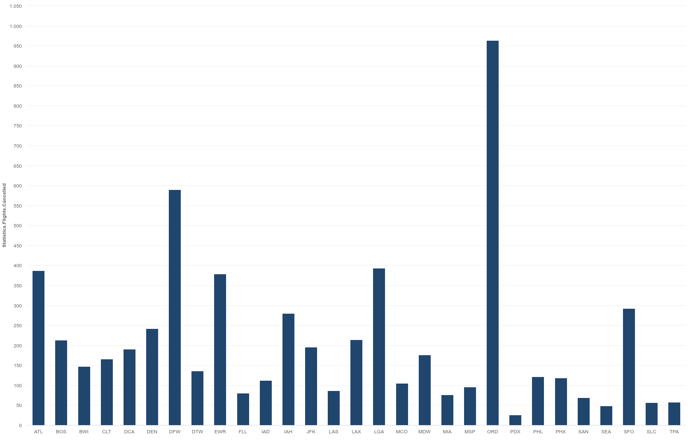
Airlines Analysis
Average Flight Canceled

Slide 12
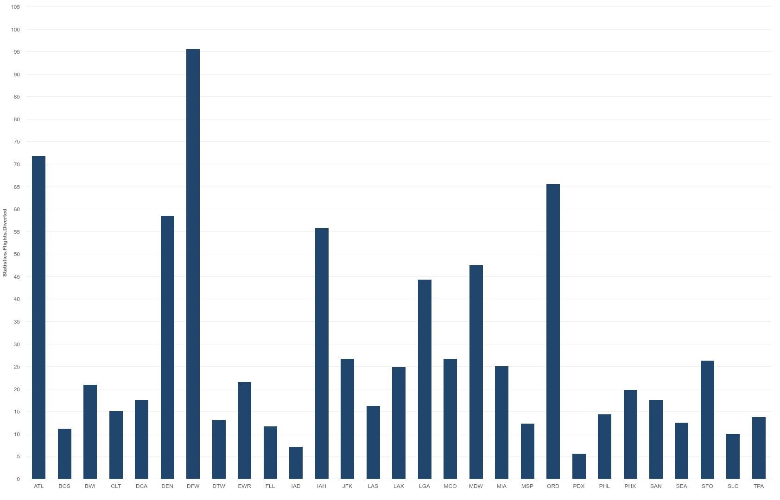
Airlines Analysis
Average Flight Diverted

Slide 13
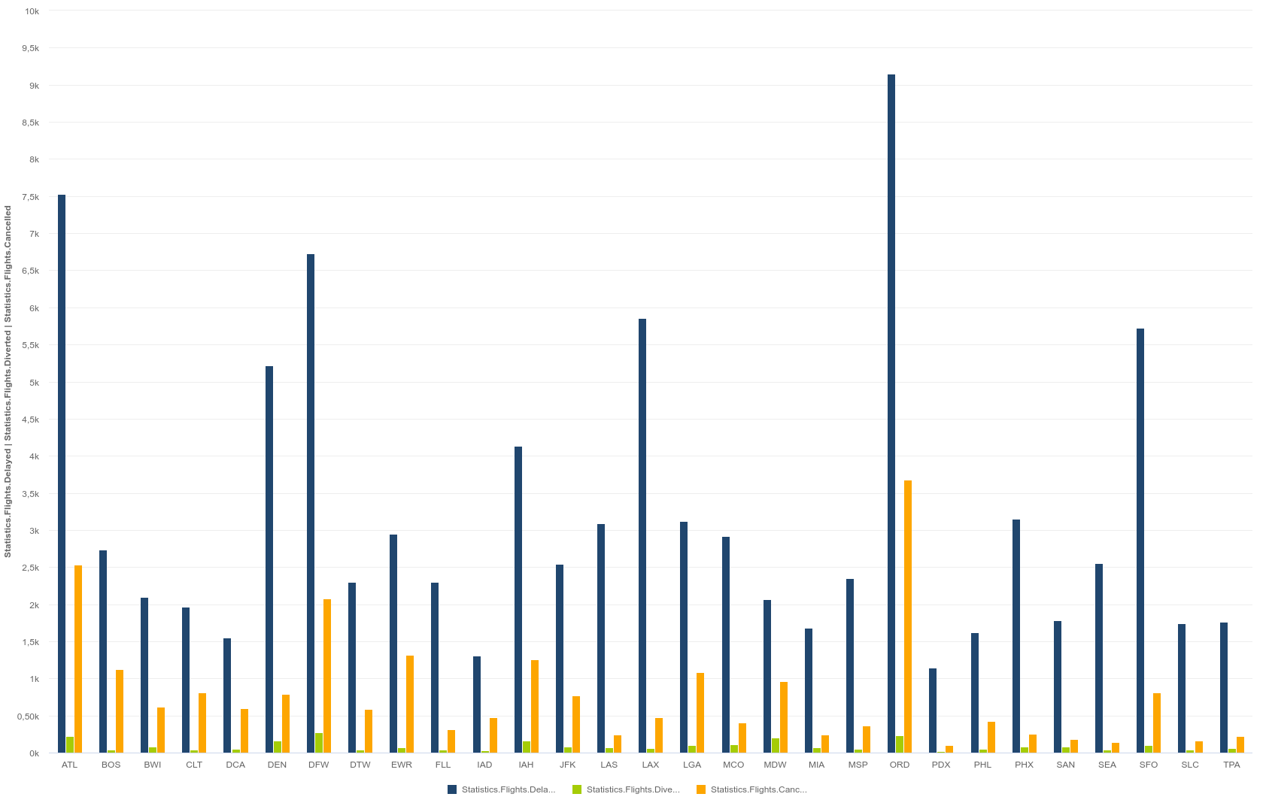
Airlines Analysis
Comparing between Maximum Flight Diverted, Delays and Canceling

Slide 14
Airelines Analysis
The dataset also shows us another way to see the situation in a more bigger scope, is the time in minutes of the delays by aircraft, weather and security.
This analysis shows us more insightful information and making us sure of the main reasons of the problem.
In the charts we see the aircraft are causing the main issue and after that weather conditions, so we have to find a solution for it.

Slide 15
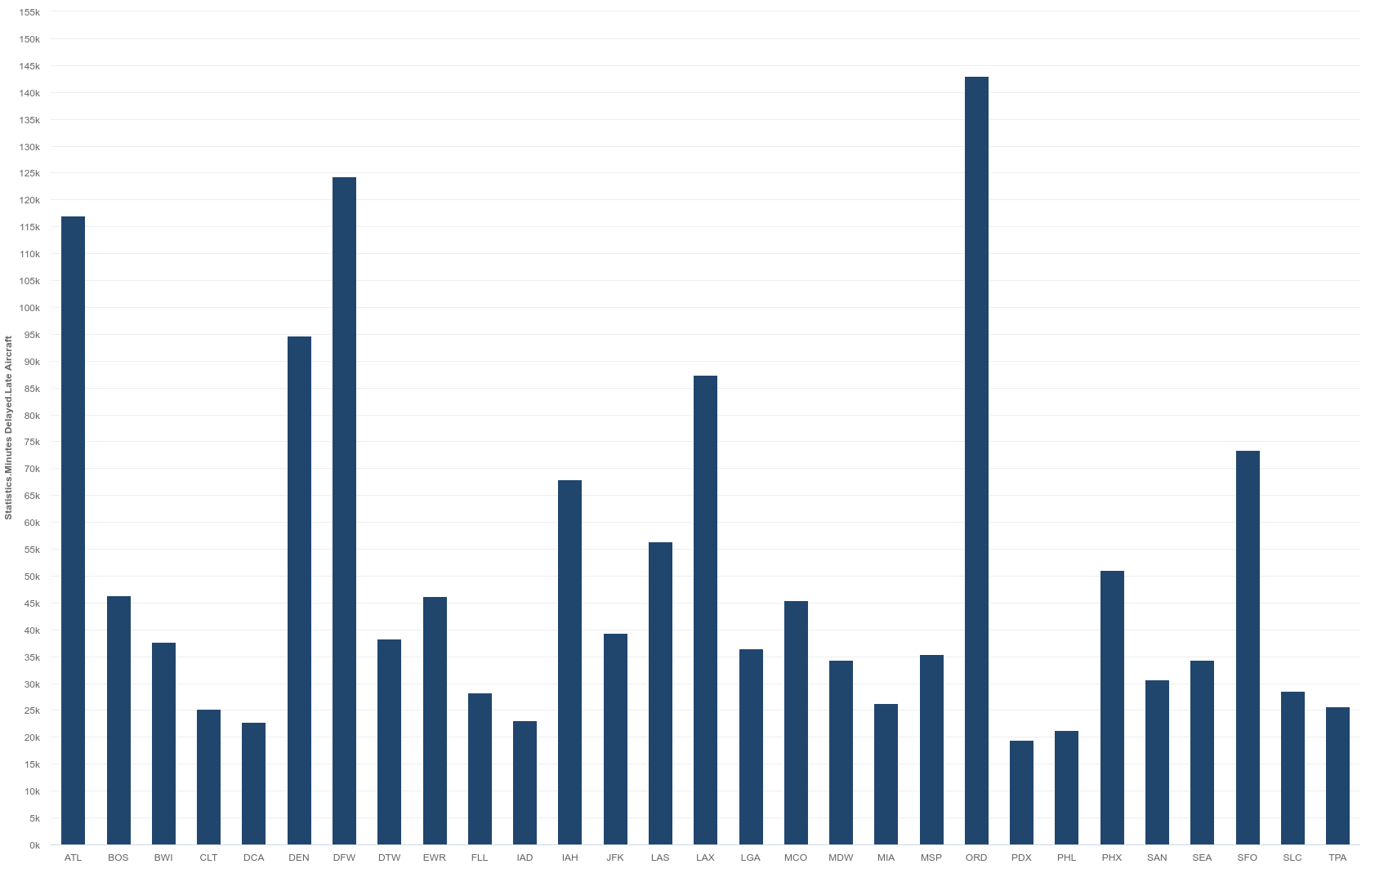
Airlines Analysis
Average Minutes Delays by Aircraft

Slide 16
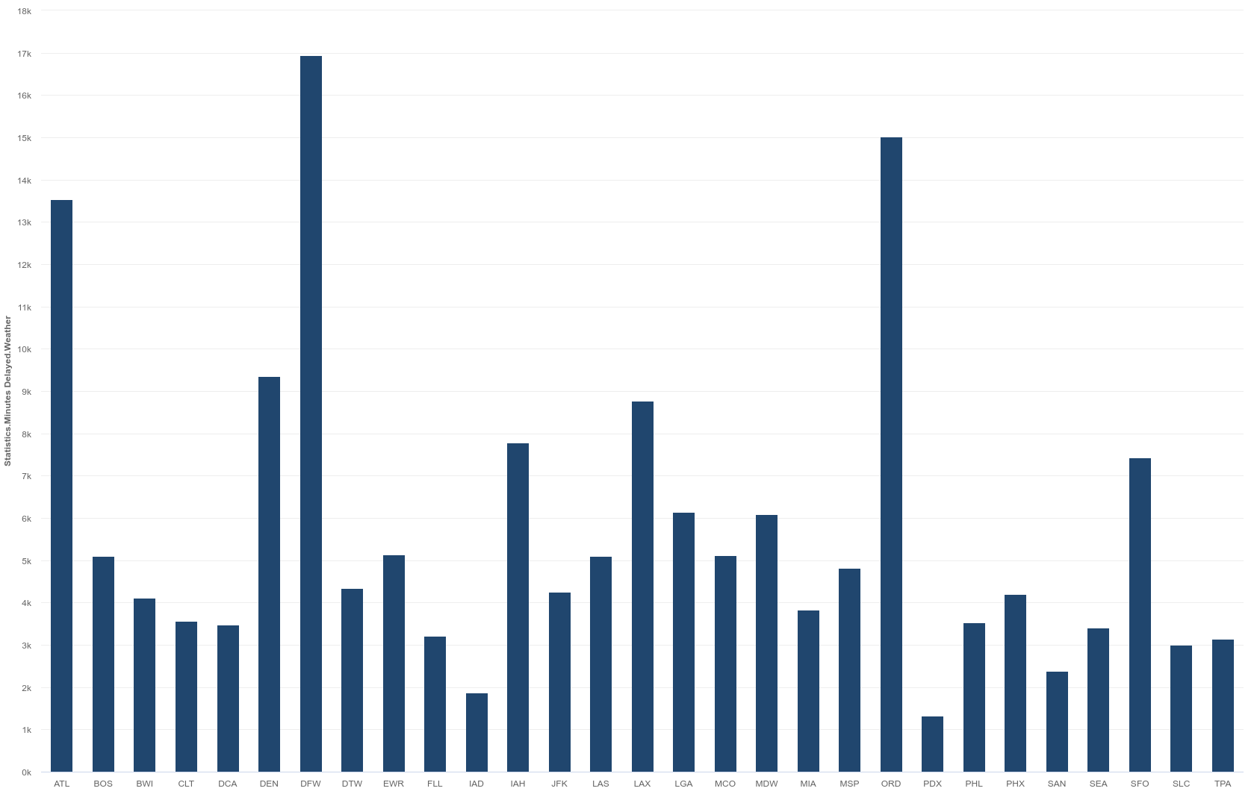
Airlines Analysis
Average Minutes Delays by Weather

Slide 17
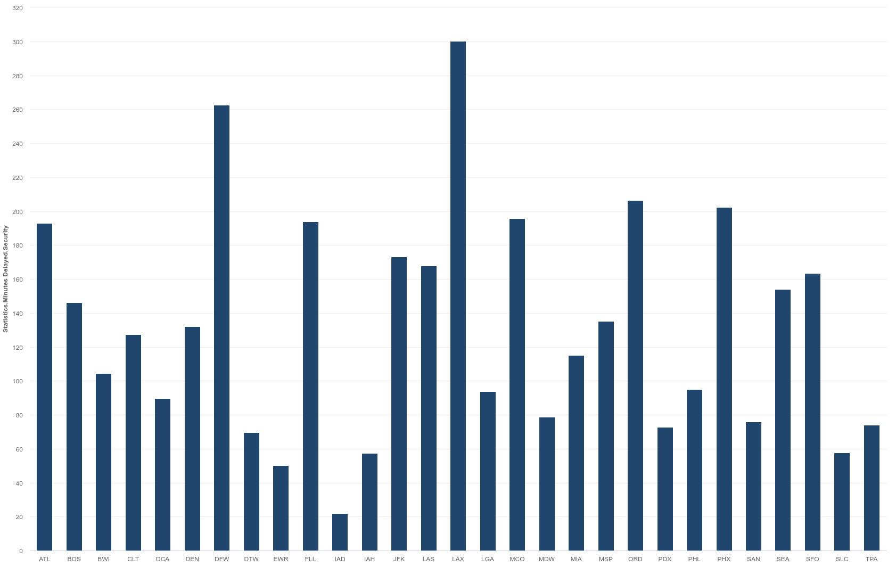
Airlines Analysis
Average Minutes Delays by Security

Slide 18
Airlines Analysis
Maximum Minutes Delays by Aircraft, Weather and Security

Slide 19
Airlines Analysis
After analyzing the dataset we viewed the all issues and problems caused by different reasons.
We found also that aircraft and carriers and the main issue caused by us as human and we should handle it.
The weather is something we cant say stop it, but we can make some improvement as admins that handles all the situation caused by weather.

Slide 20
Airlines Analysis
I recommend for the aircraft issue, to make more routs and hubs because it seems that there is less capacity than it should be.
And recommend implementing self-help technologies to handle the carrier issue.
Recommend also for the delays, to make more structured system in way making people be on move, by making restaurants, coffee shops etc. this makes people not to be bored and thinking about canceling their flight tickets.

Slide 21
Airlines Analysis
For the bonus question, yes its possible in many ways, we can use the data and see if the united states airlines damaged by the situation, or by taking international airlines and see number of delays and how they handle it, and much more we can do because if you have the data then you have everythin.

Slide 22
Thanks

