Slide 1
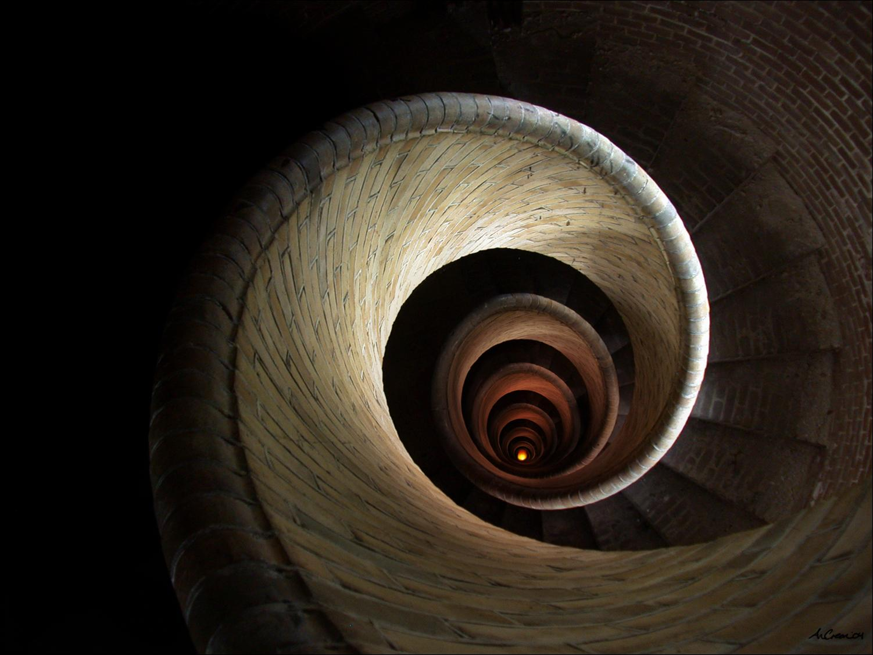
Down the rabbit Hole
Iftach Ian Amit
Managing Partner
iamit.org

Slide 2
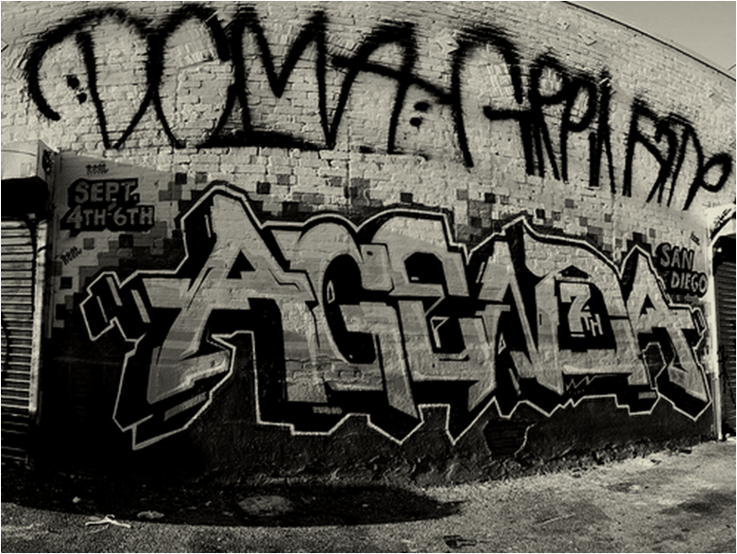

Agenda
Iftach Ian Amit – iamit.org

Slide 3




Who Am I ? (iamit)
Iftach Ian Amit
  In Hebrew it makes more sense…
Managing Partner at iamit.org
Past:
  Director Security Research @ Aladdin
  Director Security Research @ Finjan
  Various security consulting/integration
  gigs in the past
    R&D
    IT
A helping hand when needed… (IAF)
Iftach Ian Amit – iamit.org

Slide 4
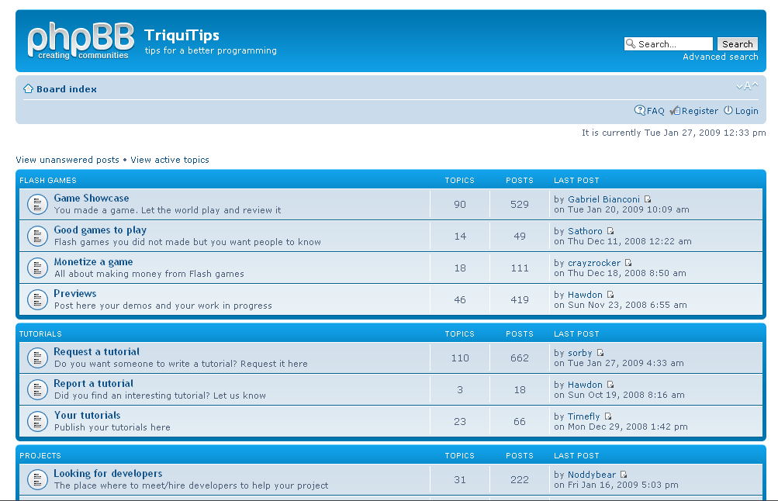
Background – how do you start anyway?
Uberskillz
And sheer luck…
Anyone familiar with triquitips.com?
  Come on – it’s a “tips for better programming site”
  Neither was I.
  How about federconsumatori.it (consumer reports for Italy)
  A lot of these started looking awfully alike… and pointing to the same place…
Iftach Ian Amit – iamit.org

Slide 5
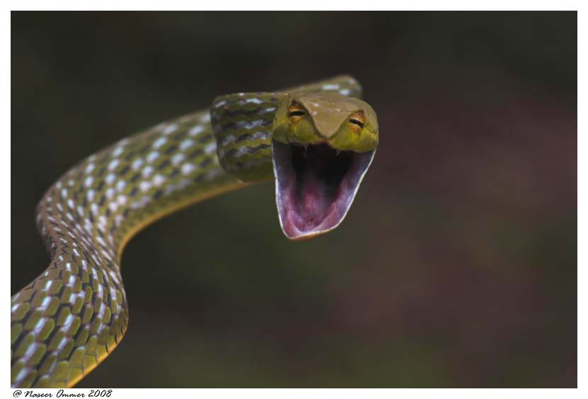
First encounters
gwtsdjeni.com
Really meaningful – and somewhat different than the usual Torpig naming convention… an extra letter gives it up!
  (should be xxxxjeni.com and we got xxxxdjeni.com)
So we take a closer look: you speak english?
  en.php
Iftach Ian Amit – iamit.org

Slide 6
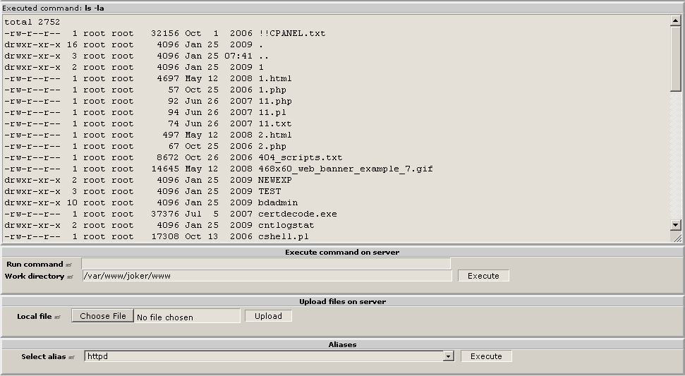
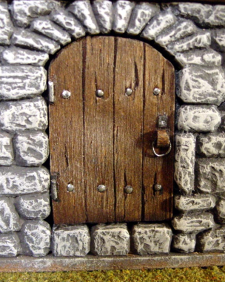
Doors, windows, whatever you want to call these…
Aha! Sherlock, I think we are on to something…
If there’s a shell, there are at least 57 of them…
Iftach Ian Amit – iamit.org

Slide 7
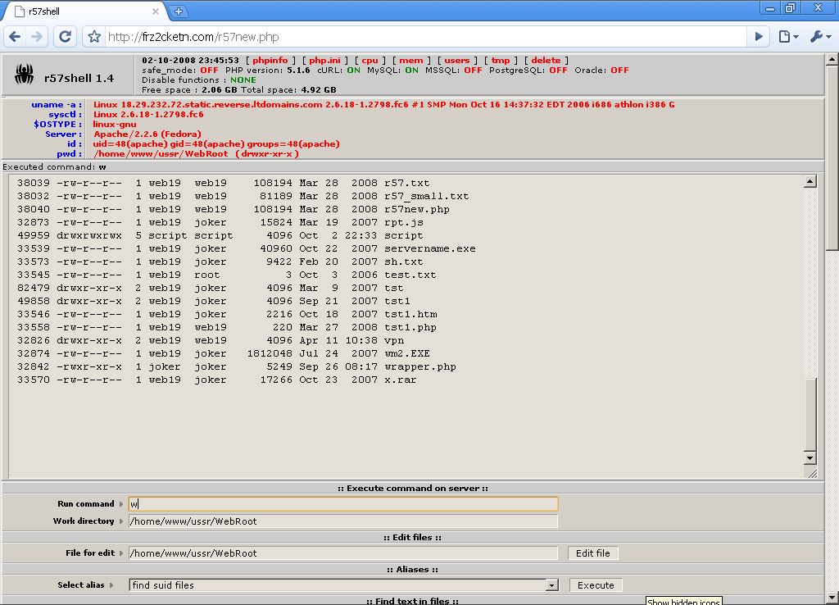

Iftach Ian Amit – iamit.org

Slide 8

Dances with lawyers
1st dilemma – have we gotten too far?
  We followed an injected script on a legitimate site (i.e. – deobfuscate, view-source of result, figure out the server general identity, enumerate).
  We ran across a service offered by the server, which was not protected by any means of user/password, nor had it any disclaimers (en.php → r57new.php).
2nd dilemma – are we going to go any further?
  We can already “see” (i.e. ‘ls’) most of the server – by the means granted to us so far
  We are not going to brute-force ourselves into anything, or guess any credentials?
Iftach Ian Amit – iamit.org

Slide 9

Slip sliding down the hole
Guess what was the decision… (thank you legal department!)
Skimming the content structure shows:
  Neosploit (in cgi-bin)
  Automated FTP Iframe injection tool
  PHPMyAdmin
  Truck full ‘o Trojans
  AWStats logs
  Setup instructions (I kid you not!)
  “mail” backend for tracking infections
  /mc366 – filled with OpenVPN certificates
  Huge list of CPanel credentials
  Some more utilities and exploits
  15 most wanted???
Iftach Ian Amit – iamit.org

Slide 10
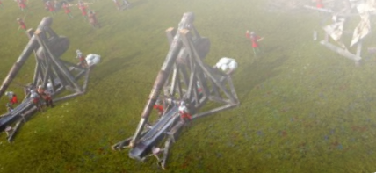
Tools – FTP IFramer
FTP IFrame auto-attacker whizbang thingy
  Was managed separately for each “user” of the system.
  Each user had run several “campaigns”
  The logs were a treasure trove… more than 200k credentials used (i.e. ran through the application)
Iftach Ian Amit – iamit.org

Slide 11

Tools - Neosploit
So you wanted to hear a bit on Neosploit…
THE “Rock Star” of crimeware toolkits.
  It even pulled an Elvis on everyone, and claimed to have disappeared…
V.1. – solid exploit and simple management, single user system. No licensing.
V.2. – multiple user support (SaaS), enhanced reporting (country, referrer, Browser/OS), multiple loader configurations. License locked to IP, server validated. Database moved to flat files.
V.3. – Enhanced licensing (locked to IP+user/pass), installation only though a SOCKS proxy, Enhanced reporting on exploit ROI, Enhanced database management.
Iftach Ian Amit – iamit.org

Slide 12
Neosploit – digging deeper
Installation – fully automated using a cgi script:
  User & password for licensing (checked when connecting to the server to fetch the build).
  Downloads the build from 0x0c0c0c0c.com
  Goes through a SOCKS proxy at 12.219.55.171:7062 (control freaks!)
  Takes care of version checking, unpacking, system (permissions, init scripts, etc…)
  Bonus – logging…
Iftach Ian Amit – iamit.org

Slide 13



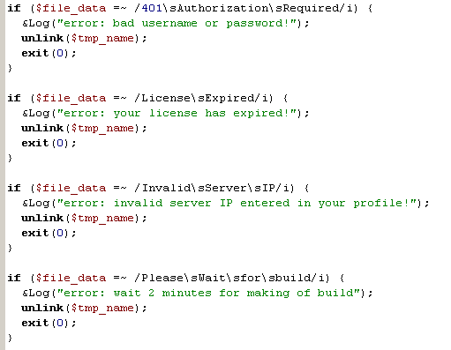
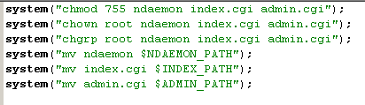

Iftach Ian Amit – iamit.org

Slide 14
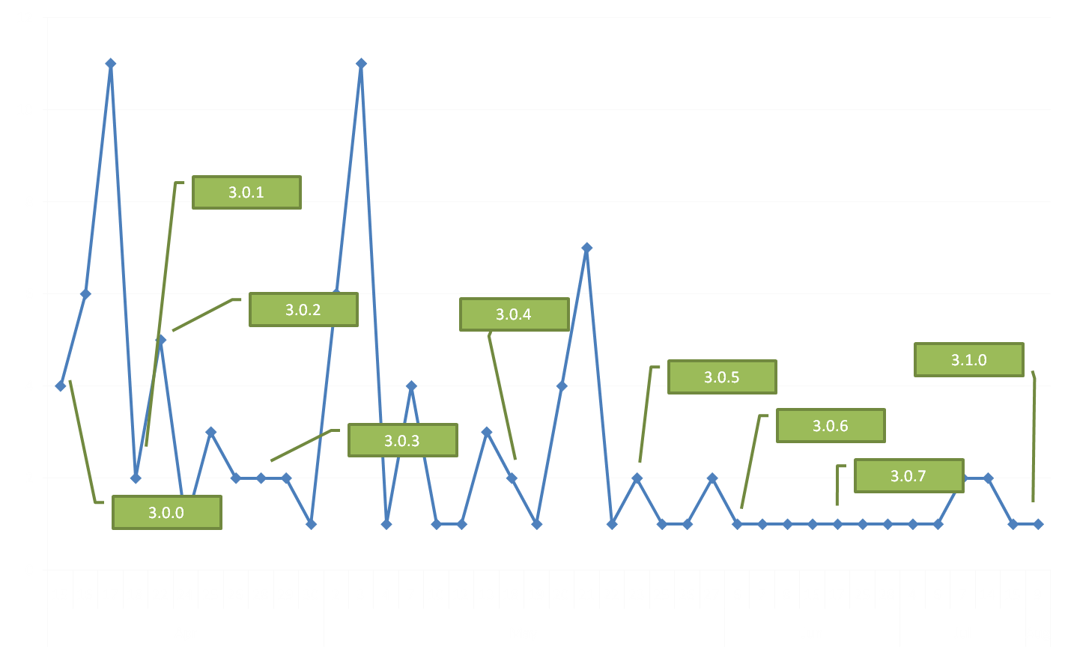
Neosploit update statistics (based on logs…)
Iftach Ian Amit – iamit.org

Slide 15
The rest ain’t that fun
ndaemon – the backend daemon
  Implements the DB interface
index.cgi – exploitation frontend
  Mostly basic decision making based on data from the backend, data from the prospective victim (geoIP, browser string, cookies, referrer, etc…)
admin.cgi – admin interface
  Basically a frontend for querying the backend for statistical data, and basic configuration
Iftach Ian Amit – iamit.org

Slide 16
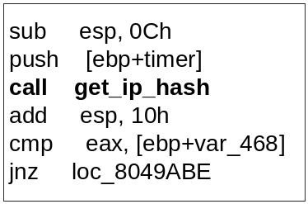
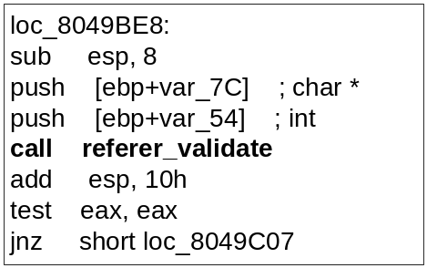
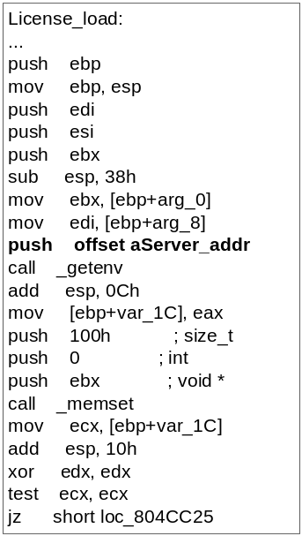
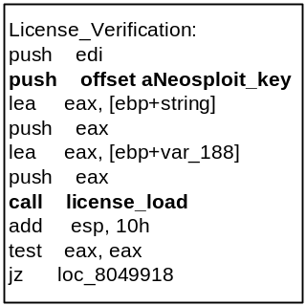
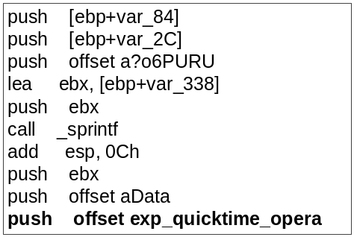
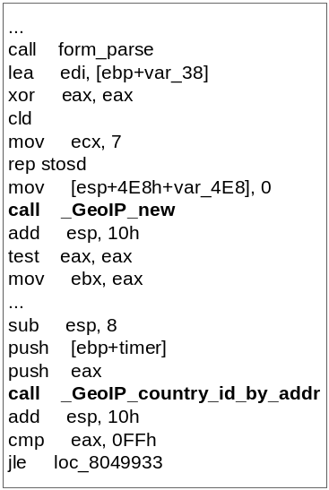
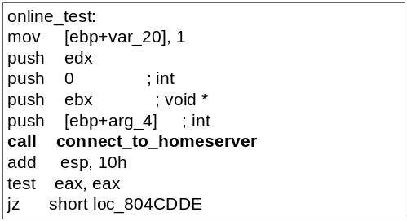
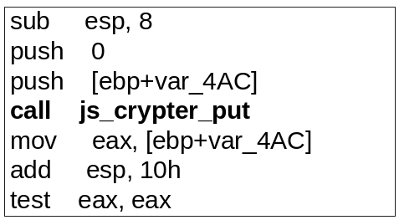
Told you so ☹
Iftach Ian Amit – iamit.org

Slide 17
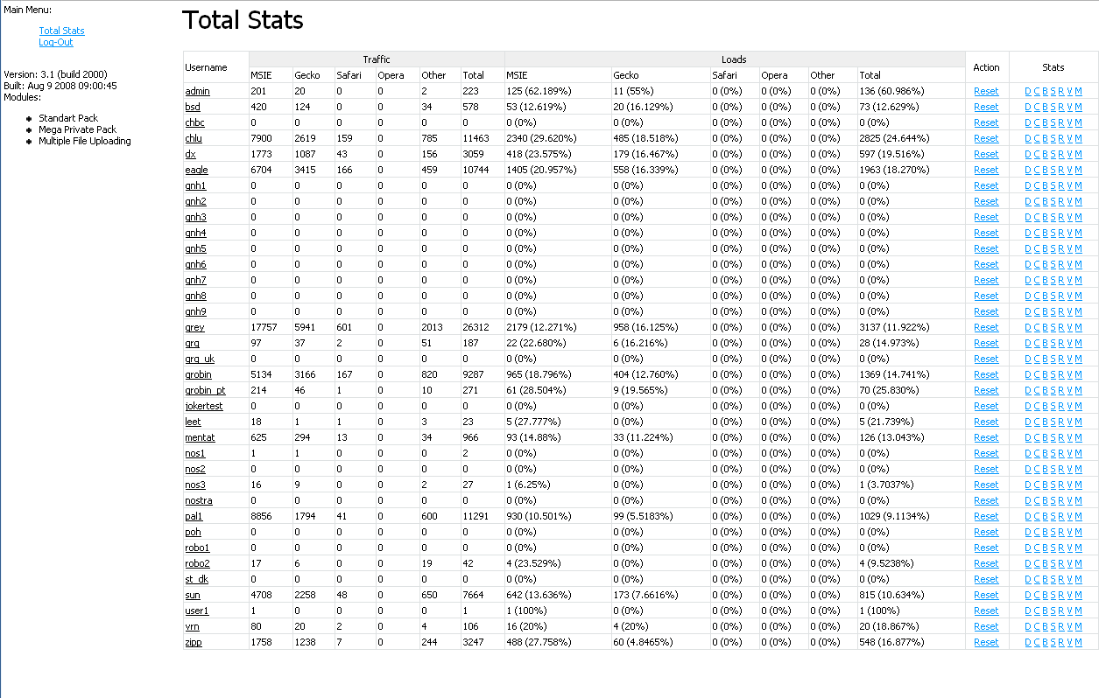
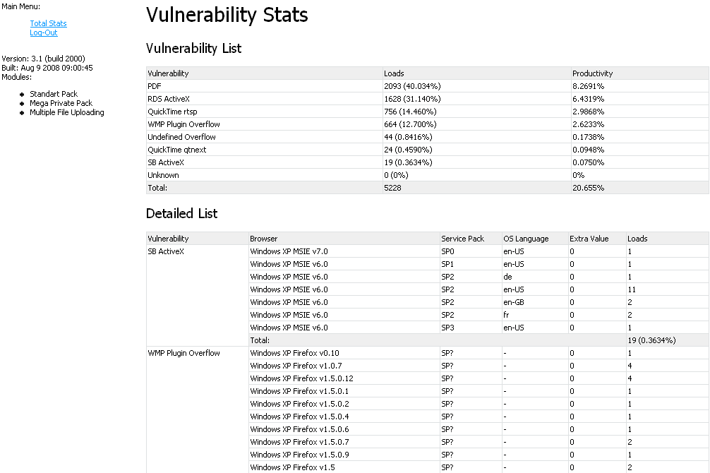
Iftach Ian Amit – iamit.org

Slide 18

Scripts – what’s the next address?
The modified Torpig domain generator
  Modified the domain generation logic (last part has an extra letter).
  Modified to also provide the injection in different formats (popunder variants).
Great for keeping track of
“next hop” planning…
Sources: /ifrmcrypt/crypt.htm,
crypt_js.htm, crypt_js_jok.htm
Iftach Ian Amit – iamit.org

Slide 19

Scripts - ProxyJudge
A cgi to test whether the victim is behind a proxy.
  Smart criminals don’t attack twice at the same spot, and need to know whether it’s worthy to unleash their mojo…
Iftach Ian Amit – iamit.org

Slide 20
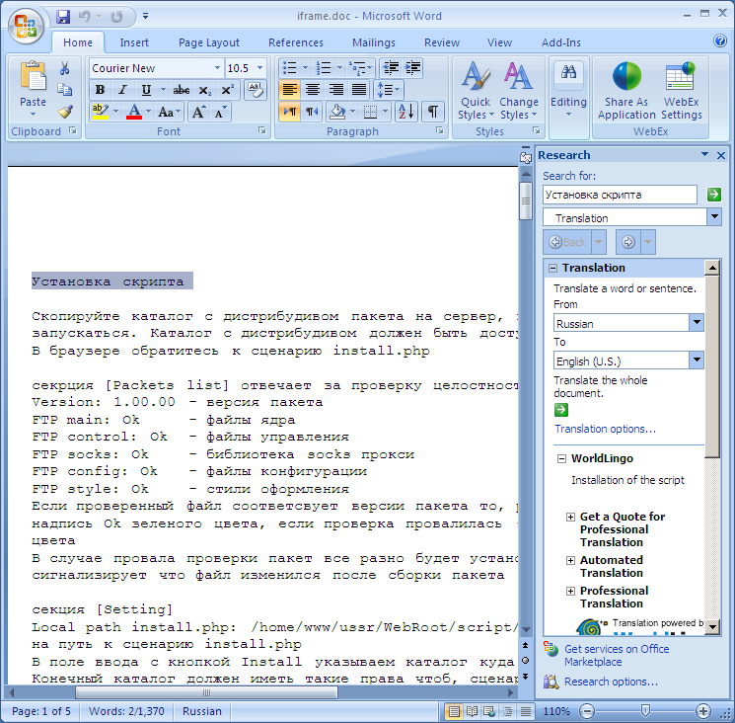

Other goodies
“Howto” in word.
  (someone from MS wants to check for licensing?)
  Run install.php, make sure the dir is writeable, and accessible from the web…
  Packer will verify the integrity of the install (!!!)
  Change the settings…
  Check results.
  Options description, logging, interpreting logs (ASCII graphics!)
All in Russian ☹
Iftach Ian Amit – iamit.org

Slide 21

Scripts – CPanel goodies
Looks like a “braindump” from grabbing interesting credentials.
TONS of CPanel login info – hundreds of domains…
  Inline comments in Russian on some of the sections:
    “clearly has not been able to look after !!!!!! ”
    “glyant OWL. previously worked as щас clearly no longer works ”
    “ekspa need to pop in and remove the soap base ”
    “this, too many sites and is not small ”
    “master admin cpanel” (near a hosting site address…)
Iftach Ian Amit – iamit.org

Slide 22
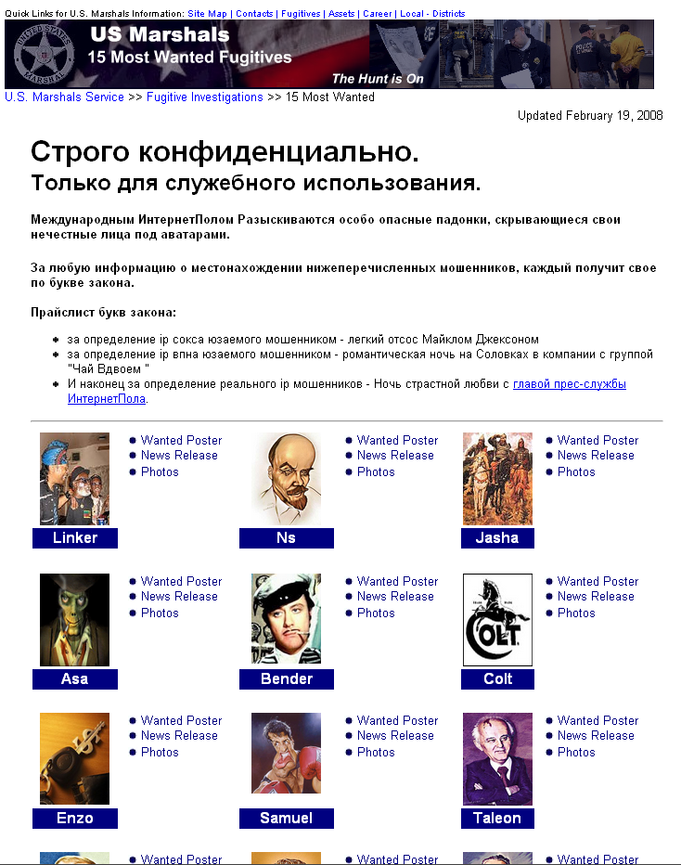
More goods
Criminal humor:
  Under “marshals_investigations_most_wanted” there are a few HTMLs, must be some internal joke or a teaser to LE…
  Nicks for the gang crew are on this (instead of the original page from the US Marshal site), along with funny caricatures of them…
Iftach Ian Amit – iamit.org

Slide 23
Meanwhile…
We haven’t just started debugging, tracing and poking around for fun!
  The second we managed to clear out the legalities, we pushed everything to CERT-CC
Coordination efforts:
  CERT-CC was highly responsive! Created a small task-force to handle the data
  Analyzed logs, segmented it to 86 different affected countries, started managing the notification process to ALL of them (inc. establishing secure comm. with a few)
  Worked with FBI and SS in the US
Iftach Ian Amit – iamit.org

Slide 24
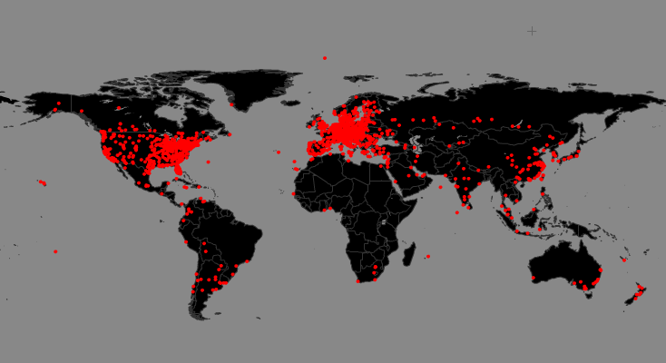
Fancy maps and all…
Iftach Ian Amit – iamit.org

Slide 25
Closure?
So, worked with CERT, got a lot of ricochets from the field (some countries the notification process was sloooooow, data got out before the notifications got to the affected parties…)
A few days to get the bulk of the sites notified.
Shows up on the “bad-guys” stats as well:
Iftach Ian Amit – iamit.org

Slide 26
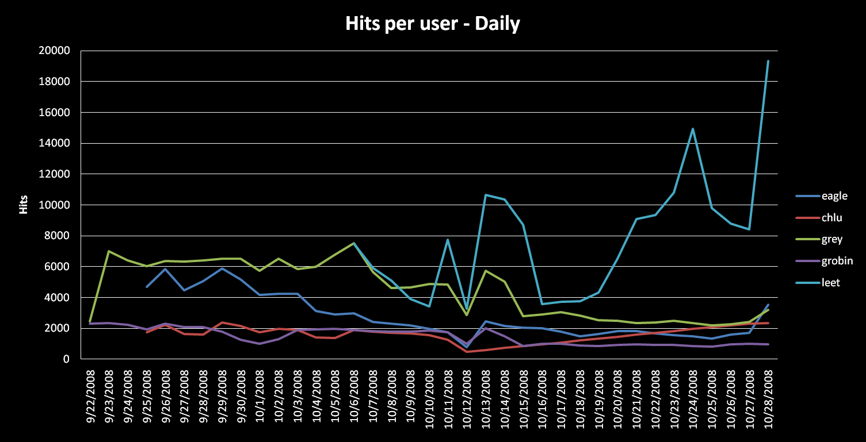
Graphing the main 5 “clients”
Iftach Ian Amit – iamit.org

Slide 27
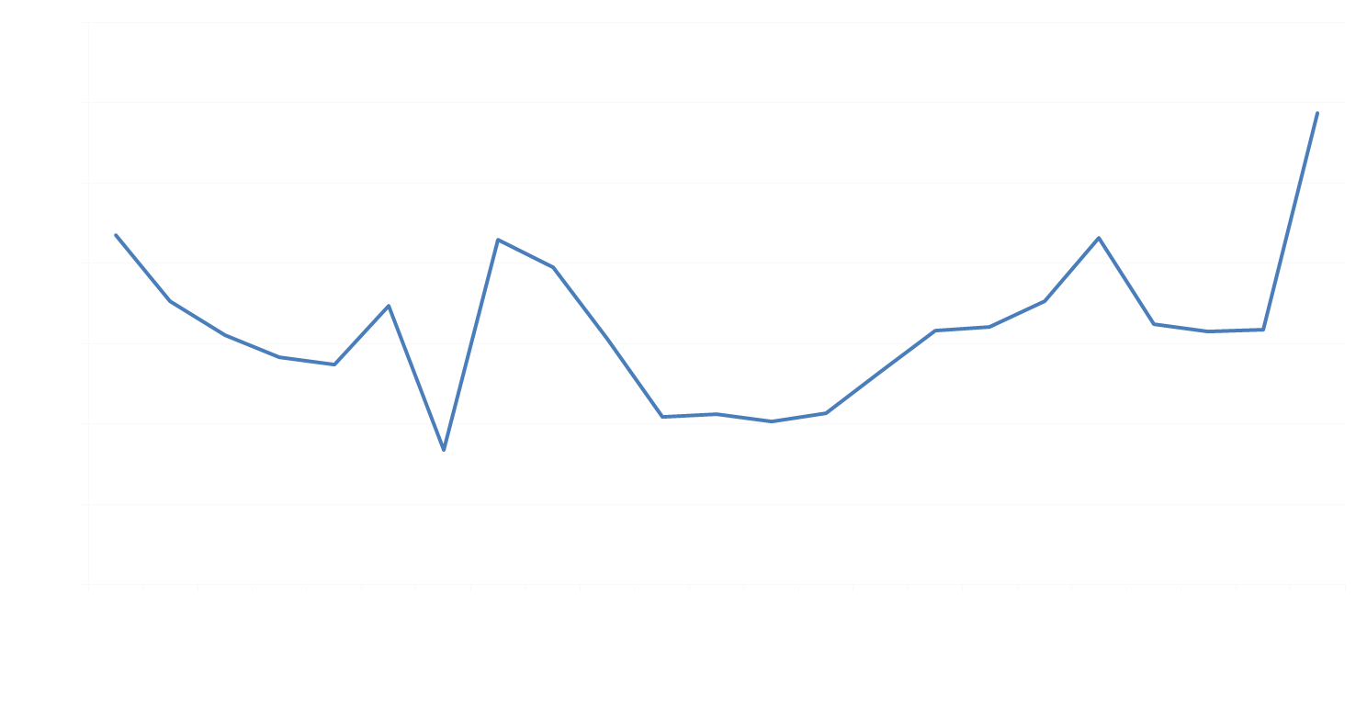
Let’s see…
Post news publication – cleanup as sites notified of breaches
eCrime operator regroups and recruits new sites, notification process continues…
eCrime operation back to normal – after stabilizing when the notification is mostly done, the new “batch” is showing some nice performance…
Graphing the total hits per day for the top 5 users of the system
Iftach Ian Amit – iamit.org

Slide 28
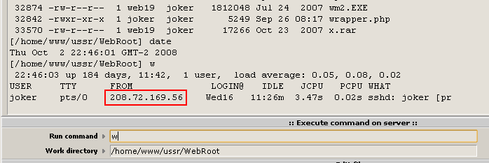
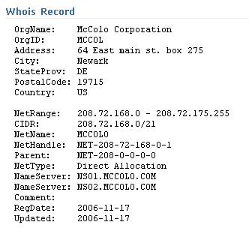
The McColo Connection?
Remember the door we were peeking through?...
Yup – well into the investigation, we caught a glimpse of the joker while he was at it…
Iftach Ian Amit – iamit.org

Slide 29

And if we are getting that close and personal
How ‘bout them .htaccess files?
  FTP IFramer, PHPMyAdmin, scripts directory… were not accessible to the general public
allow from 90.189.250.93 66.36.244.234 66.235.182.115 208.72.169.56 208.72.169.61 82.103.131.138 82.103.135.175
(That’s DC, Newark, Denmark and Russia)
Yup – these got to LE as well…
Iftach Ian Amit – iamit.org

Slide 30

How bad can this be anyway?
Sensitive images removed.
Iftach Ian Amit – iamit.org

Slide 31
Final words
What should we be looking for in terms of advancements in “Trojan technology”?
  Mostly communication
  What have we learned from the use of legitimate websites on the attack vector?
  Why not apply it to the rest of the communication channels?
Iftach Ian Amit – iamit.org

Slide 32







Trojans 2.0 Illustrated
Iftach Ian Amit – iamit.org

Slide 33
Final final word…
Taking this a step further…
  Server is being moved around, can we plant a “bug” on it to enable us to trace it (the eCrime LoJack?)
  Would enable better tracking of criminal activity patterns
  we actually thought about it…
    Legal – need to further investigate (as access has been “granted”)
    Keeping the chain of evidence (no tampering was done up to this point)
Iftach Ian Amit – iamit.org

Slide 34
Q&A
Questions?
Thank you!
iamit@iamit.org
Iftach Ian Amit – iamit.org

