Slide 1
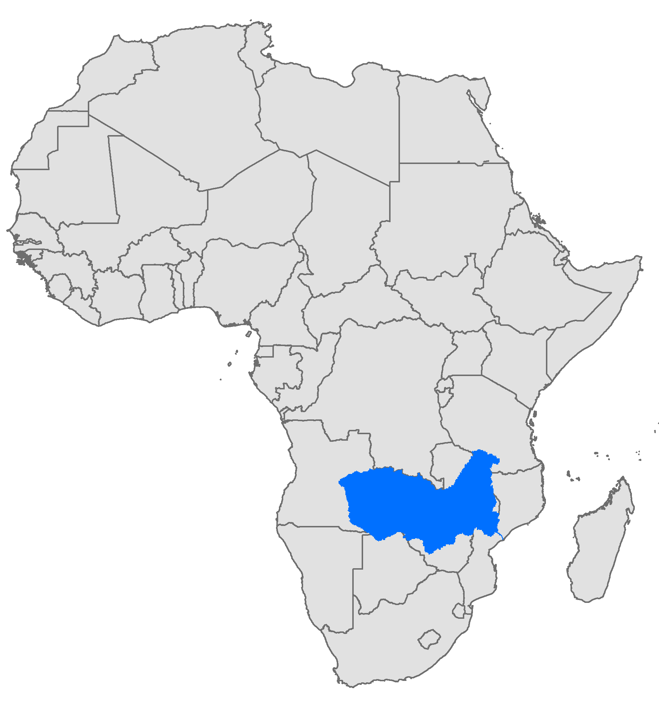
Exercise 2: looking at model results
Uncertainties from models, Climate Change
Zambezi catchment
Peter Burek, Peter Greve, Taher Kahil
International Institute for Applied Systems Analysis
Research Scholars at
Water Program

Slide 2
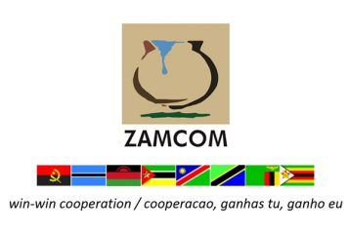
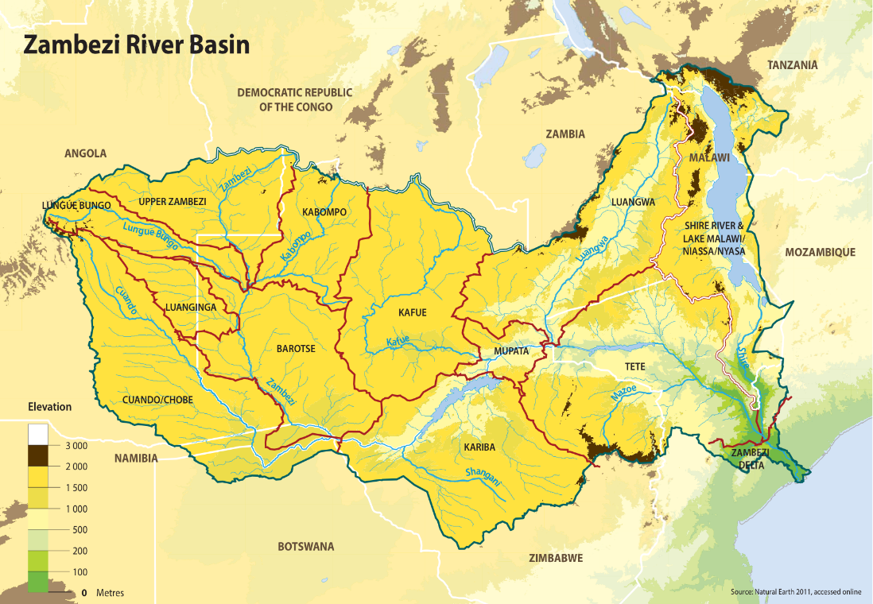
Study area: Zambezi Basin
One of the largest river basins in Africa, covering an area of 1.4 million km² and home to around 40 million people.
A transboundary basin spanning over eight countries and 21 subbasins.
Existing governance structure: ZAMCOM
Growing population and economy
Considerable potential for agriculture and hydropower development

Slide 3
Using the calibrated hydrological model to calculate input data for the hydro-economic model
3

Slide 4
Node-Link Network for Optimization
Sub-basin network
1
2
11
3
20
14
4
12
13
16
17
5
10
7
15
19
6
18
9
21
8

Slide 5
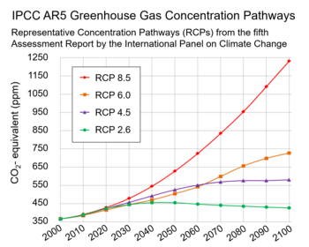
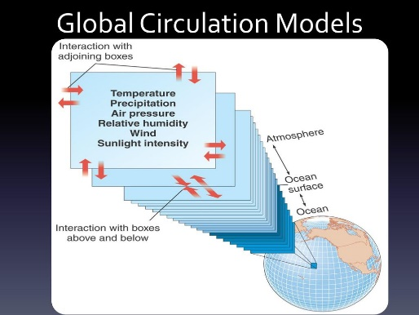
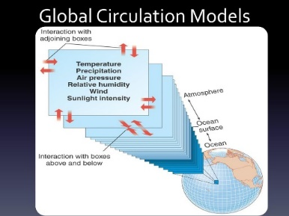
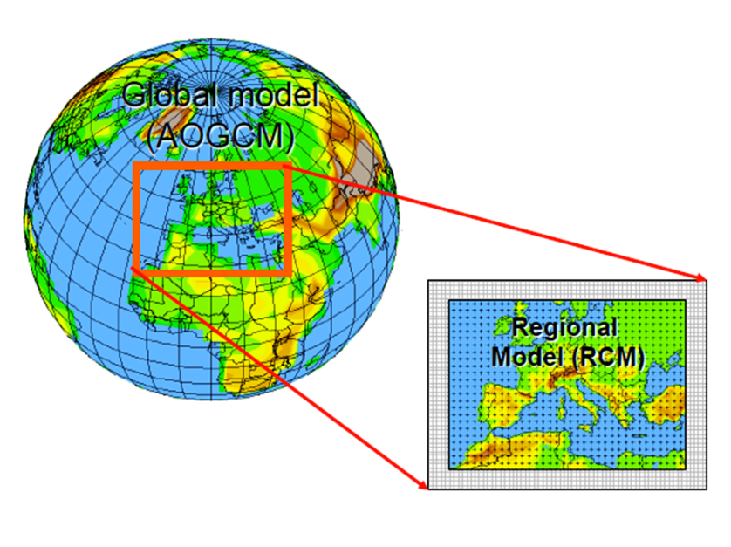

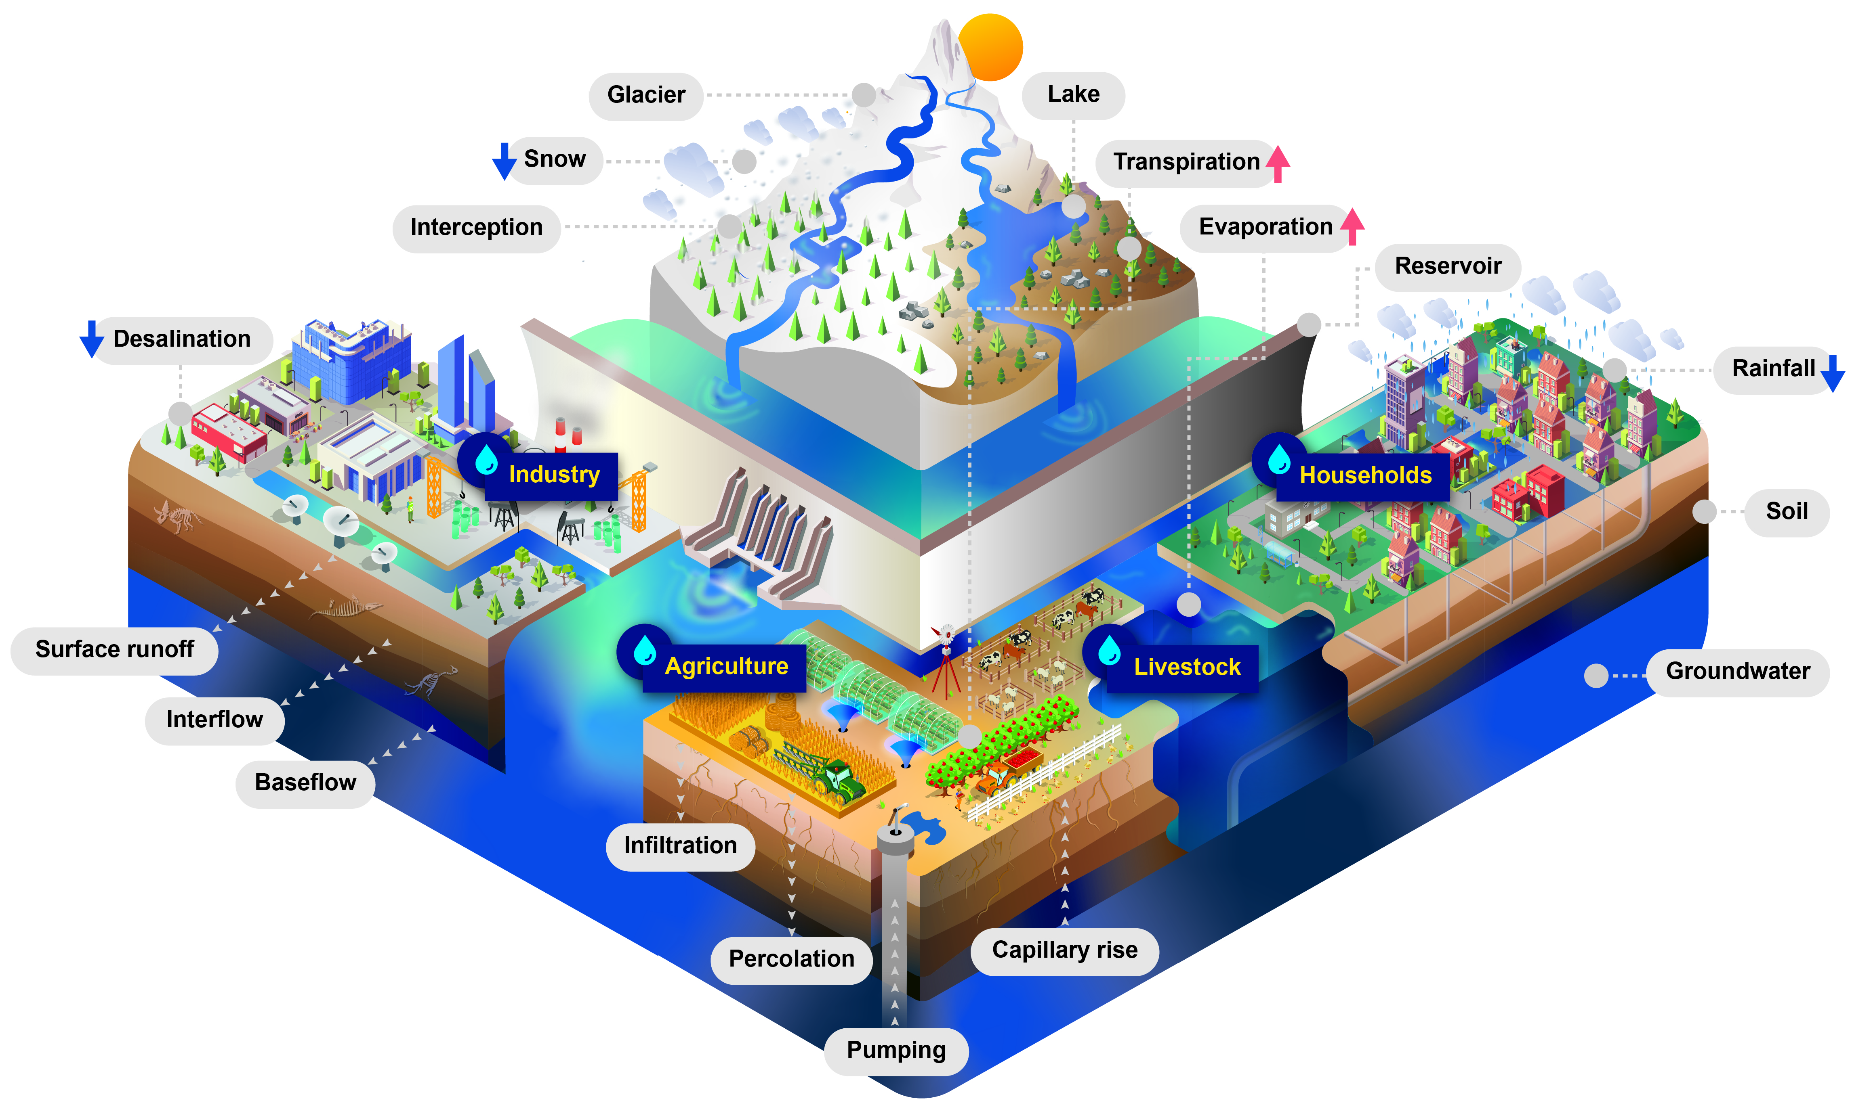
Climate Modeling Chain
1. Representative Concentration Pathway (RCP) is a greenhouse gas concentration (not emissions) trajectory adopted by the IPCC for its fifth Assessment Report (AR5) in 2014
1. Representative Concentration Pathway (RCP) is a greenhouse gas concentration (not emissions) trajectory adopted by the IPCC for its fifth Assessment Report (AR5) in 2014
2. General circulation model (GCM) is a type of climate model. It employs a mathematical model of the general circulation of a planetary atmosphere or ocean
2. General circulation model (GCM)
is a type of climate model. It employs a mathematical model of the general circulation of a planetary atmosphere or ocean
3. Regional Climate Models, Downscaling, Bias Correction
The spatial resolution of GCMs outputs is sometimes too coarse for regional adaptation. Regional Climate Models, downscaling and/or bias Correction is used to downscale and to correct GCMs
3. Regional Climate Models, Downscaling, Bias Correction The spatial resolution of GCMs outputs is sometimes too coarse for regional adaptation
4. Global Hydrological Models (GHMs) Global-scale hydrology concentrates on the role of the terrestrial hydrological cycle in System Earth. They include the processes for vegetation, soil, groundwater, river routing etc.
4. Global Hydrological Models (GHMs) Global-scale hydrology concentrates on the role of the terrestrial hydrological cycle in System Earth.
5

Slide 6
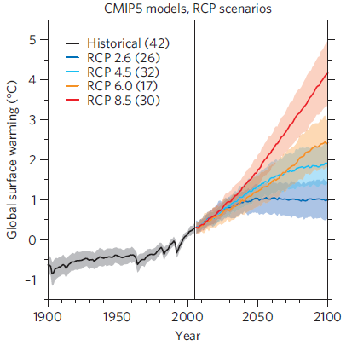
Climate projection RCPs and GCMs
Uncertainties from RCPs
Uncertainties from GCMs
Notes:
For the two basins, the SSPs and RCPs provide the context to define the regional specific change pathways, and it is expected that these scenarios can be refined (e.g. by including important regional factors) and improved (e.g. incorporating better information datasets) in collaboration with the stakeholders.

Slide 7
Climate & Hydrological uncertainty
Intra-annual variability
Scenario RCP 4.5 CMIP5 Ensemble
4 General Circulation Models
Inter-annual variability
GFDL-ESM2m
HadGEM2-ES
IPSL-CM5A-LR
MIROC5
Zambezi results from Community Water Model - Station: Katima
Period 2006-2015 – Ensemble of 40 members
Discharge [km³/month]
Hydrological model (CWATM)

Slide 8
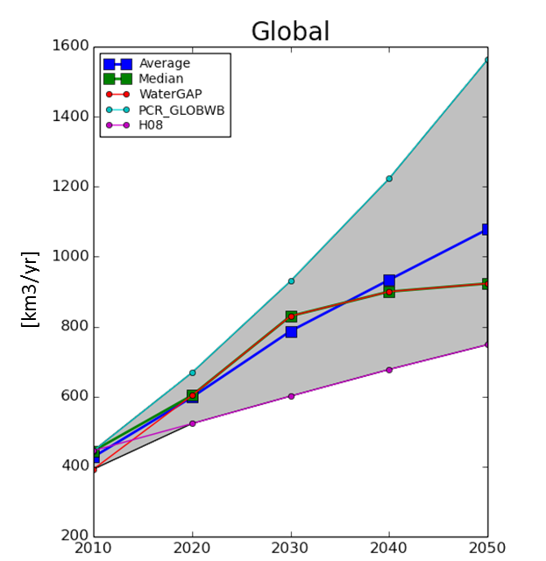

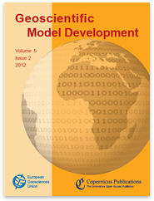
Multi-model Assessment: Water Demand
Models | Institution
WaterGAP | Kassel University (Germany), Frankfurt University (Germany)
H08 | National Institute for Environmental Studies (NIES, Japan)
PCR-GLOBWB | Utrecht University (The Netherlands)
Multi-model
Domestic water demand
Wada Y, Floerke M, Hanasaki N, Eisner S, Fischer G, Tramberend S, Satoh Y, van Vliet M, Yillia P, Ringler C, Burek P. and Wiberg D (2015), Geoscientific Model Development
Approach
Notes:
Shows demand assessment models that are part of the current fast-track consortium

Slide 9
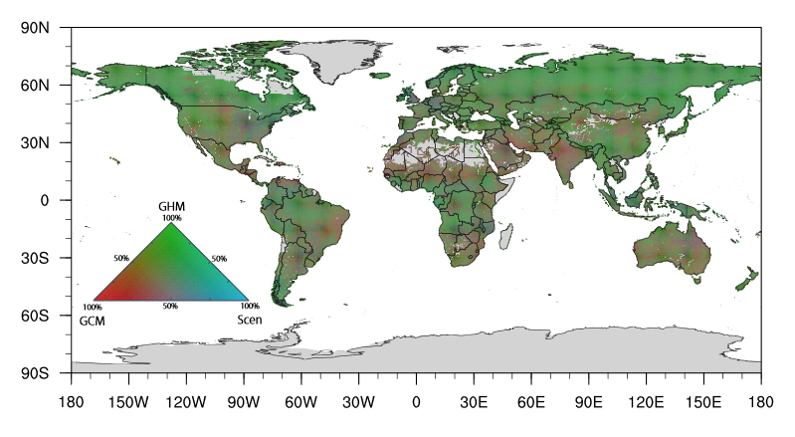
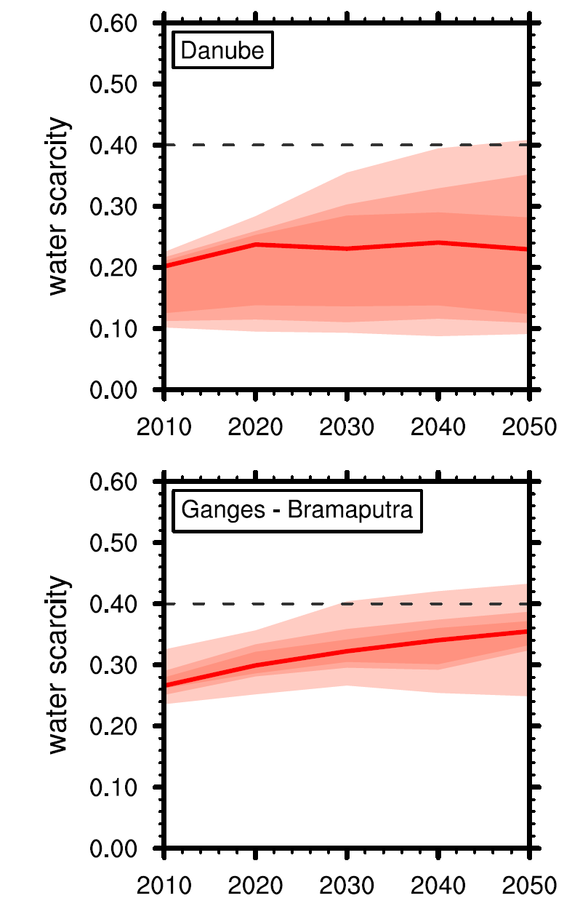
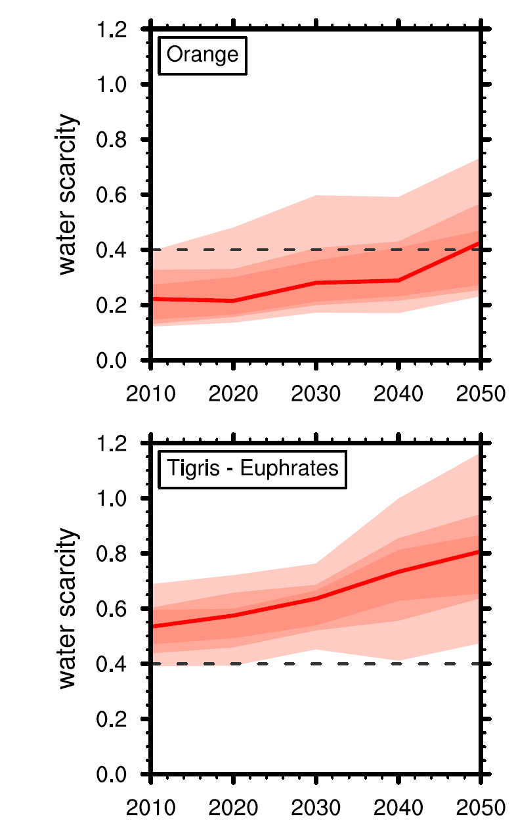
Communicate Uncertainty
Ensemble hydrological impact simulations
3 Global Hydrological Models forced by 5 Global Climate Models under 3 Water scenarios provide an ensemble of
45 global water scarcity estimates (water demand to supply ratio) (from 2005 to 2055, 0.5deg)
[Greve et al. 2018]

Slide 10
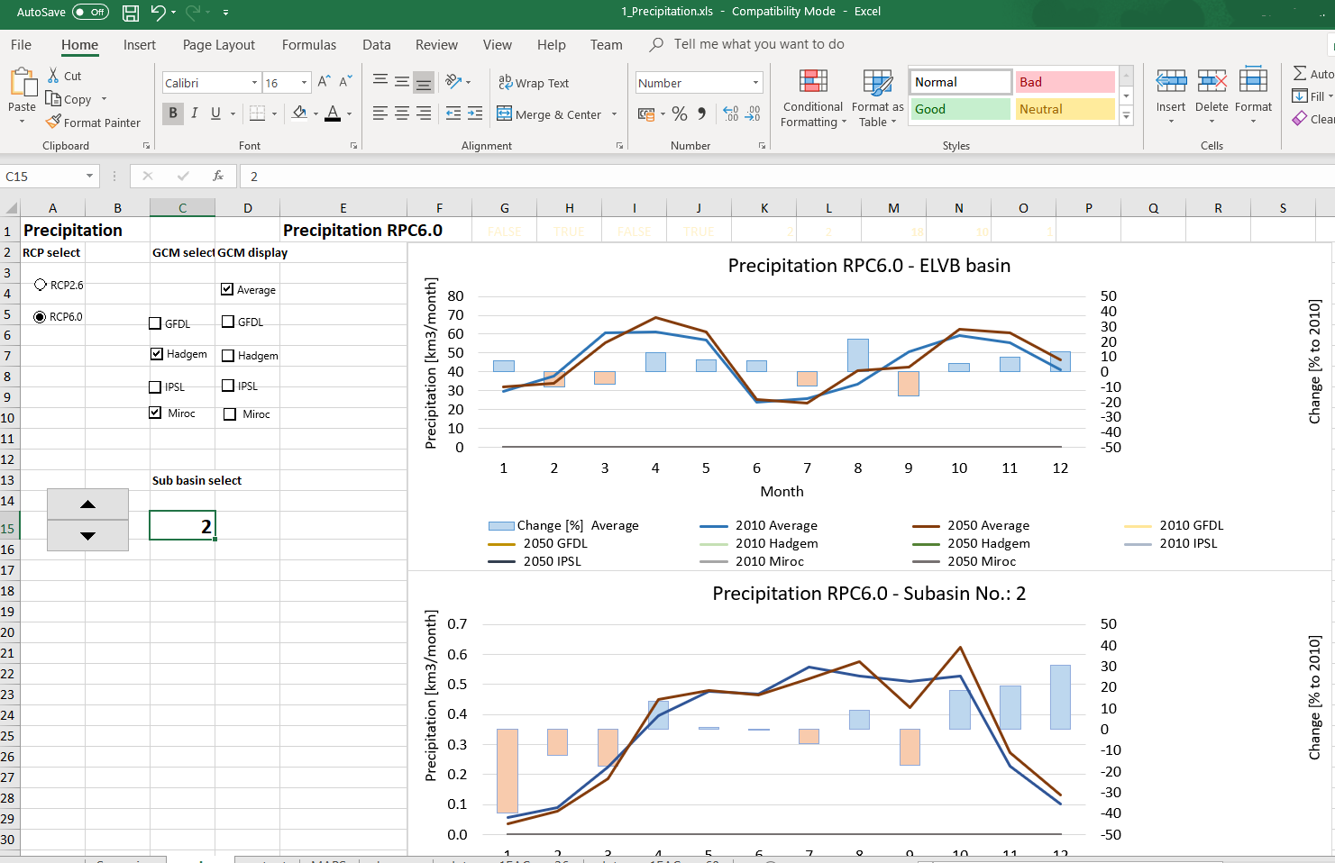
Results explorer - Excel
Based on existing knowledge
Easy to understand and manipulate on different levels of experience
Database and Excel spreadsheats available for stakeholders
Compare and explore scenarios:
Time
Sub-catchments or country
Sectors
Technologies
Policies & scenarios
Notes:
The high multi-dimensionality of the results, across sectors, countries and distributed in space and dime, makes scenario comparison a challenge.

Slide 11
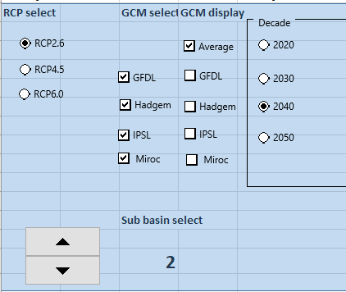
Results explorer - Excel Hands on
Look at a different excel file
1_temperature.xls, 2_precipitation.xls, 3_ runoff.xls, …
Use the options in the analyse sheet
Questions:
Do you see a difference trend between the different RCPs and between the different years? Are all sub-basins showing the same trend?
Tell about the change. Are some months more affected? Is the rainy season getting dryer/wetter/warmer …. What happen to the dry season
Are the different GCM telling the same story?
Can you tell something about uncertainty?
Can you tell something about climate change?
Notes:
The high multi-dimensionality of the results, across sectors, countries and distributed in space and dime, makes scenario comparison a challenge.

Slide 12
Results explorer - Excel
Use the options in the analyse sheet
Change the RCP
RCP 2.6
RCP 4.5
RCP 6.0
Change the decade
2020: from 2016-2025
..
2050: from 2046-2045
Which GCMs should be used to calculate the average?
These GCMs (or the average) are displayed
Scroll through the 21 sub-basins
Notes:
The high multi-dimensionality of the results, across sectors, countries and distributed in space and dime, makes scenario comparison a challenge.

Slide 13
Results explorer - Excel
Do you see a difference a trend between the different RCPs and between the different years? Are all sub-basins showing the same trend?
Tell about the change. Are some months more affected? Is the rainy season getting dryer/wetter/warmer …. What happen to the dry season
Are the different GCM telling the same story?
Can you tell something about uncertainty?
Can you tell something about climate change?
Notes:
The high multi-dimensionality of the results, across sectors, countries and distributed in space and dime, makes scenario comparison a challenge.

