Slide 1
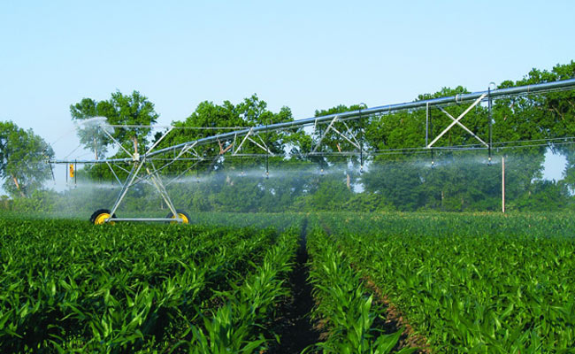
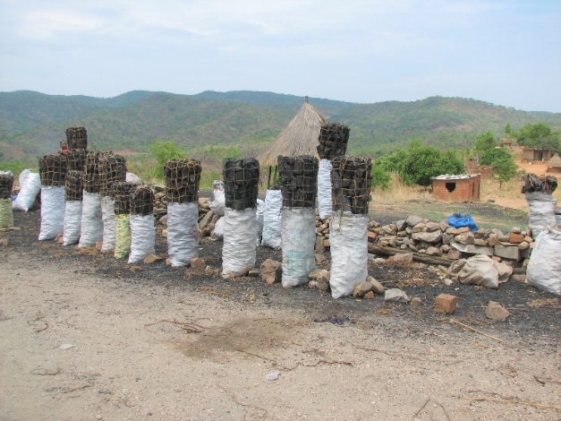
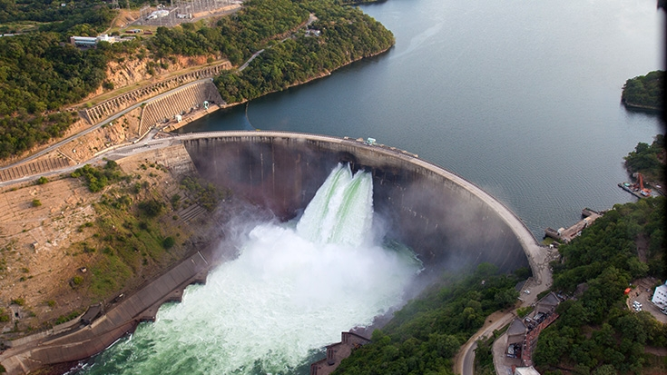
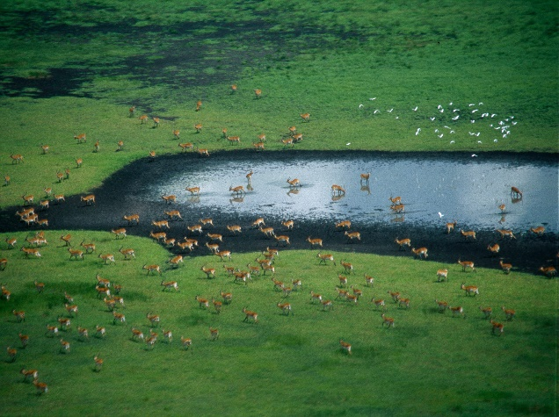
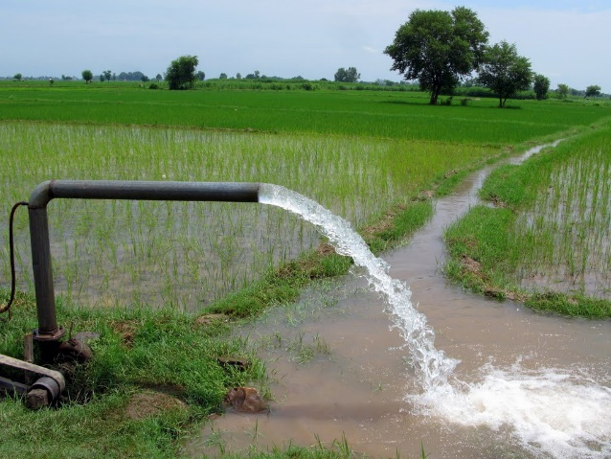
Exercise 6: Water cycles and signatures
Peter Burek, Mikhail Smilovic, Luca Guillaumot
International Institute for Applied Systems Analysis
Research Scholars at
Water Program

Slide 2
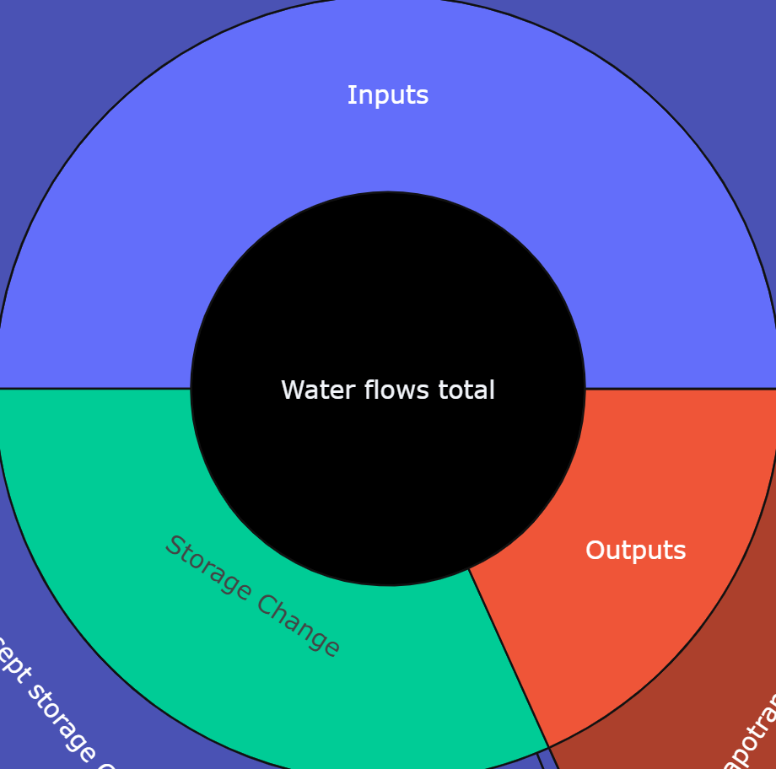
Water cycle
Inputs
A water balance is used to understand the flows through a system.
A water cycle/wheel/circle summarises the flows through a system over a certain period.
The inputs to the system equal the outputs from the system plus whatever changed in the system.
Inputs = Outputs + Storage change
Water flows through the system
Outputs
Storage Change
Notes:
The narrative as told through the water cycle, and the water balance

Slide 3
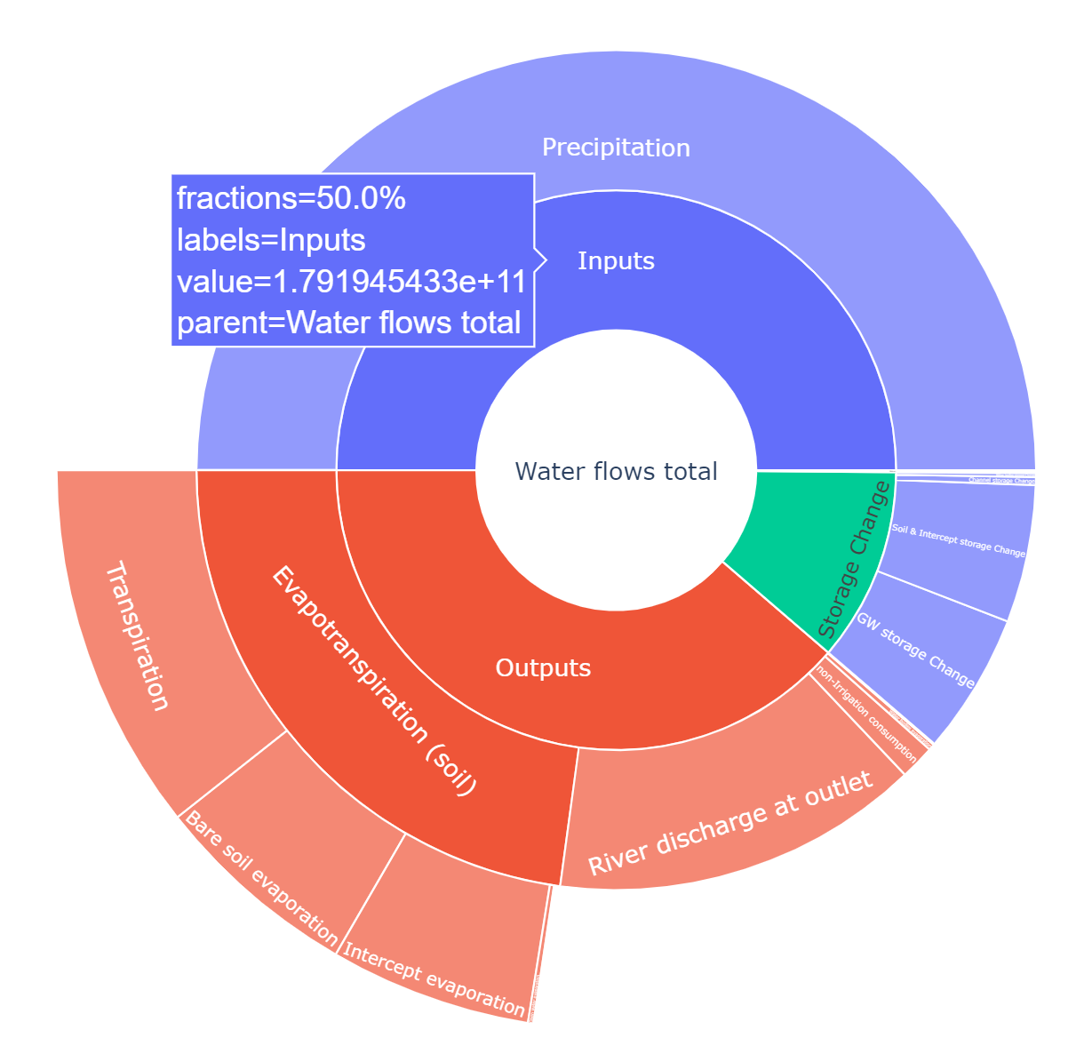
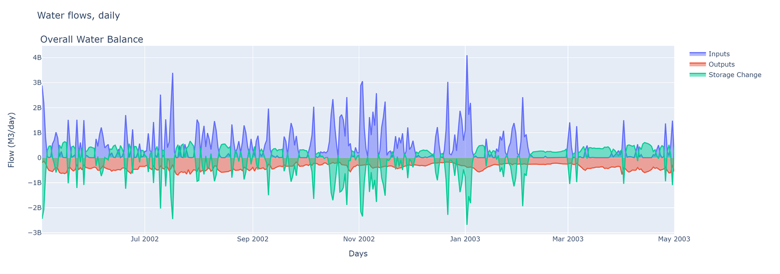
Water cycle and signature example
The Rhine basin for an example year

Slide 4

Water cycles and signatures
Install Jupyter notebooks and some python packages
Open and execute WaterCycles.ipynb using Jupyter notebook
Play CWatM with specific outputs and for your coordinates
Execute WaterCycles.ipynb, updating the outputs path and basin outlet coordiantes
Notes:
Improvement in resolution of CWatM model for basin analysis to show more details locally.

Slide 5
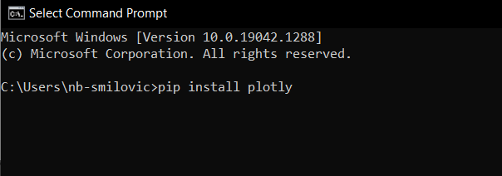
1. Install four python packages
In a command prompt terminal, type the following commands followed by the enter button (or however you may be familiar with installing packages)
pip install plotly [enter]
pip install pandas [enter]
pip install matplotlib [enter]
pip install notebook [enter]

Slide 6
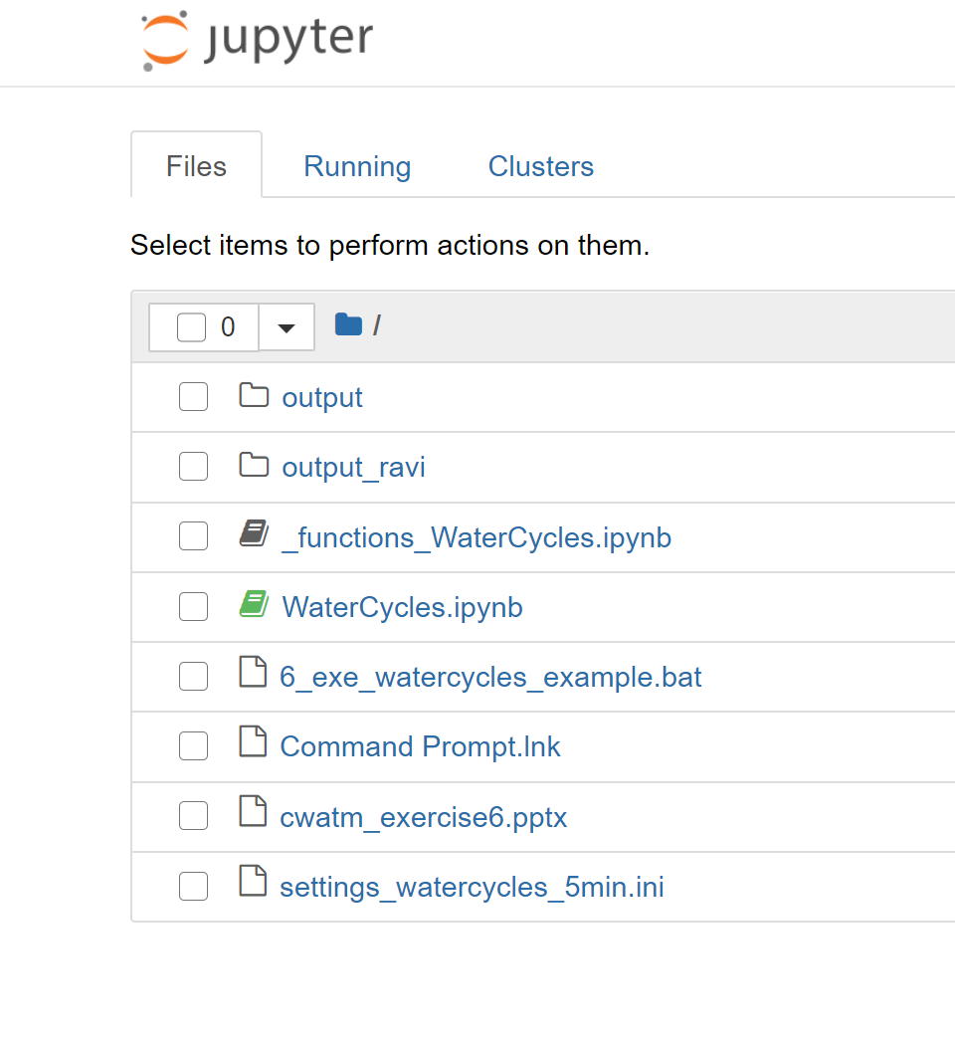
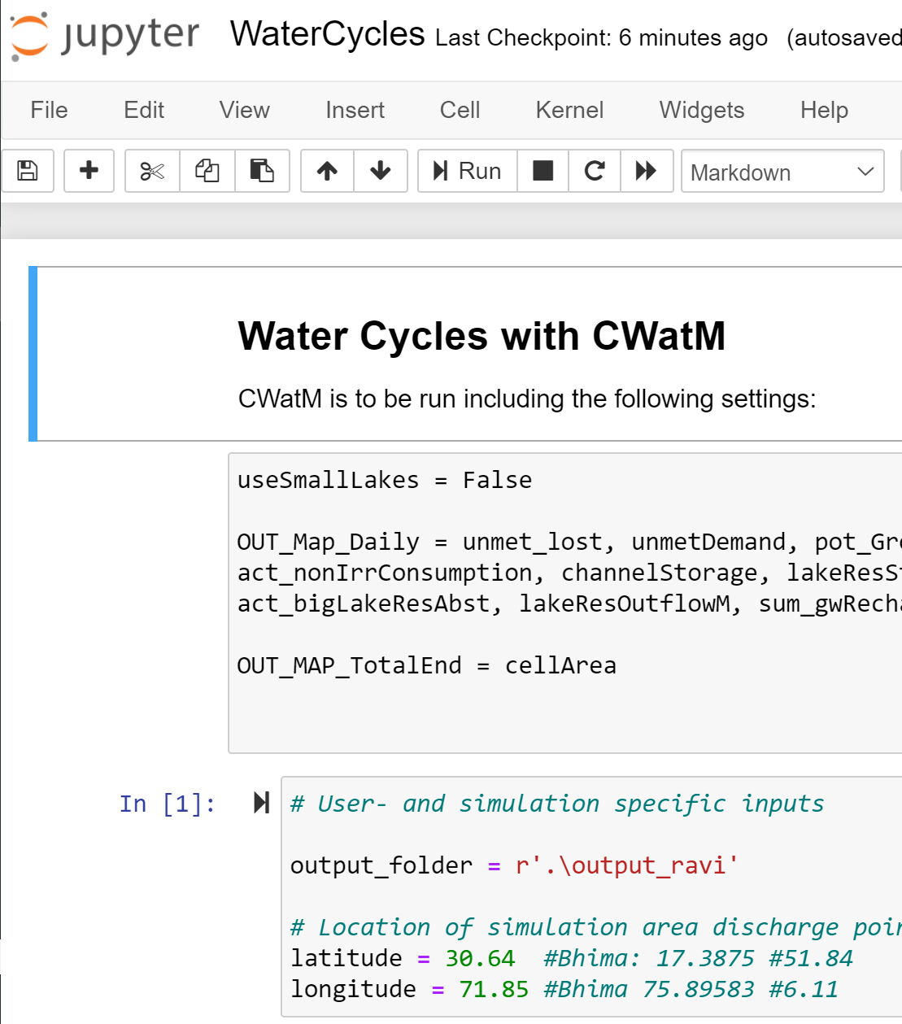
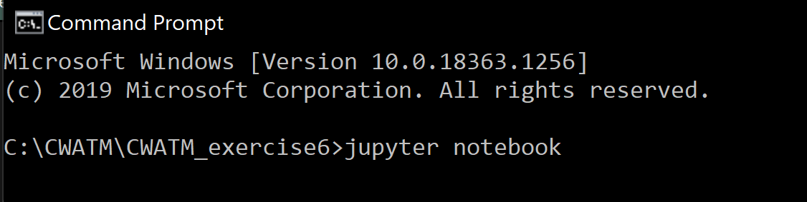
2. WaterCycles.ipynb
1. Open up the terminal within the Exercise 6 folder and type
jupyter notebook
2. Click WaterCycles.ipynb
3. Execute the notebook

Slide 7
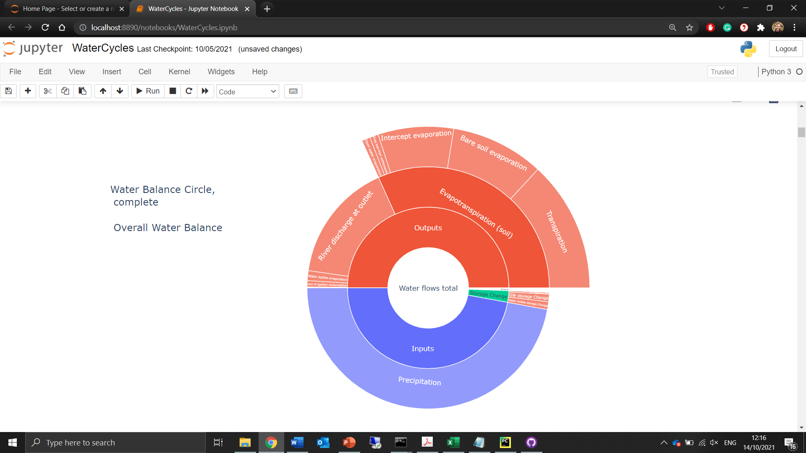
If the notebook has executed successfully, scroll down to see the collection of water cycles and signatures for an example basin.
Now to create these with your simulation data.

Slide 8
3. Play CWatM with these settings
Play CWatM with a familiar settings file, updated with the following settings:
MaskMap = Longitude Latitude (basin outlet)
Gauges = Longitude Latitude (basin outlet)
PathOut = ./output
useSmallLakes = False
limitAbstraction = False
OUT_Map_Daily = snowEvap, Rain, Snow, actTransTotal_forest, actTransTotal_grasslands, actTransTotal_paddy, actTransTotal_nonpaddy, unmet_lost, unmetDemand, pot_GroundwaterAbstract, discharge, storGroundwater, nonFossilGroundwaterAbs, Precipitation, totalET, EvapoChannel, EvapWaterBodyM, act_nonIrrConsumption, channelStorage, lakeResStorage, totalSto, sum_actTransTotal, sum_actBareSoilEvap, sum_interceptEvap, sum_openWaterEvap, addtoevapotrans, lakeResInflowM, act_bigLakeResAbst, lakeResOutflowM, sum_gwRecharge, sum_capRiseFromGW, baseflow, act_totalIrrConsumption, sum_runoff, returnFlow, act_SurfaceWaterAbstract
OUT_MAP_TotalEnd = cellArea
Alternatively, the settings file settings_WaterCycles.ini already has the correct settings. Simply change MaskMap and Gauges to the coordinates of the outlet of any basin of interest.
For example, for the Nile basin
MaskMap = 30.45 31.4
Gauges = 30.45 31.4

Slide 9
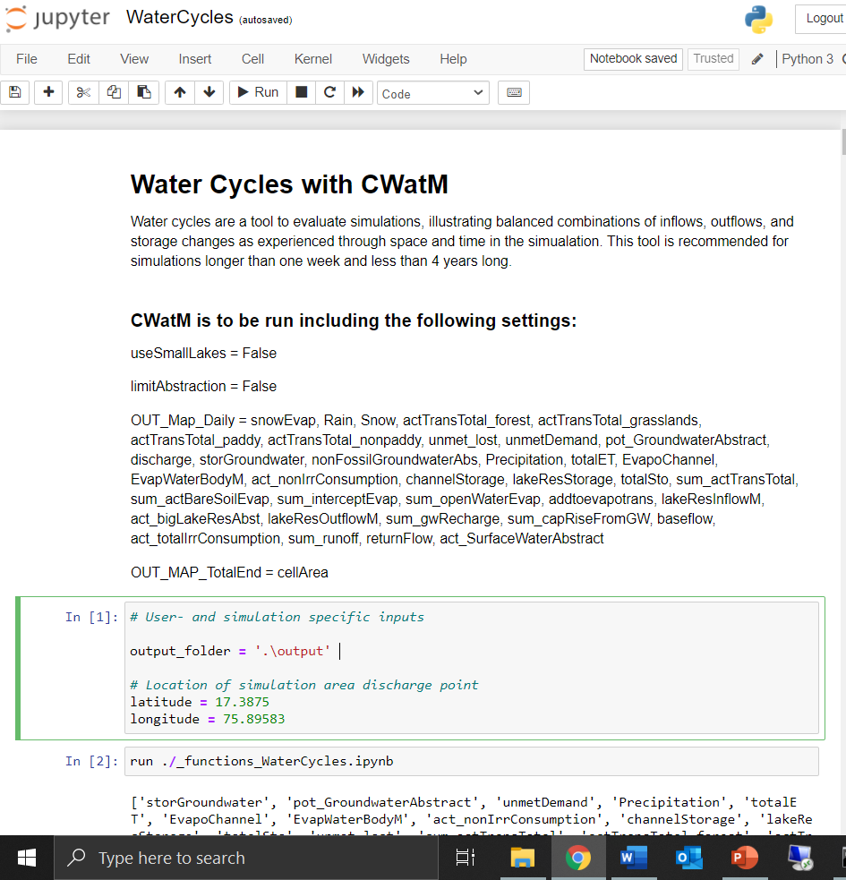
4. WaterCycles, new basin
In the Jupyter Notebook, update the output folder to the folder holding simulation results, and update the latitude and longitude coordinates to the associated basin outlet. Then, execute the Notebook.
Update output folder and
coordinates

Slide 10
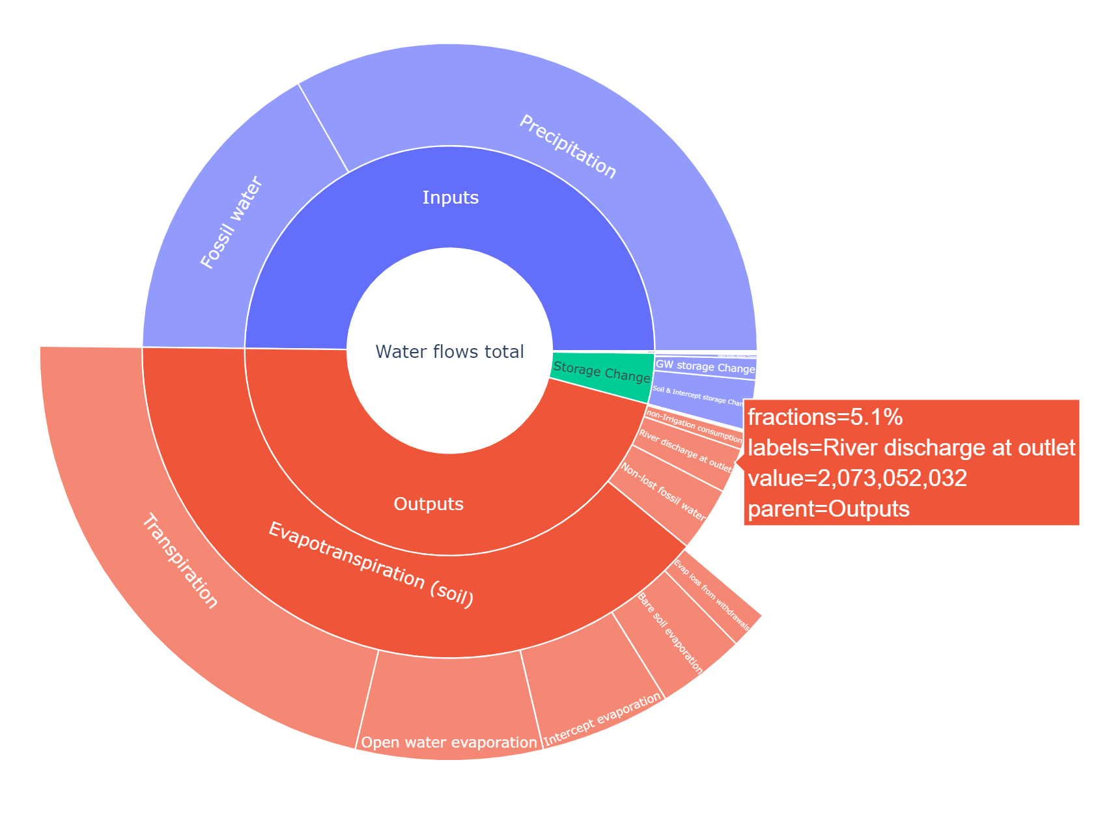
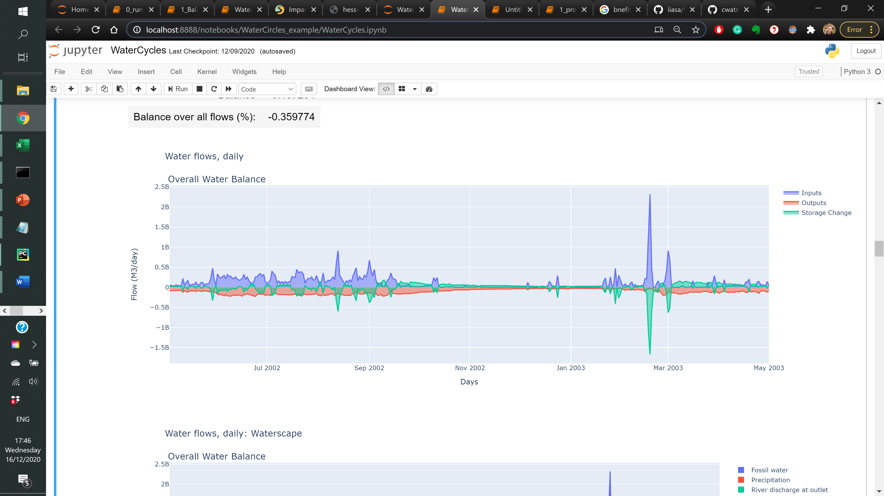
Ravi subbasin
MaskMap = 71.85 30.64 (long lat) Gauges = 71.85 30.64 (long lat)
StepStart = 01/04/2002
SpinUp = 01/05/2002
StepEnd = 01/05/2003

Slide 11
Rhine basin
MaskMap = 6.11 51.84
Gauges = 6.11 51.84
StepStart = 01/04/2002
SpinUp = 01/05/2002
StepEnd = 01/05/2003

Slide 12
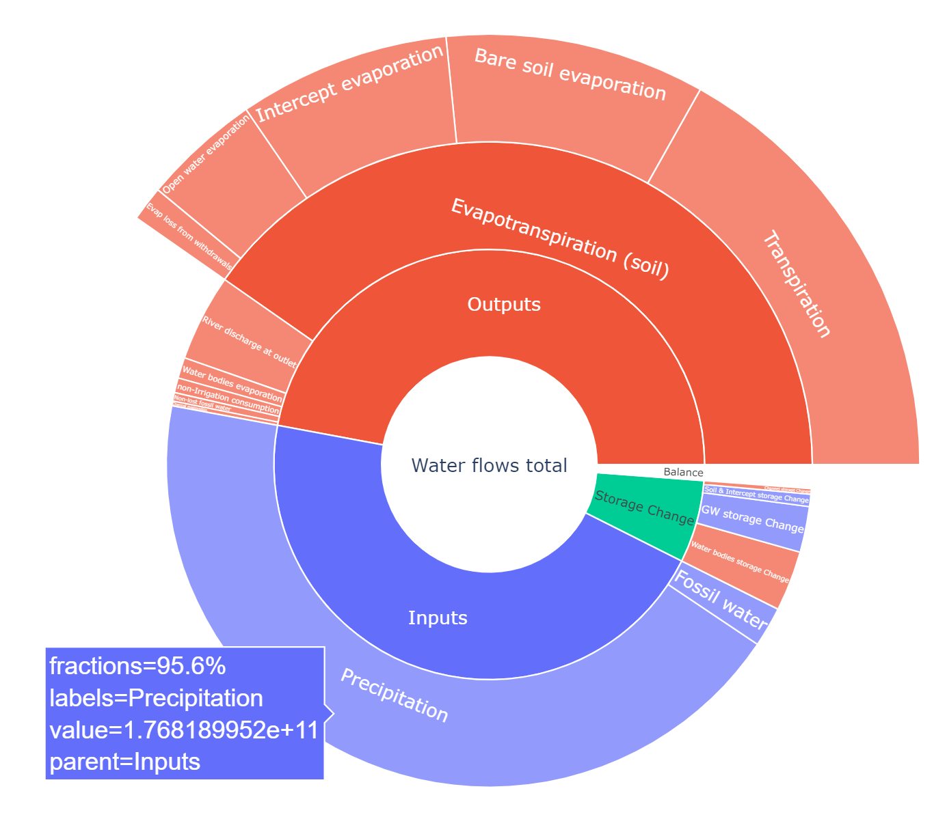
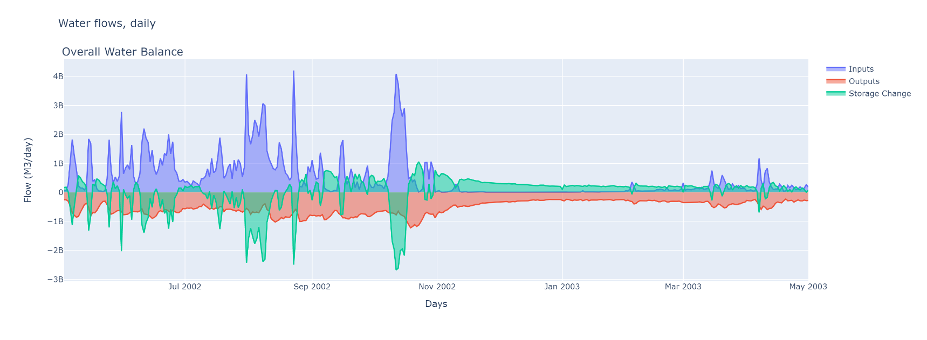
Krishna basin
MaskMap = 80.875 15.875 Gauges = 80.875 15.875
StepStart = 01/04/2002
SpinUp = 01/05/2002
StepEnd = 01/05/2003

Slide 13
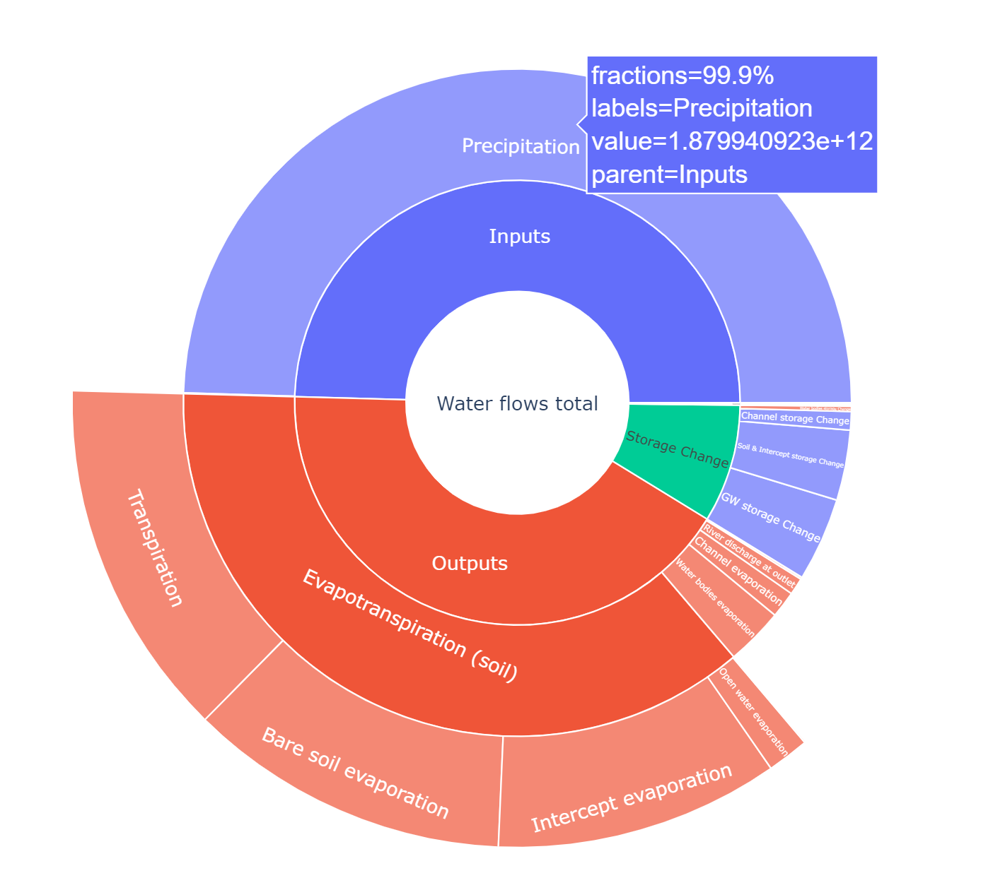
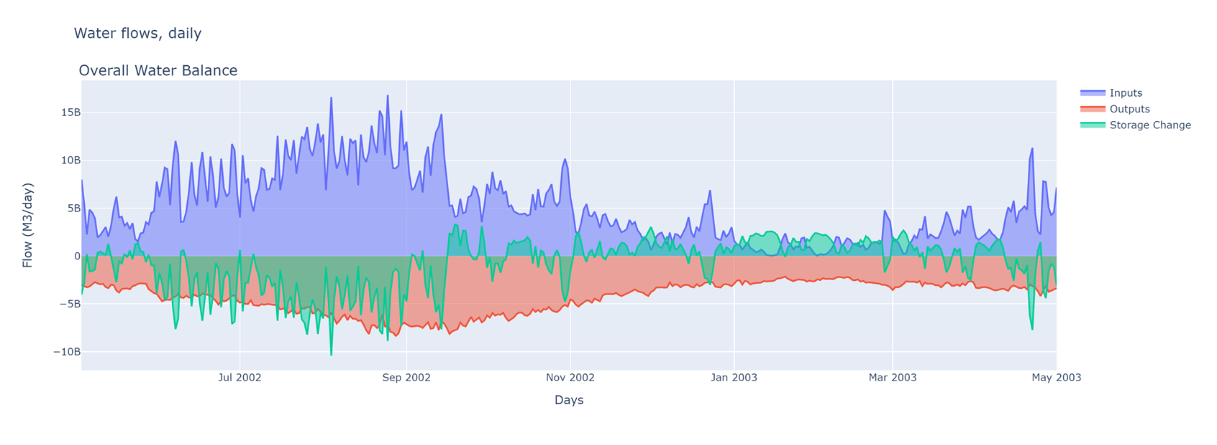
Nile basin
MaskMap = 30.45 31.4 Gauges = 30.45 31.4
StepStart = 01/04/2002
SpinUp = 01/05/2002
StepEnd = 01/05/2003

