Slide 1
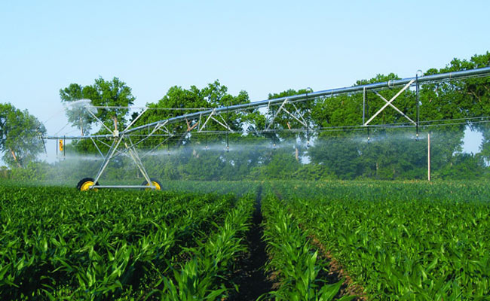
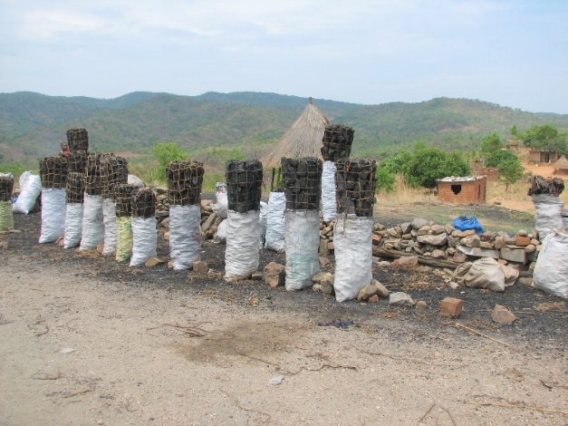
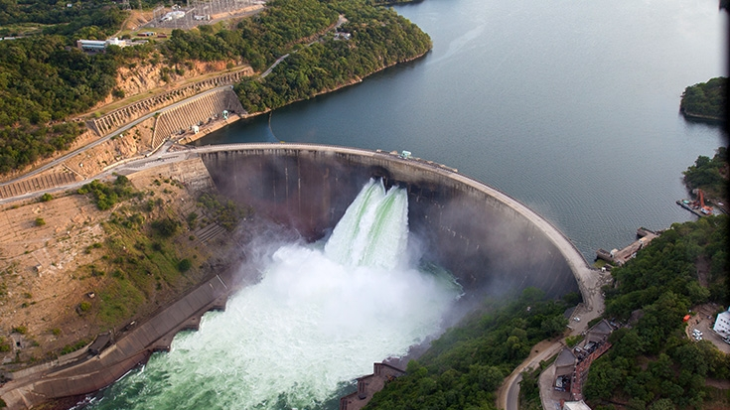
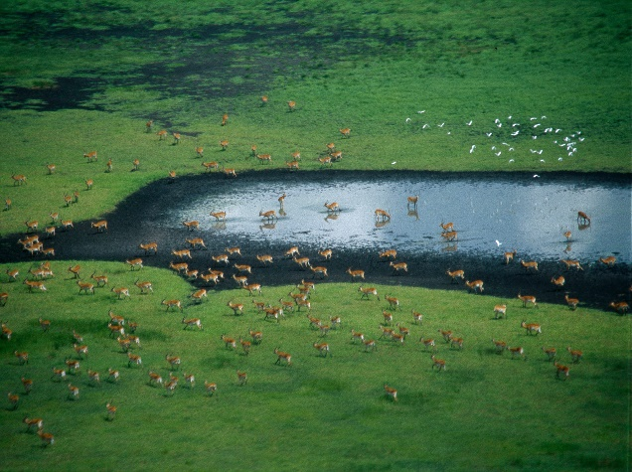
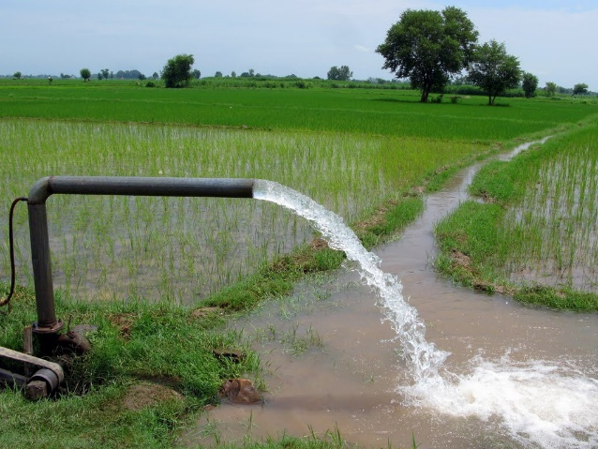
Exercise 3a: Calibration
Peter Burek, Carla Catania, Silvia Artuso International Institute for Applied Systems Analysis
Water Security Group

Slide 2

Calibration
0. What you need
1. Introduction into calibration
3. A fast calibration
4. Visualization of the results
Notes:
Improvement in resolution of CWatM model for basin analysis to show more details locally.

Slide 3
Calibration
0. What you need
• Python 3.7 - 3.12
CWatM running as python version
• additional library: deap pip install deap (or conda install deap)
• and the library: matplotlib
Notes:
Improvement in resolution of CWatM model for basin analysis to show more details locally.

Slide 4
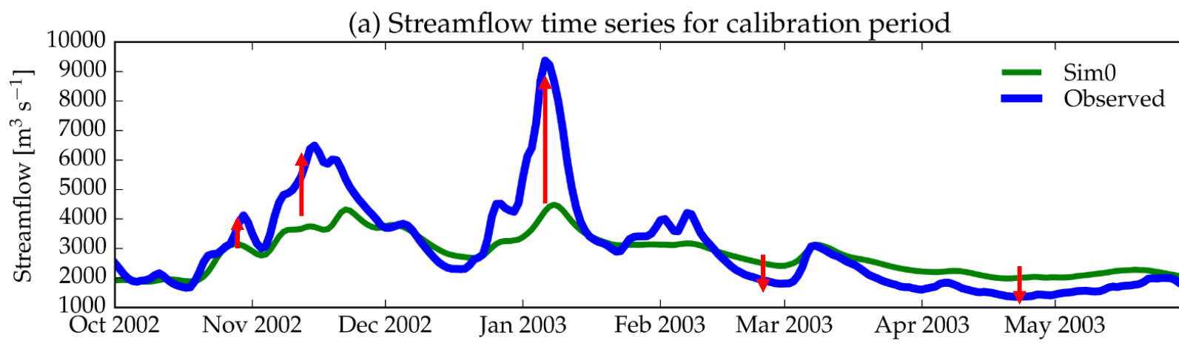
Calibration
Finding a parameter set which represents the observed discharge data
Notes:
Improvement in resolution of CWatM model for basin analysis to show more details locally.

Slide 5
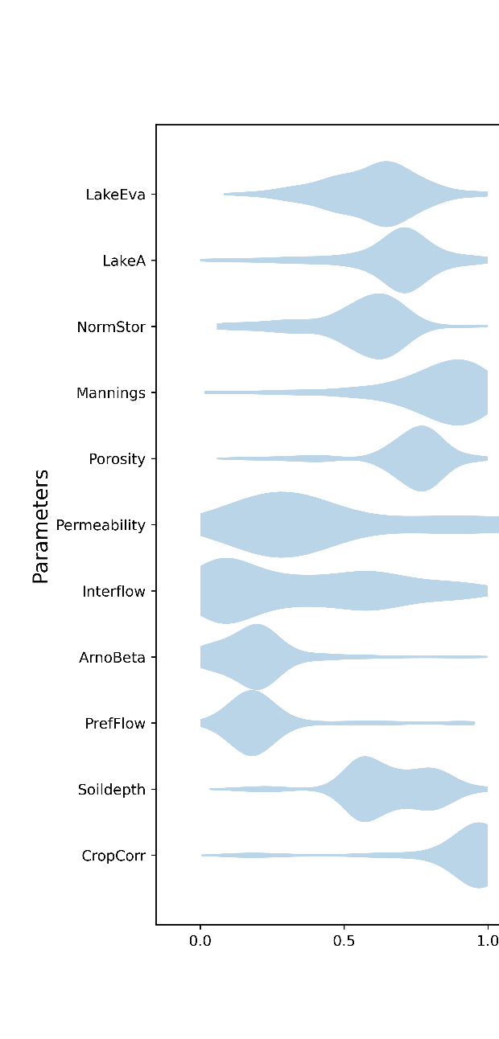
Calibration CWatM Parameters
13 parameters are calibrated:
Snow
Snowfactor as a factor to amount of snow
SnowMelt: day-degree factor how much snow is melted per ℃
Evapotranspiration
3. Crop factor as an adjustment to crop evapotranspiration
Soil
4. ksatfactor: a factor for the conductivity of soil of soil layer 1 and 2
5. soilfactor: a factor to the depth of soil layer 2
6. Preferential bypass flow: empirical shape parameter of the preferential flow relation
7. Infiltration capacity parameter: empirical shape parameter b of the ARNO model
Groundwater
8. Interflow factor: factor to adjust the amount which percolates from interflow to groundwater
9. Recession coefficient: how fast is groundwater translated into baseflow
Routing
10. Runoff concentration: how fast is the runoff at the outlet of a grid cell
11. Channel Manning’s n factor: a factor roughness in channel routing
Reservoir & lakes
12. Normal storage limit: the fraction of storage capacity used as normal storage limit
13. Lake A factor : factor to channel width and weir coefficient as a part of the Poleni weir equation
Parameter space for a calibration runs

Slide 6
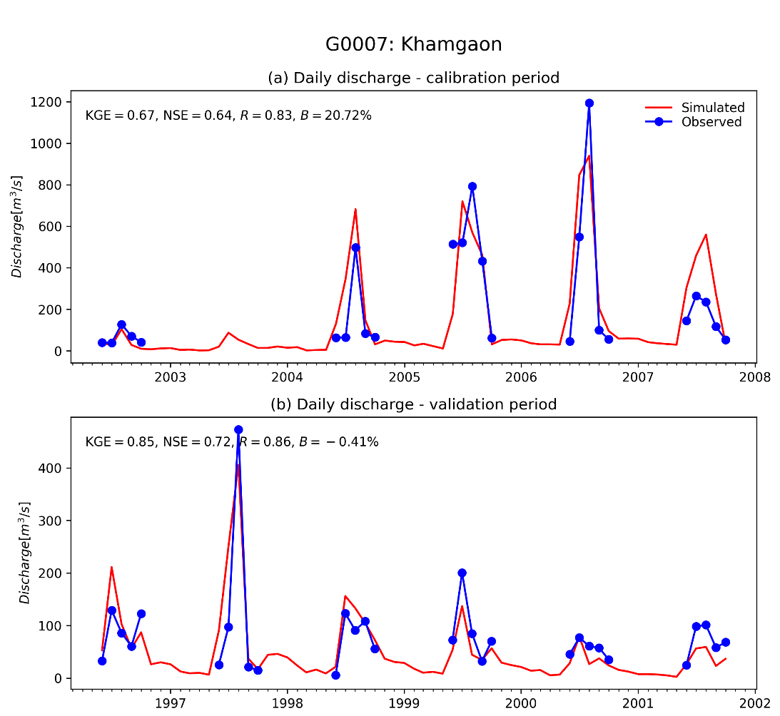
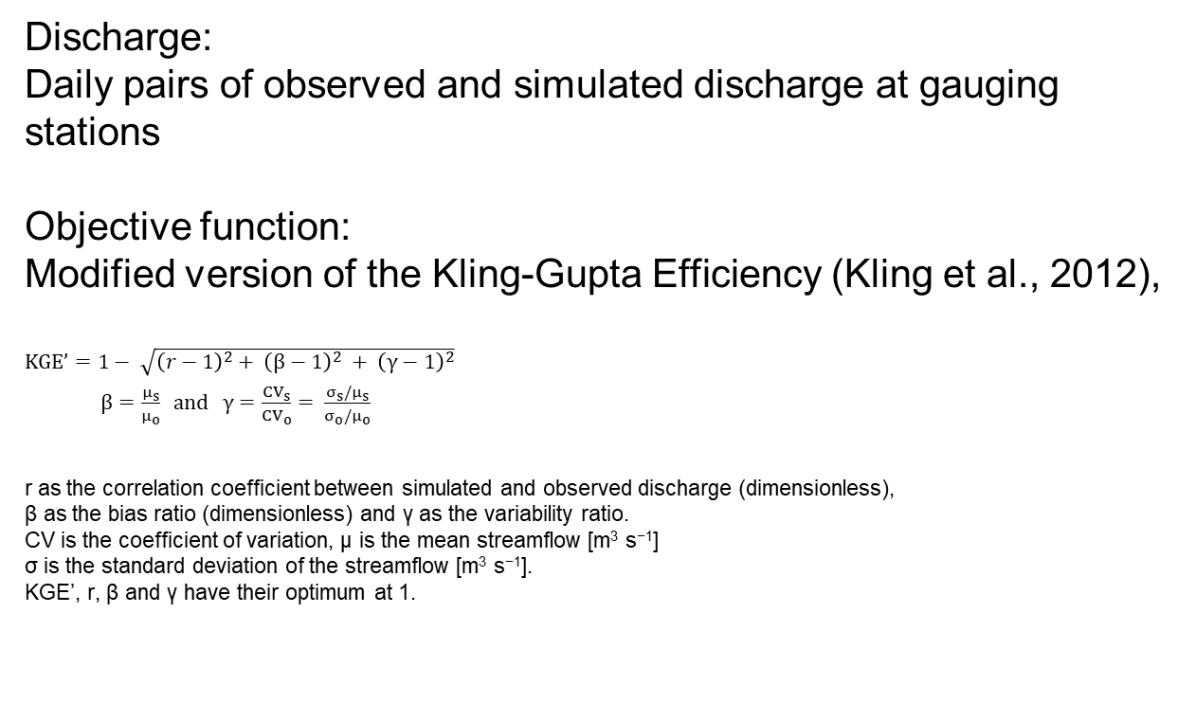
Calibration CWatM Objective function
Discharge:
Daily pairs of observed and simulated discharge at gauging stations
Objective function: Modified version of the Kling-Gupta Efficiency (Kling et al., 2012),
$KGE’=1− \sqrt{{\left(r−1\right)}^{2}+ {\left(β−1\right)}^{2} + {\left(γ−1\right)}^{2}}$
$β=\frac{μ_{s}}{μ_{o}} and γ=\frac{{CV}_{s}}{{CV}_{o}}= \frac{σ_{s}/μ_{s}}{σ_{o}/μ_{o}}$
r as the correlation coefficient between simulated and observed discharge (dimensionless), β as the bias ratio (dimensionless) and γ as the variability ratio.
CV is the coefficient of variation, μ is the mean streamflow [m³ s⁻¹] σ is the standard deviation of the streamflow [m³ s⁻¹]. KGE’, r, β and γ have their optimum at 1.
Gupta, H. V., H. Kling, K. K. Yilmaz and G. F. Martinez (2009). “Decomposition of the mean squared error and NSE performance criteria: Implications for improving hydrological modelling.” Journal of Hydrology 377(1-2): 80-91
Kling, H., M. Fuchs and M. Paulin (2012). “Runoff conditions in the upper Danube basin under an ensemble of climate change scenarios.” Journal o Hydrology 424-425: 264-277

Slide 7
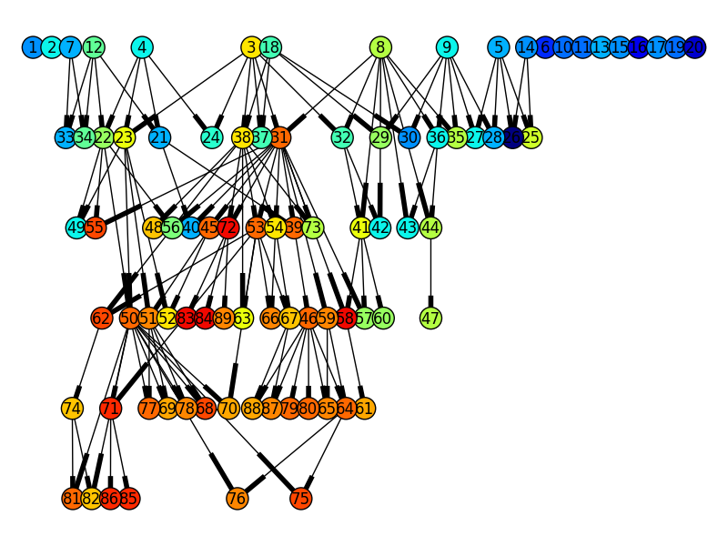
Calibration CWatM on discharge Method
Calibration is using an evolutionary computation framework in Python called DEAP (Fortin et al., 2012).
DEAP implemented the evolutionary algorithm NSGA-II (Deb et al., 2002) which is used here as single objective optimization.
- Calibration start with an initial population size (µ)
- Each generation the best pool (λ) is selected and
recombined
- After a number of generation, the best fitting calibration is found
Evolution of parameter space
Félix-Antoine Fortin, François-Michel De Rainville, Marc-André Gardner, Marc Parizeau and Christian Gagné, “DEAP: Evolutionary Algorithms Made Easy”, Journal of Machine Learning Research, vol. 13, pp. 2171-2175
Deb, K., A. Pratap, S. Agarwal and T. Meyarivan (2002). “A fast and elitist multiobjective genetic algorithm: NSGA-II.” IEEE Transactions on Evolutionary Computation 6(2): 182-197.

Slide 8
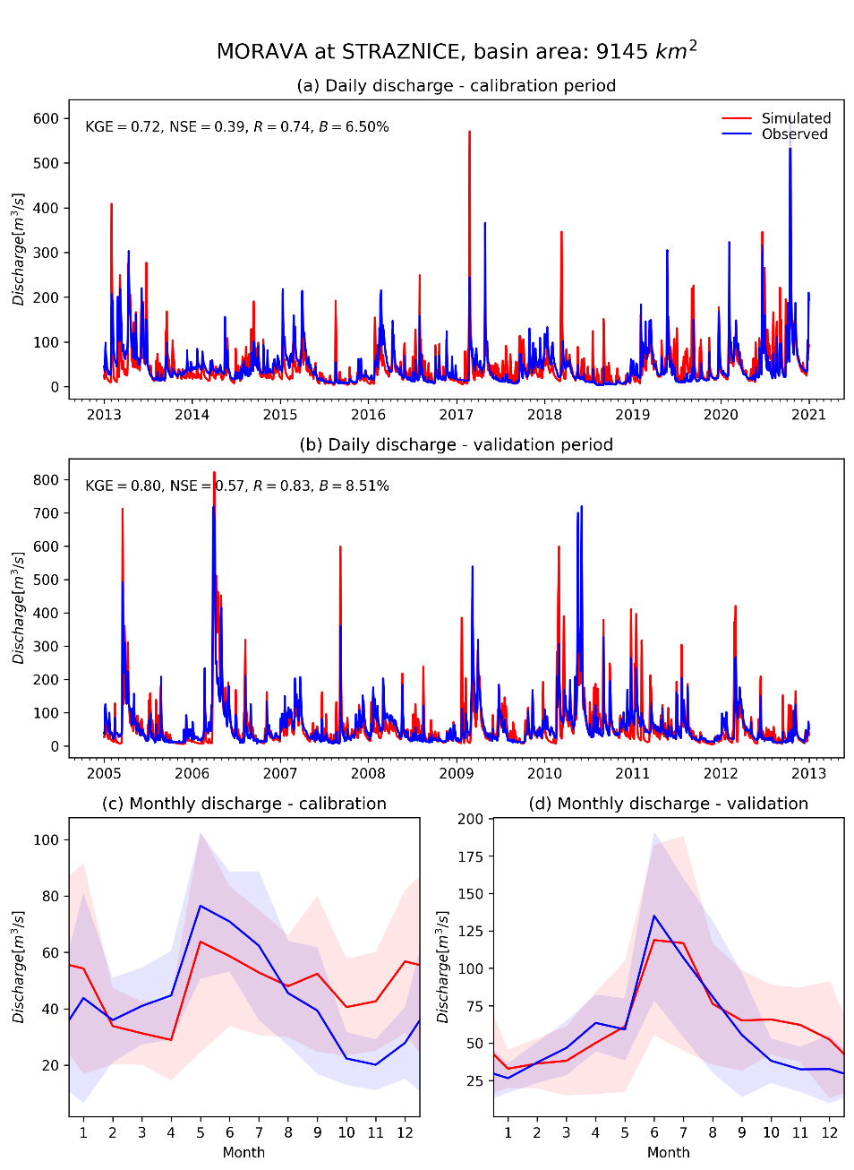
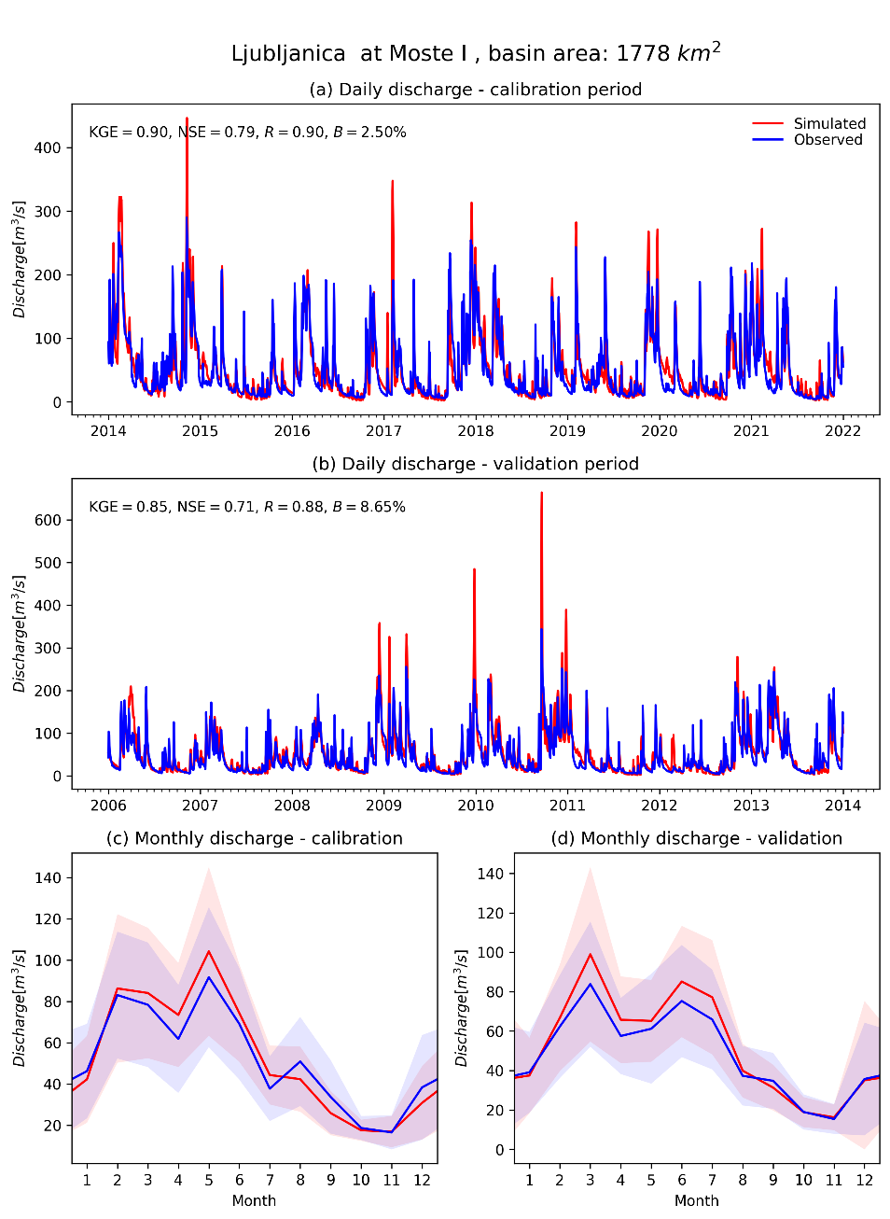
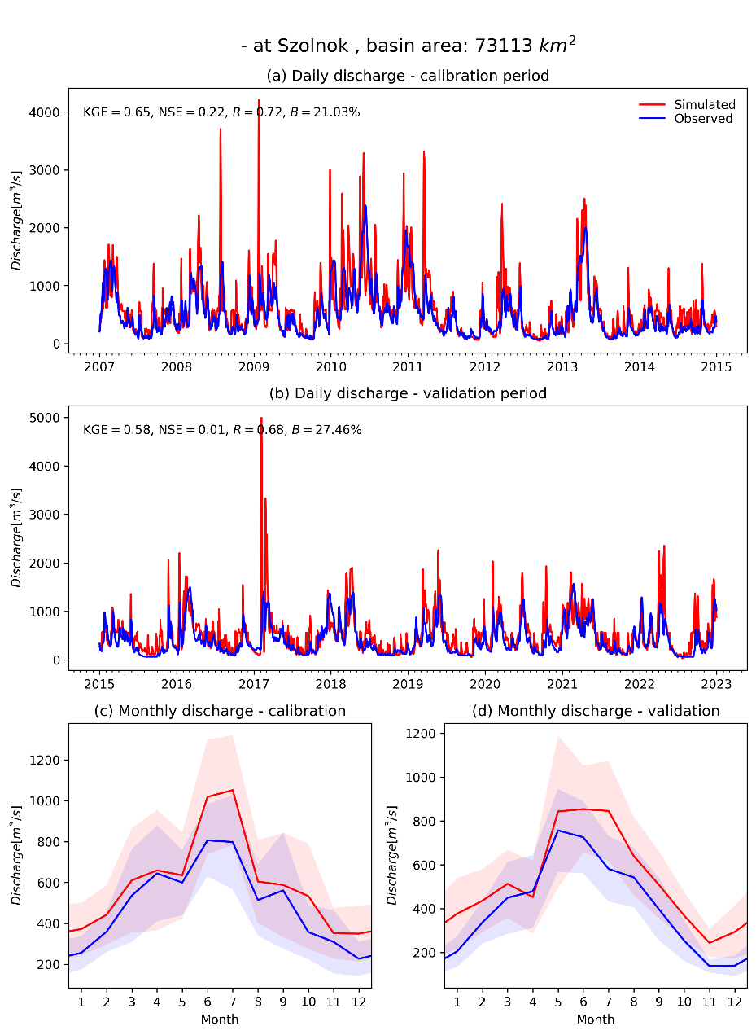
Calibration
Notes:
Improvement in resolution of CWatM model for basin analysis to show more details locally.

Slide 9
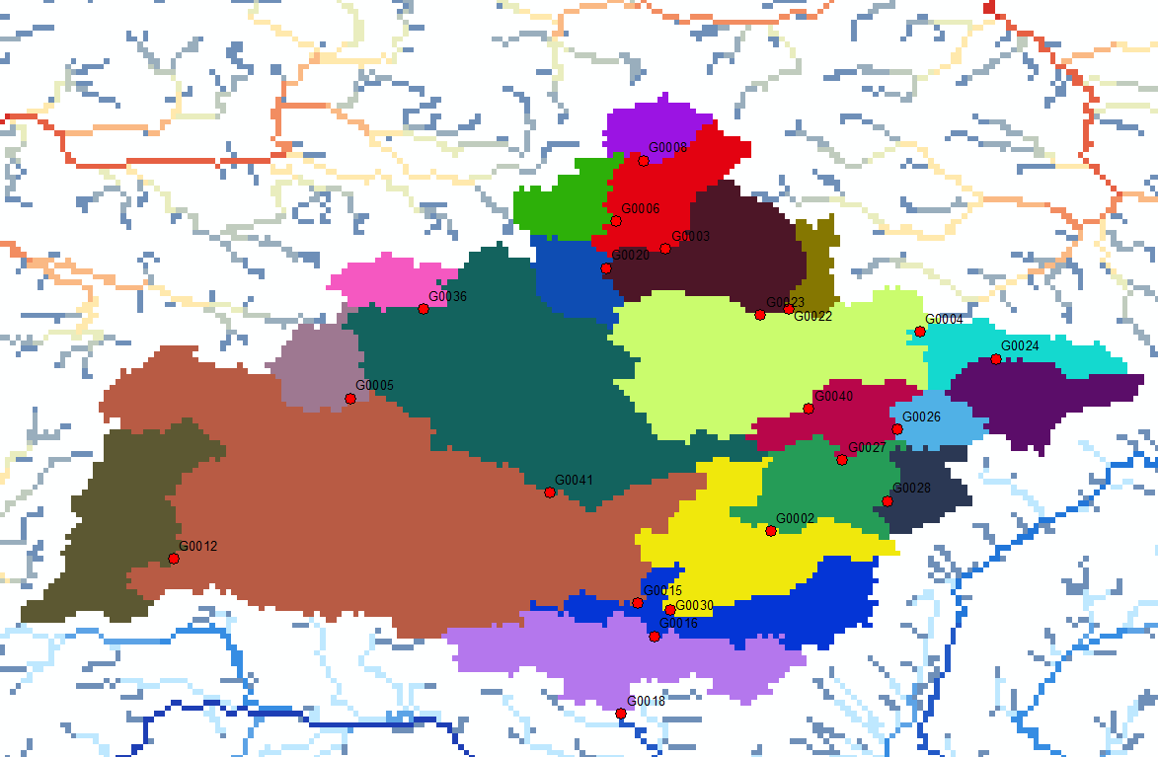
Calibration
Upstream to downstream calibration
Morava basin with 21 subbasins
Notes:
Improvement in resolution of CWatM model for basin analysis to show more details locally.

Slide 10
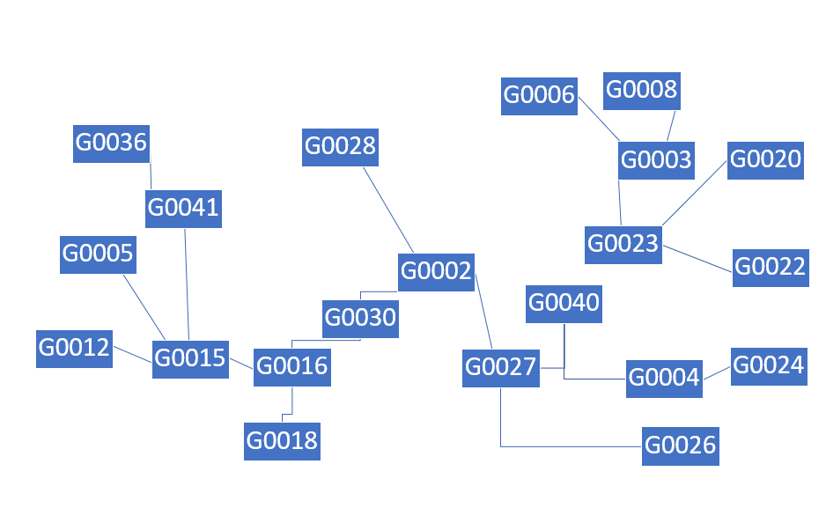
Calibration
Upstream to downstream calibration
Morava basin with 21 subbasins
Notes:
Improvement in resolution of CWatM model for basin analysis to show more details locally.

Slide 11
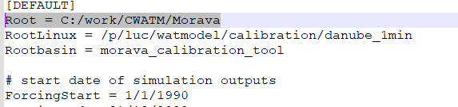

Calibration
1.Running a fast calibration for an upstream basin
Go to your basin folder and /basin_calibration_tool
Correcting path in the settings files:
Settings1_fast.txt
Set the path name to your computer settings
Set this to: use_multiprocessing = 0
Notes:
Improvement in resolution of CWatM model for basin analysis to show more details locally.

Slide 12
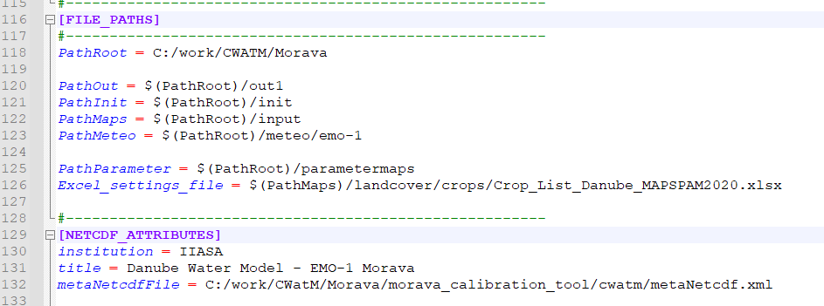
Calibration
1.Running a fast calibration for an upstream basin
Go to your basin folder and /basin_calibration_tool/templates
Correcting path in the settings files:
2) settings_morava_1min2.ini
Set the path name to your computer settings
Notes:
Improvement in resolution of CWatM model for basin analysis to show more details locally.

Slide 13
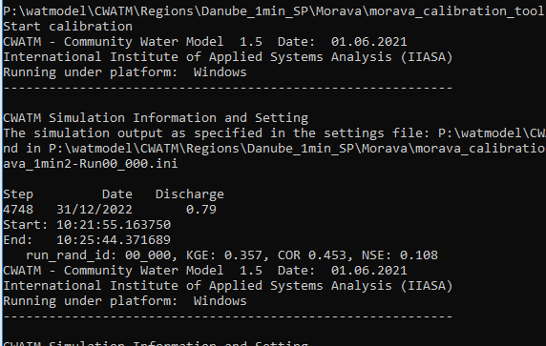
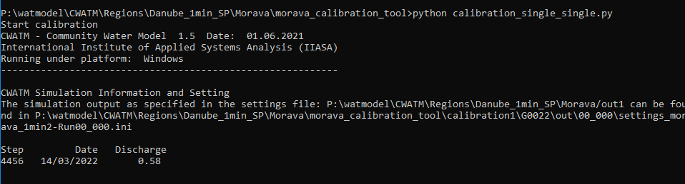
Calibration
2.Running a fast calibration for an upstream basin
Go to your basin folder and /basin_calibration_tool/
Running a fast calibration
Execute: runsingle.bat or python calibration_single_single.py
This will launch a fast calibration in an upstream basin (here: G0022)
Notes:
Improvement in resolution of CWatM model for basin analysis to show more details locally.

Slide 14
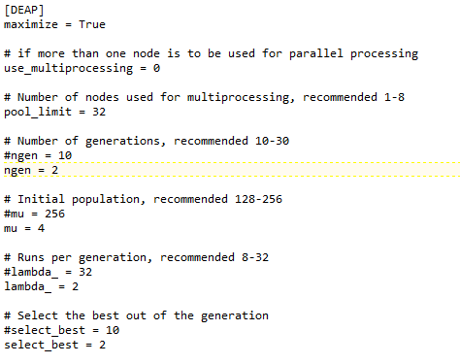

Calibration
2.Running a fast calibration for an upstream basin
The fast calibration is using only:
- Initial population of 4 (normally ≥ 256)
- 2 generations (normally ≥ 10)
- 2 runs per generation (normally ≥ 32)
Please stop the run
Change back:
Use_multiprocessing = 1
the calibration is splitting the runs for multiprocessing
Run again: runsingle.bat
Settings1_fast.txt – last part
Notes:
Improvement in resolution of CWatM model for basin analysis to show more details locally.

Slide 15
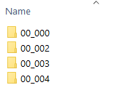
Calibration
2.Running a fast calibration for an upstream basin
The fast calibration is using only:
- Initial population of 4 (normally ≥ 256)
- 2 generations (normally ≥ 10)
- 2 runs per generation (normally ≥ 32)
Please stop the run
Change back:
Use_multiprocessing = 1
the calibration is splitting the runs for multiprocessing
Run again: runsingle.bat
Folder structure in:
morava_calibration_tool\calibration1\G0022\out
at start:
Notes:
Improvement in resolution of CWatM model for basin analysis to show more details locally.

Slide 16
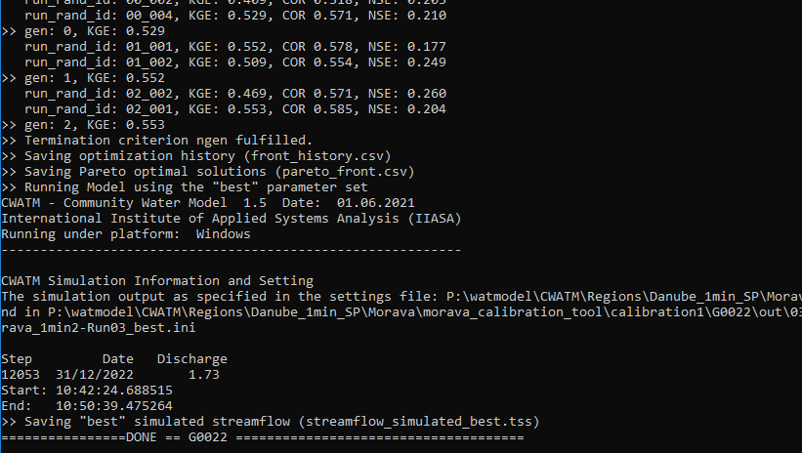
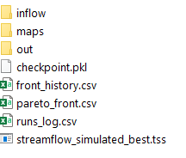
Calibration
3. Look at the results
Your DOS box should look like this
After the calibration, the subbasin is run again for a greater time period
Folder structure in:
morava_calibration_tool\calibration1\G0022\out
at end of the calibration:
Notes:
Improvement in resolution of CWatM model for basin analysis to show more details locally.

Slide 17
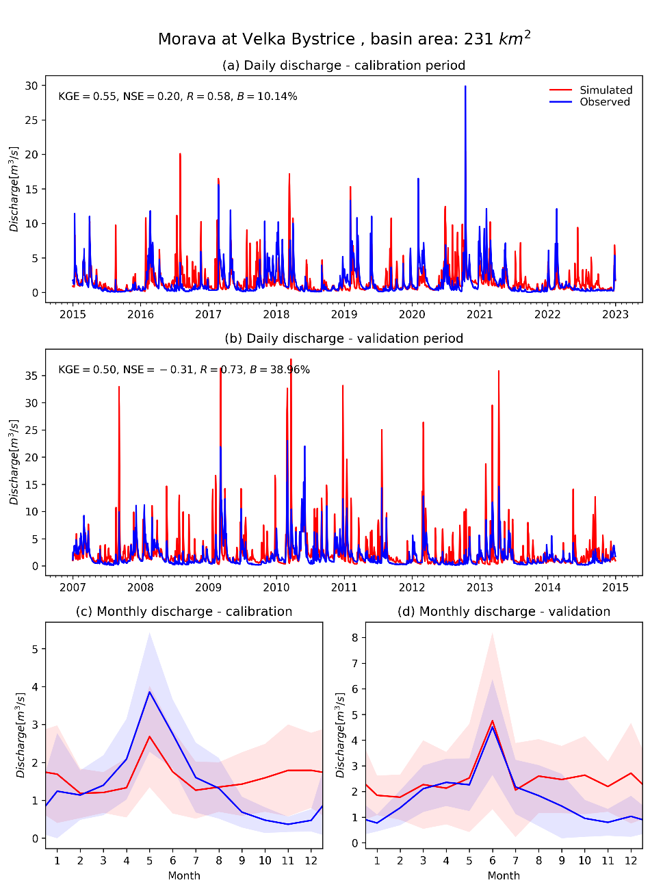
Calibration
3. Look at the results
Execute: runC10.bat or python CAL_10_COMPUTE_STATS_AND_FIGURES_TIME_SERIES.py settings1_fast.txt
To create a figure in:
yourbasin_calibration_tool\calibration1\FIGURES
This is the single basin calibration:
For a “real calibration” you have to change the [DEAP] parameter in settings1_fast
G0022_Morava_Velka_Bystrice_.png
Notes:
Improvement in resolution of CWatM model for basin analysis to show more details locally.

Slide 18
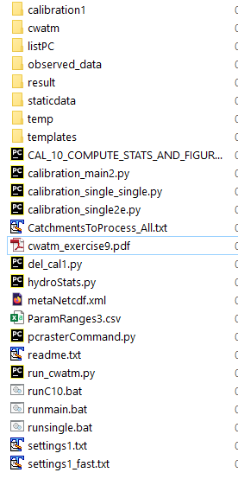
Calibration
4. Some more information
Calibration1: has the results for different subbasin in the beginning it should have only inflow, maps, out
cwatm: A copy of the model
ListPC: This has a list of subbasin. If you run top to downstream calibration with several computer: it tells each computer what is done, what is running
Observed_data: Has the metadata and the discharge timeseries of subbasin stations
Result,staticdata,temp: Some folders to store some inbetween data
Templates: hold the settingsfile for calibration with placeholders: e.g. SnowMeltCoef = %snowmelt Placeholders are filled in during each calibration run
Notes:
Improvement in resolution of CWatM model for basin analysis to show more details locally.

Slide 19
Calibration
4. Some more information
CAL_10_COMPUTE_STATS_AND_FIGURES_TIME_SERIES.py:
Tool to produce figures for each subbasin
calibration_main2.py: Prg to run a upstream to downstream calibration
calibration_single2e.py: Prg which is executed by calibration_main2.py for each subbasin. First the upstreams then working down
calibration_single_single.py:`Prg which runs a single basin. No of subbasin is hard coded del_cal1.py: Deletes all runs in calibration1
hydroStats.py Has all the objective functions
ParamRanges3.csv Here the parameter and thweir range are stored settings1_fast.txt: Settings_file for a single subbasin
settings1.txt: Settingsfile for a top-down calibration
Notes:
Improvement in resolution of CWatM model for basin analysis to show more details locally.

Slide 20
Calibration
What can go wrong 1
Run runsingle.bat python calibration_single_single.py
Your python version is starting with python3 or you have to put in the full path of your python version c:/python38/python3 calibration_single_single.py
You did not change the path in settings file settings1_fast.txt and templates/settings_morava_1min2.ini
You did not download the meteo data from Sharepoint or you did not download other data
You still have problems with the gdal library
- use the newest version of CWatM on Sharepoint
- install gdal like in https://cwatm.iiasa.ac.at/setup.html#external-libraries
You have problems with white space in file names Use e.g. “c:/white space/python.exe” calibration_single_single.py
Notes:
Improvement in resolution of CWatM model for basin analysis to show more details locally.

Slide 21
Calibration
What can go wrong 2
Run runsingle.bat python calibration_single_single.py
You did not add the libraries deap, matplotlib and pandas
Some results are already in basin/calibrationtool/calibration1/G0022 (or the G00?? You are using)
delete the files and the /out directory, make a new out directory
You cannot load the settings files, Your settings file are not stored as utf-8.
Notes:
Improvement in resolution of CWatM model for basin analysis to show more details locally.

Slide 22
Calibration
1.What can go wrong 3
Run runsingle.bat python calibration_single_single.py
You run it but it crash:
Go to basin_calibration_tool/calibration1/G00??/out
Is there a folder 00_000?
No: bad, go back to what can go wrong 2
yes: good, go into 00_000
Inside 00_000 there is a file runpy00_000.bat
type cmd in the explorer to start a new DOS box
type runpy00_000.bat and execute
CWatm is running?
Yes: very good – check if the observed data in basin_calibration_tool \observed_data/ qgis_yourbasin_5.csv are in right format
No: change settings_fast-Run00_000.ini (e.g. path name) till CWatM is running copy the changes into templates/settings.ini
Please have a look at:
https://cwatm.iiasa.ac.at/calibration.html
https://cwatm.iiasa.ac.at/calibration_tutorial.html
Notes:
Improvement in resolution of CWatM model for basin analysis to show more details locally.

