Slide 1
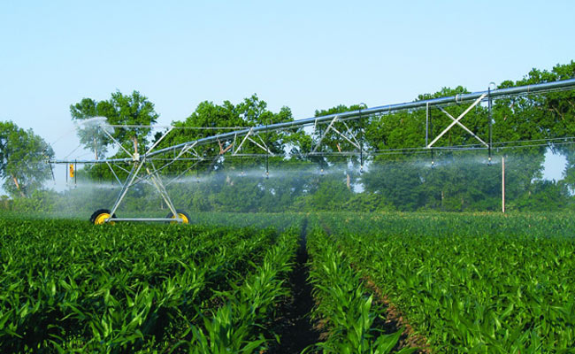
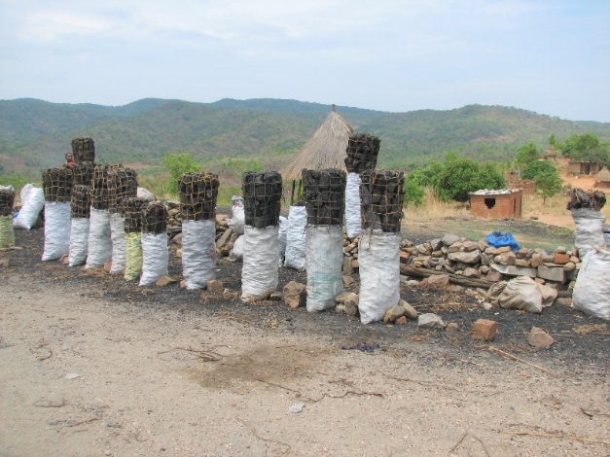
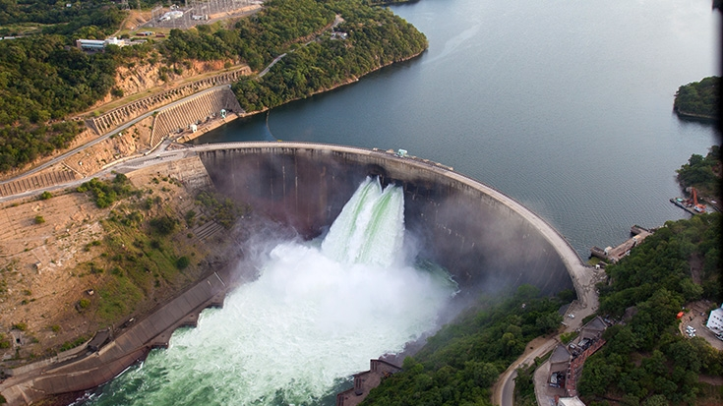
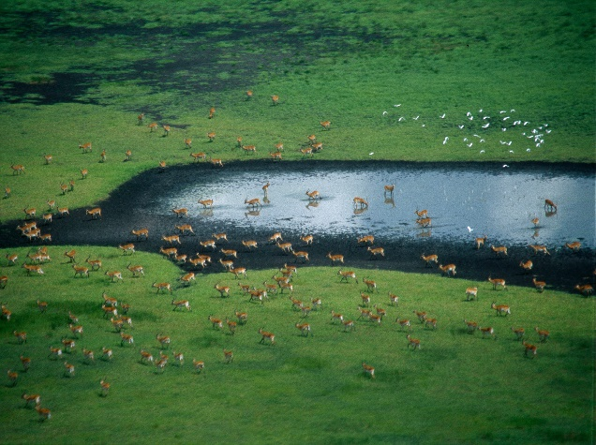
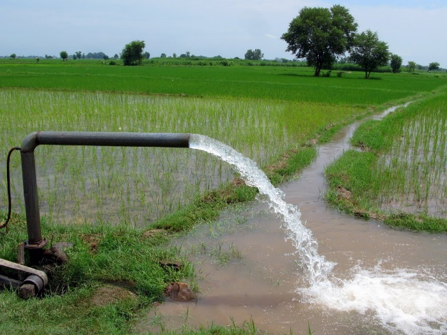
Exercise 3b: Calibration
Peter Burek, Carla Catania, Silvia Artuso International Institute for Applied Systems Analysis
Water Security Group

Slide 2

Calibration
1. Upstream to downstream calibration
2. Preparing settings files
3. Running a calibration
4. Visualization of the results
5. Creating parameter maps
Notes:
Improvement in resolution of CWatM model for basin analysis to show more details locally.

Slide 3
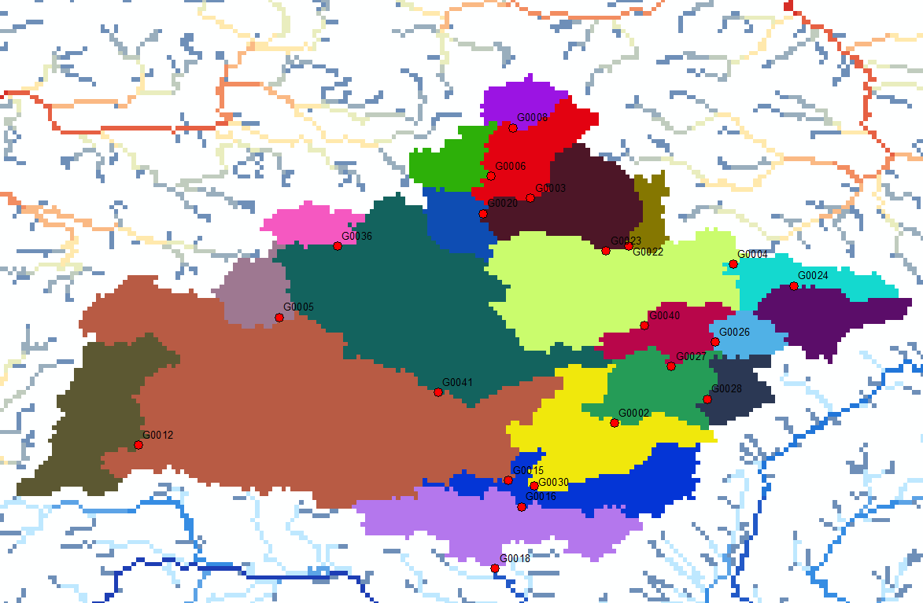
Calibration
Upstream to downstream calibration
Morava basin with 21 subbasins
Notes:
Improvement in resolution of CWatM model for basin analysis to show more details locally.

Slide 4
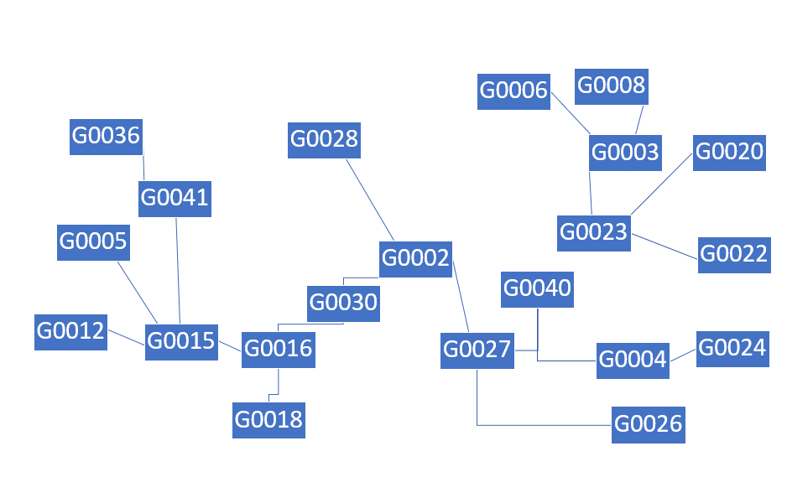
Calibration
Upstream to downstream calibration
Morava basin with 21 subbasins
Notes:
Improvement in resolution of CWatM model for basin analysis to show more details locally.

Slide 5
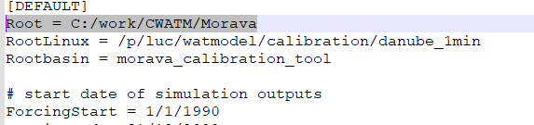

Calibration
1.Running a fast calibration for an upstream basin
Go to your basin folder and /basin_calibration_tool
Correcting path in the settings files:
Settings1.txt
Set the path name to your computer settings
Set this to: use_multiprocessing = 1
Notes:
Improvement in resolution of CWatM model for basin analysis to show more details locally.

Slide 6
Calibration
2.Running a calibration
Go to your basin folder and /basin_calibration_tool/
Running a fast calibration
Execute: runmain.bat or python calibration_main2.py
This will launch a (fast) upstream to downstream calibration
(Fast because the [DEAP] parameter are set to only a few runs)
Notes:
Improvement in resolution of CWatM model for basin analysis to show more details locally.

Slide 7
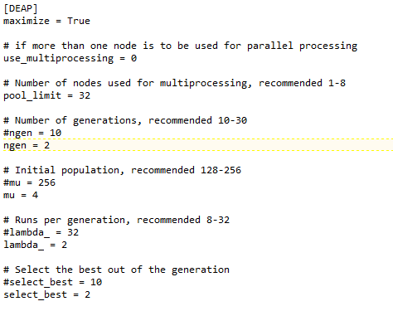
Calibration
2.Running a calibration
The fast calibration is using only:
- Initial population of 4 (normally ≥ 256)
- 2 generations (normally ≥ 10)
- 2 runs per generation (normally ≥ 32)
the calibration is splitting the runs for multiprocessing
Your computer is storing the progress of the subbasin in the folder: listPC
You can use several computers to run the same basin. Each computer will pick a new subbasin which is - not already run - which is not run by another computer - which is next in the line of upstream-downstream - after some time, it will redo unfinished subbasin
Settings1.txt – last part
Notes:
Improvement in resolution of CWatM model for basin analysis to show more details locally.

Slide 8
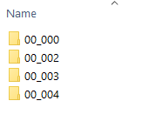
Calibration
2.Running a calibration
The fast calibration is using only:
- Initial population of 4 (normally ≥ 256)
- 2 generations (normally ≥ 10)
- 2 runs per generation (normally ≥ 32)
Please stop the run
Change back:
Use_multiprocessing = 1
the calibration is splitting the runs for multiprocessing
Run again: runsingle.bat
Folder structure in:
morava_calibration_tool\calibration1\G0022\out
at start:
Notes:
Improvement in resolution of CWatM model for basin analysis to show more details locally.

Slide 9
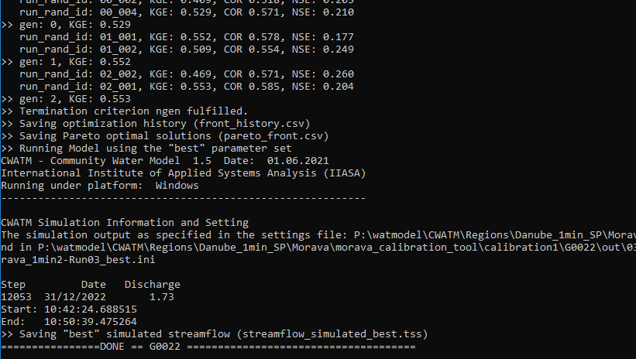
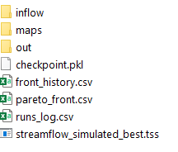
Calibration
3. Look at the results
Your DOS box should look like this
After each subbasin calibration, the subbasin is run again for a greater time period, in case that the downstream basin uses another calibration period
Folder structure in:
morava_calibration_tool\calibration1\G0022\out
at end of the calibration:
Notes:
Improvement in resolution of CWatM model for basin analysis to show more details locally.

Slide 10
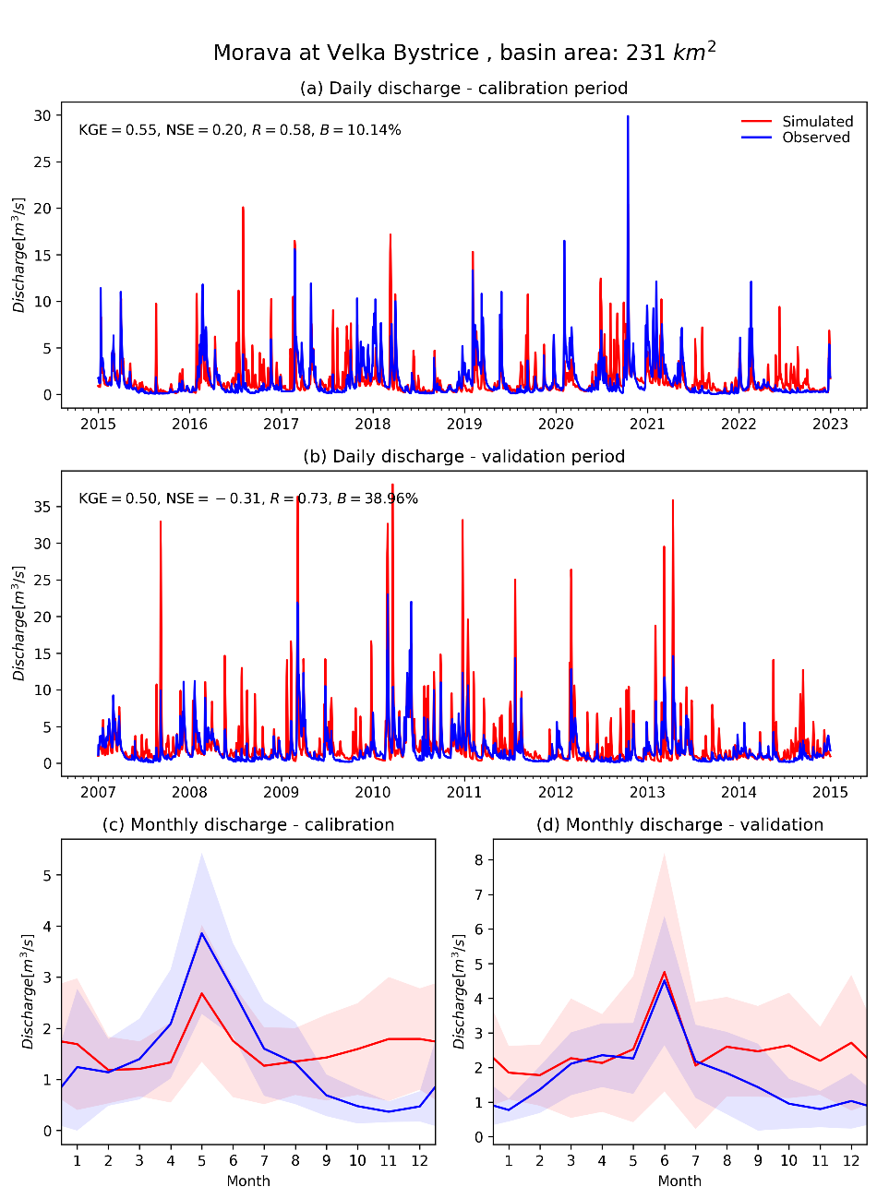
Calibration
3. Look at the results
Execute: runC10.bat or python CAL_10_COMPUTE_STATS_AND_FIGURES_TIME_SERIES.py settings1_fast.txt
To create a figures in:
yourbasin_calibration_tool\calibration1\FIGURES
G0022_Morava_Velka_Bystrice_.png
Notes:
Improvement in resolution of CWatM model for basin analysis to show more details locally.

Slide 11
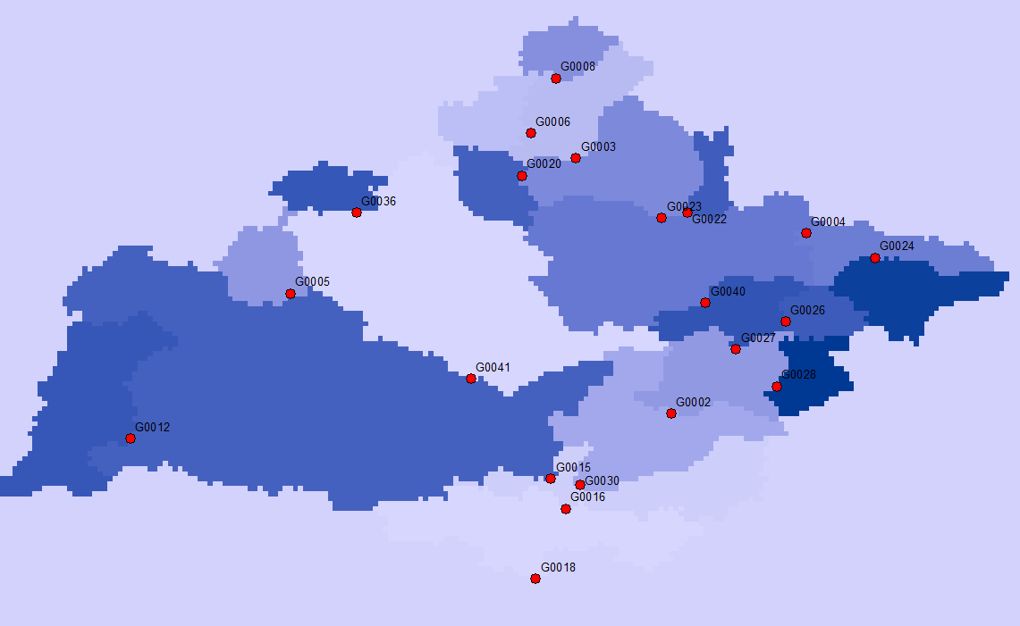
Calibration
4. Create parameter maps
python CAL_9_PARAMETER_MAPS.py
This create parameter maps in: results e.g. params_arnoB.map - you have to change the path to the settings file inside CAL_9_PARAMETER_MAPS.py
- you have to install the PCRaster Python library (we working to get rid of this library, which will make this much easier)
Map of arnoB parameter for Morava
Notes:
Improvement in resolution of CWatM model for basin analysis to show more details locally.

Slide 12
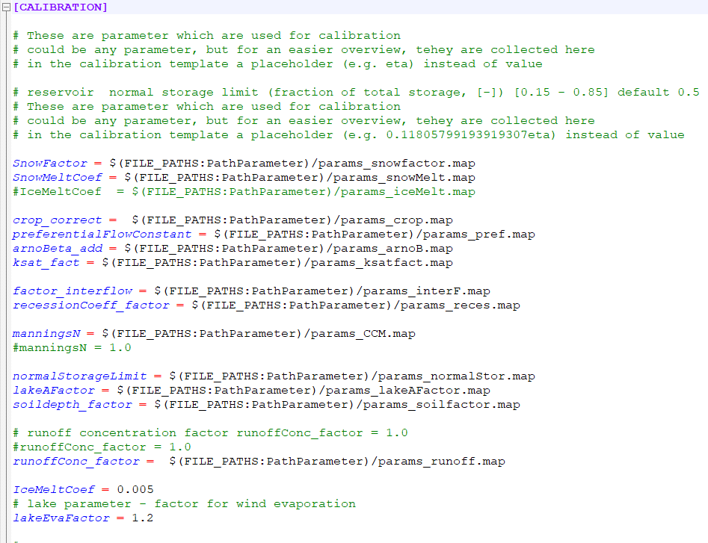
Calibration
4. Putting parameter maps in CWatM
Parameter can be a number:
SnowFactor = 1.2
But also a spatial map.
The parameter maps can be read as spatial maps into CWatM
In the section [Calibration]
SnowFactor = $(FILE_PATHS:PathParameter)/params_snowfactor.map
Notes:
Improvement in resolution of CWatM model for basin analysis to show more details locally.

Slide 13
Calibration
5. Next steps (not this time)
Preprocessing:
- putting metadata of stations and timeseries of discharge in /observed_data
- calculating which subbasins is upstream of another
- calculating the subbasins (running a basin – upstream basin + inflow from subbasins)
Notes:
Improvement in resolution of CWatM model for basin analysis to show more details locally.

Slide 14
Calibration
What can go wrong 1
Run runsingle.bat python calibration_single_single.py
Your python version is starting with python3 or you have to put in the full path of your python version c:/python38/python3 calibration_single_single.py
You did not change the path in settings file settings1_fast.txt and templates/settings_morava_1min2.ini
You did not download the meteo data from Sharepoint or you did not download other data
You still have problems with the gdal library
- use the newest version of CWatM on Sharepoint
- install gdal like in https://cwatm.iiasa.ac.at/setup.html#external-libraries
You have problems with white space in file names Use e.g. “c:/white space/python.exe” calibration_single_single.py
Notes:
Improvement in resolution of CWatM model for basin analysis to show more details locally.

Slide 15
Calibration
What can go wrong 2
Run runsingle.bat python calibration_single_single.py
You did not add the libraries deap, matplotlib and pandas
Some results are already in basin/calibration_tool/calibration1/G0022 (or the G00?? You are using)
delete the files and the /out directory, make a new out directory
Notes:
Improvement in resolution of CWatM model for basin analysis to show more details locally.

Slide 16
Calibration
1.What can go wrong 3
Run runsingle.bat python calibration_single_single.py
You run it but it crash:
Go to basin_calibration_tool/calibration1/G00??/out
Is there a folder 00_000?
No: bad, go back to what can go wrong 2
yes: good, go into 00_000
Inside 00_000 there is a file runpy00_000.bat
type cmd in the explorer to start a new DOS box
type runpy00_000.bat and execute
CWatm is running?
Yes: very good – check if the observed data in basin_calibration_tool \observed_data/ qgis_yourbasin_5.csv are in right format
No: change settings_fast-Run00_000.ini (e.g. path name) till CWatM is running copy the changes into templates/settings.ini
Please have a look at:
https://cwatm.iiasa.ac.at/calibration.html
https://cwatm.iiasa.ac.at/calibration_tutorial.html
Notes:
Improvement in resolution of CWatM model for basin analysis to show more details locally.

