Slide 1
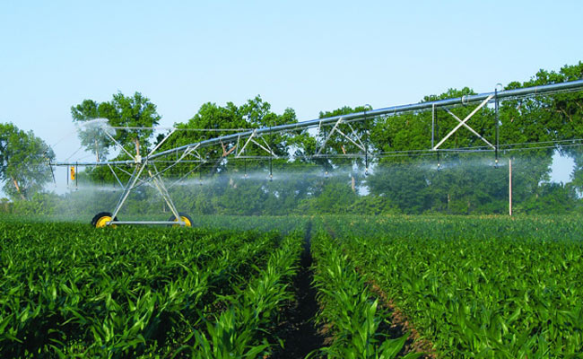
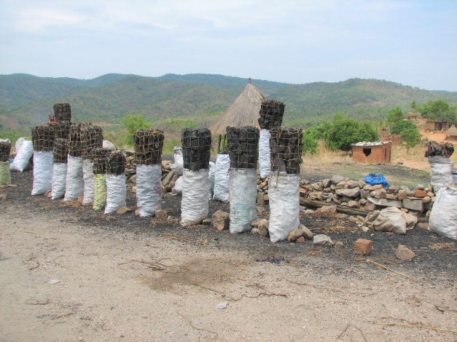
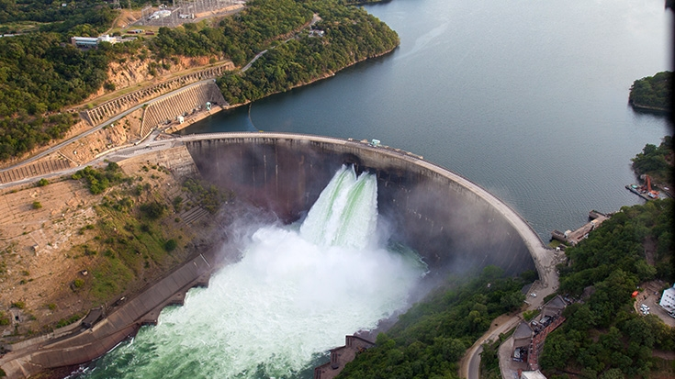
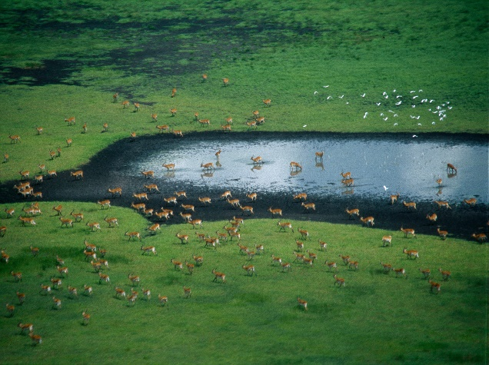
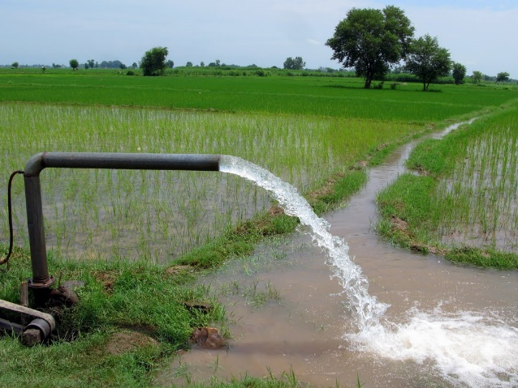
Calibration Preprocessing
Peter Burek, Carla Catania, Silvia Artuso International Institute for Applied Systems Analysis
Water Security Group

Slide 2

Calibration
0. What you need
1. Introduction into calibration
3. A fast calibration
4. Visualization of the results
Notes:
Improvement in resolution of CWatM model for basin analysis to show more details locally.

Slide 3
Calibration
0. What you need
• Python 3.7 - 3.12
CWatM running as python version
• additional library: deap pip install deap (or conda install deap)
• and the library: matplotlib
Notes:
Improvement in resolution of CWatM model for basin analysis to show more details locally.

Slide 4
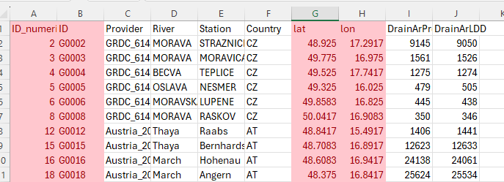
Calibration Preprocessing 1
1. Preparation
Go to your basin folder and /observed_data
In qgis_basinname_00.csv
Are the metadata. (The red ones are important, the rest is optional)
The ID (e.g.G0002) this is the reference id of the subbasin
Lat/lon of the station this lat/lon should fit to the river network, and the station lat/lon needs to be shifted, if provider location does not fir to the upstream area of rivernetwork (LDD)
Notes:
Improvement in resolution of CWatM model for basin analysis to show more details locally.

Slide 5
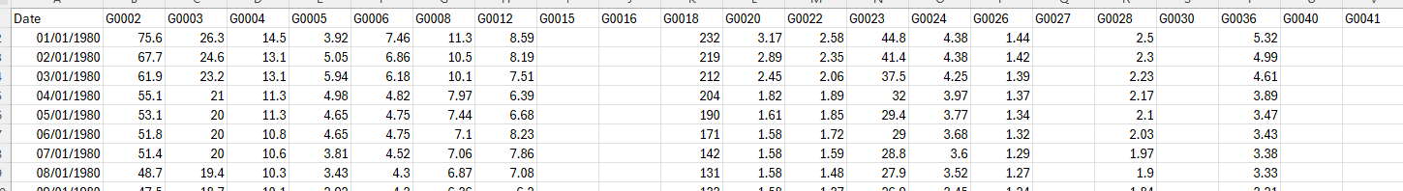
Calibration Preprocessing 1
1. Preparation
Go to your basin folder and /observed_data
In qtss_basinname_00.csv
Are the timeseries data (the ID should fit to the ID in qgis_basinname_00.csv)
If the value is missing the field should be empty
The date format should be dd/mm/yyyy
Notes:
Improvement in resolution of CWatM model for basin analysis to show more details locally.

Slide 6
Calibration Preprocessing 1
1. Preparation
Go to your basin folder and /observed_data
In qtss_basinname_00.csv
Are the timeseries data (the ID should fit to the ID in qgis_basinname_00.csv)
If the value is missing the field should be empty
The date format should be dd/mm/yyyy
Notes:
Improvement in resolution of CWatM model for basin analysis to show more details locally.

Slide 7
Calibration Preprocessing 1
1. Preparation
Create empty folders: result, calibration1, listPC
Put the ldd.tif of your basin in: staticdata
Change the file settings1.txt
[DEFAULT]
Root = P:/watmodel/calibration/danube_1min Root directory -> change path
RootLinux = /p/luc/watmodel/calibration/danube_1min Root directory if you use Linux
Rootbasin = morava_calibration_tool Directory where your calibration take place
# start date of simulation outputs
ForcingStart = 1/1/1990 Start day of calibration (is changed for each station, depending on data availability)
ForcingEnd = 31/12/2022 End day of calibration (is changed for each station, depending on data availability)
timeperiod = daily Calibration for daily or monthly values
SpinoffYears = 5 Before calibration is measuring performance the time of SpinoffYears is run
# For the figures of validation, calibration, preprocessing
MinQlength = 5 Station should have at least this amount of data
[ObservedData]
Qgis = observed_data/qgis_21thaya_00.csv Name of the metadata file (for preprocessing this is change for each step from)
QgisOut = observed_data/qgis_21thaya_01.csv Name of the new metadata file (for preprocessing this is change for each step from)
Qtss = observed_data/qtss_21thaya.csv Name of the timeseries data file
[Path]
Result = result Result are store here
Templates = templates Templates are stored here (a template of the CWatM settings file with placeholders)
SubCatchmentPath = calibration1 Results of calibration is stored here
ParamRanges = ParamRanges3.csv File with parameters to be calibrated (and range and default value)
CatchmentDataPath = staticdata Directory where the ldd.tif is stored (to calculate the subbasins)
Notes:
Improvement in resolution of CWatM model for basin analysis to show more details locally.

Slide 8
Calibration Preprocessing 1
1. Preparation
Change the file settings1.txt (second part)
[Templates]
ModelSettings = settings_morava_1min2.ini Template CWatM settings files with placeholders
RunModel = runpy.bat a batch file is generated to start runs manually (just for testing)
[MultiComputer]
# where is CWatm (only for the batch file), CWatM is run as a library -> change path
RunCwatm = P:/watmodel/Python3810/python P:\watmodel\calibration\danube_1min\morava_calibration_tool/run_cwatm.py
# for calibration_main2 to trigger each single calibration -> change path
RunCalib = P:/watmodel/Python3810/python P:/watmodel/calibration/danube_1min/morava_calibration_tool/calibration_single2f.py
# directory to write which computer works on what
listPC = listPC if you use several computer, each computer reports which subbasin it is using
[Option]
# Sets initial parameter values according to the para_first array
firstrun = True if firstrun, then firstrun uses default parameters
# the model runs with the best parameter set after the calibration
bestrun = True if bestrun, then the last long run is using the best parameter set
# Delete runs and keep only best run
delruns = True if delruns, then all runs are deleted but not the best_run
# run with sharedmemory
sharedmem = True if sharedmem, then the calibration method is using shared memory
Notes:
Improvement in resolution of CWatM model for basin analysis to show more details locally.

Slide 9
Calibration Preprocessing 1
Preparation
Change the file settings1.txt (third part)
Deap parameter for evolutionary calibration
- default parameter are out commented, here it is using a small example for testing
[DEAP]
maximize = True
# if more than one node is to be used for parallel processing
use_multiprocessing = 1
# Number of max nodes used for multiprocessing, recommended 1-32
pool_limit = 32
# Number of generations, recommended 10-15
#ngen = 10
ngen = 2
# Initial population, recommended 128-256
#mu = 256
mu = 4
# Runs per generation, recommended 8-32
#lambda_ = 32
lambda_ = 2
# Select the best out of each generation, recommend (10-16)
#select_best = 10
select_best = 2
Notes:
Improvement in resolution of CWatM model for basin analysis to show more details locally.

Slide 10
Calibration Preprocessing 1
1. Preparation
ParamRanges.csv (or how this file is called in settings1.txt)
This file has the calibration parameter, the range and the default value of each parameter
Parameter MinValue MaxValue Startvalue Unit Description
Crop 0.8 1.8 1.1 - crop factor for transpiration
Snowfactor 1.0 1.6 1.26 - multiplier for snow
Pref 0.5 8 6.6 - preferential flow (flow that bypass soil)
arnoB 0.01 1 0.03 - arno b factor for infiltration
interF 0.33 2 0.6 - interception flow
Reces 1 10 2.42 - groundwater recession
CCM 0.1 10 5.0 - factor for kinematic routing Mannings
lakeAFactor 0.333 3 1.0 - factor for lake outlet width
Ksatfact 0.66 1.33 1.0 - factor for soil ksat
normalStor 0.15 0.8 0.65 - normal storage factor for reservoirs
snowmelt 0.002 0.006 0.004 mm/day snow melt factor for day/degree approch
Soilfactor 0.8 1.3 1.0 - soil depth factor
Runoff 0.33 3.0 1.0 - runoff concentration factor
No 1 100 1 - just a number from 1 to 100
Notes:
Improvement in resolution of CWatM model for basin analysis to show more details locally.

Slide 11
Calibration Preprocessing 1
1. Preparation
ParamRanges.csv (or how this file is called in settings1.txt)
This file has the calibration parameter, the range and the default value of each parameter
Parameter MinValue MaxValue Startvalue Unit Description
Crop 0.8 1.8 1.1 - crop factor for transpiration
Snowfactor 1.0 1.6 1.26 - multiplier for snow
Pref 0.5 8 6.6 - preferential flow (flow that bypass soil)
arnoB 0.01 1 0.03 - arno b factor for infiltration
interF 0.33 2 0.6 - interception flow
Reces 1 10 2.42 - groundwater recession
CCM 0.1 10 5.0 - factor for kinematic routing Mannings
lakeAFactor 0.333 3 1.0 - factor for lake outlet width
Ksatfact 0.66 1.33 1.0 - factor for soil ksat
normalStor 0.15 0.8 0.65 - normal storage factor for reservoirs
snowmelt 0.002 0.006 0.004 mm/day snow melt factor for day/degree approch
Soilfactor 0.8 1.3 1.0 - soil depth factor
Runoff 0.33 3.0 1.0 - runoff concentration factor
No 1 100 1 - just a number from 1 to 100
Notes:
Improvement in resolution of CWatM model for basin analysis to show more details locally.

Slide 12
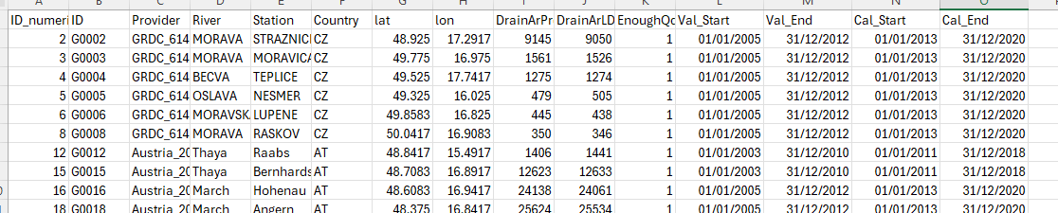
Calibration Preprocessing 1
2. Detecting the calibration and validation period
Check settings1.txt
[ObservedData]
Qgis = observed_data/qgis_21thaya_00.csv
QgisOut = observed_data/qgis_21thaya_01.csv
Run CAL_1_CAL_VAL_PERIODS_new.py
Result: observed_data/qgis_basin_01.csv
Validation start and end and calibration start and end is added, based on available data
This can be manually adjusted afterwards
Notes:
Improvement in resolution of CWatM model for basin analysis to show more details locally.

Slide 13
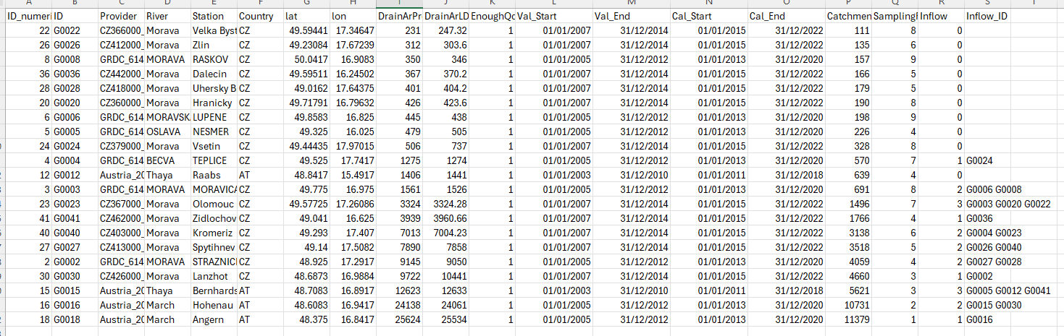
Calibration Preprocessing 1
3. Order of basins
Check settings1.txt
[ObservedData]
Qgis = observed_data/qgis_21thaya_01.csv
QgisOut = observed_data/qgis_21thaya_02.csv
Run CAL_2_PREP_new.py
Result: observed_data/qgis_basin_02.csv
Based on river network (ldd.tif)
The catchment size in cells is calculated
The order (small to big) is sorted (this is also the order of runs)
Which subbasin(s) flows into which bigger one (inflow_ID)
Notes:
Improvement in resolution of CWatM model for basin analysis to show more details locally.

Slide 14
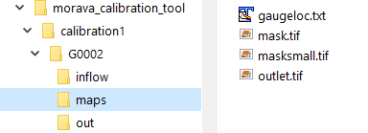
Calibration Preprocessing 1
4. Preparation of calibration folder
Run CAL_5_PREP_FORCING_new.py
Result: file structure in calibration
Based on qgis_basin_02.csv a file structure is generated in calibration:
inflow: the subbasins location which flows into this basin
Maps: the mask map of the subbasin (minus the upstream basins)
Out: the results for each calibration run
Notes:
Improvement in resolution of CWatM model for basin analysis to show more details locally.

Slide 15
Calibration Preprocessing 1
5. Preparation of settingsfile template
Change working settingsfile (a settings file which runs ok with CWatM) into a template
In templates/settings_basin.ini (should be the same name as in settings1.txt)
Replace lines with a placeholder (% is the start char of a placeholder)
inflow = %inflowflag
MaskMap = %SubCatchmentPath/maps/masksmall.tif
Gauges = %gaugeloc
StepStart = %CalStart
SpinUp = %CalSpin
StepEnd = %CalEnd
In_Dir = %inflowDir
InflowPoints = %inflowpoints
QInTS = %inflowtss
Delete or out comment all output in [Output]
# OUTPUT maps and timeseries
#OUT_Dir = $(FILE_PATHS:PathOut)
#OUT_TSS_Daily = discharge
Notes:
Improvement in resolution of CWatM model for basin analysis to show more details locally.

Slide 16
Calibration Preprocessing 1
5. Preparation of settingsfile template
Change working settingsfile (a settings file which runs ok with CWatM) into a template
In templates/settings_basin.ini (should be the same name as in settings1.txt)
Replace in [Calibration]
Parameters should be in sync with ParamRanges.csv
Delete all parameters outside [Calibration] with the same names
[CALIBRATION]
OUT_Dir = %run_rand_id
OUT_TSS_Daily = discharge
SnowFactor = %snowfactor
# Cropf factor correction
crop_correct = %crop
#Soil preferentialFlowConstant = 4.0
preferentialFlowConstant = %pref
arnoBeta_add = %arnoB
ksat_fact = %ksatfact
# interflow part of recharge factor = 1.0
factor_interflow = %interF
# groundwater recessionCoeff_factor = 1.0
recessionCoeff_factor = %reces
# runoff concentration factor runoffConc_factor = 1.0
runoffConc_factor = %runoff
#Routing manningsN = 0.04
manningsN = %CCM
# lake parameter - factor to alpha: parameter of of channel width and weir coefficient [0.33 - 3.] dafault 1.
lakeAFactor = %lakeAFactor
# reservoir normal storage limit (fraction of total storage, [-]) [0.15 - 0.85] default 0.5
normalStorageLimit = %normalStor
SnowMeltCoef = %snowMelt
IceMeltCoef = 0.005
#SnowMeltRad = %snowRad
# lake parameter - factor for wind evaporation
lakeEvaFactor = 1.2
soildepth_factor = %soilfactor
Notes:
Improvement in resolution of CWatM model for basin analysis to show more details locally.

Slide 17
Calibration Preprocessing 1
6. Ready for calibration
Check settings1.txt
[ObservedData]
Qgis = observed_data/qgis_21thaya_02.csv
QgisOut = observed_data/qgis_21thaya_02res.csv
the file qgis_basin_02.csv should have the calibration and calibration period
the file qgis_basin_02.csv shouldhave the order of subbasins and which subbasin drains where
the file qtss_basin.csv has the timeseries (in days or month)
The subbasin structure is in the folder calibration1
The most recent version of CWatM should be in the folder
The settingsfile template with placeholder is in folder templates
Notes:
Improvement in resolution of CWatM model for basin analysis to show more details locally.

Slide 18
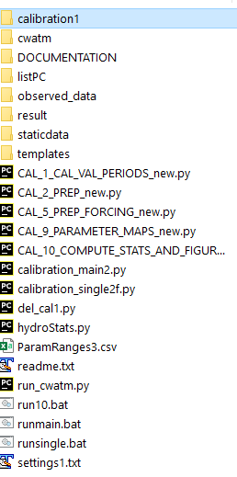
Calibration
7. Some more information
calibration_main2.py: Prg to run a upstream to downstream calibration
calibration_single2f.py: Prg which is executed by calibration_main2.py for each subbasin. First the upstreams then working down
del_cal1.py: Deletes all runs in calibration1
hydroStats.py Has all the objective functions
ParamRanges3.csv Here the parameter and their range are stored settings1.txt: Settingsfile for a top-down calibration
Notes:
Improvement in resolution of CWatM model for basin analysis to show more details locally.

