Slide 1
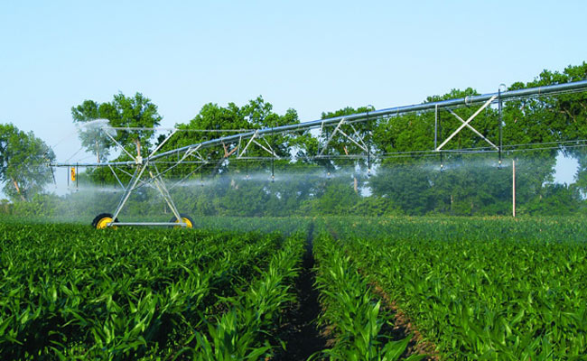
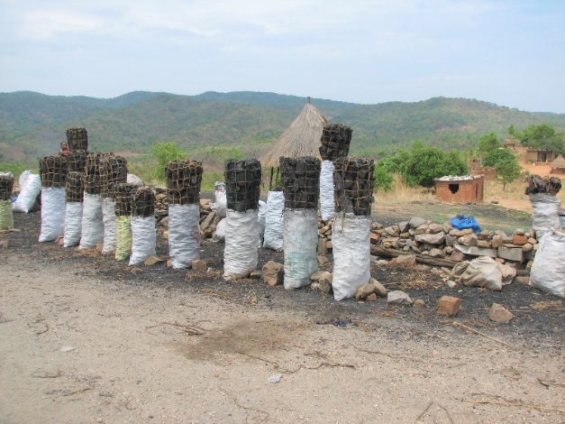
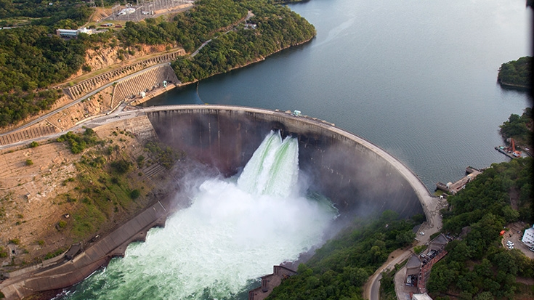
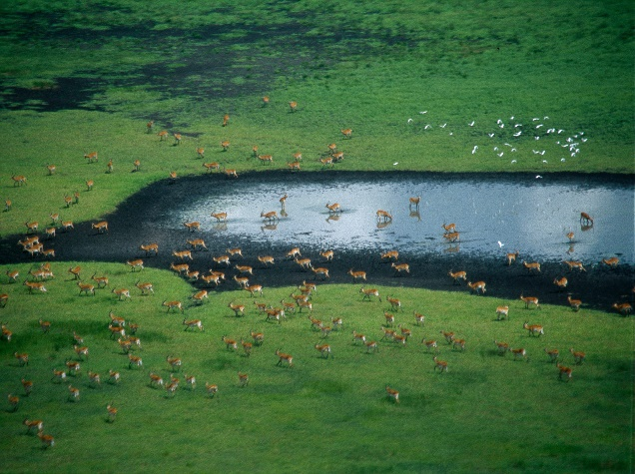
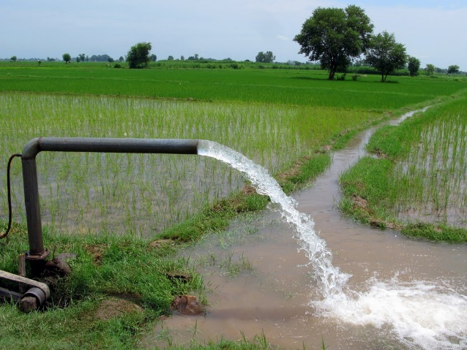
Exercise 1: Hands on CWatM
Peter Burek, Mikhail Smilovic
International Institute for Applied Systems Analysis
Research Scholars at
Water Program

Slide 2

Hands on CWatM
Running CWatM for the first time
Run CWatM with a settings file
Test the options –l , -t
Take a look at the settings file
Notes:
Improvement in resolution of CWatM model for basin analysis to show more details locally.

Slide 3

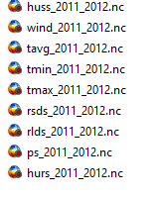
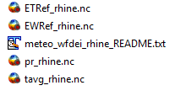
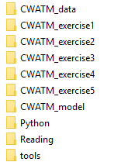
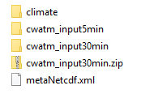
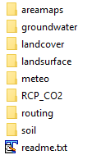
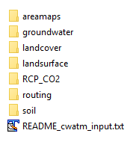


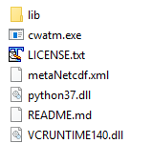
Hands on CWatM
Exercise 4: put global climate from ftp here
0. Folder structure
Extract here
Your folder structure should like this:
Root folder:
Exercise 5: put global climate from ftp here
Extract here
It does not matter if your
root folder has whitespace or any other strange characters
We are using relative paths!
Extract here
Notes:
Improvement in resolution of CWatM model for basin analysis to show more details locally.

Slide 4
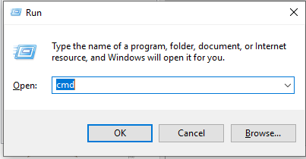
Hands on CWatM
0. Running batch files
Go to folder CWATM_exercise1
Start: 01_exe_example.bat or open a DOS command prompt
- press Windows+R
- type cmd + return
- change directory: e.g.: cd c:/CWATM/CWATM_exercise1 (or cd “c:/directory with white space/CWATM/CWATM_exercise1”)
Type ..\CWATM_model\CWatMexe\cwatm.exe
Notes:
Improvement in resolution of CWatM model for basin analysis to show more details locally.

Slide 5
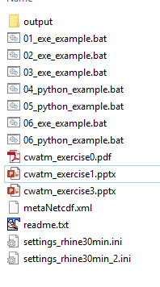
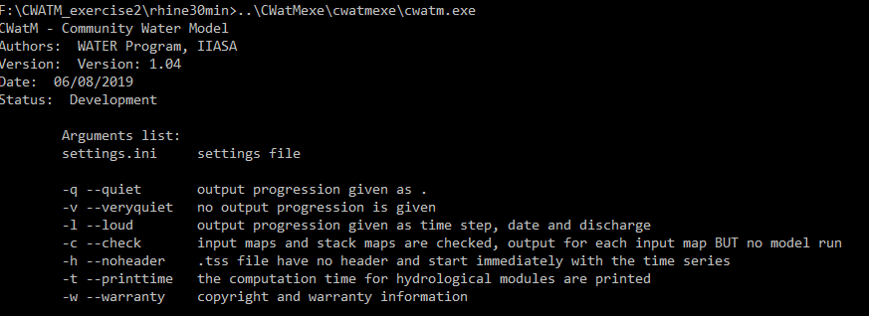
Hands on CWatM
CWAT_exercise1
Running CWatM for the first time
Go to folder CWATM_exercise1
Start: 01_exe_example.bat
Or use the command line (slide before)
cd c:/CWATM/CWATM_exercise1 ..\CWATM_model\CWatMexe\cwatm.exe
Notes:
Improvement in resolution of CWatM model for basin analysis to show more details locally.

Slide 6
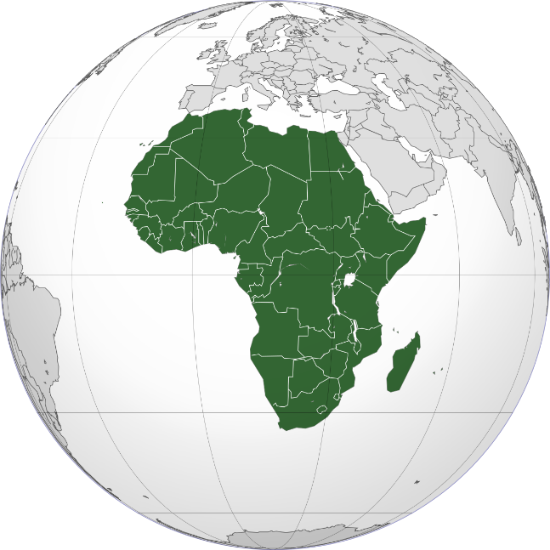
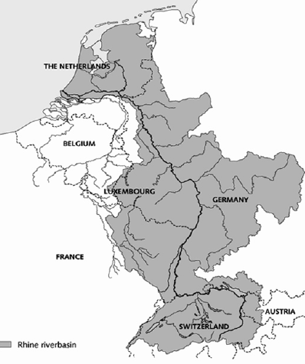
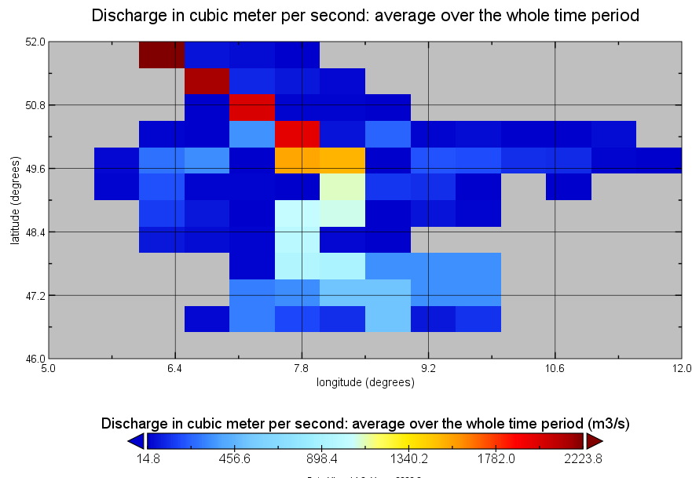
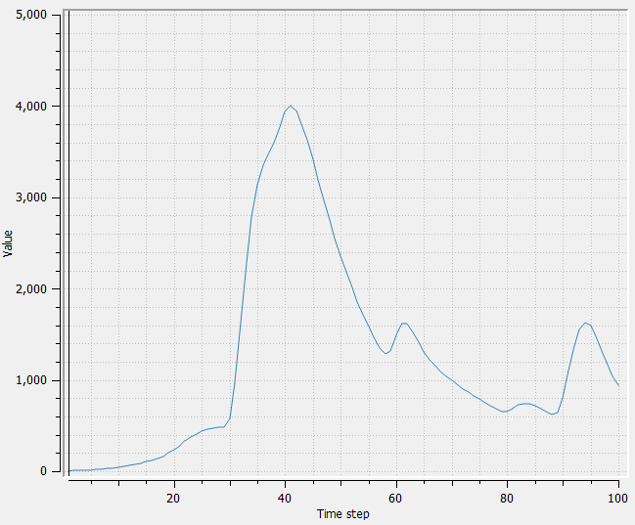
Hands on CWatM
2. Run CWatM with a settings file
Start 02_exercise.bat ../CWATM_model/CWatMexe/cwatm.exe settings_rhine30min.ini –l
Use a text editor e.g. notepad, textpad, notepad++
Look at ./output/discharge_daily.tss
Notes:
Improvement in resolution of CWatM model for basin analysis to show more details locally.

Slide 7
Hands on CWatM
3. Run CWatM with a settings file
Start 03_exercise.bat ../CWATM_model/CWatMexe/cwatm.exe settings_rhine30min.ini –l -t
Use a text editor e.g. notepad, textpad, notepad++ to change 03_exercise.bat
Notes:
Improvement in resolution of CWatM model for basin analysis to show more details locally.

Slide 8
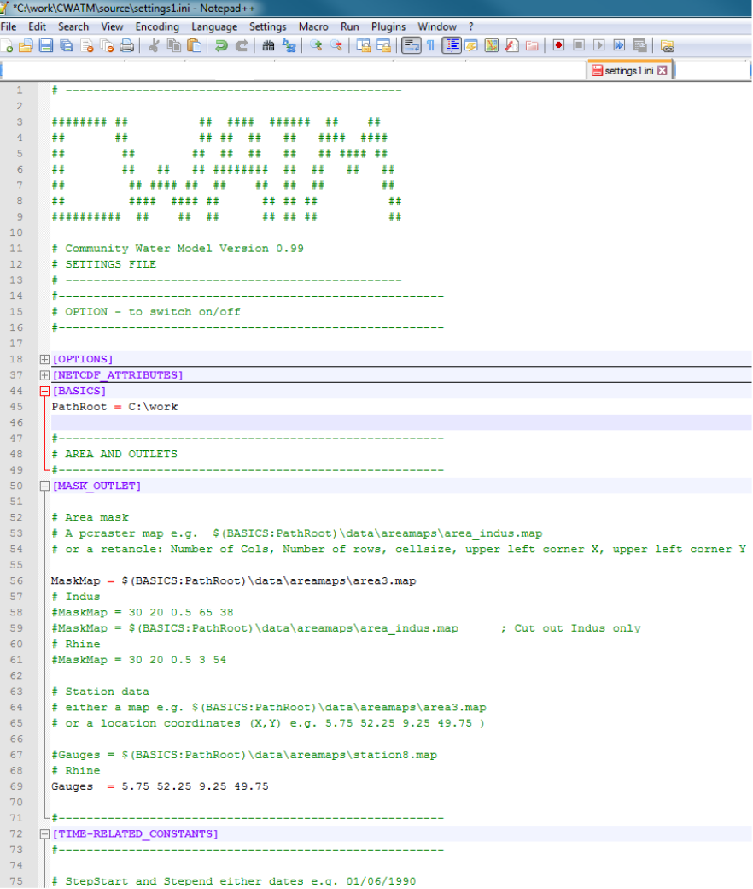
Exercise 3: Hands on CWatM
4. Take a look at the settings file
Change settings_rhine30min.ini with a text editor
Look for gauges in settings_rhine30min.ini
Change it to Gauges = 6.25 51.75 7.75 49.75
Change StepEnd = 100
Start 02_exercise.bat
Notes:
Improvement in resolution of CWatM model for basin analysis to show more details locally.

Slide 9
Hands on CWatM
9. Homework
Play around with the Rhine catchment change the settings file: settings_rhine30min.ini
Run for different times
Produce different outputs
What catchment are you interested?
Find out the coordinates (lat/lon) of the outlet point
Find out coordinates of gauges
Send me the coordinates for next lesson
Notes:
Improvement in resolution of CWatM model for basin analysis to show more details locally.

Slide 10
Problems
Most problems come from different file systems, folder structures
We try to set up everything with relative path.
Please make sure that your folders have a similar structure like in slide 3 in cwatm_exercise1.ppt
The settings file has a part:
[FILE_PATHS]
PathRoot = ../cwatm_data ../ jumps back to the previous folder
PathOut = ./output ./ uses the folder output in the same folder as the settings file or the directory you are in
PathMaps = $(PathRoot)/cwatm_input30min
PathMeteo = $(PathRoot)/climate/rhine
3. If this is not working you can use also absolute path (also with white space)
PathRoot = C/root directory/second.root/cwatm/cwatm_data
4. If you execute cwatm you can also use absolute path
instead
../CWATM_model/CWatMexe/cwatm.exe settings_rhine30min.ini –l
“C/root directory/second.root/cwatm/CWATM_model/CWatMexe/cwatm.exe” settings_rhine30min.ini –l (mind the “ if there are white spaces)
5. Some other errors we address in:
https://cwatm.iiasa.ac.at/tutorial.html#test-the-python-model-version
Notes:
Improvement in resolution of CWatM model for basin analysis to show more details locally.

