Slide 1
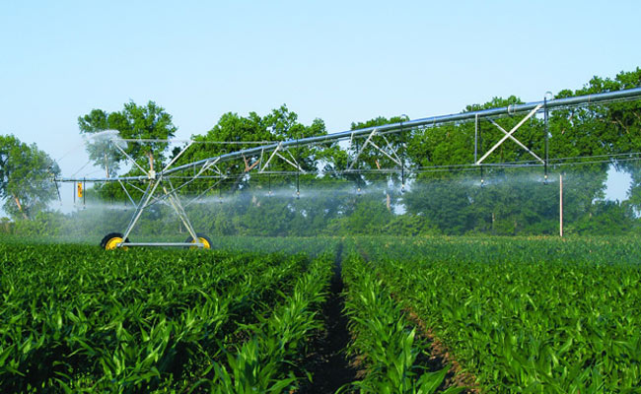
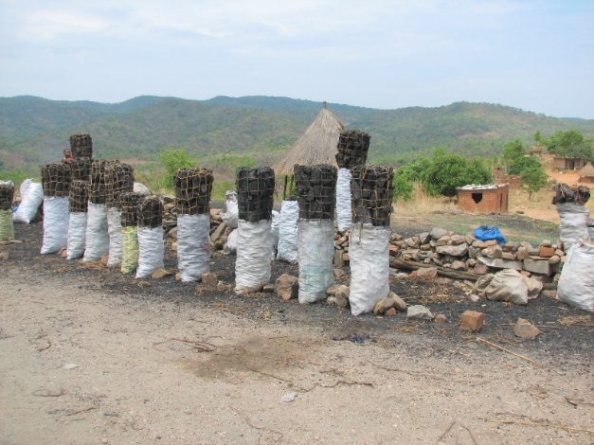
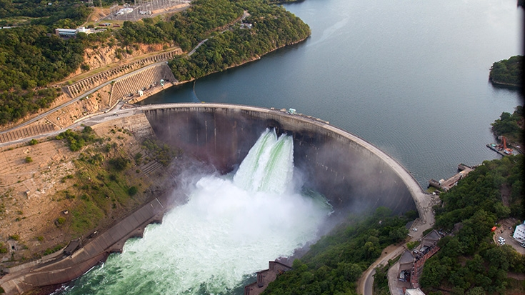
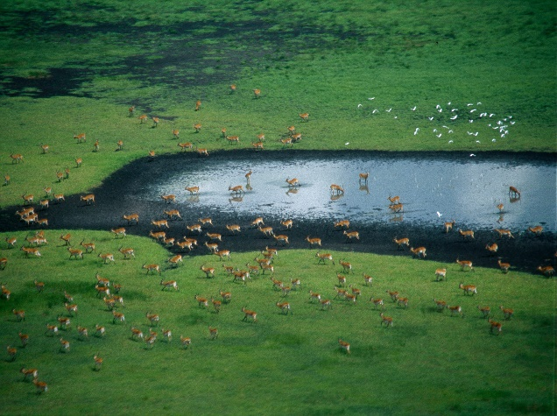
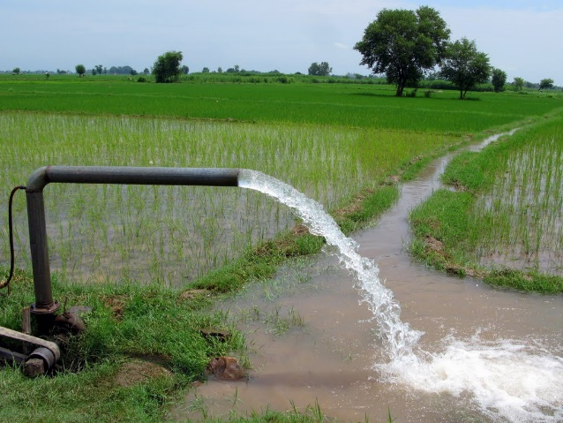
Exercise 3: Hands on CWatM
Peter Burek, Mikhail Smilovic, Luca Guillaumot
International Institute for Applied Systems Analysis
Research Scholars at
Water Program

Slide 2

Hands on CWatM – Exercise 3
Compare simulated discharge with observed discharge
Run CWatM in folder cwatm_exercise3
Look at the output in cwatm_exercise3/output
Copy output to an Excel sheet
Change the settings file and run CWatM again
Copy the output again to Excel
Explain the difference
Notes:
Improvement in resolution of CWatM model for basin analysis to show more details locally.

Slide 3
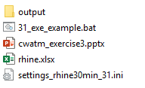
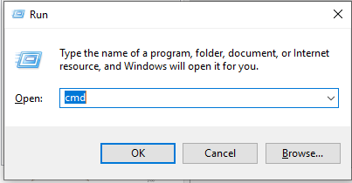
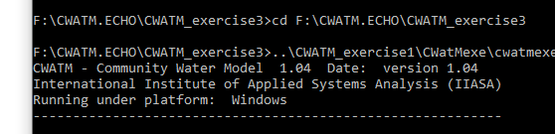
Hands on CWatM
Running CWatM
Go to folder CWATM_exercise3
Start: 31_exe_example.bat or open a DOS command prompt
- press Windows+R
- type cmd + return
- change directory: e.g. cd c:/CWATM/CWATM_exercise3 (or cd “c:/directory with white space/CWATM/CWATM_exercise3”)
Type ..\CWATM_model\CWatMexe\cwatm.exe settings_rhine30min_31.ini -l
Folder structure CWATM_exercise3
Notes:
Improvement in resolution of CWatM model for basin analysis to show more details locally.

Slide 4
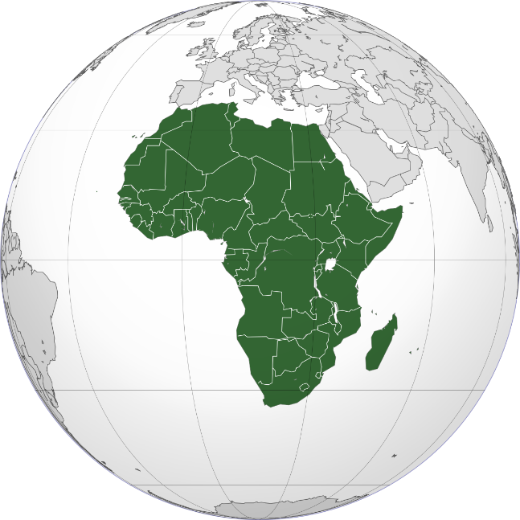
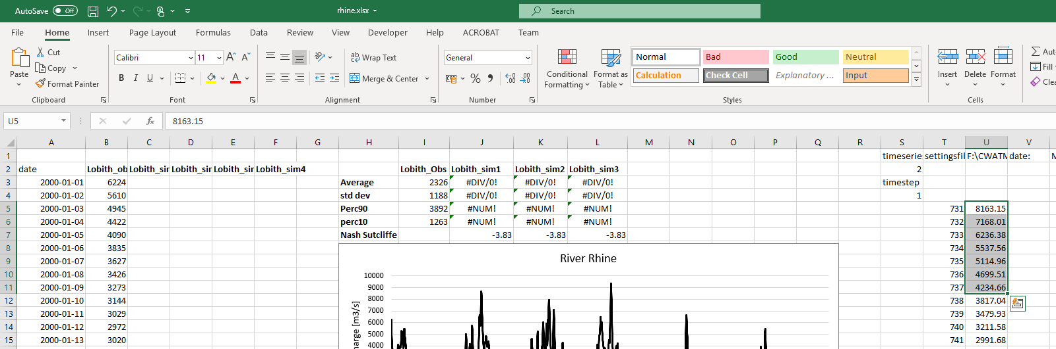
Hands on CWatM
2. Look at the output
Go into directory ./CWATM_exercise3/output
Load discharge_daily.tss into a text editor
Open ./CWATM_exercise3/rhine.xlsx
Copy content of discharge_daily.tss into rhine.xlsx with Text import Wizard
Notes:
Improvement in resolution of CWatM model for basin analysis to show more details locally.

Slide 5
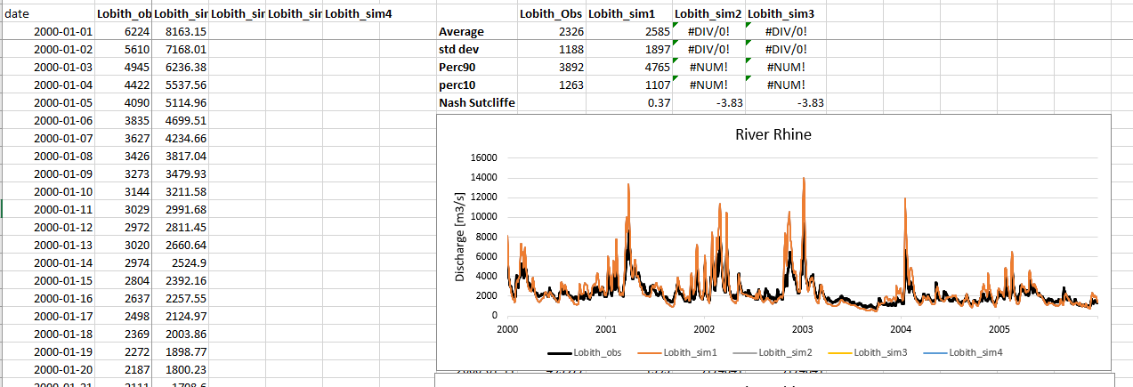
Hands on CWatM
2. Look at the output
Copy column U to column C
Notes:
Improvement in resolution of CWatM model for basin analysis to show more details locally.

Slide 6
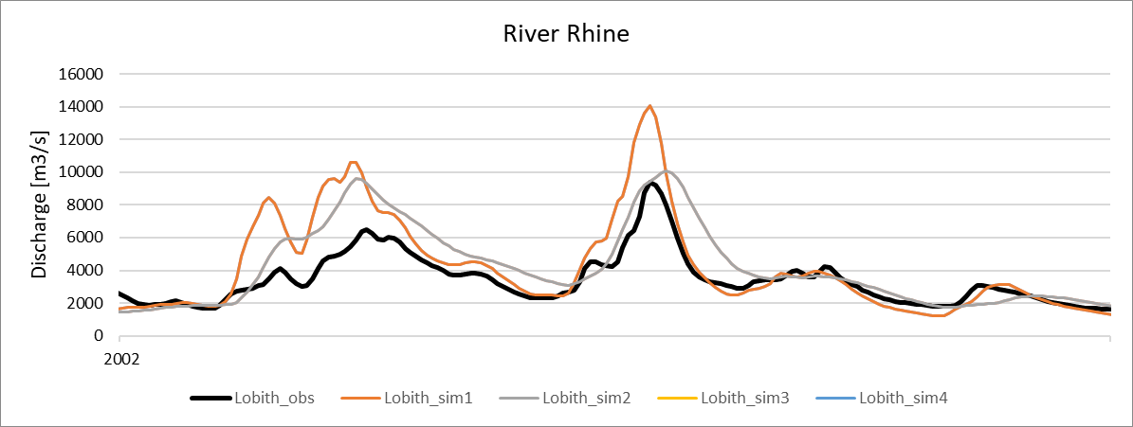
Hands on CWatM
3. Change settings file and run againa settings file
Change settingsfile instead manningsN = 1.86 manningsN = 5.0 (routing roughness is increased)
Run Start: 31_exe_example.bat again
Goto step 1 to 2 and look at the difference
Black line is observed:
Orange line is 1st run
Gray line is 2nd run
What is the difference to first run?
Why?
Notes:
Improvement in resolution of CWatM model for basin analysis to show more details locally.

Slide 7
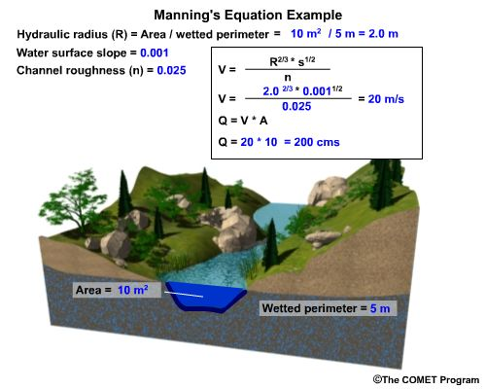
Hands on CWatM
Black line is observed:
Orange line is 1st run
Gray line is 2nd run
What is the difference to first run?
Why?
Smaller n higher velocity faster higher peak Q
Notes:
Improvement in resolution of CWatM model for basin analysis to show more details locally.

Slide 8
Problems
Most problems come from different file systems, folder structures
We try to set up everything with relative path.
Please make sure that your folders have a similar structure like in slide 3 in cwatm_exercise1.ppt
The settings file has a part:
[FILE_PATHS]
PathRoot = ../cwatm_data ../ jumps back to the previous folder
PathOut = ./output ./ uses the folder output in the same folder as the settings file or the directory you are in
PathMaps = $(PathRoot)/cwatm_input30min
PathMeteo = $(PathRoot)/climate/rhine
3. If this is not working you can use also absolute path (also with white space)
PathRoot = C/root directory/second.root/cwatm/cwatm_data
4. If you execute cwatm you can also use absolute path
instead
../CWATM_model/CWatMexe/cwatm.exe settings_rhine30min.ini –l
“C/root directory/second.root/cwatm/CWATM_model/CWatMexe/cwatm.exe” settings_rhine30min.ini –l (mind the “ if there are white spaces)
5. Some other errors we address in:
https://cwatm.iiasa.ac.at/tutorial.html#test-the-python-model-version
Notes:
Improvement in resolution of CWatM model for basin analysis to show more details locally.

