Slide 1
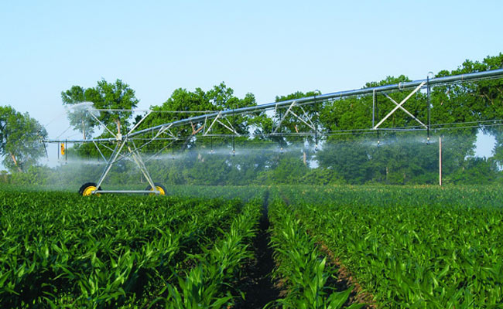
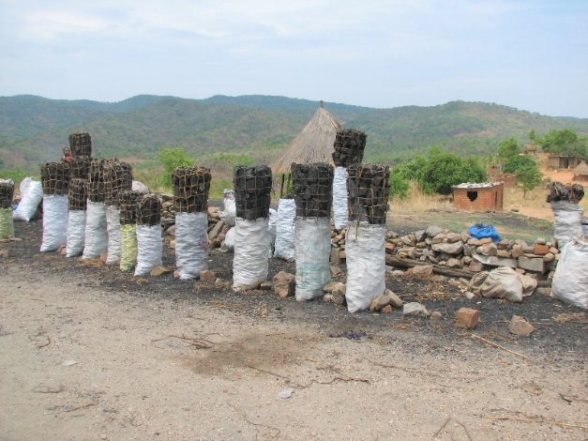
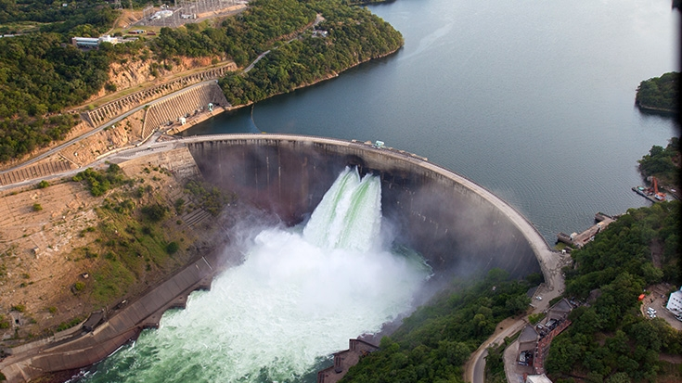
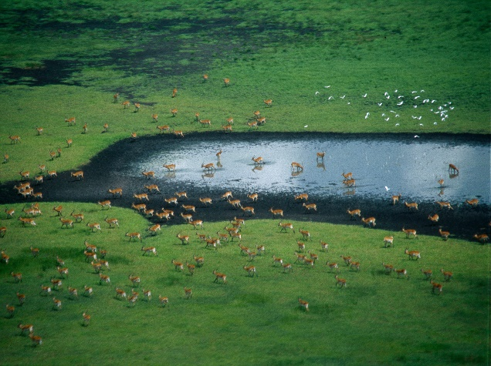
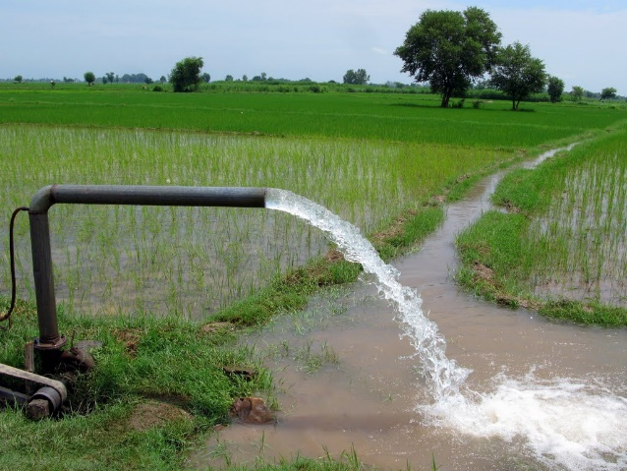
Exercise 5: Higher resolution
Peter Burek, Mikhail Smilovic, Luca Guillaumot
International Institute for Applied Systems Analysis
Research Scholars at
Water Program

Slide 2

Higher resolution – 5 arcmin
0. What you need – downloading data from FTP
The world at 30 arcsec
Example for River Rhine, Central Europe
Example for Lake Tana, Blue Nile, Ethiopia
Notes:
Improvement in resolution of CWatM model for basin analysis to show more details locally.

Slide 3
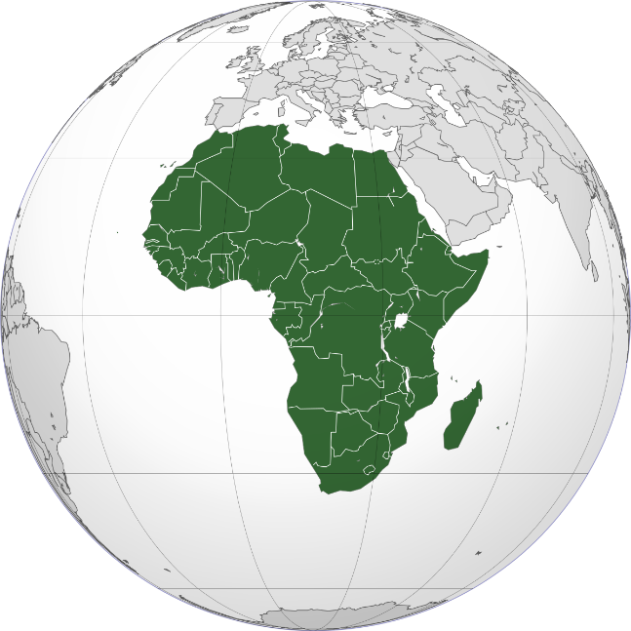
Higher resolution - 5 arcmin
0. What you need
You downloaded already the climate data (precipitation, temperature, radiation etc.) from ftp climate_2011_2012.zip or even wfdei.tar
You need a global dataset on 5 arcmin please download:
cwatm_input5min.zip from ftp
please copy to the folder CWATM_data and unzip (extract here) in
CWATM_data/cwatm_input5min
Notes:
Improvement in resolution of CWatM model for basin analysis to show more details locally.

Slide 4
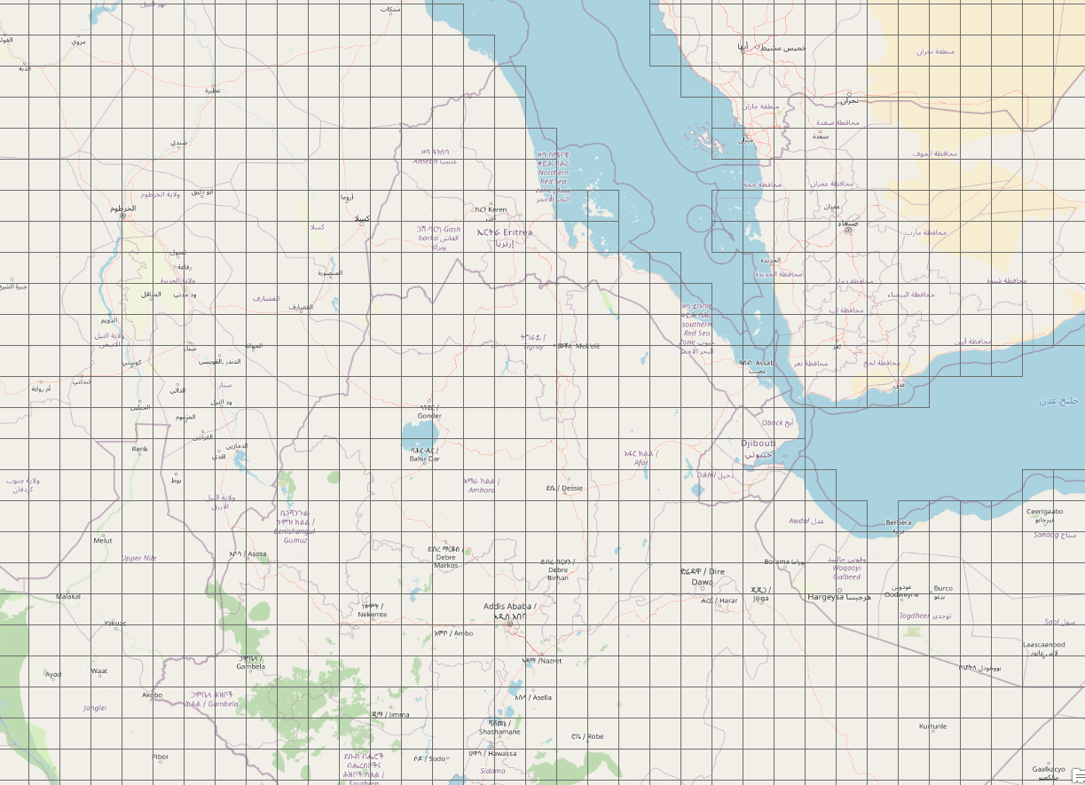
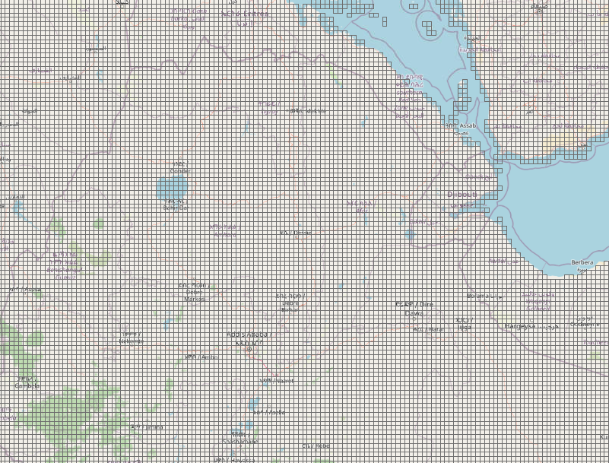
Higher resolution - 5 arcmin
2. The world in 5 arcmin raster
CWatM is a distributed model which can be used at different resolutions e.g. 30 arcmin, 5 arcmin, 1km
This is a part of the World (Ethiopia) split into 5 arcmin cells (around 10 km x 10 km)
Notes:
Improvement in resolution of CWatM model for basin analysis to show more details locally.

Slide 5
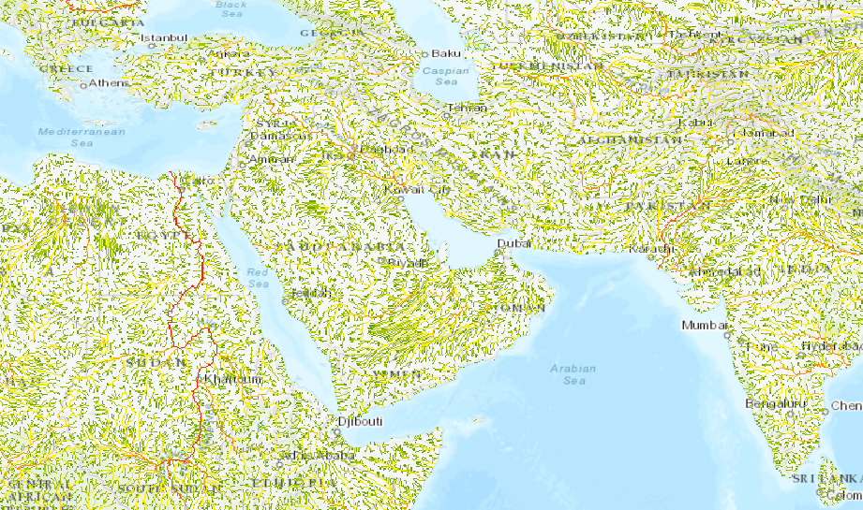
Higher resolution - 5 arcmin
3. Flow accumulation map
upstream catchment area of each cell in km²
See upstream_area_5min_km2.tif
Notes:
Improvement in resolution of CWatM model for basin analysis to show more details locally.

Slide 6
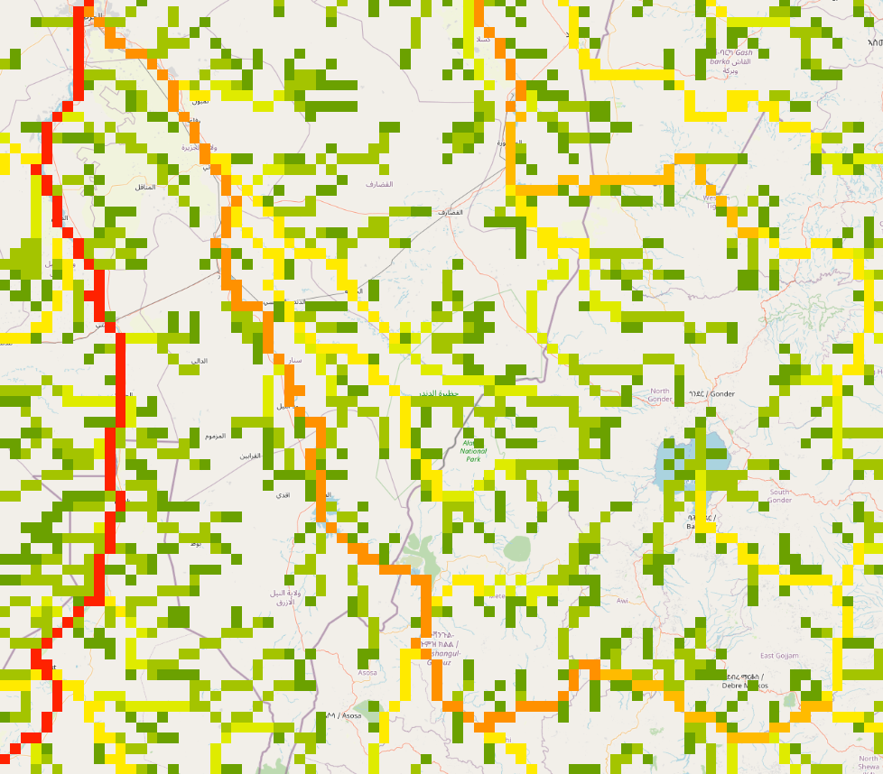
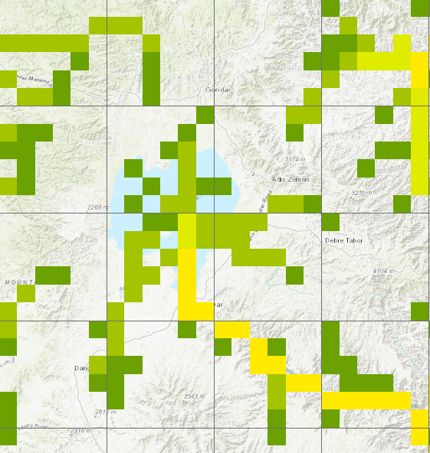
Higher resolution - 5 arcmin
4. Upstream area of lake Tana
Lake Tana, 5 arcmin resolution
Flow accumulation Lake Tana till conjunction Blue Nile with White Nile
Real location of outlet of lake Tana
and 5 arcmin network outlet
Lake Tana, Ethiopia
Notes:
Improvement in resolution of CWatM model for basin analysis to show more details locally.

Slide 7
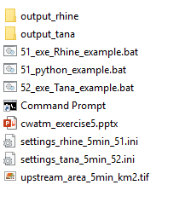
Exercise: Higher resolution - 5 arcmin
1. Run 5 arcmin for the Rhina basin
Folder: CWATM_exercise5
Based on the Rhine basin:
Run:
..\CWATM_model\CWatMexe\cwatm.exe settings_rhine_5min_51.ini -l
Or: 51_exe_rhine_example.bat
Folder structure CWATM_exercise5
Important!
We are in folder CWATM_exercise5
Please cd CWATM_exercise5
but we using the model stored in CWATM_model
Notes:
Improvement in resolution of CWatM model for basin analysis to show more details locally.

Slide 8
Exercise: Select a basin
2. Select another outlet of a basin
Based on the Rhine basin:
Change a few line in the setting: settings_rhine_5min_51.ini
And save it with the name: settings_tana_5min_52.ini
PathOut = ./output_tana Change output destination
MaskMap = 37.39 11.6
Gauges = 37.39 11.6
This will change the basin from Rhine to Lake Tana
You can use the ‘#’ to out comment a line and to keep in mind the original version!
Notes:
Improvement in resolution of CWatM model for basin analysis to show more details locally.

Slide 9
Exercise: Select a basin
2. Select another outlet of a basin
Run:
..\CWATM_model\CWatMexe\cwatm.exe settings_tana_5min_52.ini -l
Or: 52_exe_tana_example.bat
in case you did not manage, we prepared a settings file with the changes
..\CWATM_model\CWatMexe\cwatm.exe settings_tana_5min_52.ini –l
Notes:
Improvement in resolution of CWatM model for basin analysis to show more details locally.

Slide 10
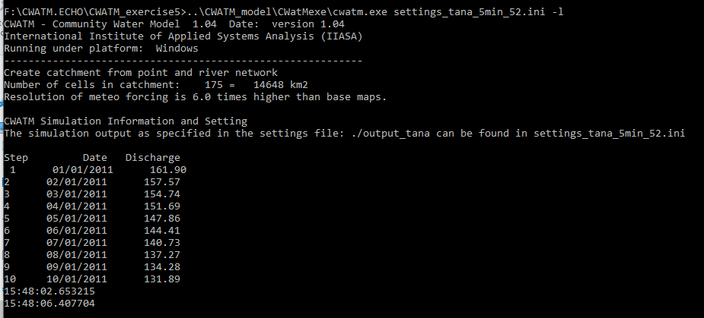
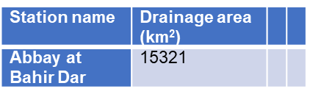
Exercise: Select a basin
3. Select another outlet of a basin
Tana basin
Basin area fits better than with 30arcmin
Notes:
Improvement in resolution of CWatM model for basin analysis to show more details locally.

Slide 11
Problems
Most problems come from different file systems, folder structures
We try to set up everything with relative path.
Please make sure that your folders have a similar structure like in slide 3 in cwatm_exercise1.ppt
The settings file has a part:
[FILE_PATHS]
PathRoot = ../cwatm_data ../ jumps back to the previous folder
PathOut = ./output ./ uses the folder output in the same folder as the settings file or the directory you are in
PathMaps = $(PathRoot)/cwatm_input30min
PathMeteo = $(PathRoot)/climate/rhine
3. If this is not working you can use also absolute path (also with white space)
PathRoot = C/root directory/second.root/cwatm/cwatm_data
4. If you execute cwatm you can also use absolute path
instead
../CWATM_model/CWatMexe/cwatm.exe settings_rhine30min.ini –l
“C/root directory/second.root/cwatm/CWATM_model/CWatMexe/cwatm.exe” settings_rhine30min.ini –l (mind the “ if there are white spaces)
5. Some other errors we address in:
https://cwatm.iiasa.ac.at/tutorial.html#test-the-python-model-version
Notes:
Improvement in resolution of CWatM model for basin analysis to show more details locally.

