Slide 1
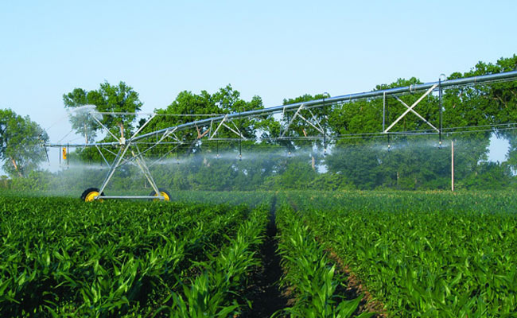
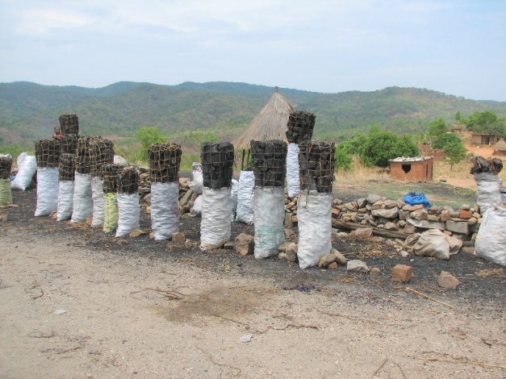
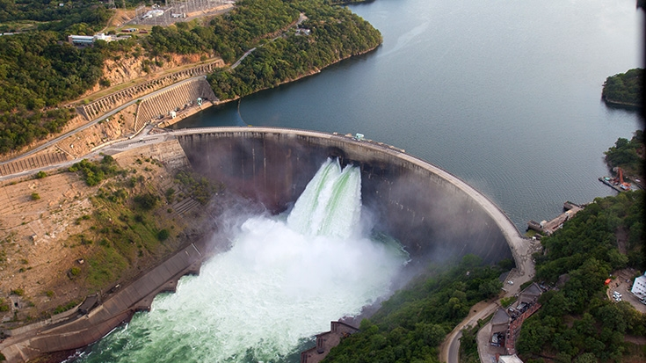
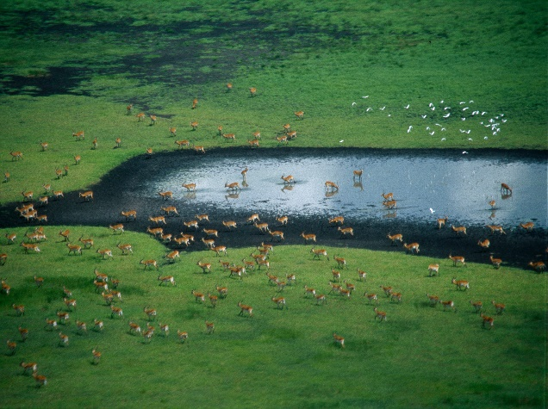
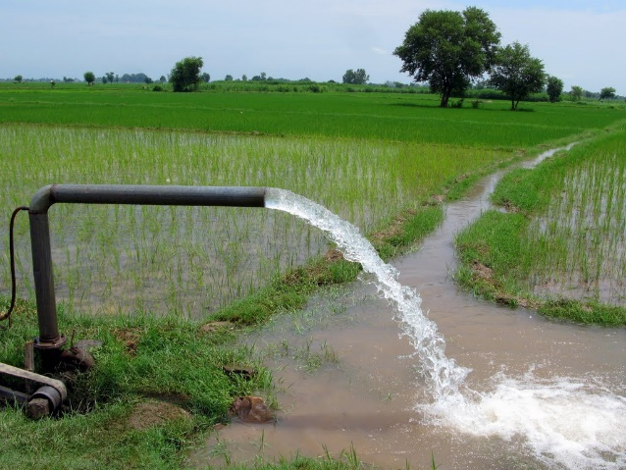
Exercise 7: Options of CWatM
Peter Burek, Mikhail Smilovic, Luca Guillaumot
International Institute for Applied Systems Analysis
Research Scholars at
Water Program

Slide 2

Options of CWatM
0. What you need
What is netCDF
Display netCDF files
Change ksat2 (saturated soil conductivity layer 2) in ArcGIS
Notes:
Improvement in resolution of CWatM model for basin analysis to show more details locally.

Slide 3
Option of CWatM
0. What you need
We go back to the Rhine basin on 30 arcmin because it is fast to execute
Notes:
Improvement in resolution of CWatM model for basin analysis to show more details locally.

Slide 4
Options of CWATM
Running a warm start
Running with and without water demnd
Landcover options
Reservoir options
Notes:
Improvement in resolution of CWatM model for basin analysis to show more details locally.

Slide 5
Options of CWATM
Running a warm start
CWatM needs to have estimates of the initial state of the internal storage variables, e.g. the amount of water stored in snow, soil, groundwater etc.:
There are three possibilities:
The initial state of the internal storage variables are unknown and a first guess has to be used e.g. all storage variables are half filled.
The initial state is known from a previous run, where the variables are stored at a certain time step. This is called warm start
A spin up time, all output is only generated after this day
The warm start is usful for:
using a long pre-run to find the steady-state storage of the groundwater storage and use it as initial value
using the stored variables to shorten the warm-up period
using the stored variables to restart every day with the values from the previous day (forecasting mode)
See also: https://cwatm.iiasa.ac.at/setup.html#initialisation
Notes:
Improvement in resolution of CWatM model for basin analysis to show more details locally.

Slide 6
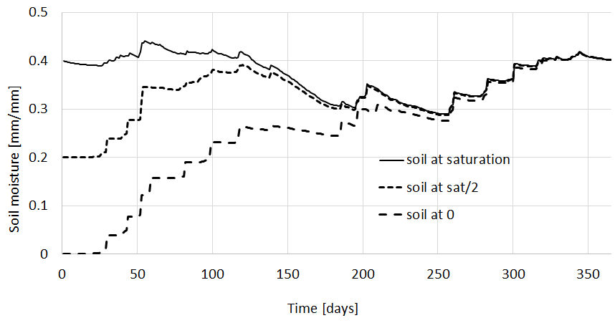
Options of CWATM
Running a warm start
Starting with different initial conditions of soil moisture
Figure shows the impact of different initial condition on the soil moisture of the lower soil.
Notes:
Improvement in resolution of CWatM model for basin analysis to show more details locally.

Slide 7
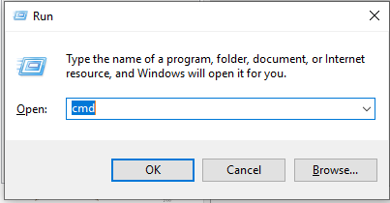
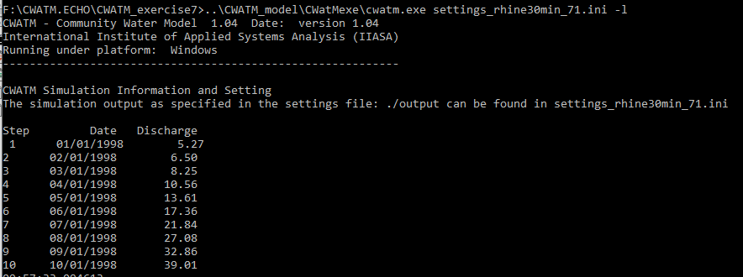
Options of CWatM
Running a warm start
Go to folder CWATM_exercise7
Start: 71_exe_example.bat or open a DOS command prompt
- press Windows+R
- type cmd + return
- change directory: e.g. cd c:/CWATM/CWATM_exercise7 (or cd “c:/directory with white space/CWATM/CWATM_exercise7”)
Type ..\CWATM_model\CWatMexe\cwatm.exe settings_rhine30min_71.ini -l
Cold start: You see the outlet of the Rhine basin has really low discharge, because it needs time to fill up
Notes:
Improvement in resolution of CWatM model for basin analysis to show more details locally.

Slide 8
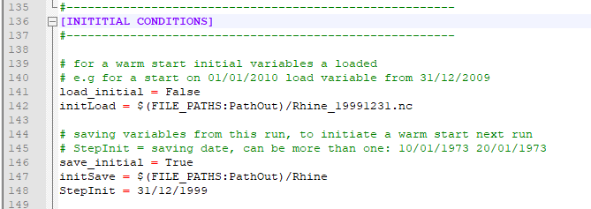
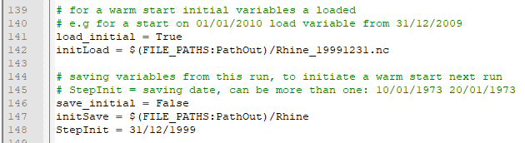
Options of CWATM
Running a warm start
Important part in settings_rhine30min_71.ini
save_initial is set to true
initSave points to outlet folder
StepInit is set to 31.12.1999 (an init file for the date 31/12/1999 is created)
Important part in settings_rhine30min_71.ini
load_initial is set to true
save_initial is set to false
initLoad is set to the initial file in ./outlet
Notes:
Improvement in resolution of CWatM model for basin analysis to show more details locally.

Slide 9
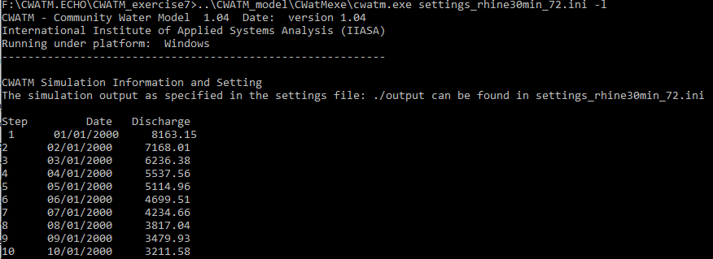
Options of CWatM
Running a warm start
Start: 72_exe_example.bat or type ..\CWATM_model\CWatMexe\cwatm.exe settings_rhine30min_72.ini -l
Warm start: You see the outlet of the Rhine basin has regular discharge, because it uses the stored values from the run before
See also: https://cwatm.iiasa.ac.at/setup.html#initialisation
Notes:
Improvement in resolution of CWatM model for basin analysis to show more details locally.

Slide 10
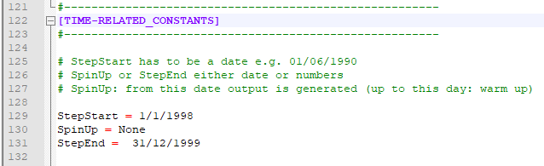

Options of CWATM
Running a warm start
Defining a spin up date:
Only after this date output variables are generated
Spin up date is defined to 1/1/1999
From this date all output timeseries and netCDFs are generated
For calibration warm up and spinup is used together:
warm up of a few decades to have a long time for groundwater and lakes to get into steady state
For each calibration run a spinup of a few years to get used to the change of calibration parameter
Notes:
Improvement in resolution of CWatM model for basin analysis to show more details locally.

Slide 11
Options of CWatM
2. Running with and without water demand
Start: 73_exe_example.bat or type ..\CWATM_model\CWatMexe\cwatm.exe settings_rhine30min_73.ini -l
Start: 74_exe_example.bat or type ..\CWATM_model\CWatMexe\cwatm.exe settings_rhine30min_74.ini –l
Difference are shown in rhine7.xlsx sheet: Rhine_waterdemand
Notes:
Improvement in resolution of CWatM model for basin analysis to show more details locally.

Slide 12
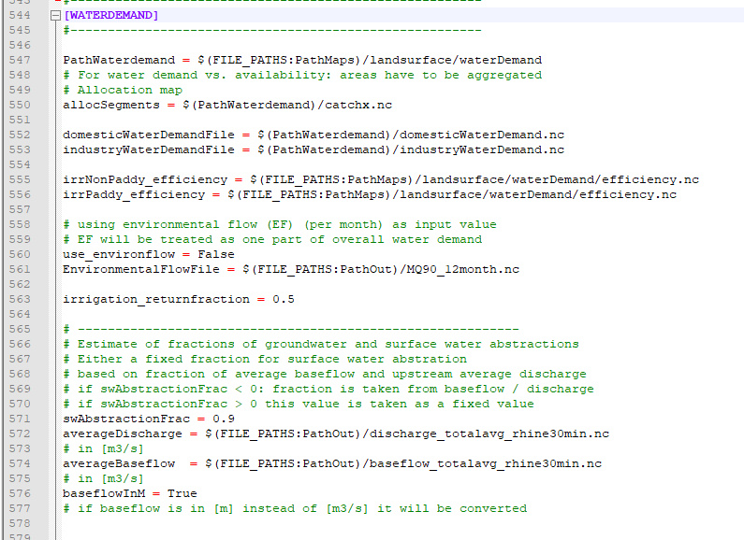
Options of CWatM
2. Running with and without water demand
Further options on water demand
Return flow fraction of irrigation:
This fraction of the difference between Irrigation withdrawal and irrigation consumption will be returned to rivers
Surface water abstraction
This value is used to distinguise where the water is taken from:
Groundwater or surface water Either a fixed fraction or a fraction from longterm baseflow / discharge
Notes:
Improvement in resolution of CWatM model for basin analysis to show more details locally.

Slide 13
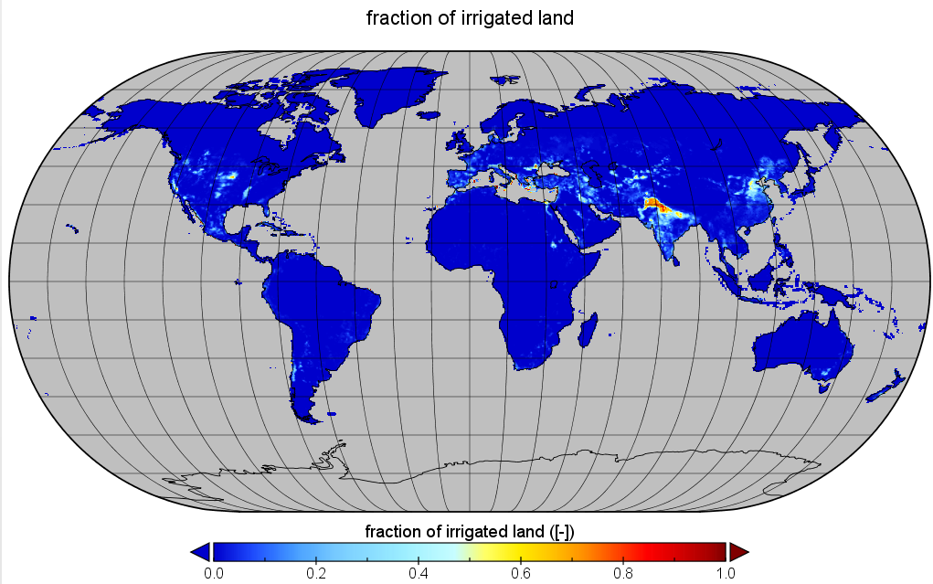
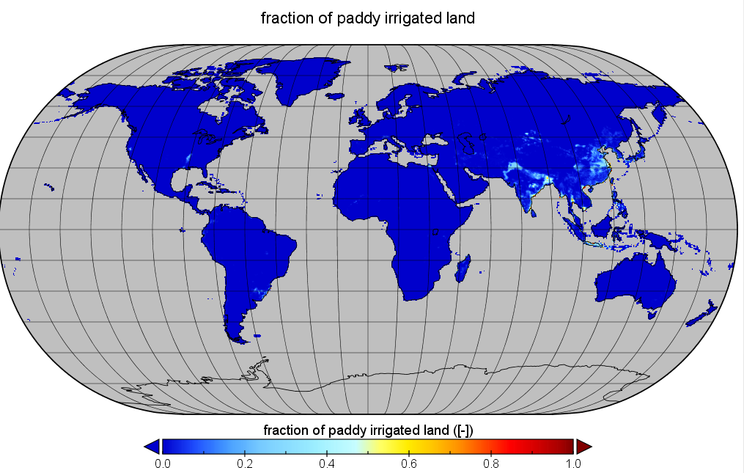
Options of CWatM
3. Changing land cover option
Land cover i.e. the fraction of different land use in a grid cell is varying over time
cities are growing (more sealed area)
Agricultural area is growing (more irrigation, maybe less forest)
CWatM accounts for that, and has a land cover fraction map for each year:
./cwatm_input30min/landsurface/fractionLandcover.nc
Fraction of non paddy irrigated land on 30 arcmin for 2010
Fraction of paddy irrigated land on 30 arcmin for 2010
Notes:
Improvement in resolution of CWatM model for basin analysis to show more details locally.

Slide 14
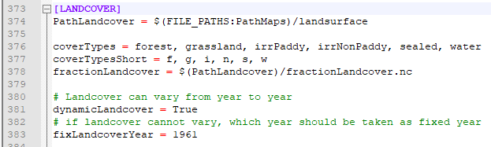
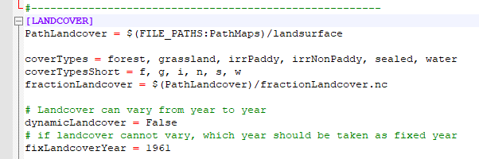
Options of CWatM
3. Changing land cover option
In the settingsfile in section [LANDCOVER]
Land cover can be dynamically changing every year
Like in:
cwatm.exe settings_rhine30min_74.ini –l
Or land cover is fixed constant for a specific year e.g. 1961
Start: 75_exe_example.bat for a fixed 1961 landcover or type ..\CWATM_model\CWatMexe\cwatm.exe settings_rhine30min_75.ini –l
Difference are shown in rhine7.xlsx sheet: Rhine_landcover
Notes:
Improvement in resolution of CWatM model for basin analysis to show more details locally.

Slide 15
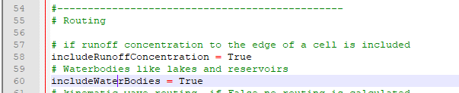

Options of CWatM
4. Changing lakes reservoir option
In the settingsfile in section [Option]
Lakes and reservoirs can put in or off, to show the effect of waterbodies
Start: 76_exe_example.bat for a run without waterbodies or type ..\CWATM_model\CWatMexe\cwatm.exe settings_rhine30min_76.ini –l
Difference are shown in rhine7.xlsx sheet: Rhine_reservoir
As in: settings_rhine30min_74.ini
Notes:
Improvement in resolution of CWatM model for basin analysis to show more details locally.

Slide 16
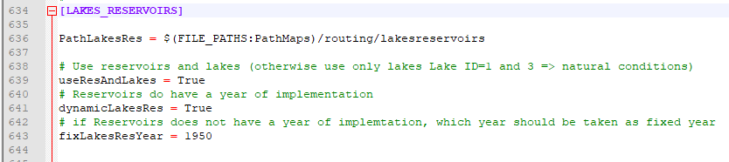
Options of CWatM
4. Changing lakes reservoir option
In the same way as for land cover, reservoirs can be
put in dynamically - depending on the year they are build, they are in
Or fixed - only the reservouirs are in, which are build until this year
In the settingsfile in section [LAKES_RESERVOIRS]
Reservoirs can be dynamically changing every year
Or reservoirs are fixed constant for a specific year e.g. 1950
For the Rhine we did not include a reservoir in the 30 arcmin setting Therefore no exercise
Notes:
Improvement in resolution of CWatM model for basin analysis to show more details locally.

Slide 17
Hands on CWatM
Starting a dos box
Go to folder CWATM_exercise7
Start: 31_exe_example.bator open a DOS command prompt
- press Windows+R
- type cmd + return
- change directory: e.g. cd c:/CWATM/CWATM_exercise7 (or cd “c:/directory with white space/CWATM/CWATM_exercise7”)
Type
..\CWATM_model\CWatMexe\cwatm.exe settings_rhine30min_71.ini -l
Notes:
Improvement in resolution of CWatM model for basin analysis to show more details locally.

Slide 18
Problems
Most problems come from different file systems, folder structures
We try to set up everything with relative path.
Please make sure that your folders have a similar structure like in slide 3 in cwatm_exercise1.ppt
The settings file has a part:
[FILE_PATHS]
PathRoot = ../cwatm_data ../ jumps back to the previous folder
PathOut = ./output ./ uses the folder output in the same folder as the settings file or the directory you are in
PathMaps = $(PathRoot)/cwatm_input30min
PathMeteo = $(PathRoot)/climate/rhine
3. If this is not working you can use also absolute path (also with white space)
PathRoot = C/root directory/second.root/cwatm/cwatm_data
4. If you execute cwatm you can also use absolute path
instead
../CWATM_model/CWatMexe/cwatm.exe settings_rhine30min.ini –l
“C/root directory/second.root/cwatm/CWATM_model/CWatMexe/cwatm.exe” settings_rhine30min.ini –l (mind the “ if there are white spaces)
5. Some other errors we address in:
https://cwatm.iiasa.ac.at/tutorial.html#test-the-python-model-version
Notes:
Improvement in resolution of CWatM model for basin analysis to show more details locally.

