Slide 1
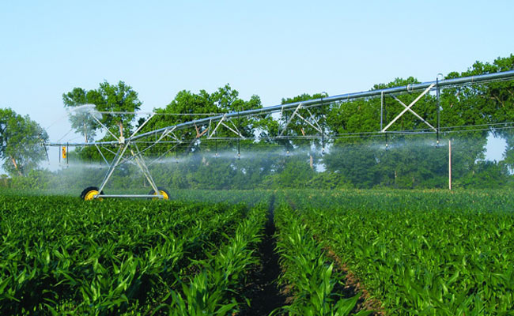
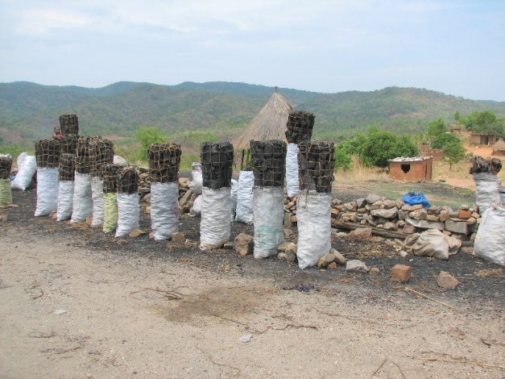
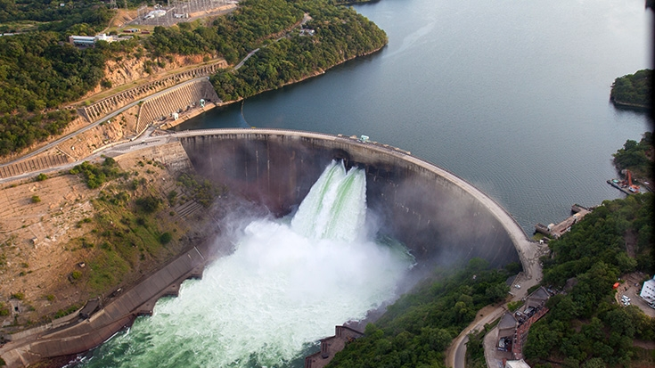
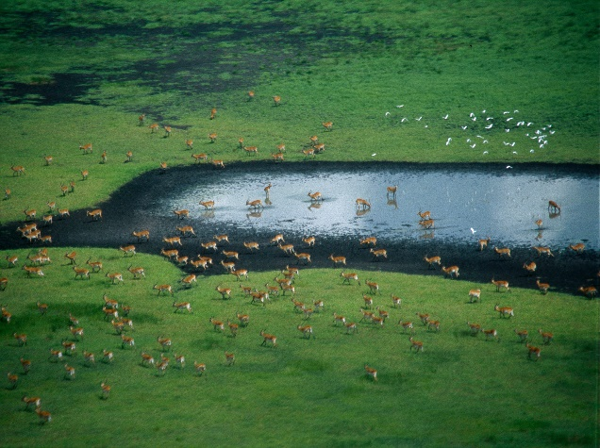
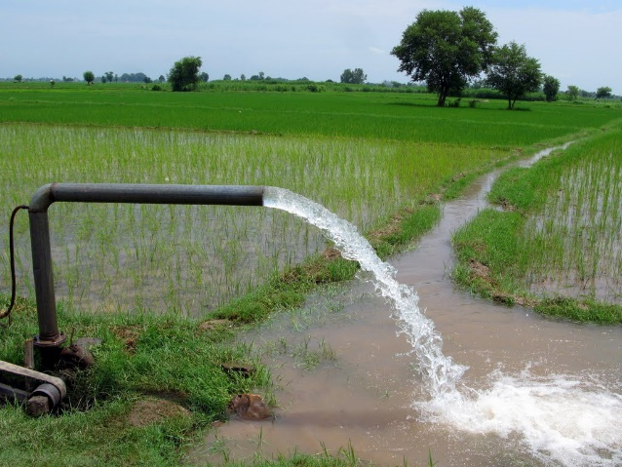
Tutorial for CWatM
International Institute for Applied Systems Analysis
Research Scholars at
Water Security Program

Slide 2
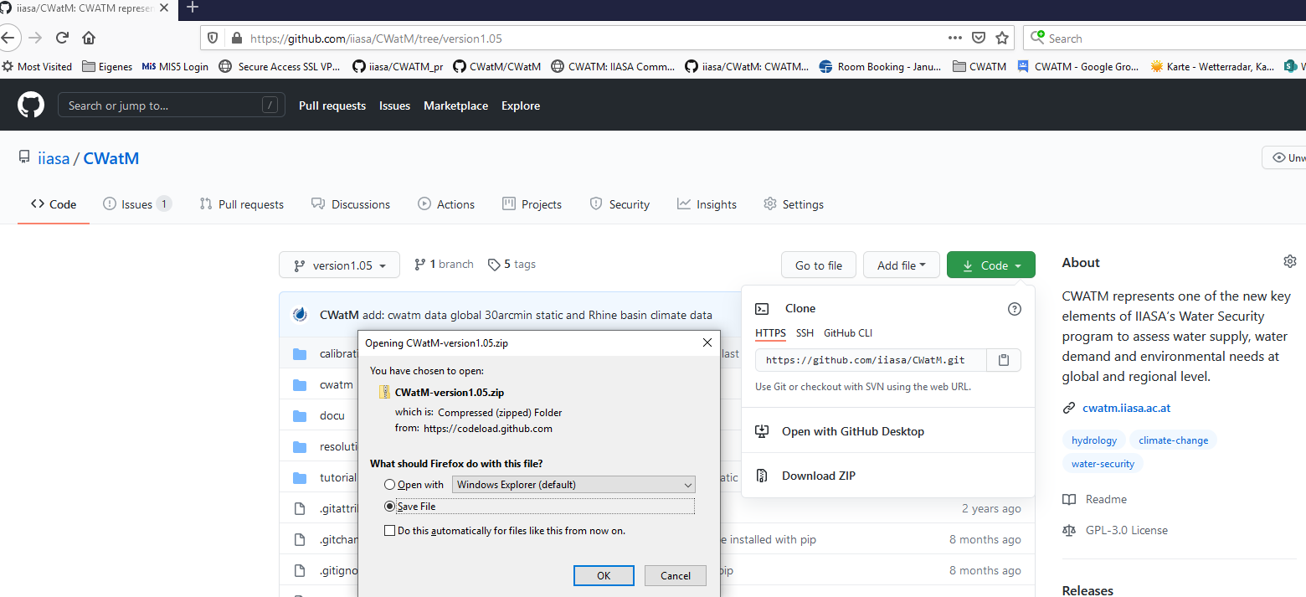
Tutorial
1. Setting up the tutorial from Github
Go to https://github.com/iiasa/CWatM
Download Code with Download ZIP
and unzip it somewhere on your computer (does not matter where)
Notes:
Improvement in resolution of CWatM model for basin analysis to show more details locally.

Slide 3
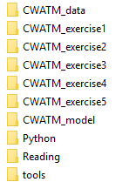

Tutorial
2. Downloading the large files stored as GitHUB LFS
Go to https://github.com/iiasa/CWatM/tree/version1.05/tutorial/CWATM_model
Click on CWatMexe.zip
Download file
Copy file to ../tutorial/CWATM_model
Extract .zip files with “Extract here” which generates the folder “CWatM” and “CWatMexe”
Notes:
Improvement in resolution of CWatM model for basin analysis to show more details locally.

Slide 4
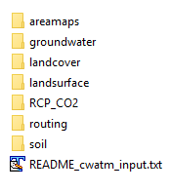
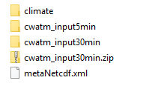
Tutorial
3. Downloading the large files stored as GitHUB LFS
Go to https://github.com/iiasa/CWatM/tree/version1.05/tutorial/CWATM_data
Click on cwatm_input30min.zip and download file
Copy file to ../tutorial/CWATM_data:
Extract .zip files with “Extract here” which generates the folder “cwatm_input30min”
Extract here
Notes:
Improvement in resolution of CWatM model for basin analysis to show more details locally.

Slide 5

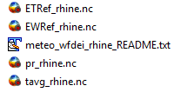
Tutorial
4. Downloading the large files stored as GitHUB LFS
Go to https://github.com/iiasa/CWatM/tree/version1.05/tutorial/CWATM_data/climate
Click on climate_rhine.zip and download file
Copy file to ../tutorial/CWATM_data/climate:
Extract .zip files with “Extract here” which generates the folder “rhine”
Extract here
Notes:
Improvement in resolution of CWatM model for basin analysis to show more details locally.

Slide 6
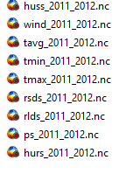
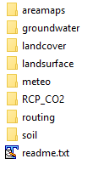

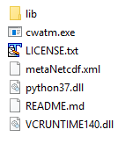
Hands on CWatM
Exercise 4: put global climate from ftp here
5. Folder structure
Extract here
Your folder structure should like this:
Root folder:
Exercise 5: put global climate from ftp here
Extract here
It does not matter if your
root folder has whitespace or any other strange characters
We are using relative paths!
Extract here
Notes:
Improvement in resolution of CWatM model for basin analysis to show more details locally.

Slide 7
Problems
Most problems come from different file systems, folder structures
We try to set up everything with relative path.
Please make sure that your folders have a similar structure like in slide 3 in cwatm_exercise1.ppt
The settings file has a part:
[FILE_PATHS]
PathRoot = ../cwatm_data ../ jumps back to the previous folder
PathOut = ./output ./ uses the folder output in the same folder as the settings file or the directory you are in
PathMaps = $(PathRoot)/cwatm_input30min
PathMeteo = $(PathRoot)/climate/rhine
3. If this is not working you can use also absolute path (also with white space)
PathRoot = C/root directory/second.root/cwatm/cwatm_data
4. If you execute cwatm you can also use absolute path
instead
../CWATM_model/CWatMexe/cwatm.exe settings_rhine30min.ini –l
“C/root directory/second.root/cwatm/CWATM_model/CWatMexe/cwatm.exe” settings_rhine30min.ini –l (mind the “ if there are white spaces)
5. Some other errors we address in:
https://cwatm.iiasa.ac.at/tutorial.html#test-the-python-model-version
Notes:
Improvement in resolution of CWatM model for basin analysis to show more details locally.

