Slide 1
EU biodiversity strategy – analysis by forest sector model with spatially-explicit forest management and biodiversity pekka.lauri@iiasa.ac.at
EU biodiversity strategy: protect 30% of EU’s forest area in 2030
=> to analyze implications of EU biodiversity strategy to EU and global forest sectors requires:
1) High resolution map about current forest managements and important biodiversity areas
-problems: forest management/biodiversity maps are usually based on remote sensing data and
statistical methods such as machine learning
-> not consistent with current forest inventory and production data (FAOSTAT, FRA 2020)
-> static products, which cannot be used for future scenario analysis
-> cannot be used to analyze product substitution and trade leakage effects
2) Biophysical model about biomass growth
-problems: biomass growth models such as dynamic global vegetation models (DGVM) do not usually
include age-class dynamics (optimal forest management) and not consistent with FAOSTAT/FRA data
3) Economic forest sector model
-problems: forest sector models are consistent with FAOSTAT/FRA data and can be used
for future scenario analysis including substitution/leakage effects, but they usually
do not include spatially-explicit forest management and biodiversity
resource objective:
1) Extended a global forest sector model (GLOBIOM-forest) to include high resolution (5 arch min ≈
10x 10 km) presentation of forest management and biodiversity
2) Use the model to analyze 30% forest area protection target in EU

Slide 2
Global forest sector model
-GLOBIOM-forest (https://github.com/iiasa/GLOBIOM_forest)
=> version of global land-use model GLOBIOM (https://iiasa.github.io/GLOBIOM/) which is
specified for forest sector analysis and solved in higher resolution (10x10km-50x50km)
=> so far used to analyze:
1) Transition to alternative forest managements in EU (https://alterfor-project.eu/)
2) Material substitution between coniferous, non-coniferous and recycled biomass-
impacts on the forest industry raw material use and regional competitiveness (Lauri
et al. 2021 accepted in Forest policy and Economics)
3) The future development of China forest sector under natural forest logging ban
(Strategic Partnerships for the Implementation of the Paris Agreement (SPIPA):
https://www.giz.de/en/worldwide/87271.html )

Slide 3
Global biomass growth model
-Global Forest Growth Model (G4M) (https://github.com/iiasa/g4gm )
=> forest growth simulation model
=> biomass growth based on NPPs from MODIS (not process based biomass growth
model)
=> calibrated to current FRA biomass stocks and available data on forest age-class
distribution
=> rotation times based biophysical optimization (max increment/stock/biodiversity), not
“economic” optimal rotation model
=> biodiversity: amount of deadwood and living biomass, important biodiversity areas
(e.g. primary forests)
=> currently solved by 50x50km resolution (will be extended to 10 x 10 km in the future)

Slide 4
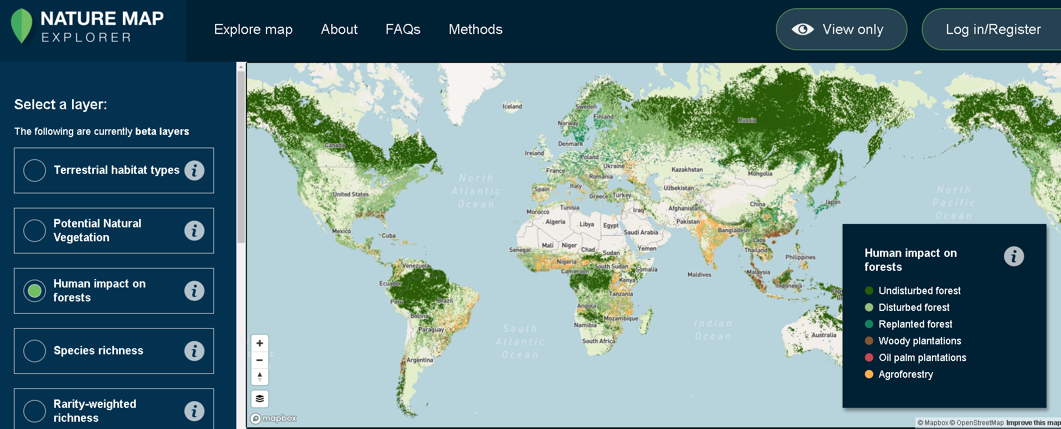
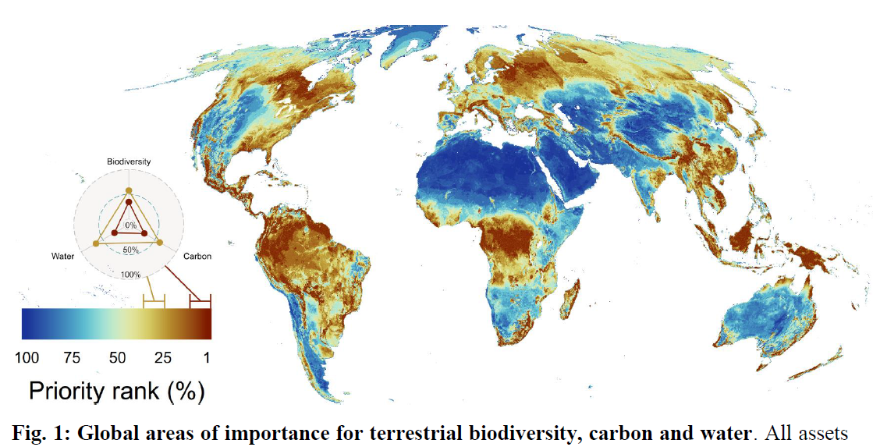
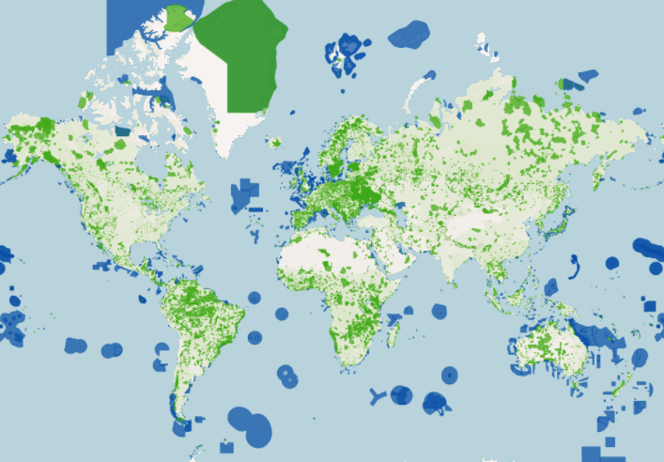
Forest management and biodiversity maps used in the model
1) Global forest management map 100x100 m resolution based on remote sensing data (Lesiv et al. 2021) (https://zenodo.org/record/4541513#.YRKilIgzaUl)
2) Global map of important biodiversity, carbon and water areas in 10x10 km resolution based on different remote sensing/ground observation data (Jung et. al 2021) (https://www.biorxiv.org/content/10.1101/2020.04.16.021444v1.full )
3) World Database of Protected Area (WDPA): global protected area map up to 100x100m resolution
(https://www.protectedplanet.net/en)

Slide 5
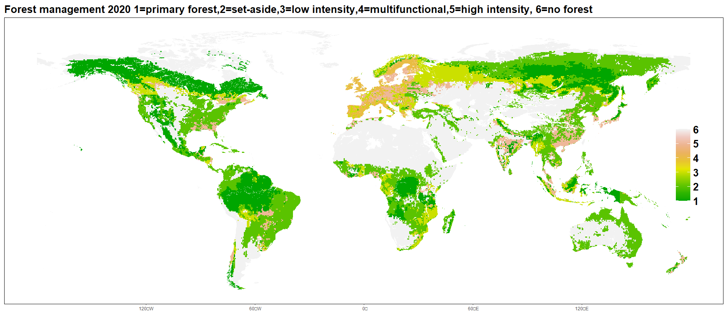
Global forest management 2020 consistent with FAOSTAT/FRA2020

Slide 6
EU biodiversity strategy
-EU biodiversity strategy: protect 30% of EU forest area in 2030
10% set-side (=complete harvest ban, includes primary forest)
20% close-to-nature (=Natura2000 management requirements)
-WDPA: already 24% of EU forest area is protected in 2020
[5% set-aside: protection type I-III and 19% close-to-nature: protection type IV-VI]
-scenarios:
baseline: 5% set-aside and 19% close-to-nature
forceS10A20: 10% set-aside and 20% close-to-nature for EU
forceS10A20_country: 10% set-aside and 20% close-to-nature for each EU country
forceS30: 30% set-aside for EU
forceS30_country: 30% set-aside for each EU country

Slide 7
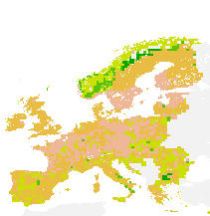
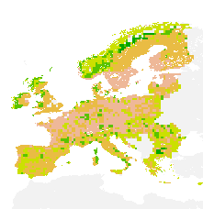
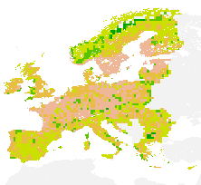
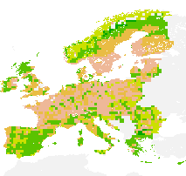
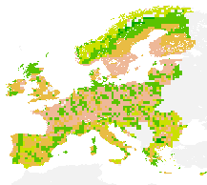

EU forest management in 2030
Baseline forceS10A20 forceS10A20_country
forceS30_country
forceS30 forceS30_country
no forest
high-intensity
multifunctional
close-to-nature
set-side
primary forest

Slide 8
Conclusions
Forest sector model with spatially-explicit management and biodiversity allows to investigate EU biodiversity strategy from economic, biophycial and land-use perspectives
2) EU biodiversity strategy has only a small effect on the competitiveness of EU forest
sector (netexports -20%) and harvest volumes (-5%) relative to baseline if the 30%
protection target is applied in the EU level and divided to set-aside 10% and close-to-
nature management 20%.
3) Using global forest management and biodiversity maps allows to extended analysis
in global level (protected 30% of EU forest area -> protect 30% of global
forest area)
4) Some technical problems to solve model in 10x10km resolution globally (big datasets,
missing G4M 10x10km data, solution time of model).
Thank you !

